Slide 1
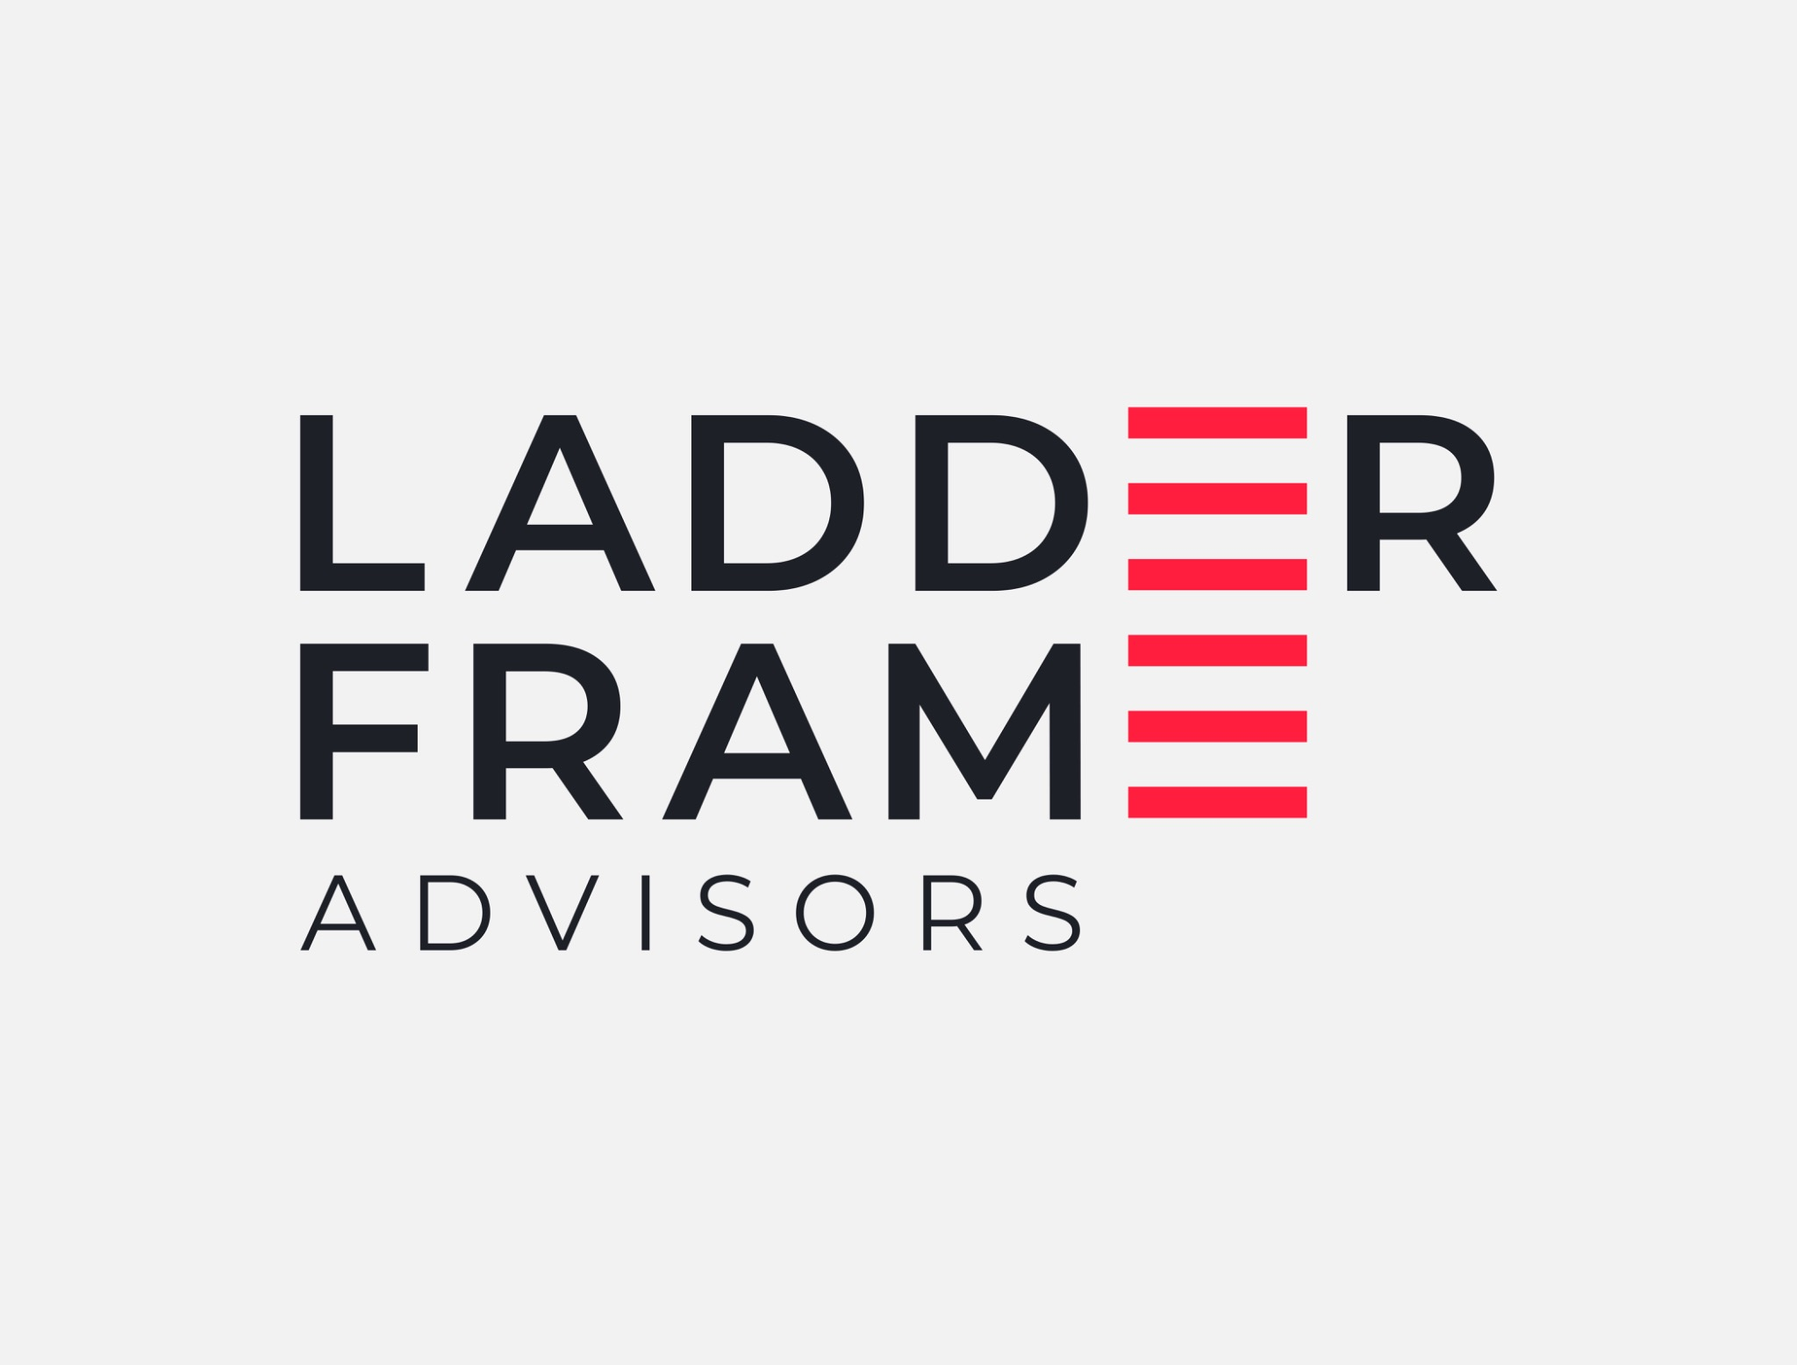
WEBSITE • WORK IN PROGRESS
THE SIX LADDERFRAME CAPABILITIES
ADVISORY FOR THE NEXT PHASE OF GROWTH.
Six connected areas of leadership focus — represented by the six red lines in our mark.
LadderFrame Advisors works with leadership teams at growth inflection points to strengthen strategy, commercial performance, operating capability and organisational readiness for what comes next.
01
GROW
Growth & Revenue Strategy
02
EXPAND
Market Expansion
03
WIN
Large Deal Structuring & Pursuit
Deep operating experience. Practical advice. Stronger leadership capability.
04
BUILD
Operating Model & Organisation
anurag@ladderframe.in | +91-9930133194
05
TRANSFORM
AI & Business Transformation
06
PERFORM
Profitability & Performance
SELECTED EXPERIENCE
27 YEARS
$160M
$65–200M
50+
$2B+
3.8%
Operating experience
Business built from zero
Complex enterprise deal range
Complex enterprise deals
Value / TCV impacted
P&L margin improvement

