Slide 1


AgroOpt
Agricultural Yield Prediction & Optimization
An end-to-end MLOps platform for smarter farm decisions
Shah Shahul | OpenClassrooms ML Engineer | March 2025
Crops: Maize | Rice | Soybean | Wheat

Slide 2
Agenda
01
Business Problem & Opportunity
02
Our Solution — AgroOpt Platform
03
Data & Methodology
04
Feature Engineering
05
Model Training & Results
06
Deployment Architecture
07
CI/CD & Testing
08
Business Value & ROI
09
Recommendations & Next Steps

Slide 3
The Business Problem
What to Plant?
How Much Will I Yield?
How Can I Improve?
Which crop will perform best given local soil, climate & region?
What is a realistic yield forecast before the season starts?
Which management changes (fertilizer, irrigation, timing) maximise output?
$200B+
70%
5-17%
US crop production annual value
of global freshwater used in agriculture
yield improvement from data-driven decisions

Slide 4
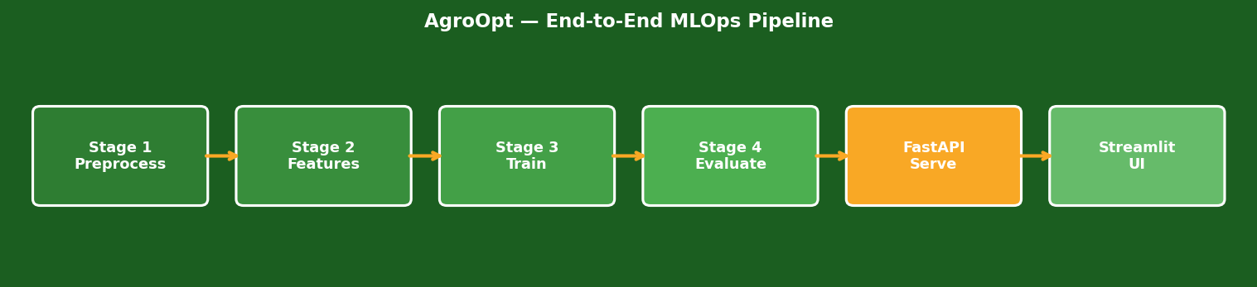
The AgroOpt Solution
Predict
Recommend
Optimize
Track
Forecast yield in hg/ha for any of 4 crops given farm conditions
Rank all 4 crops and show water/heat stress indices
Grid-search fertilizer, irrigation & harvest timing to maximise yield
Every experiment logged to MLflow for full reproducibility

Slide 5
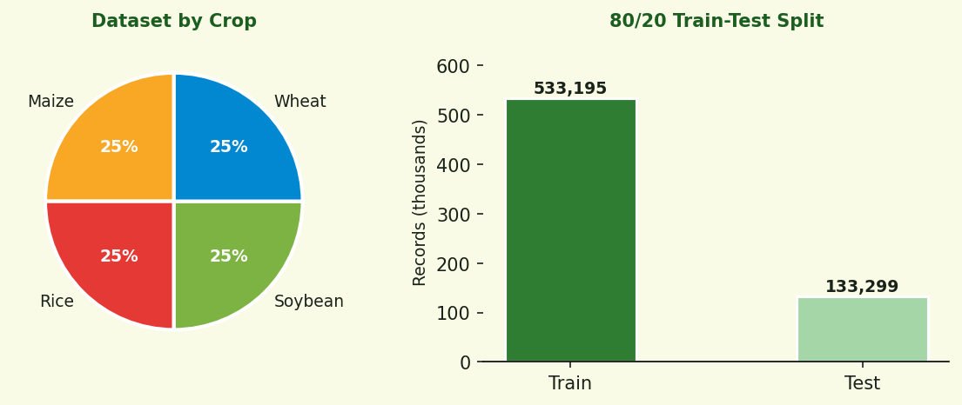
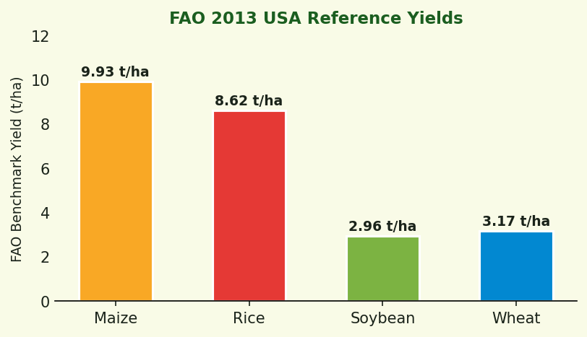
Data & Methodology
Data Sources
crop_yield.csv
666,494 farm records (synthetic USA)
FAO yield.csv
Historical USA crop yields (hg/ha)
FAO rainfall.csv
USA annual rainfall (mm)
FAO temp.csv
USA temperature (52-state mean)
666,494
4
4
0
Total Records
Crops
US Regions
Missing Values

Slide 6
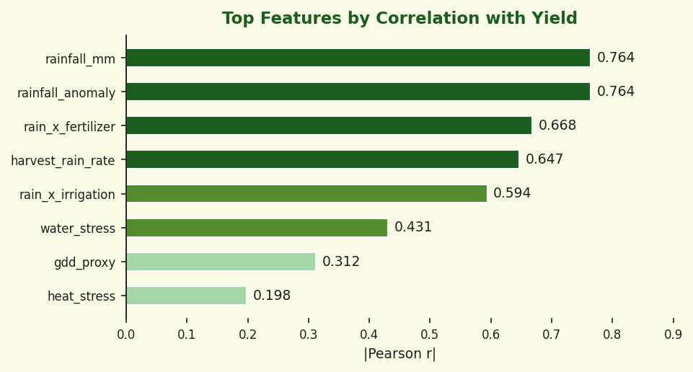
Feature Engineering — 36 Predictive Features
Domain Physics
Interaction Terms
Water stress, heat stress, GDD proxy, aridity index, soil quality score
rainfall x fertilizer rainfall x irrigation GDD x irrigation
Anomaly Features
One-Hot Encoded
Rainfall anomaly vs FAO benchmark Temp anomaly
Crop (4), Region (4) Soil type (6) Weather (3)
Rainfall dominates yield (r=0.764) — consistent with US agricultural science

Slide 7
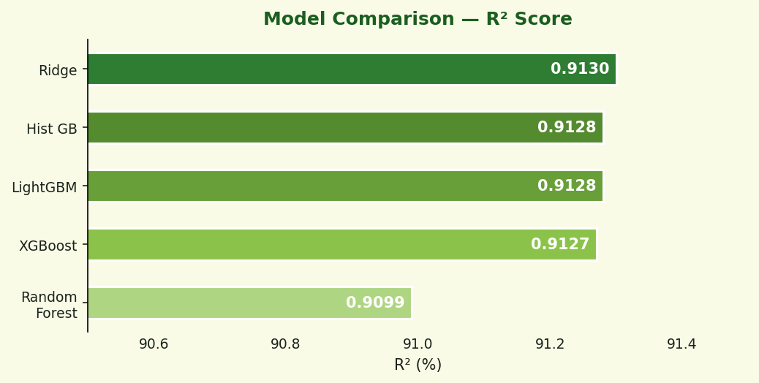
Model Training & Results
Winner: Ridge Regression
R²:
0.9130
RMSE:
4,989 hg/ha
MAE:
3,976 hg/ha
Train time:
1.4 seconds
Why Ridge wins: the synthetic dataset has predominantly linear relationships. All 5 models cluster at R2 ~0.91, confirming Ridge is the leanest choice.
MLflow tracks every run: parameters, R2, RMSE, MAE, MAPE, CV-RMSE

Slide 8
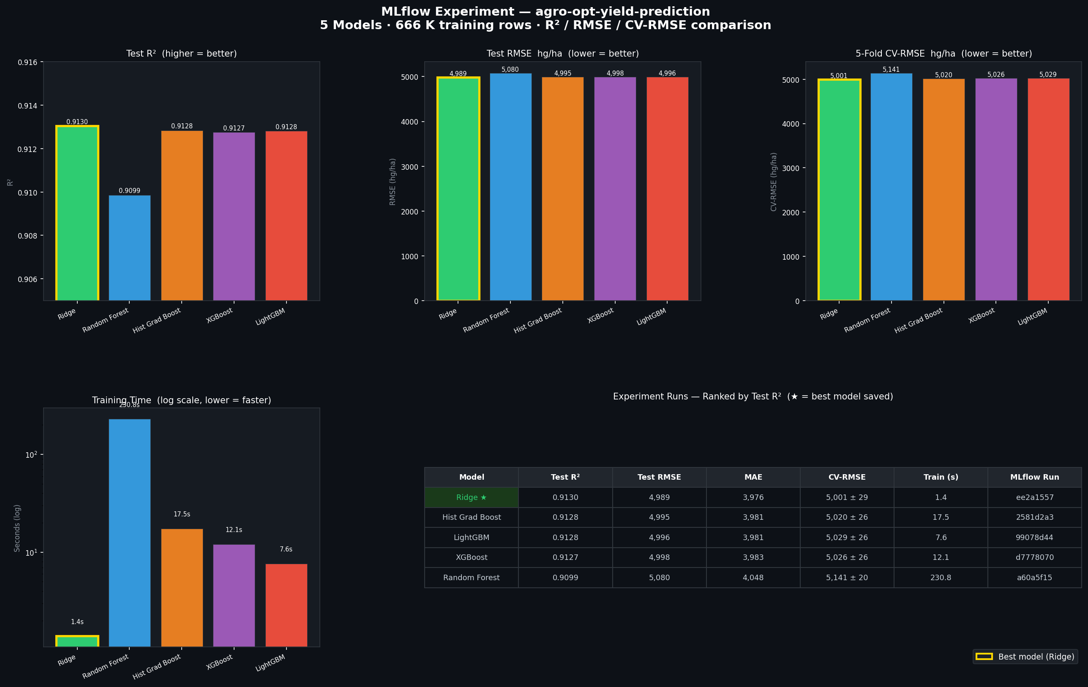
MLflow Experiment Tracking
5 models tracked — Ridge, Hist GB, LightGBM, XGBoost, Random Forest | Metrics: R2, RMSE, MAE, MAPE, CV-RMSE

Slide 9
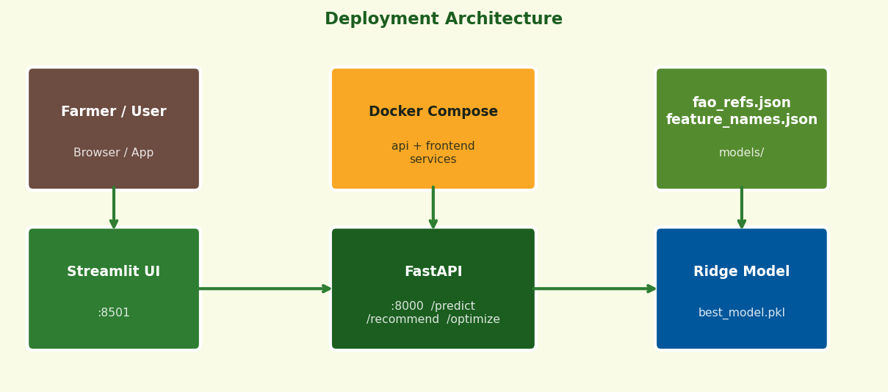
Deployment Architecture
REST Endpoints
GET
/health
Model status, version, feature count
POST
/predict
Yield forecast for a specific crop
POST
/recommend
Ranked crop list with stress indices
POST
/optimize
Best mgmt settings to maximise yield
Docker Compose: two services (api + frontend), non-root user, health checks

Slide 10
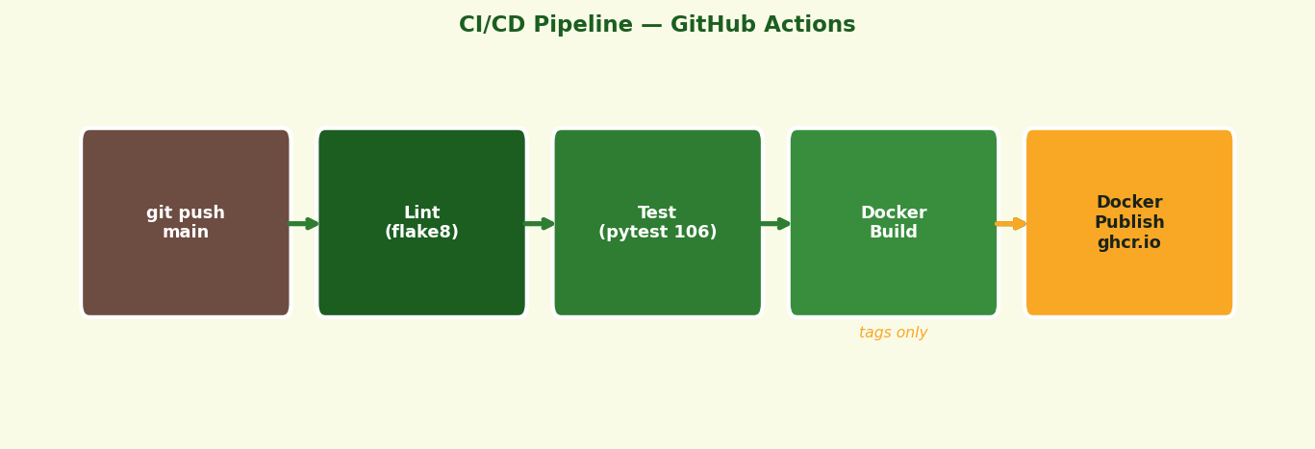
CI/CD Pipeline & Testing
30 Tests
40 Tests
36 Tests
Schema Validation
Engine Unit Tests
API Integration
Pydantic field bounds, enums, boundary values
FarmConditions, feature vectors, predictions
All 4 endpoints, valid & invalid inputs

Slide 11
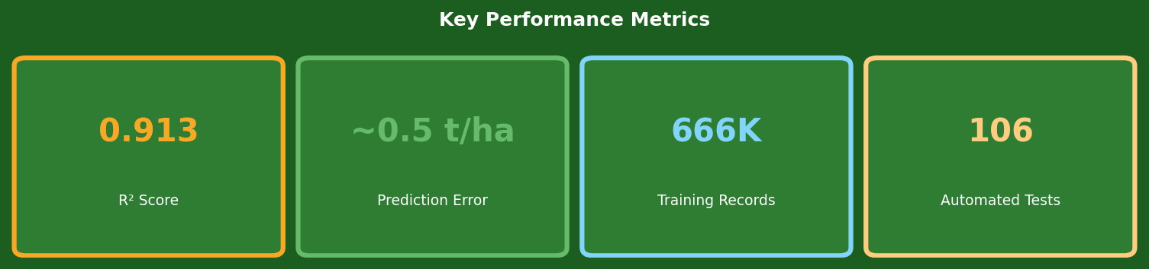
Business Value
Prediction Accuracy
Crop Recommendation
5% error on Maize (highest-volume crop). Reliable enough for planting decisions.
Instant ranking of 4 crops with water & heat stress indices for any location.
Yield Optimisation
Full Reproducibility
Grid search over fertilizer, irrigation and harvest timing returns yield-maximising plan.
MLflow logs every experiment. Any run can be reproduced from tracked parameters.
One-Command Deploy
Continuous Confidence
Docker Compose brings up the entire platform in seconds on any machine.
106 automated tests + CI pipeline catch regressions before they reach production.

Slide 12
Recommendations & Roadmap
Short-Term
Medium-Term
Long-Term
1
Replace synthetic data with real USDA/NASS records
1
County-level granularity (beyond 4 regions)
1
Satellite imagery (NDVI) as soil health proxy
2
Add prediction intervals (quantile regression)
2
NOAA 90-day weather forecast integration
2
Shift objective: max yield -> max profit
3
Reintroduce pesticide feature with real data
3
Automated retraining + drift detection
3
Multi-country expansion via FAO global data

Slide 13

Thank You
AgroOpt — Smarter Decisions, Better Harvests
Shah Shahul OpenClassrooms — Machine Learning Engineer March 2025
Questions?
github.com/shah-data-scientist/Agro_Opt

