Slide 1
Seattle Energy & Emissions Modeling
Analyzing urban energy use and environmental impact
Notes:
---

Slide 2
Seattle Energy & Emissions Modeling
Notes:
Project Overview, Project Motivation and Scope, Analytical Workflow, Exploratory Data Analysis, Feature Engineering & Data Preparation, Modeling (Iteration 1 & 2), Modeling (Iteration 3 & 4), Conclusions and Insights, Limitations and Next Steps

Slide 3

Project Overview
Carbon Neutrality Goal
  Seattle aims to achieve carbon neutrality by 2050 through comprehensive climate actions.
Energy-Intensive Buildings
  Non-residential buildings are major sources of greenhouse emissions and key reduction targets.
Predictive Energy Model
  Model estimates energy use and CO₂ emissions using building attributes without direct data.
Weather-Normalized Metrics
  SiteEnergyUseWN metric adjusts for climate variability for reliable energy usage patterns.
Notes:
Seattle has committed to achieving carbon neutrality by 2050 as part of its comprehensive climate action plan. A significant portion of the city’s greenhouse gas emissions originates from non-residential buildings, including commercial, institutional, and industrial facilities. These structures are energy-intensive and thus represent a critical target for emission reduction strategies. To address this, the project aims to develop a predictive model capable of estimating energy consumption and CO₂ emissions for buildings that lack direct measurement data. The model leverages readily available structural attributes such as building size, age, type, HVAC system, and insulation characteristics. A key methodological choice is the use of SiteEnergyUseWN (kBtu), a weather-normalized metric, instead of raw SiteEnergyUse. This adjustment accounts for climatic variability, offering a more consistent and reliable indicator of energy usage patterns over time. The broader impact of this initiative is the creation of a scalable and cost-effective framework that supports citywide sustainability planning and helps prioritize retrofitting efforts. By enabling accurate estimations without the need for expensive field measurements, the model contributes to Seattle’s long-term carbon-neutral strategy.

Slide 4

Project Motivation and Scope
Limitations of Previous Survey
  2016 survey was detailed but costly and time-consuming, limiting citywide scalability.
Predictive Modeling Approach
  Developing a data-driven model using structural and operational data without expensive field measurements.
Project Goals
  Create explainable model predicting energy and CO2 emissions and identify key structural drivers.
Scalability and Impact
  Enable citywide, reproducible energy planning tools to enhance energy efficiency and reduce costs.
Notes:
The motivation for this project stems from the limitations of the 2016 Seattle Energy Benchmarking Survey, which provided detailed insights into building energy use and emissions but was both costly and time-consuming. Scaling such an approach to cover the entire city is impractical. Therefore, this project seeks to extend those insights by developing a predictive modeling workflow that utilizes structural and operational building data instead of relying on expensive field measurements. The primary goals include building an explainable, data-driven model that can predict energy consumption and CO₂ emissions, identifying key structural drivers of energy performance, and enabling reproducible, citywide scalability for planning and monitoring. This approach not only reduces costs but also enhances the feasibility of implementing energy efficiency measures across a broader range of buildings. By focusing on structural attributes that are commonly available, the model ensures accessibility and applicability, making it a valuable tool for municipal planners and sustainability advocates.

Slide 5
Analytical Workflow
Exploratory Data Analysis
  Identify patterns, outliers, and trends to understand data distribution.
Feature Engineering and Cleaning
  Create predictors and handle missing data for robust model inputs.
Supervised Learning Models
  Train and evaluate regression models predicting energy use and emissions.
Feature Importance and Interpretation
  Highlight key building attributes influencing energy performance.
Conclusions and Policy Insights
  Translate results into practical tools for city planning decisions.
Notes:
The analytical workflow for the Seattle Energy & Emissions Modeling project is structured into five key steps. First, Exploratory Data Analysis (EDA) is conducted to identify patterns, outliers, and trends within the dataset. This step is crucial for understanding the underlying data distribution and preparing for effective modeling. Second, Feature Engineering and Data Cleaning involve creating new predictors that capture relevant building characteristics and handling missing data to ensure model robustness. Third, Supervised Learning techniques are employed to train, tune, and evaluate regression models that predict energy use and emissions. Fourth, Feature Importance and Interpretation highlight the most influential building factors, providing insights into which attributes drive energy performance. Finally, Conclusions and Policy Insights translate the modeling results into practical tools for city planning, enabling informed decision-making and strategic prioritization of retrofitting efforts. This structured approach ensures that the model is both scientifically rigorous and practically applicable.

Slide 6

Exploratory Data Analysis
Data Uniqueness
  Many Largest Property types have only one property, showing high uniqueness in the dataset.
Skewed Variables
  Number of floors, parking area, and gross floor area are strongly right-skewed.
Missing ENERGY STAR Scores
  ENERGY STAR Score missing at random in 33.71% of cases, showing no pattern.
Correlations and Transformations
  Log transformations strengthened correlations between building features and energy use.
Notes:
The Exploratory Data Analysis (EDA) phase revealed several important insights about the dataset. Histograms of numerical variables showed that most building types or properties contain only one building, indicating a high level of uniqueness. Key variables such as number of floors, parking area, and gross floor area are strongly right-skewed, suggesting that a few large buildings dominate overall energy consumption and emissions. This skewness extends to energy and CO₂ emissions data, reinforcing the need to account for outliers in the modeling process to maintain realism. The ENERGY STAR Score was frequently missing (33.71%) and showed no discernible pattern, implying random absence. Scatter plots indicated roughly linear relationships between building area, parking, and energy/emission variables, which became clearer after applying logarithmic transformations. These log-transformed variables exhibited stronger correlations suitable for regression modeling. Notably, there was little correlation between SiteEnergyUseWN (kBtu) and ENERGY STAR Score, suggesting that other factors such as area, number of floors, and HVAC systems are more predictive. Box plots of Site Energy Use by building type also displayed high dispersion, indicating substantial heterogeneity and supporting the need for multivariate models.

Slide 7
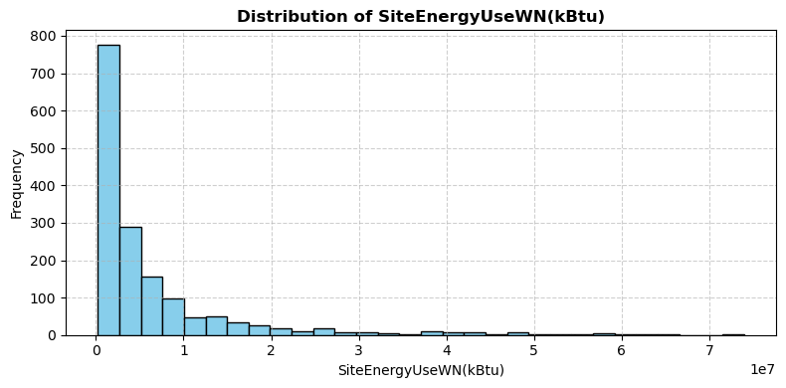
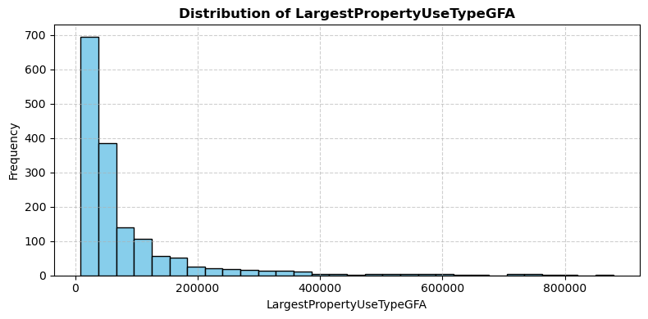
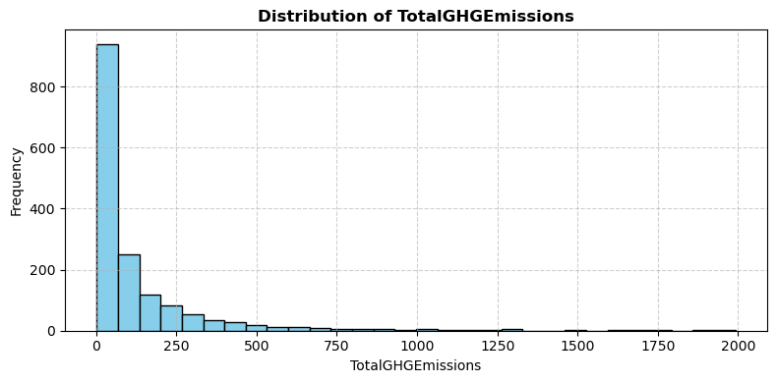
HISTOGRAMS

Slide 8
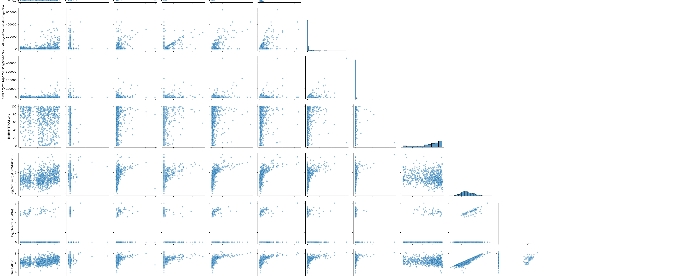
PAIRPLOTS

Slide 9
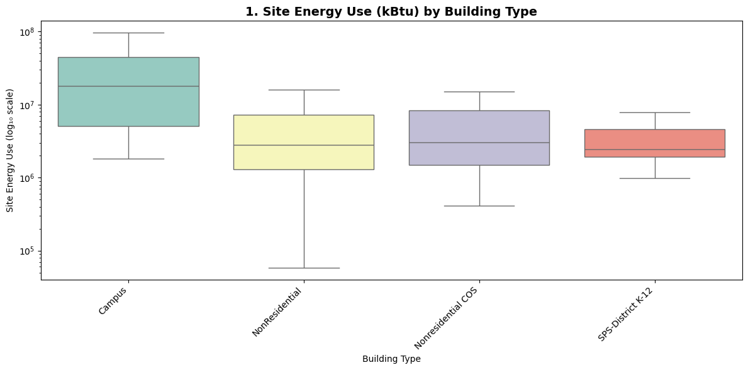
BOXPLOTS

Slide 10
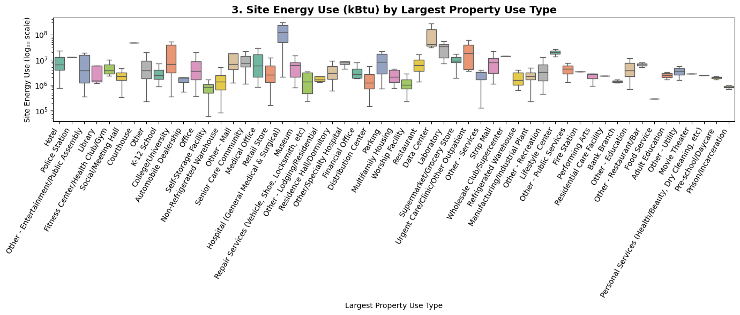
BOXPLOTS

Slide 11

Feature Engineering & Data Preparation
Creation of Engineered Features
  New variables like building age and energy ratios enhanced model insights and performance.
Data Imputation Strategy
  Missing ENERGY STAR Scores were imputed with mean values per building type to maintain dataset completeness.
Correlation Filtering
  Highly correlated and less relevant features were removed based on analysis and expert judgment.
Outlier Trimming Approach
  Only extreme energy use and emission outliers above the 99th percentile were trimmed to keep realistic data.
Notes:
Feature engineering and data preparation involved creating new variables and refining the dataset to enhance model performance. Key engineered features included building age, calculated at the time of analysis; energy ratios representing the proportion of electricity and gas use relative to total energy; the largest property area ratio, defined as the largest property area divided by total gross floor area; and a categorical energy mix variable describing the combination of steam, electricity, and gas sources. Additionally, a boolean variable was introduced to indicate mixed-use properties, excluding parking due to its minimal energy contribution. For data imputation, the ENERGY STAR Score, missing in approximately 33.71% of cases, was filled using the mean value for each building type, acknowledging the limited validity of this approach. Correlation filtering was applied to remove highly correlated or less-relevant features based on pairwise analysis and expert judgment. Outliers in energy use and emissions were trimmed only above the 90th percentile to preserve realistic extremes, ensuring robust modeling. These steps collectively improved data quality and model reliability.

Slide 12

Modeling (Iteration 1 & 2)
Iteration 1 Overview
  ENERGY STAR Score was a key predictor but removed due to missing data issues. Feature importance retained for comparison.
Iteration 2 Improvements
  Model excluded ENERGY STAR Score and included hyperparameter tuning, improving robustness and generalization.
Model Performance Metrics
  R² values showed improved test set performance, indicating possible underfitting and better generalization.
Updated Feature Insights
  New dominant structural predictors emerged, emphasizing the value of accessible building attributes like Surface Area and the usage type.
Notes:
The modeling process began with two initial iterations. In Iteration 1, the ENERGY STAR Score was included as a predictor and emerged as the second-most important variable for energy use and third for emissions. However, due to its high missingness and uncertain imputation, it was excluded in subsequent models to enhance reliability. Feature-importance plots and coefficients from this version were retained for comparison. Iteration 2 excluded the ENERGY STAR Score and incorporated hyperparameter tuning. The resulting model achieved R² values of 0.65 for energy use and 0.55 for emissions. Interestingly, test-set R² values were higher—0.77 for energy and 0.69 for emissions—suggesting potential underfitting or variability due to data splitting. Despite reduced training performance, the model demonstrated improved generalization, indicating solid robustness. Updated feature-importance charts from this iteration highlighted new dominant structural predictors, reinforcing the value of using readily available building attributes for modeling.

Slide 13
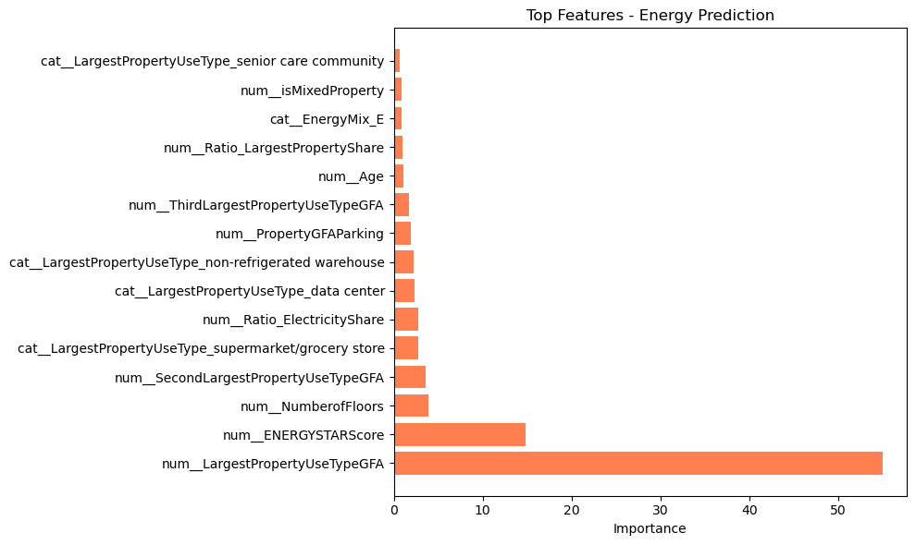
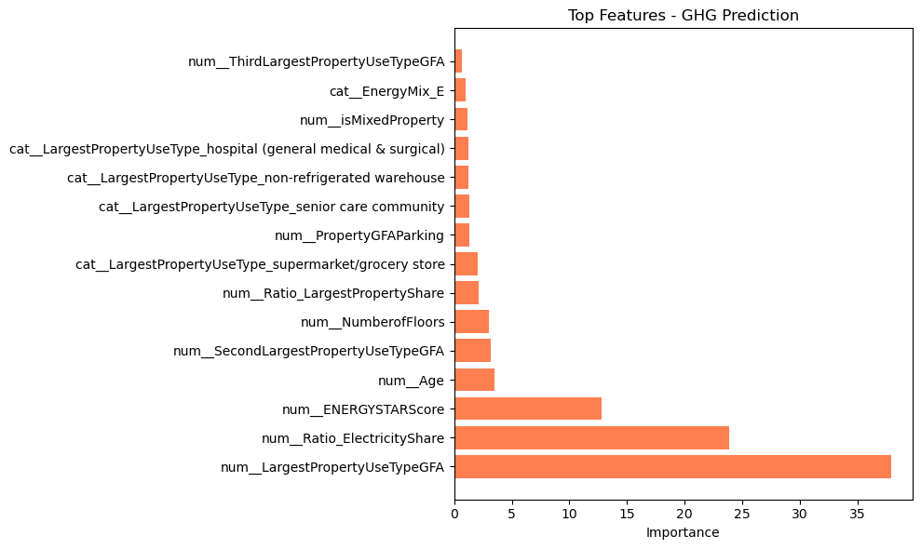
Modeling (Iteration 1)

Slide 14
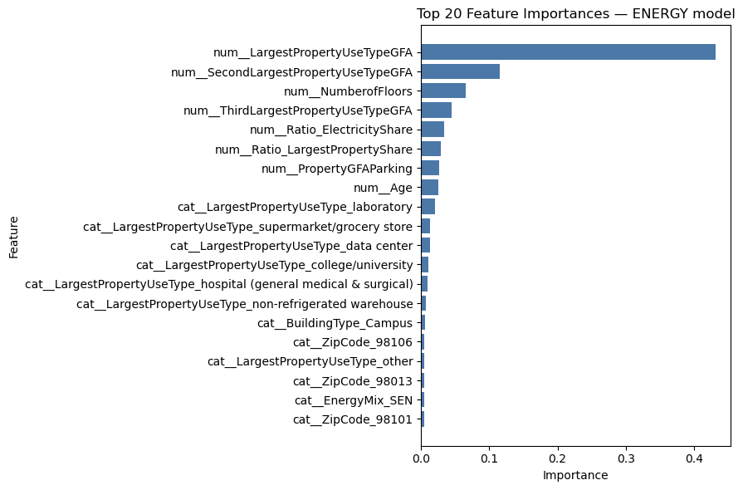
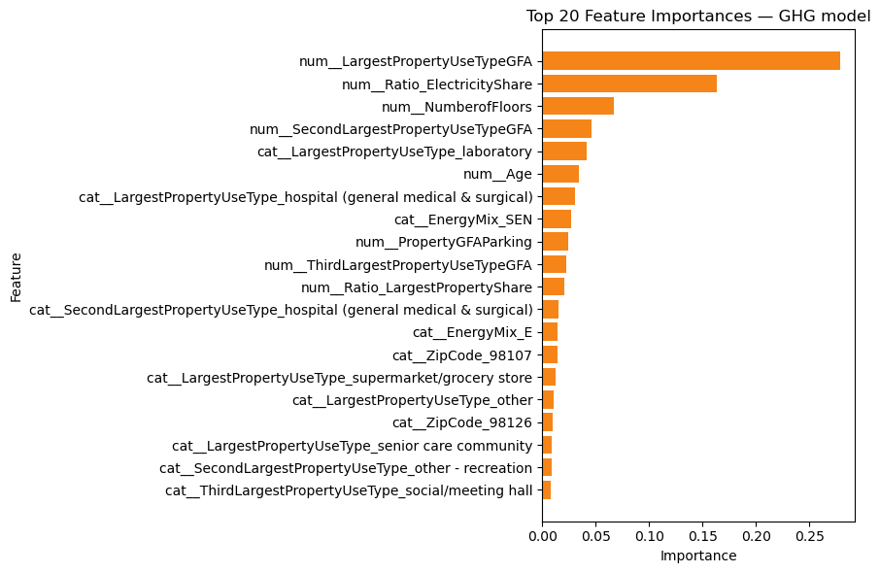
Modeling (Iteration 2)

Slide 15
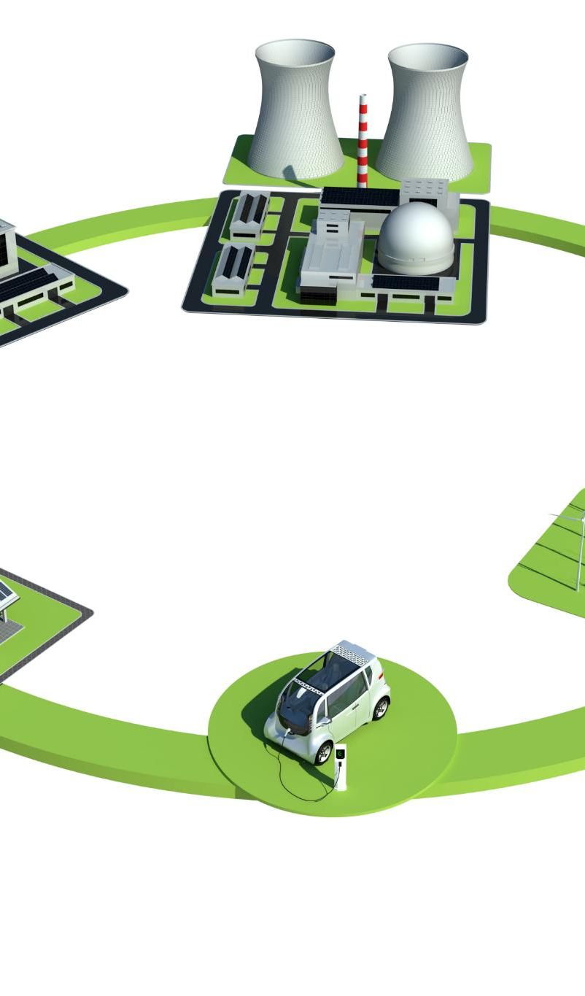
Modeling (Iteration 3 & 4)
Iteration 3 Predictor Choice
  For Emissions, SiteEnergyUseWN was used as a predictor. This improved emissions prediction accuracy significantly.
Feature Selection Strategy
  Features outside the top 20 importance were dropped to reduce noise and enhance model clarity and robustness.
Iteration 4 Transformation Impact
  Logarithmic transformations addressed skewness but did not improve results beyond Iteration 3's performance.
Final Model Selection
  Iteration 3 chosen for balanced accuracy, interpretability, and robustness supporting sustainability forecasting.
Notes:
Iterations 3 and 4 focused on refining the model for better accuracy and interpretability. In Iteration 3, SiteEnergyUseWN (kBtu) was used directly as a predictor for TotalGHGEmissions due to its strong correlation with emissions. Features outside the top 20 importance from previous runs were dropped to minimize noise. Although general performance metrics did not show major improvement, emissions prediction accuracy became excellent, validating the approach. Energy-use predictions remained moderate but stable. Iteration 4 applied logarithmic transformations to both target variables to address skewness. However, this did not yield better results compared to Iteration 3. Consequently, Iteration 3 was selected as the final model, offering a balanced combination of accuracy, interpretability, and robustness. This iteration effectively captures the relationship between energy use and emissions, making it a practical tool for forecasting and planning in support of Seattle’s sustainability goals.

Slide 16
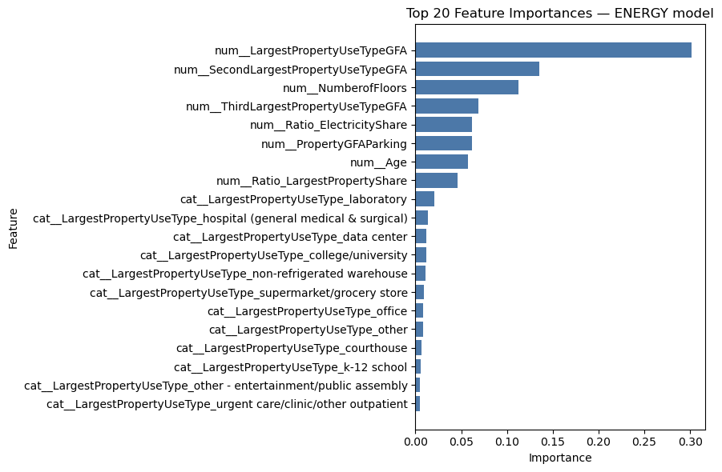
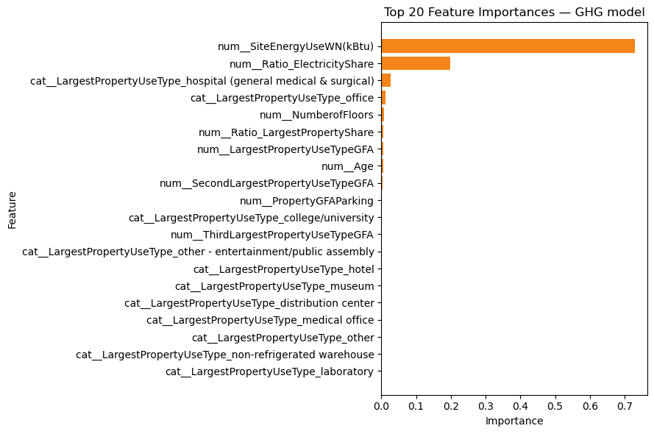
Modeling (Iteration 3)

Slide 17
Modeling (Iteration 4)

Slide 18

Conclusions and Insights
Model Selection and Performance
  Iteration 3 model excels in emissions prediction with moderate energy use accuracy. It manages dataset variability well.
Practical Application Benefits
  The model estimates energy and emissions for buildings without direct data, supporting carbon-neutral goals.
Scalability and Cost-Effectiveness
  Relies on easily accessible structural data, ensuring citywide implementation is scalable and affordable.
Guidance for Future Planning
  Insights from feature importance and model results guide data collection and sustainability policies.
Notes:
The final model, based on Iteration 3, was chosen for its strong performance in predicting emissions and moderate accuracy in estimating energy use. Despite the dataset’s wide variability and heterogeneity, the model delivers satisfactory results that support practical applications. It enables reasonable estimation of energy consumption and emissions for buildings lacking direct measurements, aligning with Seattle’s long-term carbon-neutral strategy. While not perfect, the model serves as a valuable forecasting and planning tool, helping city planners and sustainability advocates make informed decisions. Its reliance on readily available structural data ensures scalability and cost-effectiveness, making it suitable for citywide implementation. The insights gained from feature importance and model performance also provide guidance for future data collection and policy development, reinforcing the model’s utility in supporting municipal sustainability efforts.

Slide 19

Limitations and Next Steps
Data Reliability Issues
  Model accuracy depends heavily on valid and representative training data sets.
Missing Building Attributes
  Important building features like HVAC type and insulation are absent, limiting model insight.
Next Steps for Improvement
  Plans include gathering richer building data and exploring self-reporting from property managers.
Future Model Goals
  More comprehensive inputs will improve precision and policy relevance for sustainability planning.
Notes:
Despite its strengths, the model has several limitations that must be addressed in future work. Data reliability remains a key concern, as model accuracy depends on valid and representative training data. Additionally, some critical building attributes are absent, limiting the model’s explanatory power. To overcome these challenges, the next steps include improving data reliability and completeness, and collecting richer building-level variables such as HVAC system type and efficiency, degree of insulation and surface area covered, percentage of glass façade and natural-lighting design, and building orientation relative to sunlight. Exploring self-reporting by property managers could also help fill data gaps. With more comprehensive inputs, future models can achieve higher precision and stronger policy relevance, enhancing their utility for citywide sustainability planning and emissions reduction.

