Slide 1
Trip Genie
Bhargavi Chevva | Ketan Jadhav | Jovian Jaison | Deep Shah
Team 7

Slide 2
Table of contents
01
02
03
04
Introduction
Technologies
Functionality
Microservices

Slide 3
01
Introduction

Slide 4
Introduction
Travel app that allows users to effortlessly plan their next adventure.
Enable users to search among various tourist spots and book a package to get the best experience conveniently

Slide 5
02
Technologies

Slide 6
Tech Stack
Java
MongoDB Atlas
PostMan
Designed the application using Java on Android Studio
Database to store travel destinations and bookings
To fetch and post information to MongoDB database using API

Slide 7
03
Functionality

Slide 8
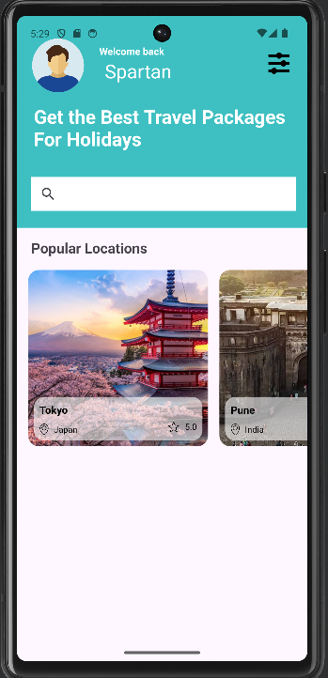
Home Page
Search bar
Popular Destinations
Expandable menu bar:
Bookings data
Info section

Slide 9
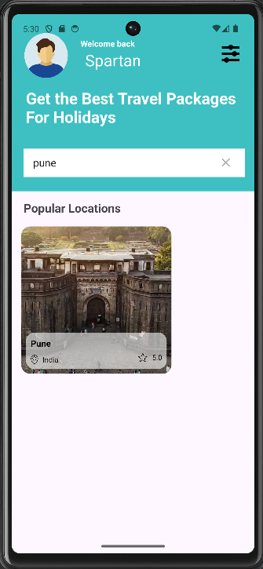
Home Page
Search bar
Popular Destinations
Expandable menu bar:
Bookings data
Info section

Slide 10
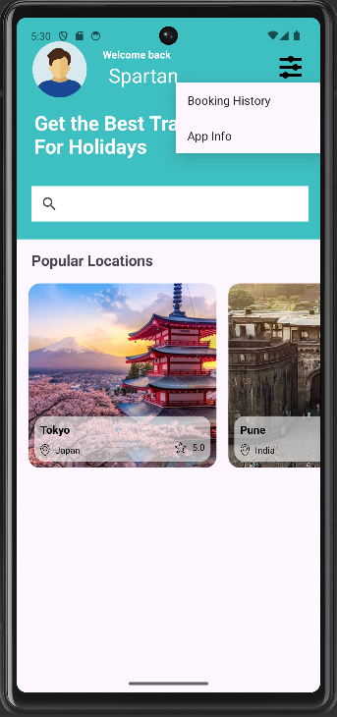
Home Page
Search bar
Popular Destinations
Expandable menu bar:
Bookings data
Info section

Slide 11
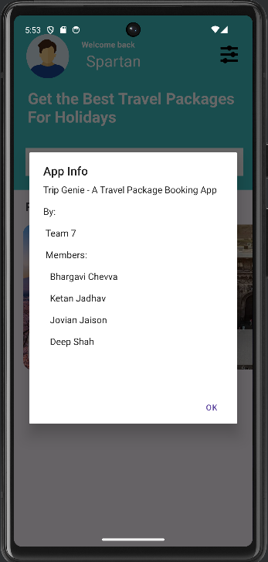
Home Page
Search bar
Popular Destinations
Expandable menu bar:
Bookings data
Info section

Slide 12
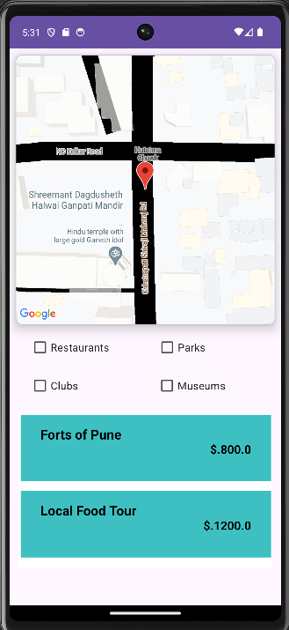
Details Page
Map
Filter (Checkboxes)
Available Packages

Slide 13
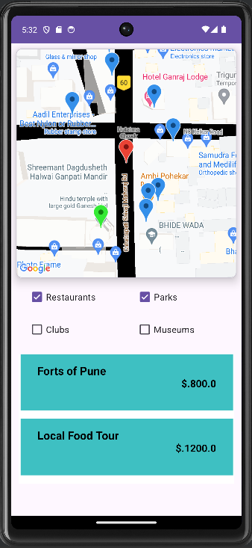
Details Page
Map
Filter (Checkboxes)
Available Packages

Slide 14
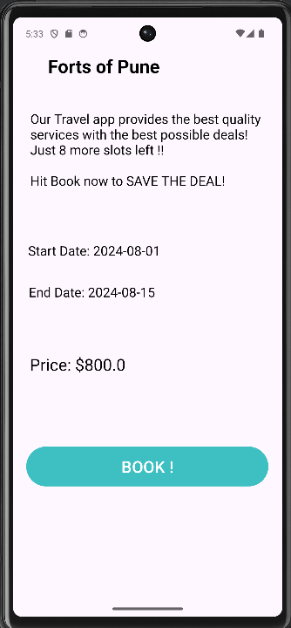
Package Page
Package information
Book button

Slide 15
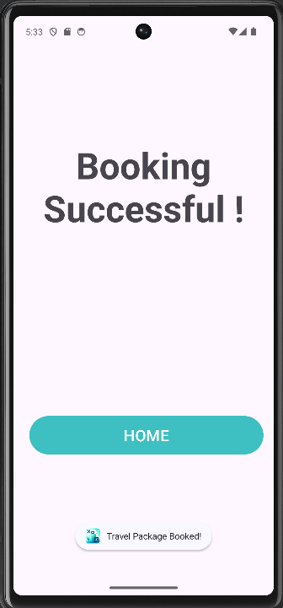
Booking Confirmation Page
Confirmation
Home button

Slide 16
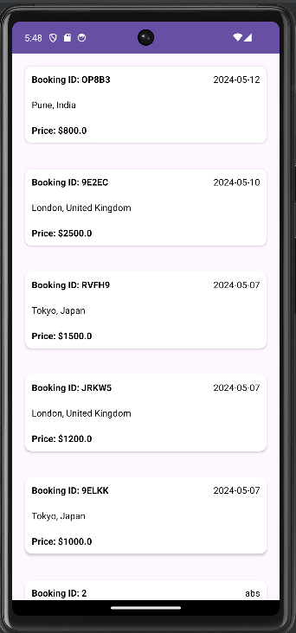
Bookings Page

Slide 17
04
Microservices
Scalable | Flexible | Available

Slide 18
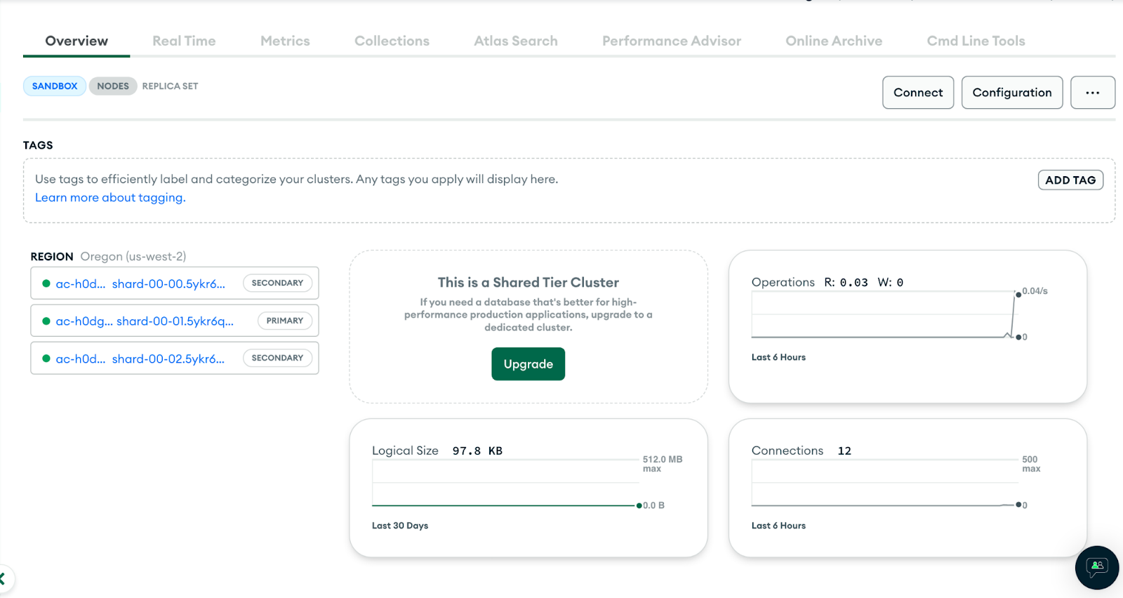
Why MongoDB?

Slide 19
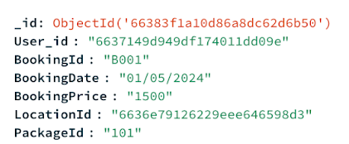
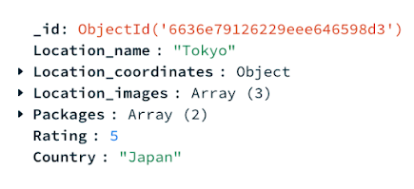
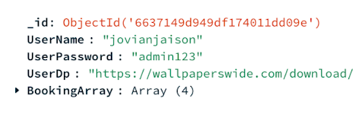
Collections
table.booking
table.location
table.user

Slide 20
APIs
 | Type | URL | Input | Function
1 | GET | /booking | user_id | getBookingForUser
2 | GET | /location | location_id | getLocationById
3 | GET | /location/all | N/A | getAllLocations
4 | POST | /booking | JSON object | putBooking

Slide 21
Thank You!
Do you have any questions?

