Slide 1
Quora Question Pairing
CS6120 Natural Language Processing
Final Project Proposal
Foram Shah, Dhavan Sanghvi, Nidhi Bodar

Slide 2
Outline
Introduction
Dataset
EDA ( Exploratory Data Analysis )
Preprocessing
Methodology
XGBoost with word level TF-IDF
XGBoost with n-gram level TF-IDF
XGBoost with char level TF-IDF
BERT model
Performance Measures and Evaluation.
Future Work and Conclusion

Slide 3
Introduction and Dataset

Slide 4
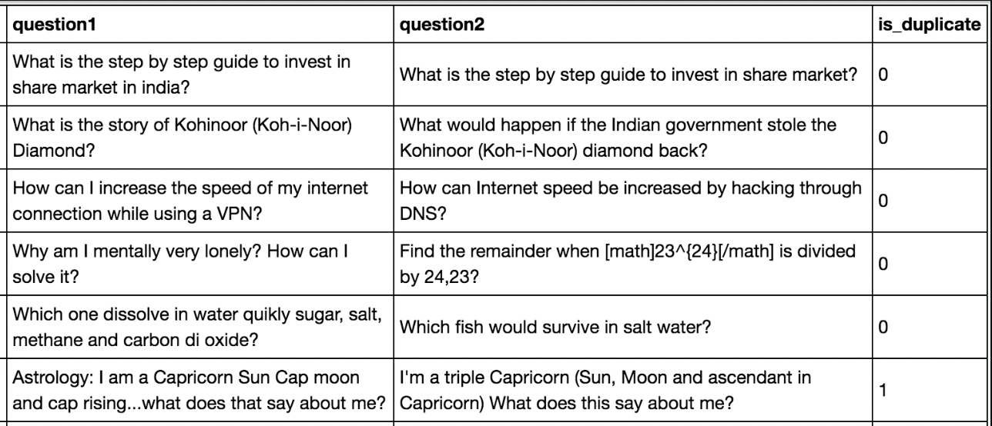
Introduction
Applications
Comment matching
Similar reviews
Plagiarism
Deliverables
Objective
Models
Related Work

Slide 5
Dataset Overview and Preprocessing
Quora Question Pairs Corpus
Training Set & Testing Set: 80:20 ratio
EDA - Exploratory Data Analysis
Count bar graph
Word distribution
Density Graph
Word Cloud
Preprocessing
Tokenization
Lemmatization

Slide 6
Exploratory Data Analysis

Slide 7
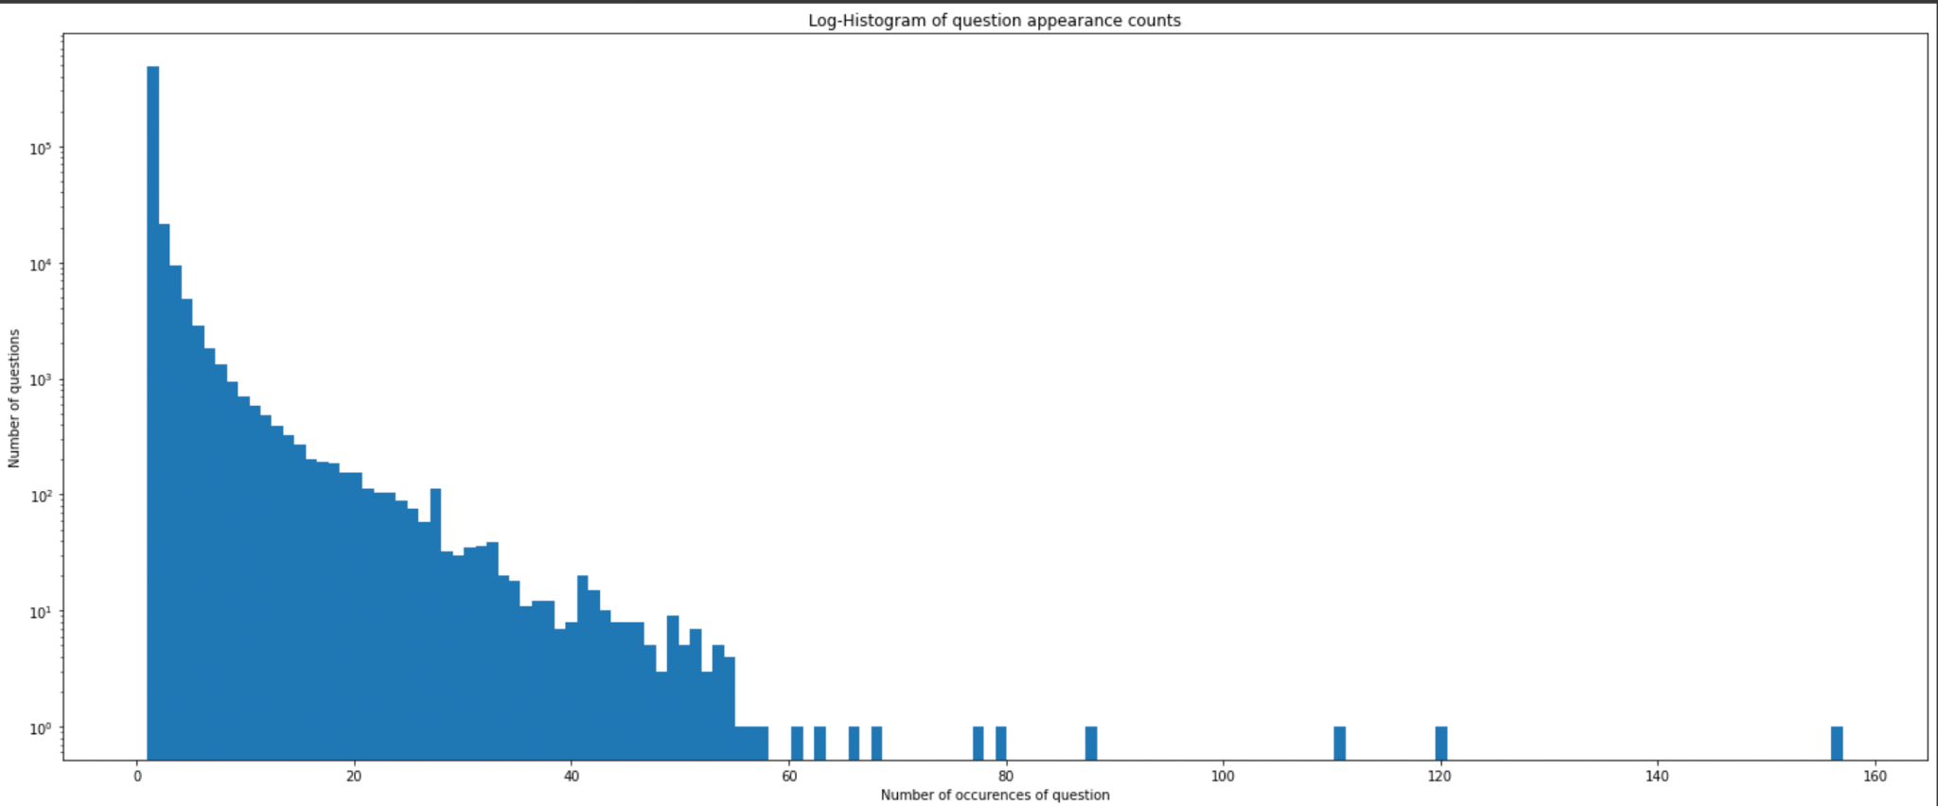
Histogram plot

Slide 8
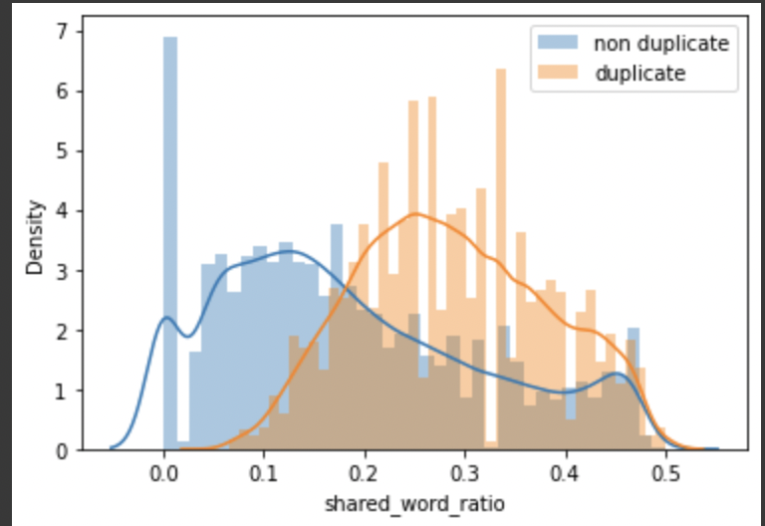
Density plot

Slide 9
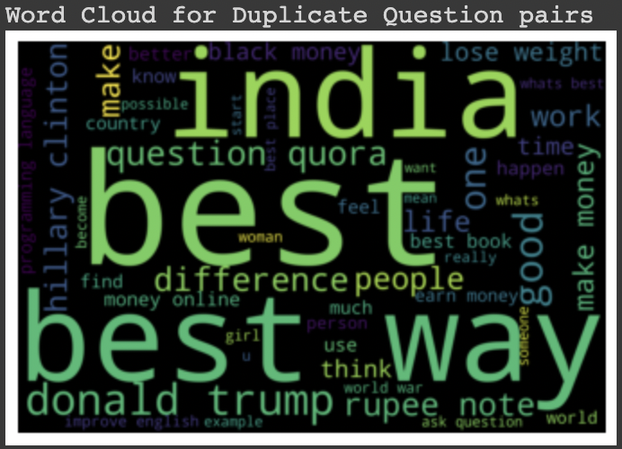
Word Cloud

Slide 10
Methodology

Slide 11
Algorithms - TF-IDF word level & XGBoost
TF-IDF (term frequency-inverse document frequency) is a statistical measure that evaluates how relevant a word is to a document in a collection of documents.
This is done by multiplying two metrics:
How many times a word appears in a document.
The inverse document frequency of the word across a set of documents.
XGBoost is an optimized distributed gradient boosting library designed to be highly efficient, flexible and portable.
It implements machine learning algorithms under the Gradient Boosting framework.
XGBoost provides a parallel tree boosting (also known as GBDT, GBM) that solve many data science problems in a fast and accurate way.
Here, the documents are vectorized and fitted at word level.
We have max_features configured as 5000 and we are using binary:logistic as our objective in XGBoost classification.

Slide 12
Algorithms - TF-IDF n-gram level & XGBoost
The concept is similar to previous model, the only change here is that, the documents are vectorized and fitted at n-gram level of (2,3).
Configurations for XGBoost:
max_features = 5000
Objective = binary:logistic
Max_depth = 50
Configurations for TF-IDF:
analyzer='word'
token_pattern=r'\w{1,}'
ngram_range=(2,3)

Slide 13
Algorithms - TF-IDF char level & XGBoost
The concept is similar to previous model, the only change here is that, the documents are vectorized and fitted at character level.
Configurations for XGBoost:
max_features = 5000
Objective = binary:logistic
Max_depth = 50
Configurations for TF-IDF:
analyzer=’char’
token_pattern=r'\w{1,}'
ngram_range=(2,3)

Slide 14
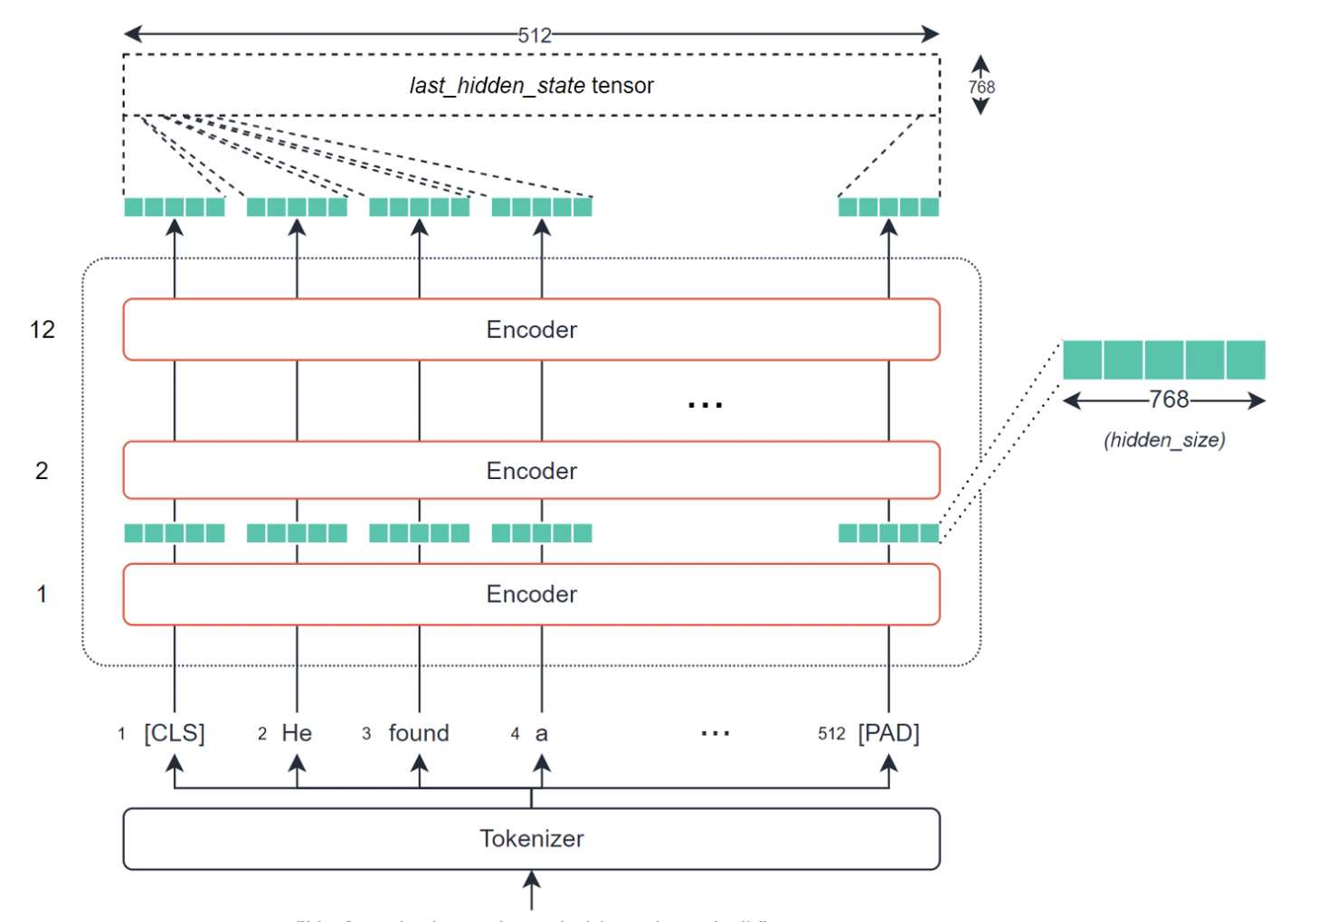
Algorithms - TF-BERT Model
BERT is great at creating these dense vectors, and each encoder layer outputs a set of dense vectors.
We have used a BERT model of base 128.
For hidden layer, we have used relu as activation function.
We have also added an early stop function if the loss value is not changed for 3 consecutive epochs.
For output layer, we have used sigmoid as activation function.
Also for similarities, we are using euclidean distance.

Slide 15
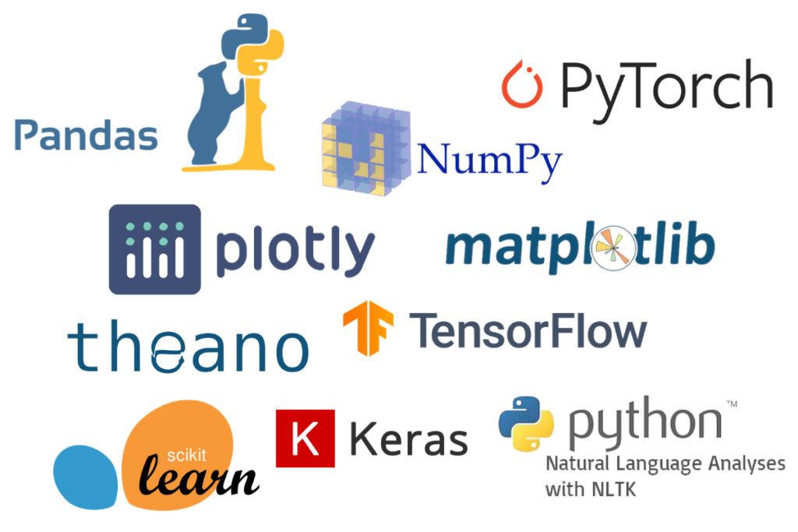
Libraries and Tools

Slide 16
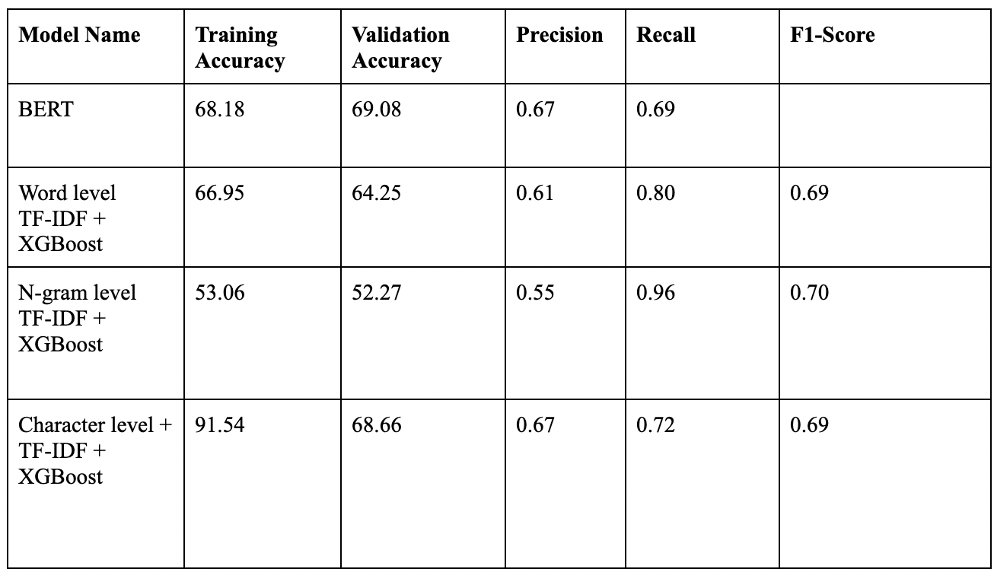
Evaluation:
Observation:
BERT model has the highest validation accuracy.
Accuracy drastically decreased with word and n-gram level TF-IDF
Accuracy of char level TF-IDF was comparable with BERT.
Training accuracy of char level was too high compared to validation accuracy, which suggest overfitting of the model.
Notes:
For final results - We plan to predict the missing word in the sentence and show the comparison of different models on the basis of performance measures to find the model best suited for the task.

Slide 17
Future Work
Limited Computing Resources
Larger dataset
More complex models in BERT.
Review and comment data corpus.
Auto-complete of question.

Slide 18
Works Cited
Lakshay Sharma, Laura Graesser, Nikita Nangia, Utku Evci, “Natural Language Understanding with the Quora Question Pairs Dataset” , Cornell University, June 2020
Andreas Chandra, Ruben Stefanus, “Experiments on Paraphrase Identification Using Quora Question Pairs Dataset”, Cornell University, June 2020.
Z Chen, H Zhang, X Zhang, L Zhao, “Quora Question Pairs” , 2018.
INDIAN JOURNAL OF SCIENCE AND TECHNOLOGY, “Identifying Similar Question Pairs Using Machine Learning Techniques”, June 2021.
K. Abishek, Basuthkar Rajaram Hariharan & C. Valliyammai , “An Enhanced Deep Learning Model for Duplicate Question Pairs Recognition”, August 2018.

