Slide 1
AI-NATIVE GROUP HR
Internship Final Review
Designing AI-native operating models for TMTC and TAS,
and building an AI-First Hiring Platform from scratch.
PRESENTED BY · Nirmit Shah , Tata Sons Group Digital
May 2026
1 / 11
Notes:
[~30s] Good morning. I'm Nirmit, and this is my internship final review covering the AI-Native Group HR project.
Over the past two months, I worked on three things: designing AI-native operating models for two Tata Group HR verticals — TMTC and TAS — and building UX AI-First Hiring Platform from scratch.
In the next 20 minutes, I'll walk you through the context, what I set out to do, how I did it, what I found, what I recommend. Let's start with why this project exists.

Slide 2
Tata Group HR runs on expert humans and manual rails AI can help change that
CONTEXT
200+
THE OPPORTUNITY
learning programs run annually by TMTC
No LMS · No faculty database
▸ Redesign the operating model; not bolt AI onto today's process
▸ AI handles first-draft work; humans own every decision gate
▸ Institutional intelligence compounds across programs and hiring cycles
▸ Two verticals chosen for deep-dive: TMTC (learning & development) and TAS (talent acquisition)
▸ Plus a third proof point: a hiring platform built from scratch with help of Tata Comms (Commotion team)
10
HR systems across Group HR
Three vendor platforms · No integration
~300
CVs screened by hand per campus hiring cycle
Manual triage · no screening rubric automation
AI-NATIVE GROUP HR · PANEL PRESENTATION
2 / 11
Notes:
[~120s] Context. Tata Group HR operates across 30 companies, four functional pillars, and roughly 14 distinct HR processes. I mapped all 14 at the Group level and narrowed to two verticals for deep work.
TMTC — the Tata Management Training Centre — runs over 200 learning programs a year. Experts design and deliver every one. But there's no LMS, no faculty database, no alumni tracking. Institutional memory lives in people's heads and SharePoint folders. When someone moves roles, that memory walks out the door.
TAS — the Tata Administrative Service — manages the Group's flagship leadership talent pipeline. Eight lifecycle stages, ten HR systems with zero integration across them. About 300 CVs screened by hand per campus cycle. The selection rubric is so confidential it can't be shared with any technology system — which creates an interesting design constraint we'll come back to.
The opportunity isn't to bolt AI onto today's process. It's to redesign the operating model so that AI does the first-draft work — drafting program designs, scoring candidates, matching faculty, scheduling interviews — while humans own every decision that requires judgment.
Two verticals for operating model design, plus a third proof point: a fully built AI-First Hiring Platform.
Bridge: what specifically did I set out to achieve?

Slide 3
Three objectives - diagnose, design, prove
OBJECTIVES
01
DIAGNOSE
Map current-state processes, interview stakeholders, identify bottlenecks and pain points across TMTC and TAS.
6 interview rounds · 9 process maps created · stakeholder quotes
02
DESIGN
Create AI-native operating models with role workbenches, agent catalogues, governance frameworks, and implementation roadmaps.
2 strategy memos · 36 AI agents designed · decision-rights matrix
03
PROVE
Build working prototypes that demonstrate the principle — AI drafts, humans decide — at interactive depth.
2 UI prototypes · 8 UX flowcharts
AI-NATIVE GROUP HR · PANEL PRESENTATION
3 / 11
Notes:
[~90s] Three objectives, each building on the last.
First — diagnose. Map how TMTC and TAS actually work today, not how the org chart says they should. Six interview rounds with stakeholders from program directors to coordinators. Nine detailed process maps covering Open, Flagship, and Custom programs across Demand, Build, and Deliver phases.
Second — design. Turn the diagnosis into AI-native operating models. Not "add AI to step 7" but "redesign the entire workflow." Two comprehensive strategy memos — one for TMTC, one for TAS — covering 36 AI agents total, role workbenches for every persona, governance frameworks, decision-rights matrices, and phased roadmaps.
Third — prove. Build working prototypes that show the principle isn't just theoretical. Two interactive Prototypes: the TMTC Journey Studio showing how a Program Director works with AI to design learning programs, and the AI-First Hiring Platform showing how a manager hires through a Teams chat, 8 UX flowcharts, and an architecture decision log.
Bridge: how did I approach this?

Slide 4
Six interview rounds · nine process maps · two prototypes · two strategy memos
METHODOLOGY
STAKEHOLDER DISCOVERY
PROCESS MAPPING
▸ 6 interview rounds (Meeting 1–6)
▸ Level-2 deep dive with TAS Lead
▸ Voice-of-stakeholder quotes captured
▸ Pain points ranked by frequency
▸ 9 maps: 3 Types of Program- Open · Flagship · Custom
▸ Across 3 Stages- Demand · Build · Deliver
▸ Current-state bottleneck annotations
▸ Volume and time metrics extracted
STRATEGY SYNTHESIS
PROTOTYPING
▸ TMTC strategy memo (19 agents)
▸ TAS strategy memo (17 agents)
▸ AI-native operating models
▸ Decision-rights + governance + roadmap
▸ TMTC Journey Studio (React + TS)
▸ AI Hiring Platform (React + TS)
▸ 11 AI worker contracts
▸ 8 UX flowcharts
AI-NATIVE GROUP HR · PANEL PRESENTATION
4 / 11
Notes:
[~90s] Four workstreams, each feeding the next.
Stakeholder discovery — six formal interview rounds plus a Level-2 deep dive with the TAS Lead. Every pain point quoted and attributed. The interviews revealed that the biggest problems aren't technology problems — they're operating model problems. The technology just makes them visible.
Process mapping — nine detailed maps covering how Open, Flagship, and Custom programs move through Demand, Build, and Deliver phases. These maps are where the bottleneck numbers come from: 200 programs, zero LMS, 20–25 days of email logistics per program.
Strategy synthesis — two comprehensive memos, one per vertical. TMTC: 19 AI agents across the full program lifecycle. TAS: 17 AI agents with the Sealed Rubric Vault at the centre. Both with decision-rights matrices, governance frameworks, and phased roadmaps.
Prototyping — not wireframes. Two fully interactive React + TypeScript applications. The TMTC Journey Studio with 8 views across 3 roles. The AI Hiring Platform with 25 interaction moments across 4 personas and 11 AI worker contracts backed by 275 automated tests.
Bridge: what did I find?

Slide 5
TMTC today - 200 programs, no LMS, institutional memory trapped with people
KEY FINDINGS & ANALYSIS
200+
No
No
5y
No
programs/year
LMS
faculty Database
of dossiers
Wanted by Program Directors
Continuous alumni
tracking
"We reuse maybe 10% of what we build. The rest sits in someone's SharePoint folder and nobody finds it again."
— TMTC Stakeholder
▸
Experts design every program from scratch; institutional intelligence doesn't compound
▸
Faculty selection driven by relationships, not systematic ratings or evidence-based matching
▸
Program Coordinators spend 30–40% of capacity on logistics - nominations, dossiers, certificates
▸
No closed-loop learning: feedback collected but not fed back into program design or faculty evaluation
AI-NATIVE GROUP HR · PANEL PRESENTATION
5 / 11
Notes:
[~120s] TMTC — the Tata Management Training Centre. This is where the findings get concrete.
200+ programs a year. Zero LMS. Zero faculty database. The centre wants five years of program dossiers searchable — today they have none in a structured format. Zero alumni tracking beyond ad hoc LinkedIn checks.
The quote on screen captures it perfectly: "We reuse maybe 10% of what we build." Every Custom program starts almost from scratch because there's no structured memory of what worked before, which faculty delivered well, which cohort profiles matched which learning designs.
Faculty selection runs on relationships and memory, not on systematic evidence. Program Coordinators — the operational backbone — spend a third of their time on logistics: chasing nominations, assembling dossiers, generating certificates. And the feedback loop is broken: Forms feedback gets collected after every program, but it doesn't systematically feed back into the next program's design or the faculty's evaluation.
The opportunity isn't to add AI to this process. It's to redesign the process so that every program feeds the next.
Bridge: what does that redesigned model look like?

Slide 6
AI-native TMTC - six layers, five role workbenches, 19 agents
KEY FINDINGS & ANALYSIS
FIVE ROLE WORKBENCHES
Signal & Intake
Sponsor requests · nominations · feedback · alumni moves
PD
AI-assisted learning strategist
Knowledge / Data Fabric
Programs · dossiers · content · faculty · learners · feedback
PM
Learning journey product owner
AI Intelligence Engines
Demand Brain · Journey Studio · Delivery Engine · Concierge
PC
AI-orchestrated delivery manager
Role Workbenches
PD · PM · PC · Learner · Alumnus - role-specific AI surfaces
Learner
Continuous learner
Human Decision Gates
Progaram Route · Program design · faculty · budget · impact approvals
Alumnus
Living leadership learning graph
Learning Loop
Every program updates content · ratings · cohort insights · next recs
19 agents · AI drafts, humans decide
AI-NATIVE GROUP HR · PANEL PRESENTATION
6 / 11
Notes:
[~120s] The AI-native TMTC operating model. Six layers, read top-down.
Signal & Intake captures everything — group company requests, nominations, feedback, alumni career moves. The Knowledge and Data Fabric structures it into searchable, reusable institutional memory. AI Intelligence Engines — the Demand Brain, the Journey Studio, the Delivery Engine, the Experience Concierge — power the recommendations. Role Workbenches give each persona their own AI-powered surface. Human Decision Gates ensure judgment stays human at every approval point. And the Learning Loop closes the circle — every program automatically feeds insights back into the next.
Five role workbenches. The Program Director becomes an AI-assisted learning strategist — AI prepares sponsor context, drafts program architectures, shortlists faculty with ratings. The PM becomes a learning journey product owner — AI surfaces reusable content, synthesises cohort profiles, matches faculty. The PC becomes AI-orchestrated — nominations, logistics, dossiers, certificates largely automated, PC handles exceptions. Learners get a concierge. Alumni get a living profile that recommends what's next.
19 specialised agents across the full lifecycle. Each one does one thing well. Each one has a human checkpoint.
Bridge: TAS follows the same pattern — with one critical twist.

Slide 7
TAS today and AI-native version – secured screening rubric, confidence gates, 17 agents
KEY FINDINGS & ANALYSIS
CURRENT PROCESS MAP
Demand
sensing
Channel
planning
Source &
screen
Selection
panels
Offer &
onboard
Stint
matching
Y1–Y2
program
Alumni
network
4 bottlenecks: vendor data dependency · manual CV screening · project–candidate matching · Chroma sync cycle
AI-NATIVE MODEL
6 ROLE WORKBENCHES
Recruiting Lead
Y1–2 Lead
Demand · Orchestrate · Deliver · Prioritise
Panellist (CXO)
Candidate
Knowledge / Data / Governance Fabric
Company SPOC
Finance
SECURED SCREEING RUBRIC — the rubric is never accessed by chat based LLM. Scored outside by deterministic AI worker.
17 agents · AI drafts, humans decide
AI-NATIVE GROUP HR · PANEL PRESENTATION
7 / 11
Notes:
[~120s] TAS — compressed into one slide because it follows the same six-layer pattern as TMTC, but with one critical innovation.
Current state: 8-stage lifecycle from demand sensing to alumni network. Ten systems, three vendor platforms, zero integration. About 300 CVs screened by hand per campus cycle. Four specific bottlenecks: vendor data dependency, manual CV screening, project-to-candidate matching during stints, and the Chroma performance management sync cycle.
The AI-native model: Demand, Orchestrate, Deliver, Prioritise — same layered architecture as TMTC. Six role workbenches: Recruiting Lead, Year 1–2 Lead, Panellist, Candidate, Company SPOC, and Finance. 17 specialised agents.
But the critical twist is the Sealed Rubric Vault — highlighted at the bottom. The TAS selection rubric is so confidential that the TAS Lead explicitly said it cannot be shared with any external system. Our design solves this: the rubric is never sent to any LLM. It's scored outside by a deterministic service. AI works around the rubric — generates candidate evidence, structures the data — but never sees the scoring weights. This is the single most important governance constraint in the entire project, and it drove the architecture of the Rubric AI Worker.
Bridge: let me show you what this looks like when you actually use it.

Slide 8
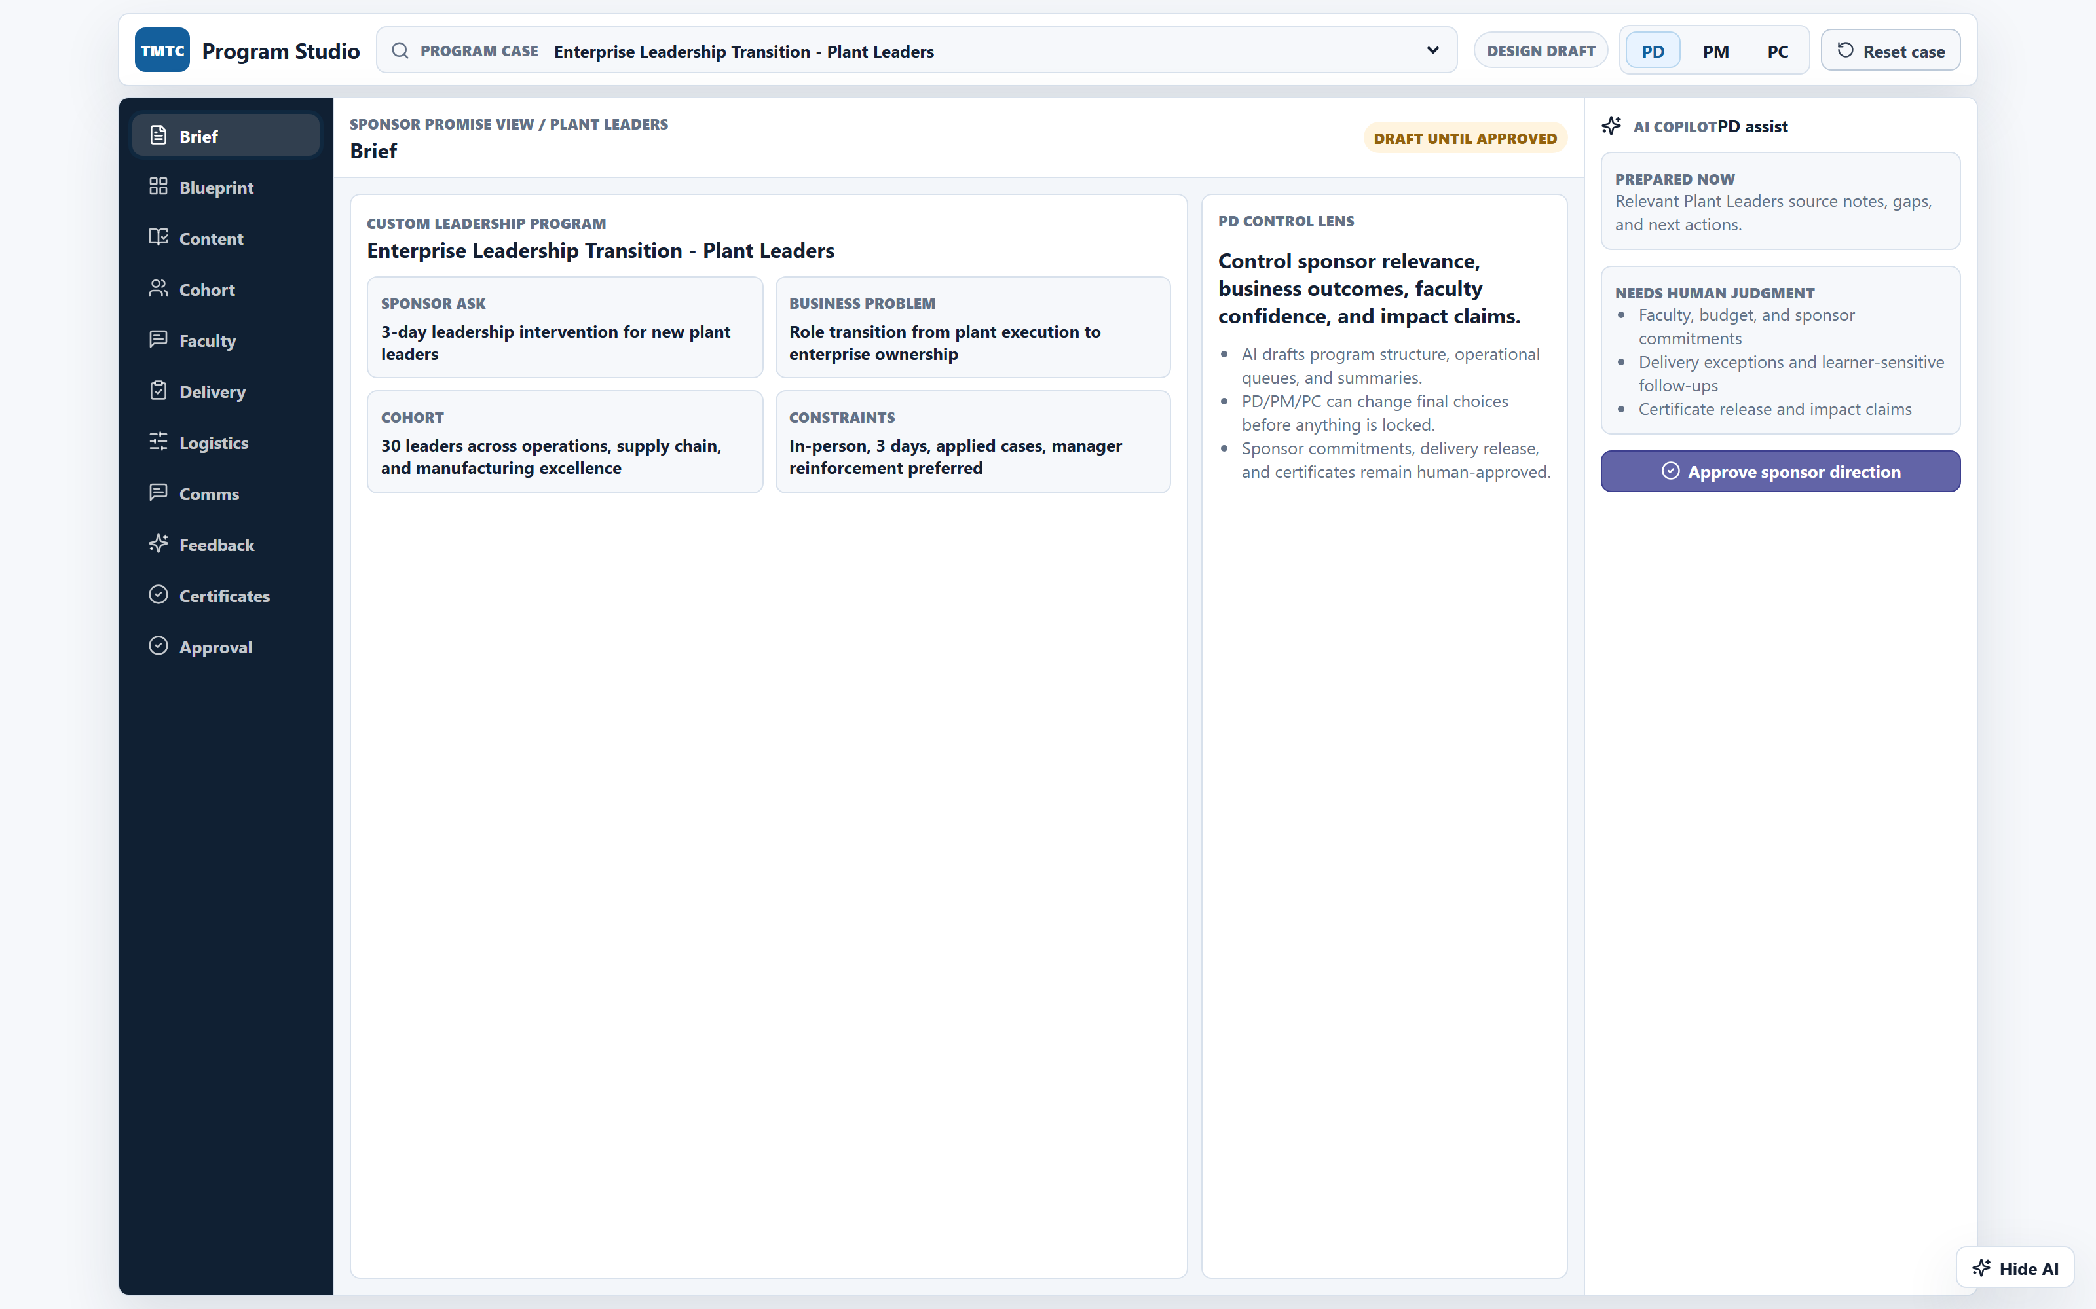
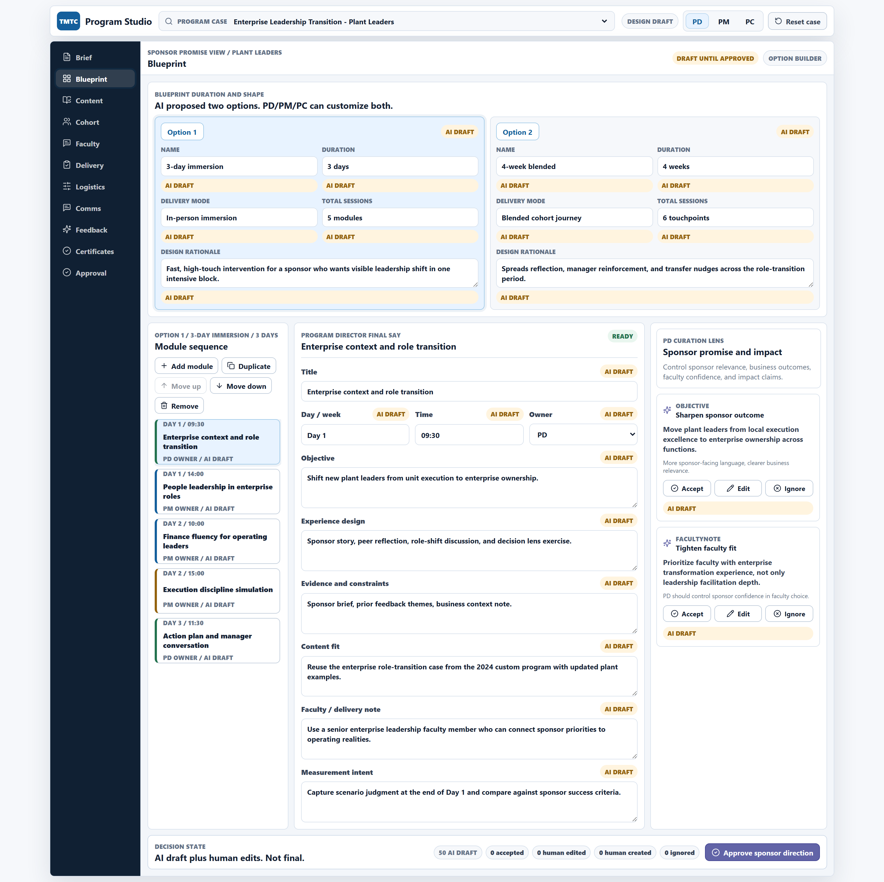
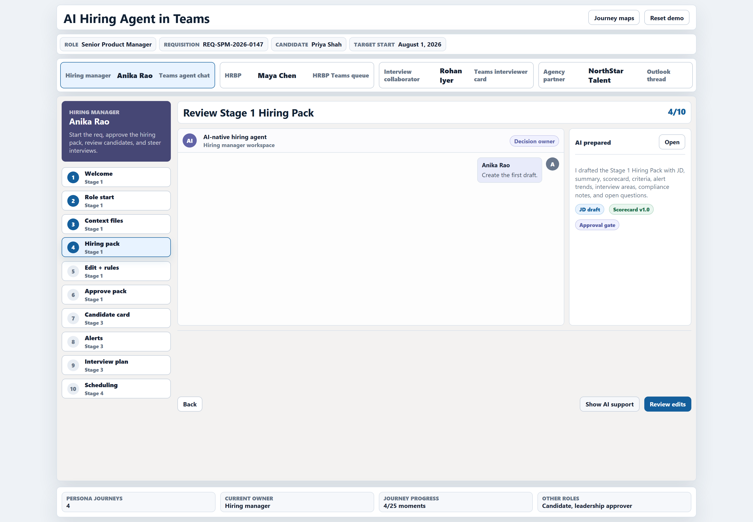
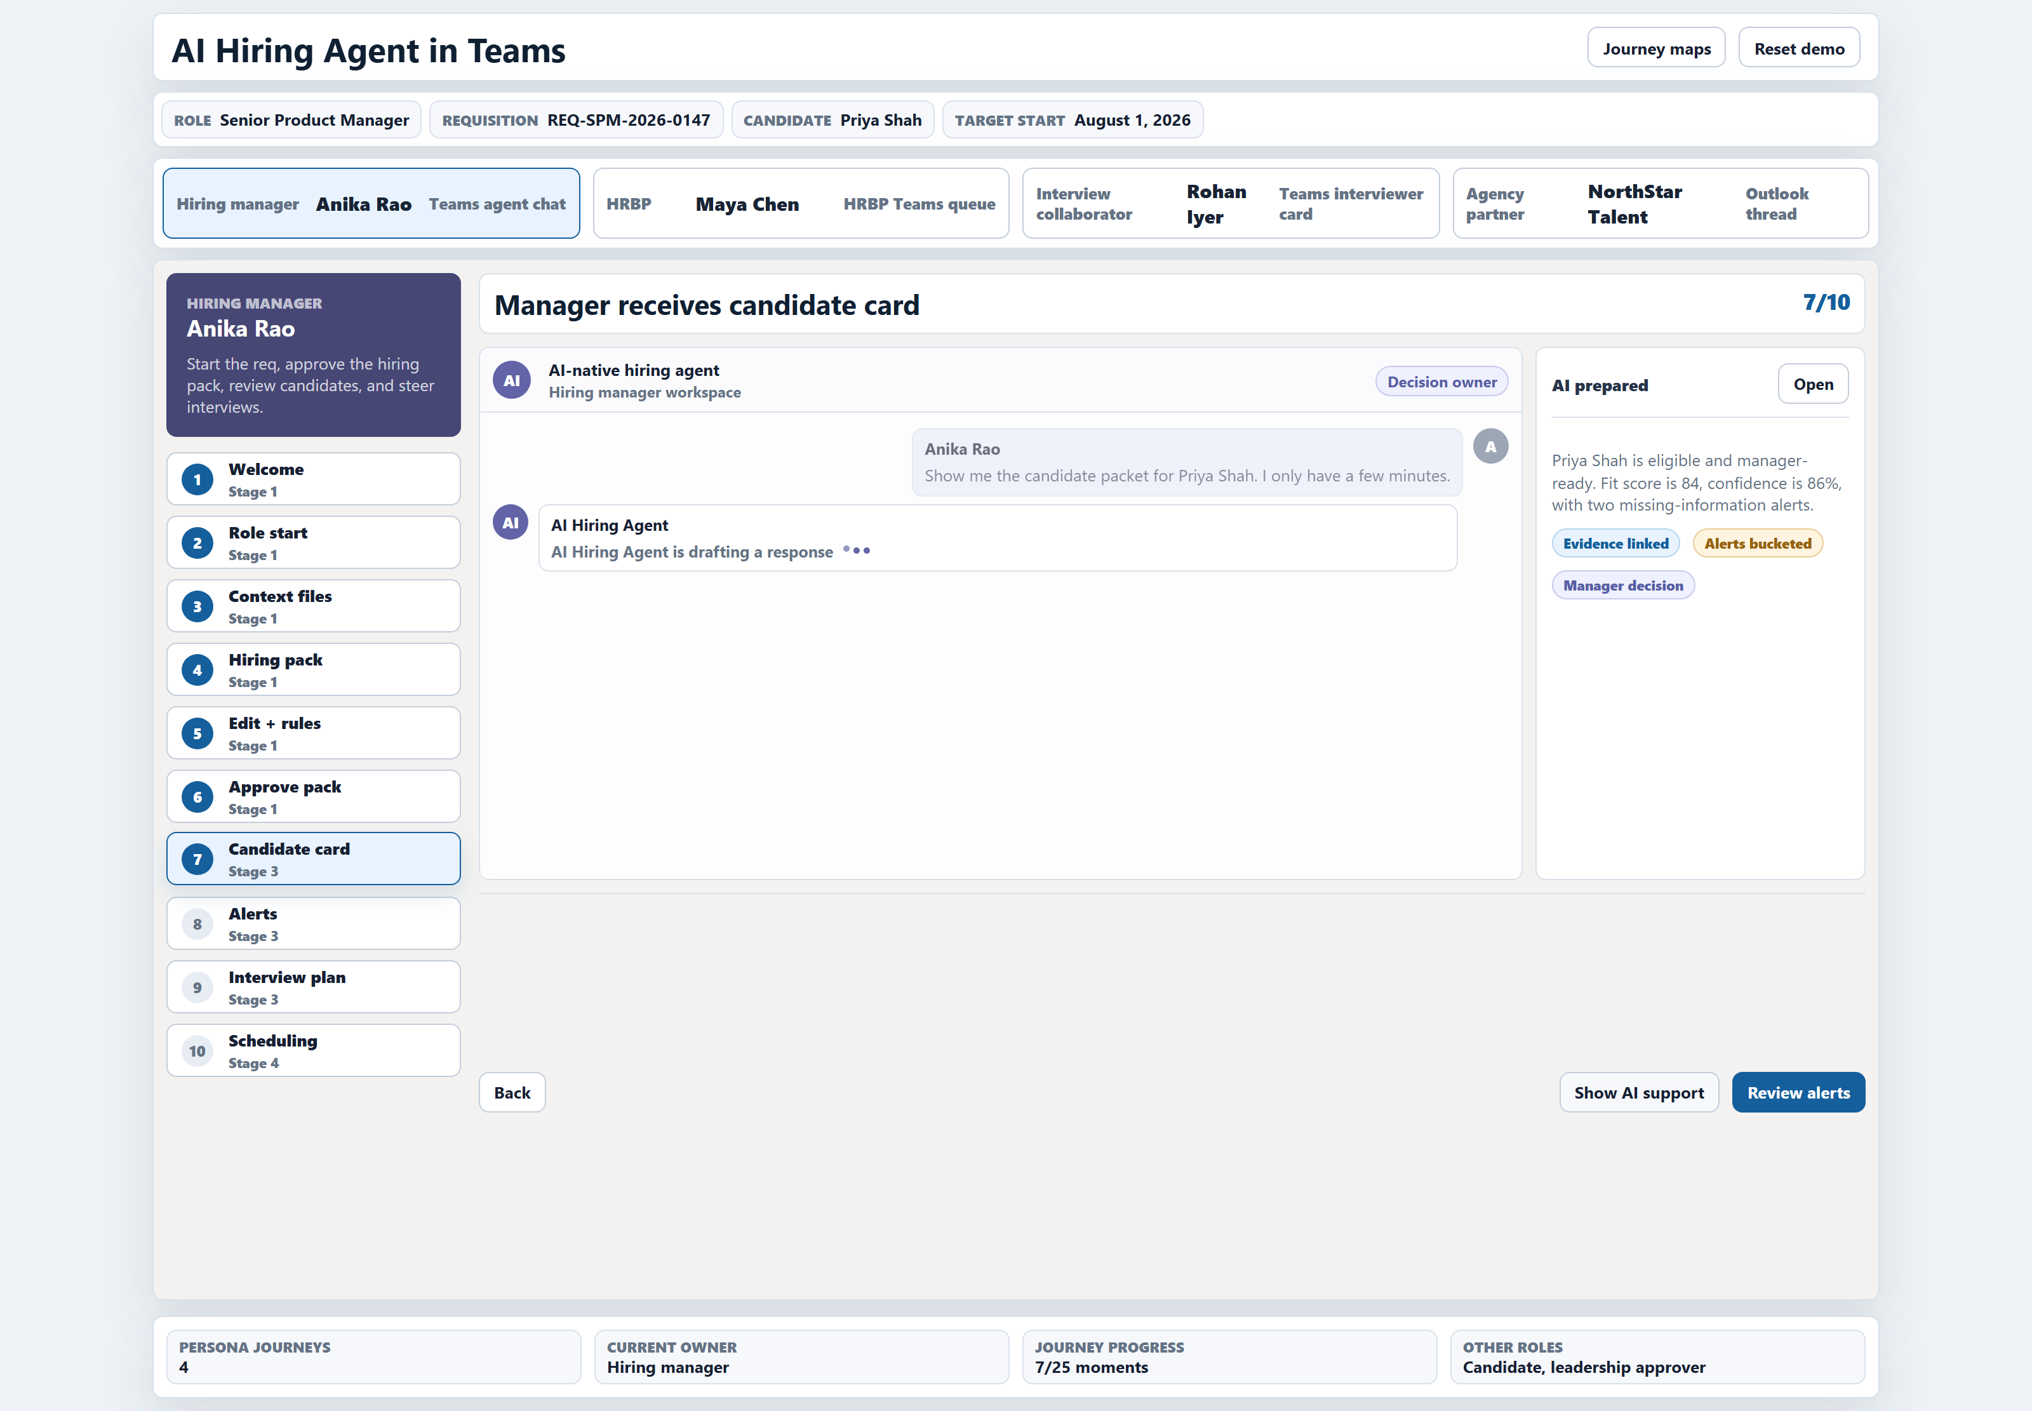
From the prototypes - TMTC Journey Studio and AI Hiring Platform
KEY FINDINGS & ANALYSIS
TMTC — PD Brief view
TMTC — AI-drafted Blueprint
Hiring — Manager Hiring Pack
Hiring — Candidate Card (84%)
AI-NATIVE GROUP HR · PANEL PRESENTATION
8 / 11
Notes:
[~90s] Four screenshots from two working prototypes — not wireframes, not mockups, interactive applications.
Top-left: TMTC Journey Studio — the PD Brief view. The Program Director sees sponsor context, business objectives, and audience captured for the AI to reason against. Everything the AI generates references this brief.
Top-right: the Blueprint view. AI has drafted two program architecture options — Option 1 and Option 2 — each with a structured rationale. The PD accepts, edits, or ignores at field level. Every AI suggestion carries provenance — where it came from, why it's recommended.
Bottom-left: AI Hiring Platform — the Manager Hiring Pack. The manager described a role in a Teams chat. AI generated a complete JD, a scorecard, screening criteria, alert trends, and compliance notes. One card, one approval.
Bottom-right: the Candidate Card. 84% fit score with evidence linked. Alerts bucketed into three tiers: blocking issue, review alert, information signal. The manager never reads a raw resume — they read the evidence.
Two different domains. Same principle: AI proposes with evidence, humans decide with confidence.
Bridge: the synthesis — what does this pattern tell us?

Slide 9
Notes:
TMTC Journey Studio — the PD Brief view. The Program Director sees sponsor context, business objectives, and audience captured for the AI to reason against. Everything the AI generates references this brief.

Slide 10
Notes:
Top-right: the Program Blueprint view. AI has drafted two program architecture options — Option 1 and Option 2 — each with a structured rationale. The PD accepts, edits, or ignores at field level. Every AI suggestion carries provenance — where it came from, why it's recommended.

Slide 11
Notes:
Bottom-left: AI Hiring Platform — the Manager Hiring Pack. The manager described a role in a Teams chat. AI generated a complete JD, a scorecard, screening criteria, alert trends, and compliance notes. One card, one approval.

Slide 12
Notes:
the Candidate Card. 84% fit score with evidence linked. Alerts bucketed into three tiers: blocking issue, review alert, information signal. The manager never reads a raw resume — they read the evidence.
Two different domains. Same principle: AI proposes with evidence, humans decide with confidence.
Bridge: the synthesis — what does this pattern tell us?

Slide 13
Three implementations, one principle – AI Drafts, Humans Decide the pattern generalizes
KEY FINDINGS & ANALYSIS
TMTC
TAS
HIRING PLATFORM
Learning programs
Talent acquisition
Lateral hiring
▸ 19 AI agents
▸ 5 role workbenches
▸ Six-layer operating model
▸ Human decision gates
▸ Program memory as data fabric
▸ 17 AI agents
▸ 6 role workbenches
▸ 4-layer operating model
▸ Secured Screening Rubric
▸ Living TAS Workforce Graph
▸ 11 AI workers
▸ 4 personas
▸ Three-layer platform
▸ Confidence-gated handoffs
Common principle: AI handles first-draft work · Humans own every decision gate
47 AI agents/workers · 15 role workbenches · 3 HR domains · 1 architectural principle
AI-NATIVE GROUP HR · PANEL PRESENTATION
9 / 11
Notes:
[~90s] The synthesis. Three very different HR domains — learning program management, talent acquisition and selection, lateral hiring — and they all arrived at the same architecture.
TMTC: 19 agents, 5 role workbenches, a six-layer operating model where humans own every decision gate.
TAS: 17 agents, 6 role workbenches, the same six-layer model. Plus the Sealed Rubric Vault — a governance innovation that ensures the most sensitive scoring rule never touches an LLM.
Hiring Platform: 11 workers, 4 personas, a three-layer platform with confidence-gated handoffs. Built and tested end-to-end.
47 agents and workers across all three. 15 role workbenches. Three domains. One principle: AI drafts, humans decide.
This is the key finding: the principle holds whether you're designing a leadership program, screening TAS candidates, or scheduling an interview. The pattern generalises — any Group HR vertical can follow this model.
Bridge: so what do I recommend?

Slide 14
Roadmap - clean the institutional memory, automate coordination, then platformise
RECOMMENDATIONS
PHASE 1
0–90 days
PHASE 2
3–6 months
PHASE 3
6–18 months
Foundation
Controlled pilots
Platformisation
▸ SharePoint cleanup + taxonomy
▸ Program memory template
▸ Rubric Vault architecture
▸ Feedback report automation
▸ Faculty database MVP
▸ AI safety workshop
▸ Custom proposal assistant
▸ Nomination tracker + reminders
▸ Faculty matching MVP
▸ Content reuse (tagged search)
▸ Candidate triage pilot
▸ Alumni update pilot
▸ LMS integration
▸ Program asset graph
▸ Role-based workbenches
▸ Cohort + Group company intelligence
▸ Program Impact dashboard
▸ Learning Program Journey Studio
Each phase builds the data layer the next phase needs. Governance and decision-rights framework runs across all three.
AI-NATIVE HR · PANEL PRESENTATION
10 / 11
Notes:
[~120s] Recommendations. Three phases, and the sequence matters — each phase builds the data layer that the next phase needs.
Phase 1, zero to 90 days — Foundation. Clean up SharePoint. Establish a program memory template so every program from now on creates a reusable record. Architect the Rubric Vault so TAS can start automating triage without exposing the rubric. Automate the feedback reporting pipeline. Build a faculty database MVP. And run an AI safety workshop to establish governance principles.
Phase 2, three to six months — Controlled pilots. AI-assisted custom proposal drafting. A nomination tracker that chases follow-ups automatically. Faculty matching that ranks by expertise, ratings, availability, and cost. A content reuse layer over SharePoint. First candidate triage pilot with the Secured Rubric Vault. Alumni profile updates for a flagship cohort.
Phase 3, six to eighteen months — Platformisation. LMS integration. The full program asset graph. Role-based workbenches for PD, PM, PC. Cohort and sponsor intelligence. Impact dashboards. The Journey Studio at scale.
The governance framework — decision rights, what AI must never do alone, the metrics framework — runs across all three phases.
Bridge: but none of this starts without three decisions.

Slide 15
Three decisions the organisation needs to make
RECOMMENDATIONS
01
SOURCE OF TRUTH BEFORE LMS
What interim system holds program and candidate data while the LMS is being selected? SharePoint with structured metadata? MS Lists? A lightweight custom layer? This determines how quickly Phase 1 can start.
02
CONSENT MODEL FOR DATA
What learner and candidate data can AI access, and under what rules? LinkedIn enrichment (public only, with consent)? LMS history? Post-program manager feedback? This determines how smart the AI can actually be.
03
GOVERNANCE OWNERSHIP
Who owns the AI governance framework — TMTC alone, or Group HR IT? TMTC-only is faster to start. Group HR IT is more sustainable. This determines the rollout model for other verticals.
AI-NATIVE HR · PANEL PRESENTATION
11 / 12
Notes:
[~90s] Three decisions. These aren't recommendations I can make — they're choices only the organisation can make. Everything else follows from them.
Decision one — source of truth before LMS. TMTC is selecting an LMS, but that's months away. Meanwhile, where does structured program and candidate data live? SharePoint with better metadata? MS Lists? This isn't a technology question — it's a commitment question. Until there's a source of truth, the data fabric has nowhere to grow.
Decision two — consent model. How much learner and candidate data can AI work with? Public LinkedIn? LMS history? Manager feedback? The answer determines how useful the AI can actually be. Too restrictive and it's a glorified search engine. Too permissive and you have a governance problem.
Decision three — governance ownership. TMTC manages its own AI governance framework, or Group HR IT takes ownership? TMTC-only is faster — they're a contained, expert team. Group HR IT is more sustainable and sets the precedent for rolling this model to other verticals.
Bridge: finally, what I personally took away from this project.

Slide 16
What I learnt — and what the organisation can take forward
LESSONS LEARNT
FOR SELF
FOR THE ORGANISATION
▸ Process maps before solutions — understanding the current state deeply changed what I designed
▸ Prototyping is a trust accelerator — showing a working screen converts sceptics faster than a strategy slide
▸ MBB-grade citation discipline — every claim traceable to a source forces intellectual honesty
▸ Stakeholder-first discovery — the best design insights came from quotes, not frameworks
▸ AI governance is a design constraint, not an afterthought — the Sealed Rubric Vault emerged from one interview quote
▸ AI-native is operating model redesign, not automation — bolting AI onto broken processes amplifies the breakage
▸ The "AI drafts, humans decide" principle scales across domains — 3 different verticals, same architecture
▸ Governance enables adoption, not blocks it — the Rubric Vault and confidence gates build trust, not bureaucracy
▸ Data quality before AI ambition — every AI feature is bottlenecked by the data fabric underneath it
▸ Prototype-driven engagement works — interactive demos converted abstract strategy into concrete commitment
AI-NATIVE HR · PANEL PRESENTATION
12 / 13
Notes:
[~150s] What I took away — two columns.
For self. First — process maps before solutions. I spent the first three weeks just mapping how things actually work. That investment changed everything I designed afterward. The bottlenecks I found in the process maps were completely different from what the org chart suggested.
Second — prototyping is a trust accelerator. When I showed the TMTC team a working screen where the PD could see AI-drafted program options with rationale, the conversation shifted from "will AI replace us?" to "can we try this with a real program?" Showing beats telling.
Third — citation discipline. The MBB approach of citing every single claim to a source forces you to separate what you know from what you assume. It's intellectually honest in a way that most strategy work isn't.
Fourth — stakeholder-first discovery. The single most important design decision in this entire project — the Sealed Rubric Vault — came from one sentence in one interview: "the rubric cannot be shared with any external system." That quote produced an entire architecture pattern.
Fifth — AI governance as a design constraint, not an afterthought. When you design for governance from day one, it becomes an enabler. When you bolt it on later, it becomes a blocker.
For the organisation. AI-native means redesigning the operating model, not automating the current one. The "AI drafts, humans decide" principle works across three different domains. Governance — the Rubric Vault, the confidence gates — builds trust, not bureaucracy. Data quality is the bottleneck, not AI capability. And prototype-driven engagement converts sceptics faster than strategy decks.
Bridge: thank you. Here's what I've delivered.

Slide 17
Thank you - deliverables and next steps
PROJECT REPORT
2 INTERACTIVE
PROTOTYPES
2 STRATEGY
MEMOS
EXECUTIVE DECK
Full analysis, inline-cited,
18 sections
TMTC Journey Studio
AI Hiring Platform
TMTC (19 agents)
TAS (17 agents)
CXO presentation
All deliverables available for review · Prototypes runnable locally · Every claim traceable to source
Questions?
AI-NATIVE HR · PANEL PRESENTATION
11 / 11
Notes:
[~30s] Thank you. Here's what I've delivered: a project report with inline citations across 18 sections and 4 appendices. Two interactive prototypes — both runnable on locally. Two strategy memos — one per vertical — covering 36 AI agents with decision-rights frameworks. And a 30-slide executive deck for the CTO and CIO.
Everything is traceable. Every claim resolves to an interview quote, a process map, a slide from the discovery deck, or a screenshot from the prototype.
I'm happy to take questions.

