Slide 1

AI-NATIVE HR
TMTC and TAS:
Operating Models Reimagined
Current state, AI-native redesign, and a phased path to implementation.
PREPARED BY · Nirmit Shah (TAS Summer Intern)
1 / 27
Notes:
[~30s]
Good evening. My name is Nirmit Shah, I'm a TAS Summer Intern, and this is the final review of the AI-Native HR project.
Over the past several weeks, I've focused on two Group HR workstreams - TMTC and TAS; and arrived at a recommendation we can act on.
The premise is straightforward: Group HR can be made AI-native. In the next 25–30 minutes, I'll walk you through why I believe that, what it means concretely for TMTC and TAS, and how to start; including a working prototype I'll demo.
Let me set the stage with the executive summary.

Slide 2
Executive Summary
Two deliverables, one decision frame.
WHAT WE DID
WHAT WE'RE PROPOSING
Mapped all major Group HR processes, ran 6 stakeholder interview rounds, mapped the systems landscape, prototyped UX for TMTC, wrote strategy memos for TMTC + TAS.
Adopt an AI-native operating model for TMTC and TAS. Implement in three phases, clean the knowledge base, automate the coordination, then platformise.
WHAT WE'RE NOT PROPOSING
WHAT IS YET TO BE DECIDED
A new platform RFP. A Group-HR-wide reorg. An LMS replacement. A vendor swap. These are downstream of the asks below.
Three decisions: source-of-truth before LMS, consent model for learner / candidate data, AI governance ownership.
AI-NATIVE HR · FINAL REVIEW
2 / 27
Notes:
[~90s] One slide on what we're doing here.
What we did: We mapped roughly 14 processes across all four Group HR pillars, conducted 6 rounds of stakeholder interviews — including in depth dives on TMTC and TAS; audited the systems landscape (10 systems, 3 vendor platforms, zero integration), wrote two parallel-depth strategy memos, and built a clickable UX prototype.
What we're proposing: Not "add AI to current processes." A redesign. AI handles the first pass on coordination, retrieval, drafting, and synthesis. Humans hold the calls that matter such as Group Company diagnosis, faculty choice, the TAS rubric, the stint match, the panelist evaluation, the impact narrative. The model is: AI drafts, humans decide.
What we're NOT proposing: A new platform RFP, an LMS replacement, a Group-HR-wide reorg, a vendor swap. Those are all downstream decisions
What's yet to be decided: Three things — the source-of-truth before LMS, the consent model for learner/candidate data, and who owns AI governance.
Bridge: let me start with the headline

Slide 3
Four pillars serve 30+ group companies and
Tata Sons, but with a lean team.
CHRO
TAS & Internal
Mobility
People
Studio
Performance,
Rewards & IT
HR
Operations
5 recruiting channels,
4 vendors
COP governance
TAS reports & tracking
Flagship Programs
DEI Initiatives
TMTC (200+ prog/yr)
CXO benchmarking
LTI design review
Increment cycles
Hire-to-retire
Benefits & payroll
~300 Tata Sons employees
Kaizad Sethna
Poornima Pandey
Vinay Choudhary
Aparajita Shankar
30+ Group Companies (Tata Steel, TCS, Tata Motors, Tata Power, ...)
AI-NATIVE HR · FINAL REVIEW
3 / 27
Notes:
[~60 seconds]
Context slide. Group HR operates as four pillars under the CHRO — TAS & Internal Mobility led by Kaizad Sethna, People Studio led by Poornima Pandey (which houses TMTC, DEI, and Flagship Programs), Performance, Rewards & IT led by Vinay Choudhary, and HR Operations led by Aparajita Shankar.
This lean central team simultaneously runs two modes: internal HR for roughly 300 Tata Sons employees, and group-wide governance, data, and capability programs across 30+ companies — Tata Steel, TCS, Tata Motors, Tata Power, and many more.
The critical insight from discovery: the team is stretched thin. Logistics, follow-ups, and manual coordination consume most of operational capacity. That's the opening for AI — not to replace the expertise, but to free it from the manual rails.
Bridge: so where does the AI-native opportunity sit?

Slide 4
Group HR can be AI-native. TMTC and TAS
are the proof points.
THE OPPORTUNITY
WHY TMTC FIRST
WHY TAS NEXT
14 processes mapped.
5 systemic themes.
13 AI-native transformation opportunities.
The pattern holds across all of them: AI as orchestration + memory layer; humans as the judgement layer.
200 programs/year
No LMS support,
Faculty Details + content trapped in SharePoint,
Custom Program curation is high-judgement work with no institutional memory.
Highest upside, clearest model.
Six different hiring channels.
5+ disconnected systems manual screening at large scale
Manual project-candidate matching,
Manual manpower reporting.
AI-NATIVE HR · FINAL REVIEW
4 / 27
Notes:
[~75s] The thesis in one slide.
Three pillars.
First, the opportunity is real and bounded. We mapped 14 processes, surfaced five systemic themes, and identified 13 AI-native transformation opportunities. The pattern is consistent across every vertical: AI handles orchestration and memory; humans handle judgement.
Second, TMTC is the right first vertical. 200 programs a year, no LMS, faculty details and content trapped in SharePoint, custom curation is the highest-judgement work — and there's no institutional memory layer supporting it. Program Directors reconstruct company history from memory each time. When people leave, knowledge leaves with them.
Third, TAS proves the pattern generalizes. Six hiring channels feeding into the same gate, eight disconnected systems, ~300 CVs screened per campus by a single screener against a confidential rubric, 25-day panelist coordination chains — all over email.
Bridge: let me show you how we got from the original Group-HR-wide scope to two deep verticals.

Slide 5
The project narrowed from Group-wide to
Deep dive on 2 verticals
PHASE 1
Breadth pass
PHASE 2
Focus
PHASE 3
Deep-dive verticals
6 stakeholder interviews across 4 group HR pillars
14 processes mapped
5 systemic themes diagnosed
▶
13 AI-native opportunities identified
impact × feasibility matrix
▶
Finally, 2 Verticals decided for deep dive-
TMTC
TAS
AI-NATIVE HR · FINAL REVIEW
5 / 27
Notes:
[~90s] Quick context on scope, because it shaped everything.
Phase 1 was breadth — 6 interview rounds across all four pillars, 14 processes mapped. That gave us a landscape and five systemic themes: manual coordination consuming the team, institutional memory living in people, confidentiality blocking obvious AI adoption, vendor concentration as a quiet risk, and the core insight — the opportunity is operating-model redesign, not point automation.
Phase 2 was focus. We plotted the 13 AI-native opportunities against an impact × feasibility matrix.
Phase 3 narrowed to two deep verticals — TMTC and TAS.
Bridge: methodology in one slide, then we go into TMTC

Slide 6
Six interview rounds · nine process maps · one prototype · two strategy memos
The four artefact families that make every claim in this deck defensible.
6 STAKEHOLDER INTERVIEW ROUNDS
9 PROCESS MAPS
Meeting 1 — Group HR structure
Meeting 2 — HR Ops · Meeting 3 — Comp & Benefits
Meeting 4 — DEI · Meeting 5 — TMTC · Meeting 6 — TAS
+ Level-2 Deep Dive on TGI / DEI / TAS / TMTC
TMTC: Open / Flagship / Custom × Demand / Build / Deliver
TAS: current-state L1 + L2, AI-native L1 + L2
+ 4 hiring-stage HLD/UX diagrams
2 STRATEGY MEMOS
1 CLICKABLE PROTOTYPE
AI-Native-TMTC-Strat.md — 16 sections · 19 agents
TAS_Strategy_Memo.md — 16 sections · 17 agents
Parallel-depth · inline-cited in the report
React + TypeScript · 3 role workbenches (PD / PM / PC)
11 sections · 2 program archetypes
Progressive approval gate · field-level AI provenance
AI-NATIVE HR · FINAL REVIEW
5 / 25
Notes:
[~60s] Methodology, one slide, four artefacts.
Six interview rounds — including a Level-2 deep dive on TAS that surfaced the things only the person doing the work knows. That deep dive is where the 25-day panellist coordination, the rubric confidentiality concern, the Tata Sons billing layer, and the personal-files-on-paper finding all came from.
Nine process maps covering TMTC and TAS lifecycles end-to-end, plus current-state and AI-native versions for TAS.
Two parallel-depth strategy memos. Both at 16 sections; TMTC has 19 agents in its catalogue and TAS has 17.
And a working prototype I'll demo in five minutes. React, TypeScript, three role workbenches, eleven sections, progressive approval gate.
Bridge: TMTC current state.

Slide 7
TMTC today - expert curators, manual rails, institutional memory
trapped in people
200
In-Progress
10 Days
5 years
No
programs/year across
Flagship, Open, Custom
LMS (CSOD) Deployment for TMTC programs. Meanwhile Excel, email and SharePoint are the daily drivers for most of the work at TMTC
Average Custom Program Curation time. This covers diagnostics with the group company to the step of initial proposal
of program dossiers Program Directors
want before meeting with group companies for custom program consultation
post-program engagement
layer; alumni tracked manually.
Voice from the room:
“There is central SharePoint which stores program details… but there is no SOP that makes it compulsory to follow it every time. It has not been updated for quite some time now. We talk to people who conducted the program and there are some times when people have left the company.”
— TMTC stakeholder, Program Manager
AI-NATIVE HR · FINAL REVIEW
6 / 27
Notes:
[~120s] TMTC current state. The numbers tell the story before any analysis.
200 programs/year across three tracks — Flagship (tiered leadership journeys), Open (fixed-calendar, companies nominate from brochures), and Custom (sponsor-driven, co-designed with the company). PDs operate as Key Account Managers for assigned group companies — at least 2 PDs per company. PMs shadow PDs. PCs are the operational backbone.
Zero LMS. Program calendar, registrations, communications — all on email and Excel. Briefs and brochures on SharePoint, shared by email. The CSOD LMS deployment is in progress, but today, Excel and email are the daily drivers.
Zero structured faculty database. Faculty selection is experience- and relationship-driven. No active database of topic expertise, ratings, delivery history, availability, or cost. The risk: over-dependence on familiar faculty, missed alternatives, weak performance comparison.
10 days average Custom Program curation time — from diagnostics with the group company to initial proposal. PDs want 5 years of prior program context before walking into a conversation — and that doesn't exist as a system today.
Zero post-program engagement layer. Alumni tracking is manual LinkedIn checks. PDs flagged the need for "what next?" guidance after leadership programs.
And this is the quote that anchors the work — a TMTC Program Manager told us:"There is central SharePoint which stores program details… but there is no SOP that makes it compulsory to follow it every time. It has not been updated for quite some time now. We talk to people who conducted the program and there are sometimes when people have left the company."
That's not an AI problem. That's an operating-model problem. AI is what makes the redesign feasible.
Bridge: the framing that matters most

Slide 8
The opportunity is operating-model redesign not
AI bolted onto today's process
AI-ASSISTED (the quick wins)
AI-NATIVE (process redesign)
▸ PD asks Copilot to draft a proposal.
▸ PC summarises MS Forms feedback faster.
▸ Faculty database = a spreadsheet.
▸ LMS = a record of attendance + completion.
▸ Alumni contacted occasionally.
▸ AI prepares 5-yr group company context, diagnoses likely problem, retrieves similar programs, drafts route + journey + proposal.
▸ Feedback structured, benchmarked, linked to faculty/content, fed back into next program.
▸ Faculty intelligence: live recommendation layer with ratings, expertise, cost, fit, reuse rights.
▸ LMS = one node in a learner profile that supports personalization, readiness, post-program nudges, alumni progression.
▸ Alumni = continuous engagement graph with next-best-learning, network matching, impact signals.
AI-NATIVE HR · FINAL REVIEW
7 / 27
Notes:
[~75s] This is the single most important framing in the entire deck.
Left column — AI-assisted. The easy add. Copilot in each role. Faster Excel. PD asks Copilot to draft a proposal. PC summarises MS Forms feedback faster. Faculty database stays a spreadsheet. LMS is just a record of attendance. Alumni contacted occasionally. Same operating model, slightly faster.
Right column — AI-native. Process redesign. AI prepares the 5-year group company context, diagnoses likely problems, retrieves similar programs, drafts the route, the journey, the proposal. Feedback isn't just summarised — it's structured, benchmarked, linked to faculty and content, and fed back into the next program. Faculty intelligence becomes a live recommendation layer. The LMS becomes one node in a learner profile that supports personalisation and post-program nudges. Alumni enter a continuous engagement graph.
The difference isn't tools. It's where the data lives, who applies the rubric, who owns the next-best-action.
A concrete example: today, a PD reconstructs the sponsor relationship from memory before a Group Company meeting. In the AI-native model, the Group Company Insight Agent has already prepared the 5-year brief, the likely capability themes, the prior feedback, suggested discovery questions. The PD reads it, validates it, and walks in with judgement intact and groundwork done.
That's what AI-native means.
Bridge: what does that operating model look like end-to-end?

Slide 9
AI-native TMTC - six layers, one closed loop
LAYER 6
Learning loop; every program updates content, faculty ratings, cohort insights, group company history, next recommendations.
LAYER 5
Human decision gates - route approval , design approval , faculty/vendor approval , budget approval , impact-claim approval.
LAYER 4
Role workbenches/interfaces - PD · PM · PC · learner · alumnus · group company SPoC · faculty · leadership.
AI intelligence engines - Demand Brain(senses portfolio gaps) · Learning Journey Studio(drafts journeys and modules) · Delivery & Impact Engine(runs the delivery cockpit and feedback synthesis) · Experience Concierge. (learner and alumni engagement)
LAYER 3
LAYER 2
Knowledge / data fabric – program briefs · dossiers · content · faculty · learners · feedback · alumni · group company interactions · governance metadata.
LAYER 1
Signals & intake – Group Company requests · CHRO inputs · nominations · TTU/LMS searches · feedback · fill rates · alumni moves · company context.
AI-NATIVE HR · FINAL REVIEW
8 / 27
Notes:
[~75s] The TMTC AI-native operating model in six layers. Read bottom-up.
Layer 1 — Signal & Intake. Every input the system listens to: Group Company requests, CHRO inputs, nominations, TTU/LMS searches, feedback, fill rates, alumni moves, company context.
Layer 2 — Knowledge/Data Fabric. The structured store of programs, dossiers, content, faculty, learners, feedback, alumni, Group Company interactions, and governance metadata. This is what's missing today, and it's the unblocker for everything above it.
Layer 3 — AI Intelligence Engines. Four engines: Demand Brain (senses portfolio gaps), Learning Journey Studio (drafts journeys and modules), Delivery & Impact Engine (runs the delivery cockpit and feedback synthesis), Experience Concierge (learner and alumni engagement). These run on the fabric.
Layer 4 — Role Workbenches. PD, PM, PC, learner, alumnus, Group Company SPOC, faculty, leadership — each a different view on the same underlying state.
Layer 5 — Human Decision Gates. Route approval, design approval, faculty/vendor approval, budget approval, impact-claim approval. Humans here, always.
Layer 6 — Learning Loop. This closes the circle. Every program updates content, faculty ratings, cohort insights, Group Company history, and next recommendations. Every program makes the next one smarter.
Bridge: how does this look in the role workbenches?

Slide 10
Five role workbenches, one principle -
PROGRAM DIRECTOR (PD)
PROGRAM MANAGER (PM)
PROGRAM COORDINATOR (PC)
AI handles: group company briefs · 5-yr program history · route options · journey drafts · faculty shortlists · proposal/SOW · value narratives.
AI handles: past-dossier retrieval · journey variants · faculty briefs · cohort synthesis · delivery cockpit · feedback synthesis · memory capture.
AI handles: nomination tracking · reminders · preference collection · standard comms · dossier generation · certificates · feedback drafts.
PD owns: business-problem framing · program route choice · faculty fit · budget · client relationship.
PM owns: journey coherence · experience quality · delivery readiness · cohort fit · escalation.
PC owns: exception handling · hospitality · on-ground judgement · faculty + participant experience.
LEARNER
ALUMNUS
AI handles: onboarding Q&A · pre-read recommendations · readiness checks · reflection prompts · next-best-learning.
AI handles: profile refresh · personalised content · network matching · next-tier readiness signals (under consent).
AI drafts. Humans decide.
Learner owns: goals · application · feedback.
Alumnus owns: relationship · progression decisions.
AI-NATIVE HR · FINAL REVIEW
9 / 27
Notes:
[~90s] Five role workbenches, one principle.
PD becomes an AI-assisted learning strategist. AI does the groundwork — Group Company brief, prior program retrieval, route options, journey drafts, faculty shortlist, proposal draft, sponsor value narratives. PD does the judgement — sponsor trust, business-problem framing, route choice, faculty fit, budget, impact claims. Agents in play: Sponsor Insight Agent, Demand & Portfolio Agent, Program Route Agent, Faculty Matching Agent, and more.
PM becomes a learning journey product owner. AI retrieves past dossiers, generates journey variants, drafts faculty briefs, synthesises cohort profiles, runs a delivery cockpit, synthesises feedback, captures program memory. PM owns journey coherence, experience quality, delivery readiness, escalation.
PC becomes an AI-orchestrated delivery manager. AI tracks nominations, sends reminders, drafts standard comms, generates dossiers and certificates, reconciles attendance. PC owns exceptions, hospitality, on-ground judgement, faculty and participant experience. PCs currently handle everything from travel preferences to gift coordination — much of which is highly automatable.
Learner gets a TMTC Learning Concierge — onboarding Q&A, pre-reads, reflection prompts, next-best-learning. AI never evaluates learners for employment or infers sensitive traits.
Alumnus enters a living leadership learning graph — under consent — with profile refresh, personalised content, network matching, next-tier readiness signals.
Bridge: I'd like to show you what this looks like in the prototype.

Slide 11
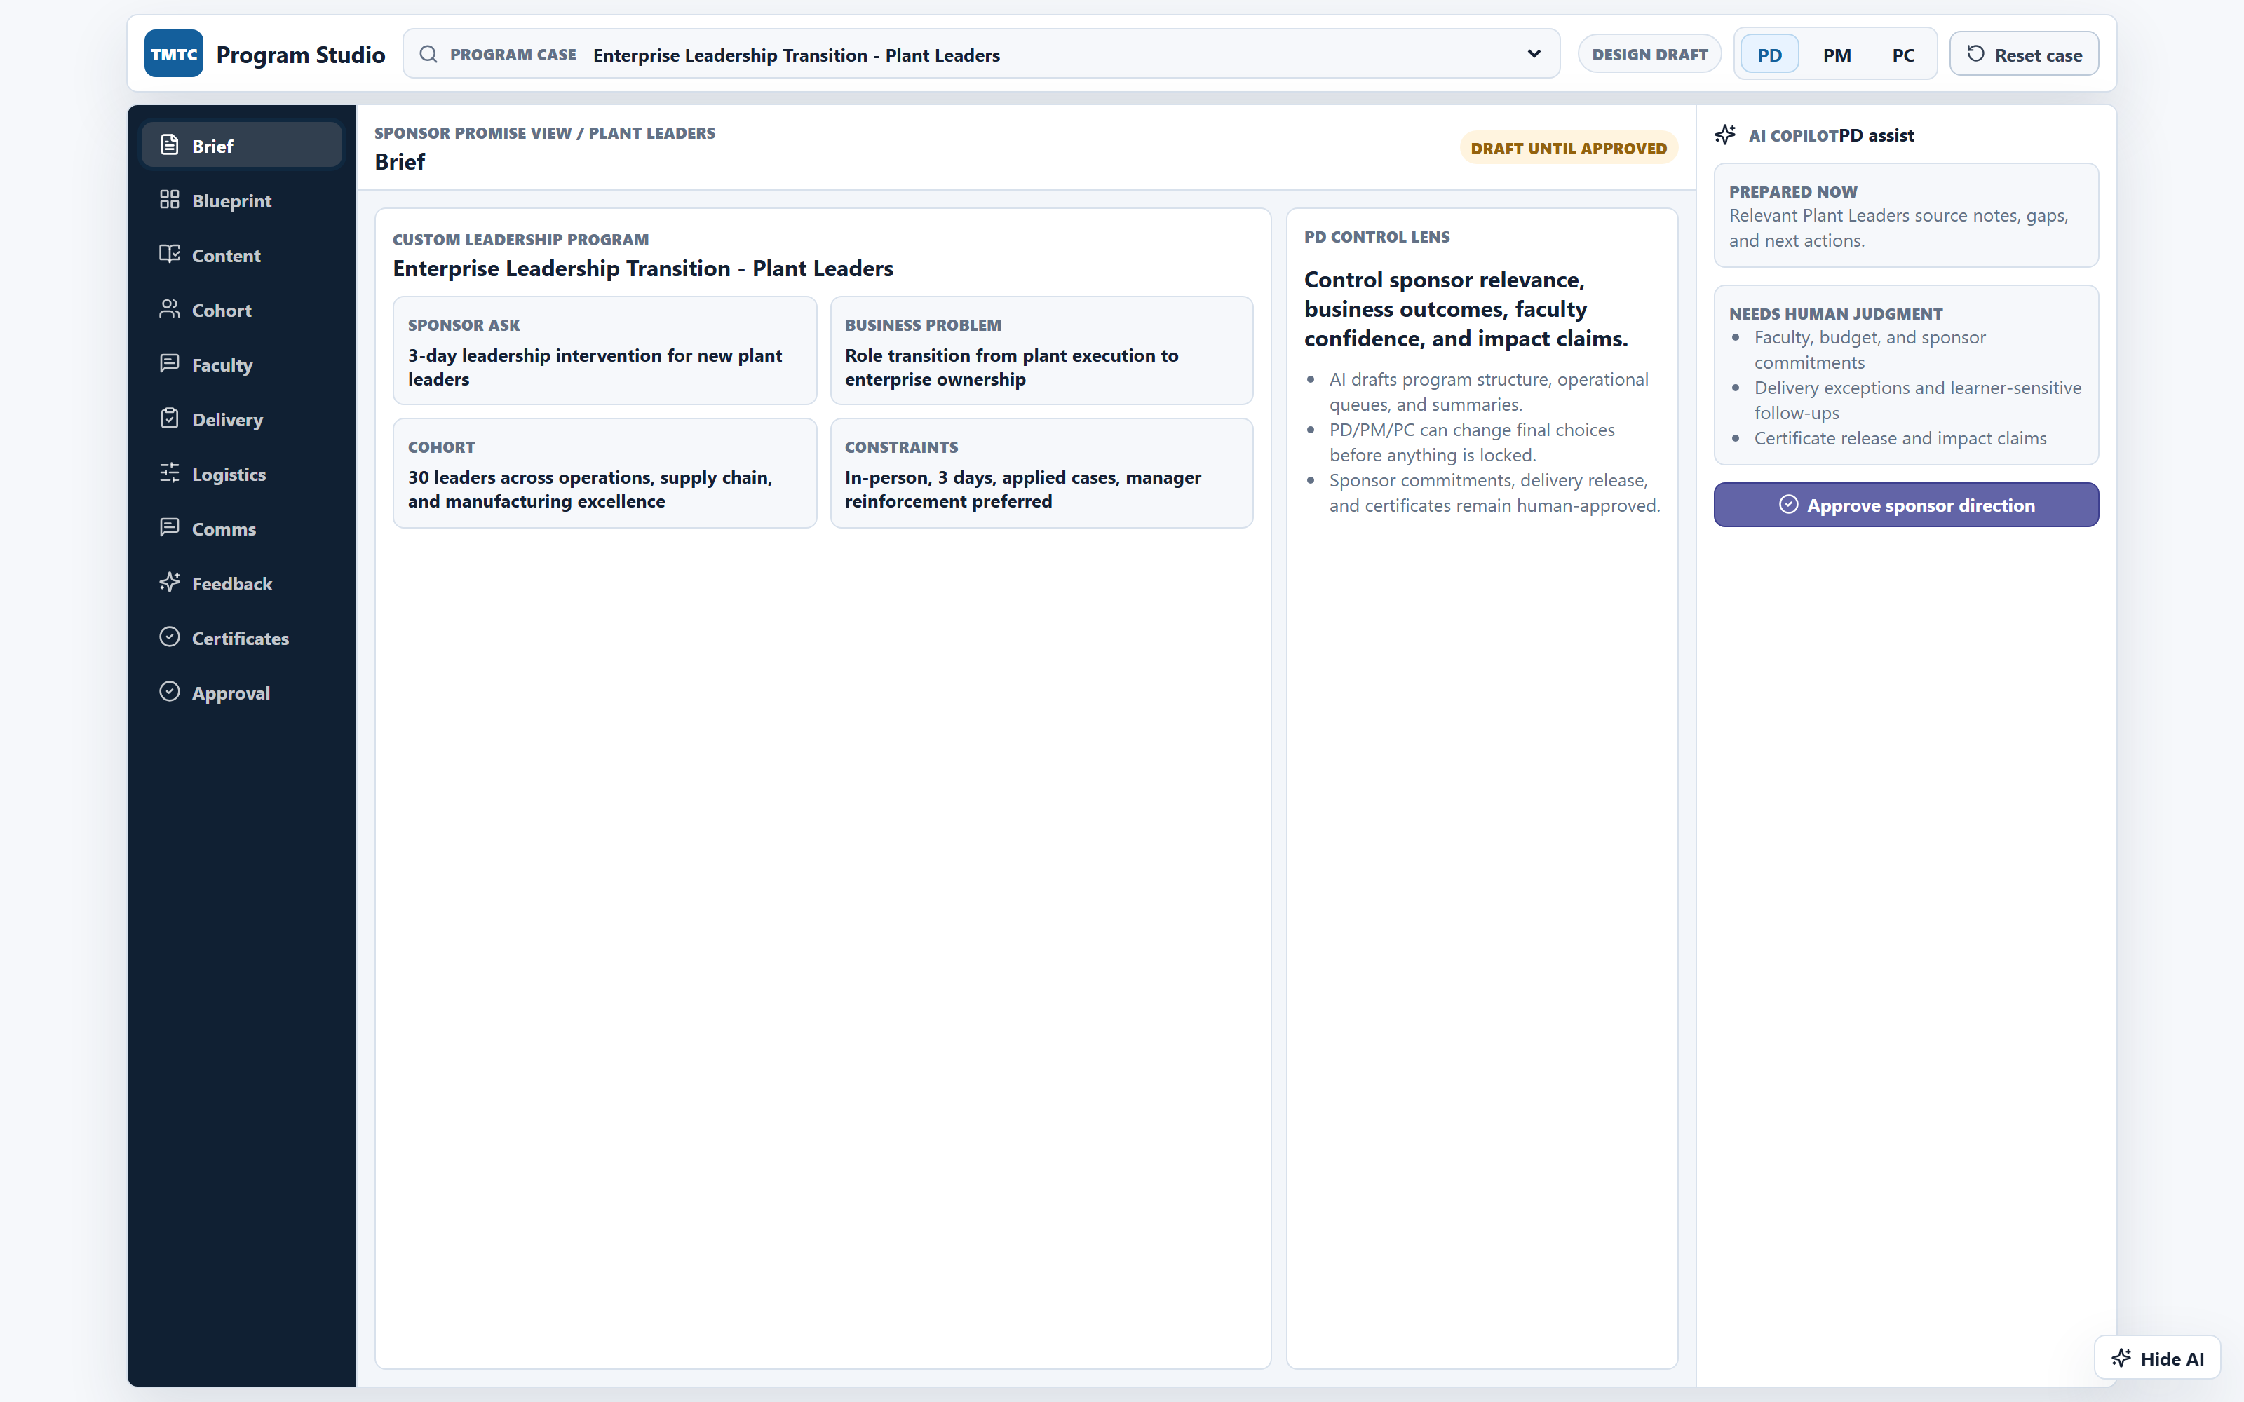
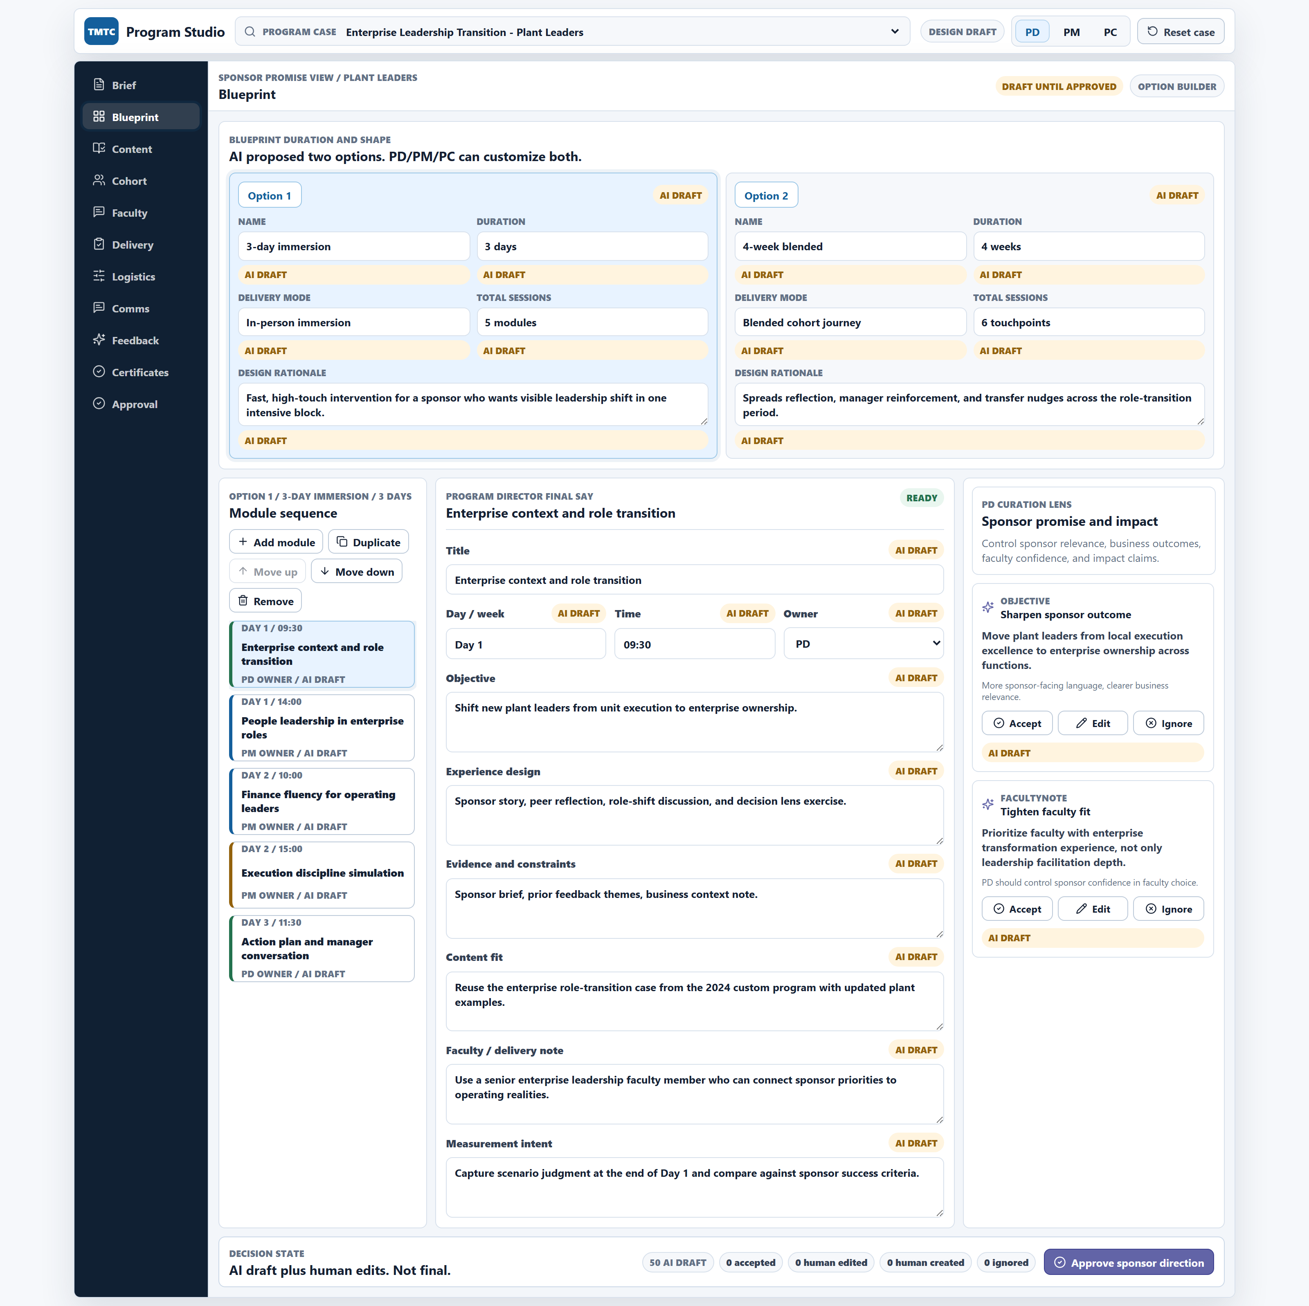
From the prototype – the PD workbench:
AI proposes options, PD decides
Brief view - Group company context, business objective, audience.
Blueprint view - AI drafts Option 1 vs Option 2 with rationale.
AI contributions tagged as ai / accepted / edited / ignored ,completely auditable, not opaque.
AI-NATIVE HR · FINAL REVIEW
10 / 27
Notes:
[~90s] This is the PD workbench in the prototype.
On the left — the Brief view. Group Company context, business objective, audience, evidence the PD wants to anchor the AI's reasoning against. This is the input that makes everything downstream credible.
On the right — the Blueprint view. AI proposes two program options side-by-side with rationale. Option 1 is a 3-day immersion; Option 2 is a 4-week blended journey. Both are tagged "AI draft." The PD accepts, edits, or ignores each field. The state of every field — ai, accepted, edited, ignored, created — is tracked. So when this design goes to approval, the reviewer can see exactly what AI suggested and what the human did with it. AI's contribution is auditable, not opaque.
This is the answer to the trust question we got from interviewees: how do I know if AI's helping me or replacing me? You can see it.
Bridge: same pattern, PM and PC views.

Slide 12
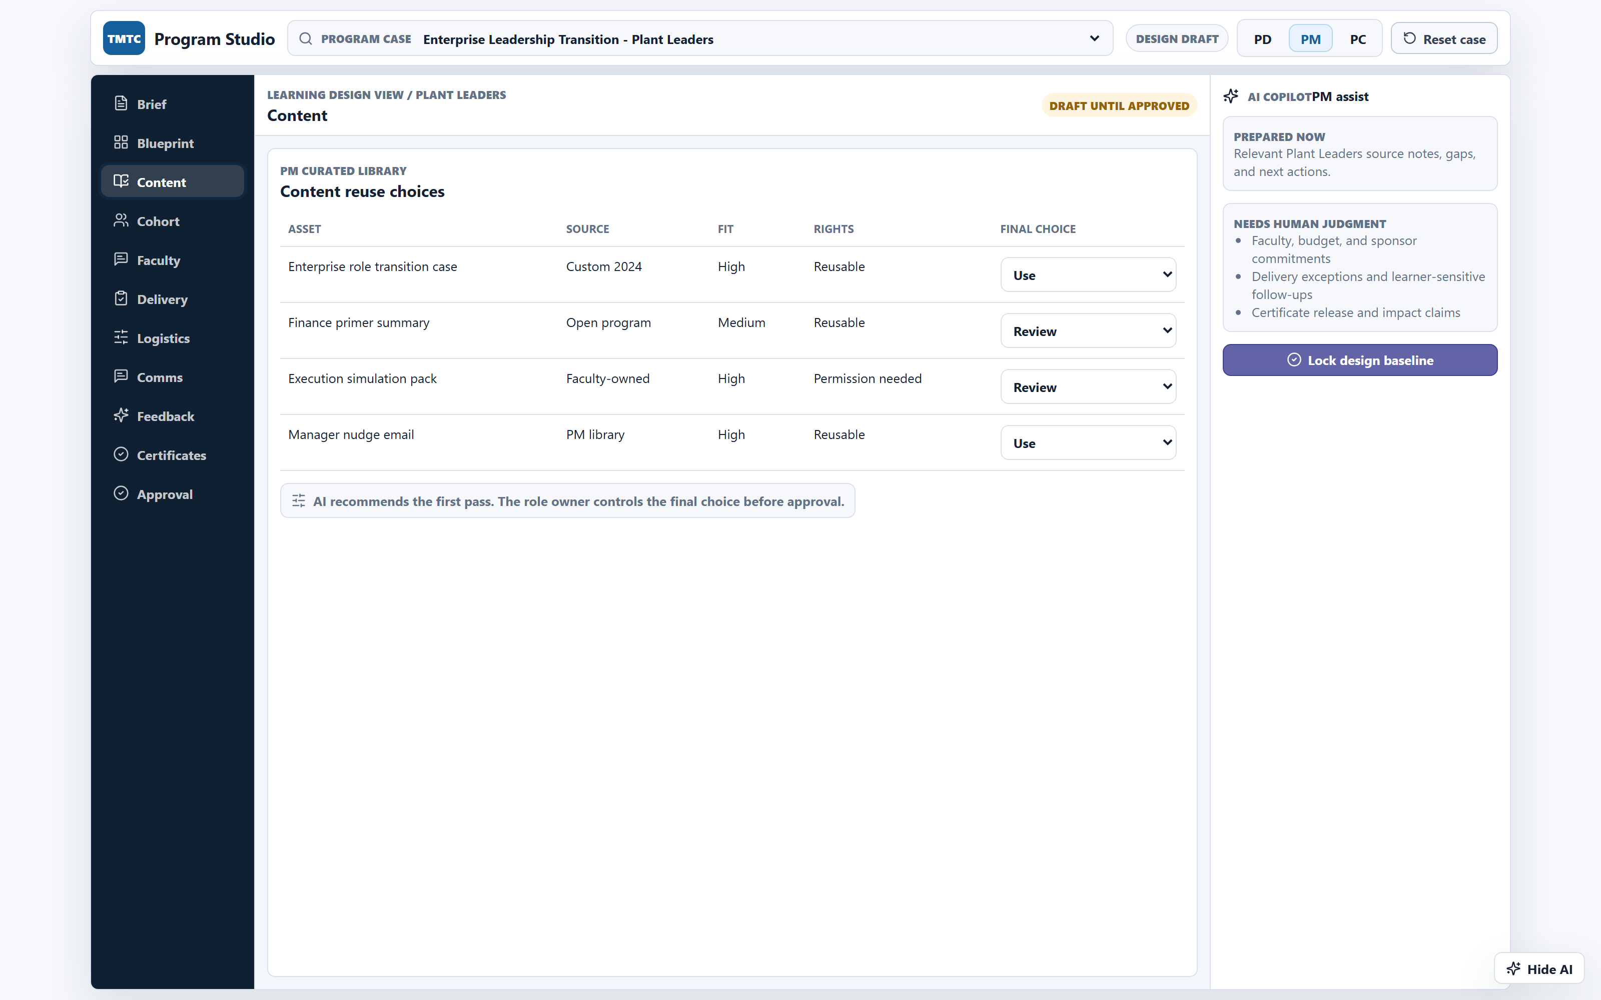
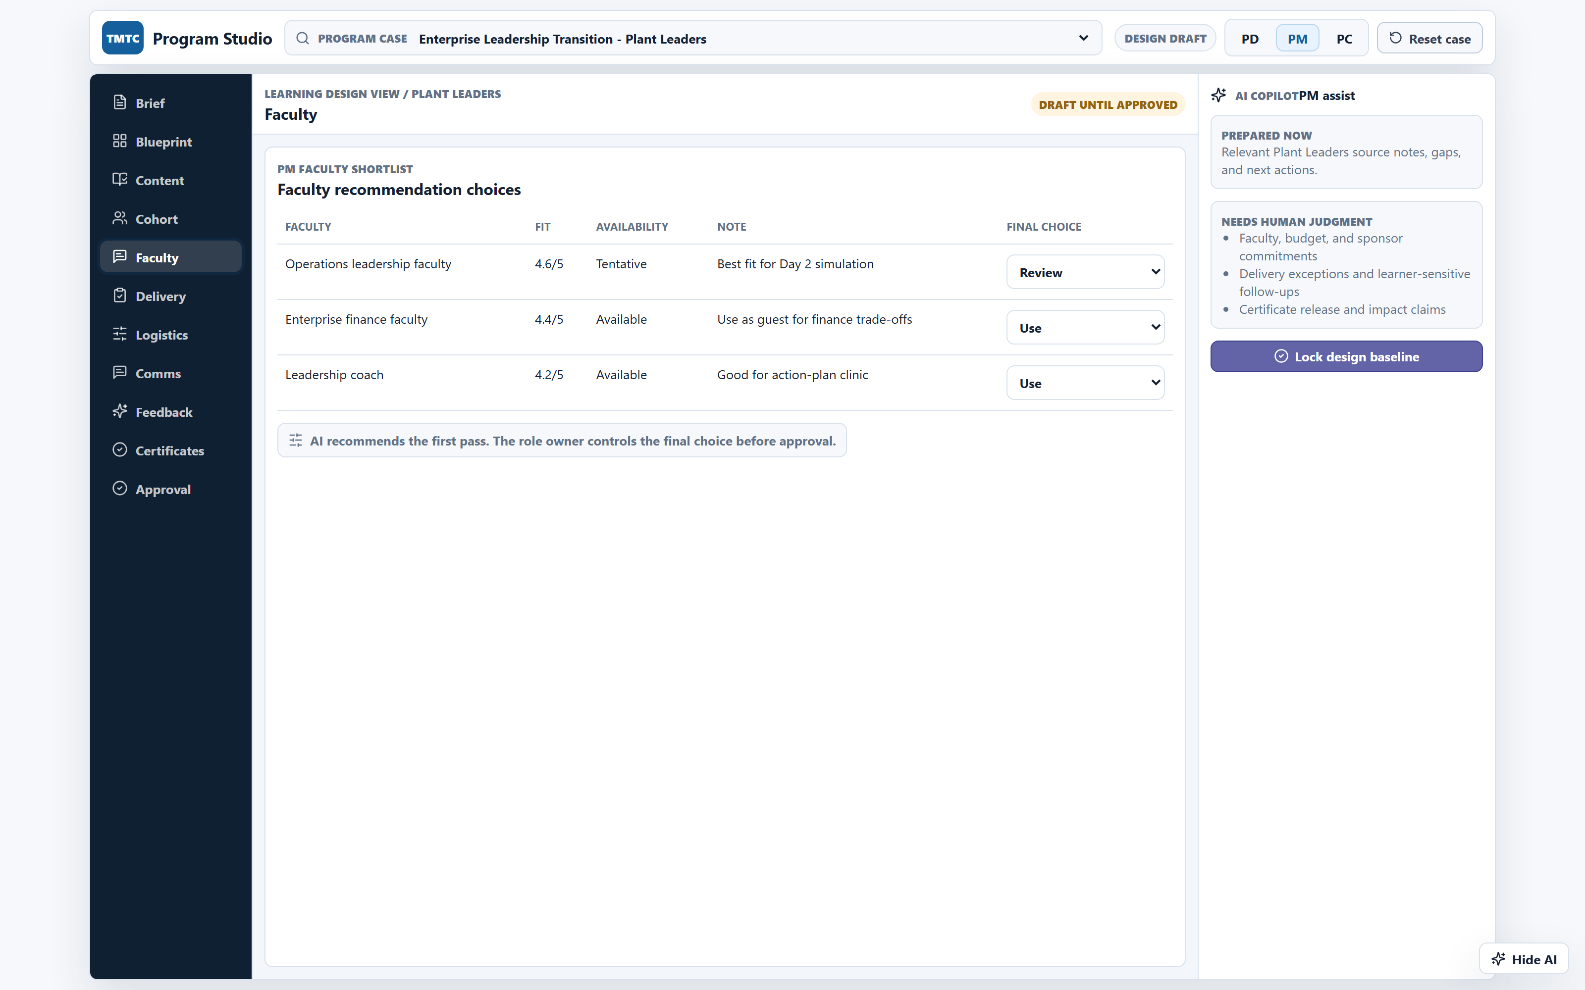
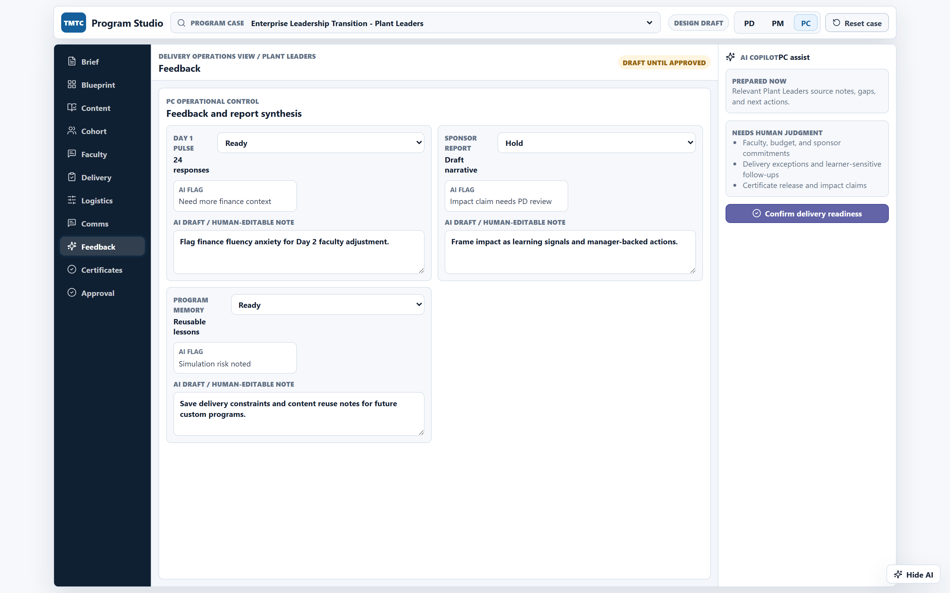
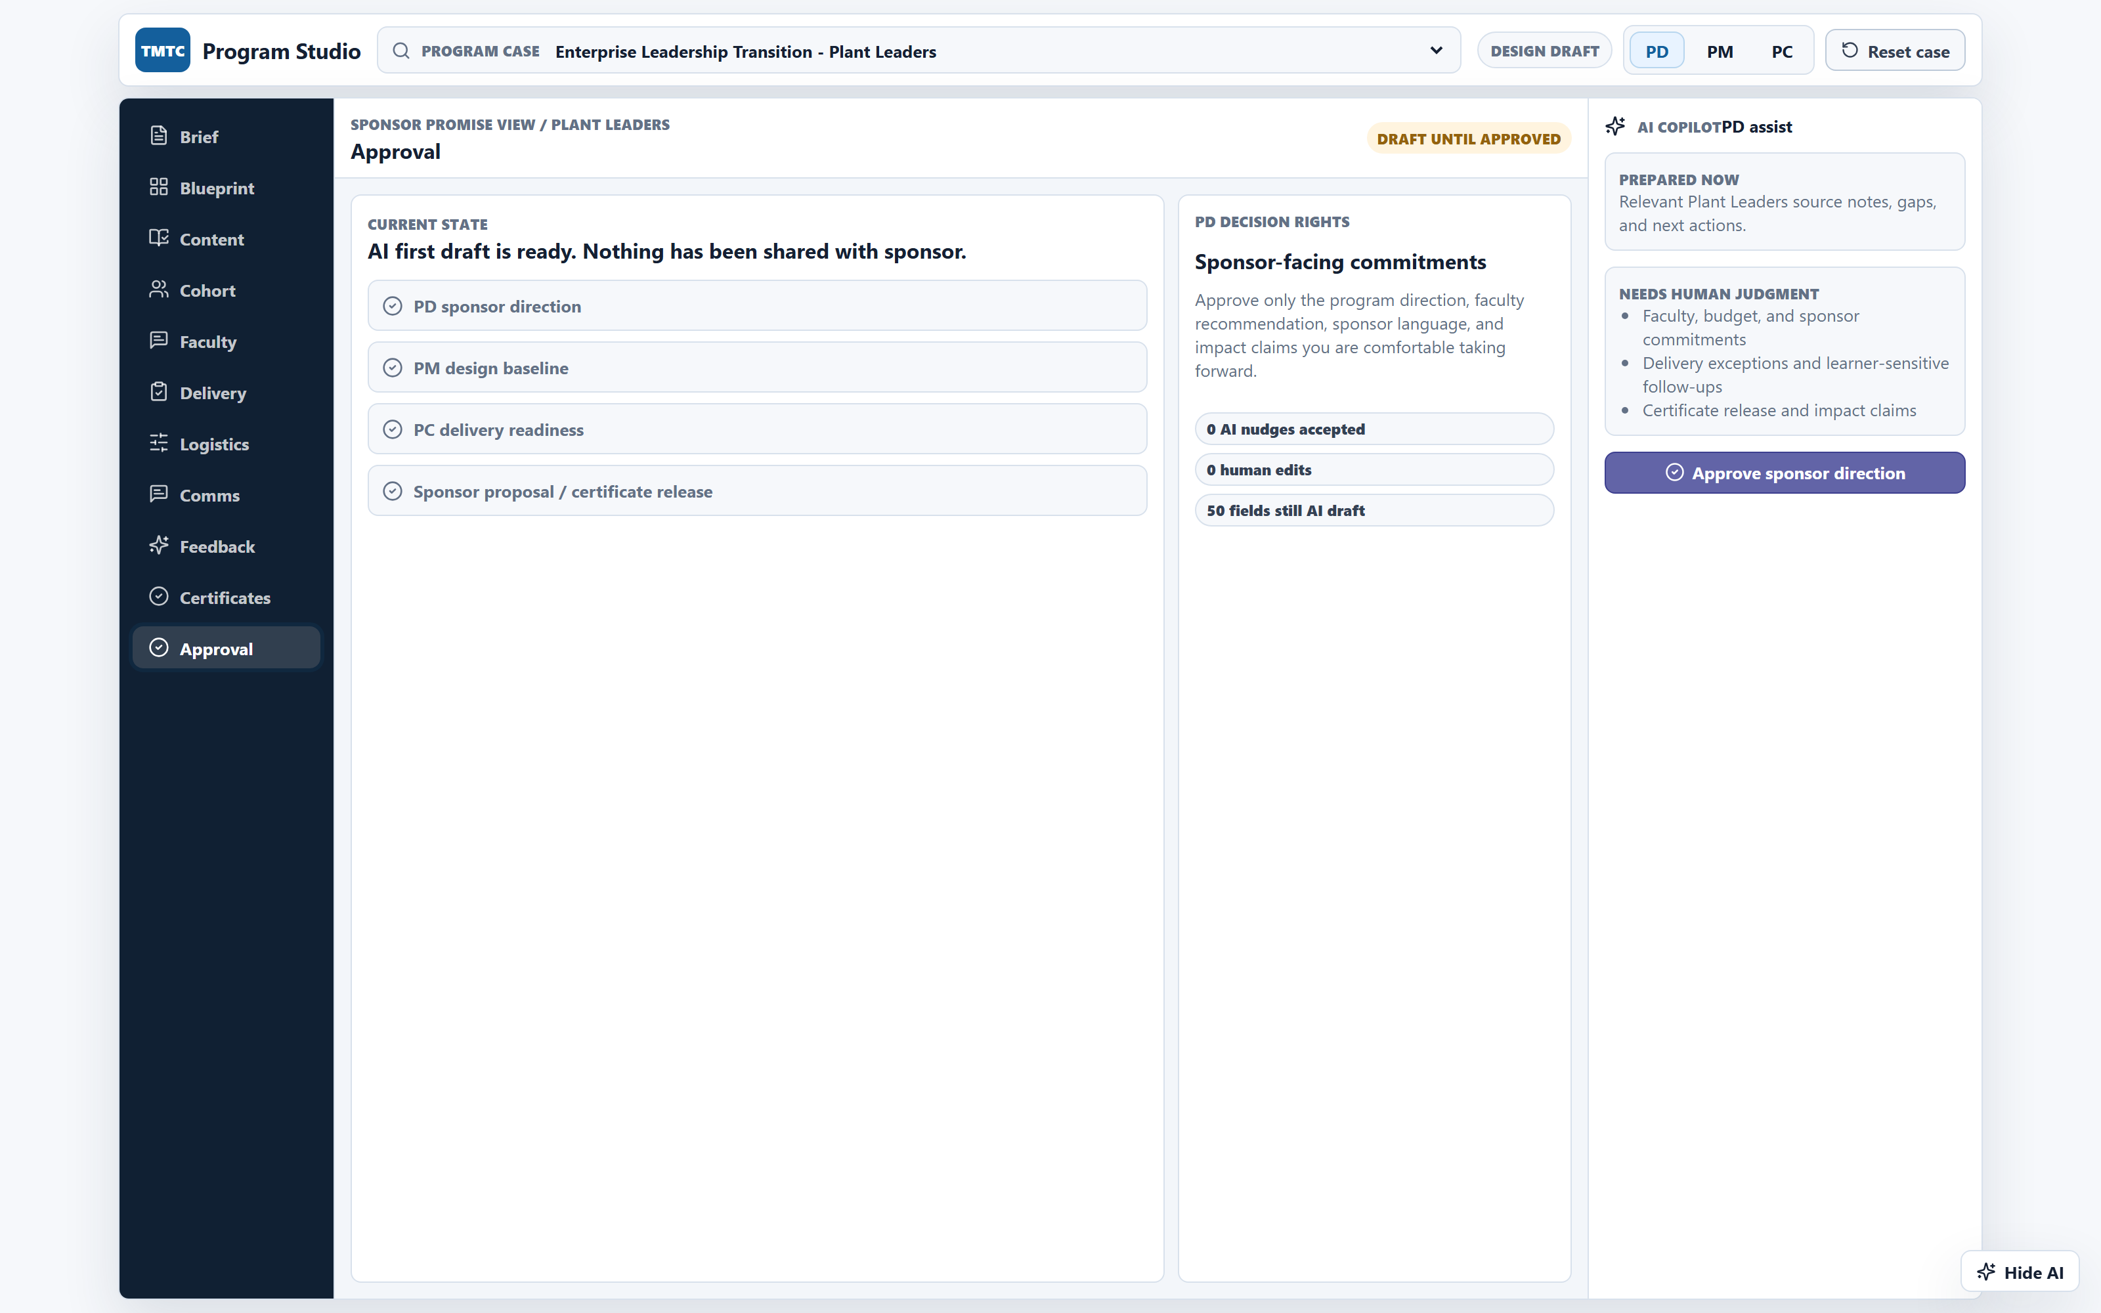
PM and PC workbenches — content reuse, faculty matching, approval gate
PM · Content
PM · Faculty
PC · Feedback
Approval
AI-suggested modules with provenance.
Ranked faculty with reasoning.
AI-extracted feedback themes.
Progressive sign-off locks design.
Same field-level provenance pattern across every workbench section.
AI-NATIVE HR · FINAL REVIEW
11 / 27
Notes:
[~90s] Same pattern across PM and PC.
PM Content view — AI suggests modules, each with provenance. The PM sees not just "what's the module" but "where did the AI get this from, and have we used it before?"
PM Faculty view — AI ranks faculty against the cohort. Reasoning is visible — expertise match, prior delivery, rating, availability. PD makes the final call.
PC Feedback view — AI synthesises session feedback into themes. PC reviews, PM/PD approve the narrative. This is the conversation we had in Meeting 5 where the team said they spend two weeks on each feedback report.
And the approval gate — progressive sign-off. PD signs Group Company direction. PM signs design baseline. PC signs delivery readiness. PD signs Group Company proposal release. Each step locks the previous. So you can't accidentally ship a program where the PC hasn't confirmed logistics, or the PM hasn't validated faculty.
This is Scenario 2 in action. Bridge: which brings us to the scenario decision.

Slide 13
Two scenarios on the table - Scenario 2 as goal;
Scenario 1 as transition stage
SCENARIO 1 · Personal Agents Pack
SCENARIO 2 · Learning Program Platform
▸ Role-by-role AI assistance
▸ End-to-end AI orchestration
▸ AI inside each existing role workbench
▸ AI orchestrates the full lifecycle
▸ Org chart + lifecycle + systems unchanged
▸ Shared data fabric + shared agents
▸ Lower change management · faster trust
▸ Heavier change · higher LMS dependency
▸ Quick wins inside 90 days
▸ Compounding institutional intelligence
▸ Memory + alumni layer remain weak
▸ Built-in post-program + alumni layer
▸ Each role's AI stays in its silo
▸ PC capacity freed for high-judgement work
RECOMMENDATION
Learning Program Platform as the destination · Personal Agents Pack as the trust-building 90-day ramp.
AI-NATIVE HR · FINAL REVIEW
12 / 27
Notes:
[~120s] The scenario decision. We presented two scenarios to TMTC stakeholders during the journey work.
Scenario 1 — Personal Agents Pack. AI added inside each existing role workbench. PD gets an AI co-pilot for briefs and proposals. PM gets AI for journey drafting and feedback synthesis. PC gets AI for nomination tracking and dossiers. The org chart, lifecycle, and system landscape stay largely unchanged. Strengths: Lower change management, faster trust, quick wins in 90 days, survives an LMS delay. Weaknesses: Each role's AI stays in its silo. Institutional memory doesn't compound. The alumni layer and post-program engagement remain weak.
Scenario 2 — Learning Program Platform. AI as the orchestration layer across the full lifecycle. Shared data fabric, shared agents, role workbenches as views. Strengths: Every program improves the next. Cohort intelligence, sponsor history, faculty performance, alumni engagement all compound. PC capacity freed for high-judgement work. Cross-program asset reuse becomes real. Weaknesses: Heavier change management, higher dependency on the data fabric maturing first, greater governance surface area.
The recommendation: Learning Program Platform as the destination. Personal Agents Pack quick wins in the first 90 days as the trust-building ramp. Four reasons:
Quick wins recover capacity and demonstrate safety within one quarter.
The data fabric matures in parallel — SharePoint cleanup, program memory template, faculty database MVP — all high-value on their own and prerequisites for Scenario 2.
Scenario 2 is where the operating-model leverage lives — compounding intelligence.
The prototype already demonstrates Scenario 2 mechanics — progressive approval gate, field-level provenance, role-switch view.
Bridge: TAS. The pattern generalises.

Slide 14
TAS today - 8-stage lifecycle, 4 manual bottlenecks,
~300 CVs screened by hand per campus
Application
(6 channels)
Vendor
Assessment
Manual
Screening
Campus
Interviews
Project
Matching
Year 1
Performance
Year 2
Placements
Reporting &
Cost-Recovery
Three vendor platforms with zero integration. Prospect.ai/Unstop/InsideIIM/iON connected only by Excel-merge. ~14 colleges × ~300 CVs reviewed each recruiting season with single screener per campus, no second-eye check.
No vendor integration
Manual panelist engagement
T-25 outreach to CXO panelists by email · T-20 to T-2 manual travel + accommodation · candidate resume shared 5 minutes before interview · no system to track confirmations.
Manual candidate-stint matching
4 cycles × 45–50 companies × 2× projects vs candidates · entire flow over email · matching rule unwritten · candidate preference resolves conflicts.
Chroma + manual manpower reports
Per-candidate × stint × stakeholder appraisal provisioning done manually · Quarterly Excel-by-email manpower with no SPOC change channel · paper personal files.
AI-NATIVE HR · FINAL REVIEW
13 / 27
Notes:
[~120s] TAS today. The 8-stage lifecycle is clear; the four manual bottlenecks are the story.
Bottleneck 1 — No vendor integration. Three vendor platforms — Prospect.ai, Unstop, InsideIIM — plus TCS iON, with zero integration. Data moves by Excel-merge. Two collation paths: Prospect.ai path for Campus + InvicTAS (iON application + Prospect.ai assessment → manual Excel merge → rubric applied), and Unstop path for TIC (quiz + gamified + video screen integrated inside Unstop → single dataset → rubric still applied manually). When vendor data and iON data conflict, resolution depends on the screener's judgement with no formal reconciliation rule and no audit trail. ~300 CVs per campus, 14 colleges per intern season, screened by a single screener per campus — no second-eye check on borderline calls.
Bottleneck 2 — 25-day panellist coordination. CXO-level panellists contacted 25 days before interview. Travel, accommodation, scheduling — all email. The candidate resume hits the panellist 5 minutes before the interview. No system tracks confirmations. No escalation path if a panellist goes silent.
Bottleneck 3 — Stint matching. Four cycles a year, 45–50 companies per cycle, twice as many projects as candidates. The entire flow is email. The matching rule is unwritten — current project, favourite domain, favourite company. When two companies want the same candidate, candidate preference resolves it.
Bottleneck 4 — Year 1 PM in Chroma + manpower reports. Per candidate × per stint × per stakeholder — the team manually generates appraisal cycles, provisions IDs, runs reminder cadence. The TAS Lead told us:"Data is not moving immediately." The quarterly manpower report is Excel-by-email with no automated channel. When someone leaves a group company, TAS finds out by checking — not by notification. Personal files are paper, not searchable.
Bridge: AI-native TAS in one diagram.

Slide 15
AI-native TAS – sense-demand, orchestrate, deliver, prioritize
4. PRIORITIZE
Evidence based selection · candidate guidance · panelist scheduling · group company SPOC project/role intake.
TAS KNOWLEDGE,
DATA + GOVERNANCE
Living TAS graph: candidate · project · company · stakeholder · manpower
Rubric AI Worker: sealed scoring; rubric never accessed by an LLM chat.
Consent · PII · bias · audit logs
3. DELIVER
AI based project-candidate matching · Automated Chroma alerts · L&D + readiness · placement decision support.
2. ORCHESTRATE
Multi-channel application windows · vendor data ingestion · eligibility + bias rules · rubric based scoring · shortlist with rationale.
1. DEMAND
Sense hiring channel quality + hiring capacity · Recommend channel mix · TAS lead reviews and approves plan.
THE HARD CONSTRAINT - THE SHORTLISTING RUBRIC STAYS SECURED
The TAS screening rubric is never interfaced via LLM chat. Scoring is done by a deterministic Rubric AI Worker having specific API interfaces. The rubric never directly used outside of the worker environment.
AI-NATIVE HR · FINAL REVIEW
14 / 27
Notes:
[~120s] AI-native TAS. Four orchestration layers on the left, the shared knowledge fabric on the right, the hard constraint at the bottom.
Layer 1 — Demand. AI senses channel quality and hiring capacity, recommends channel mix. TAS Lead approves the plan. Today this is done by gut feel and Excel — tomorrow it's data-driven.
Layer 2 — Orchestrate. Multi-channel application windows opened programmatically. Vendor data ingested from Prospect.ai, Unstop, InsideIIM. Eligibility and bias rules applied. And here's the key point — the sealed rubric is applied outside any LLM by the Rubric AI Worker. It's a deterministic scoring engine with specific API interfaces. AI only ever sees observable attributes and the resulting score. Never the weightings. The rubric is never directly used outside of the worker environment.
Layer 3 — Deliver. AI matches projects to candidates with explainable rationale. Chroma cycles auto-provisioned. L&D + readiness tracking, COP role matching, placement decision support.
Layer 4 — Prioritise. Evidence-based selection, candidate guidance, panellist scheduling, Group Company SPOC project/role intake.
The right column — the TAS knowledge graph: a living graph of candidate, project, company, stakeholder, and manpower entities. Plus the Rubric AI Worker (the vault). Consent, PII, bias monitoring, audit logs.
The hard constraint at the bottom, repeated explicitly: the rubric is never interfaced via LLM chat. This came directly from the TAS Lead's quote:"I don't know if the LLM can guarantee that the formula is only visible to me… it could lead to very big leak and conflict of interest." We design around this concern, not against it.
Bridge: TAS workbenches.
.

Slide 16
TAS role workbenches mirror TMTC
RECRUITING & SELECTION LEAD
YEAR 1–2 PROGRAM LEAD
INTERVIEW PANELISTS
AI: channel calendar · vendor collation · rubric-blind triage · panellist concierge · TIC video triage.
AI: stint matching graph · appraisal orchestrator · transfer concierge · manpower reconciliation · Tata Sons billing draft.
AI: pre-briefed dossier · calendar logistics · iON evaluation capture.
Owns: secured rubric · screening calls · panellist briefing · channel quality.
Owns: matching conversations · appraisal narrative · Y2 exceptions · finance approvals · alumni.
Owns: evaluation · conversation · reasoning trace.
CANDIDATE / TAS RECRUIT
GROUP COMPANY HR SPOC
AI: hiring channel-specific Q&A · stint matching transparency · Y1 PM reminders · Y2 placement support · living profile (consented).
AI: auto-drafted quarterly manpower report · automated job change-event detection · share-of-expenses transparency.
AI drafts. Humans decide.
Owns: goals · preferences.
Owns: validation · proactive updates.
AI-NATIVE HR · FINAL REVIEW
15 / 27
Notes:
[~90s] Five roles, same "AI drafts, humans decide" pattern as TMTC.
Recruiting & Selection Lead becomes a channel orchestrator and judgement custodian. AI handles channel calendar, vendor collation, rubric-blind triage (ranking on observable attributes only), panellist concierge (the full T-25 to T-0 chain), and TIC video triage (~1,000 videos pre-ranked). The Lead owns the sealed rubric, the screening calls on borderline candidates, the panellist briefing, and channel quality strategy.
Year 1–2 Program Lead becomes a stewardship product owner. AI handles stint matching graph (ranked matches with explainable rationale), appraisal orchestrator (Chroma cycle provisioning, ID generation, reminder cadence, ETR risk surfacing), transfer concierge (Y2, 3-application cap tracking), manpower reconciliation, and Tata Sons billing drafts. The Lead owns matching conversations, the appraisal narrative, Y2 exceptions, finance approvals, and alumni relationships.
Panellists get a pre-briefed dossier 24–48 hours ahead — not 5 minutes. Calendar logistics handled. Evaluation in iON with optional reasoning trace. AI never rates the candidate or pre-fills the evaluation.
Candidates get a concierge across the full lifecycle — channel-specific Q&A, stint match transparency, Y1 PM reminders, Y2 placement support, living profile under consent.
Group Company HR SPOCs get a portal — AI auto-drafts the quarterly manpower update, SPOC validates, change events pushed proactively. The Excel-by-email cycle becomes a continuous data channel. The data already exists at the group company; it just doesn't flow back today.
Bridge: shared spine across TMTC and TAS.

Slide 17
Tata Sons AI-First Hiring Platform;
11 AI workers, one API, zero portal interactions
The hiring manager spends 15 minutes. The platform does the rest.
EXPERIENCE
11
275
Conversation based · approval cards · aggregated platform views
AI Workers
Automated Tests
Modular: Communication Channel (Teams → Slack → web)
PLATFORM
4
4
Workflow rules · audit trail · identity · confidence gating
User
Personas
Hiring Stages
Modular: Nothing; this is the durable IP
AI WORKERS
1
11 specialized workers · prompts · schemas · models
Modular: Model + provider swappable per worker
Central Hiring Platform
AI-NATIVE HR · FINAL REVIEW
16 / 27
Notes:
[~90s]The third implementation. Beyond operating model designs for TMTC and TAS, we also built a working hiring platform that demonstrates AI-native principles at engineering depth.
The headline: the hiring manager spends 15 minutes total. The platform does the rest.
Three layers, cleanly separated:
Experience layer — conversation-based, approval cards, aggregated views. The channel is swappable: Teams today, Slack, WhatsApp, or web tomorrow.
Platform layer — workflow rules, audit trail, identity, confidence gating. This is the durable IP. Nothing is swappable here — this is the compounding asset.
AI Workers layer — 11 specialised workers, each doing one thing well. Prompts, schemas, models. The model and the provider are swappable per worker independently. Change GPT-4 to Claude under the JD Writer? One config change, code untouched. Minutes, not weeks.
The key architectural insight: the only "thick" boundary is between Platform and AI Workers — one HTTP envelope (POST /aiworker/run), eleven workers behind it via the Commotion gateway. Add a twelfth worker tomorrow? One config change.
275 automated tests, 4 hiring stages, 4 user personas, 1 central platform.
Bridge: how those 11 workers map to the four hiring stages.

Slide 18
Four stages · 4 personas –
JD crafting request to Interview calendar invite
STAGE 1
Request Definition
STAGE 2
HRBP & Agency
STAGE 3
Scoring
STAGE 4
Interview
JD Writer
Context Extractor
Screening Rules
JD Change Assessor
Agency Recommender
Resume Parser
Application Scorer
Red Flag Detector
Cross-Match
Interview Planner
Slot Ranker
Manager describes role
in Teams chat → AI
generates JD
HRBP reviews changes,
AI recommends agencies,
creates Outlook drafts
Agency submits CV →
AI parses, scores, flags
risks, suggests matches
AI generates interview
plan, ranks scheduling
Calendar options
User Personas
Manager · Anika Rao
HRBP · Maya Chen
Collaborator · Rohan Iyer
Agency · NorthStar
10 steps
8 steps
3 steps
4 steps
AI-NATIVE HR · FINAL REVIEW
17 / 27
Notes:
[~120s] Walk one hiring cycle end-to-end. Four stages, four personas, 25 interaction moments.
Stage 1 — Request Definition (Manager: Anika Rao, 10 steps). Manager types "I need a Senior PM in Mumbai" into the Teams chat. Three AI workers activate: JD Writer infers role intent and drafts the JD + scorecard. Context Extractor pulls signals from uploaded files — old JDs, org charts, leadership notes. Screening Rules generates must-haves, good-to-haves, auto-reject criteria, and alert trends.
Stage 2 — HRBP & Agency (HRBP: Maya Chen, 8 steps). HRBP gets a review card in Teams. JD Change Assessor separates grammar fixes from material intent changes — grammar doesn't need re-approval. Agency Recommender ranks agencies by specialisation, contract status, past fill rate. One click creates personalised Outlook drafts.
Stage 3 — Scoring (Collaborator: Rohan Iyer, 3 steps). Agency submits a CV by email. Resume Parser normalises the profile at 84% confidence. Application Scorer scores against the HRBP-approved rubric. Red Flag Detector catches short stints and unexplained gaps. Cross-Match spots alternate role fits — routed to HRBP, not auto-swapped.
Stage 4 — Interview (Agency: NorthStar, 4 steps). Interview Planner generates a 4-round plan with competency mapping. Slot Ranker proposes three scheduling bundles: fastest to start, most balanced, most candidate-friendly.
Four personas, 25 moments, one principle: AI does the grunt work, humans own every judgment call. The manager never left Teams. The HRBP never opened a portal. Chat IS the product.
Bridge: the governance mechanism that makes this safe.
afe.

Slide 19
Confidence-gated handoffs –
AI defers, humans decide in one click
AI worker
produces output
→
Confidence
score (0–100%)
→
Above
threshold?
YES →
Proceed
automatically
NO ↓
Review card → Teams
Approve / Override
▸
Every AI decision carries a confidence score and a written reason
▸
Thresholds are configurable per deployment and set by HR leadership, not engineers
▸
One click: approve or override (with reason), every decision logged, audit-ready
▸
Two quality nets: validation at worker output + again at platform database write
AI-NATIVE HR · FINAL REVIEW
18 / 27
Notes:
[~90s] The governance mechanism. Every score, every flag, every recommendation the platform produces carries two things: a confidence number (0–100%) and a written reason.
The flow: AI worker produces output → confidence score assigned → is it above threshold? Yes → proceed automatically. No → review card sent to the human's Teams chat.
Example: Red Flag Detector finds "3 stints under 1.5 years in last 4 years" — confidence 62%. Below threshold. A review card lands with the AI's reasoning and two buttons: Approve and Override (with reason). One click — human in the loop, decision logged, audit-ready.
Thresholds are configurable per deployment, set by HR leadership, not engineers. Want red flags to go to humans more often? Move the threshold from 80% to 90%. Done in seconds, no deploy.
Two separate quality nets — even if a model hallucinates or a worker drifts, malformed output never touches the database. Validation happens at the worker output level and again at the platform database write level.
This is the pattern that makes the whole system safe: explainable, overridable, auditable, and configurable without engineering.
Bridge: let me show you what this looks like in the prototype.

Slide 20
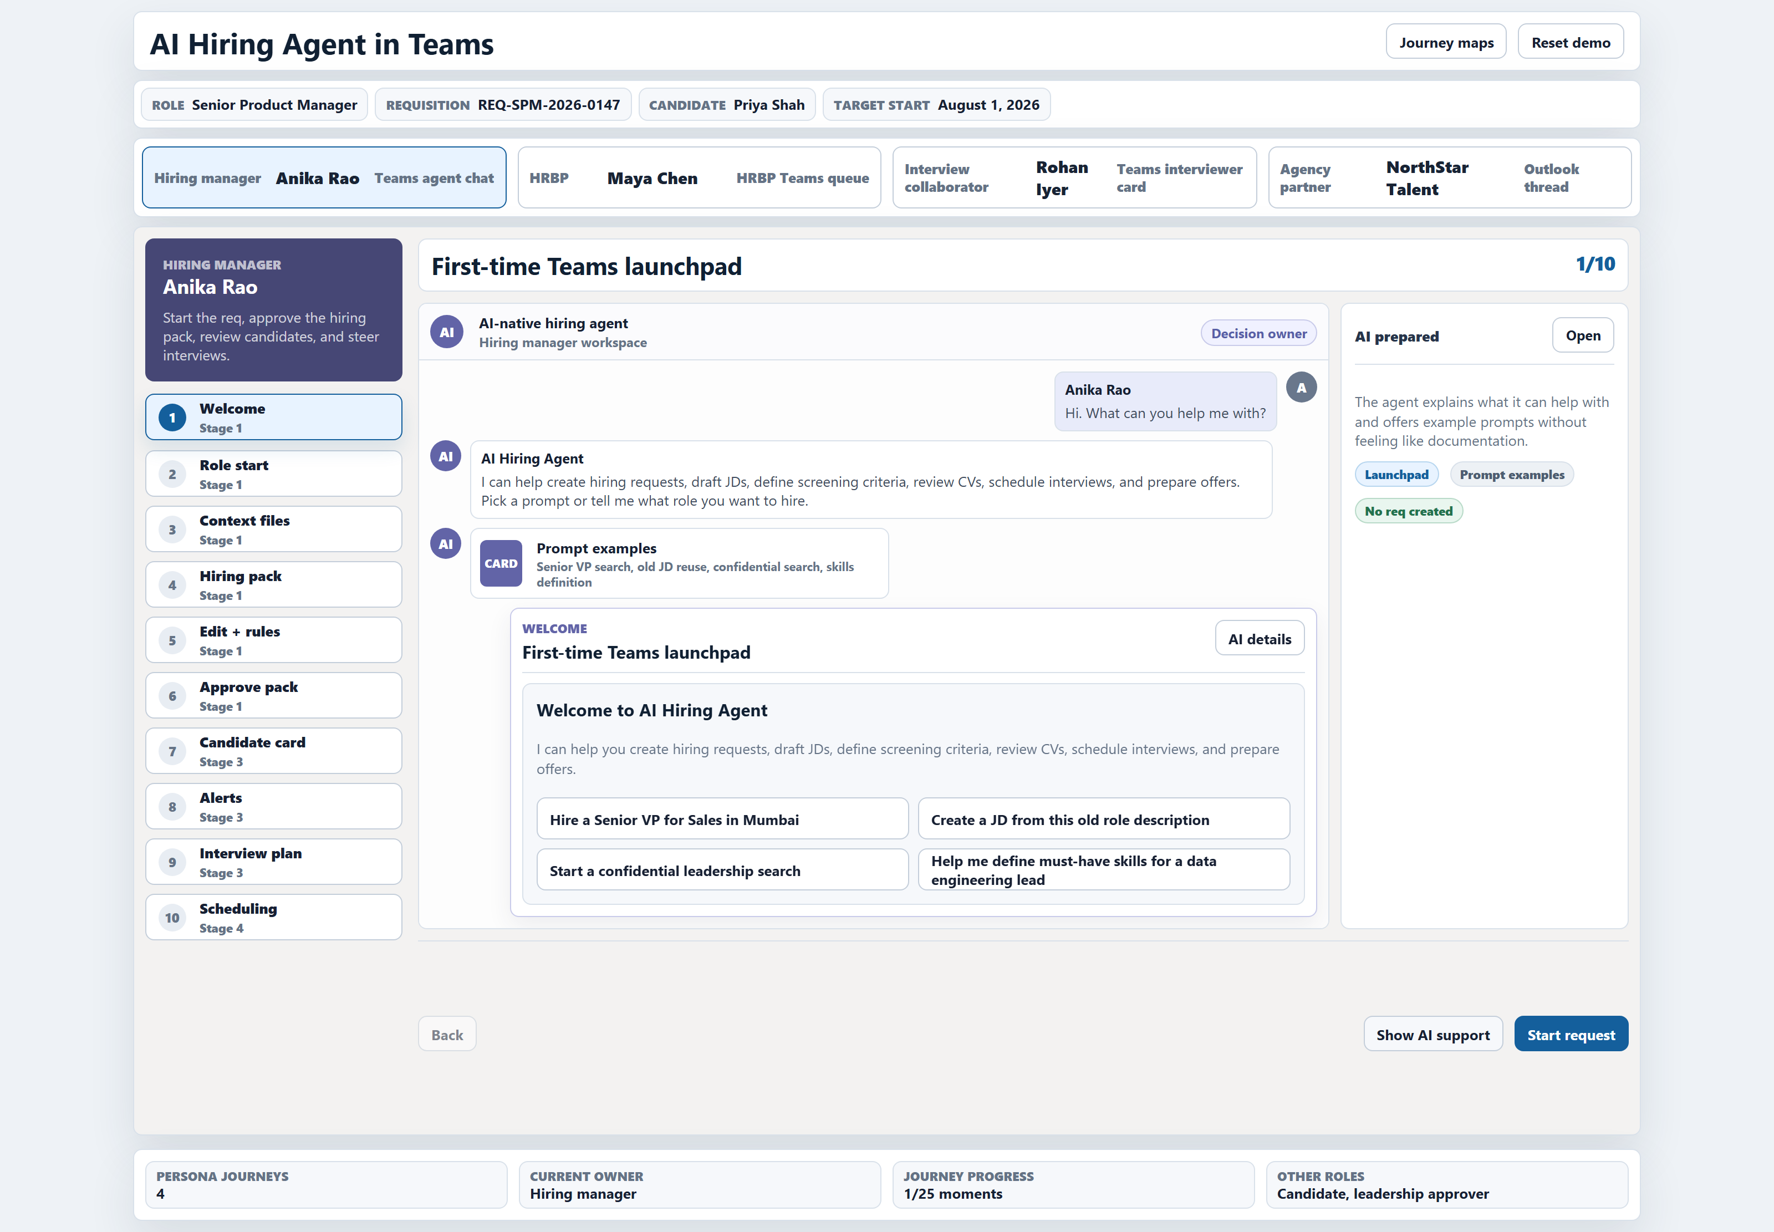
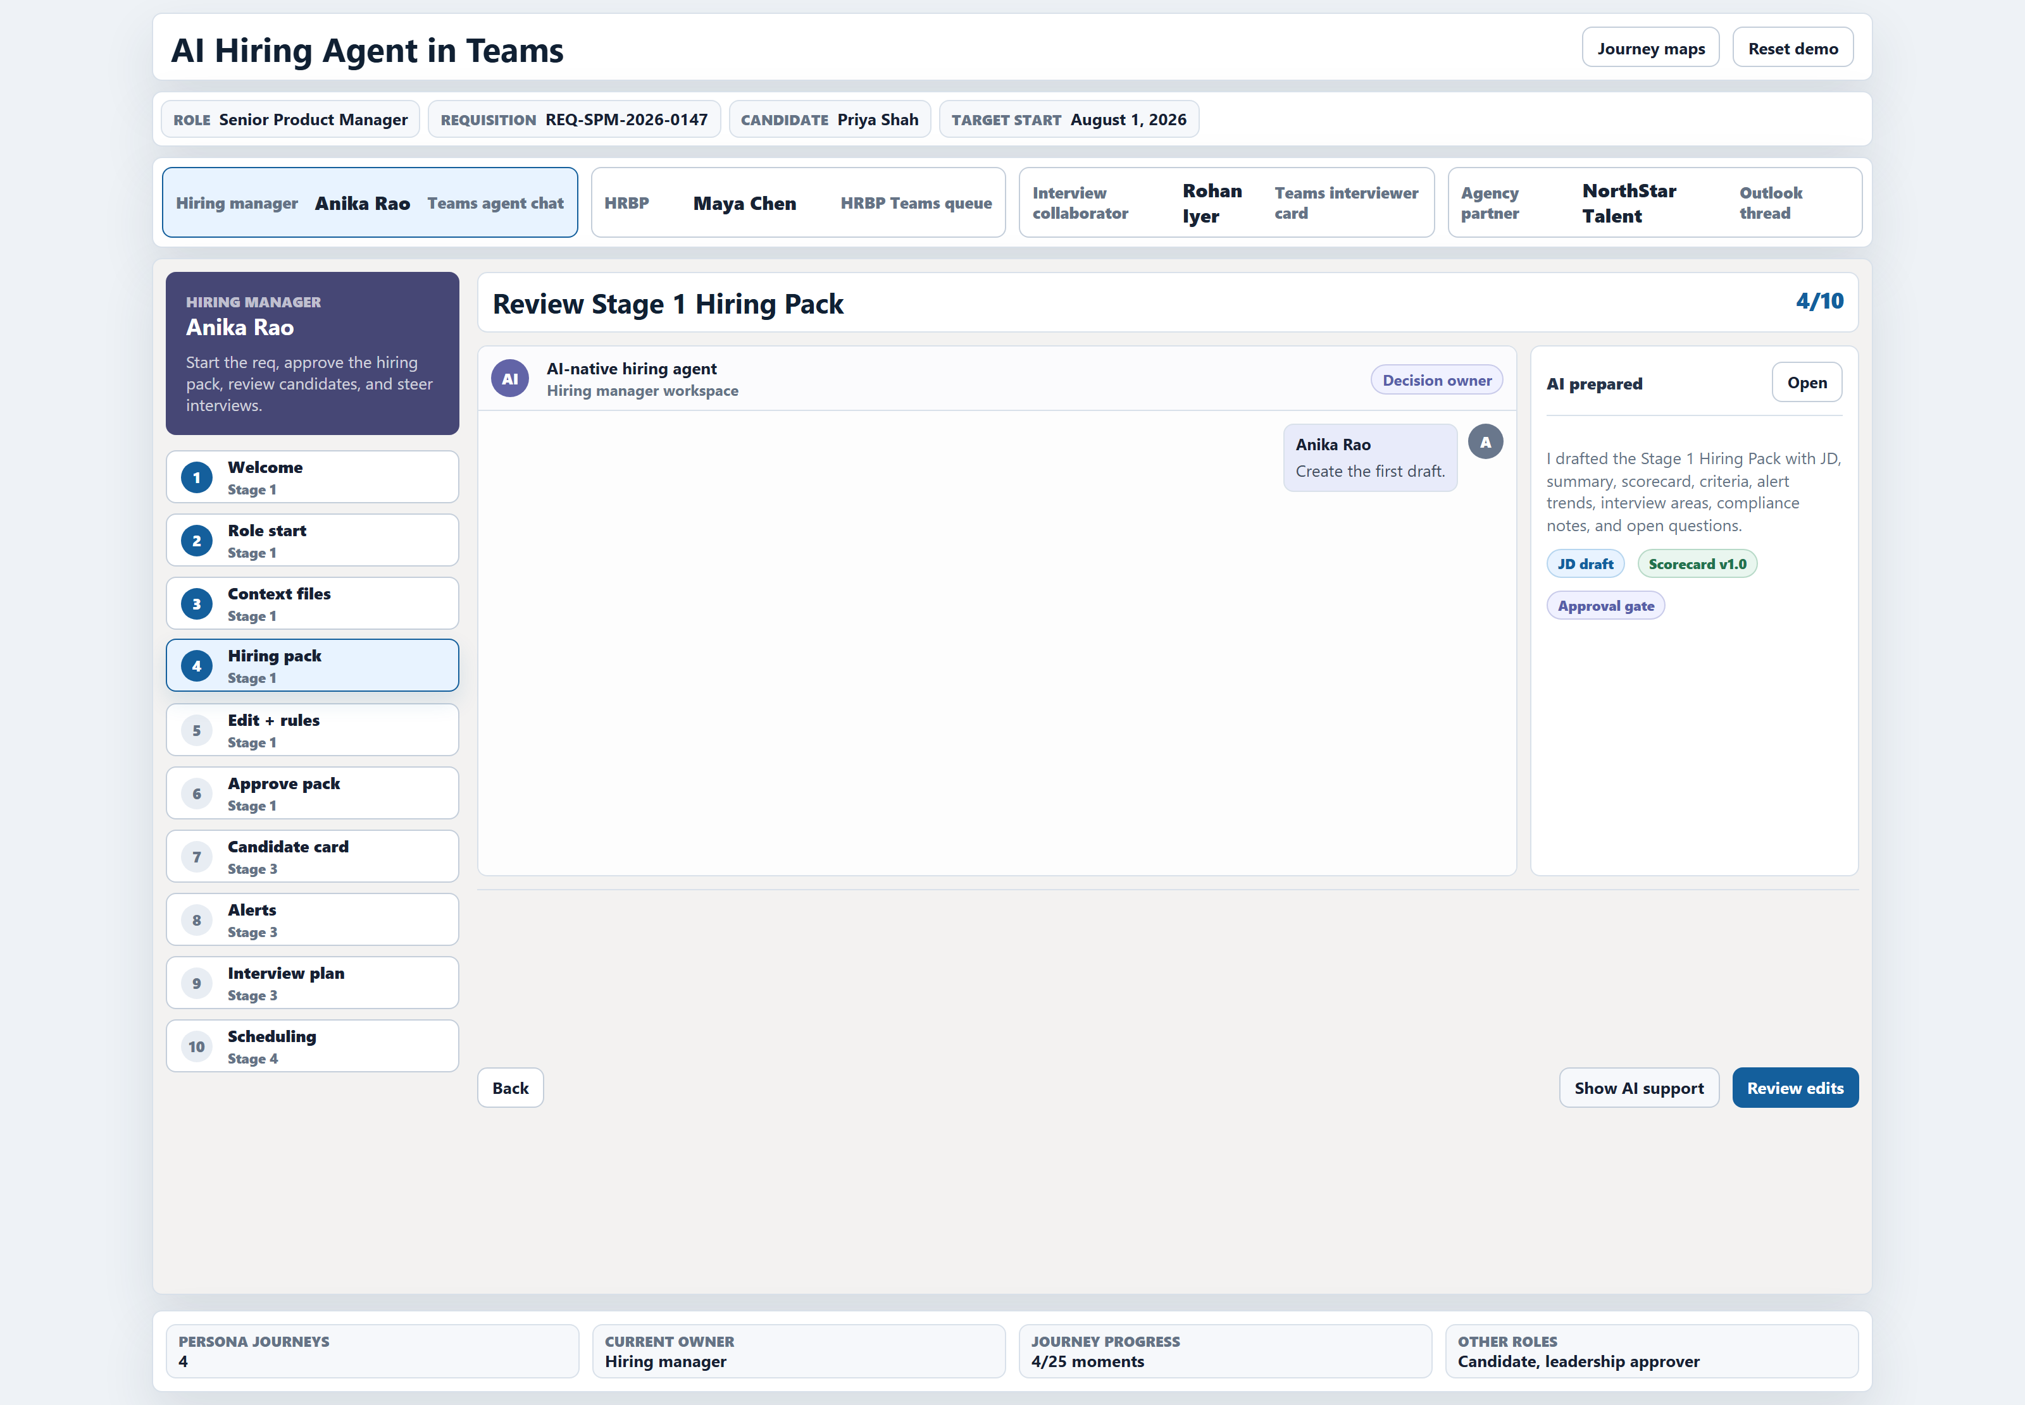
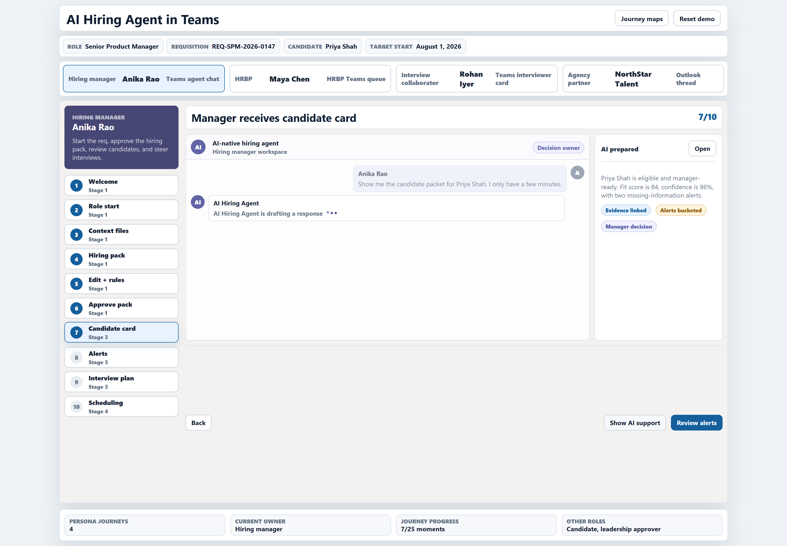
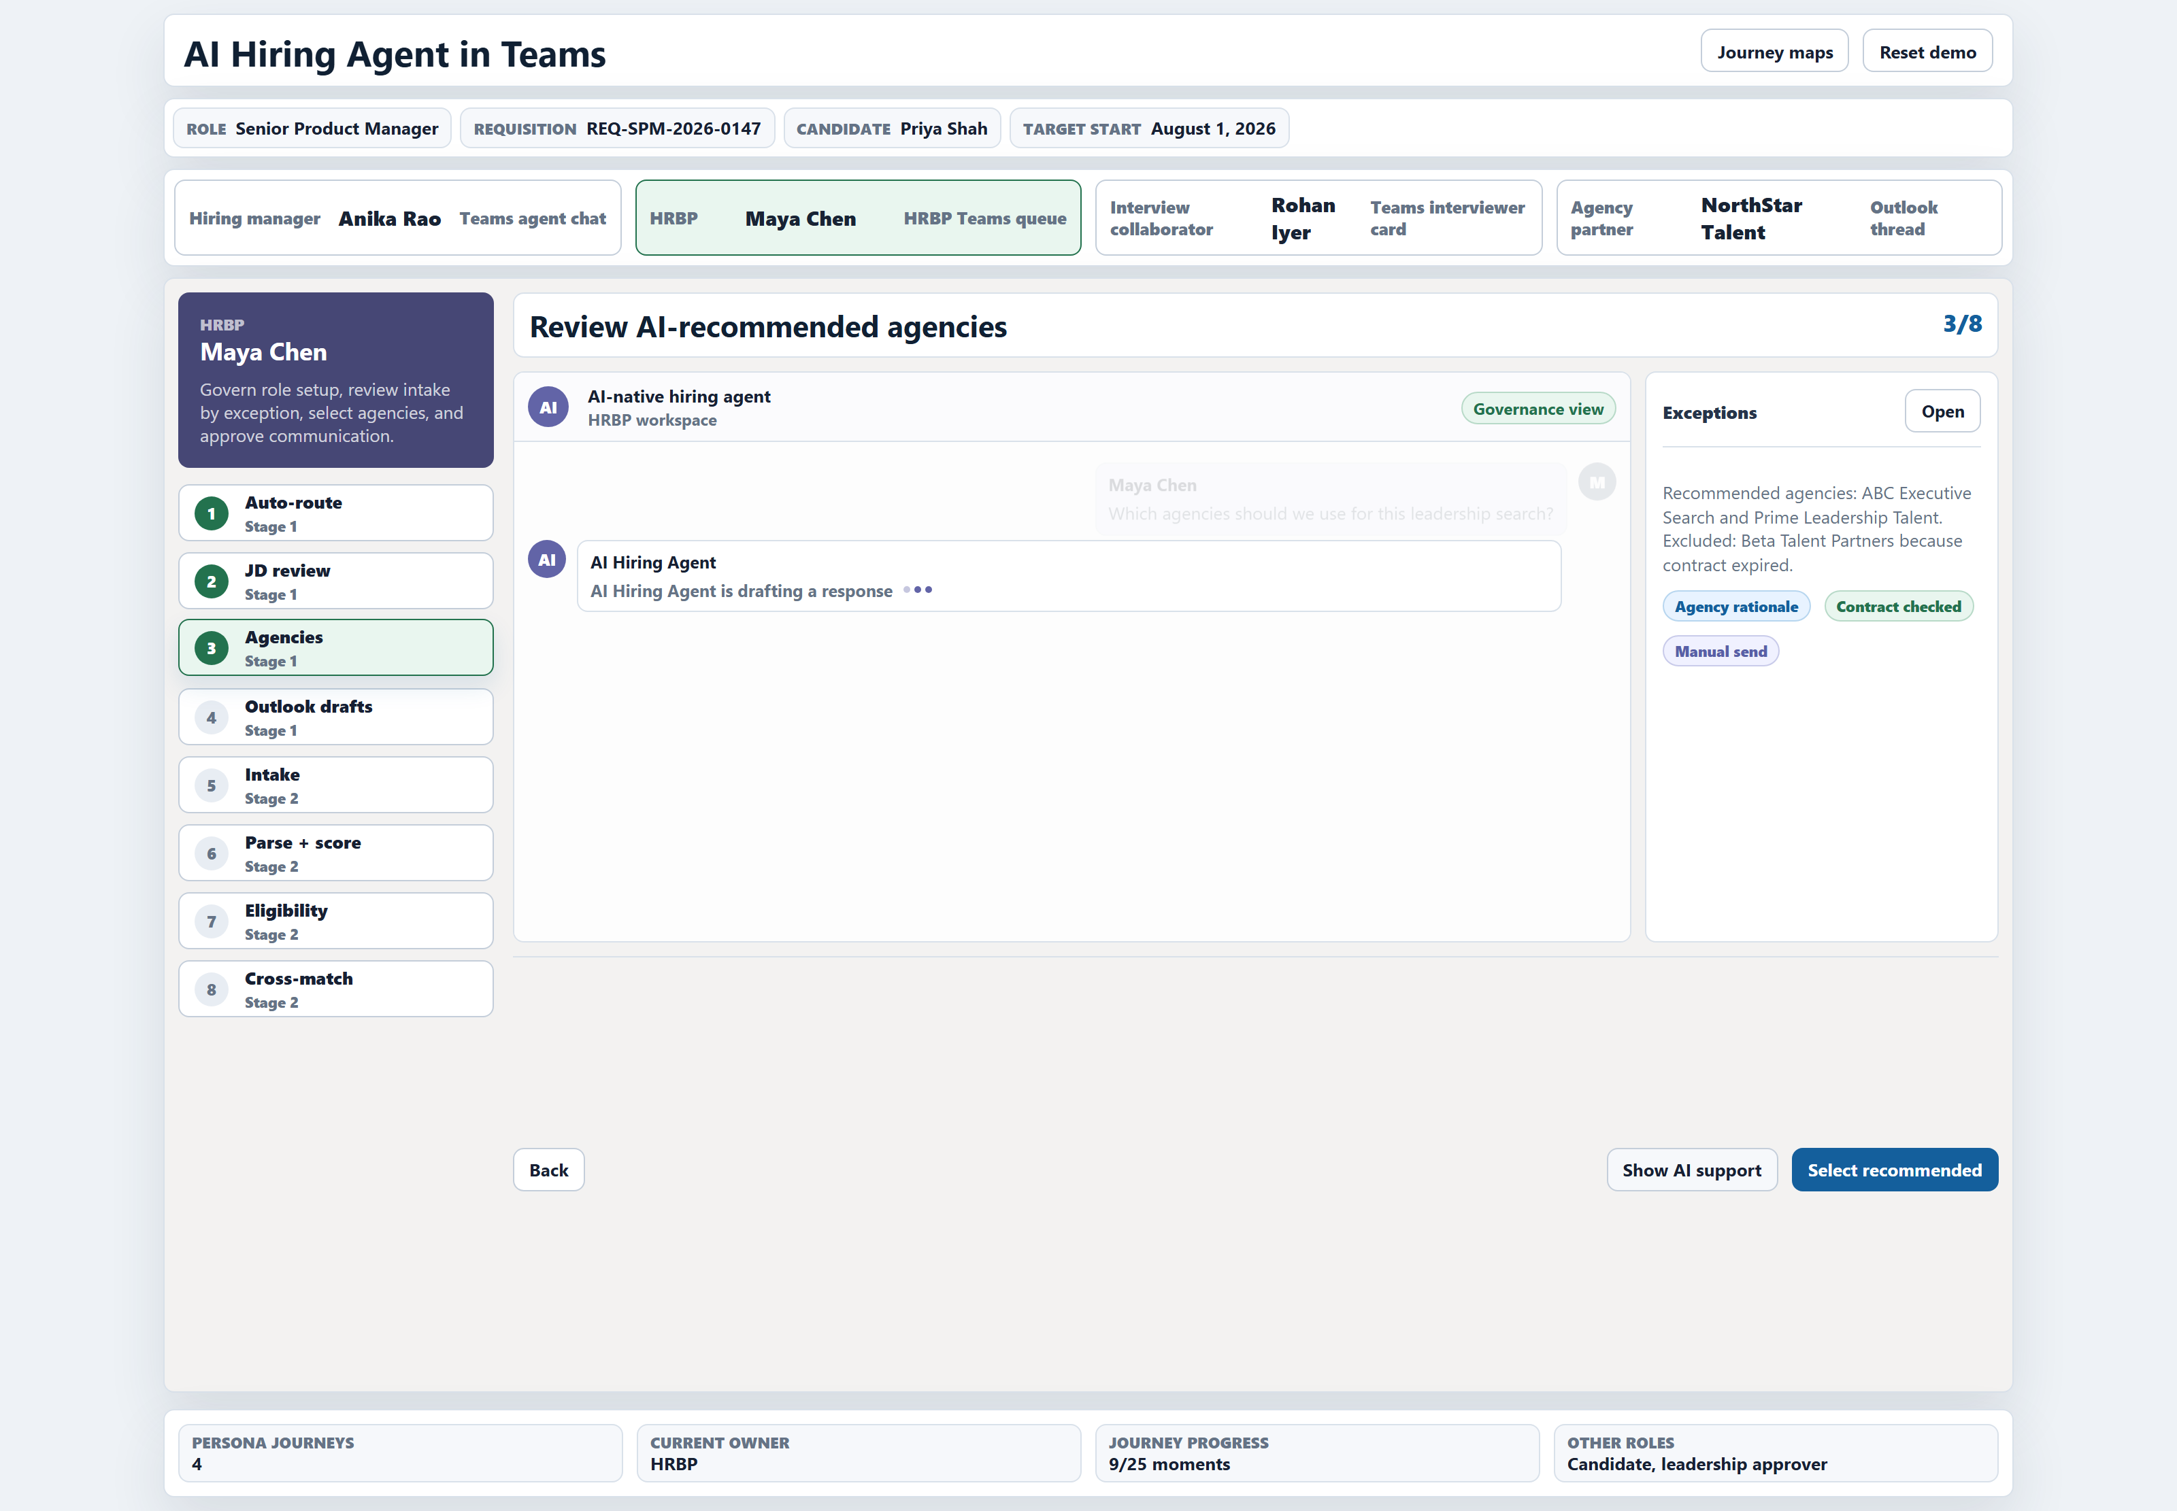
From the prototype — Manager and HRBP hiring experience
Manager — Teams launchpad
Manager — Hiring Pack
Manager — Candidate Card (84%)
HRBP — Agency Recommendation
AI-NATIVE HR · FINAL HR
19 / 27
Notes:
[~90s] Four screenshots from the working prototype.
Top-left — the manager opens Teams and sees the AI Hiring Agent. No portal, no login. Just a chat. Sample prompts help first-time users: "Hire a Senior VP for Sales in Mumbai", "Create a JD from this old role description."
Top-right — the Hiring Pack. AI has generated a full JD, a scorecard, screening criteria, alert trends, and compliance notes. The manager reviews, edits if needed, and approves. One card, one click.
Bottom-left — the Candidate Card. Priya Shah, 84% fit score. Evidence linked. Alerts bucketed into three tiers: blocking issue, review alert, info signal. The manager never reads a raw resume — they read the evidence.
Bottom-right — the HRBP view. Agency Recommendation with rationale: specialisation match, contract status, past fill rate. HRBP selects, and the platform creates one Outlook draft per agency with the JD attached.
The manager never left Teams. The HRBP never opened a portal. Chat IS the product.
Bridge: the synthesis — three implementations, one principle.

Slide 21
Three implementations, one principle –
AI drafts, humans decide
TMTC
TAS
HIRING PLATFORM
Learning programs
Talent acquisition
Lateral hiring
▸ 19 AI agents
▸ 5 role workbenches
▸ Six-layer operating model
▸ Human decision gates
▸ Program memory as fabric
▸ 17 AI agents
▸ 6 role workbenches
▸ Six-layer operating model
▸ Secured Scoring Rubric Vault
▸ Living TAS Graph
▸ 11 AI workers
▸ 4 personas / workbenches
▸ Three-layer platform
▸ Confidence-gated handoffs
▸ 275 automated tests
Common principle: AI handles first-draft work · Humans own every decision gate · The pattern generalises to any Group HR vertical
AI-NATIVE HR · FINAL REVIEW
20 / 27
Notes:
[~75s] The synthesis slide. Three very different HR domains — and they all arrived at the same architecture.
TMTC (Learning programs): 19 agents, 5 role workbenches, a six-layer operating model, human decision gates at every approval, program memory as the data fabric.
TAS (Talent acquisition): 17 agents, 6 role workbenches, the same six-layer model, the Sealed Rubric Vault ensuring the most sensitive scoring rule never touches an LLM, the Living TAS Graph as source of truth.
Hiring Platform (Lateral hiring): 11 workers, 4 personas, a three-layer platform (Experience, Platform, AI Workers), confidence-gated handoffs, 275 automated tests.
That's 47 agents and workers across all three. 15 role workbenches. Three domains. One principle: AI drafts, humans decide.
The common principle: AI handles first-draft work. Humans own every decision gate. The pattern generalises to any Group HR vertical — whether it manages learning journeys, selects leadership talent, or fills open roles. Define the AI workers, define the human gates, define the governance rules, and let the architecture handle the orchestration. Only the domain knowledge changes.
Bridge: shared spine — decision rights

Slide 22
What AI must never do alone - decision rights at a glance
Decision area
AI role
Human owner
Why this stays human
Pursue custom program / route choice
Analyse + recommend
PD / leadership
Sponsor trust + strategic priority
Business problem diagnosis
Hypothesise + ask
PD
Frame matters more than answer
Faculty / vendor selection
Rank with evidence
PD / PM
Cohort fit + relationship
Budget approval
Draft estimate
Finance / leadership
Financial accountability
Sponsor reporting + impact claims
Synthesise evidence
PD / leadership
Reputation + credibility
TAS rubric content + application
Used to generate confidence score
TAS Lead alone
Human Context
TAS screening decision
Rank + reasoning trace
TAS Lead
Borderline calls + fairness
Stint match + Y2 placement offer
Rank + rationale
Lead + candidate + company
Career trajectory
Manpower reconciliation + share-of-expenses
Draft + flag
Finance + Lead
Audit + cost-recovery accuracy
AI-NATIVE HR · FINAL REVIEW
21 / 27
Notes:
[~90s] Decision rights at a glance. The full matrix is in the report; this is the front nine. Every row follows the same pattern: AI's role → human owner → why this stays human.
Pursue custom program / route choice — AI analyses and recommends; PD and leadership decide. Because sponsor trust and strategic priority matter more than data.
Business problem diagnosis — AI hypothesises and asks; PD decides. Because framing the problem matters more than answering it.
Faculty / vendor selection — AI ranks with evidence; PD/PM decide. Because cohort fit and faculty relationship are not optimisable from data alone.
Budget approval — AI drafts the estimate; finance and leadership approve. Financial accountability is non-negotiable.
Sponsor reporting and impact claims — AI synthesises evidence; PD and leadership sign off. Reputation and credibility.
The TAS rubric — this is the unique row, highlighted. AI's role is none. It's sealed. TAS Lead alone. The reason is the LLM cross-prompt leak risk articulated by
the Lead in Meeting 6. We respect it completely.
TAS screening — AI ranks with reasoning trace; Lead makes the call on borderlines. Fairness on edge cases requires human judgement.
Stint match + Y2 placement — AI ranks with rationale; Lead + candidate + company decide together. Career trajectory is not an optimisation problem.
Manpower reconciliation + share-of-expenses — AI drafts and flags; finance approves. Audit and cost-recovery accuracy are non-negotiable.
Bridge: metrics.

Slide 23
Metrics framework - efficiency · quality · impact · trust · adoption
EFFICIENCY
PROGRAM / HIRING QUALITY
BUSINESS IMPACT
How much time we recover
Whether the work is better
Whether sponsors / companies see value
▸ Time to draft custom proposal
▸ Time to generate program dossier
▸ Time per 300-CV screening cycle
▸ Panellist logistics days per campus
▸ Stint matching cycle time
▸ Participant satisfaction · faculty rating
▸ Cohort fit score
▸ Borderline-flag accuracy (TAS)
▸ Override rate per channel
▸ ETR miss rate (TAS Y1)
▸ Sponsor satisfaction · renewal rate
▸ Custom program conversion
▸ Open program seat fill rate
▸ Channel conversion rate (TAS)
▸ Cost-recovery accuracy (TAS)
LEARNER / ALUMNI / CANDIDATE
AI ADOPTION + TRUST + SAFETY
Whether the experience compounds
Whether the operating model is adopted
▸ Post-program engagement
▸ Alumni profile freshness
▸ Next-level program progression
▸ Retention through Y2 (TAS)
▸ Alumni 5-year career progression
▸ AI recommendation acceptance rate
▸ Human override rate
▸ Source citation coverage
▸ Hallucination / error incidents
▸ Rubric leak attempts — target: 0
AI-NATIVE HR · FINAL REVIEW
22 / 27
Notes:
[~60s] Metrics framework. Five families, applicable to both TMTC and TAS with vertical-specific variants.
Efficiency — how much time we recover. Proposal drafting time, dossier generation time, screening cycle time per 300 CVs, panellist logistics days per campus, stint matching cycle time, Chroma provisioning time per candidate × stint.
Quality — whether the work is better. Participant satisfaction, faculty rating, cohort fit, content relevance (TMTC). Borderline-flag accuracy, override rate per channel, panellist no-show rate, ETR miss rate (TAS).
Business impact — whether sponsors and companies see value. Sponsor satisfaction, renewal rate, custom program conversion, open program seat fill rate (TMTC). Channel conversion rate, cost-recovery accuracy, group company satisfaction with stint outcomes (TAS).
Learner / alumni / candidate — whether the experience compounds. Post-program engagement, alumni profile freshness, next-level program progression (TMTC). TAS retention through Year 2, alumni 5-year career progression (TAS).
AI adoption, trust, safety — whether the operating model is safe and being used. Acceptance rate, override rate, source citation coverage, hallucination incidents. And one hard target: rubric leak attempts — zero. That's how we measure we're keeping the promise from the previous slides.
Bridge: roadmap.

Slide 24
Implementation Roadmap - clean the memory first;
automate coordination next; platformise after
PHASE 1 0–90 days
PHASE 2 3–6 months
PHASE 3 6–18 months
TMTC
▸ SharePoint cleanup + taxonomy
▸ Program memory template
▸ Faculty database MVP
▸ Prompt packs + safety workshop
TAS
▸ Vendor collation MVP
▸ Rubric AI Worker
▸ Panelist coordination tracker
▸ Manpower SPOC tracker
▸ Prompt packs + safety workshop
TMTC
▸ Custom proposal assistant pilot
▸ Feedback synthesis dashboard
▸ Faculty matching MVP
▸ Content reuse MVP
TAS
▸ Rubric-blind triage MVP
▸ Panelist Concierge pilot
▸ Stint Matching Agent pilot
▸ Chroma provisioning automation
TMTC
▸ LMS integration with Platform
▸ Program asset graph
▸ Role-based workbenches
▸ Cohort intelligence
▸ Sponsor / alumni graph
▸ Audit + bias dashboard
TAS
▸ Vendor adapter layer
▸ Living TAS Graph
▸ Role-based workbenches
▸ Audit + bias dashboard
AI-NATIVE HR · FINAL REVIEW
23 / 27
Notes:
[~90s] Roadmap. Three phases. Both verticals run in parallel.
Phase 1 — 0 to 90 days — Clean the memory. For TMTC: SharePoint cleanup + taxonomy, standard program memory template, faculty database MVP, dossier generation template, feedback report automation MVP, prompt packs and AI safety workshop. For TAS: vendor collation MVP (Prospect.ai + iON), the Rubric AI Worker (this is the most critical first build — without it, rubric-blind triage can't begin safely), panellist coordination tracker, manpower SPOC tracker, stint matching tracker, prompt packs and AI safety workshop.
Phase 2 — 3 to 6 months — Automate the coordination. For TMTC: custom proposal assistant pilot, feedback synthesis dashboard, faculty matching MVP, content reuse MVP, learner profile pilot, alumni update pilot. For TAS: rubric-blind triage MVP on campus channels, TIC video triage MVP, Panellist Concierge pilot, Stint Matching Agent pilot, Chroma provisioning automation, SPOC portal MVP, personal file digitisation pilot.
Phase 3 — 6 to 18 months — Platformise. For TMTC: LMS integration, program asset graph, role-based workbenches, cohort intelligence, sponsor/alumni graph, audit + bias dashboard. For TAS: vendor adapter layer, Living TAS Graph, role-based workbenches, Chroma + COP integration, audit + bias dashboard.
The sequence is deliberate. We don't start by building a platform. We start by making the data and the rubric AI-ready. Then we automate the highest-friction coordination. Then we platformise once trust and governance are proven.
Bridge: risks

Slide 25
Risks we are actively managing and how ?
Rubric leak via LLM cross-prompt access
Sealed Rubric AI Worker; deterministic scoring without outside access.
Adoption fatigue; too many agents, too fast
Phased pilots, role-specific prompt packs, safety workshops.
Data quality risk; SharePoint incomplete, content untagged
Phase-1 cleanup + mandatory metadata + memory pack per program.
Vendor lock-in/shutdown: Prospect.ai/Unstop/InsideIIM
Vendor adapter pattern + contracted data portability.
Bias risk in screening + matching
Continuous override review, audit logs, bias-flag rate metric.
Over-automation damaging relationship-led work
Decision-rights framework enforced; human touchpoint at every gate.
PII / consent failure (LinkedIn, alumni data)
Consent model + role-based access + retention rules.
Hallucination + source-grounding failures
Source traceability on outputs; human approval on sponsor-facing.
AI-NATIVE HR · FINAL REVIEW
24 / 27
Notes:
[~75s] Eight risks we're actively managing. Each with a specific mitigation.
1. Rubric leak via LLM cross-prompt access — the Sealed Rubric AI Worker is the answer. Deterministic scoring, never in any LLM, no outside access.
2. Adoption fatigue — too many agents, too fast — phased pilots, role-specific prompt packs, AI safety workshops. Start with high-value, role-specific wins.
3. Data quality risk — SharePoint incomplete, content untagged — Phase 1 cleanup is the unblocker. Mandatory metadata and a program memory pack per program prevents regression.
4. Vendor lock-in / shutdown (Prospect.ai, Unstop, InsideIIM) — vendor adapter pattern means a vendor swap is a contained operation, not a full retooling. We should also contract data portability.
5. Bias risk in screening + matching — continuous override review, audit logs, bias-flag rate as a first-class metric. Historical familiarity with certain faculty, companies, or candidates can bias recommendations — diversity checks and override review catch this.
6. Over-automation damaging relationship-led work — the decision-rights framework is enforced. The asymmetric cost is real: a wrong stint match takes a quarter to surface; a wrong faculty pick can damage a sponsor relationship for years. Human touchpoints at every gate.
7. PII / consent failure (LinkedIn, alumni data) — consent model up-front, role-based access, retention rules. We never used public LinkedIn in this work; references to enrichment are framed as future capability under consent.
8. Hallucination + source-grounding failures — source traceability on every AI output. Human approval on every sponsor-facing artefact.
Bridge: the three decisions.

Slide 26
Three decisions we need from this room
1. WHAT IS THE OFFICIAL SOURCE OF TRUTH FOR PROGRAMS — BEFORE THE LMS?
TMTC currently has no LMS for its 200 programs/year. Phase 1 needs an interim system of record (SharePoint + Lists / a curated repository / a lightweight portal). The choice shapes every downstream agent.
2. WHAT IS THE CONSENT MODEL FOR LEARNER / CANDIDATE / ALUMNI DATA — ESPECIALLY PUBLIC LINKEDIN ENRICHMENT?
TMTC PDs have specifically asked for LMS + LinkedIn for cohort intelligence; TAS holds candidate PII through a multi-year journey. Without an approved consent model, we cannot enable Cohort Intelligence, Group Company Insight, or the Alumni Graph.
3. WHO OWNS AI GOVERNANCE — TMTC ALONE OR GROUP HR IT?
The Rubric Vault for TAS, the audit log for TMTC, the bias-monitoring dashboard, and the shared data fabric all need a single custodian. Without this, every agent rollout will re-debate the controls.
AI-NATIVE HR · FINAL REVIEW
21 / 25
Notes:
[~90s] Three decisions we need from this room.
One — the source of truth question. TMTC has no LMS. We need an interim system of record before the LMS arrives, because Phase 1 — SharePoint cleanup, program memory template, faculty database — all need a canonical place to live. SharePoint + MS Lists is the lowest-friction answer; a lightweight curated portal is better. Your call.
Two — the consent model. PDs have asked specifically for LMS + LinkedIn for cohort intelligence. TAS holds candidate PII through a multi-year journey, including the alumni layer. Without an approved consent model, we cannot turn on Cohort Intelligence, the Group Company Insight Agent, or the Alumni Graph. This is not a technology question — it's a policy decision.
Three — AI governance ownership. The Rubric Vault, the audit log, the bias-monitoring dashboard, the shared data fabric — these all need a single custodian. The choice is between TMTC owning it alone — close to the work — or Group HR IT owning it — close to the platform discipline. You decide.
These are the three asks. The rest of the work is execution.
Bridge: one closing slide on what's in the pack.

Slide 27
Appendix · TMTC agent catalogue (19 agents)
Demand & Portfolio Agent
Learner & Cohort Intelligence Agent
Impact Measurement Agent
Senses demand + portfolio gaps
Cohort profile + pre-reads
L2 / L3 / L4 evidence
Group Company Insight Agent
Nomination & Registration Agent
Group Company Value Narrative Agent
5-yr company brief before meeting
Tracks nominations
Group Company report + renewal
Program Route Agent
Logistics Agent
Alumni Engagement Agent
Custom / Open / Flagship
Venue · accommodation · travel
Living alumni layer
Learning Journey Studio
Faculty / Speaker Coordination
Next-Best-Learning Agent
Drafts journey + modules
Faculty logistics
Recommends next program
Content & Case Reuse Agent
Dossier Generation Agent
Knowledge Governance Agent
Finds reusable assets
Creates program dossier
Audit + traceability
Faculty & Vendor Matching Agent
Live Delivery Support Agent
Ranks faculty + vendors
Tracks delivery exceptions
Proposal & Budget Drafting Agent
Feedback Synthesis Agent
Drafts proposal / SOW
Themes + report draft
Full table — purpose · trigger · data inputs · human checkpoint · feasibility · metrics — in the report (Appendix B).
AI-NATIVE HR · FINAL REVIEW
25 / 27
Notes:
[Appendix] Full TMTC agent catalogue — 19 agents.
Each has a defined purpose, main users, trigger, required data, outputs, human checkpoint, feasibility today, future need, and metrics. The full table is in Appendix B of the report.
If asked about any specific agent — say, the Group Company Insight Agent — I can walk through its inputs (5-year program history, prior feedback, public company context), outputs (briefing note, discovery questions, hypotheses), and human checkpoint (PD validates before Group Company meeting).

Slide 28
Appendix · TAS agent catalogue (17 agents)
Channel Orchestrator
Appraisal Orchestrator
Candidate Concierge
6-channel calendar
Chroma cycles · IDs · ETR risk
Full lifecycle Q&A
Vendor Collation Agent
Demo Call Companion
Audit & Bias Agent
Prospect.ai · Unstop · InsideIIM → iON
Brief companies on Chroma
Systemic bias · leakage
Rubric-Blind Triage Agent
Transfer Concierge
Rubric AI Worker (Vault)
Ranks on observable attributes only
Y2 · 3-application cap tracking
Sealed scoring outside LLM
TIC Video Triage Agent
Manpower Reconciliation Agent
Sensing & Demand Agent
Pre-ranks ~1,000 idea videos
Quarterly + change events
Channel demand + quality shifts
Panellist Concierge
Tata Sons Billing Adapter
Living TAS Graph
T-25 → T-0 chain
Cost-recovery invoicing
Source of truth across lifecycle
Stint Matching Agent
SPOC Portal Agent
Ranked matches per cycle
Group-company manpower channel
Full table in the report (Appendix B). Rubric AI Worker (highlighted navy) is the most critical first build.
AI-NATIVE HR · FINAL REVIEW
26 / 27
Notes:
[Appendix] Full TAS agent catalogue — 17 agents.
The Rubric AI Worker is highlighted in navy because it's the most critical first build. Without it, none of the rubric-blind triage work can begin safely.
The 17 agents map cleanly to the 5 role workbenches and the TAS lifecycle. The full table — triggers, data inputs, human checkpoints, feasibility today, future need, metrics — is in Appendix B of the report.

Slide 29
Appendix · Voice from the room — interview quotes that anchor the work
TMTC stakeholder · PM · on the missing LMS
“There is no LMS for TMTC programs, the program calendar, participant registrations, all is done manually through email, excel and the program briefs and brochure are stored in SharePoint and shared before the program starts via email.”
TMTC Stakeholder · PD · on the pre-interaction knowledge base
“There is a need for a pre-interaction knowledge base, so before we interact with the company we know about which programs have been conducted for them in last 5 years, what was the content etc. so as to know the client better and rather than a pull, it can be push strategy.”
TAS Lead · on the rubric confidentiality blocker
“If I give the AI agent the formula to score a candidate (which itself is very confidential and is limited to handful of people) … I don't know if [the LLM] can guarantee that the formula is only visible to me … it could lead to very big leak and conflict of interest in hiring TAS candidates.”
TAS Lead · on the top AI ask
“I would genuinely want to have the AI take over the project and candidate matching in each stint and since it happens 4 times a year all over mail and manually … given the personal information like name, email etc is safe from any leaks.”
AI-NATIVE HR · FINAL REVIEW
27 / 27
Notes:
[Appendix] Voice from the room — four quotes that anchor everything in this deck.
Quote one — the missing LMS. This is why Phase 1 starts with SharePoint cleanup and program memory templates.
Quote two — Philip Mathew's ask for a pre-interaction knowledge base. This is exactly the Group Company Insight Agent. We're not inventing a use case; we're answering one.
Quote three — the TAS Lead's rubric confidentiality blocker. This is the single quote that produces the Sealed Rubric AI Worker, the entire rubric-blind triage pattern, and the hard governance constraint on slide 14.
Quote four — the TAS Lead's top AI ask. Project–candidate matching. This is the Stint Matching Agent, which sits at the centre of Phase 2 for TAS.
Every claim in this deck resolves to a quote, a slide from the discovery deck, a section of a strategy memo, a sheet of a process map, or a screenshot of the prototype. The full audit trail lives in the report.

