Slide 1

Understanding Housing Rents and Consumer Price Index: A Metropolitan Area-Level Analysis
IS – 597: Programming and Quality in Analytics

Slide 2
Objective
To create a tool for metropolitan area-level analysis of 'fair market rates' in housing rents and understand its relationship with the consumer price index.
The tool can:
Help identify the correlation between housing rents and the consumer price index.
Enable a more granular analysis of selected zip codes in the metropolitan area to identify areas that exhibit anomalies with respect to free market rates.

Slide 3
Hypotheses
Hypothesis 1: There is a correlation between FMR and CPI where the CPI is independent and influences the FMR. There is a time lag between these two parameters.
Hypothesis 2: Areas of anomalies in the FMR prices can be detected by studying FMR and CPI, indicating any regulatory interventions to control housing rents.

Slide 4
Free Market Rate
The Department of Housing and Urban Development (HUD) calculates benchmarks for fair rents
Aim is to ensure reasonable housing rents for low-income individuals and families
Program applies to certain government housing units
Helps participants in government housing programs access affordable housing

Slide 5
Impact on apartment rents
Landlords in HUD programs must follow the yearly free market rate guidelines.
If a landlord's rent is higher than the FMR, they must lower it. Conversely, if the FMR increases, tenants in the program will have to pay a higher rent.
This system maintains a balance between fair rents for tenants and profitability for landlords.

Slide 6
Consumer Price Index
Consumer Price Index (CPI) is an economic indicator, calculated by the Bureau of Labor Statistics (BLS), which indicates the change in cost of living over time
The calculation of free market rents considers economic indicators.
It is fair to assume that CPI can have an indirect impact on the free market rates.

Slide 7
Source of Data
https://www.huduser.gov/portal/ (U.S. Department of Housing and Urban Development)
https://www.bls.gov/ (U.S. Bureau of Labor Statistics)

Slide 8
Limitations of the data
FMR data via API is only available for 2017 and beyond.
Consumer price index is only calculated for a limited number of metro areas (22).
Not a true indicator of the housing rents market.

Slide 9
Data Collection
BLS series ID (txt)
List of all metro areas in the country (API)
Small area (zip code) FMR (CSV)
Metro Area FMR for a state (API)
Metro Area Consumer Price Index (API)

Slide 10
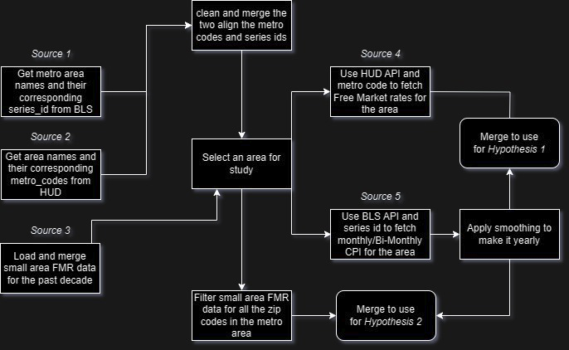
Data Processing

Slide 11
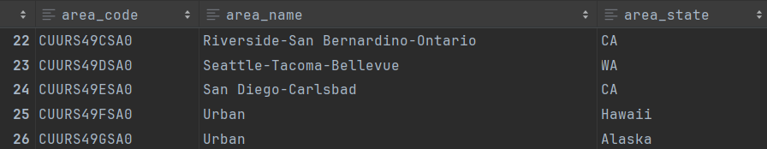
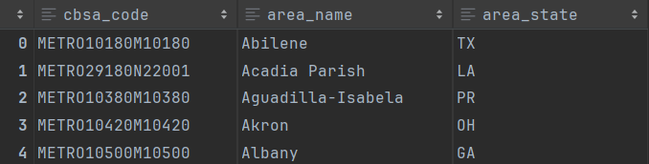
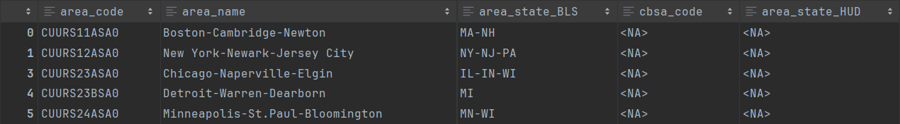

Slide 12
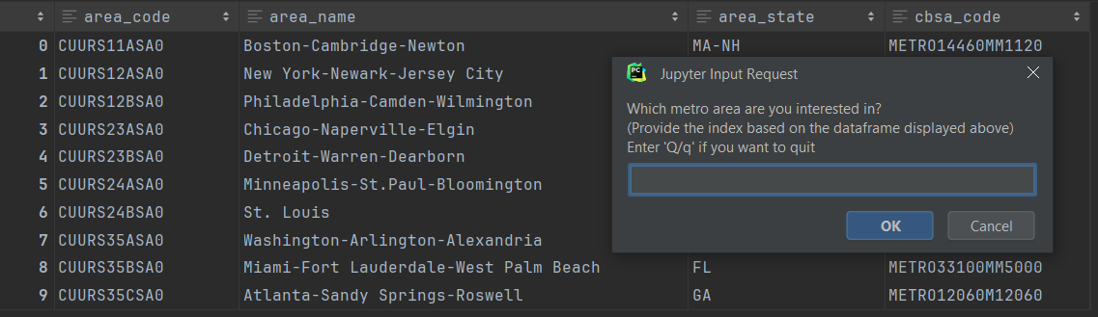
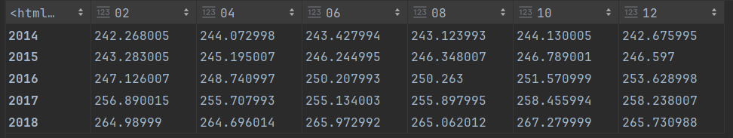
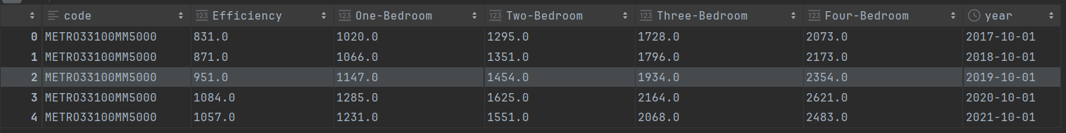

Slide 13
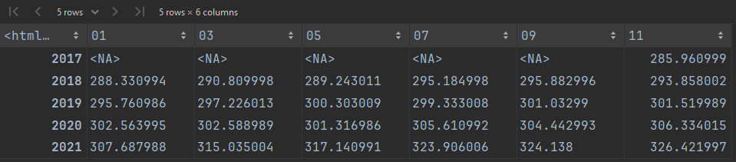
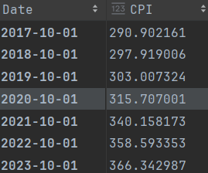
Smoothing CPI data

Slide 14
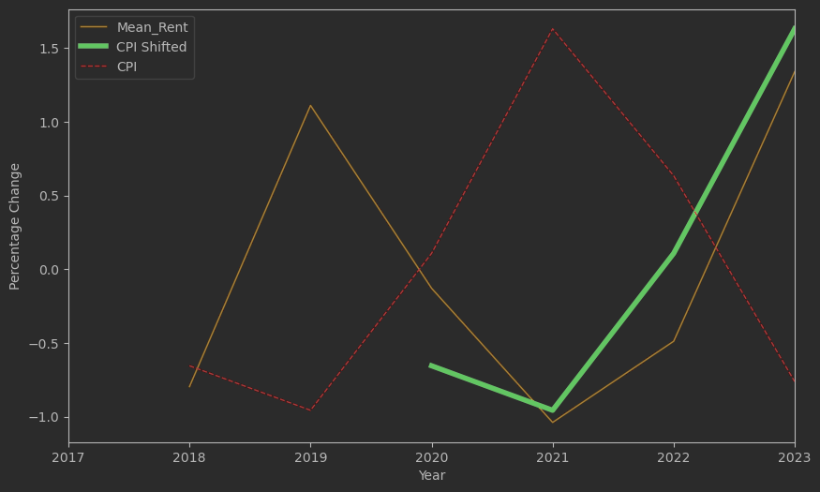
Identifying Lag in CPI and FMR

Slide 15
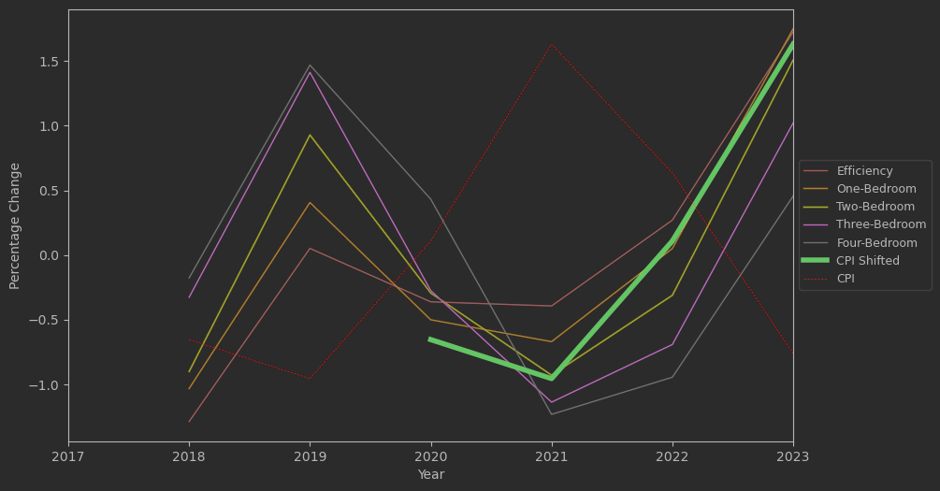
For lag = 2 years the trend line for rent matches the shape of the trend line for the consumer price index
A lag of 2 years is consistent for all the apartment types.
It can be concluded that the 'fair market rates' for this metro area are correlated with the consumer price index and the effect is visible after 2 years. Hence, Hypothesis 1 is proven.

Slide 16
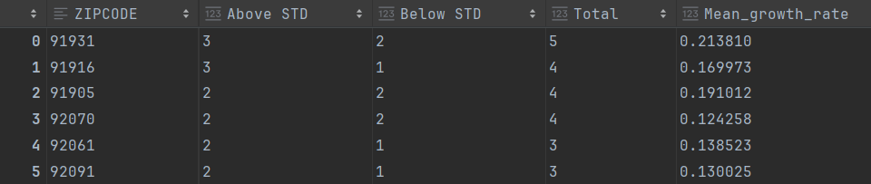
Identifying Areas with anomalies in rent rends
The 'Total' column indicates the number of years when rents in the zip code exhibited a growth rate 2 standard deviations away from the mean growth rate of the rent for the metro area.
The 'Above STD' column indicates the number of years when the rent in the zip code had a growth rate of more than 2 standard deviations from the mean growth rate.
The 'Below STD' column indicates the number of years when the rent growth rate was 2 standard deviations lower than the mean growth rate.

Slide 17
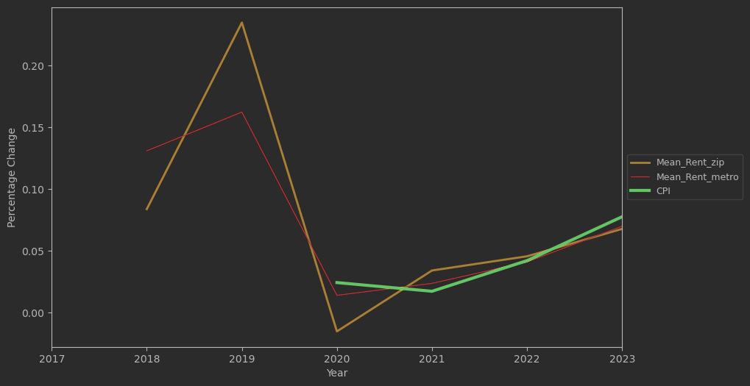
Area following the general trend

Slide 18
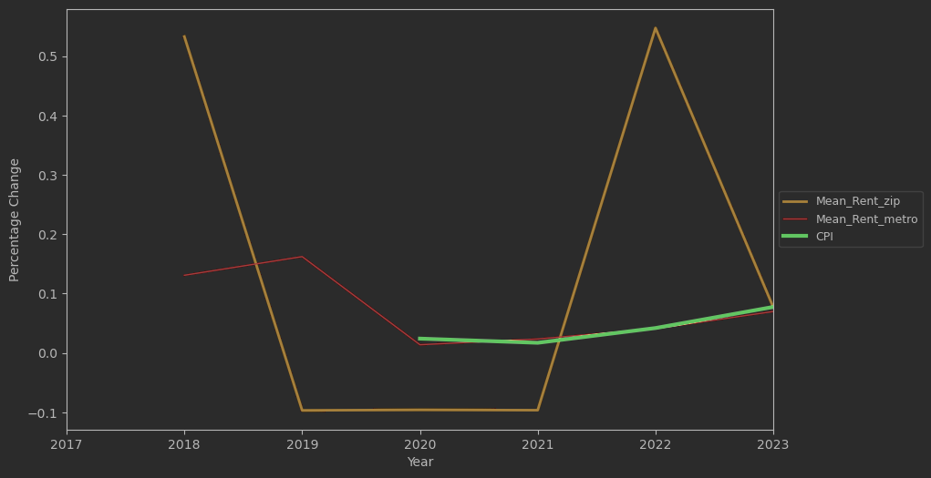
Area of anomaly

Slide 19
Contd.
The two analyses of two different zip codes prove that areas of anomalies in the metropolitan concerning housing rents can be detected by analyzing the fair market rates and the consumer price index of the area.

Slide 20
Thank You

