Slide 1

Department of Computer Science Gujarat University
5 Year Integrated M.Sc.(Computer Science)
Semester - V
Shop Zone
Presented By:
Aasima Mansuri(18)
Khushi Shah(45)
Krisa shah(46)
Jinal Vachheta(58)
Under the Guidance of :
Dr. Jigna Satani

Slide 2
Table of Content
Project Profile
Project Description
Introduction
Scope
Methodology
System Architecture
System Design(Diagrams)
DFD & ER
Or
Use Case,Activity,Sequence,class
Data Dictionary
Screenshots
Testing and Conclusions
Future Work
Bibliography

Slide 3
Project Profile
Name Of The Project | Shop Zone
Aim | Creating One-Stop Online Shop for All Fashion Needs
Tools, Technology and framework | HTML ,CSS ,MYSQL , Bootstrap, JSP , JDBC, Servlet
Duration | ( 6 months)
Minimum software and hardware requirements | Windows Operating System, Internet Connection RAM: 4GB Browser
Team size | 4 members
Team members | Mansuri Aasima (18) Vachheta Jinal (58) Shah Khushi (45) Shah Krisa (46)

Slide 4
Project Description
Introduction
Shop Zone is dedicated to offering a range of high-quality apparel for men, women, and children. We aim to provide a convenient and user-friendly shopping experience for every one.
Key features:
Product sorting by category, size, color, and price.
User-friendly account registration and login.
Shopping cart management and order placement.
Secure payment options like UPI and Cash on Delivery.
Role-based access for Customers, Admins, and Delivery Person.

Slide 5
Project Description
Scope
Shop Zone is a simple platform where customers can easily browse, filter, and buy fashion products. It allows users to register, manage their cart, place orders, and cancel them if needed. Admins handle products and orders, and delivery staff update delivery details. Future features will include better payment options and order tracking.

Slide 6
Project Description
Methodology
Requirement Gathering: Identifying features like product browsing, account management, and order processing.
System Design: Creating diagrams to plan the system's structure and workflow.
Development: Building the platform using HTML, CSS, JSP, JDBC, Servlets, Bootstrap, and MySQL.
Testing: Ensuring functionality, usability, and security.
Deployment: Making the system live for users.
Future Enhancements: Planning upgrades like better payment options and real- time tracking.

Slide 7
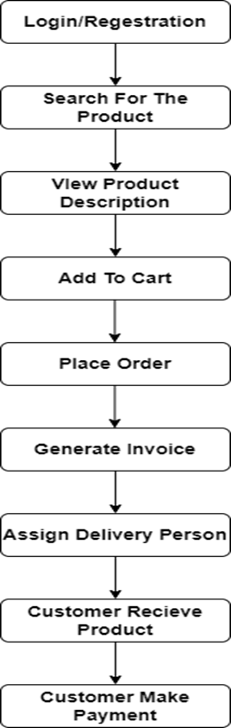
Flow of System

Slide 8
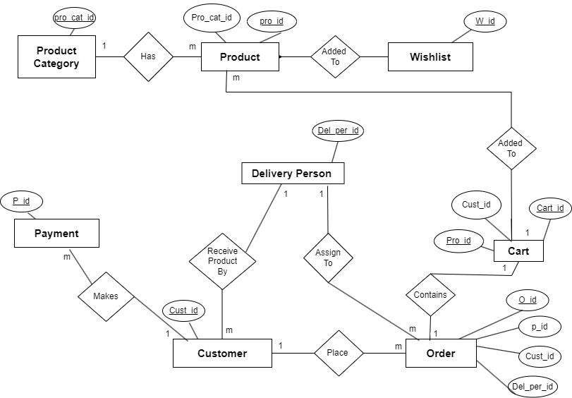
System Architecture
ER diagram

Slide 9
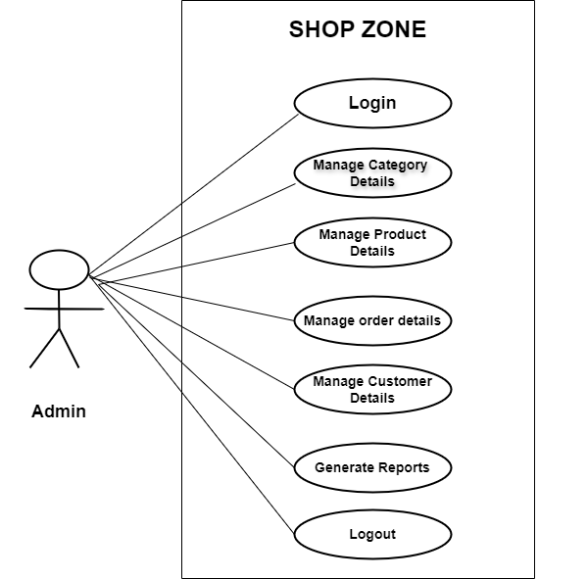
System Design
Use case diagram

Slide 10
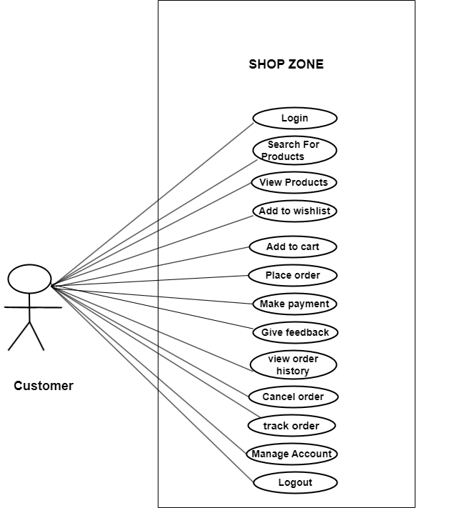
use case diagram of customer

Slide 11
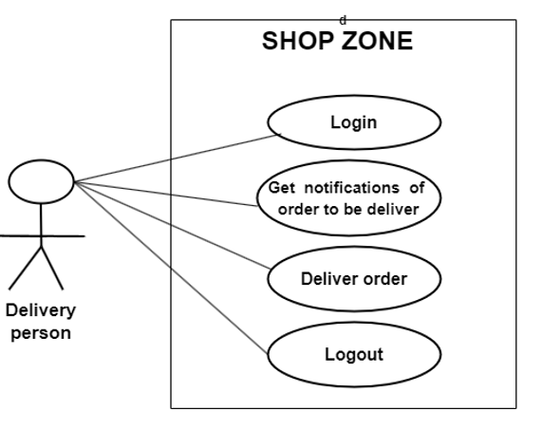
use case diagram of delivery person

Slide 12
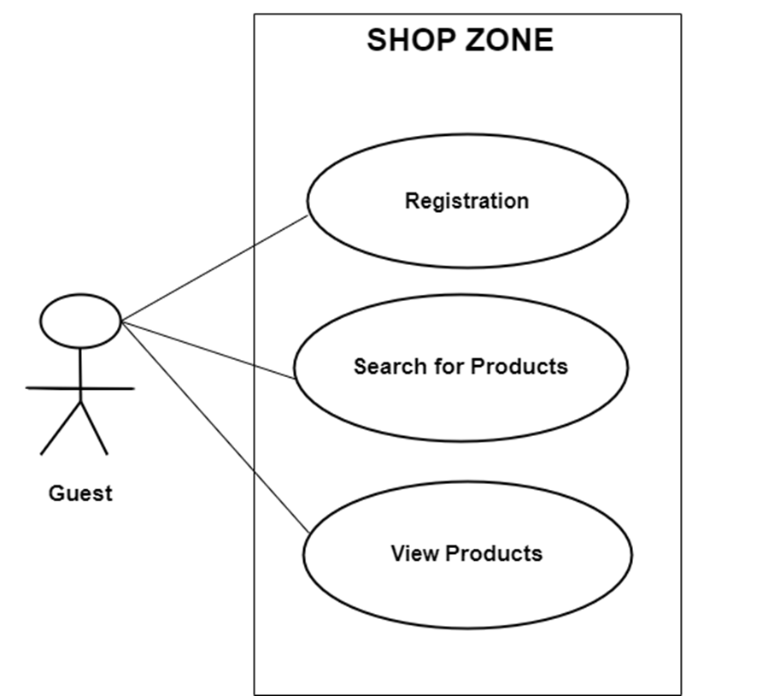
use case diagram of guest

Slide 13
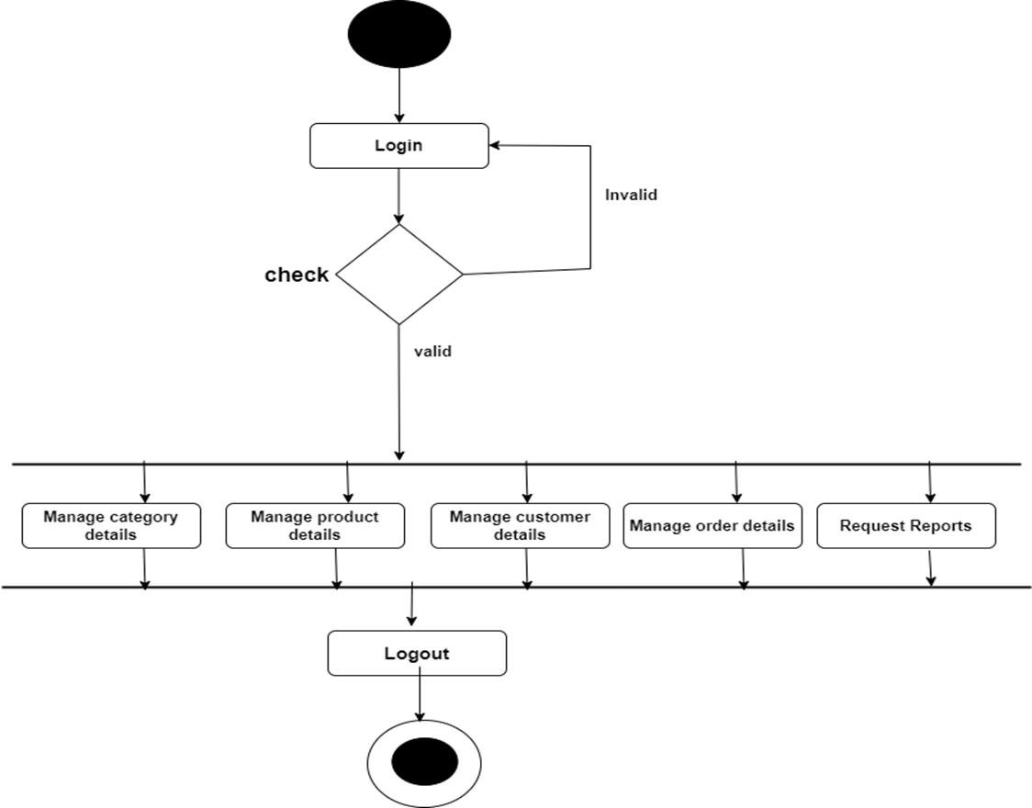
Activity diagrams
Activity diagram of admin

Slide 14
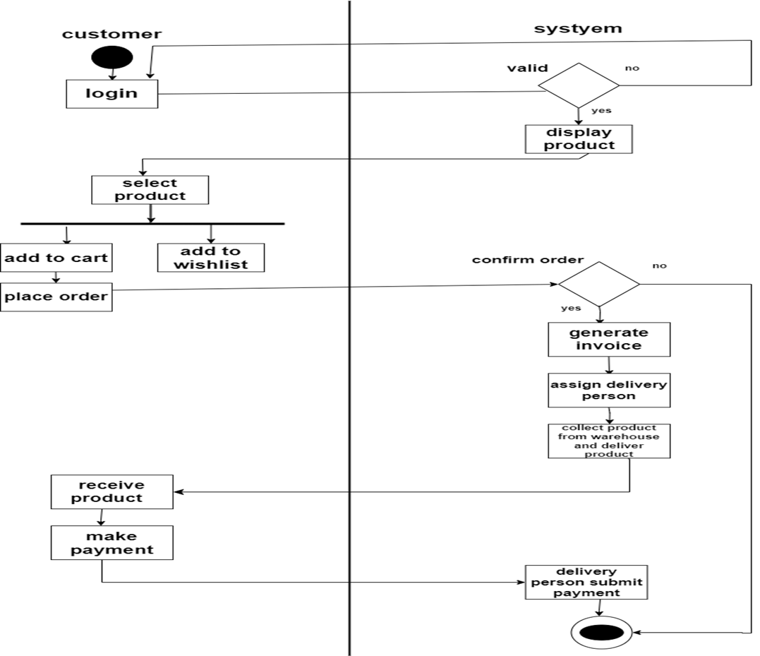
Activity Diagram of User(customer , system)

Slide 15
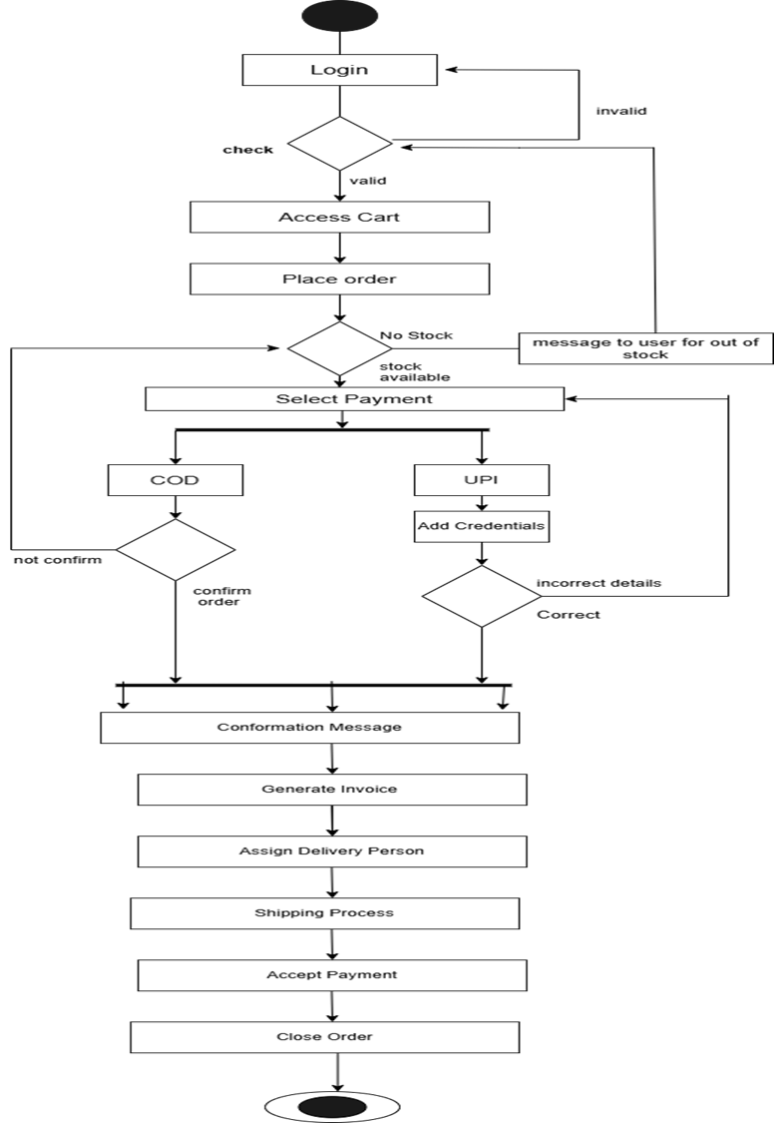
Activity diagram of order and payment

Slide 16
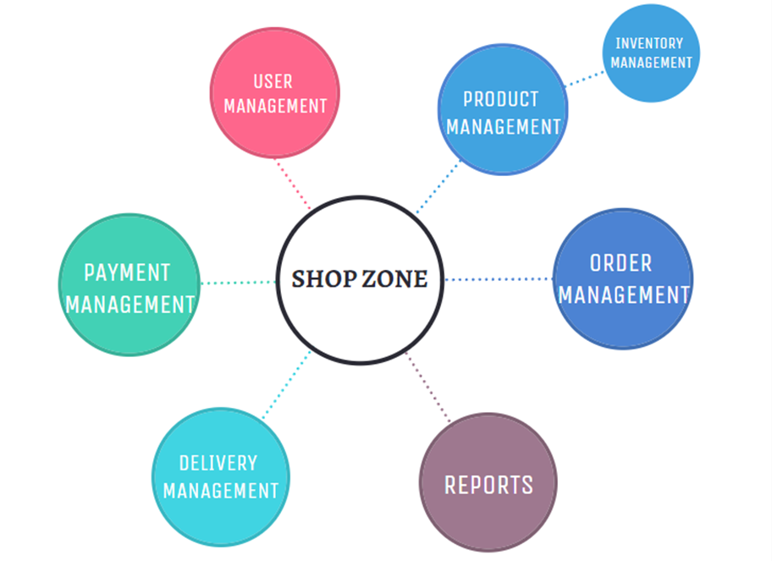
Module hierarchy

Slide 17
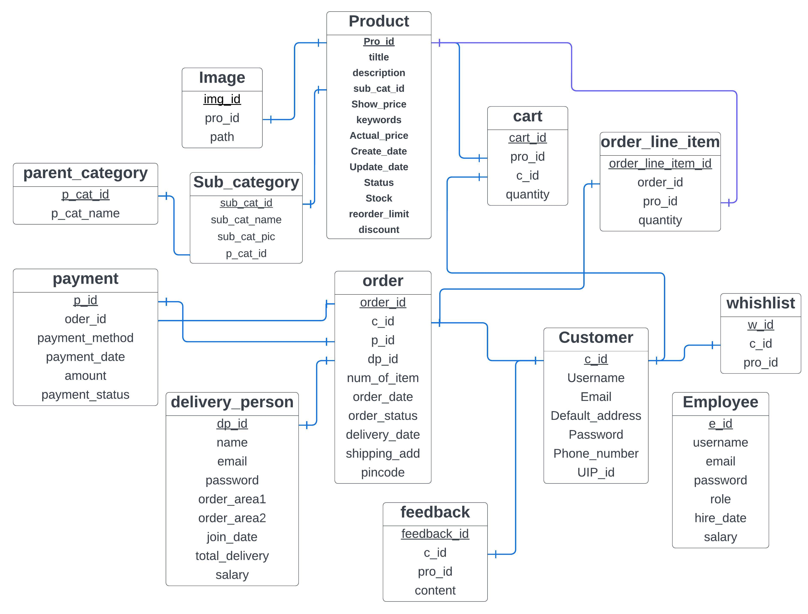
Data Dictionary
about
Total products
upi_id
upi_id

Slide 18
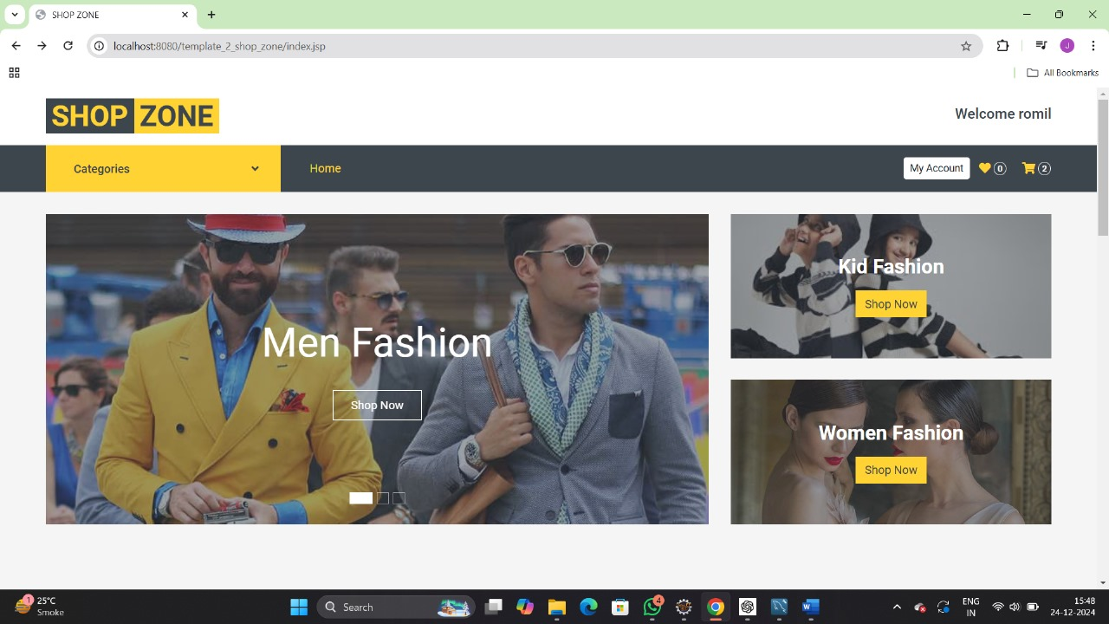
Home Page

Slide 19
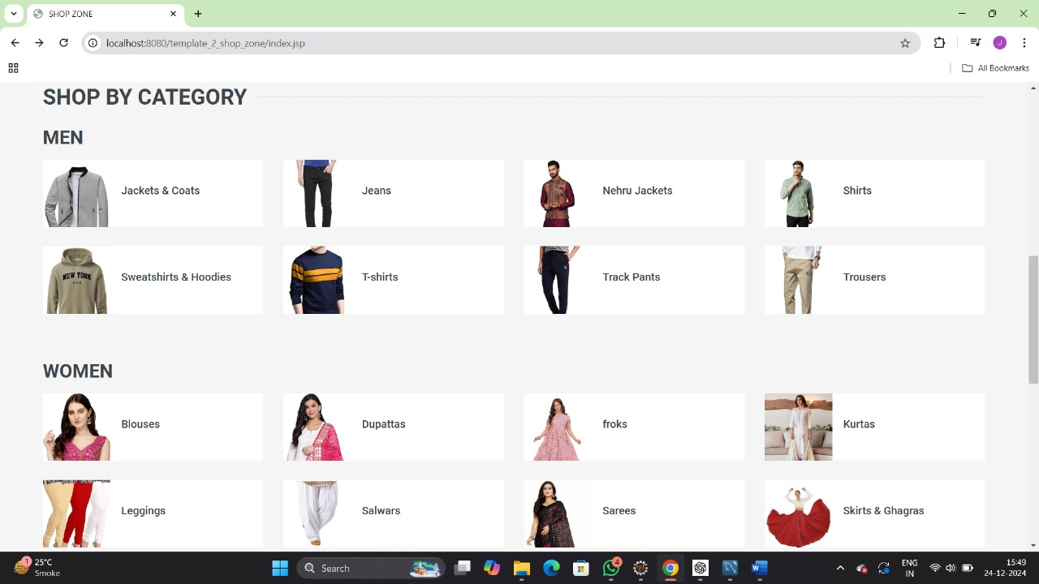
Home Page

Slide 20
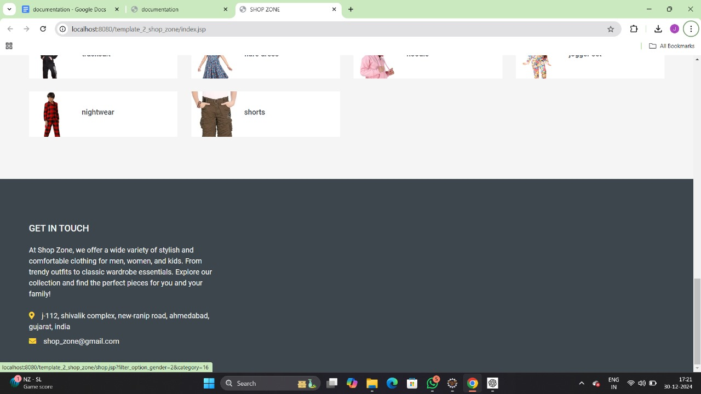
Home Page

Slide 21
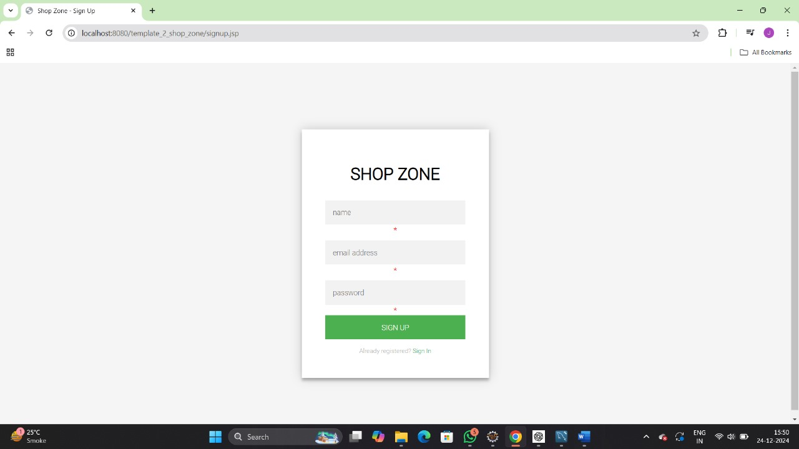
Sign UP Page

Slide 22
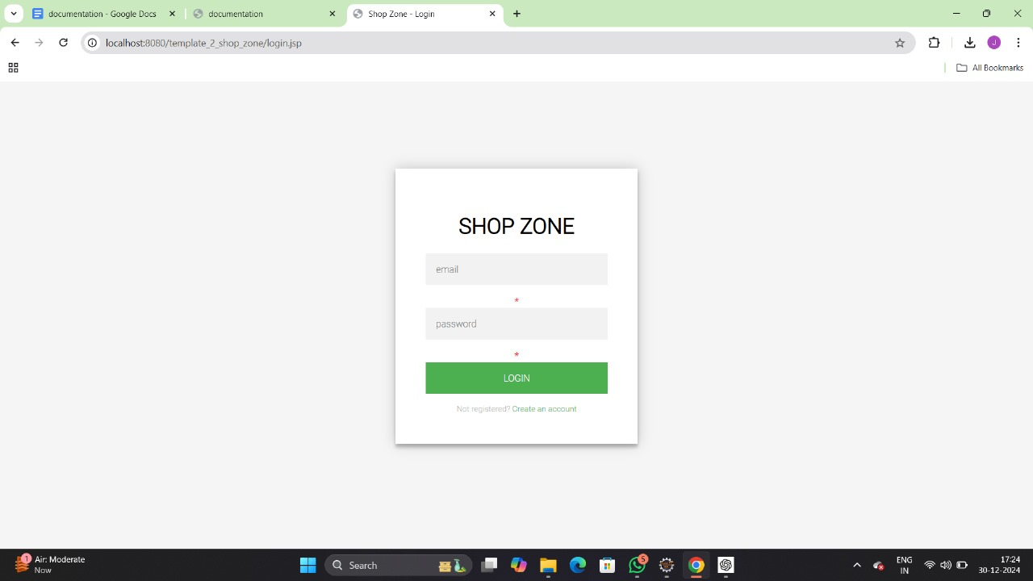
Login Page

Slide 23
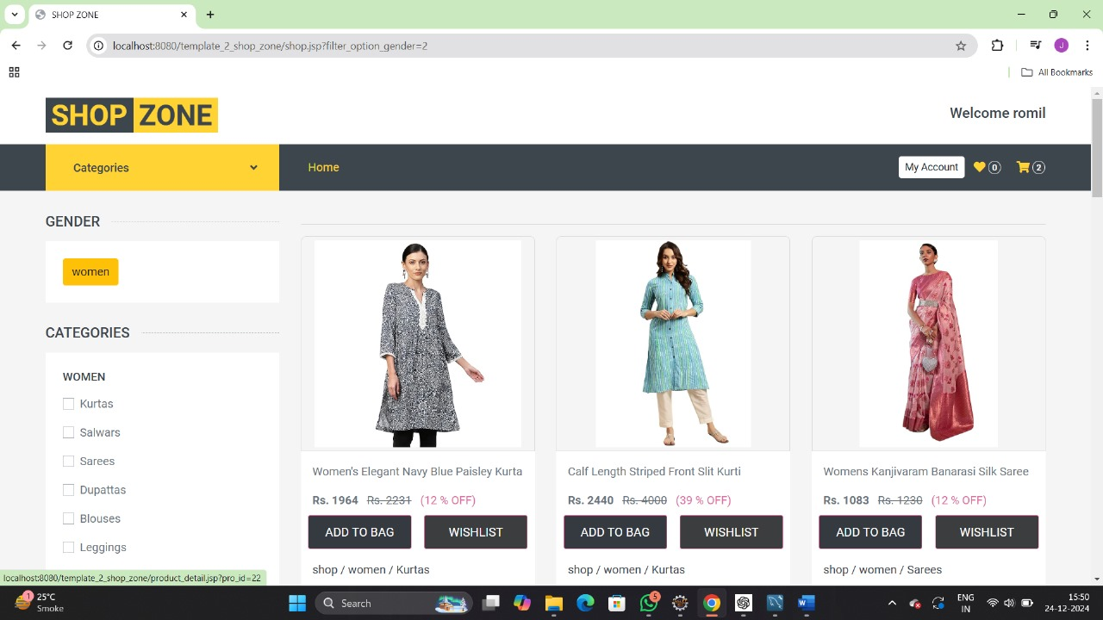
Shop Page

Slide 24
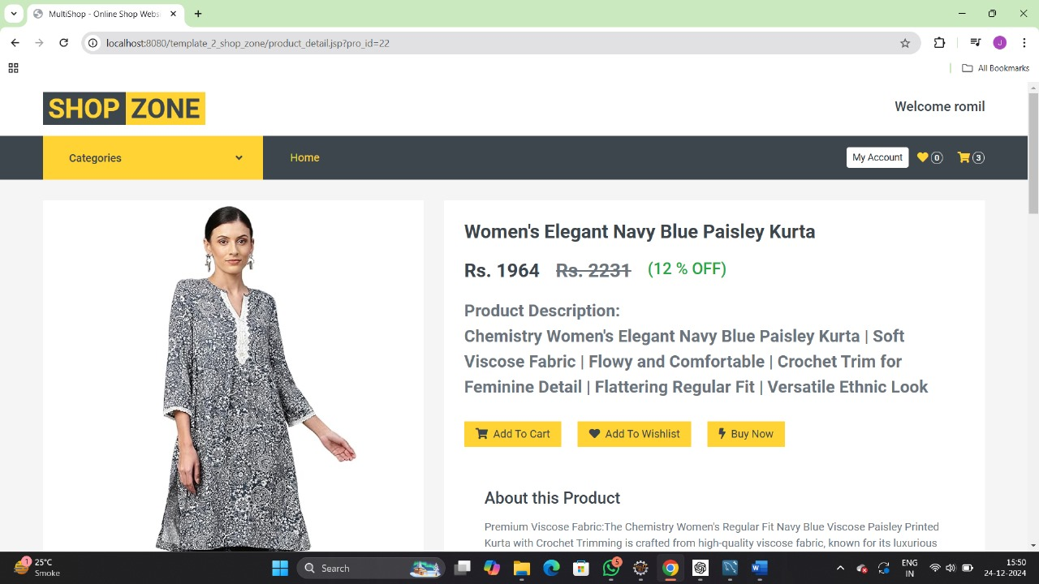
Product Detail Page

Slide 25
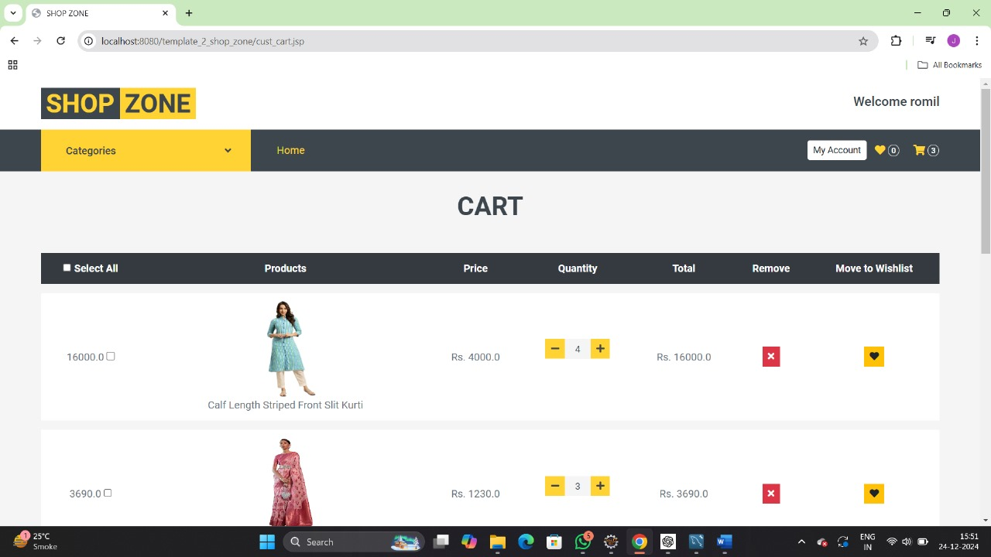
Cart

Slide 26
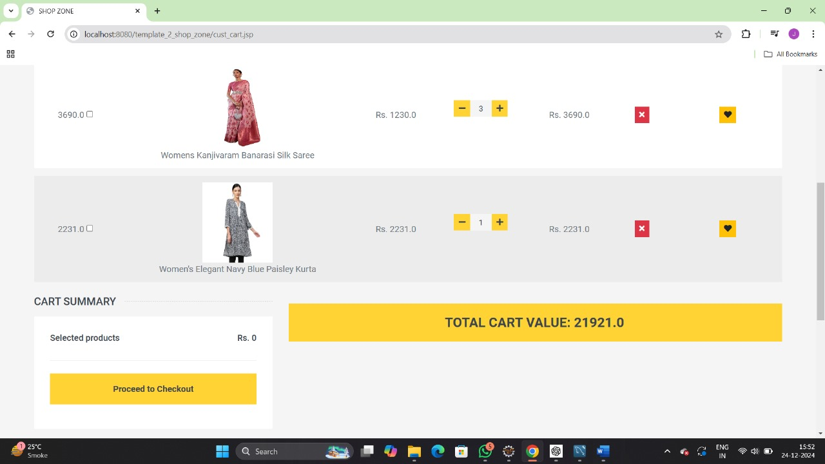
Cart

Slide 27
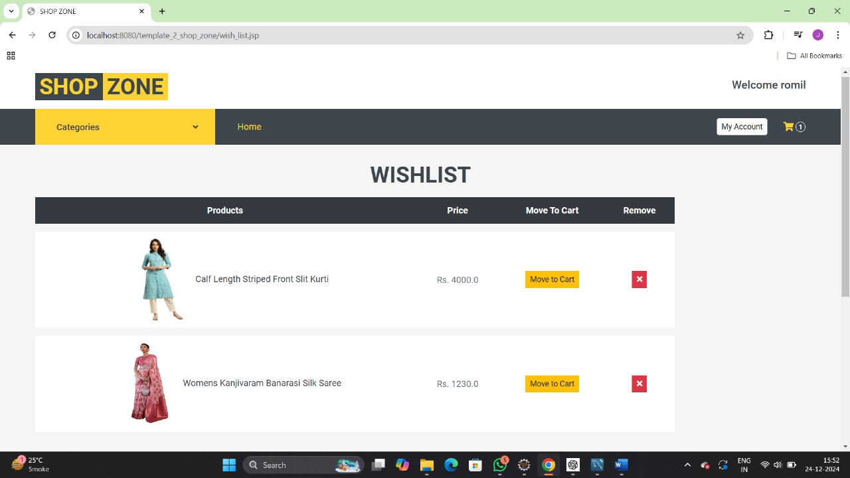
Wishlist

Slide 28
Product Detail Page

Slide 29
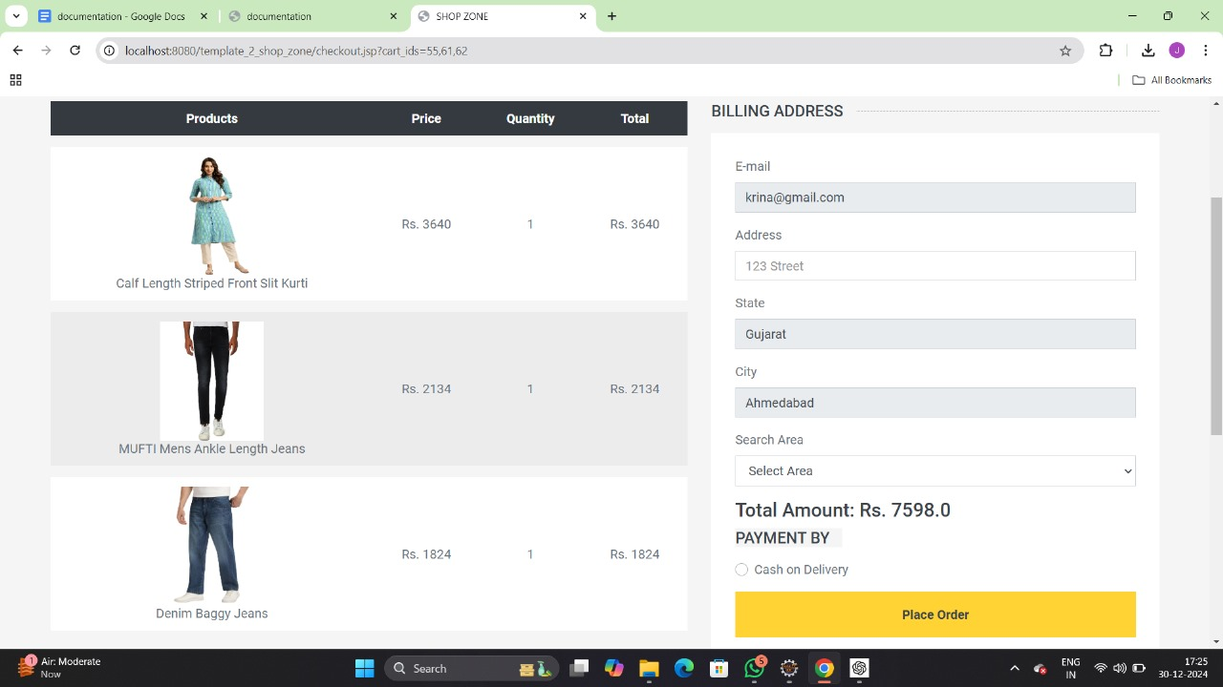
Check out Page

Slide 30
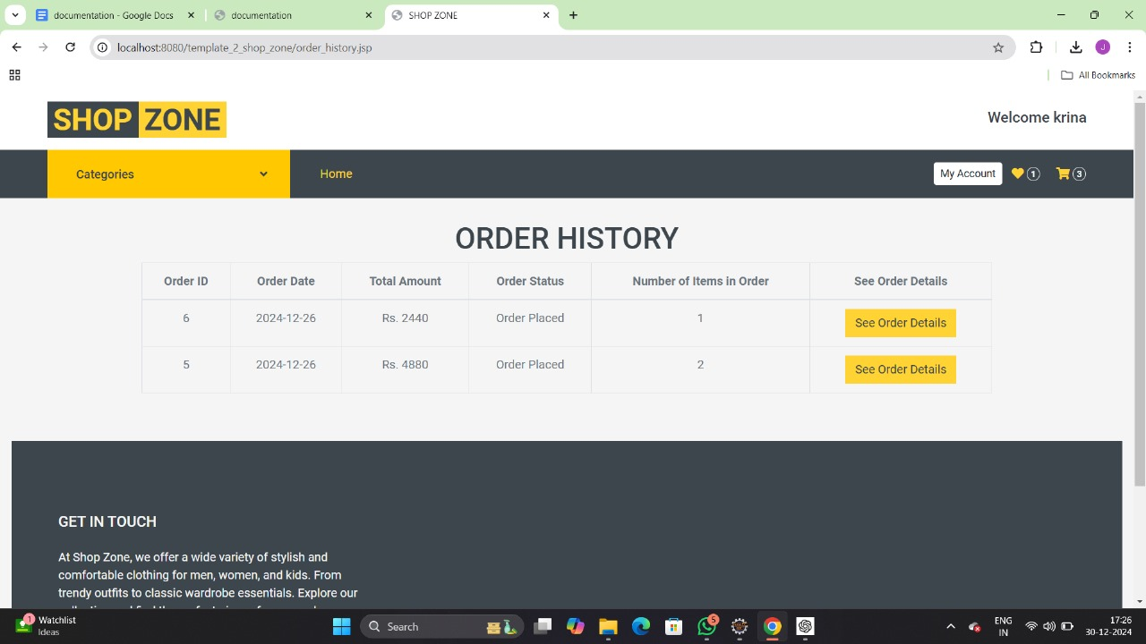
Order History Page

Slide 31
System Testing
System testing ensures that all components of the Shop Zone platform work together as expected. Different testing schemes were applied to validate the functionality, performance, and security of the system.
Testing Types
Functional Testing
Security Testing
Usability Testing
Performance Testing

Slide 32
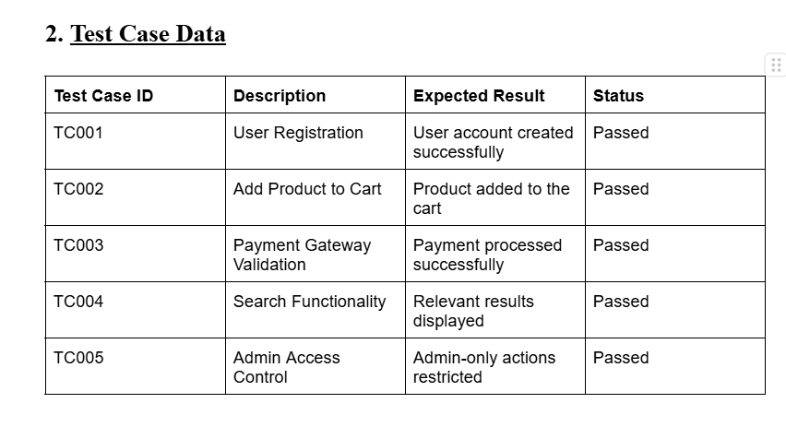
System Testing

Slide 33
System Testing
Summary of Results
All core functionalities of Shop Zone were successfully tested, and no critical issues were identified.
The system meets the requirements for functionality, usability, and security.
Minor improvements were suggested to enhance performance and user experience.
This testing ensures that Shop Zone is reliable and ready for deployment.

Slide 34
Conclusion
Shop Zone is an easy-to-use platform where customers can browse and buy fashion products. It offers features like filtering products, managing accounts, and secure order processing for a smooth shopping experience. The project is designed to grow, with plans for future features like better payment options and order tracking. It provides a simple and reliable solution for online shopping.

Slide 35
Future Work
Advanced Payment Options:.
Mobile Application:
Customer Reviews and Ratings:
Real-Time Order Tracking:
Discount Coupons and Loyalty Programs:
6. Inventory Management for Admins:
7. Customer care Support:
8. Social Media Integration:

Slide 36
Bibliography
Jsp and servlet :
https://docs.oracle.com/javaee/5/tutorial/doc/bnafe.html#:~:text=A%20servlet%20is%20a%20Java,a%20request%2Dresponse%20programming%20model
https://www.oreilly.com/library/view/more-servlets-and/0130676144/
Product images:
Freepik
Pixabay
figma.com

