Slide 1

MISSION REPORT

Slide 2
Motivation
Create a database for each completed and future SpaceX mission to outer space
How a private company is keeping up with its goal of reducing space transportation costs and to enable colonization of Mars
Get a sense of the complexity of a single mission by looking at the critical components

Slide 3
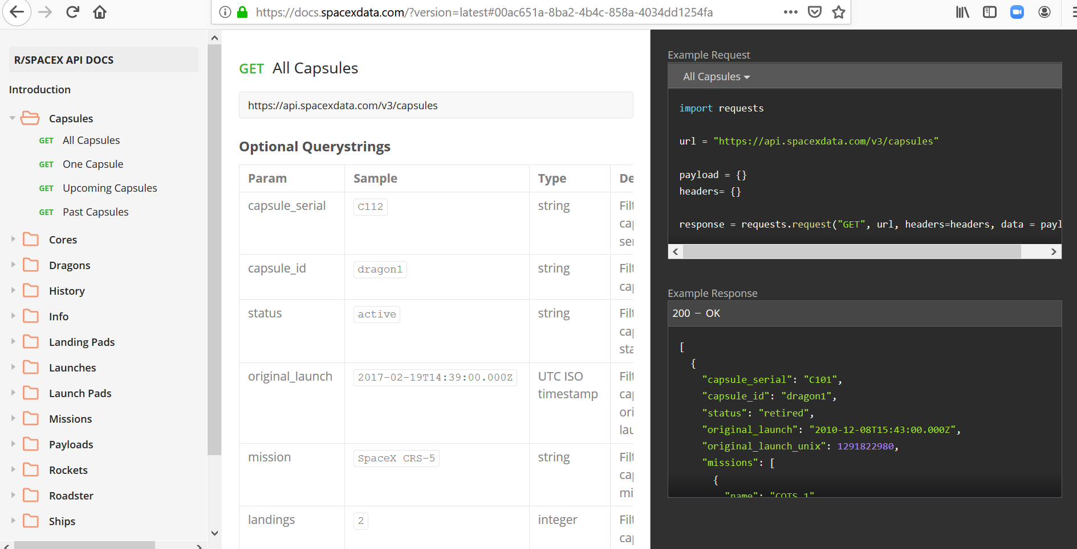
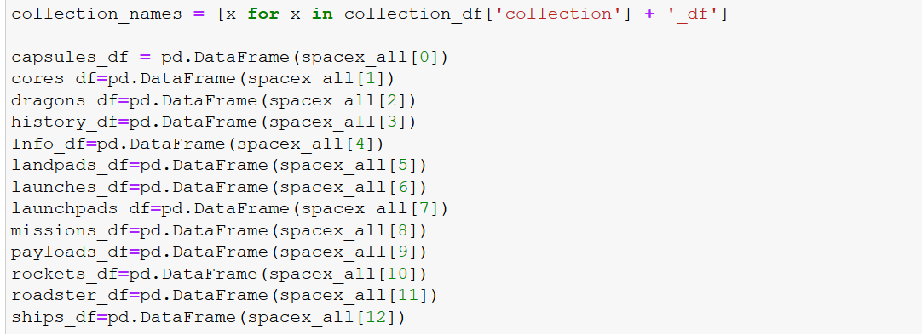
DATA Extraction:
Based on SpaceX API
https://api.spacexdata.com/v3

Slide 4
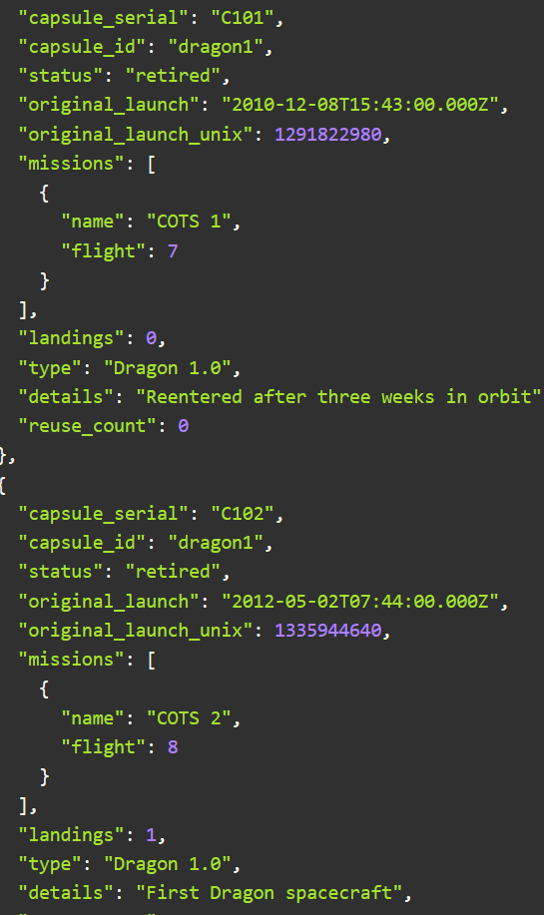
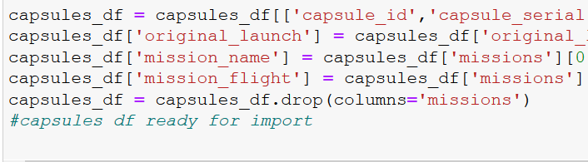
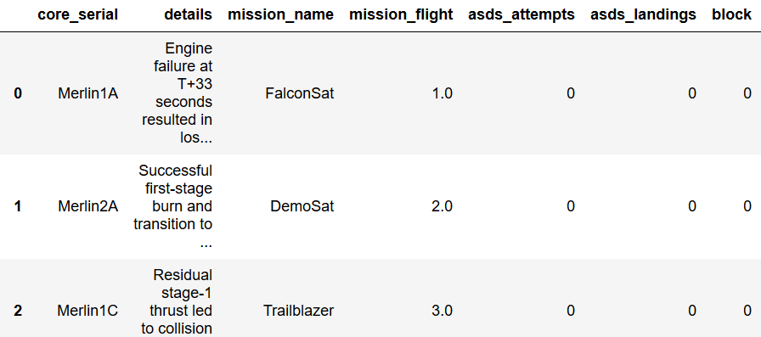
DATA Exploration and cleanup
Get data from spacex API
Transformation tasks
Dataframes created
Unix date converted to date time format
Connect with SQL DB

Slide 5
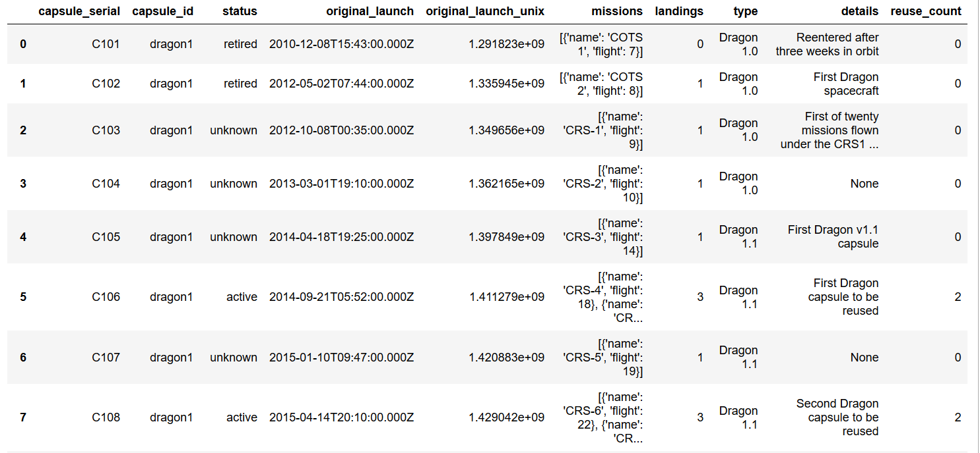
Full Data Frame

Slide 6
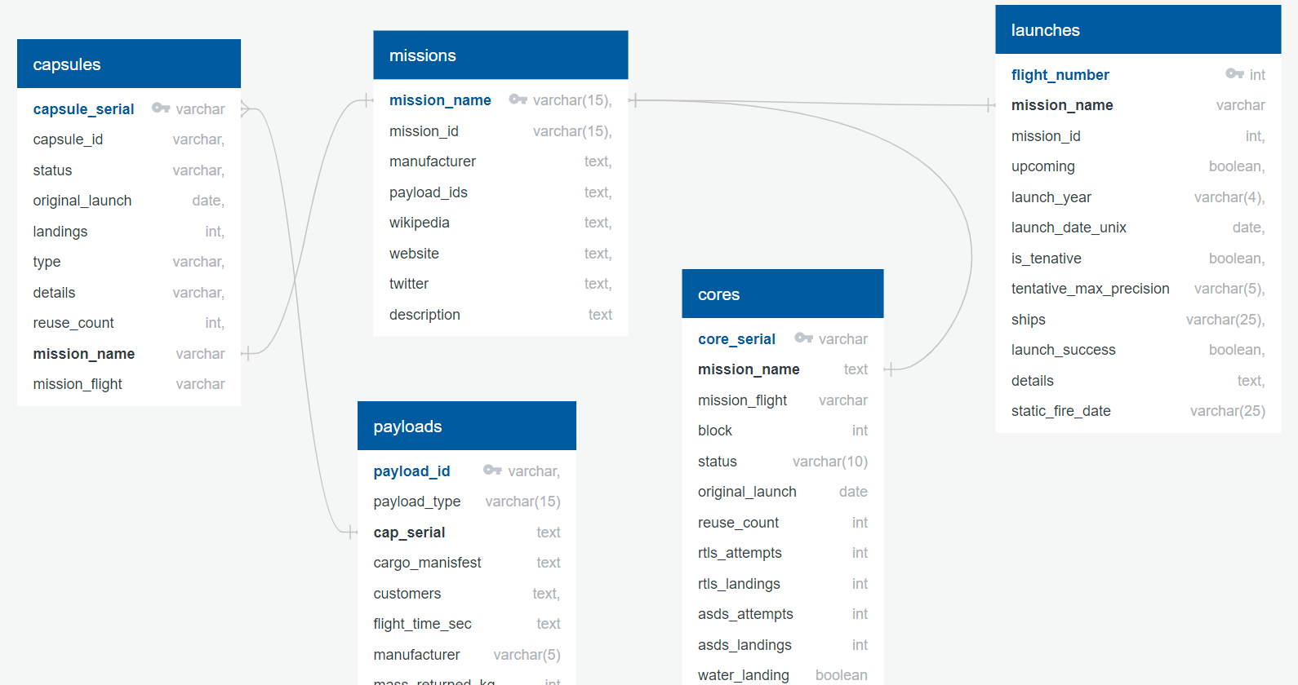
Data migration into a RDMS
ERD Diagram
Tables created:
capsules, cores, dragons, missions, launches

