Slide 1
Clear Presentation
Things I learned from Jane Abbott, Patrick Winston, and twelve years as a tour guide
Hosea Siu
BWSI Cog*Works 2021
Notes:
My name is Hosea Siu, and
this is a presentation on how to give clear presentations.
Also known as things I learned from Jane Abbott, Patrick Winston, and twelve years as a tour guide.

Slide 2
your success in life
your ability to speak
your ability to write
quality of your ideas
=
+
+
Notes:
Prof. Patrick Winston likes to say… [click]
People come in with varying levels of experience and comfort with public speaking
By the end of this talk, you will have a basic set of tools for how to give clear presentations.

Slide 3
Outline of this talk
How to start
Heuristics and slides
Your project presentations
How to stop

Slide 4
How to start
How to start
Heuristics and slides
Your project presentations
How to stop

Slide 5
joke
self-introduction
story
Notes:
You could start with a joke (but probably don’t in most cases)
Audience isn’t ready for it yet – they’re still getting used to you and the way you speak, and you’re still trying to set the tone
You might use a joke later, but beginning is probably a little early
You could start by introducing yourself (you may or may not need to).
You could start with a story. Since stories tend to be longer than jokes, you get to set the tone

Slide 6
Start with a promise.
Notes:
What is your audience here for?
How did we start this class last week? (With week overview, what we were going to learn, which was our promise as teaching staff to you)
At the beginning of this talk, I said that by the end of this talk, you will have several useful tools in your arsenal for presenting in front of others.

Slide 7
Heuristics and slides
How to start
Heuristics and slides
Your project presentations
How to stop

Slide 8
Four sample heuristics* for giving talks
*simple, efficient rules to solve a problem

Slide 9

Cycle through your ideas.
Notes:
Cycle – spaced repetition of the same idea, to ensure that everyone gets it, even if they zoned out the first time
Tell them what you’re going to tell them
They tell them
Then tell them what you just told them

Slide 10
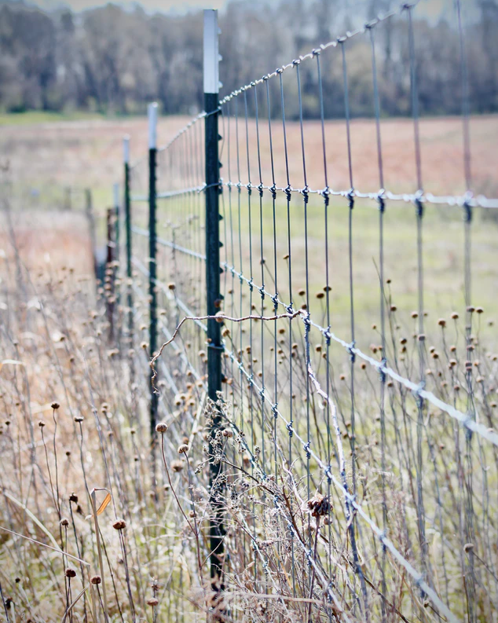
Build a fence.
Notes:
Build a fence
Distinguish your idea from someone else’s idea
Also means to tell us what your idea is and what it is not, which is particularly important in pitches
This talk is a combination of what I learned from Jane Abbott and Patrick Henry Winston, but in the context of Design of Assistive Technology, as presented to high school students

Slide 11
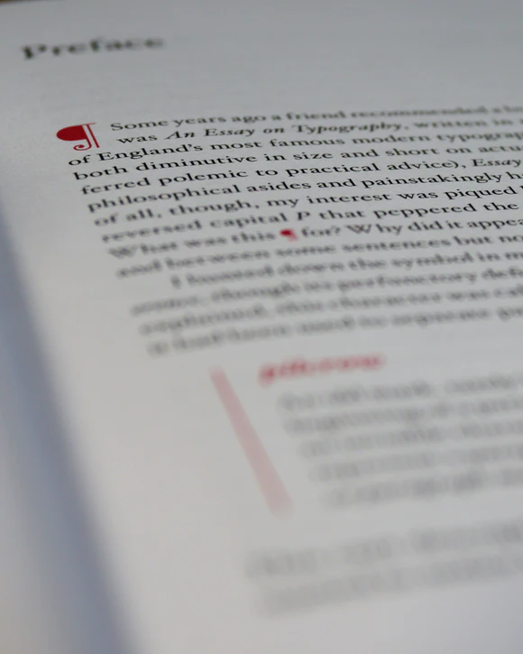
Use verbal punctuation.
Notes:
Verbal punctuation – outlines and pauses, repetitions and rhythms of your speech; they give opportunities for people to get back on

Slide 12
What might a fourth heuristic be?

Slide 13

Ask a question.
Notes:
Ask a question

Slide 14
cycle
fence
punctuate
question
Notes:
One way to remember is with a story mnemonic.
Your job is to come up with a mnemonic story to remember these four heuristics.
Warning – abrupt transition to next slide. Ready?

Slide 15




Crimes Against Slidemaking
Read right off your slides. Be sure to inform your audience that you know how to read. This is important to establish your credibility.
Use small font sizes to fit as much information into your talk as possible
Use fun clip art to give your audience a break
Use animations whenever possible
Logos are awesome and show that you’re legit

Slide 16
This slide intentionally left blank to let you rest your eyes.

Slide 17
Words as guidance
Ensure font legibility
Purposeful visual aids
Intentional animations
Sparing logo use
Notes:
The secret is that you can actually read off your slides, but your words should be guidance and cues, and your verbal track should add to your slides
Importantly, ask if your slides are meant to stand alone – stand-alone slides are very different from and much more wordy than slides for oral presentation (we will not ask you to make standalone slides)
I chose those pictures earlier very intentionally, because I think that taken together, they form a good mnemonic set that can help you remember the four heuristics

Slide 18
Slide and slide layouts
Western audiences focus on the top left first
Help your reader focus
Avoid unnecessary slide elements
The quick brown fox jumps over the lazy dog.
The quick brown fox jumps over the lazy dog.
The quick brown fox jumps over the lazy dog.
The quick brown fox jumps over the lazy dog.
The quick brown fox jumps over the lazy dog.
Notes:
Western audiences focus on the top left
Gray-outs are used in my outline slides, where there is a lot of text, to help you have a visual flow of where we are

Slide 19
Purposeful repetition
Build purposeful repetition into the presentation
Build purposeful repetition into the presentation
Other examples of purposeful repetition in this talk?
Notes:
Purposeful repetition helps keep the audience engaged by acting as verbal punctuation to let people who might have zoned out a way back onto your presentation
This can be used internal to a slide, or throughout your presentation as a form of cycling
This is a meta repetition, as you’ll also see on the next slide

Slide 20
Your project presentations
How to start
Heuristics and slides
Your project presentations
How to stop

Slide 21
Introduction
Connect with audience
Introduce your topic
Introduce your objective
Notes:
You don’t need to do much to connect with the audience in this class’ project presentations, but it might be a good thing to do if you’re presenting your work outside of this class
Your topic in this case might be your co-designer and the problem that they are facing
Your objective is to solve that problem, and you might be trying to convince us that you have a good way to solve it
You might also be asking for help, in the form of technical questions, or connections, or funding

Slide 22
Background
Knowledge
Motivation
Interest
Notes:
In some cases, your audience (us as staff and students) already know some things about your project, but we might have forgotten or want a reminder, or just want to see you present it so you have a chance to practice
What is your motivation?
Why should the audience care?

Slide 23
Main body
Lead with the familiar
Land on the important
Notes:
Start with something your audience knows before bringing us into unknown territory, especially if introducing new ideas
Land on the important
Example: “given what we just described about my user’s limited mobility and desire to play golf, these were our product design requirements”
As technical presentations, your design review slides will probably contain more content per slide than what you’re seeing here because you need to provide the context
As a general rule of thumb, content-dense slides should be treated as taking 1 minute per slide

Slide 24
Presenting complex charts and diagrams
Use builds
Highlight salient parts

Slide 25
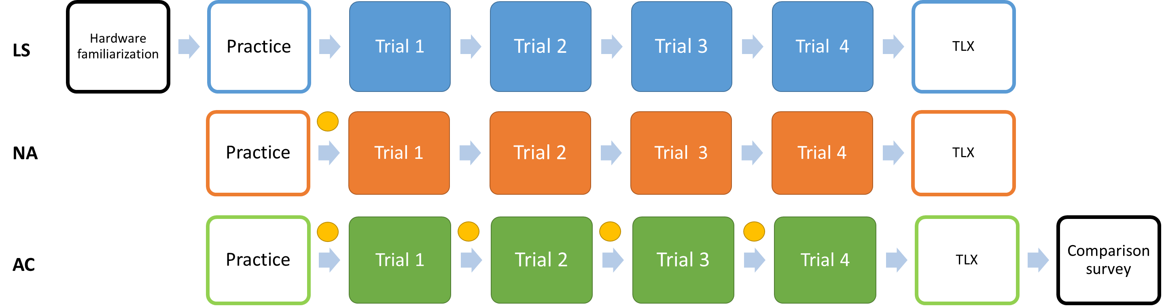
The experiment
2 minute break + survey
5 minute break
12 grasps
48 grasps
3 controller orders used:
LS-NA-AC
AC-NA-LS
LS-AC-NA
n = 18
6 subjects per order
sEMG mapping update
Notes:
This is the slide we want to build to – lots of stuff going on, but not necessarily more complicated than some diagrams you might put up
Focus on how the slide builds

Slide 26
The experiment
2 minute break + survey
5 minute break
12 grasps
48 grasps
3 controller orders used:
LS-NA-AC
AC-NA-LS
LS-AC-NA
n = 18
6 subjects per order
sEMG mapping update
Notes:
We start with hardware familiarization, then give the subject some practice with the exoskeleton, before leading into the main trials
Practice is 12 grasps, each trial is 48, and there is a 2 minute break and a survey between each trial
There is also a 5-minute break at the end, during which they’ll fill out a NASA TLX survey
We’ll repeat this procedure two more times, for a total of three controllers

Slide 27
Comparing adaptation over time
Information about human adaptation
Information about human + exoskeleton adaptation
in situ sEMG mapping update
post-hoc sEMG mapping update
Notes:
The AC controller updates itself after each trial, but we also perform post-hoc updates during the non-adaptive trials to look at the counterfactual of what the exoskeleton’s behavior would have been like if it did update
The counterfactuals tell us about the human-only adaptations to the exoskeleton using the exoskeleton as a proxy
The in-situ mapping updates tell us about the adaptations by both the human and the exoskeleton

Slide 28
Conclusions
or, how to stop
Notes:
- See next slides

Slide 29
How to stop
How to start
Heuristics and slides
Your project presentations
How to stop

Slide 30
Questions?
Notes:
- You could stop by asking for questions. This is a good way to stop verbally, but this is a terrible way to end your slides because the slide that will sit up there as you take questions contains no information.

Slide 31
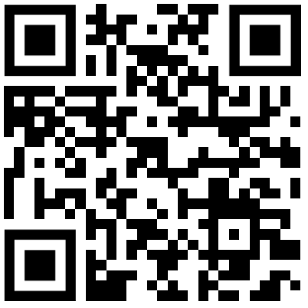
For more details, visit
https://rsokl.github.io/CogWeb/
Notes:
You could point to more details on a website
Nobody will write this down, but some people may take a picture or scan your QR code, so this is less terrible now than in the past

Slide 32
The end
Notes:
Don’t do this

Slide 33
Leave your contributions on the last slide

Slide 34
Contributions: tools for clear presentation
Start with a promise
Slide and oral presentation heuristics
Keeping slides clean and directing your audience
Project presentation items
End with your contributions and/or a call to action
Notes:
These are the contributions of this talk
We gave you a set of tools. Not all of them apply all of the time, and don’t just blindly use them. These are also recommendations – they are not the only way to do presentations!
At the end of BWSI, everyone in the entire program has to give some kind of presentation
My expectation for you is that this class will have, by far, the best presentations in all of BWSI
Now I’ll take questions

