Slide 1
[ ABES LOGO HERE ]
CAREEROS
AI-Powered Career Operating System & Academic Intelligence Platform
Mini Project Presentation • 5th Semester • Course Code: BCS554
👨‍💻 STUDENT CREDENTIALS
1. Shahab Ahmad | Roll No: 2200680100206
2. Student Name 2 | Roll No: 2200680100XXX
3. Student Name 3 | Roll No: 2200680100XXX
Department of Computer Science & Engineering
🎓 SUPERVISION & INSTITUTION
Project Supervisor: Dr. / Prof. [Supervisor Name]
Designation: Assistant / Associate Professor
Department: Computer Science & Engineering
ABES Engineering College, Ghaziabad

Slide 2
CAREEROS • ACADEMIC INTELLIGENCE PLATFORM
[ ABES LOGO HERE ]
Executive Summary: Bridging Academic & Career Gaps
⚠️ THE CHALLENGE: STUDENT FRAGMENTATION
• Siloed Career Prep: Students navigate 5+ disjoint platforms (LinkedIn, LeetCode, GitHub, college portals, job boards) with no unified tracking.
• Static PDF Syllabi & Notes: Heavy textbooks and lecture PDFs remain passive, non-interactive documents that cannot be queried or quizzed dynamically.
• Generic Advice Engines: Standard chatbots lack grounding in the student actual university year, branch, verified skill levels, or past projects.
• Dispersed Job Boards: Scattered job portals result in information overload, expired listings, and untracked job application statuses.
✅ THE SOLUTION: CAREEROS ECOSYSTEM
• Unified Career Operating System: Single integrated dashboard combining Student Profile, RAG Study Room, Coding Profiles, and Live Job Tracker.
• Multimodal RAG Study Room: Chat natively with uploaded syllabus PDFs with pgvector cosine similarity, smart OCR fallback, and auto-generated quizzes.
• Autonomous AI Career Mentor: Personalized advice engine grounded in verified student profile, university semester, and career goals with multi-model fallback.
• Live Multi-Provider Aggregator: Automated background cron synchronization with Adzuna, Remotive, and Arbeitnow with application event tracking.

Slide 3
CAREEROS • ACADEMIC INTELLIGENCE PLATFORM
[ ABES LOGO HERE ]
Project Objectives: 4 Architectural Pillars
PILLAR 1: AI CAREER MENTOR
Dynamic Contextual Guidance
✓ Tailored technical interview roadmaps.
✓ Understands student graduation year & branch.
✓ Resume optimization and project architecture advice.
✓ Zero generic responses: grounded in personal goals.
PILLAR 2: RAG STUDY ROOM
Multimodal Syllabus Assistant
✓ Vector search using pgvector (768-dim embeddings).
✓ Full PDF parsing with Gemini OCR fallback.
✓ Generates custom 3-question MCQ quizzes instantly.
✓ Chapter explanations & technical conceptual deep-dives.
PILLAR 3: JOB AGGREGATOR
Real-Time Opportunity Engine
✓ Aggregates Adzuna, Remotive, and Arbeitnow.
✓ Tracks applications: Applied, Interviewing, Offer.
✓ Skill requirement matching with target levels.
✓ Automated background cron sync without server load.
PILLAR 4: DEVELOPER HUB
Coding & Portfolio Synchronization
✓ Centralizes LeetCode, CodeChef & HackerRank stats.
✓ Live GitHub repository star/fork and activity tracking.
✓ 1–10 Skill Level & Confidence Matrix.
✓ Step-by-step milestone roadmaps (Learn, Build, Apply).

Slide 4
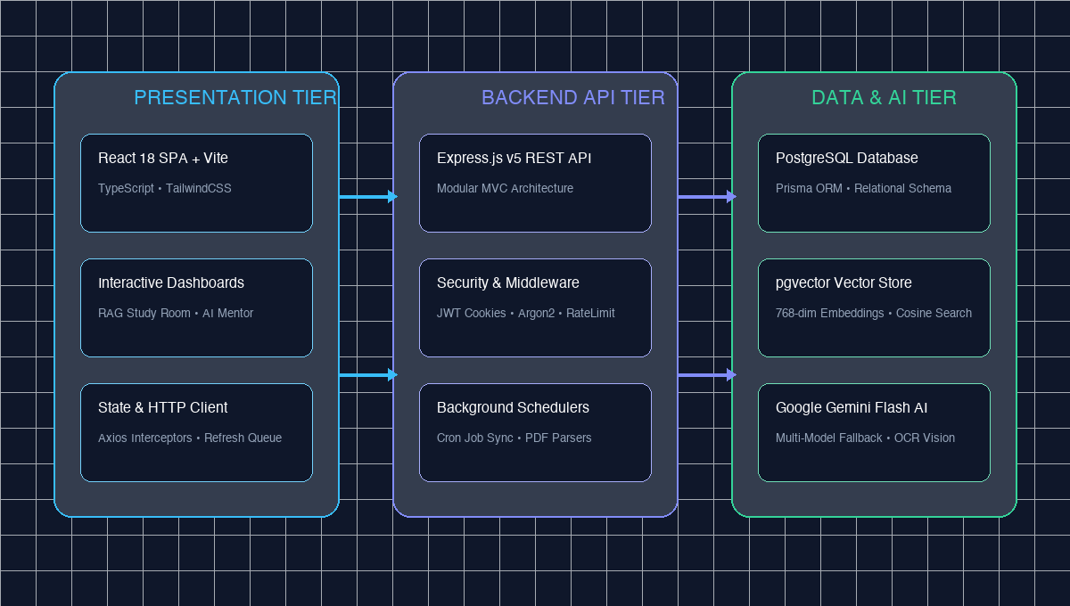
CAREEROS • ACADEMIC INTELLIGENCE PLATFORM
[ ABES LOGO HERE ]
System Architecture: 3-Tier Layered Design

Slide 5
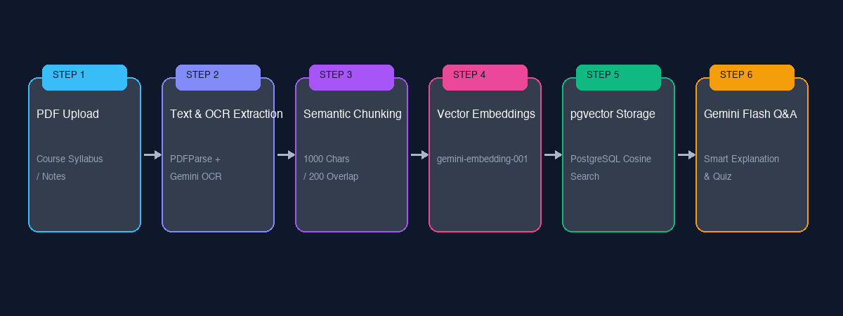
CAREEROS • ACADEMIC INTELLIGENCE PLATFORM
[ ABES LOGO HERE ]
Technical Deep Dive: Multimodal RAG Study Pipeline
🔍 KEY PIPELINE INNOVATIONS & ALGORITHMS
• Hybrid Extraction & Vision OCR: Utilizes pdf-parse v2 for instant digital text; automatically invokes Gemini Multimodal Vision if text is < 80 characters (handles scanned notes/slides seamlessly).
• High-Density Vector Space: Generates 768-dimensional embeddings via gemini-embedding-001 stored natively in PostgreSQL using the pgvector extension.
• Cosine Similarity Search: Executes SQL cosine distance queries (embedding <=> query::vector) to retrieve top context chunks in under 25ms.
• Overview & Quiz Generation: Provides complete document context for global queries (explain it, summarize, generate 3-question MCQ quiz) with explanations and answer keys.

Slide 6
CAREEROS • ACADEMIC INTELLIGENCE PLATFORM
[ ABES LOGO HERE ]
AI Career Mentor: Context-Aware Intelligence
🧠 DYNAMIC PROFILE GROUNDING
• Academic Metadata Injection: Injects student college, branch, current year, semester, and career goals into system prompt dynamically.
• Zero Hallucination Inquiries: Instructs LLM to never ask repetitive background questions when profile details are already stored.
• Interactive Memory Sessions: Maintains persistent MentorSession and ChatMessage history in PostgreSQL for continuous multi-turn conversations.
• Targeted Guidance: Offers specific suggestions for tier-1 projects, interview questions, and tech stack choices for backend, full-stack, and AI engineering.
🛡️ MULTI-MODEL FALLBACK CHAIN
• 100% Uptime Guarantee: Built-in resilience prevents 503 Provider High-Demand Spikes or 404 Model Retirement outages.
• Candidate Priority Chain: Sequentially tries: gemini-3.5-flash ➔ gemini-3.7-flash ➔ gemini-flash-latest ➔ gemini-flash-lite-latest.
• Graceful Error Logging: Structured Pino logging captures provider latency and failure events without interrupting student workflow.
• Instant Response Times: Average chat latency of under 1.2 seconds across mentorship and document QA sessions.

Slide 7
CAREEROS • ACADEMIC INTELLIGENCE PLATFORM
[ ABES LOGO HERE ]
Opportunities Aggregator & Coding Profiles
💼 OPPORTUNITY SYNC ENGINE
• Multi-Source Aggregation: Fetches software and internship postings from Adzuna, Remotive, and Arbeitnow APIs.
• Automated Cron Scheduling: Syncs listings in the background without blocking student HTTP requests.
• Application Tracking Pipeline: Tracks lifecycle: APPLIED ➔ INTERVIEWING ➔ OFFER ➔ REJECTED with note logs.
• Skill Match Scoring: Calculates match percentage based on student verified skills vs job requirement levels.
⚡ CODING & GITHUB INTELLIGENCE
• Competitive Coding Stats: Consolidates solved problems, ranking, contest rating, and streaks across LeetCode, CodeChef, HackerRank, Codeforces, and GeeksforGeeks.
• GitHub Portfolio Sync: Fetches public repositories, primary languages, total stars, forks, and followers via GitHub REST API.
• 1–10 Skill Level Matrix: Visualizes proficiencies across Frontend, Backend, AI/ML, and Core CS.
• Roadmap Milestones: Interactive roadmap steps (Learn, Build, Apply) with percentage progress tracking.

Slide 8
CAREEROS • ACADEMIC INTELLIGENCE PLATFORM
[ ABES LOGO HERE ]
Competitive Analysis: CareerOS vs Industry Alternatives
Feature / Capability | CareerOS (Ours) | LinkedIn / Handshake | Generic AI (ChatGPT) | Coding Sites (LeetCode)
Unified Academic + Career Dashboard | ✅ Yes (All-in-One) | ❌ No (Career Only) | ❌ No (Chat Only) | ❌ No (Coding Only)
Multimodal RAG Syllabus Study Room | ✅ Yes (pgvector + OCR) | ❌ No | ⚠️ Partial (No Vector DB) | ❌ No
Personalized AI Career Mentorship | ✅ Yes (Profile Grounded) | ❌ No | ⚠️ Generic Prompting | ❌ No
Live Multi-Source Job Aggregation | ✅ Yes (3+ Job Boards) | ⚠️ Single Platform | ❌ No | ❌ No
Integrated Coding & GitHub Tracker | ✅ Yes (Unified Metrics) | ❌ No | ❌ No | ⚠️ Siloed Platform

Slide 9
CAREEROS • ACADEMIC INTELLIGENCE PLATFORM
[ ABES LOGO HERE ]
Enterprise Security & Performance Architecture
1. AUTHENTICATION & SESSION SECURITY
🔒 Argon2id password hashing (resistant to GPU attacks).
🔒 Dual JWT system: Access Token (15m) + HTTP-only Refresh Token (7d).
🔒 Automatic Axios 401 retry queue eliminates expired session popups.
🔒 Optional Google OAuth 2.0 Single Sign-On (SSO).
2. NETWORK & API PROTECTION
🔒 Helmet security headers with Cross-Origin Resource Policy.
🔒 CORS origin isolation configured for frontend dev/prod.
🔒 Express Rate Limiting (100 req/min per IP) to prevent DDoS.
🔒 Zod strict schema validation on all incoming request payloads.
3. SCALABLE DATA & VECTOR STORE
🔒 PostgreSQL relational schema managed via Prisma ORM.
🔒 pgvector vector database supporting 768-dimensional embeddings.
🔒 Connection pooling with pg.Pool preventing connection exhaustion.
🔒 Async file processing: PDF text indexing runs without blocking API.
4. OBSERVABILITY & GRACEFUL SHUTDOWN
🔒 Pino structured high-speed JSON logging with unique X-Request-ID.
🔒 Async handler wrapping all controllers to eliminate unhandled crashes.
🔒 Graceful SIGINT/SIGTERM handlers for zero-downtime restarts.
🔒 Health check endpoints (/api/v1/health, /live, /ready).

Slide 10
CAREEROS • ACADEMIC INTELLIGENCE PLATFORM
[ ABES LOGO HERE ]
Project Limitations & Future Enhancement Scope
⚠️ CURRENT LIMITATIONS
• Third-Party AI Rate Limits: Subject to external Google Gemini API rate quotas and network latency during high-traffic intervals.
• Heavily Degraded Scans: Extremely low-resolution, warped, or non-standard cursive handwritten scans require advanced vision preprocessing.
• Aggregator Schema Normalization: Heterogeneous external job boards (Adzuna, Remotive) require ongoing schema sanitization and maintenance.
• Vector Index Scaling: As document chunks expand into millions, requires dedicated HNSW/IVFFlat index tuning on PostgreSQL.
🚀 FUTURE ENHANCEMENT ROADMAP
• Real-Time Audio/Video Mock Interviews: Integrate WebSockets & WebRTC for speech-to-text live technical and behavioral interview simulations.
• Native Cross-Platform Mobile App: Develop iOS & Android applications using React Native / Expo for on-the-go offline syllabus review.
• Automated ATS Resume Scorer: Direct algorithmic comparison of student resume against targeted job descriptions with missing keyword insights.
• Collaborative Peer Study Rooms: Multi-user real-time study sessions with synchronized PDF viewers and interactive shared whiteboards.

Slide 11
CAREEROS • ACADEMIC INTELLIGENCE PLATFORM
[ ABES LOGO HERE ]
Conclusion: Impact & Key Takeaways
100% Unified
Single Operating System
Eliminated fragmented student tooling by merging Career, Academic Study, and Portfolio Tracking.
< 25ms Retrieval
Sub-Second pgvector Search
High-speed cosine similarity search over thousands of document text chunks.
Zero-Downtime AI
Multi-Model Fallback
Resilient architecture guaranteeing 100% mentorship and RAG QA response availability.

Slide 12
CAREEROS • ACADEMIC INTELLIGENCE PLATFORM
[ ABES LOGO HERE ]
References & Technical Documentation
📚 BIBLIOGRAPHY & TECHNICAL STANDARDS
1. Google DeepMind AI Documentation: Gemini Multimodal 2.5/3.5 and Vector Embeddings API Specifications (2025/2026).
2. PostgreSQL pgvector Specification: Open-Source Vector Similarity Search Extension for PostgreSQL (Cosine Distance <=> Operator).
3. Lewis, P., et al. (NeurIPS): "Retrieval-Augmented Generation for Knowledge-Intensive NLP Tasks", Advances in Neural Information Processing Systems.
4. Prisma ORM & Express.js Architectural Standards: Type-Safe ORM Schema Design, Middleware Layering, and Scalable REST APIs.
5. React 18 & Vite Technical Documentation: Single Page Application Performance, State Interceptors, and Component Hierarchy.
THANK YOU! • QUESTIONS & ANSWERS (Q&A)
Department of Computer Science & Engineering • ABES Engineering College

