Slide 1

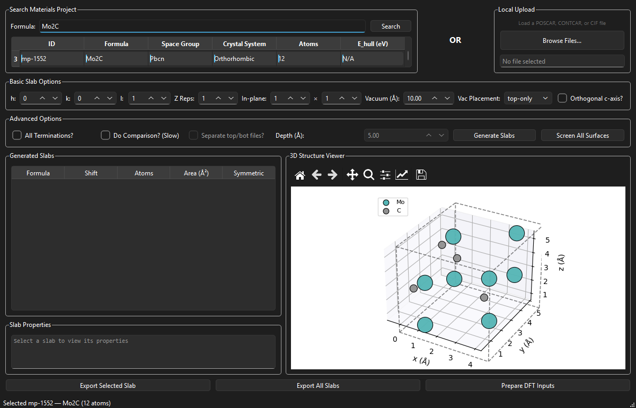
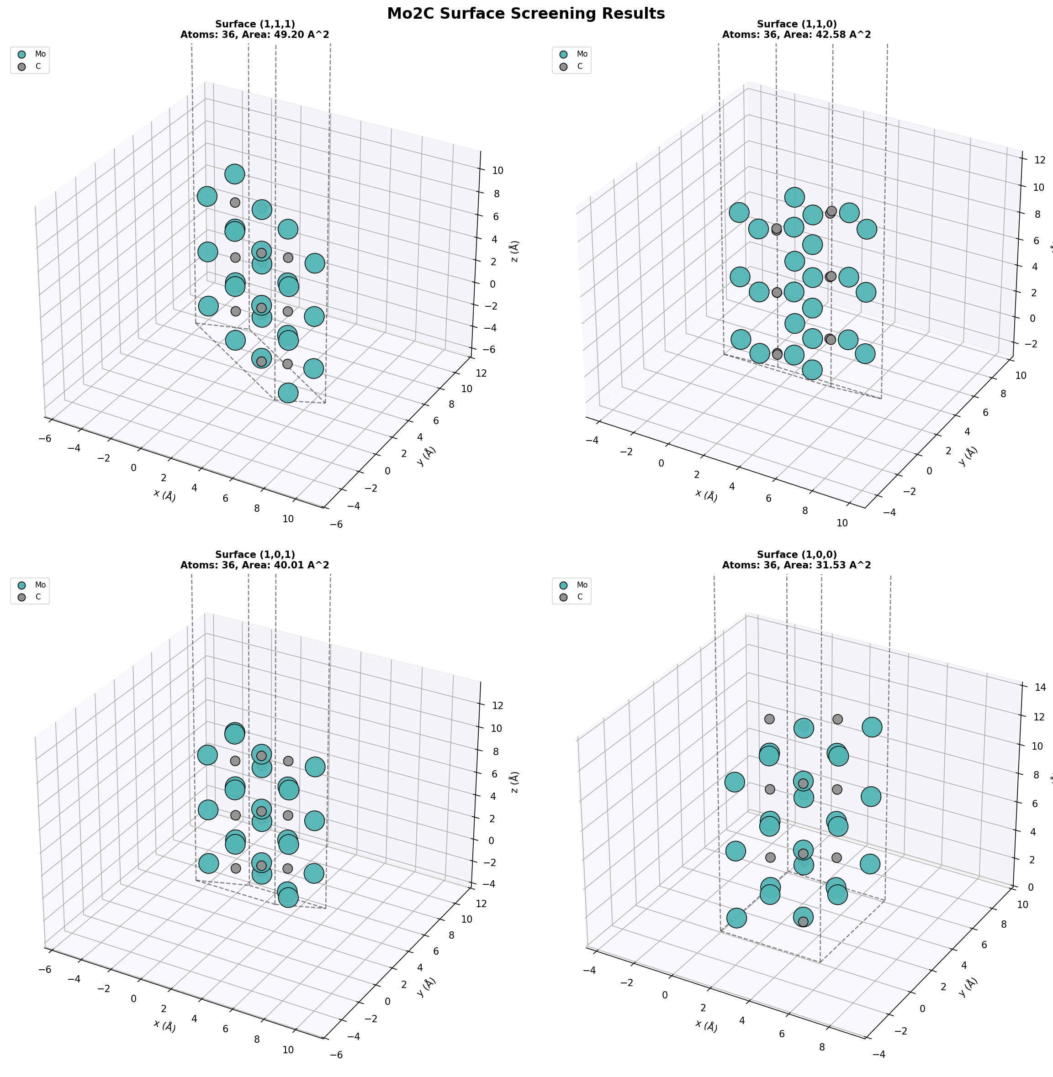
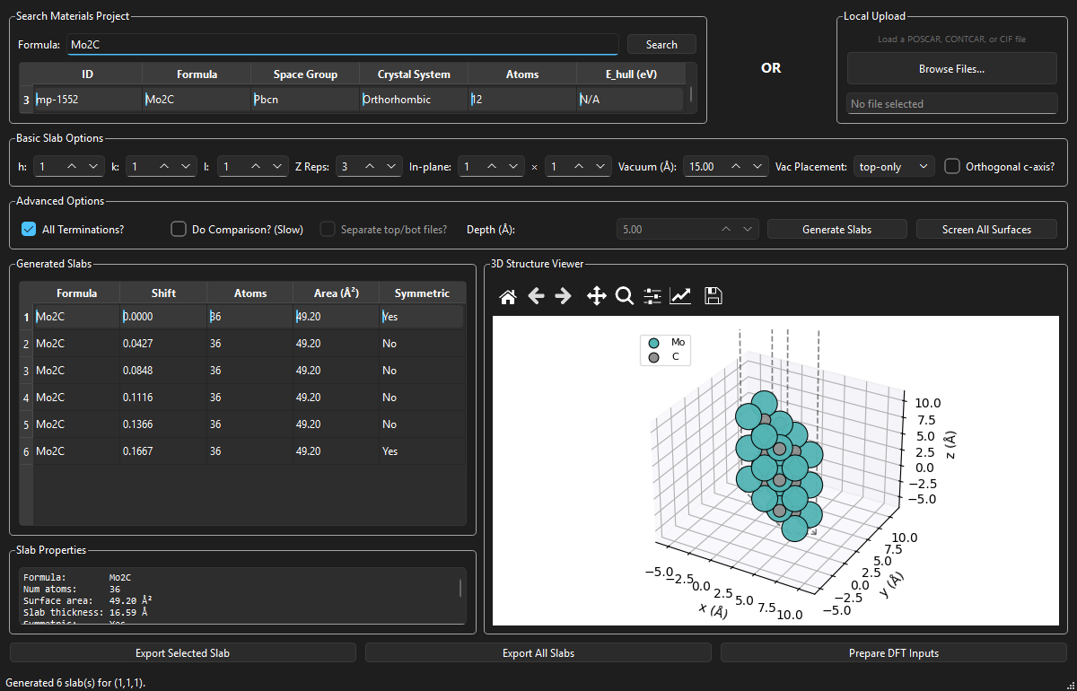
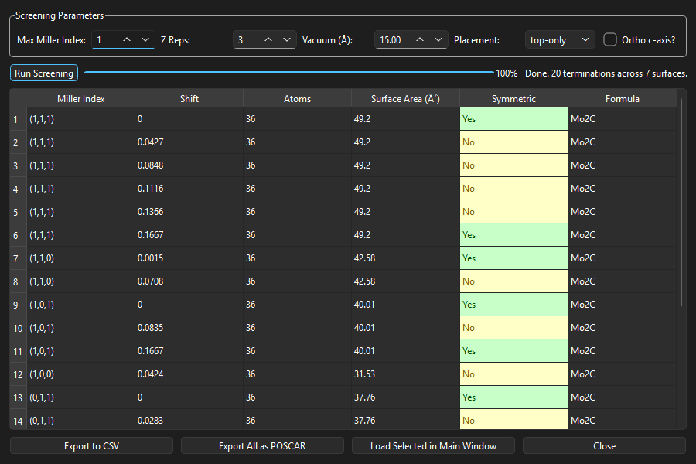
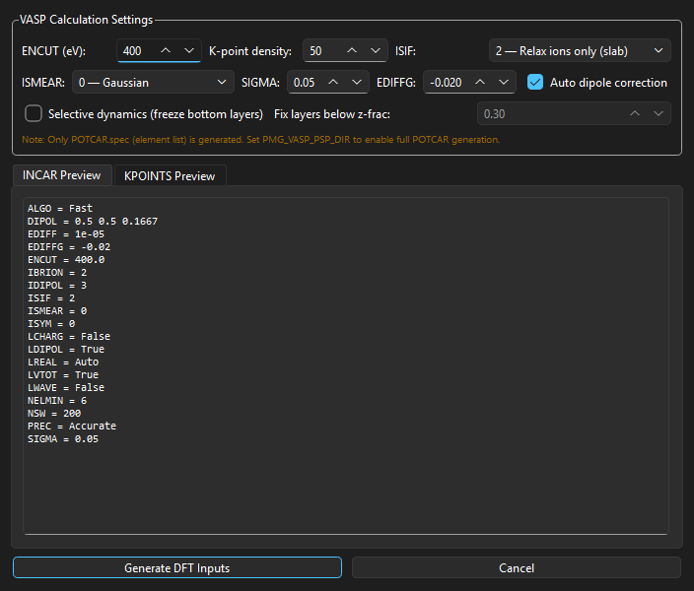
SlabGen: An Interactive Platform for Automated
Surface Slab Generation, Screening, and DFT Workflow Preparation
Shahab Afshar and Zeinab Hajali Fard
Iowa State University of Science and Technology
Motivation
• Surface properties govern catalytic activity, corrosion resistance, and thin-film growth
• DFT slab calculations require careful setup: proper terminations, vacuum, and dipole corrections
• Manual slab construction is tedious and error-prone -- systematic screening of orientations is impractical by hand
• No existing tool integrates structure retrieval, generation, screening, and DFT prep in one interface
SlabGen automates the entire pipeline from bulk crystal to DFT-ready slab models.
1. Structure Retrieval
Search Materials Project for Mo₂C, select ground-state mp-1552 (Pbcn, orthorhombic, 12 atoms).
Case Study: Mo₂C Surfaces
Molybdenum carbide is a promising non-precious-metal catalyst for hydrogen evolution (HER), CO₂ reduction, and Fischer-Tropsch synthesis. Understanding surface terminations is critical for rational catalyst design.
Screening Results
• Structure: mp-1552 (Pbcn, orthorhombic, 12 atoms)
• 20 unique terminations across 7 surface orientations
• 8 symmetric + 12 asymmetric terminations identified
• Surface areas range: 24.63 - 49.20 Å²
Mo₂C Surface Gallery
3D visualization of four representative Mo₂C surfaces generated by SlabGen.
Architecture & Workflow
Python + pymatgen + PySide6 (Qt6) + matplotlib
1. Search: Query Materials Project by formula or load POSCAR/CIF
2. Configure: Set Miller indices (h,k,l), vacuum thickness, z-repetitions
3. Generate: Create slabs with all unique terminations
4. Screen: Batch-explore symmetrically distinct surfaces
5. Export: POSCAR files + complete VASP input sets
Key Algorithm: oriented_slab_replication
Two-stage approach avoids atom-stretching artifacts:
(1) Orient bulk so target (hkl) aligns with z-axis, replicate
(2) Apply SlabGenerator with (001) for vacuum and terminations
2. Slab Generation
Mo₂C (1,1,1) surface: 6 unique terminations, 36 atoms each, 49.20 Å² surface area, 15 Å vacuum.
Screening Summary
Surface Terms Area(Å²) Symmetric
(0,0,1) 2 24.63 2 / 2
(0,1,0) 2 28.62 1 / 2
(1,0,0) 1 31.53 0 / 1
(0,1,1) 4 37.76 2 / 4
(1,0,1) 3 40.01 2 / 3
(1,1,0) 2 42.58 1 / 2
(1,1,1) 6 49.20 2 / 6
Total: 20 terminations | 10 symmetric, 10 asymmetric
Key Features
• Materials Project API integration (search by formula)
• Interactive 3D structure viewer (Jmol color scheme)
• Batch surface screening with symmetry analysis
• Auto dipole correction (LDIPOL, IDIPOL) for slab DFT
• Selective dynamics (freeze bottom layers)
• CSV export, batch POSCAR export
• SLURM job script generation
3. Surface Screening
20 terminations across 7 Mo₂C surfaces (max Miller index 1). Color-coded symmetry, sortable table, CSV export.
Conclusions & Future Work
• SlabGen provides an integrated workflow from bulk crystal to DFT-ready slab models
• Systematic screening enables rapid surface exploration with symmetry classification
• Mo₂C case study: 20 terminations across 7 surfaces characterized in seconds
Future Directions
• DFT surface energy calculations and Wulff construction
• Automated convergence testing workflows
• Adsorbate placement on generated surfaces
References
[1] Ong et al., Comp. Mater. Sci. 68, 314 (2013) - pymatgen
[2] Jain et al., APL Mater. 1, 011002 (2013) - Materials Project
[3] Sun & Ceder, Surf. Sci. 617, 53 (2013) - Surface energies
4. DFT Input Generation
VASP INCAR with auto dipole correction, KPOINTS (k_z=1 for slab), POSCAR, SLURM script. Live preview.
GPSS Research Conference | Iowa State University | February 20, 2026
Built with Python | pymatgen | PySide6 | matplotlib
github.com/shahab-afshar/SlabGen

