Slide 1

SlabGen
An Interactive Platform for Automated Surface Slab
Generation, Screening, and DFT Workflow Preparation
Shahab Afshar and Zeinab Hajali Fard
Iowa State University of Science and Technology
GPSS Research Conference | February 20, 2026

Slide 2
Motivation
Why surface slab modeling matters
• Surface properties govern catalytic activity, corrosion resistance, and thin-film growth
• DFT slab calculations require careful construction: proper terminations, vacuum thickness, and dipole corrections
• Manual slab setup is tedious and error-prone -- systematic screening of multiple orientations is impractical by hand
• No existing tool integrates structure retrieval, slab generation, screening, and DFT input preparation in a single GUI
SlabGen automates the entire pipeline from bulk crystal to DFT-ready slab models.
2/12

Slide 3
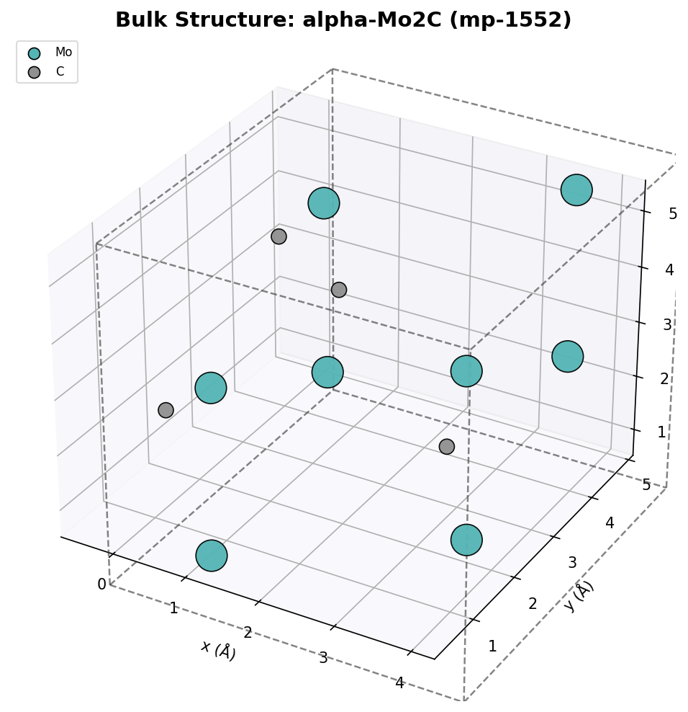
Background
Key concepts in computational surface science
Surface Slab Model
• Miller indices (h,k,l) define the crystallographic plane for cutting
• Terminations: different atomic layers exposed at the surface (same orientation, different cuts)
• Vacuum layer separates periodic slab images in DFT
• Symmetric slabs avoid spurious dipole moments; asymmetric slabs need dipole correction
DFT for Surfaces
• Surface energy: γ = (E_slab - n×E_bulk) / (2A)
• Wulff construction: equilibrium crystal shape from γ values
• VASP inputs: INCAR (ISIF=2), KPOINTS (k_z=1), POSCAR
3/12

Slide 4
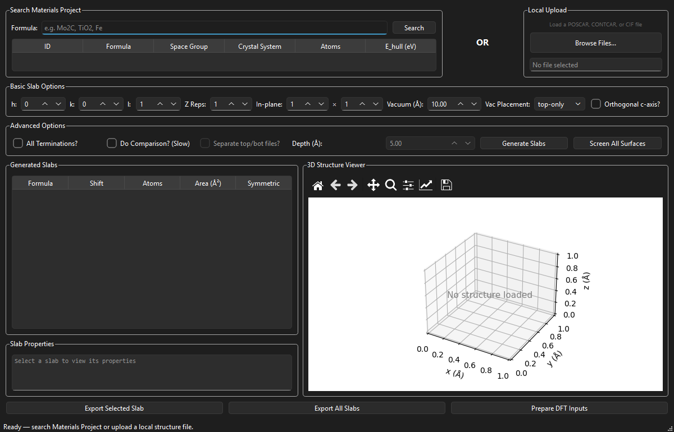
SlabGen Architecture
Technology Stack
• Python + pymatgen (materials analysis)
• PySide6 / Qt6 (cross-platform GUI)
• matplotlib (embedded 3D visualization)
• Materials Project API (structure database)
Modular Design
core/slab_generator.py
Slab generation + oriented replication
core/screening.py
Batch Miller index screening
core/dft_inputs.py
VASP input file generation
core/visualization.py
3D structure plotting
ui/main_window.py
Primary GUI with integrated viewer
4/12

Slide 5
Key Algorithm: oriented_slab_replication
Two-stage approach avoids atom-stretching artifacts
Stage 1: Orient
Rotate bulk crystal so target (h,k,l) plane aligns with the z-axis, then replicate along z to desired thickness.
Stage 2: Generate
Apply SlabGenerator with (0,0,1) on oriented structure to add vacuum and enumerate all unique terminations.
➡
Why two stages?
• Direct SlabGenerator on arbitrary (h,k,l) can produce distorted atomic positions for complex unit cells
• Pre-orienting + z-replication ensures physical atom spacing is preserved before vacuum is applied
• Enables correct slab models for any crystal system (cubic, orthorhombic, hexagonal, ...)
5/12

Slide 6
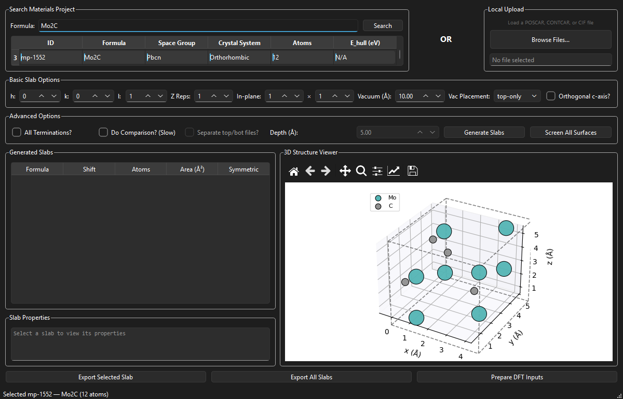
Demo: Structure Retrieval from Materials Project
Search & Select
1. Enter chemical formula (Mo₂C)
2. Query Materials Project API
3. Browse results: ID, space group, crystal system, atoms
4. Select structure to load into 3D viewer
Selected: mp-1552
• Alpha-Mo₂C (Pbcn, orthorhombic)
• 12 atoms per unit cell
• Ground-state polymorph (E_hull = 0)
6/12

Slide 7
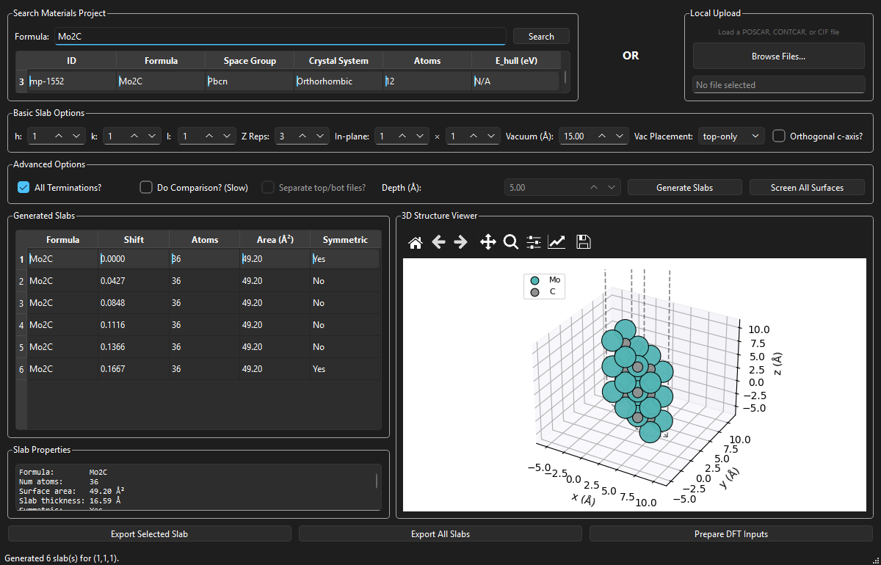
Demo: Slab Generation -- Mo₂C (1,1,1)
Parameters
• Miller indices: (1, 1, 1)
• Z repetitions: 3
• Vacuum: 15 Å
• All terminations: enabled
Results
• 6 unique terminations
• 36 atoms per slab
• 49.20 Å² surface area
• 2 symmetric + 4 asymmetric
7/12

Slide 8
Demo: Slab Inspection & 3D Visualization
Slab Properties
Formula: Mo₂C
Atoms: 36
Surface area: 49.20 Å²
Slab thickness: 16.59 Å
Symmetric: Yes (shift 0.0)
3D Viewer Features
• Interactive rotation and zoom
• Jmol color scheme (element-based)
• Lattice box with axis labels
• Updates on slab selection
8/12

Slide 9
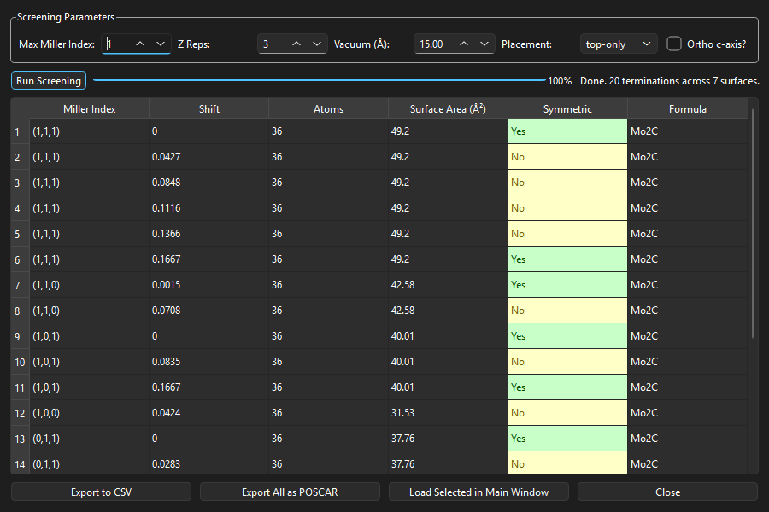
Demo: Systematic Surface Screening
Batch Screening
• All symmetrically distinct Miller indices up to max index
• Runs in background thread (GUI stays responsive)
• Progress bar with live updates
Mo₂C Results (max index 1)
• 7 surface orientations
• 20 unique terminations
• Color-coded: green = symmetric, yellow = asymmetric
Export Options
• CSV table export
• Batch POSCAR export (all slabs)
• Load any slab into main viewer
9/12

Slide 10
Screening Results: Mo₂C Surface Characterization
Surface
Terminations
Area (Å²)
Symmetric
Asymmetric
(0,0,1)
2
24.63
2
0
(0,1,0)
2
28.62
1
1
(1,0,0)
1
31.53
0
1
(0,1,1)
4
37.76
2
2
(1,0,1)
3
40.01
2
1
(1,1,0)
2
42.58
1
1
(1,1,1)
6
49.20
2
4
Total
20
--
10
10
Structure: alpha-Mo₂C (mp-1552, Pbcn, orthorhombic, 12 atoms) | Max Miller index: 1 | Z reps: 3 | Vacuum: 15 Å
10/12

Slide 11
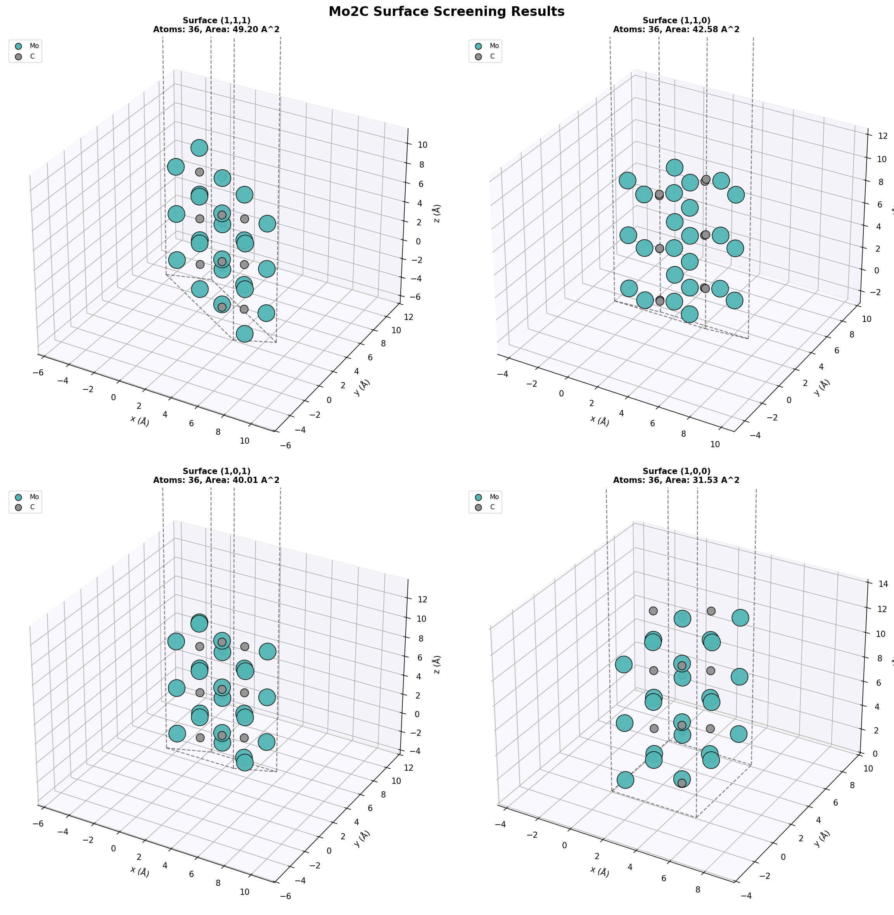
Mo₂C Surface Gallery
11/12

Slide 12
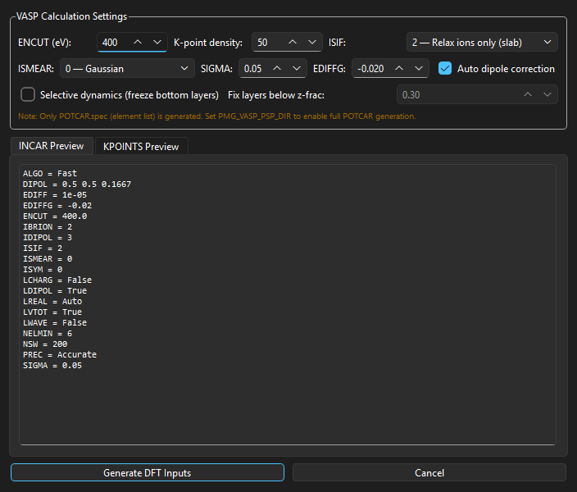
Demo: DFT Input Generation
Generated VASP Inputs
• INCAR with slab-optimized settings (ISIF=2, ISMEAR=0)
• Auto dipole correction (LDIPOL, IDIPOL=3, DIPOL from COM)
• KPOINTS with k_z = 1 for slab geometry
• POSCAR + POTCAR.spec
• SLURM job submission script
Advanced Options
• Selective dynamics: freeze bottom N layers
• Adjustable ENCUT, k-density, EDIFFG
• Live INCAR and KPOINTS preview tabs
12/12

Slide 13
Conclusions & Future Work
Conclusions
• SlabGen provides an integrated workflow from bulk crystal to DFT-ready slab models
• Systematic screening enables rapid surface exploration with symmetry classification
• Mo₂C case study: 20 terminations across 7 surfaces characterized in seconds
• Open-source, cross-platform (Python + PySide6)
Future Directions
• DFT surface energy calculations and Wulff construction
• Automated convergence testing workflows
• Adsorbate placement on generated surfaces
• Support for heterostructure interface modeling
References
[1] Ong et al., Comp. Mater. Sci. 68, 314 (2013)
[2] Jain et al., APL Mater. 1, 011002 (2013)
[3] Sun & Ceder, Surf. Sci. 617, 53 (2013)
Thank you! | Questions?
13/13

