Slide 1

TENNIS PROJECT
Nima Bayat
1404/04/30

Slide 2
Questions:
Question 2 : The Average Height of All Players
Question 5 : Sets Are Typically Played In A Tennis Match
Question 8 : Difference In The Number Of Double Faults Based On Gender
Question 11 : Average Duration Of Matches
Question 14 : Most Common Type Of Surface
Question 17 : The Average Number Of Breaks Of Serve Per Match

Slide 3
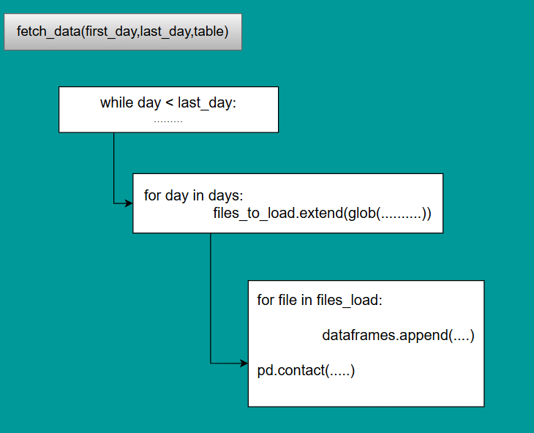
Fetch Data Function

Slide 4
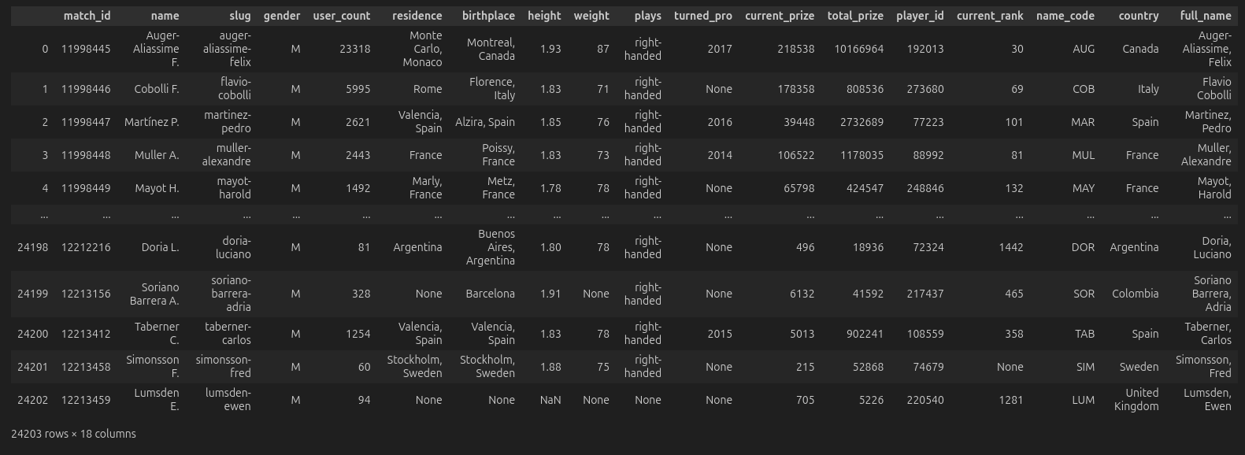
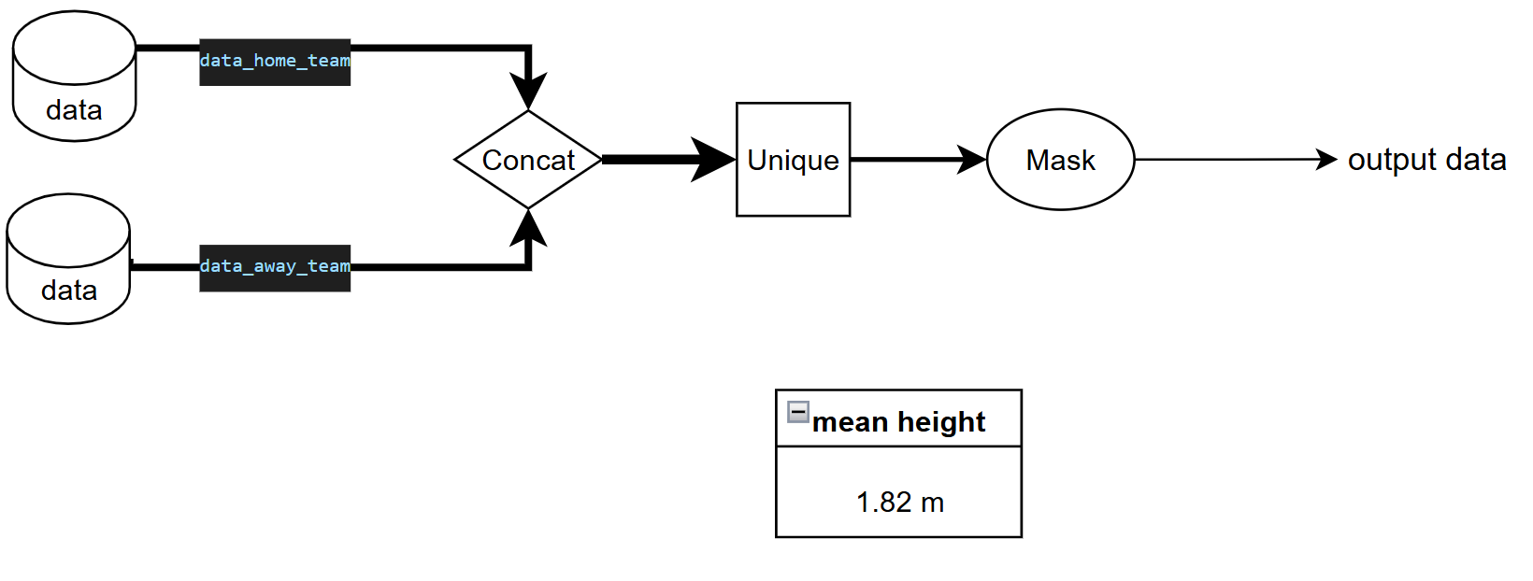
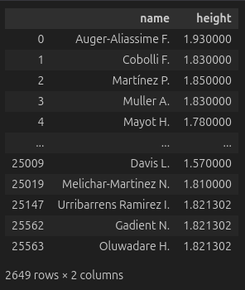
Question 2
The Average Height of All Players

Slide 5
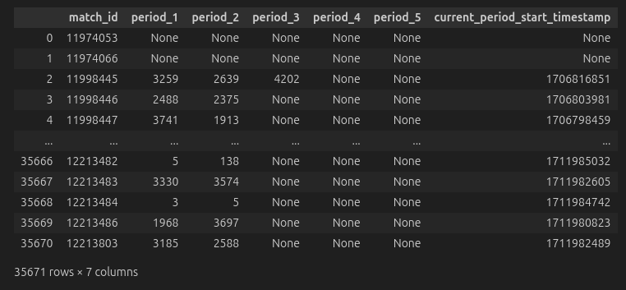
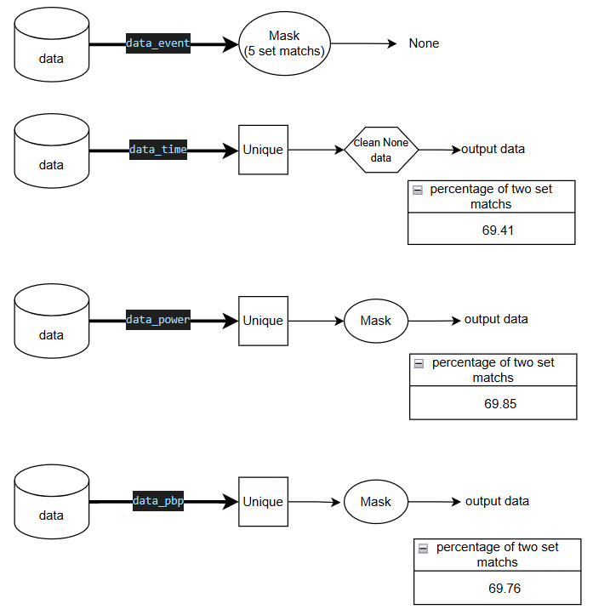
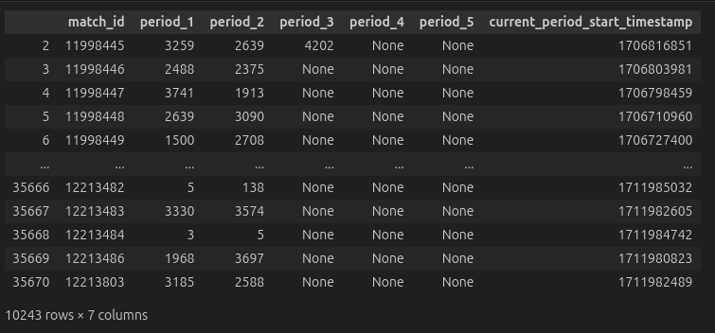
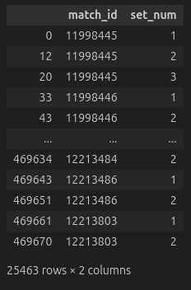
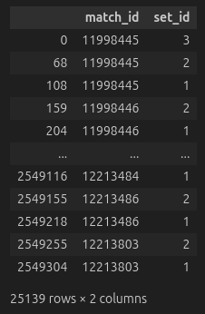
Question 5
Sets Are Typically Played In A Tennis Match

Slide 6

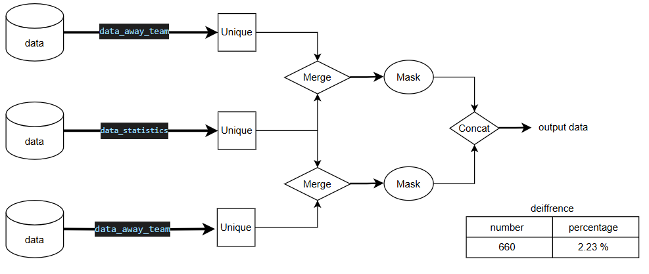
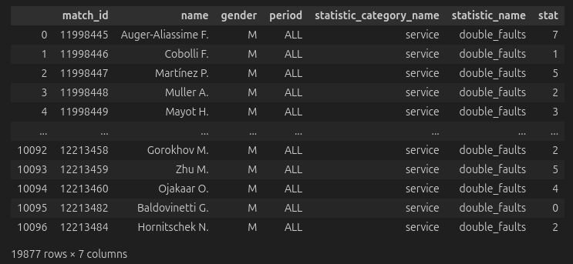

Question 8
Difference In The Number Of Double Faults Based On Gender

Slide 7
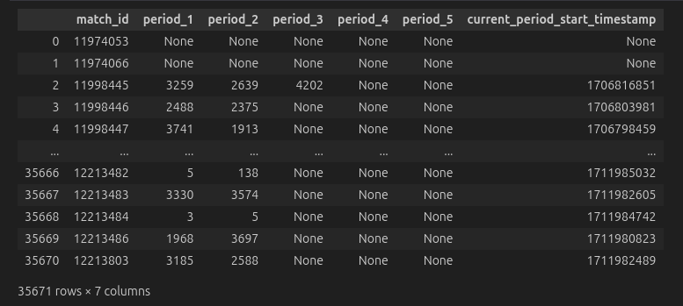
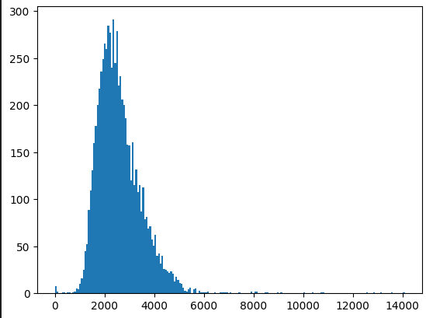

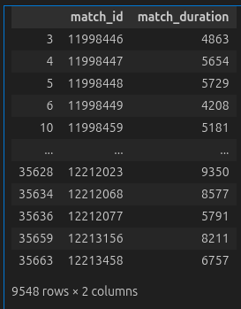
Question 11
Average Duration Of Matches

Slide 8
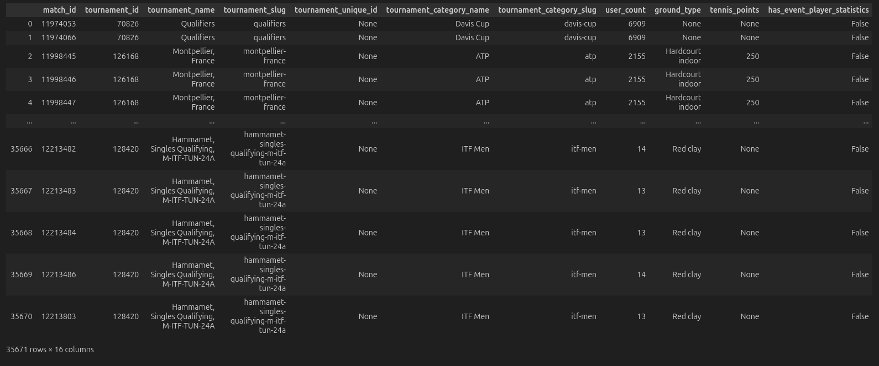
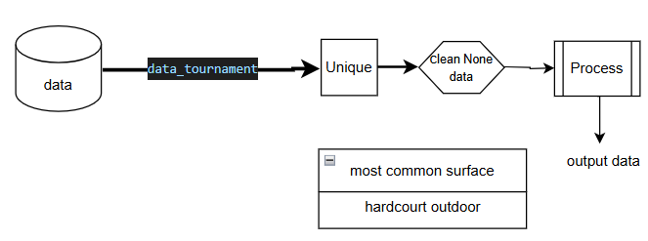
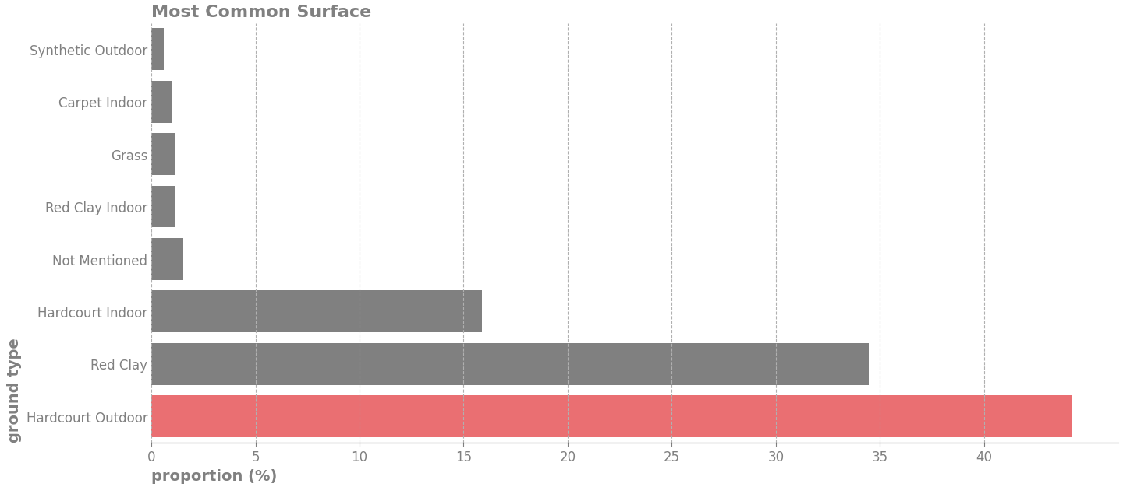
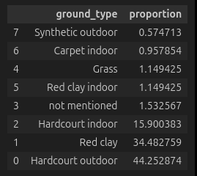
Question 14
Most Common Type Of Surface

Slide 10
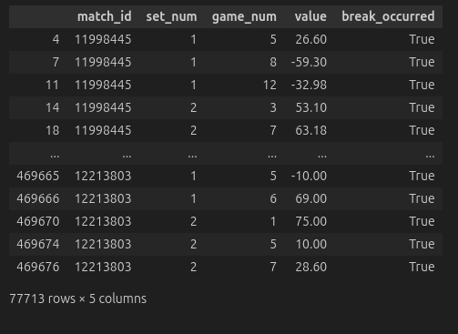
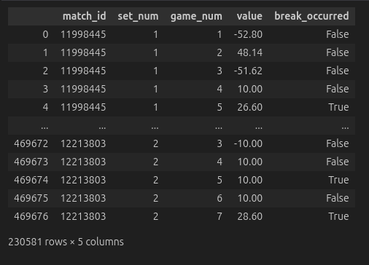
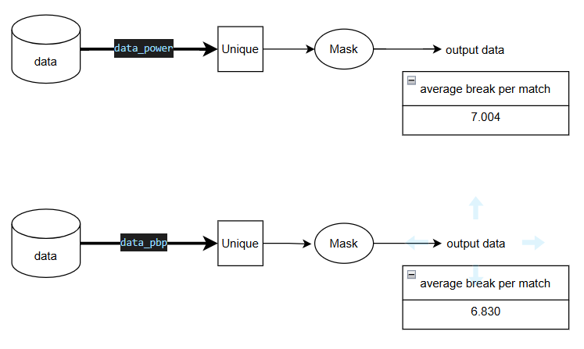
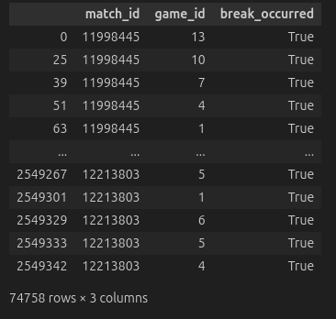

Question 17
The Average Number Of Breaks Of Serve Per Match

Slide 11
The end

