Slide 1

Virtual Veterinary
Consultation Platform
Raouf
Connecting pet owners with licensed veterinarians
— anytime, from home.
عيادة رؤوف
Holberton School
The Team
Graduation Project — 2026
👤
Shahad Fahad Alsaneea
👤
Shadan Khaled Alkharji
👤
Lina Abdulaziz Alduaylij
👤
Alanoud Mohsen Alharthi

Slide 2
Project Overview & MVP Concept
Our team explored several project ideas and evaluated them based on:
MVP Scope
Feasibility
✓ Register as pet owners or veterinarians.
Innovation
✓ Search for veterinarians.
Technical complexity
✓ Communicate through messaging or video consultations.
✓ Browse pets available for adoption.
Project timeframe
✓ Contact adoption providers directly.
Slide 2 / 10

Slide 3





Process Summary
Key stages, decisions & challenges throughout the project journey
Discovery
Planning
Development
Testing
Deployment
Brainstormed multiple project ideas.Identified real problems faced by pet owners.Evaluated ideas based on impact and feasibility.
Selected PawCare as the MVP.Defined project scope and core features.Assigned team roles and responsibilities.
Built the frontend and backend.Implemented authentication and user roles.Developed messaging, consultations, and adoption features.
Tested major functionalities.Fixed bugs and improved user experience.Verified system performance and usability.
Prepared the final MVP.Deployed the application for demonstration.Documented the project and presentation materials.
Slide 3 / 10

Slide 4
TECHNICAL ARCHITECTURE
Technical Architecture & Engineering Highlights
A Scalable, Secure, and Real-Time Full-Stack Tele-Veterinary Solution

Slide 5






FULL-STACK ARCHITECTURE OVERVIEW
The system implements a decoupled multi-tier topology separating the client interaction, asynchronous application backend, and real-time network states.
Presentation Layer (FE)
Layer Architectural Separation
Application Layer Business Logic (BE)
This architecture separates presentation, business logic, real-time communication, and data persistence layers, improving maintainability and scalability.
Data Persistence Layer
RTC & Channel Management
Reverse Proxy & Static File Server
Containerization
SLIDE 02

Slide 6


Database Architecture & Data Persistence
A robust data persistence layer was designed using PostgreSQL to manage and maintain all platform data.
Relationships between entities were carefully designed to ensure data integrity, consistency, and efficient retrieval of information across the platform.
Django ORM was utilized to map application models to database tables, simplifying data access while maintaining database abstraction and consistency.
To support production deployment, the database was hosted on Aiven, providing managed PostgreSQL services with secure access, automated maintenance, and high availability.

Slide 7







Authentication & User Management
A complete authentication and authorization system was implemented to support two distinct user roles:
Pet Owners
Veterinarians
Admin
Key functionality includes:
Secure account registration.
Email verification and account activation.
JWT-based authentication.
Role-based access control.

Slide 8
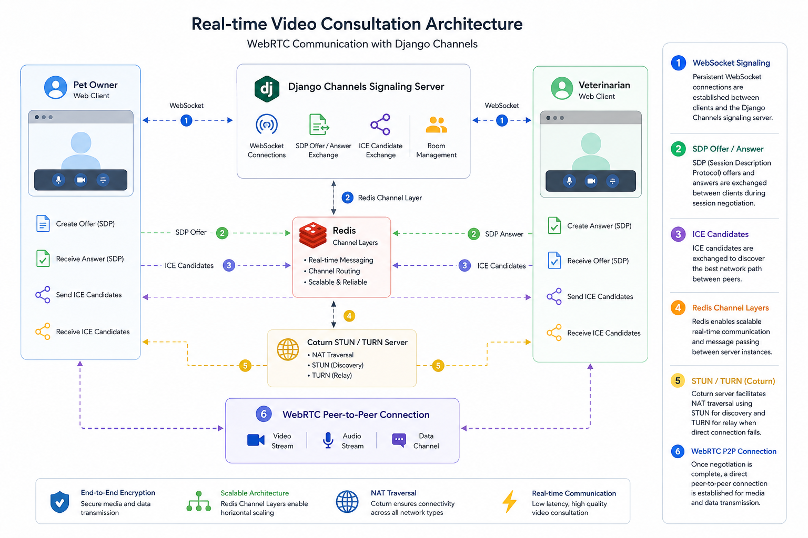

Slide 9
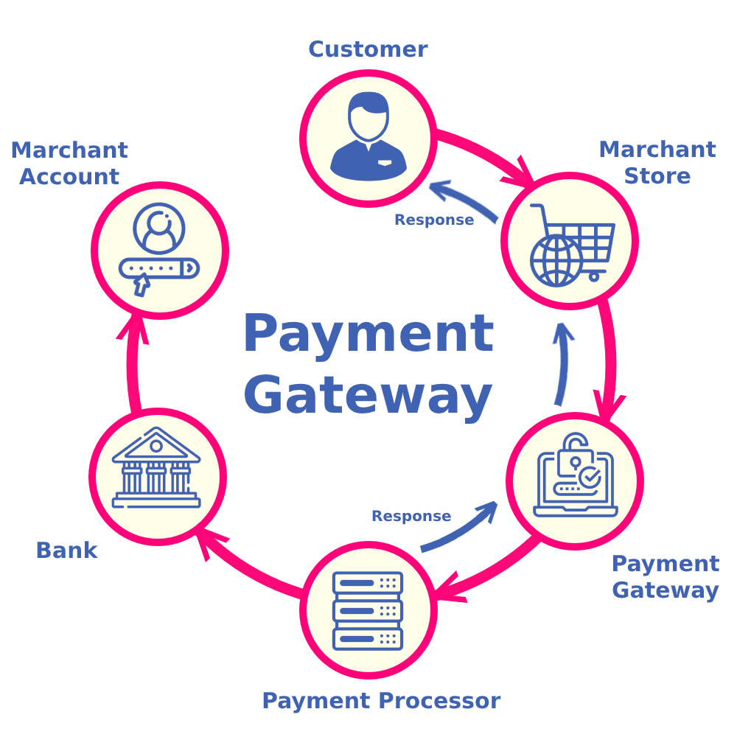

Payment Integration
The platform integrates the Moyasar Payment Gateway to support secure online transactions.
Secure payment processing.
Appointment-payment association.
Payment status verification.
Automatic booking confirmation after successful payment.

Slide 10

Email Automation System
Automated email services were integrated using Resend and Django Anymail.
Secure payment processing.
Appointment-payment association.
Payment status verification.
Automatic booking confirmation after successful payment.

Slide 11
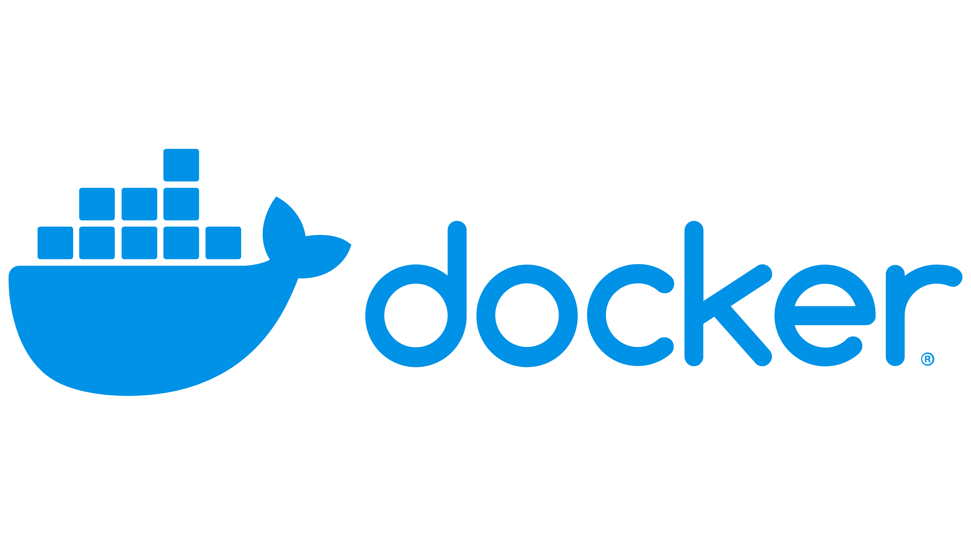
Containerization & Infrastructure Engineering
The entire application stack was containerized using Docker.
Separate containers were configured for:
Django Backend.
Nginx
RedisCoturn
TURN Server
Docker Compose orchestrates communication between services through a dedicated internal network, ensuring consistent development, testing, and deployment environments.
This approach significantly simplifies deployment and infrastructure management.

Slide 12
Testing & Quality Assurance
To improve reliability and maintain code quality, automated testing was implemented across multiple layers of the system.
Testing included:
Tools used:
Pytest-Django
Faker
Coverage
Vitest
React Testing Library
API endpoint validation.
Authentication and authorization testing.
Business logic verification.
Database interaction testing.
Frontend component testing.
User interaction testing.
End to End Testing
This testing strategy helped identify issues early and increased confidence in production readiness.

Slide 13


Deployment & Production Environment
The final production architecture supports secure communication, real-time consultations, scalable deployment, and reliable system performance.
The platform was deployed using a cloud-based architecture:
Frontend deployed on Vercel.
Backend deployed on Render.
PostgreSQL hosted on Aiven.
Nginx used for request routing and static asset delivery.
Redis used for real-time communication services.
Daphne ASGI Server used to support HTTP and WebSocket connections.

Slide 14
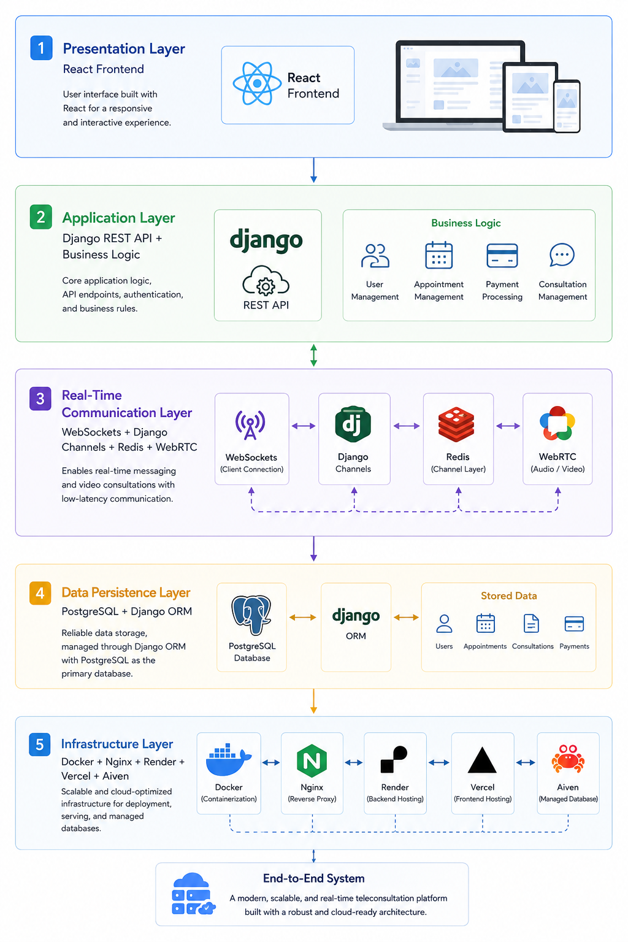
Technical Architecture Summary

Slide 15
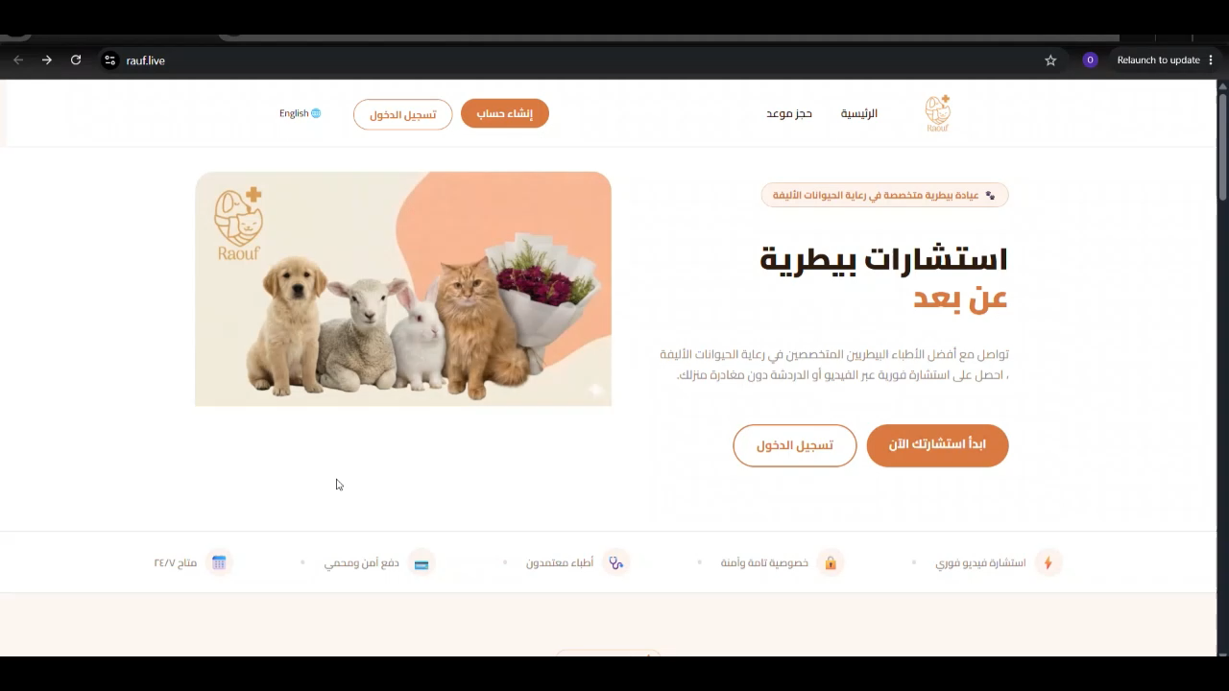
Demo
Slide 6 / 10

Slide 16
Results & Lessons Learned
5
3
100%
✓
Core MVP Features
Delivered
User Roles
Implemented
Video Calls
Functional
Live at
rauf.live
Lessons Learned
Effective Team Collaboration Clear role separation and continuous collaboration improved development efficiency and accelerated problem-solving.
Adapting to New Technologies Working with WebRTC, WebSockets, cloud services, and payment integrations strengthened our ability to learn and apply new technologies.
Building Reliable Systems Implementing secure payment processing and stable real-time communication enhanced the system's reliability and performance.
Professional Growth The project provided practical experience in full-stack development, deployment, testing, and delivering a production-ready application.
Slide 9 / 10

Slide 17
Virtual Veterinary Consultation — Built for the Arab World
Next Steps
→ Store Section
→ Launch iOS & Android mobile apps
Thank You · Holberton School · Graduation Project 2026

