Slide 1
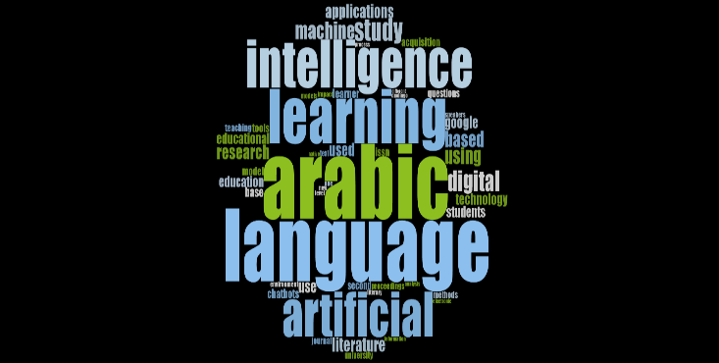
PSAU
Home
About
Content
Others
Page 01
ARABIC SENTIMENT
ANALYSIS
Using AraBERT and SVM
Supervised by: Dr. Sonia Hashish
Alshikah Alqahtani • Shahad Almubki • Shahad Alzoman
Department of Data Sciences • PSAU • 2026
Prince Sattam bin Abdulaziz University
Text Mining IS 0661 • 2026

Slide 2

PSAU
Home
About
Content
Others
Page 02
INTRODUCTION & PROBLEM
Why Arabic Sentiment Analysis?
Positive
Arabic is one of the fastest-growing languages online
Millions of reviews in hotels, books & products
Morphological complexity & multiple dialects
Critical need for automated opinion mining
Negative
Mixed
Task: Classify Arabic text into 3 categories
Prince Sattam bin Abdulaziz University
Text Mining IS 0661 • 2026

Slide 3
PSAU
Home
About
Content
Others
Page 03
DATASET & PREPROCESSING
99,999
33,333
100%
Arabic Reviews
Per Category
Balanced
Preprocessing Steps:
Before → After
1. Diacritics Removal (كَتَبَ → كتب)
Before | After
الفندقْ رائعًُ جداً 10/10 | الفندق رائع
الكتابْ لم يُعجبني إطلاقاَ :( | الكتاب يعجبني اطلاقا
2. Hamza Normalization (أ ا إ → ا)
3. Cleaning (links, numbers, emojis)
4. Tokenization
5. Stopword Removal (NLTK Arabic)
Prince Sattam bin Abdulaziz University
Text Mining IS 0661 • 2026

Slide 4
PSAU
Home
About
Content
Others
Page 04
MODELS & ARCHITECTURE
SVM — Baseline
AraBERT — Main Model
TF-IDF Vectorizer (10,000 features)
LinearSVC — Linear kernel, C=1.0
Trained on full dataset (80K samples)
Fast & computationally lightweight
bert-base-arabertv02
Pre-trained on 23GB Arabic text
Epochs:3 LR:2e-5 Batch:16
Fine-tuned on 2,000 samples*
VS
Classical ML Approach
*GPU limitation
Prince Sattam bin Abdulaziz University
Text Mining IS 0661 • 2026

Slide 5
PSAU
Home
About
Content
Others
Page 02
TOOLS & LIBRARIES
Data Processing: pandas -> data loading & manipulation, numpy -> numerical operations
Arabic NLP: pyarabic -> diacritics removal & hamza normalization, nltk -> Arabic stopword removal
Models: scikit-learn -> SVM, TF-IDF,evaluation metrics. Transformers-> AraBERT loading & fine-tuning, torch (PyTorch) -> model training & GPU support
Visualization: matplotlib -> bar charts & comparisons, seaborn -> confusion matrix heatmaps
Task: Classify Arabic text into 3 categories
Prince Sattam bin Abdulaziz University
Text Mining IS 0661 • 2026

Slide 6
PSAU
Home
About
Content
Others
Page 05
QUANTITATIVE RESULTS
Model | Accuracy | Precision | Recall | F1-Score
SVM (Baseline) | 63.4% | 0.63 | 0.63 | 0.63
AraBERT (Main) | 62.4% | 0.68 | 0.62 | 0.63
F1-Score per Category:
Model | Negative | Positive | Mixed
SVM | 0.69 | 0.68 | 0.54
AraBERT | 0.60 | 0.72 | 0.57
Prince Sattam bin Abdulaziz University
Text Mining IS 0661 • 2026

Slide 7
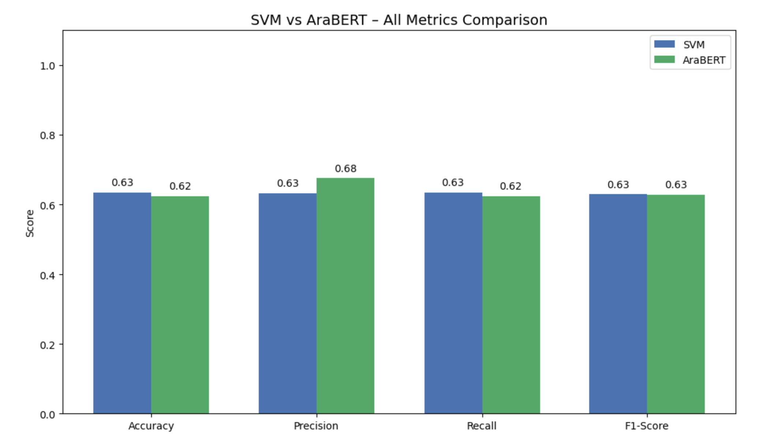
PSAU
Home
About
Content
Others
Page 06
PERFORMANCE COMPARISON
Prince Sattam bin Abdulaziz University
Text Mining IS 0661 • 2026

Slide 8
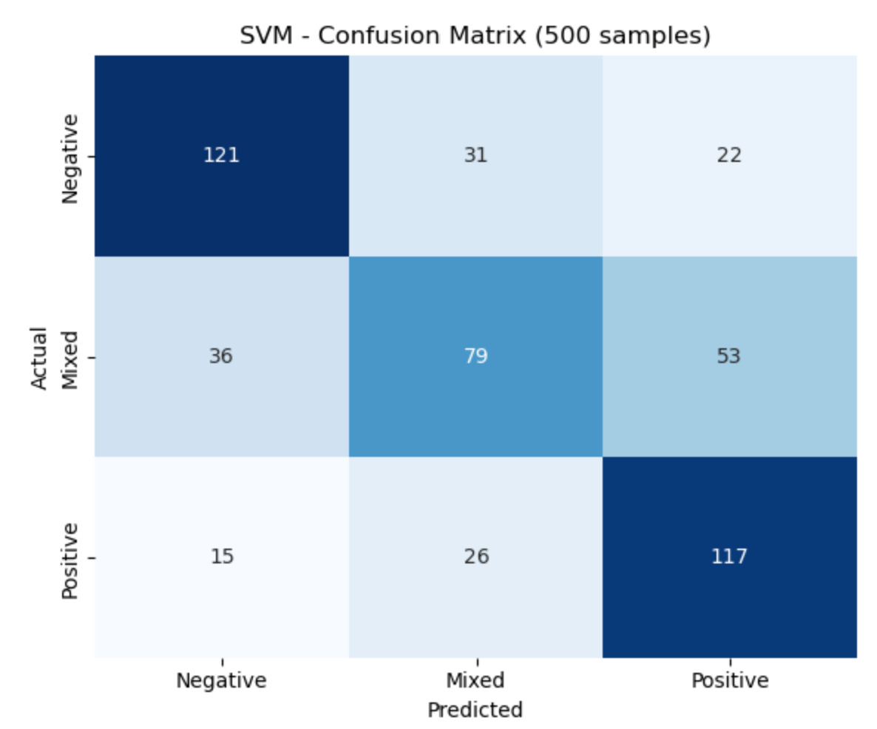
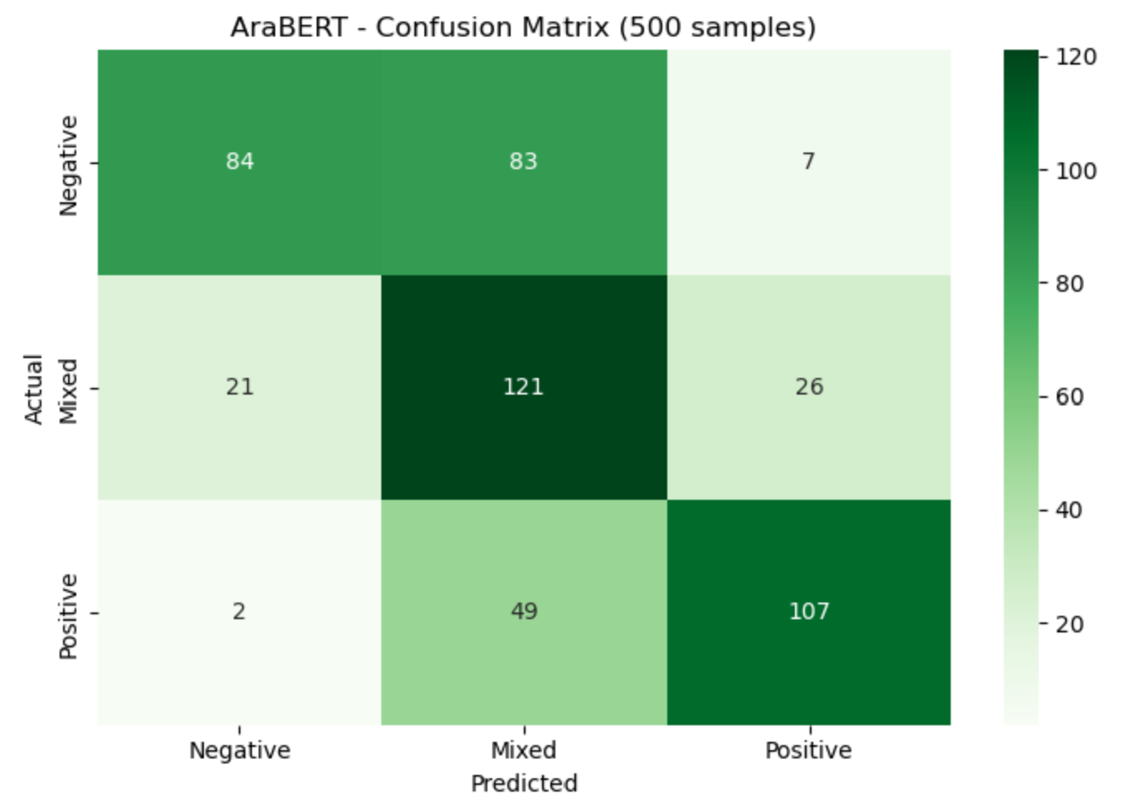
PSAU
Home
About
Content
Others
Page 07
CONFUSION MATRIX ANALYSIS
SVM
AraBERT
Add screenshot:
arabert_confusion_matrix.png
Both models show highest misclassification in the Mixed category
Prince Sattam bin Abdulaziz University
Text Mining IS 0661 • 2026

Slide 9
PSAU
Home
About
Content
Others
Pag 08
ERROR ANALYSIS
500
36.6%
37.6%
Mixed
Shared Test Samples
SVM Error Rate
AraBERT Error Rate
Hardest Category
Root Causes of Errors:
Mixed texts contain contradictory keywords — models detect only one sentiment
Colloquial Arabic varies significantly from Modern Standard Arabic
AraBERT fine-tuned on limited data (2,000 samples) due to GPU constraints
Sarcasm and implicit sentiment are difficult to detect
"The room is clean, but the service is terrible" → Model predicts: Negative
Prince Sattam bin Abdulaziz University
Text Mining IS 0661 • 2026

Slide 10
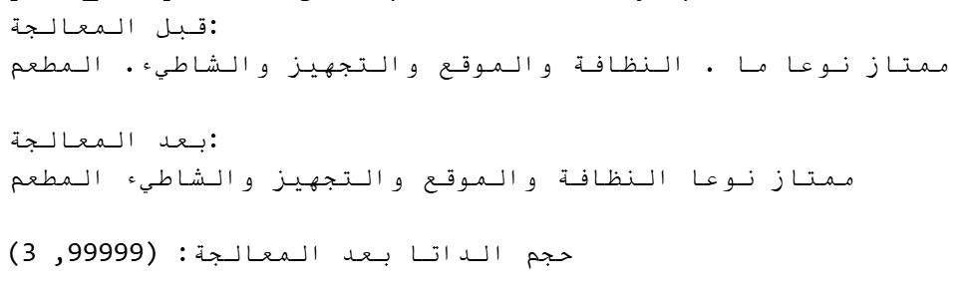
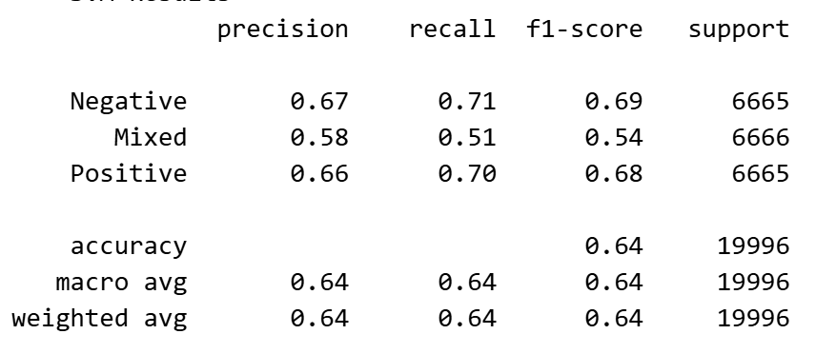
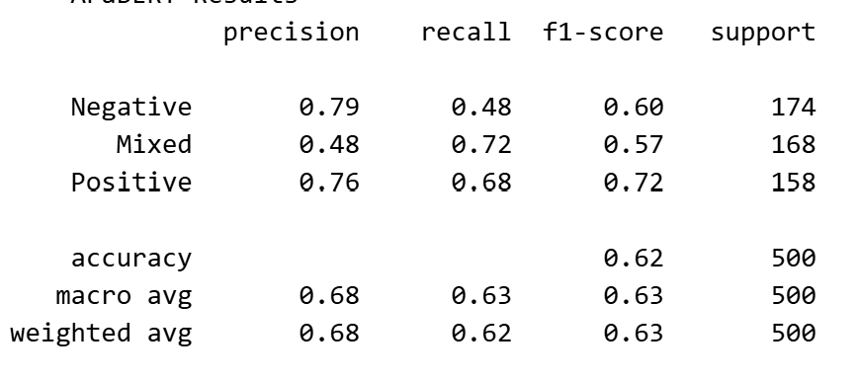
PSAU
Home
About
Content
Others
Page 09
DEMO — LIVE CODE OUTPUT
01
Preprocessing Output
02
SVM Classification Report
03
AraBERT Results
Prince Sattam bin Abdulaziz University
Text Mining IS 0661 • 2026

Slide 11
PSAU
Home
About
Content
Others
Page 10
CONCLUSION &
FUTURE WORK
Key Findings:
AraBERT achieves higher Precision (0.68 vs 0.63)
Mixed category is hardest for both models
SVM is faster & cost-effective for simple tasks
Full GPU training expected to boost AraBERT significantly
Future Work:
Data augmentation • AraELECTRA / Gemma-Arabic • Sentiment lexicons
Thank You • شكراً جزيلاً • Questions?

Slide 12
PSAU
Page 10
Thank you

