Slide 1
KNOW YOUR FAMILY
& Get Set Up
True Nation Israelite Congregation · Staff Orientation

Slide 2
WHO WE ARE
OUR MISSION
OUR 5 CAMPUSES
A covenant community grounded in truth — building families and raising righteous generations across the globe.
Los Angeles, CA
Headquarters — Bishop Tazayawan
Detroit, MI
Satellite — Bishop Yahzeqel
Macon, GA
Satellite — Bishop Yahzeqel
4
5
7
Philippines
International — Bishop Banayah (liaison)
Branches
Campuses
Cities
Ghana
International — Bishop Izar (liaison)
Every campus is united under one covenant — one truth, one family.

Slide 3
HOW WE'RE ORGANIZED
BISHOPS
APOSTLES
DEACONS
JUDGES
Governance
& Oversight
Doctrine
& Teaching
Administration
& Resources
Righteousness
& Counsel
★ COUNCIL = Bishops + Apostles (not a separate branch)
Every member belongs to one or more departments within a branch.

Slide 4
BISHOPS BRANCH
Governance & Oversight
Bishop Tazayawan
Bishop Yahzeqel
Los Angeles, CA
Detroit, MI · Macon, GA
Headquarters
Satellite Campuses
Bishop Banayah
Bishop Izar
Philippines
Ghana
International Liaison
International Liaison + Maintenance Lead
Joint Committee with Apostles: SCICA Summit — Leads: Bishop Tazayawan + Apostle Yashami

Slide 5
APOSTLES BRANCH
Doctrine & Teaching
Apostles: Ash Napash · Yashami
DISCIPLES
MARKETING
PRODUCTION
Lead: Ash Napash, Yashami
Lead: TBD
Lead: Yashami
No sub-groups
Graphic Design · Social Media
Sound · Videography · Photography · Camera & Lights · A/V · Stage Production · Art · PARADOX (team)
PUBLICATION
YOUTH DEVELOPMENT
Lead: Shamar
Lead: Tazayawan
Quarterly Brew · Newsletter
T.E.L.A. · Jr Disciples · Little Lions · Maiden Ewe Academy · Naqam Fresh · Naqam Varsity

Slide 6
DEACONS BRANCH
Administration & Resources
Deacons: Kahan · Kabash · Kanash · Ahman · Rakab · Shamar
CBD (Community Building)
Clerical
Custodial
E.R.T.
Lead: Multiple leads
Lead: Kabash
Lead: Kawan
Lead: Kanash
Fellowship & Service
Finance
Holistic Health & Healing
IT
Lead: Kahan
Lead: Marayam
Lead: TBD
Lead: Shahad
Maintenance
Performing Arts
Security
Textiles & Attire
Lead: Rakab
Lead: Kabash
Lead: Ahman
Lead: Kanash

Slide 7
JUDGES BRANCH
Righteousness & Counsel
COUNSELING
MINISTRIES
Leads: Tazayawan + Yashami
Oversight: Bishops + Apostles
Members:
Sanhedrin — Committee
· Tazayawan
· Yahzeqel
Elders Ministry — BanaYah / Apostles
· BanaYah
Prayer Ministry — BanaYah / Apostles
· Izar
· Ash Napash
Prison Ministry — BanaYah / Apostles
· Yashami
SOV — Sword of the Word — Marayam, asst Qawalyah

Slide 8
PART 2
YOUR PROFILE SETUP
Complete your intranet profile to connect
with your community — it takes about 5 minutes.

Slide 9
WHAT IS YOUR PROFILE?
YOUR PROFILE IS:
BEFORE YOU START:
Your identity card on the True Nation intranet
Your @truenation.org email
(sign in first)
Tied to your @truenation.org account
A photo of yourself
(for your profile picture)
Visible to leadership and staff in the directory
Emergency contact info
(name + phone number)
How we connect you to the right teams and events
About 5 minutes
(that's all it takes)

Slide 10
PROFILE SETUP · STEPS 1–3
1
2
3
Legal & Hebrew Name
Gender & Location
Emergency Contact
Enter your full legal first and last name, plus your Hebrew name if you have one.
Select your gender and your home campus / location.
Add a secondary emergency contact — their name and phone number.
Steps 1 – 3 of 6

Slide 11
PROFILE SETUP · STEPS 4–6
4
5
6
Skills & Ministries
Family Members
Profile Photo
Tap to select your skills and the ministry areas that interest you. Choose as many as apply.
Add names of family members who also attend True Nation.
Upload a clear photo of yourself — this will appear in the staff directory.
Steps 4 – 6 of 6

Slide 12
AFTER YOU SUBMIT
Here's what happens automatically:
01
Profile Saved
Your information is written to the True Nation staff directory instantly.
02
Admin Notified
The IT team receives an automatic notification that your profile is complete.
03
You're in the Directory
Your name and profile appear for leadership and staff to find you in the intranet.
Questions? Contact IT — Shahad (IT Lead)

Slide 13
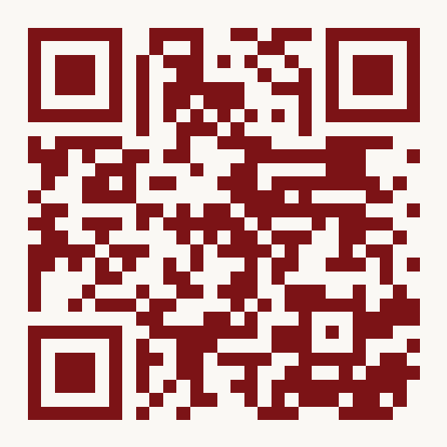
QUESTIONS?
Scan to complete your profile:
truenation.vercel.app/setup
Contact IT for help:
Shahad — IT Department Lead

