Slide 1

Assessment Management System
AMS
REVIEW 1 PRESENTATION
Shahad Aziz Al-hadhrami | Aya Said Al-raqumi | Shahad Hamed Al-brumi
Supervisor: Dr. Narayanasamy Rajendran
Department of Information Technology | Cyber Security Specialization

Slide 2
Agenda
01
Problem Statement & Objectives
3 min
02
System Overview & Architecture
5 min
03
Security Focus
4 min
04
Development Progress
5 min
05
Live Screenshots & Demo
8 min
06
Next Steps & Q/A
5 min
Total: ~30 minutes

Slide 3

Problem Statement
Current Challenges
Manual assessment processes across different reviewers and supervisors
Our Solution: AMS
Delays, errors, and inconsistencies in grade consolidation
A secure, centralized web-based system for managing and consolidating course project assessment marks with role-based access, multi-factor authentication, and full audit logging.
Potential data breaches with unsecured mark handling
No centralized platform for multi-phase project evaluations
Difficulty tracking assessment progress across semesters
Security-First Approach
Built by Cyber Security students

Slide 4






Project Objectives
Secure Authentication
Flexible Assessment Workflow
Multi-Role Access
Implement login with MFA, password policies, and brute-force protection via Fail2Ban
Support configurable evaluation phases with customizable rubric templates and scoring
Five distinct roles: Super Admin, Coordinator, Supervisor, Reviewer, and Student
Grade Consolidation
Audit & Compliance
Reports & Export
Auto-calculate final marks using configurable aggregation methods (Average, Sum, Max)
Full activity logging for every mark change, unlock, override, and proxy entry
Generate PDF reports and CSV/Excel exports for external Student Information Systems

Slide 5
System Architecture & Tech Stack
Admin Panel
Staff Panel
Student Panel
/admin
/staff
/student
Super Admin, Coordinator
Supervisor, Reviewer
Student (read-only)
15 screens
5 screens
2 screens
Technology Stack
Backend
Laravel 12
Audit Log
Spatie Activitylog v4
Admin UI
FilamentPHP v5
Database
MySQL 8.x
Auth
Laravel Fortify + MFA
Styling
Tailwind CSS v4
RBAC
Spatie Permission v7
PDF
Laravel DomPDF

Slide 6





Security Architecture
Cyber Security is our core focus
Multi-Factor Auth
RBAC
Password Policies
TOTP-based MFA via Laravel Fortify for all user accounts
5 roles with strict panel isolation using Spatie Permission
Leaked password detection via Laravel Pwned Passwords
Intrusion Detection
Audit Logging
Data Integrity
Fail2Ban integration for brute-force login protection
Every mark change, unlock, and override is fully logged
Soft deletes, encrypted transit, and immutable submission locks

Slide 7
System Data Flow
1.0
2.0
3.0
Manage Master Data
▶
Build Workflow Rules
▶
Configure Semester
Users, Departments, Courses, Grading Scales
Rubric Templates, Criteria, Phase Templates
Semesters, Projects, Group Assignments
▼
4.0
5.0
6.0
Process Assessments
▶
Consolidate Grades
▶
Reports & Export
Dynamic Rubric Forms, Draft/Submit, Proxy Marking
Auto-calculation, Aggregation, Overrides
Dashboards, PDF Reports, CSV/Excel Export

Slide 8
Database Architecture
Domain 1
5 tables
Domain 2
5 tables
Users & Master Data
Template Pool
users, departments, specializations, courses, grading_scales
rubric_templates, criteria, score_levels, phase_templates, phase_rubric_rules
Domain 3
5 tables
Domain 4
4 tables
Academic Sandbox
Execution & Scoring
semesters, projects, project_student, project_reviewer, coordinator_semester
evaluations, evaluation_scores, consolidated_marks, consolidated_mark_components
16 Tables | 4 Domains | 82 Functional Requirements

Slide 9

Development Progress
Completed Modules
20+
Dashboard with real-time widgets and charts
Screens Implemented
Bulk Import (Users, Projects, Rubrics via CSV)
Admin + Staff + Student
Departments and Specializations management
Courses management
Grade Scaling configuration
82
9
User Management with role assignment
Rubric Templates with criteria and score levels
Requirements
Widgets
Student Panel (complete)
Reviewer Panel (complete)
5
16
Supervisor Panel (complete)
User Roles
DB Tables

Slide 10
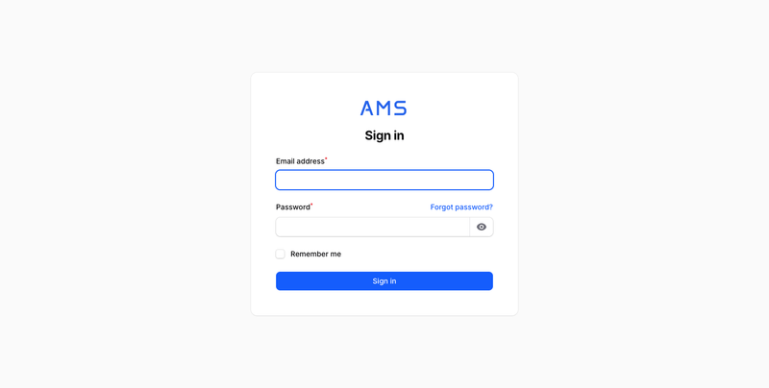
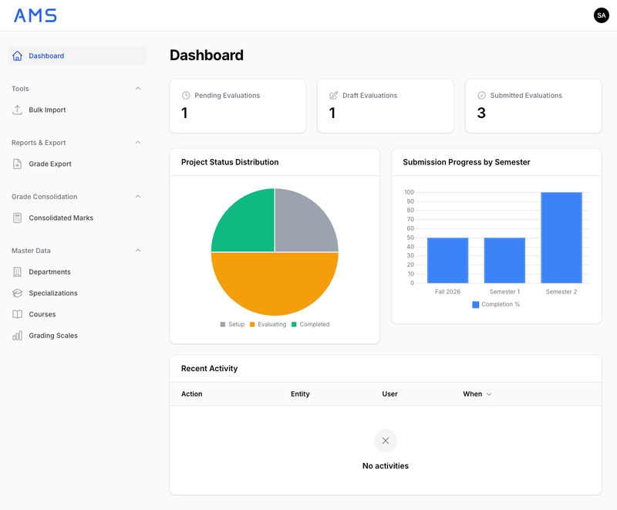
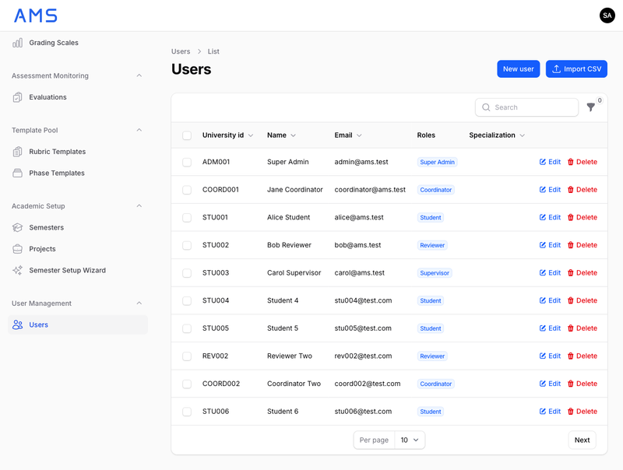
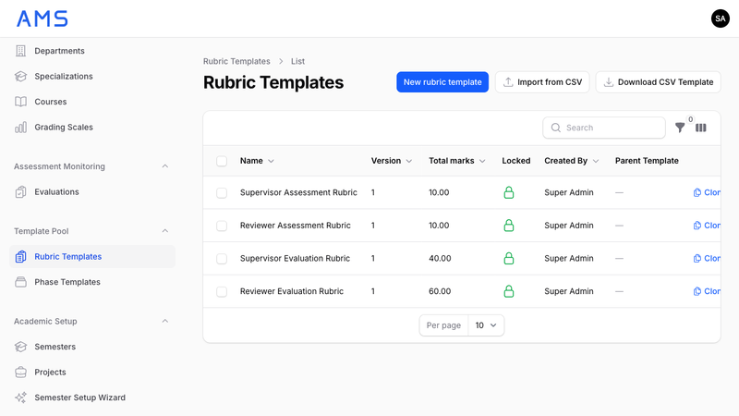
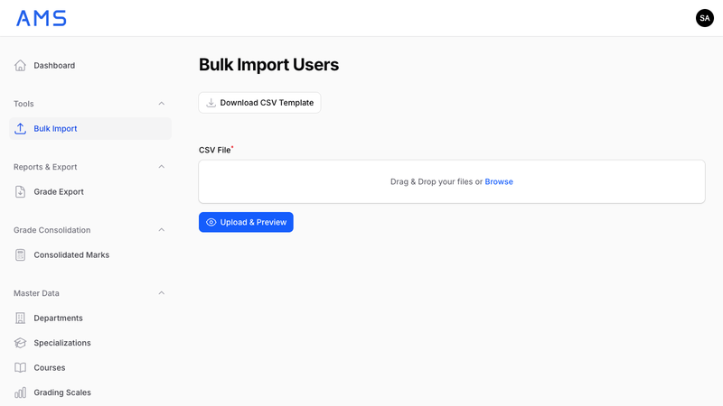
Admin Panel
Super Admin & Coordinator View
Secure Login with MFA
Admin Dashboard
User Management
Rubric Templates
Bulk Import

Slide 11
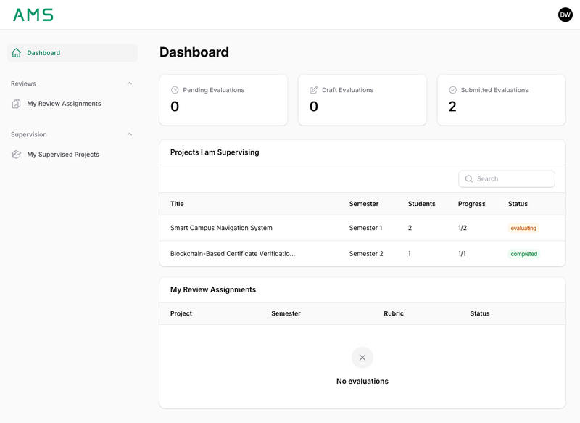

Staff Panel
Supervisor & Reviewer View
Dual-Role Dashboard
Key Features
Separate supervision and review sections
Dynamic evaluation form with rubric rendering
Group and individual scoring within same rubric
Save as draft or submit with confirmation
Project detail view with team and progress
Fill order enforcement per evaluator

Slide 12
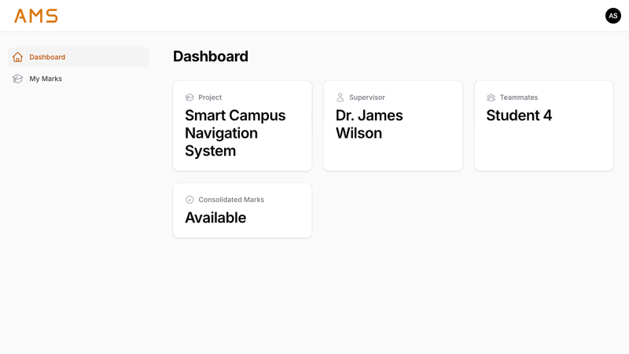
Student Panel
Read-Only Student View
Student Dashboard
Student Features
View project info and teammates
See supervisor name and course details
View internal marks (supervisor)
View consolidated final marks
See letter grade and GPA
All data is strictly read-only
Reviewer identities stay anonymous
Students can only see their own internal marks and consolidated results. Reviewer identities remain anonymous.

Slide 13
Team Contributions
S
A
S
Shahad Aziz
Al-hadhrami
Aya Said
Al-raqumi
Shahad Hamed
Al-brumi
System documentation and design
Backend development (Laravel)
Frontend design and styling
Database schema and DFD design
FilamentPHP panel development
Student panel development
UI/UX testing and feedback
Security implementation (MFA)
Grade consolidation logic
Rubric template management
Assessment execution engine
Testing and quality assurance

Slide 14
Next Steps
Security Hardening
01
Performance Optimization
02
Penetration testing, vulnerability assessment, and security audit of the entire system
Load testing, query optimization, and caching strategy implementation
User Acceptance Testing
03
Deployment & Documentation
04
Testing with real supervisors, reviewers, and coordinators for feedback
Production deployment setup, user manual, and admin documentation

Slide 15
Thank You
Questions & Discussion
Shahad Aziz | Aya Said | Shahad Hamed
Supervisor: Dr. Narayanasamy Rajendran
Assessment Management System | Review 1 | Department of Information Technology

