Slide 1

Assessment Management System
AMS
REVIEW 1 PRESENTATION
Shahad Aziz Al-hadhrami | Aya Said Al-raqumi | Shahad Hamed Al-brumi
Supervisor: Dr. Narayanasamy Rajendran
Department of Information Technology | Cyber Security Specialization

Slide 2

Problem Statement
Current Challenges
Marks are recorded in different files — prone to errors and missing data
Our Solution: AMS
Grade calculations are done manually, causing delays
A secure and centralized web-based system for managing and consolidating course project assessments.
Designed to simplify the entire process with role-based access for students, staff (reviewers & supervisors), and coordinators.
Sensitive academic data may not be fully protected
No centralized platform for multi-phase project evaluations
No audit trail for who entered or changed a mark
Enforces Confidentiality, Integrity & Availability
Built by Cyber Security students

Slide 3






Project Objectives
Secure Login
Multi-Phase Mark Entry
Auto-Consolidation
Create secure login interfaces for all assessors, with MFA and brute-force protection.
Enable entry of marks for Proposal, First Review, Second Review, and Final Review.
Consolidate all assessment marks automatically using configurable aggregation methods.
CIA Principles
Secure Audit Reports
Coordinator Control
Enforce Confidentiality, Integrity, and Availability throughout system architecture and data handling.
Generate secure, auditable reports for academic records with full activity logging.
Enable coordinators to manage semesters, projects, proxy entry, and final grade oversight.

Slide 4
System Architecture & Tech Stack
Admin Panel
Staff Panel
Student Panel
/admin
/staff
/student
Super Admin, Coordinator
Supervisor, Reviewer
Student (read-only)
15 screens
5 screens
2 screens
Technology Stack
Backend
Laravel 12
Audit Log
Spatie Activitylog v4
Admin UI
FilamentPHP v5
Database
MySQL 8.x
Auth
Laravel Fortify + MFA
Styling
Tailwind CSS v4
RBAC
Spatie Permission v7
PDF
Laravel DomPDF

Slide 5






Security Architecture
Cyber Security is our core focus
Multi-Factor Auth (MFA)
Role-Based Access (RBAC)
AES-256 — Data at Rest
TOTP-based MFA via Laravel Fortify for all user accounts — reduces unauthorized access
5 isolated roles with strict panel separation (Admin, Staff, Student) via Spatie Permission
Symmetric AES-256 encryption for all database data. Faster processing with lower overhead than asymmetric
TLS 1.3 + HTTPS — In Transit
bcrypt Password Hashing
Intrusion Detection & Audit
All data in transit encrypted via TLS 1.3 over HTTPS — prevents Man-in-the-Middle (MITM) attacks
All passwords hashed using bcrypt with adaptive cost factor — resistant to brute-force attacks
Fail2Ban for brute-force protection. Full activity logging for every mark change, unlock, and override

Slide 6
Database Architecture
Domain 1
5 tables
Domain 2
5 tables
Users & Master Data
Template Pool
users, departments, specializations, courses, grading_scales
rubric_templates, criteria, score_levels, phase_templates, phase_rubric_rules
Domain 3
5 tables
Domain 4
4 tables
Academic Sandbox
Execution & Scoring
semesters, projects, project_student, project_reviewer, coordinator_semester
evaluations, evaluation_scores, consolidated_marks, consolidated_mark_components
16 Tables | 4 Domains | 82 Functional Requirements

Slide 7

Development Progress
Completed Modules
20+
Screens
Admin + Staff + Student
Dashboard with real-time widgets and charts
Bulk Import (Users, Projects, Rubrics via CSV)
82
Requirements
Departments and Specializations management
Functional
Courses management
Grade Scaling configuration
5
User Roles
User Management with role assignment
RBAC enforced
Rubric Templates with criteria and score levels
Student Panel — fully developed
16
DB Tables
Reviewer Panel — fully developed
4 Domains
Supervisor Panel — fully developed

Slide 8
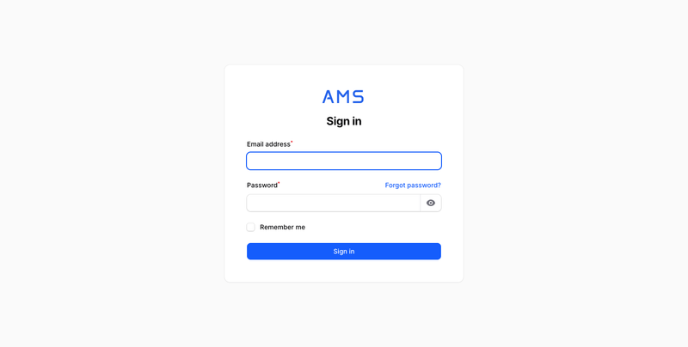
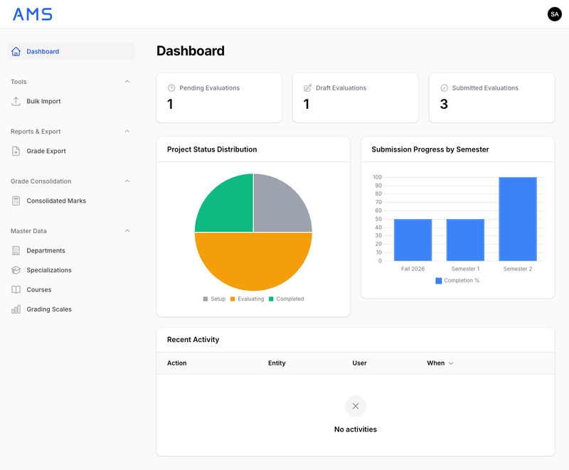
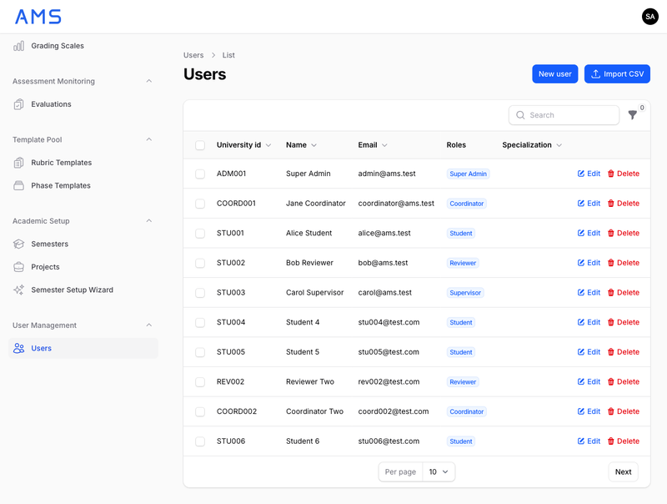
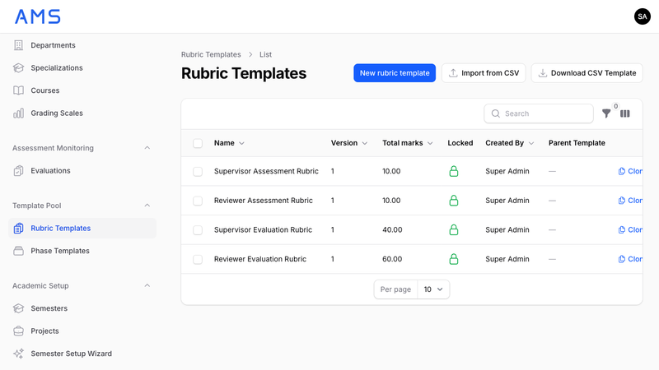
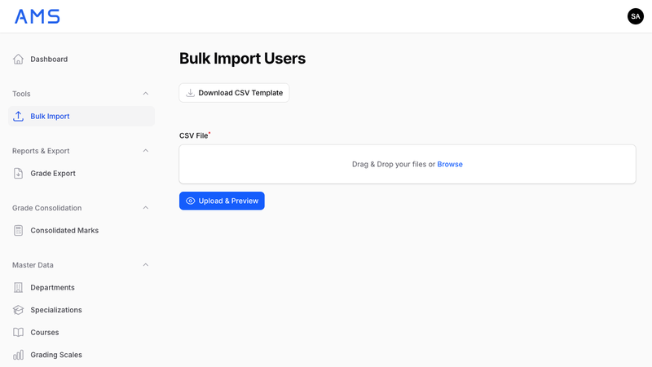
Admin Panel
Super Admin & Coordinator View
Secure Login + MFA
Admin Dashboard
User Management
Rubric Templates
Bulk Import

Slide 9
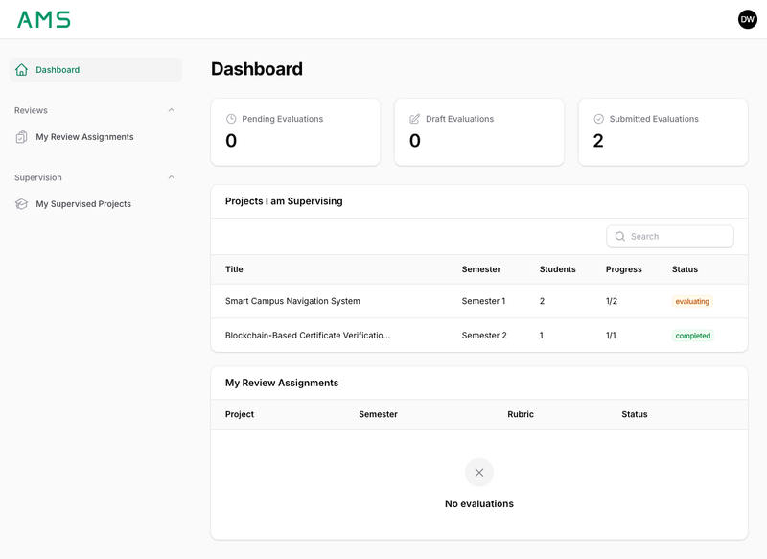

Staff Panel
Supervisor & Reviewer View
Dual-Role Dashboard
Key Features
Separate supervision and review sections
Dynamic evaluation form with rubric rendering
Group and individual scoring in same rubric
Save as draft or submit with confirmation
Project detail view with team and progress
Fill order enforcement per evaluator

Slide 10
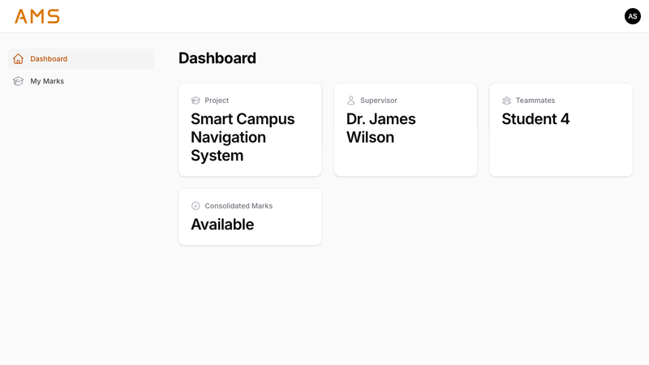
Student Panel
Read-Only Student View
Student Dashboard
Student Features
View project info and teammates
See supervisor name and course
View internal marks (supervisor)
View consolidated final marks
See letter grade and GPA
All data is strictly read-only
Reviewer identities stay anonymous
Students see only their own marks. Reviewer identities remain anonymous throughout the process.

Slide 11

Next Steps
Security Hardening
01
Performance Optimization
02
Penetration testing, vulnerability assessment, and security audit of the entire system
Load testing, query optimization, and caching strategy implementation
User Acceptance Testing
03
Deployment & Documentation
04
Testing with real supervisors, reviewers, and coordinators for feedback
Production deployment setup, user manual, and admin documentation

Slide 12
Conclusion
Our project provides a secure and centralized solution for managing course project assessments in universities. It improves accuracy, saves time, and ensures data security through well-designed features and access control.
We believe this system can make the assessment process more efficient and reliable for all users.
Accuracy
Security
Efficiency
Automated consolidation eliminates manual calculation errors
AES-256, TLS 1.3, MFA, RBAC, and full audit trail
Centralized system accessible to all stakeholders

Slide 13
Thank You
Questions & Discussion
Shahad Aziz | Aya Said | Shahad Hamed
Supervisor: Dr. Narayanasamy Rajendran
Assessment Management System | Review 1 | Department of Information Technology

