Slide 1
Section 14.4
Gradients and the Directional Derivatives in the Plane

Slide 2
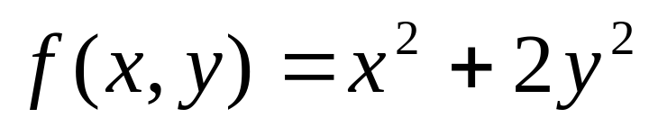
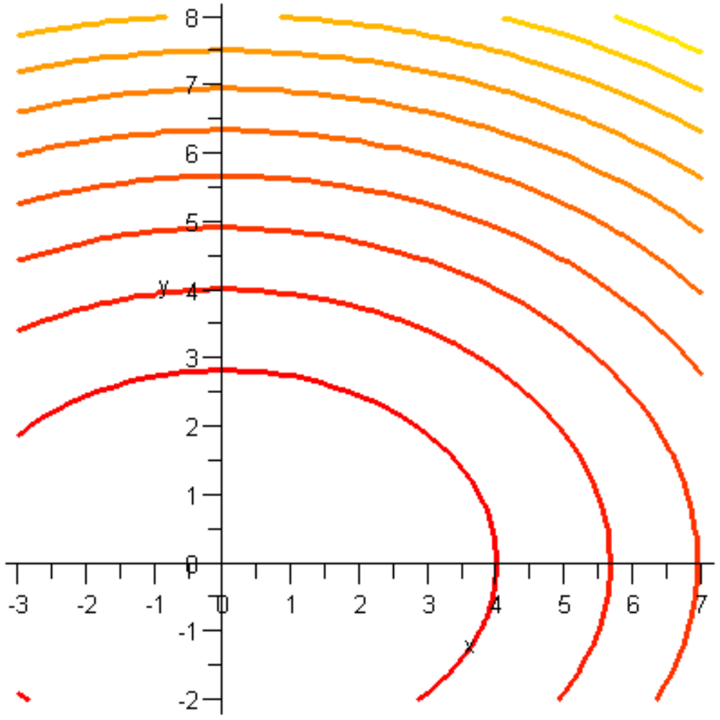
The following is a contour plot of the function

Slide 3
In the last couple sections we were focused on determining the rate of change in the direction of x and the direction of y
There are an infinite amount of directions for which we can find a rate of change (at a given point)
On the handout you were asked to do this by estimation using a contour plot
We are going to learn how to do this analytically and how Maple can help us with our calculations

Slide 4

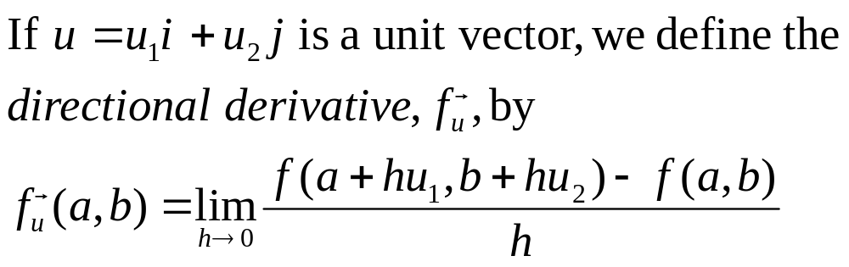
Directional Derivative of f at (a,b) in the Direction of a Unit Vector
This gives us the rate of change of f in the direction of at (a,b)
Let’s take a look at how we can calculate this analytically

Slide 5
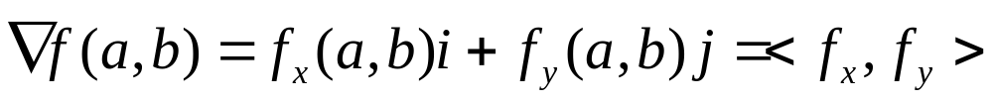
The Gradient Vector
The Gradient Vector of a differentiable function f at the point (a,b) is
Notice the gradient is a vector whose components are made up of the partial derivatives of the given function
We can find gradients for functions of more than two variables

Slide 6
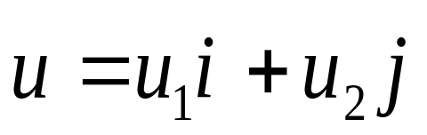
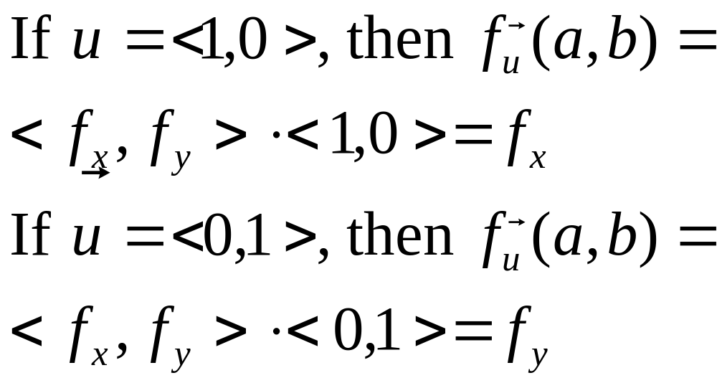
The Directional Derivative and the Gradient
If f is differentiable at (a,b) and is a unit vector, then
Notes about the above

Slide 7
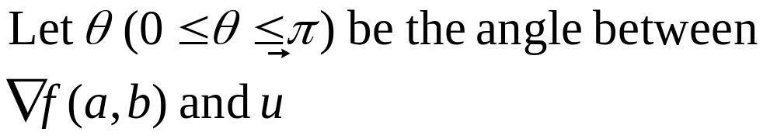
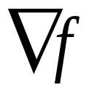


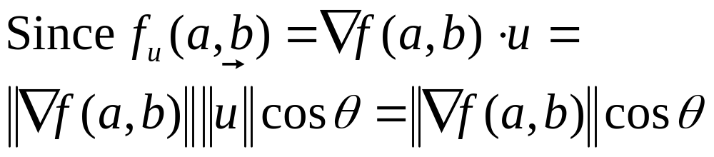
When is it maximum? Minimum?
The gradient of a function always points in the direction of maximum rate of increase
(a,b)

Slide 8
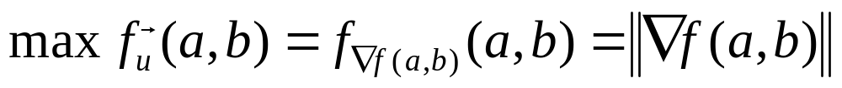
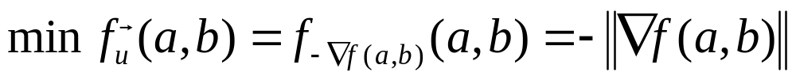
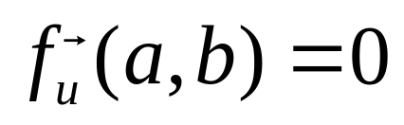
If θ = 0, then our direction is the same as the gradient and
If θ = π, then our direction is the opposite of the gradient and
If θ = π/2, then our direction is the perpendicular to the gradient and

Slide 9
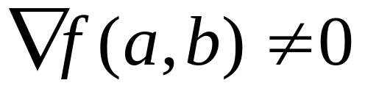
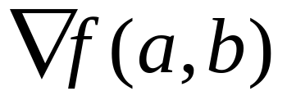
Geometric Properties of the Gradient Vector in the Plane
If f is a differentiable function at the point (a,b) and then
The direction of
  Is perpendicular to the contour of f through (a,b)
  In the direction of increasing f
The magnitude of the gradient vector
  Is the maximum rate of change of f at that point
  Large when the contours are close together and small when they are far apart

