Slide 1
Introduction to High-Performance Computing (HPC)
Supercomputers and Clusters
Computer Organization and Architecture | November 2025

Slide 2
What is HPC?
• HPC = High-Performance Computing
• Uses supercomputers and clusters for complex computational tasks
• Handles massive datasets and simulations
• Processes calculations at unprecedented speeds
• Essential for solving problems beyond traditional computing
2

Slide 3
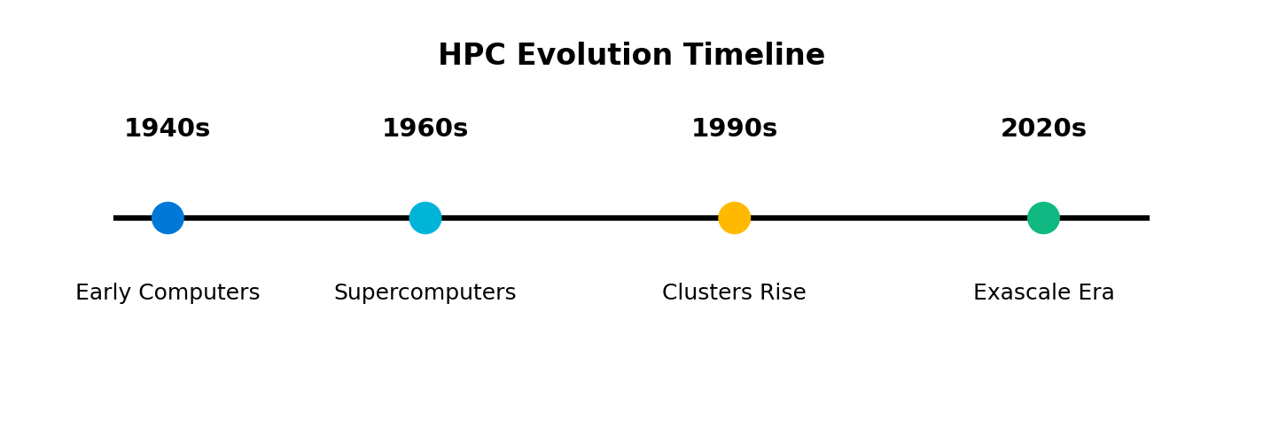
Brief History of HPC
Evolution from early computers to exascale supercomputers
3

Slide 4
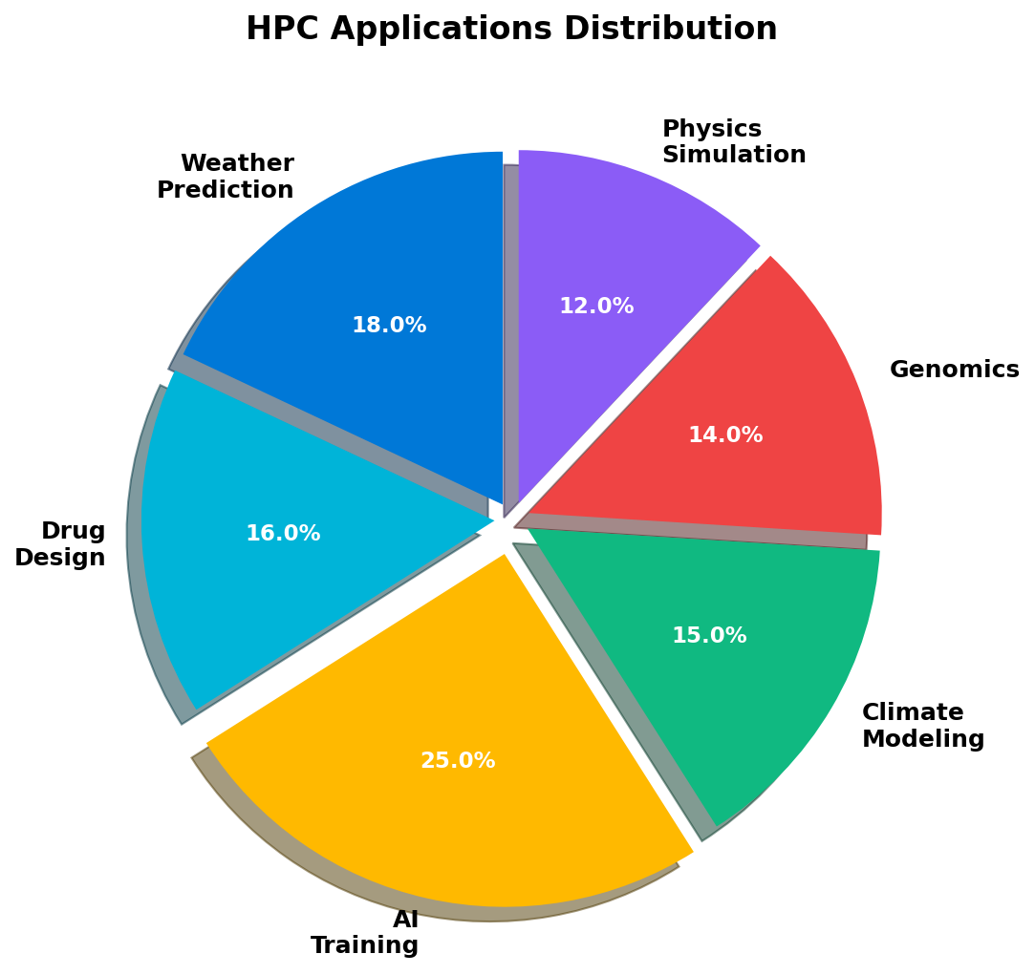
Why HPC Matters
• Solves complex real-world problems
• Weather prediction & climate modeling
• Drug discovery & molecular design
• AI training & deep learning
• Scientific research & simulations
4

Slide 5
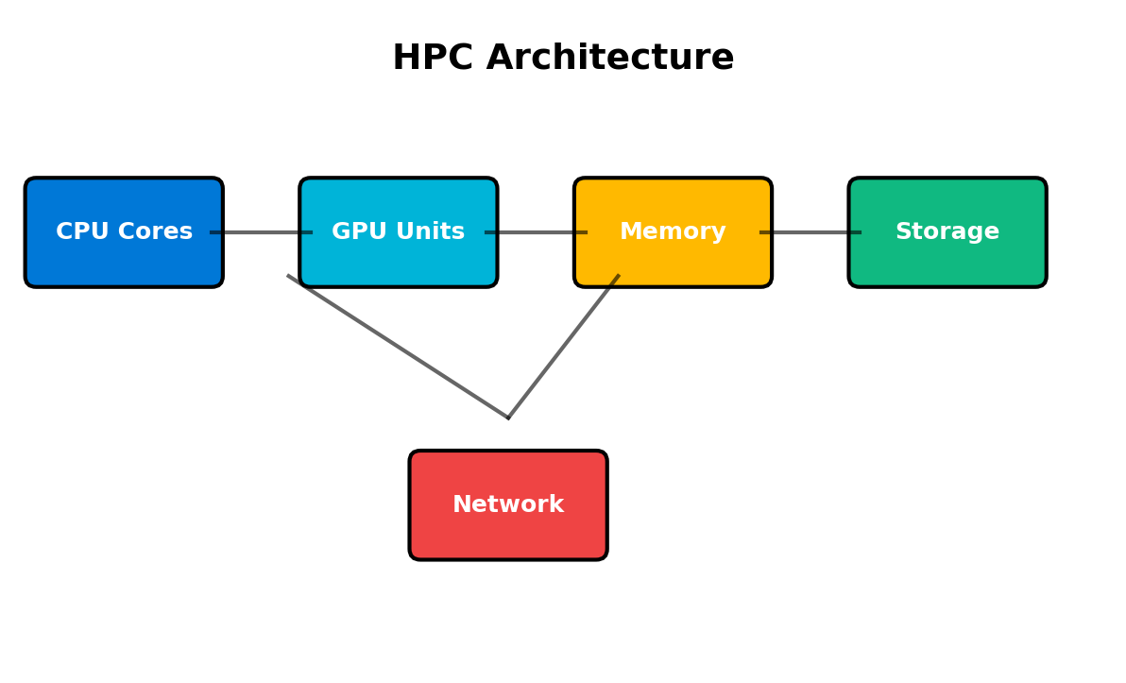
Connection to Computer Architecture
• Parallel processing fundamentals
• Multi-core CPUs & GPUs
• Distributed memory systems
• High-speed interconnects
• Cache hierarchies & optimization
5

Slide 6
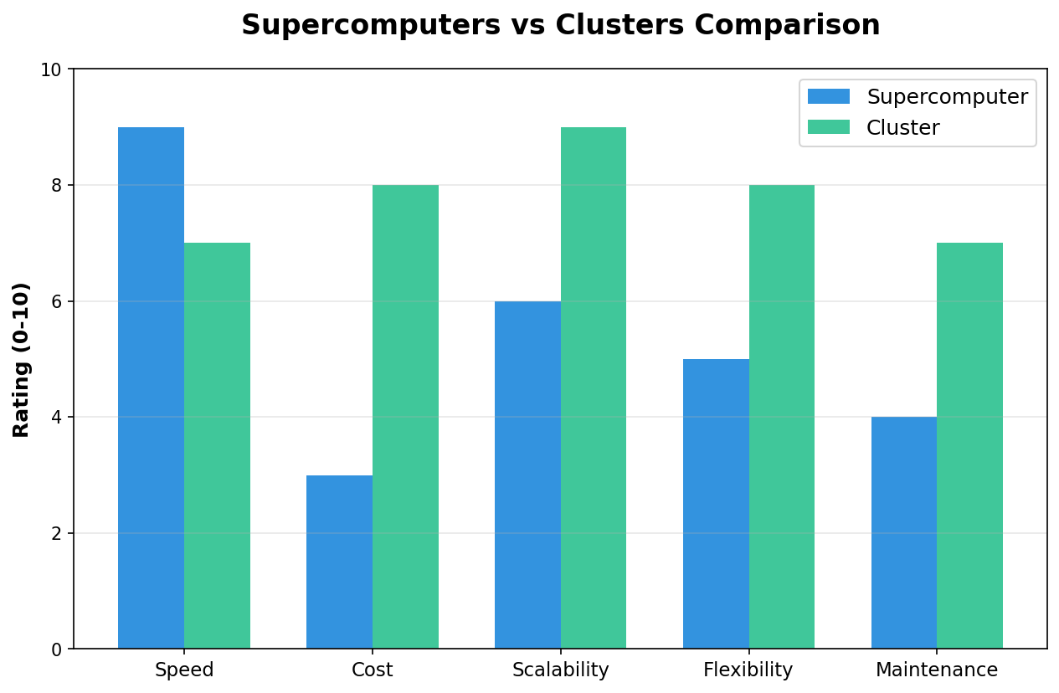
Supercomputers vs Clusters
Comparing performance, cost, scalability, and flexibility
6

Slide 7
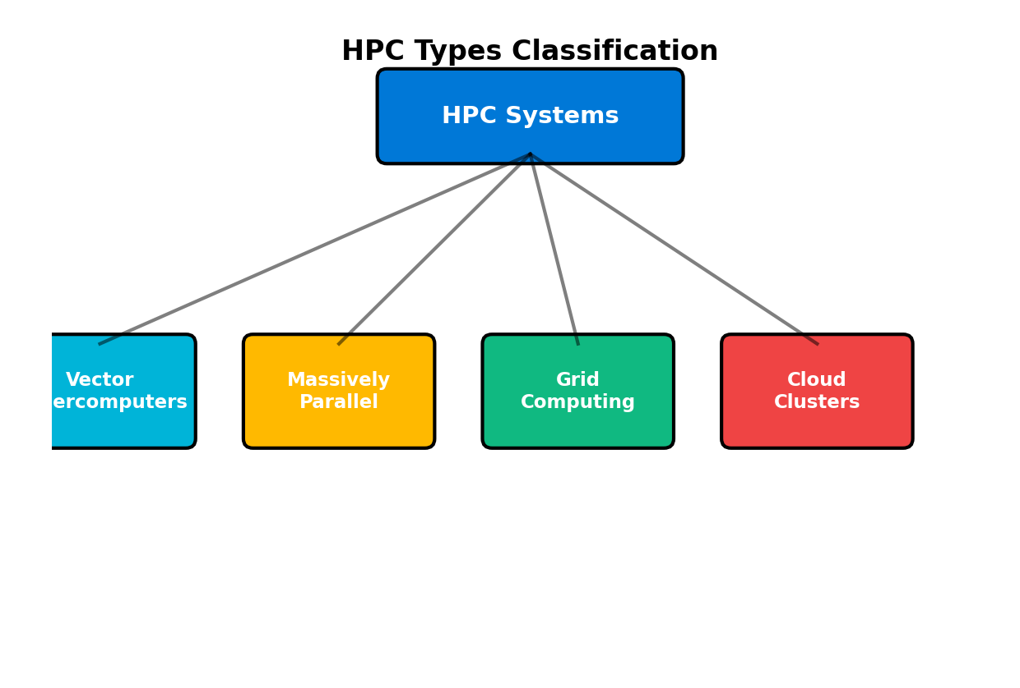
Types of HPC Systems
Classification of HPC architectures and approaches
7

Slide 8
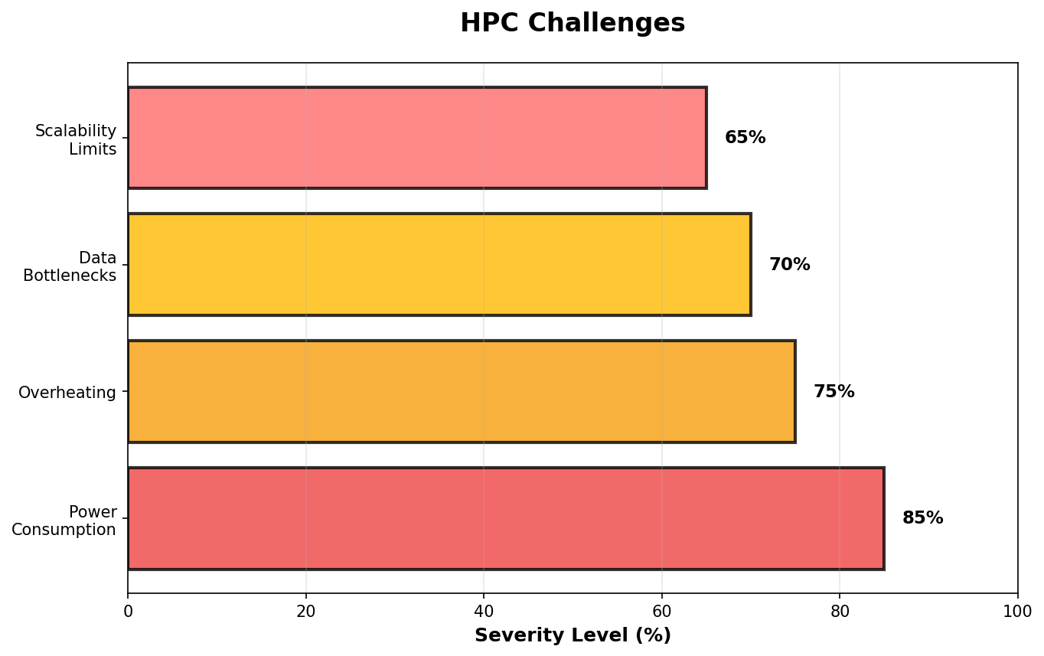
HPC Challenges
• High power consumption
• Thermal management issues
• Data transfer bottlenecks
• Scalability limitations
• Programming complexity
8

Slide 9
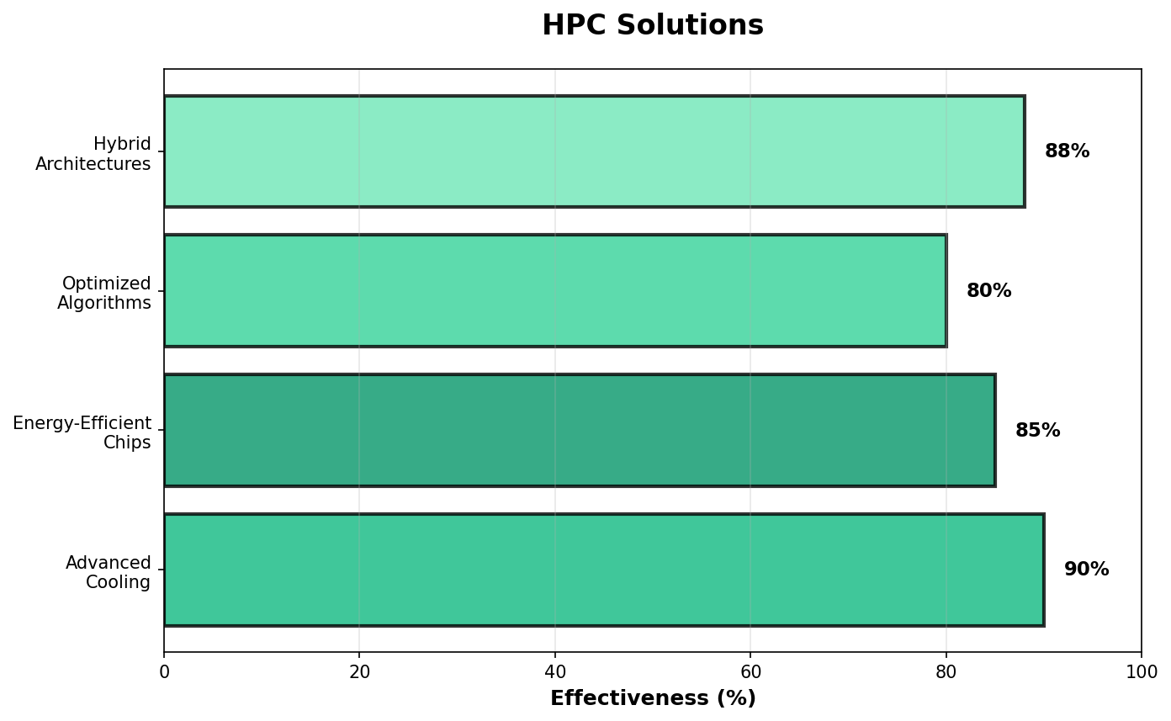
Solutions to HPC Challenges
• Advanced liquid cooling systems
• Energy-efficient chip designs
• Optimized algorithms & compilers
• Hybrid CPU-GPU architectures
• Improved interconnect technologies
9

Slide 10
Project Analysis Summary
• HPC evolves through continuous innovation
• Technology comparisons drive improvements
• Classification helps understand diverse approaches
• Challenges are systematically addressed
• Performance gains enable new discoveries
10

Slide 11
Recent HPC Technologies
• Exascale supercomputers (e.g., Frontier, Aurora)
• Quantum computing accelerators
• Neuromorphic computing chips
• AI-optimized hardware (TPUs, NPUs)
• Advanced memory technologies (HBM, CXL)
11

Slide 12
Latest HPC Research
• AI-driven HPC for genomics and proteomics
• Record-breaking COVID-19 modeling simulations
• Fusion energy research breakthroughs
• Climate change prediction improvements
• Materials science discoveries
12

Slide 13
Recent HPC Developments
• Green HPC initiatives reducing carbon footprint
• Edge computing integration with HPC
• Open-source HPC software ecosystems
• Cloud-based HPC services expansion
• International HPC collaborations
13

Slide 14
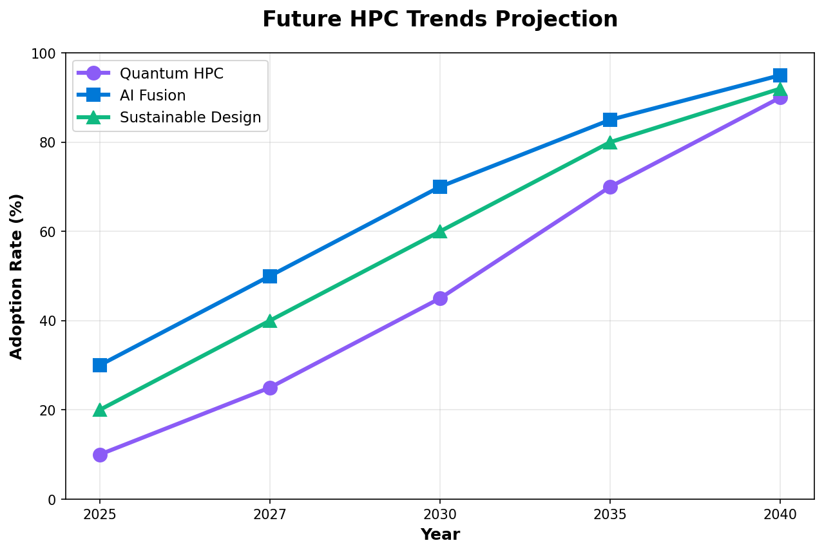
Future HPC Trends
• Quantum-classical hybrid systems
• AI and HPC convergence
• Sustainable computing designs
• Ubiquitous HPC access
• Personalized medicine platforms
14

Slide 15
Future HPC Directions
• Global collaborative research networks
• Open-source HPC democratization
• Space-based computing clusters
• Biological computing integration
• Autonomous HPC systems
15

Slide 16
Key Takeaways
• HPC powers scientific and technological innovation
• Evolution from mainframes to exascale systems
• Tackles humanity's most complex challenges
• Continuous advancement in hardware and software
• Critical for future discoveries and breakthroughs
16

Slide 17
Real-World HPC Impact
• Hurricane prediction saves thousands of lives
• Drug discovery accelerated from years to months
• Universe simulations reveal cosmic mysteries
• Protein folding breakthroughs (AlphaFold)
• Climate models guide policy decisions
17

Slide 18
HPC in Action
• Parallel task distribution across thousands of nodes
• Real-time data processing at petabyte scale
• Speedup: Days → Hours → Minutes
• Workflow: Problem → Decomposition → Parallel Execution → Results
• Example: Weather forecast in 30 minutes for 7-day prediction
18

Slide 19
Ongoing Challenges & Ethics
• Cybersecurity in distributed systems
• Ethical AI in HPC applications
• Energy sustainability concerns
• Digital divide and access inequality
• Responsible use of computational power
19

Slide 20
Thank You!
Questions & Answers
For more information: hpc-research@university.edu

