Slide 1

MS CSE Final Project Presentation A Prototype of a Secured File Storing and Sharing System for Cloud Storage Infrastructure
Prepared & Presented by
Md. Shahadul Alam Patwary
ID: 1815414050
Supervised by
Dr. Rajesh Palit
Date: December 15, 2019

Slide 2
What is Cloud Computing?
On-demand availability of computer system resources, especially data storage and computing power, without direct active management by the user

Slide 3
Cloud Services
Infrastructure as a Service (IaaS)
Platform as a Service (PaaS)
Software as a Service (SaaS)
Storage as a Service

Slide 4


Infrastructure as a Service (IaaS)
Offers services such as storage, networking, and virtualization in a pay-as-you-go manner

Slide 5


Platform as a Service (PaaS)
Provides application development tools so that developers don’t need to write applications from scratch

Slide 6


Software as a Service (SaaS)
A software delivery model in which applications are hosted by third-party providers who make those applications available to customers over the internet

Slide 7



Storage as a Service
A business model in which a company provides its storage infrastructure to another company or individuals to store data

Slide 8
BUT THERE IS ONE CATCH..!!!

Slide 9
Confidentiality/Security
refers to protection against unauthorized access

Slide 10
Why?
All the data stored in cloud storage can be accessed by the service providers.
Service providers keep replicated data for reliability. Even after user deletes those files, replicated data still remains

Slide 11
What can be Done?
Delete the files in such a way that they can never be recovered, also referred to as Assured File Deletion

Slide 12
HOW TO ASSURE FILE DELETION..??

Slide 13
File Assured Deletion (FADE)
An overlay system on top of existing cloud services
Protects deleted data with policy-based file assured deletion using standard cryptographic techniques

Slide 14
What is Policy-based Deletion?
Each file is associated with a file access policy. File is encrypted with Data-key and Data-key is encrypted with a Control-key corresponding to the policy. When the policy is revoked, the file can no longer be recovered. Control-keys are maintained by a Key Manager

Slide 15
SO WE’VE GOT THE SOLUTION, Right..??

Slide 16
WRONG..!!

Slide 17
Why?
What if the cloud service provider collaborates with the key manager?
Intruders can read the file access policy by packet sniffing because, communication between the client application and the key manager is done in plaintext
What if the file needs to be shared?

Slide 18
Simplified File Assured Deletion (SFADE)
An overlay system on top of existing cloud services
A randomly generated key is used for file encryption
Does not rely upon key manager

Slide 19
Shortcomings of SFADE
Lacks file sharing support
What if the user forgets his/her passphrase?

Slide 20
What do we have to offer?
A model that can share files securely
Without relying upon any trusted entity
Using existing cryptographic algorithms
With significantly reduced overhead

Slide 21
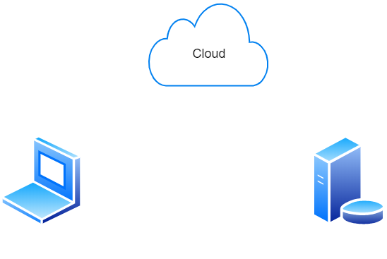
Architecture (Top Level)

Slide 22
Prototype Demonstration

Slide 23
Architecture (Details)

Slide 24
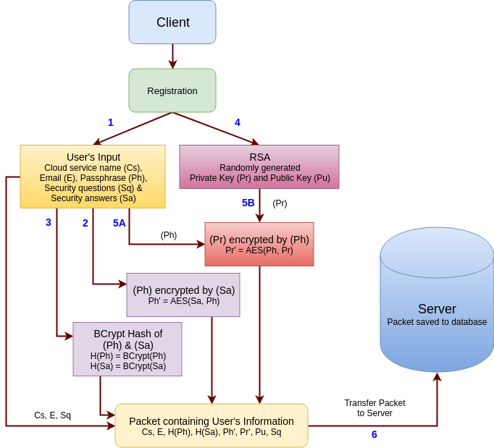
Registration

Slide 25
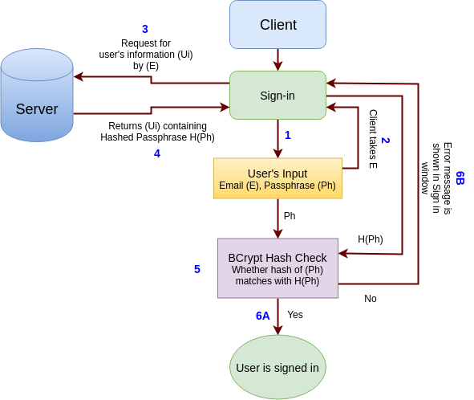
Sign in

Slide 26
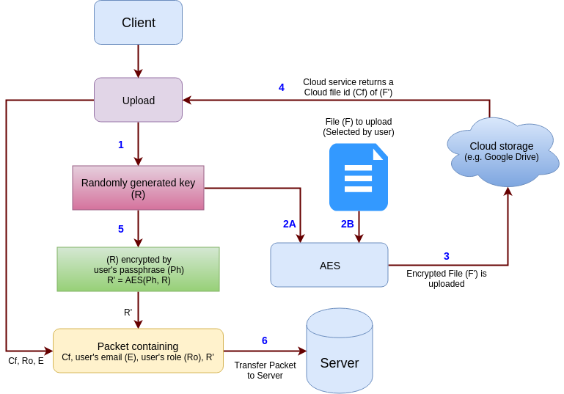
File Upload

Slide 27
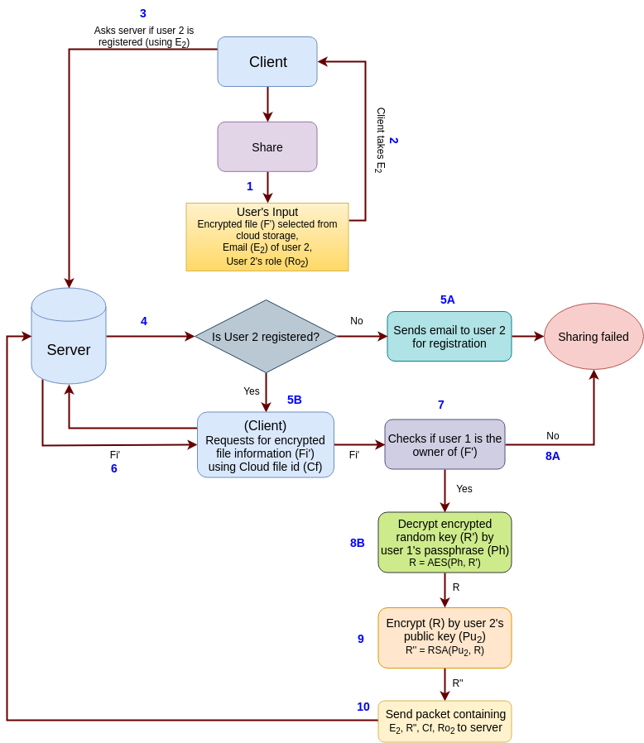
File Sharing

Slide 28
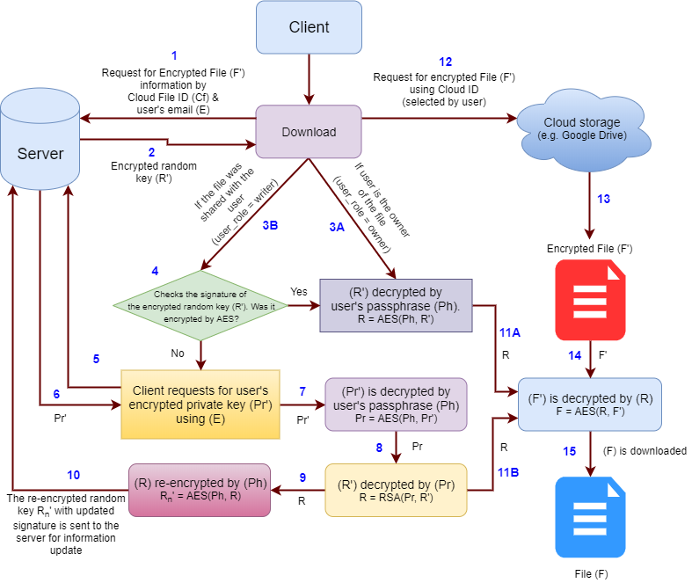
File Download

Slide 29
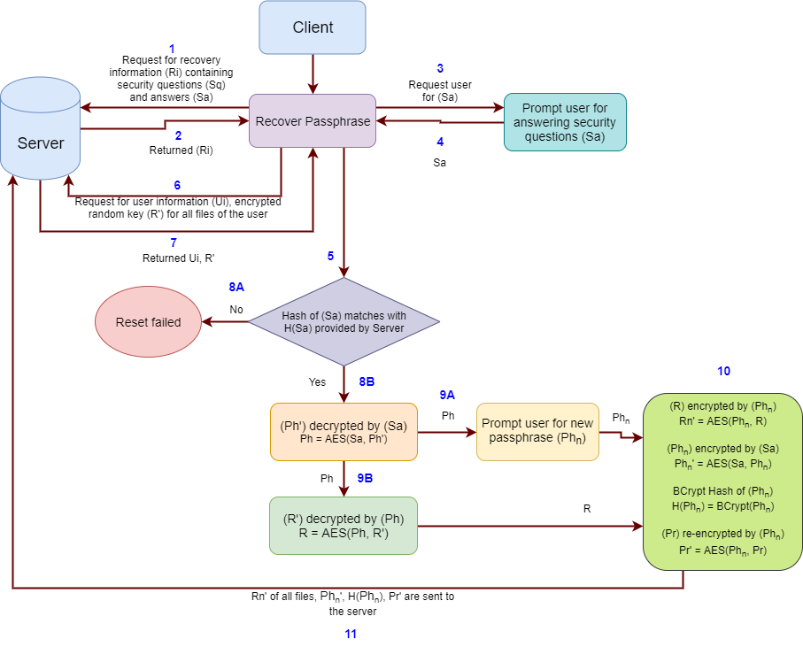
Passphrase Recovery

Slide 30
Limitations
User will lose access to his/her valuable file(s) if contents stored in the database is altered
Risk of becoming a second point of failure

Slide 31
Future Works
Adding more versatile user roles
Add more features to our implementation
Building a mobile version of the client application

Slide 32
Conclusion
Our model can store and share files securely in cloud storage. The primary goal was to resolve issues that were introduced with its predecessors which is accomplished successfully.

Slide 33
Bibliography
Alam, S., & Palit, R. (2019). A Prototype of a Secured File Storing and Sharing System for Cloud Storage Infrastructure. 2019 International Conference on Sustainable Technology and Engineering (i-COSTE & IEEE CSDE)

Slide 34
References
Tang Y., Lee P.P.C., Lui J.C.S., Perlman R. (2010) FADE: Secure Overlay Cloud Storage with File Assured Deletion. In: Jajodia S., Zhou J. (eds) Security and Privacy in Communication Networks. SecureComm 2010. Lecture Notes of the Institute for Computer Sciences, Social Informatics and Telecommunications Engineering, vol 50. Springer, Berlin, Heidelberg
Habib, A. B., Khanam, T., & Palit, R. (2013). Simplified File Assured Deletion (SFADE) - A user friendly overlay approach for data security in cloud storage system. 2013 International Conference on Advances in Computing, Communications and Informatics (ICACCI).

Slide 35
Any Questions…??

Slide 36
Thank You…

