Slide 1


IoT device type identification
R Rulzzz
Daniel ,Shahaf ,Yonatan ,Yeachiav ,Rom

Slide 2
Research question
Given the data on IoT IP stream identify the device the stream origin from
The goal: find a model with maximum accuracy
We redefine the research question to sub-questions:
How to identify unknown device
Does reducing the problem to binary classifier maximize the accuracy

Slide 3
The Data
The data composed of
Train file with ~400,000 entries
Test file
The data include the information on each session between the end device to the base station(Server)
First in order to work with the data we will begin the pre processing

Slide 4
Data pre-processing
Remove Std=0 columns
Turned categorical variables to dummies \ bins
Try to remove outliers for some models
Skewness and kortosis

Slide 5
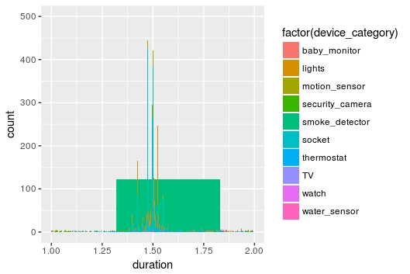
Duration

Slide 6
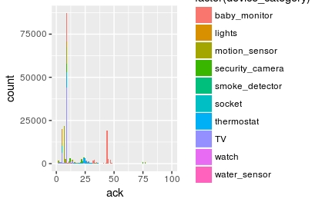
Acks

Slide 7
Methods and tools
Cause we have a multi classification problem we decided to create model to each device
by doing so we reduce the problem to binary classification for each device.
In order to recognize the unknown device we specified a threshold
the threshold was optimized
For records with only 1 high probability class – classify him as such

Slide 8
Methods and tools (continued)
We used the following models :
RandomForestCalsifer
Keras neural network
Logistic Regression

Slide 9
Additional issues
Under sampling to balance classes
Logistic regression didn’t worked as excepted
Lack of time&submmisions

Slide 10
Result
Public score is 0.86125

Slide 11
Future work
Run PCA
Try more models such as KNN, XGBoost etc
Tuning the devices models

