Slide 1

Malignant Comment Classifier Project
Submitted by:
AKSHAY DINESH SHAH

Slide 2
ACKNOWLEDGMENT
I express my sincere gratitude to Flip Robo Technologies for giving me the opportunity to work on this project on Malignant Comment Classifier using machine learning algorithms and NLTK suite of libraries and also, for providing me with the requisite datasets for training and testing prediction accuracies of the models. I acknowledge my indebtedness to the authors of the papers titled: “Toxic Comment Classification” and “Machine learning methods for toxic comment classification: a systematic review” for providing me with invaluable knowledge and insights into what constitute as malignant and benign comments and the role of natural language processing tools and techniques in identifying them and in helping build models to classify input comments as malignant and benign.

Slide 3
INTRODUCTION
With the proliferation of social media there has been an emergence of conflict and hate, making online environments uninviting for users. There is a lack of models for online hate detection. Online hate, described as abusive language, aggression, cyberbullying, hatefulness and many others has been identified as a major threat on online social media platforms. Social media platforms are the most prominent grounds for such toxic behaviour. Our goal is to build a prototype of online hate and abuse comment classifier which can used to classify hate and offensive comments so that it can be controlled and restricted from spreading hatred and cyberbullying.

Slide 4

The Dataset
The data set contains the training set, which has approximately 1,59,000 samples and the test set which contains nearly 1,53,000 samples. All the data samples contain 8 fields which includes ‘Id’, ‘Comments’, ‘Malignant’, ‘Highly malignant’, ‘Rude’, ‘Threat’, ‘Abuse’ and ‘Loathe’.
The label can be either 0 or 1, where 0 denotes a NO while 1 denotes a YES. There are various comments which have multiple labels. The first attribute is a unique ID associated with each comment.

Slide 5
Features
Malignant: It is the Label column, which includes values 0 and 1, denoting if the comment is malignant or not.
Highly Malignant: It denotes comments that are highly malignant and hurtful.
Rude: It denotes comments that are very rude and offensive.
Threat: It contains indication of the comments that are giving any threat to someone.
Abuse: It is for comments that are abusive in nature.
Loathe: It describes the comments which are hateful and loathing in nature.
ID: It includes unique Ids associated with each comment text given.
Comment text: This column contains the comments extracted from various social media platforms.

Slide 6
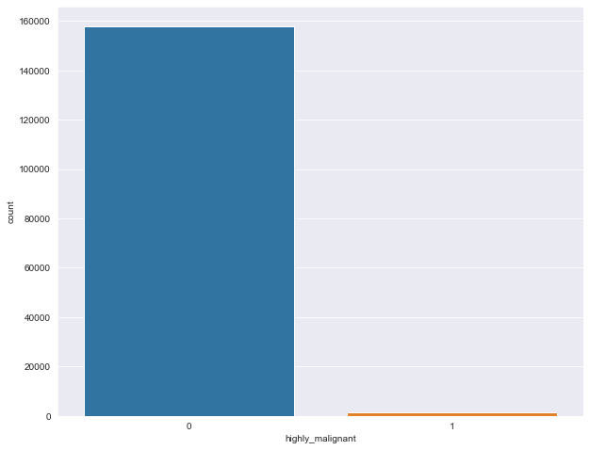
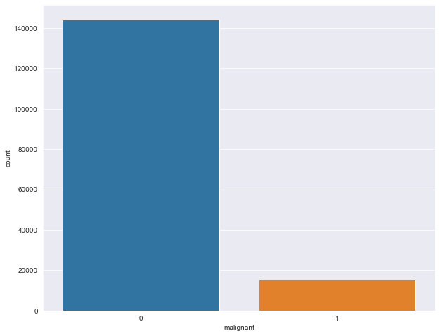
Exploratory Data Analysis (EDA):
Bar plots, Count plots, Distplots, WordClouds were used to visualise the data of all the columns and their relationships with Target variable.

Slide 7
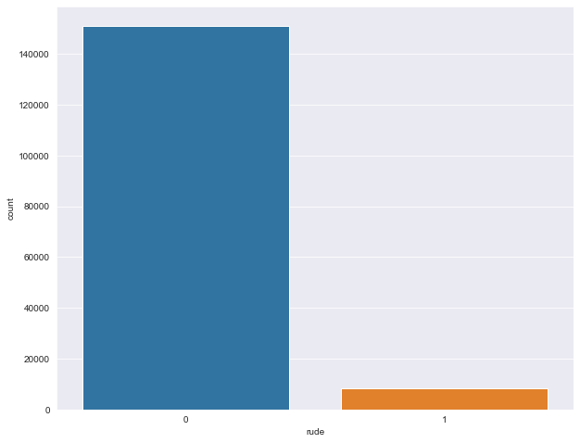




Slide 8

Points to remember
There are no duplicates values in the dataset.
There are no null values in Dataset.
Data given by Flip robo Technologies
Data are text Data, so we need to use NLP approached for ML

Slide 9
Data Preprocessing
As a first step I have imported required libraries and I have imported the dataset which was provided in excel format.
Then I did all the analysis like checking shape, value counts, info, duplicates value null values etc.
I have also dropped “id”, column as I found they are useless.
While checking for null values I found null values in the dataset.
Make columns to check length of strings in particular comments.
Convert all text data into lower case.
Replace time date format to text format.
Replace all numerical no to text format.
Replace numeric IP address to text format.
Remove head and tail blank spaces.
Then, make CLAENTEXT function to prepare text data, in that function remove string punctuation, tokenize comment in words, remove stop words like(I, me, u, our, have, had, etc) than, using POS TAG(part of speech) lemmatization the words.
Apply this function to comment text column.
Again, make column to check clean text length.
Using TFIDF Vectorize transform text to vectors and extract features for models

Slide 10
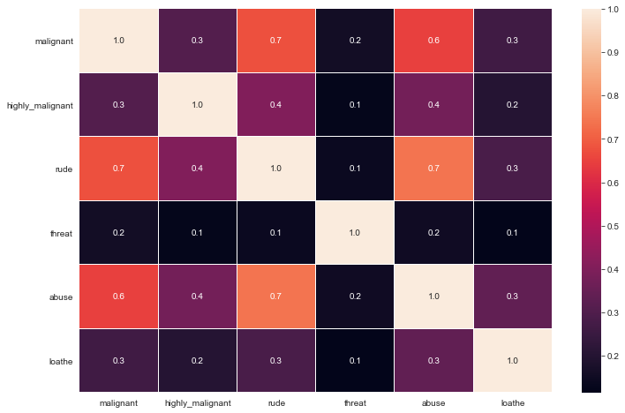
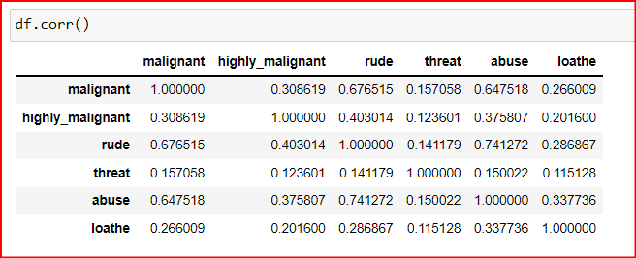
Correlation:
From the graphs above it is observed that columns: Rude,Abuse, Malignant have highest positive correlation with comment_type.

Slide 11

Data Visualization

Slide 12
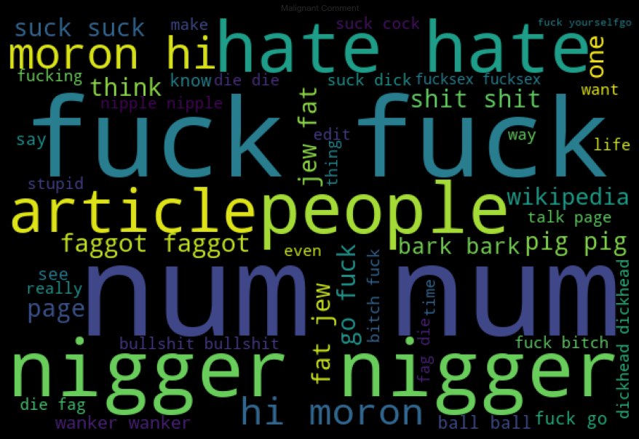
Malignant

Slide 13
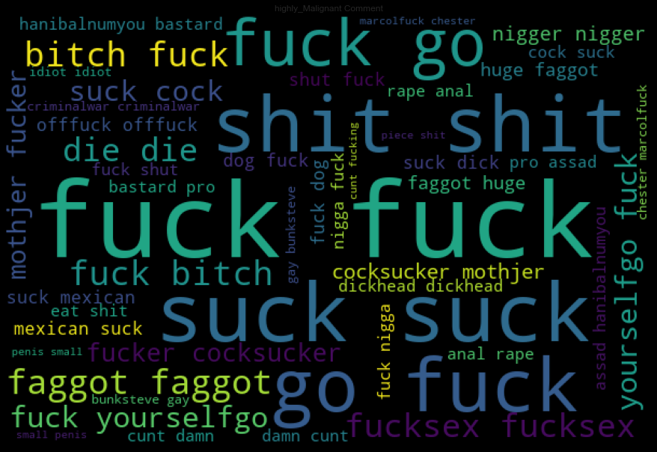
Highly_Malignant

Slide 14
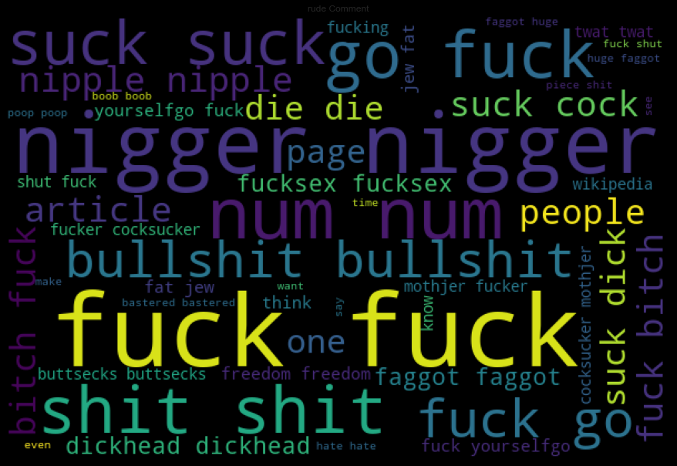
Rude

Slide 15
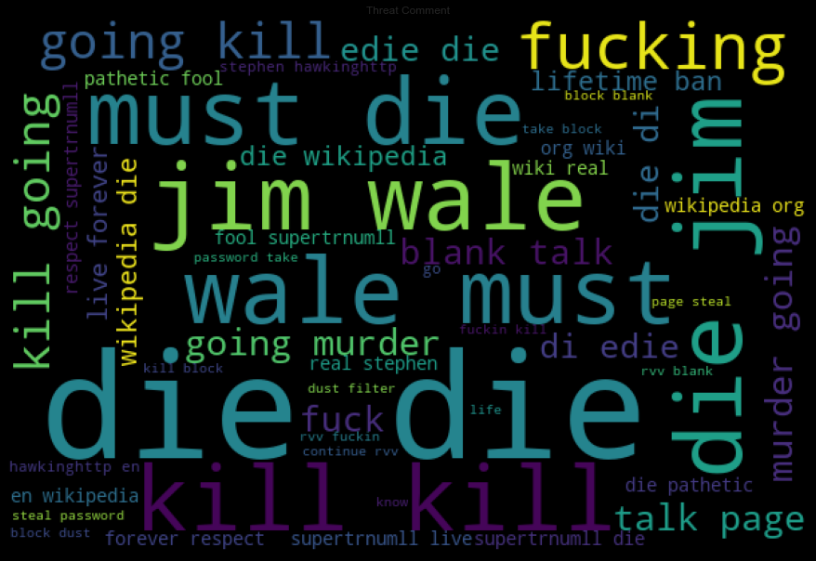
Threat

Slide 16
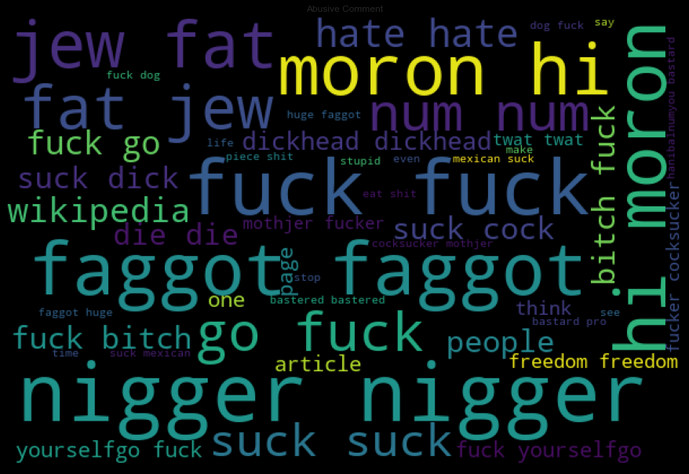
Abusive

Slide 17
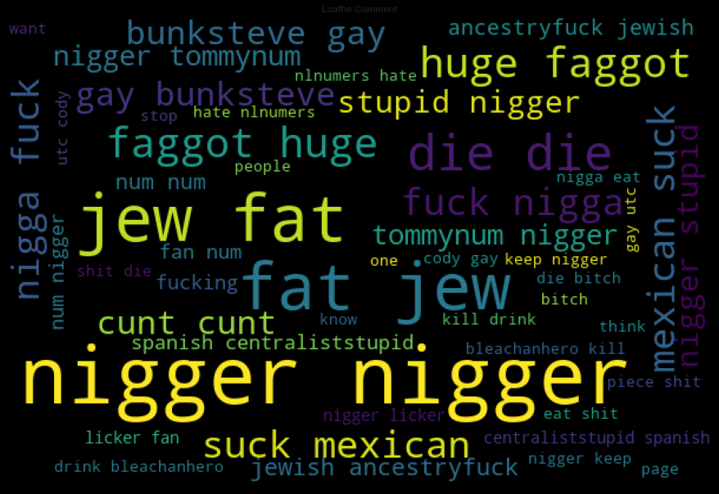
Loathe

Slide 18
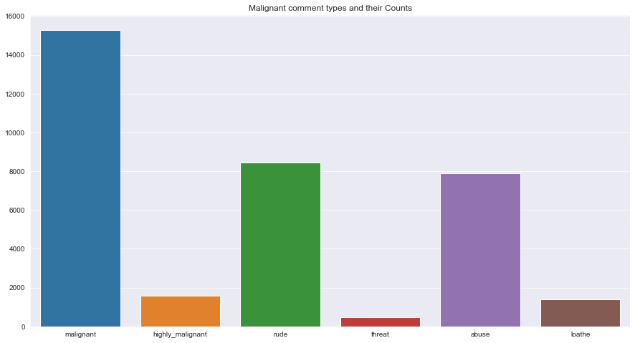
Analytical Problem Framing
The graphs show that the string length of comments was drastically brought down after processing.
The graph shows the composition of toxic comments, of which majority are malignant followed by rude comments, abusive comments, highly malignant comments, hateful comments and threats.

Slide 19
Feature Engineering
The comments data could belong to more than one label simultaneously(rude comments are at the same time malignant and in some cases can also be deemed hateful, abusive comments are hateful and can be highly malignant at the same time, threats are highly malignant too etc.)
Since each of the categories had very small data available to work with, a new column: ‘comment_type’ was created which only had binary classes: 0 which represented all the benign comments and 1 which represented all the comments which fell under malignant, highly malignant, abusive, hateful, rude, threat features. This column acted as Target Label column for malignant comment classification.

Slide 20
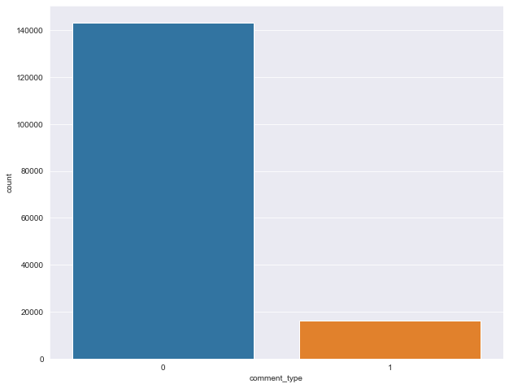
Visualising data in Target column

Slide 21

Model Building

Slide 22
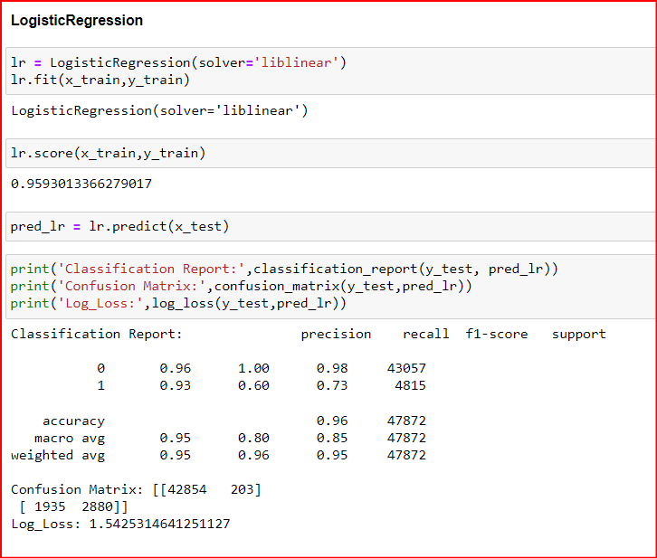
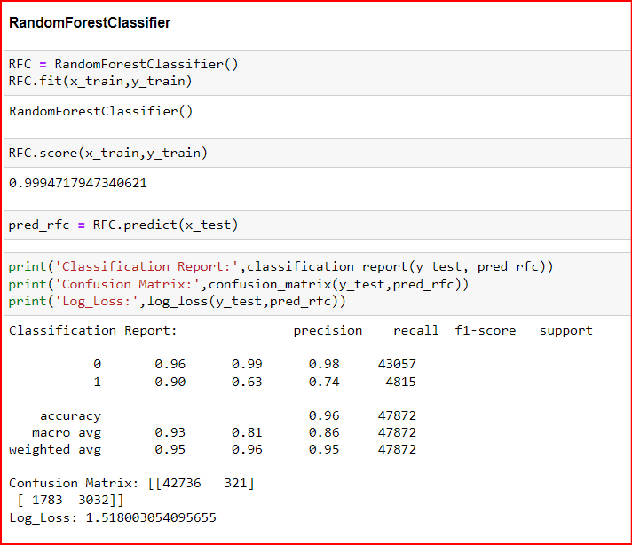

Slide 23
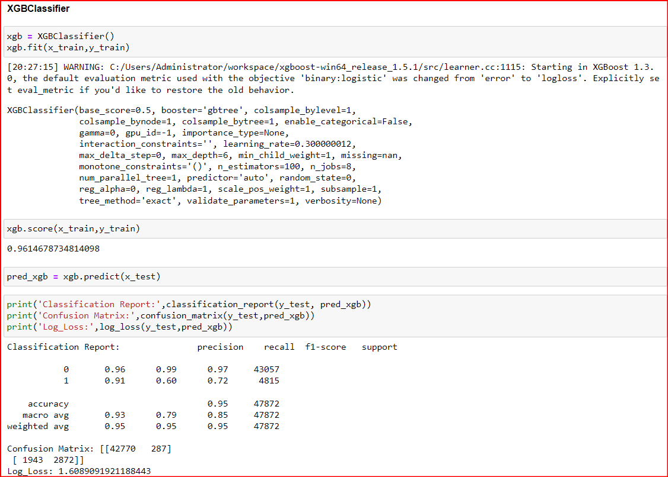

Slide 24
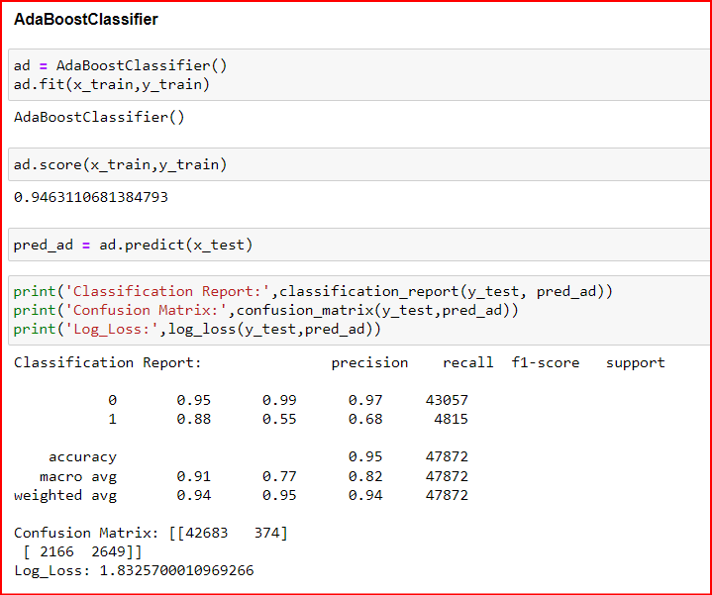
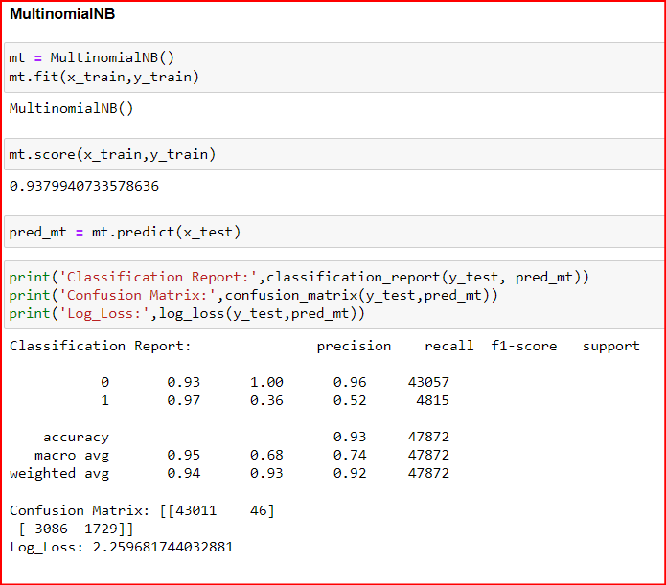

Slide 25
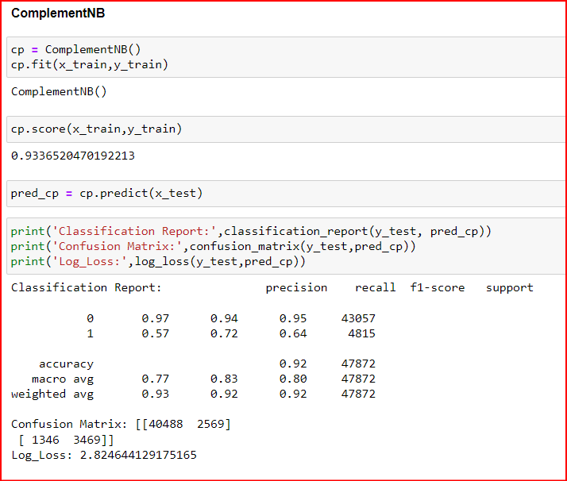
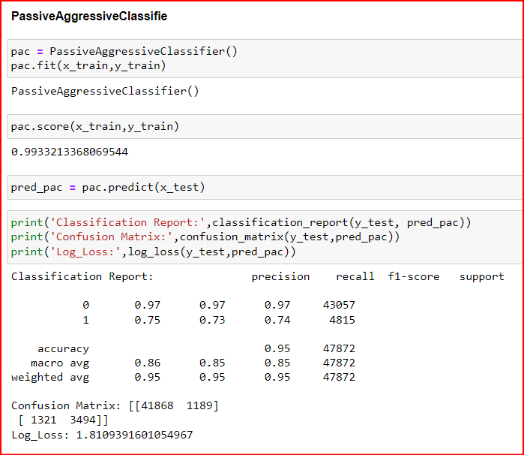

Slide 28
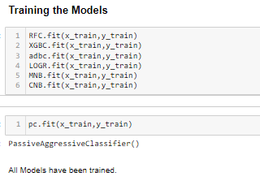

Slide 29
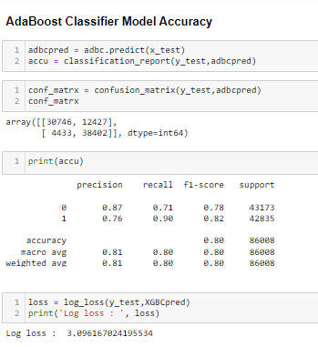
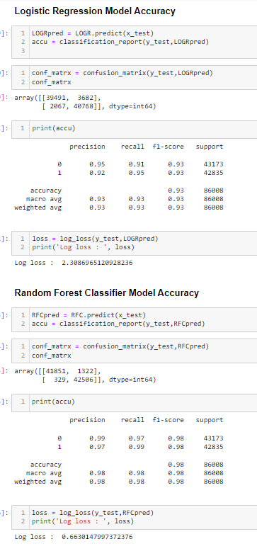
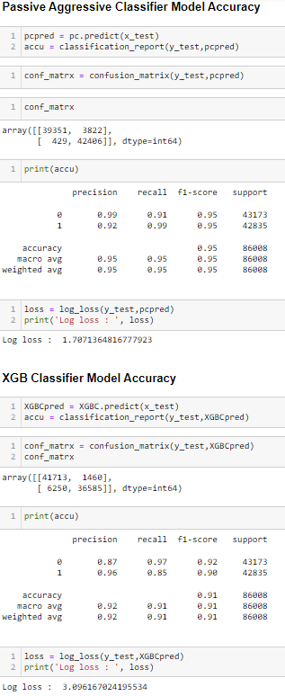
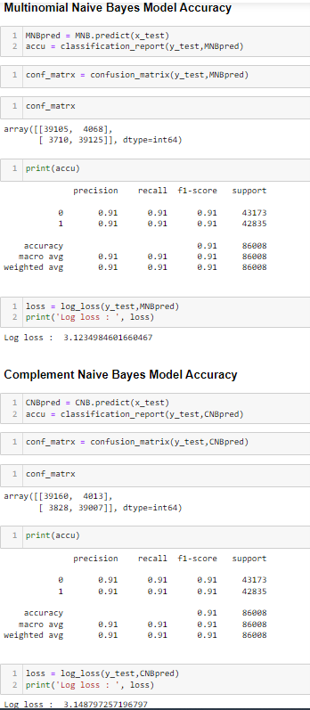

Slide 30
Model/s Development and Evaluation
Model Cross Validation
Cross validation is a technique for assessing how the statistical analysis generalises to an independent data set.It is a technique for evaluating machine learning models by training several models on subsets of the available input data and evaluating them on the complementary subset of the data. Using cross-validation, there are high chances that we can detect over-fitting with ease. Model Cross Validation scores were then obtained for assessing how the statistical analysis generalises to an independent data set. The models were evaluated by training several models on subsets of the available input data and evaluating them on the complementary subset of the data.

Slide 31
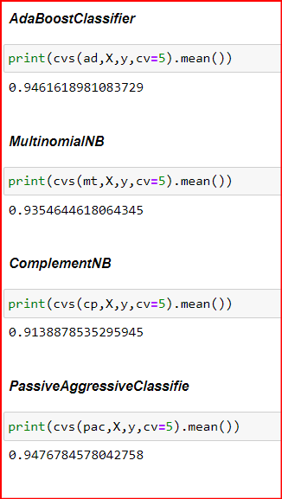
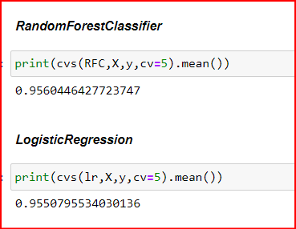
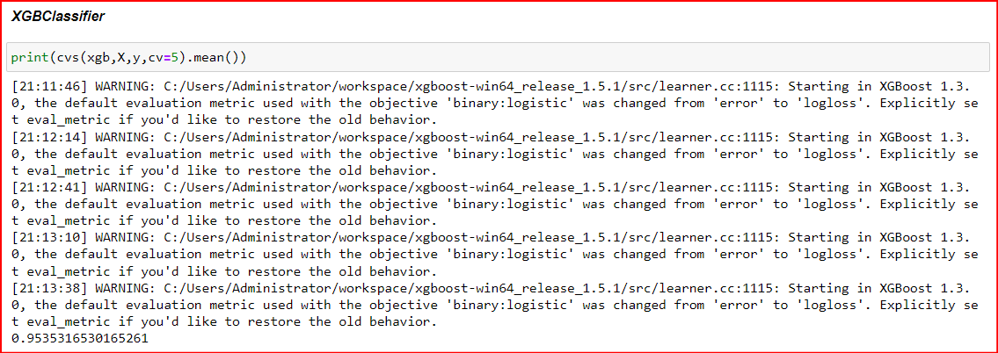
Cross Validation

Slide 32
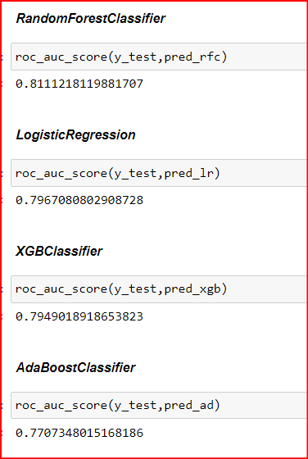
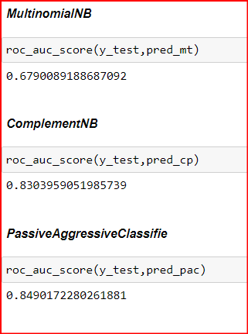
ROC AUC Scores
The score is used to summarize the trade-off between the true positive rate and false positive rate for a predictive model using different probability thresholds. The AUC value lies between 0.5 to 1 where 0.5 denotes a bad classifier and 1 denotes an excellent classifier.

Slide 33
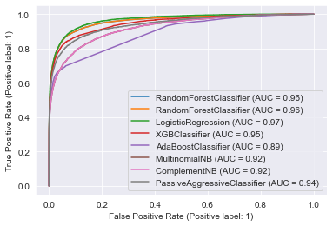
ROC AUC curves
The AUC-ROC curve helps us visualize how well our machine learning classifier is performing. ROC curves are appropriate when the observations are balanced between each class.

Slide 34
Interpretation of the Results
Based on comparing the above graphs, roc_auc_scores, Precision, Recall, Accuracy Scores with Cross validation scores and log loss scores, it is determined that Random Forest Classifier and Logistic Regression are the best models for the dataset.

Slide 35
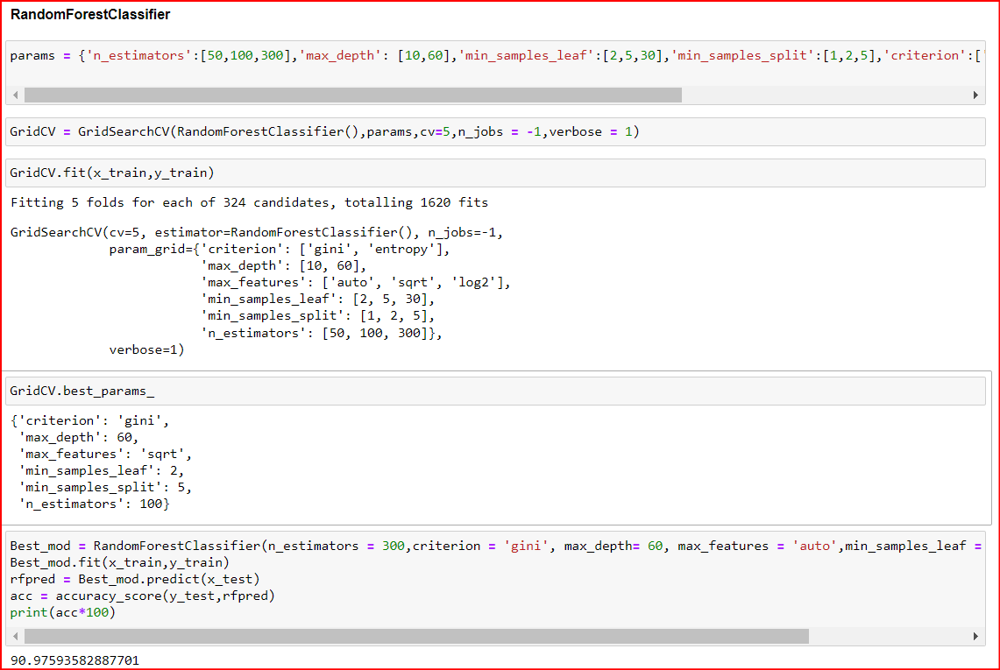
Hyper Parameter Tuning
GridSearchCV was used for Hyper Parameter Tuning of the Random Forest Classifier model.

Slide 36
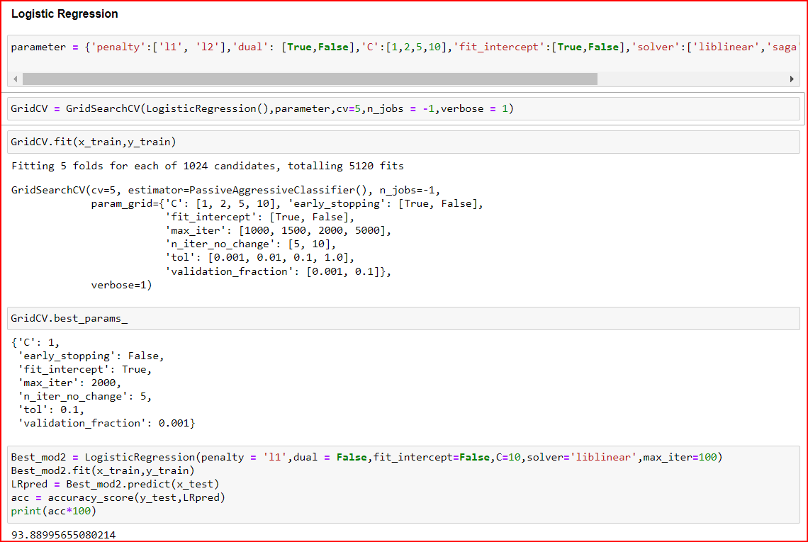
GridsearchCV was used for Hyper Parameter Tuning of the Logistic Regression model.

Slide 37
Result
After Tuning the hyper parameters and based on the input parameter values and after fitting the train datasets it is found that Logistic Regression model performs the best.
The model was saved and the Test Dataset was then prepared for final classification work by the model. This model was then tested using the Test Dataset. The model performed with good amount of accuracy.

Slide 38
CONCLUSION
Learning Outcomes of the Study in respect of Data Science
The various data pre-processing and feature engineering steps in the project lent cognizance to various efficient methods for processing textual data. The NLTK suite is very useful in pre-processing text-based data and building classification models.
The models were trained on a highly imbalanced dataset where the total malignant comments formed only 10% of the entire available data, which seriously affected the training and accuracy of the models. By training the models on more diverse data sets, longer comments, and a more balanced dataset, more accurate and efficient classification models can be built.

Slide 39

THANK YOU

