Slide 1


Software Project Lab - 1
Implementation of PageRank Algorithm
Presented by
Shah Alam Abir
Roll: 1439
Session: 2021-2022
Supervised by
Dr. Ahmedul Kabir
Associate Professor
IIT, University of Dhaka

Slide 2
Table of Contents
1
Introduction
4
The Web as a Graph
2
Project Motivation
5
Random Surfer Model
3
Features
6
PageRank Formula

Slide 3
1
Introduction

Slide 4
PageRank Algorithm is an algorithm used by Google Search Engine to rank web pages in search engine results.
It was developed by Larry Page and Sergey Brin, the co-founders of Google, while they were graduate students at Stanford University.
Introduction

Slide 5
PageRank is designed to assess the importance and relevance of web pages in the context of search engine results.
The underlying idea is that valuable and authoritative web pages are more likely to be linked to by other web pages.
Therefore, a web page with many high-quality incoming links is considered more valuable and is likely to rank higher in search results.
Introduction

Slide 6
2
Project Motivation

Slide 7
Project Motivation
Foundation of Modern Search Engines
Refining Search Precision
Impact on Accessibility
Real-World Applications
Academic and Research Value

Slide 8
3
Features

Slide 9
Features
Main Feature:
Implementation of PageRank Algorithm (that was developed by Larry Page & Sergey Brin) by solving 2 core page ranking problems.
Visualizing Pages ranking after every iterations of iterative model
Sub Feature:
Can add new pages
Can find neighbours of a particular page
Show List of the dangling nodes Showing Initial Transition Matrix (made from the web graph)
Showing Gooogle Matrix (made of PageRank formula)

Slide 10
4
The Web as a Graph

Slide 11
The web as a Graph
We can represent WWW’s structure as a huge directed graph, where node’s of that graph are the webpages and edges are the links between webpages.
C
B
F
A
E
D

Slide 12
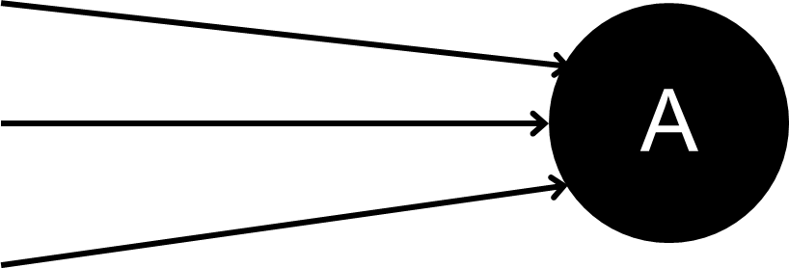
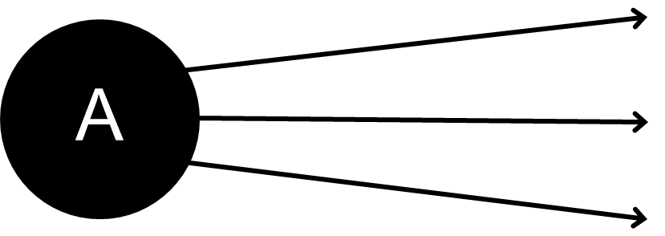
The web as a Graph
Inbound links are links that point from another website to the target website
Outbound links are links that point to another websites from target website

Slide 13
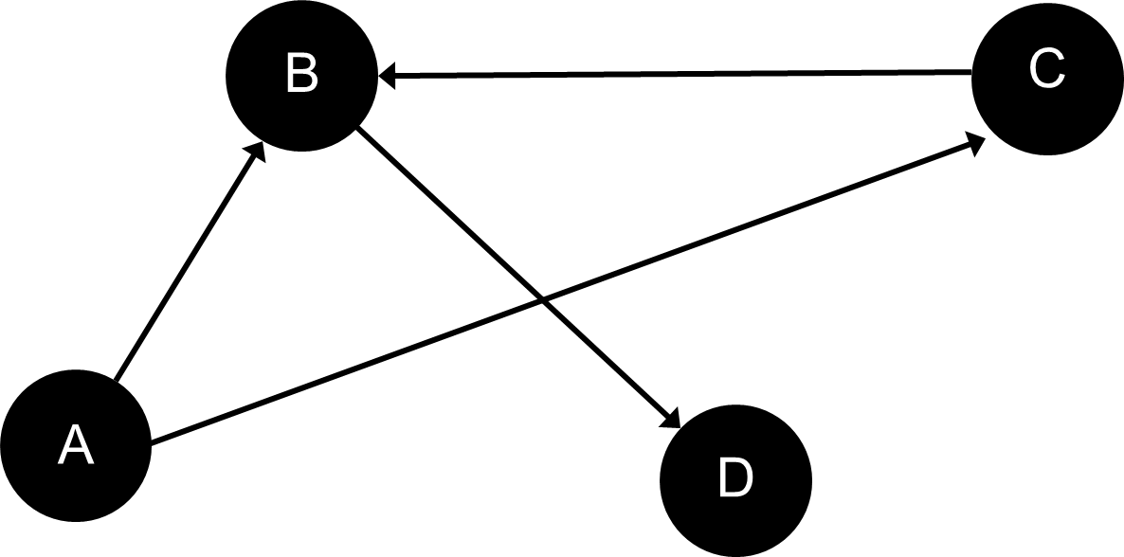
The web as a Graph
Dangling Nodes are the nodes with no outbound links
Dangling Links are links that point to the dangling nodes
Here D is a Dangling Node
BD is a dangling Link

Slide 14
5
Random Surfer Model

Slide 15
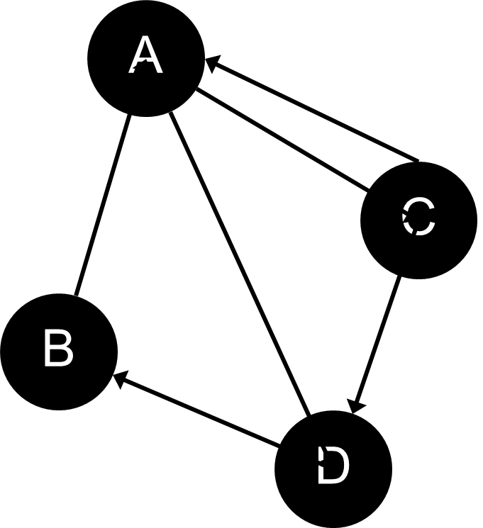
Random Surfer Model
The Random Surfer Model is a conceptual framework used in the context of web page ranking algorithms, particularly in understanding Google's PageRank algorithm. It is a simplified representation of how a hypothetical internet user behaves when navigating the web and is used to explain the concept of PageRank.

Slide 16
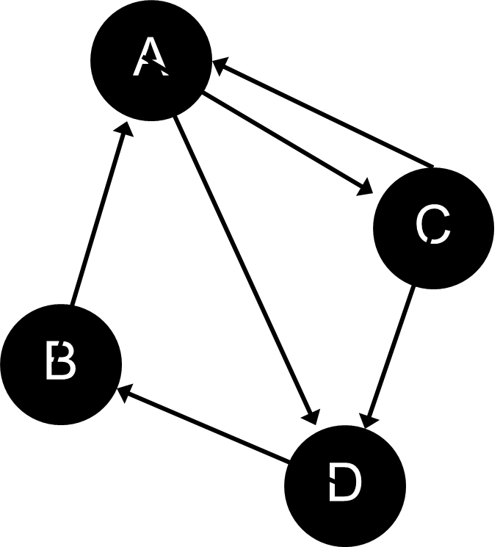

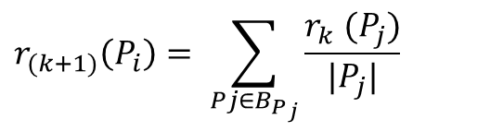
Random Surfer Model
Matrix Presentation
 | A | B | C | D
A | 0 | 0 | 0.5 | 0.5
B | 1 | 0 | 0 | 0
C | 0.5 | 0 | 0 | 0.5
D | 0 | 1 | 0 | 0
$$r_{(k+1)}\left(P_{i}\right)= \sum_{{Pj∈B_{P}}_{j}}{\frac{r_{k} (P_{j})}{|P_{j}|}}$$
The PageRank of a page $P_{i}$, denoted $r(P_{i})$, is the sum of the Page-Ranks of all pages pointing into $P_{i}.$
where $B_{P_{i}}$ is the set of pages pointing into $P_{i}$ and |$P_{j}$| is the number of out-links from page $P_{j}$ .
Transition matrix H

Slide 17
Random Surfer Model (Iterative Calculation)
Initializing page rank for every page with 1/n. Where, n is the total number of webpages of the graph. Thus, we will have another matrix X with initialized page-rank value.
A | ¼
B | ¼
C | ¼
D | ¼
From previous slide we got Transition matrix H
We will perform matrix multiplication X = HX iteratively until it converge. Then we will get a modified page-rank matrix X.
Now, if we sort them according to probability, then we will get webpages in descending order.
Matrix X

Slide 18

Problems with Random Surfer Model
But, there is two major problem with this Random Surfer Model. These are –
If there is any dangling node [webpage], then all the elements of the final matrix will be 0.
If some nodes of the graph is highly connected, then probability of these particular group of nodes becomes significantly higher then other nodes. Because of this, a random surfer iterates through a group of nodes again and again.

Slide 19
6
PageRank Formula

Slide 20
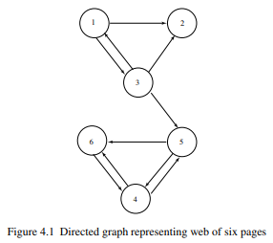
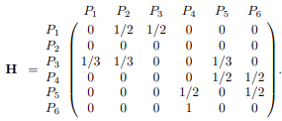
PageRank Formula
PageRank Algorithm appeared to solve these 2 core problem and sum up with a satisfactory ranking of webpages
Initial Transition Matrix of the graph

Slide 21


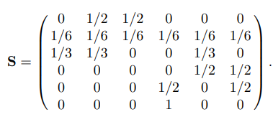

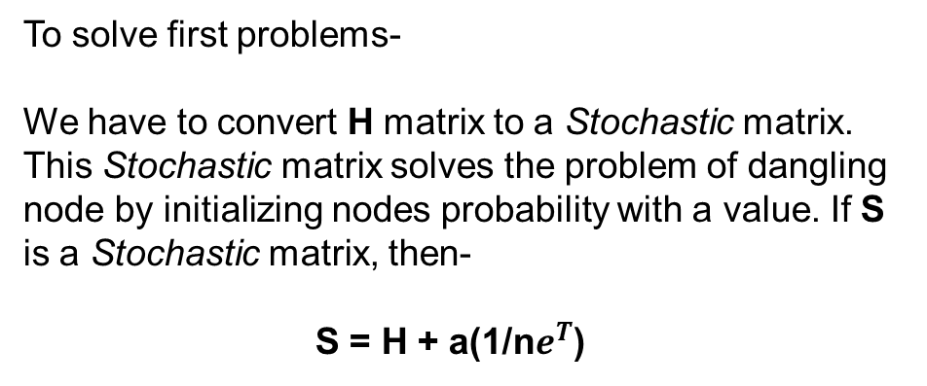
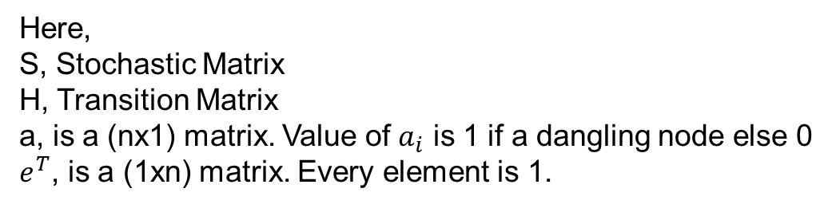
PageRank Formula
To solve first problems-
We have to convert H matrix to a Stochastic matrix. This Stochastic matrix solves the problem of dangling node by initializing nodes probability with a value. If S is a Stochastic matrix, then-
S = H + a(1/n$e^{T}$)
$e^{T}$ Matrix
a Matrix
Here,
S, Stochastic Matrix
H, Transition Matrix
a, is a (nx1) matrix. Value of $a_{i}$ is 1 if a dangling node else 0
$e^{T}$, is a (1xn) matrix. Every element is 1.
S Matrix

Slide 22
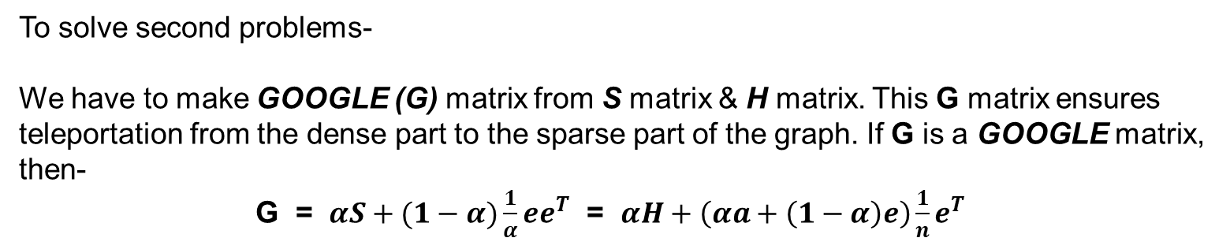

PageRank Formula
To solve second problems-
We have to make GOOGLE (G) matrix from S matrix & H matrix. This G matrix ensures teleportation from the dense part to the sparse part of the graph. If G is a GOOGLE matrix, then-
G = $αS+(1−α)\frac{1}{α}ee^{T}$ = $αH+\left(αa+\left(1−α\right)e\right)\frac{1}{n}e^{T}$
Here,
G, GOOGLE Matrix
S, Scholastic Matrix
H, Transition Matrix
a, is a (nx1) matrix. Value of $a_{i}$ is 1 if a dangling node else 0
$e,$is a (nx1) matrix. Every element is 1
$e^{T}$, is a (1xn) matrix. Every element is 1.
α, is the damping factor. It ensures the teleportation.
Damping Factor
The damping factor in the PageRank algorithm is a parameter that represents the probability that a random surfer, navigating the web by clicking on links, will continue to browse and click on links within the current web page rather than jumping to a completely random page.

Slide 23
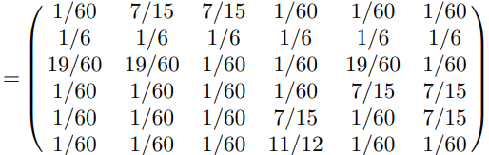

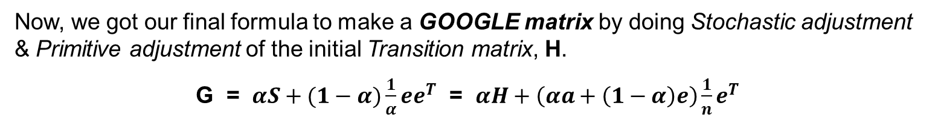
PageRank Formula
Now, we got our final formula to make a GOOGLE matrix by doing Stochastic adjustment & Primitive adjustment of the initial Transition matrix, H.
G = $αS+(1−α)\frac{1}{α}ee^{T}$ = $αH+\left(αa+\left(1−α\right)e\right)\frac{1}{n}e^{T}$
G
e Matrix
a Matrix
$e^{T}$ Matrix
Now, We will perform Iterative matrix multiplication X = GX until it converges. Then we will get a modified page-rank matrix, X. Then, by sorting \ matrix X according to probabilistic value, we will get webpages in descending order.

Slide 24
Thank you
Github: https://github.com/shahalam22/SPL-1

