Slide 1


WalkSafe
Navigation Assistant for Visually Impaired Persons in
Dense Urban Environments
PRESENTED BY
SUPERVISED BY
Shah Alam Abir
Dr. Md. Nurul Ahad Tawhid
BSSE — 1439
IIT, University of Dhaka
Associate Professor
Institute of Information Technology,
University of Dhaka
02 August 2026
Notes:
1

Slide 2
Overview
01
Project Overview
06
Component Diagram
02
Requirements
07
AI Pipeline
03
Usecase Diagram
08
Demo
04
Activity Diagram
09
Status & What’s Next
05
ER Diagram
10
References
Notes:
2

Slide 3
Project Overview: The Gap
“Visually impaired people in dense urban environments face moment-to-moment dangers that no current assistive tool is designed to handle completely.”
01
02
03
The Environment Problem
The Tool Problem
The Verification Problem
Streets in Dhaka are unplanned and unpredictable. Tactile paving, wide pavements, and clear pedestrian zones do not exist in most areas.
Existing tools like White Cane could reach only to 1-2 steps ahead. It fails if there’s a moving object. Also GPS system could help with navigation but can’t detect obsacles in real time.
A blind user cannot glance up and see the
guidance is wrong. Every instruction is taken on faith, and a false "path clear" is
undetectable until impact.
Notes:
5

Slide 4




Project Overview: WalkSafe
Standard Camera
Smart Pipeline
Spoken Guidance
Live video feed
Perception + Decision
Via earphone
What the user hears:
Move forward — path clear”
“Stop — person approaching from your right”
“Step left — obstacle ahead at 1 metre”
“Caution — low object above, slow down”
Positioning: a supplementary aid. Every requirement assumes the user also has a cane or guide dog.
Notes:
7

Slide 5
Project Overview: Scope
In Scope
Out of Scope
Smartphone camera, remote GPU service
Route planning, maps, destinations
Depth, agent tracking, motion
Reading text, signs, faces
Distance, time-to-collision, risk per agent
Traffic signals, road crossing
Walkable openings, measured in metres
Kerbs, stairs, drop-offs — declared limit
Nine commands — speech, earcon, haptic
Indoor mapping
On-phone check — offline, overrides server
Replacing cane, guide dog, or O&M training
Session logging of derived metrics + analytics view
Notes:
10

Slide 6
Functional Requirements
01
02
03
Capture and Perception
Interpretation
Navigation Decision
04
05
06
07
Guidance Delivery
Safety and Failure Handling
Setup, Session, Accessibility
Logging and Review
Total 26 Functional Requirements covered under 7 Areas
Notes:
5

Slide 7
Functional Requirements
FR-2 — Estimate distance to obstacles and to the ground ahead
FR-5 — Distance, approach speed and time-to-collision per agent, from measured frame times
FR-9 — Exactly one command per cycle from the nine, by fixed-order rules, cautious default
FR-12 — Speak each command, play its earcon, vibrate for urgent ones
FR-19 — Announce that guidance has stopped on any fault. Never fail silently
FR-23 — Spoken setup: FOV, mounting, depth check, and a left/right test that blocks use if it fails
FR-24 — Record every decision with its values. Store no images due to privacy concern
Notes:
10

Slide 8
Non-Functional Requirements
01
Safety
  Every failure leaves the system more cautious — never less (NFR-5)
  Left and right are never reversed (NFR-6)
  No fault is signalled by silence alone (NFR-7)
04
05
06
07
Performance
Reliability
Accessibility
Resources
A hard deadline for phone warnings, a looser one for server guidance; late guidance is discarded, not spoken (NFR-1–4)
A long session runs without a crash or an unannounced loss of capability; no single dependency failure ends a session (NFR-9, 10)
Everything reachable without sight; earphones optional, because the user must hear the street (NFR-11–13)
Bounded battery and data; every threshold in one config file, models swappable without touching the rules (NFR-14–16)
Total 16 Functional Requirements covered under 5 Areas
Notes:
5

Slide 9
Commands and Levels
Command Vocabulary
Capability Levels
Stop
L0
Everything working | Full command vocabulary
Yield
L1
Slow Down
Poor visibility ig. glare, rain, blur | Cautious commands only; announce reduced confidence
Walk Slow
L2
Walk Forward
Server unreachable | Obstacle warnings only; announce loss of route guidance
Sidestep Left
L3
Sidestep Right
On-phone check unavailable | Announce that guidance has stopped; issue none
Turn Left
L4
Battery exhausted or user ends session | Announce shutdown with reason
Turn Right
Notes:
10

Slide 10
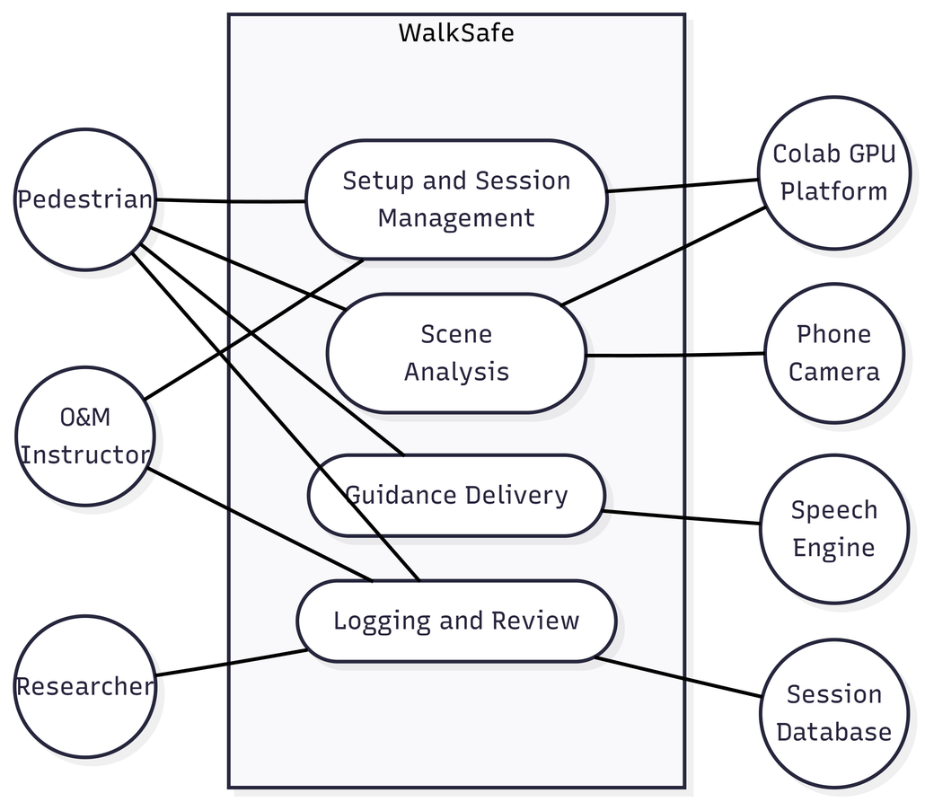
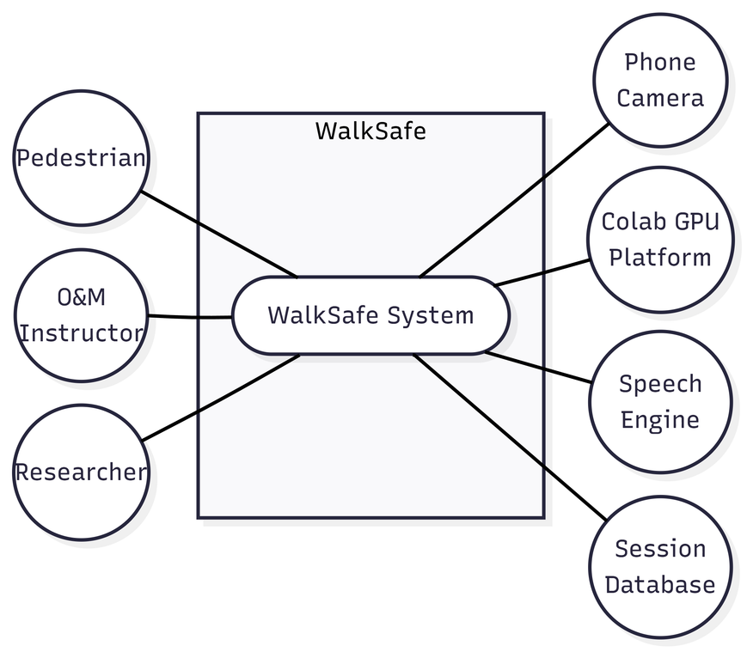
Usecase Diagram : Level 0 & 1
Level 0
Level 1
Notes:
10

Slide 11
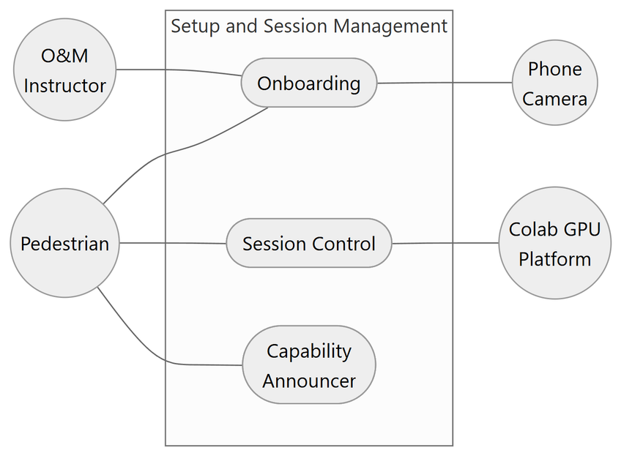
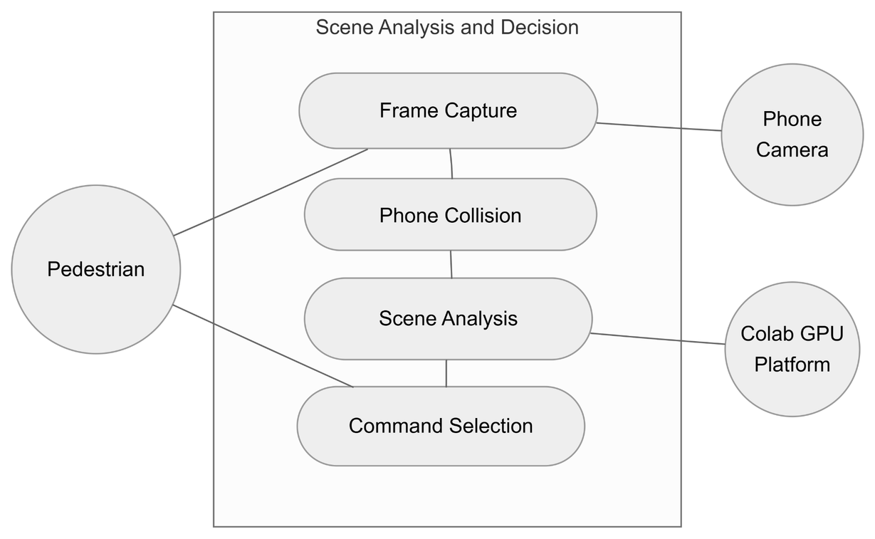
Usecase Diagram : Level 1.1 & 1.2
Level 1.1
Level 1.2
Notes:
10

Slide 12
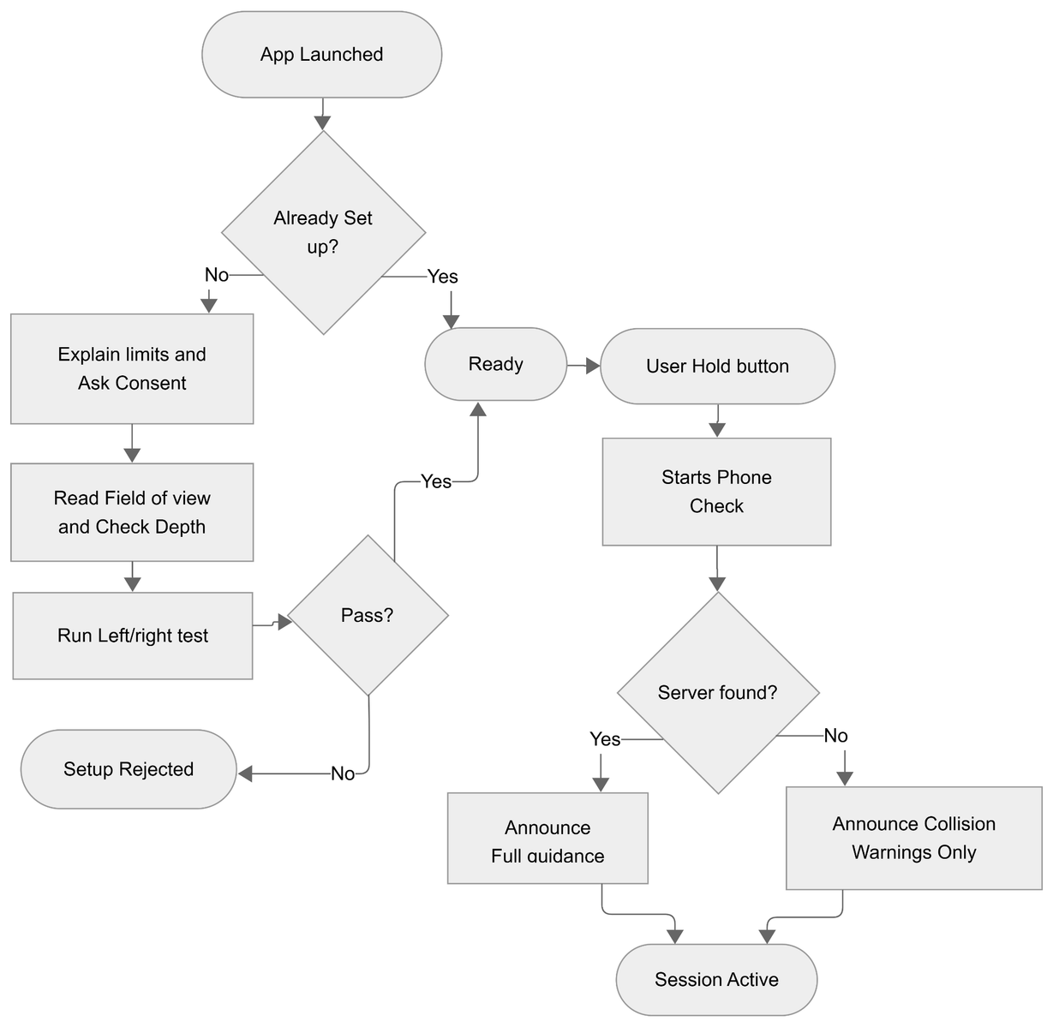
Activity Diagram : Setup & Session Start
Notes:
10

Slide 13
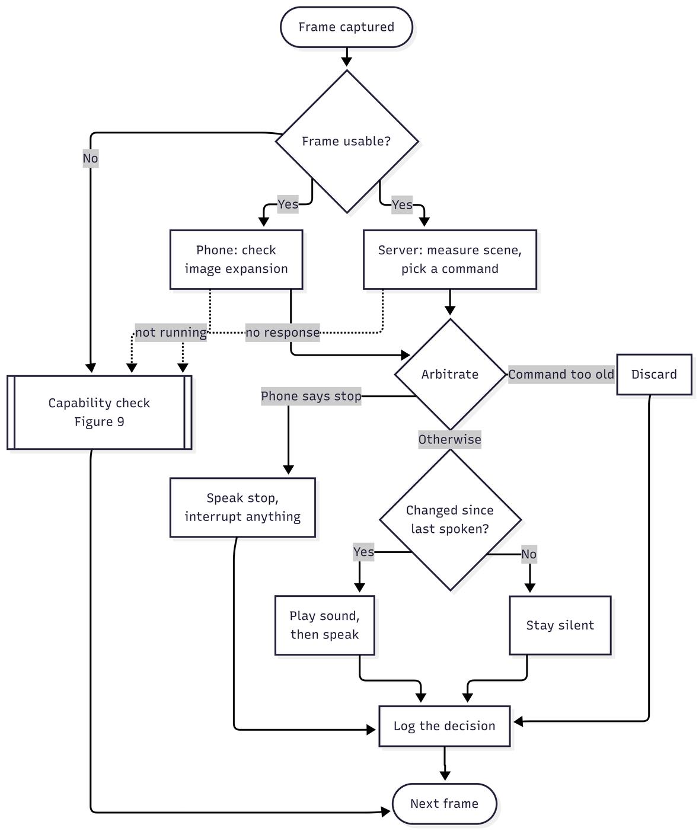
Activity Diagram : Guidance Loop
Notes:
10

Slide 14
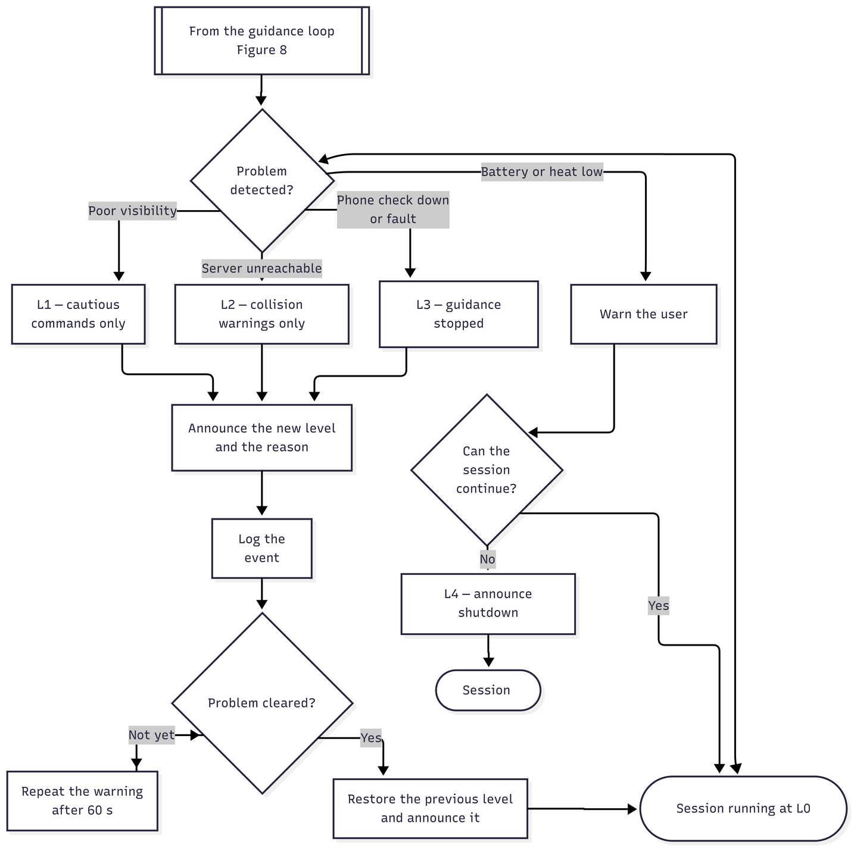
Activity Diagram : Capability Change and Recovery
Notes:
10

Slide 15
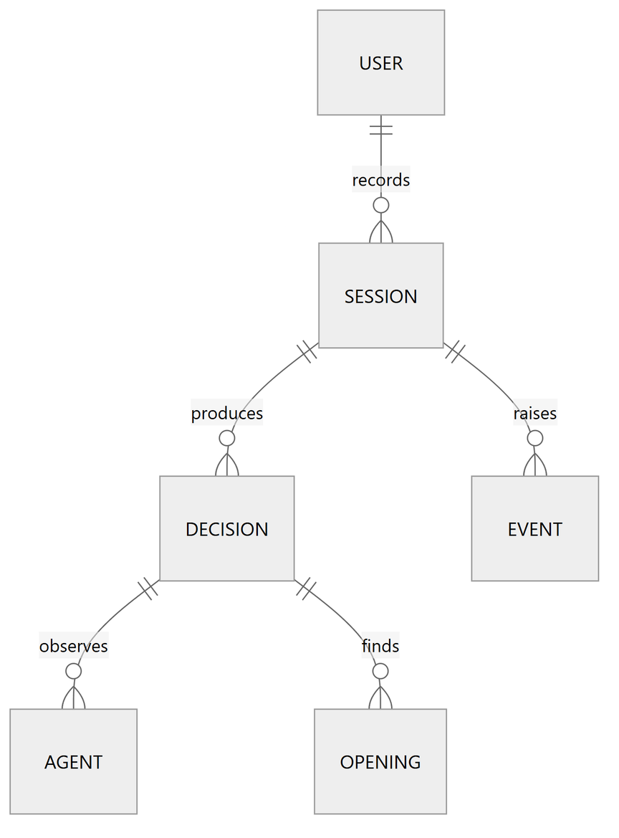
ER Diagram
Notes:
10

Slide 16
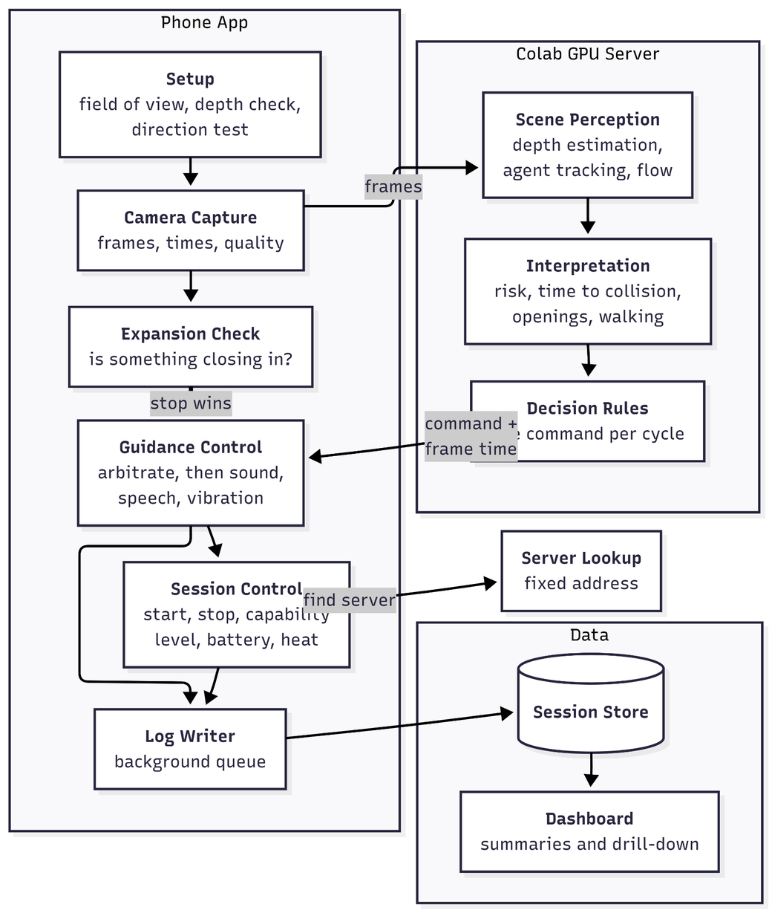
Component Diagram
Notes:
10

Slide 17
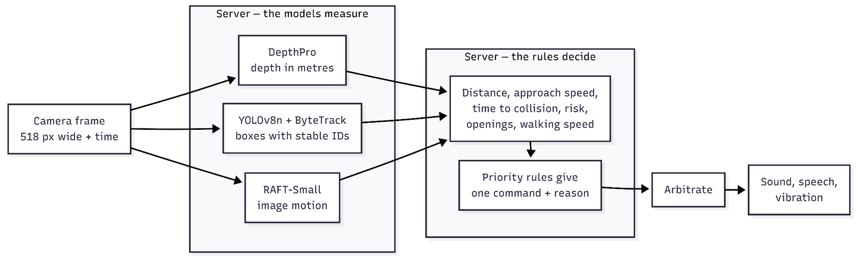
AI Pipeline
Notes:
10

Slide 18
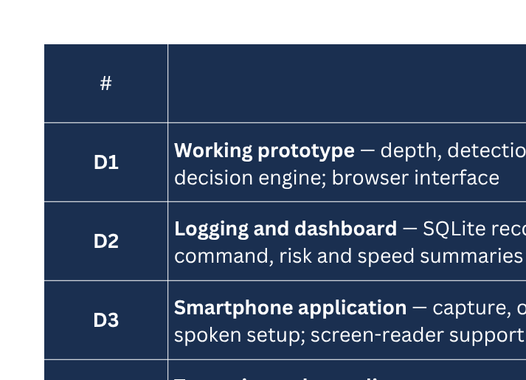
Status & What’s Next
Notes:
10

Slide 19
Key Technologies & Tools
Language
Text-to-Speech
Python
edge-tts (fully offline)
Object Detection
Camera Interface
YOLOv8n (Ultralytics)
OpenCV
Multi-Object Tracking
Deep Learning
ByteTrack
PyTorch
Depth Estimation
Version Control
Apple Depth Pro
Git, GitHub
Motion Analysis
Demo Platform
RAFT-Small (Optical Flow)
Phone Camera with Colab Inference
Notes:
10

Slide 20
References
[1] Z. Teed and J. Deng, “RAFT: Recurrent All-Pairs Field Transforms for Optical Flow,” ECCV 2020.
[2] L. Zhang et al., “ByteTrack: Multi-Object Tracking by Associating Every Detection Box,” ECCV 2022.
[3] Apple ML Research, “Depth Pro: Sharp Monocular Metric Depth in Less Than a Second,” arXiv:2410.02073, 2024.
[4] G. Jocher et al., “Ultralytics YOLOv8,” GitHub Repository, 2023.
[5] World Health Organization, “Blindness and Vision Impairment,” WHO Fact Sheet, 2023.
[6] H. Ye, Y. Chen and Z. Liu, “Sound of Vision: Natural Soundscape Synthesis for the Visually Impaired,” ICCV 2021.
Notes:
13

Slide 21
Thank You
Any Questions?
Shah Alam Abir · BSSE-1439
Supervised by: Dr. Md. Nurul Ahad Tawhid
Institute of Information Technology, University of Dhaka
Notes:
14

