Slide 1


WalkSafe
Navigation Assistant for Visually Impaired Persons in
Dense Urban Environments
PRESENTED BY
SUPERVISED BY
Shah Alam Abir
Dr. Md. Nurul Ahad Tawhid
BSSE — 1439
IIT, University of Dhaka
Associate Professor
Institute of Information Technology,
University of Dhaka
02 August 2026
Notes:
1

Slide 2
Overview
01
Motivation
05
How WalkSafe Works
02
Problem Statement
06
Key Technologies
03
Existing Solutions & Their Gaps
07
References
04
Our Proposed Idea
Notes:
2

Slide 3


Motivation
43 Million Blind Worldwide
Cities Are Getting Denser
WHO 2023: 43M completely blind, 250M+ severely impaired. Over 80% live in low/middle-income countries.
Rapid urbanisation creates chaotic, crowded streets. Unplanned footpaths are dangerous for VI persons every day.
Who Faces the Highest Risk
Those navigating without a companion in dense public spaces on a daily basis
Those in unplanned urban areas — no tactile pavements, no accessible pedestrian crossings
Those who cannot afford guide dogs, LiDAR wearables, or professional rehabilitation services
Notes:
3

Slide 4
Problem Statement
“Visually impaired people in dense urban environments face moment-to-moment dangers that no current assistive tool is designed to handle completely.”
01
02
03
The Environment Problem
The Tool Problem
The Speed Problem
Streets in Dhaka are unplanned and unpredictable. Tactile paving, wide pavements, and clear pedestrian zones do not exist in most areas.
Existing tools were designed for structured environments. They fail when obstacles are moving, unpredictable, and approaching from all directions.
Any system taking more than 0.5 seconds is too slow. A pedestrian at normal pace covers 1 metre every 1.4 seconds — there is no margin.
Notes:
5

Slide 5
Existing Solutions & Their Limitations
Tool / Approach | What It Does | Why It Falls Short
White Cane | Detects ground-level obstacles within arm's reach | No awareness of moving people, overhead objects, or fast-approaching agents
Guide Dog | Dynamically avoids obstacles | Expensive, not scalable, culturally uncommon in Bangladesh
GPS Navigation Apps | Turn-by-turn route directions | Works at city scale — useless at footpath and crowd scale
LiDAR Wearables /Smart Cane | Precise 3D obstacle mapping | Costs $400–$600+; impractical for everyday use
AI Camera Assistants | Describes scenes using vision-language models | Response takes 2–5 seconds — far too slow for active walking
Notes:
6

Slide 6




Our Proposed Idea — WalkSafe
Standard Camera
Smart Pipeline
Spoken Guidance
Live video feed
Perception + Decision
Via earphone
What the user hears:
Move forward — path clear”
“Stop — person approaching from your right”
“Step left — obstacle ahead at 1 metre”
“Caution — low object above, slow down”
Notes:
7

Slide 7
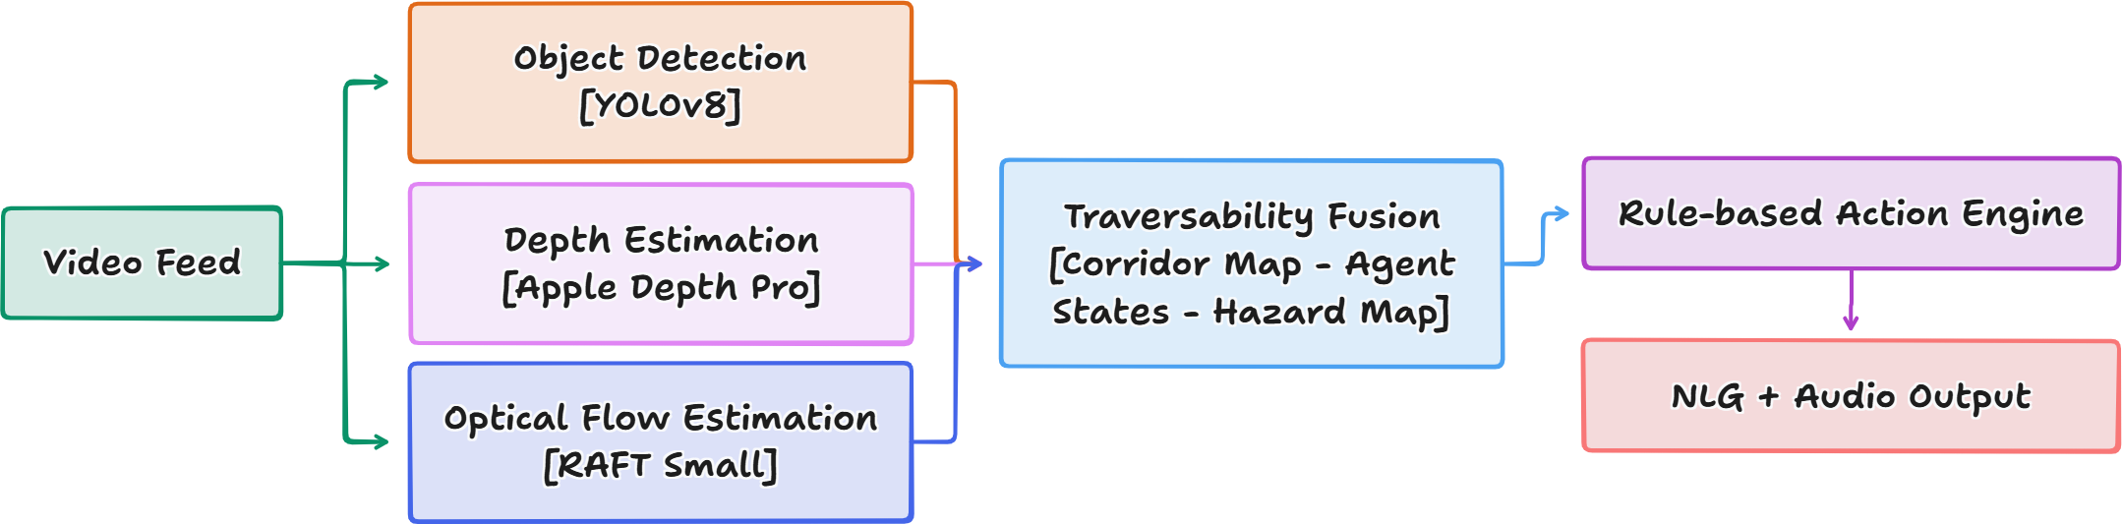
How WalkSafe Works?
Notes:
8

Slide 8
Key Technologies & Tools
Language
Text-to-Speech
Python
edge-tts (fully offline)
Object Detection
Camera Interface
YOLOv8n (Ultralytics)
OpenCV
Multi-Object Tracking
Deep Learning
ByteTrack
PyTorch
Depth Estimation
Version Control
Apple Depth Pro
Git, GitHub
Motion Analysis
Demo Platform
RAFT-Small (Optical Flow)
Standard laptop webcam / USB
Notes:
10

Slide 9
References
[1] Z. Teed and J. Deng, “RAFT: Recurrent All-Pairs Field Transforms for Optical Flow,” ECCV 2020.
[2] L. Zhang et al., “ByteTrack: Multi-Object Tracking by Associating Every Detection Box,” ECCV 2022.
[3] Apple ML Research, “Depth Pro: Sharp Monocular Metric Depth in Less Than a Second,” arXiv:2410.02073, 2024.
[4] G. Jocher et al., “Ultralytics YOLOv8,” GitHub Repository, 2023.
[5] World Health Organization, “Blindness and Vision Impairment,” WHO Fact Sheet, 2023.
[6] H. Ye, Y. Chen and Z. Liu, “Sound of Vision: Natural Soundscape Synthesis for the Visually Impaired,” ICCV 2021.
Notes:
13

Slide 10
Thank You
Any Questions?
Shah Alam Abir · BSSE-1439
Supervised by: Dr. Md. Nurul Ahad Tawhid
Institute of Information Technology, University of Dhaka
Notes:
14

