Slide 1
Four parts, one autonomous receiver
Track 1 (Advanced): Deep-Space Communication & Signal Intelligence
Team Rover Rangers · MATLAB in Space Hackathon · October 3, 2026
Notes:
Each team member built one part of Track 1. The four parts are presented separately, exactly as each member made them, followed by one conclusion that brings together what was achieved.

Slide 2
Four parts of Track 1
Modulation classification and blind Doppler correction
1
RadioML classifier, blind Doppler correction, RadioML 2018 and a command-decoding demo
Blind deep-space receiver
2
Find, identify, clean and decode on simulated links, with the Voyager convolutional code
Real telemetry frames through a hostile channel
3
861 real SatNOGS frames sent through Doppler drift, dropouts and hops, recovered autonomously
Decoding a real satellite pass
4
OrigamiSat-2 pass recorded by a SatNOGS ground station, decoded end to end
Notes:
The order goes from simulated benchmarks to real satellite data: first identifying and correcting signals on RadioML, then a full blind receiver with error-correcting code, then real telemetry through a hostile channel, and finally a real satellite pass.

Slide 3
Modulation classification and blind Doppler correction
Part 1
RadioML classifier, blind Doppler correction, RadioML 2018 and a command-decoding demo
Presented by Priyanka
Notes:
Section divider for Part 1. The following slides are this part's original deck, unchanged.

Slide 4
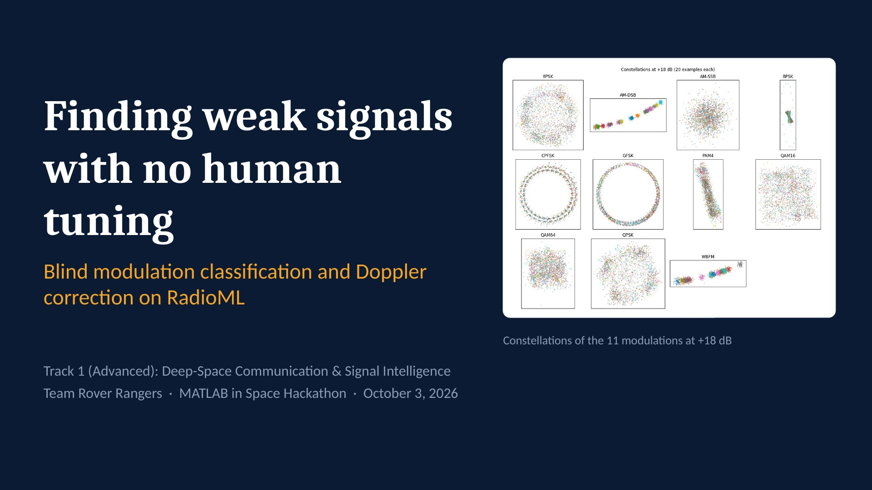
Notes:
We built a receiver that identifies the modulation of weak, drifting radio signals and removes Doppler offset on its own, with no human tuning. Everything is trained and tested on RadioML, with a pipeline ready for real SatNOGS satellite recordings.

Slide 5
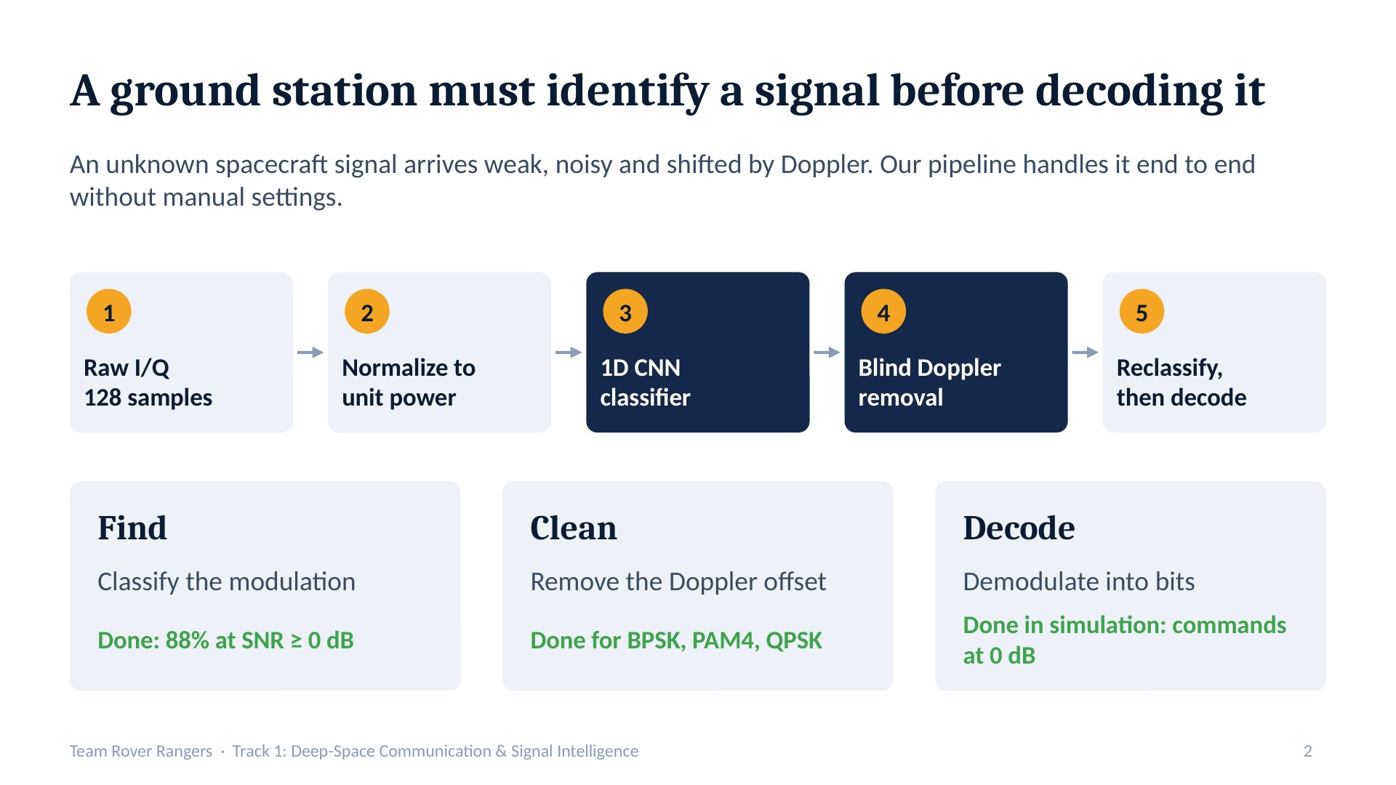
Notes:
The track asks us to find, clean and decode weak signals with no human tuning. Finding means identifying the modulation, cleaning means removing impairments like Doppler. We completed find and clean; decode is future work.

Slide 6
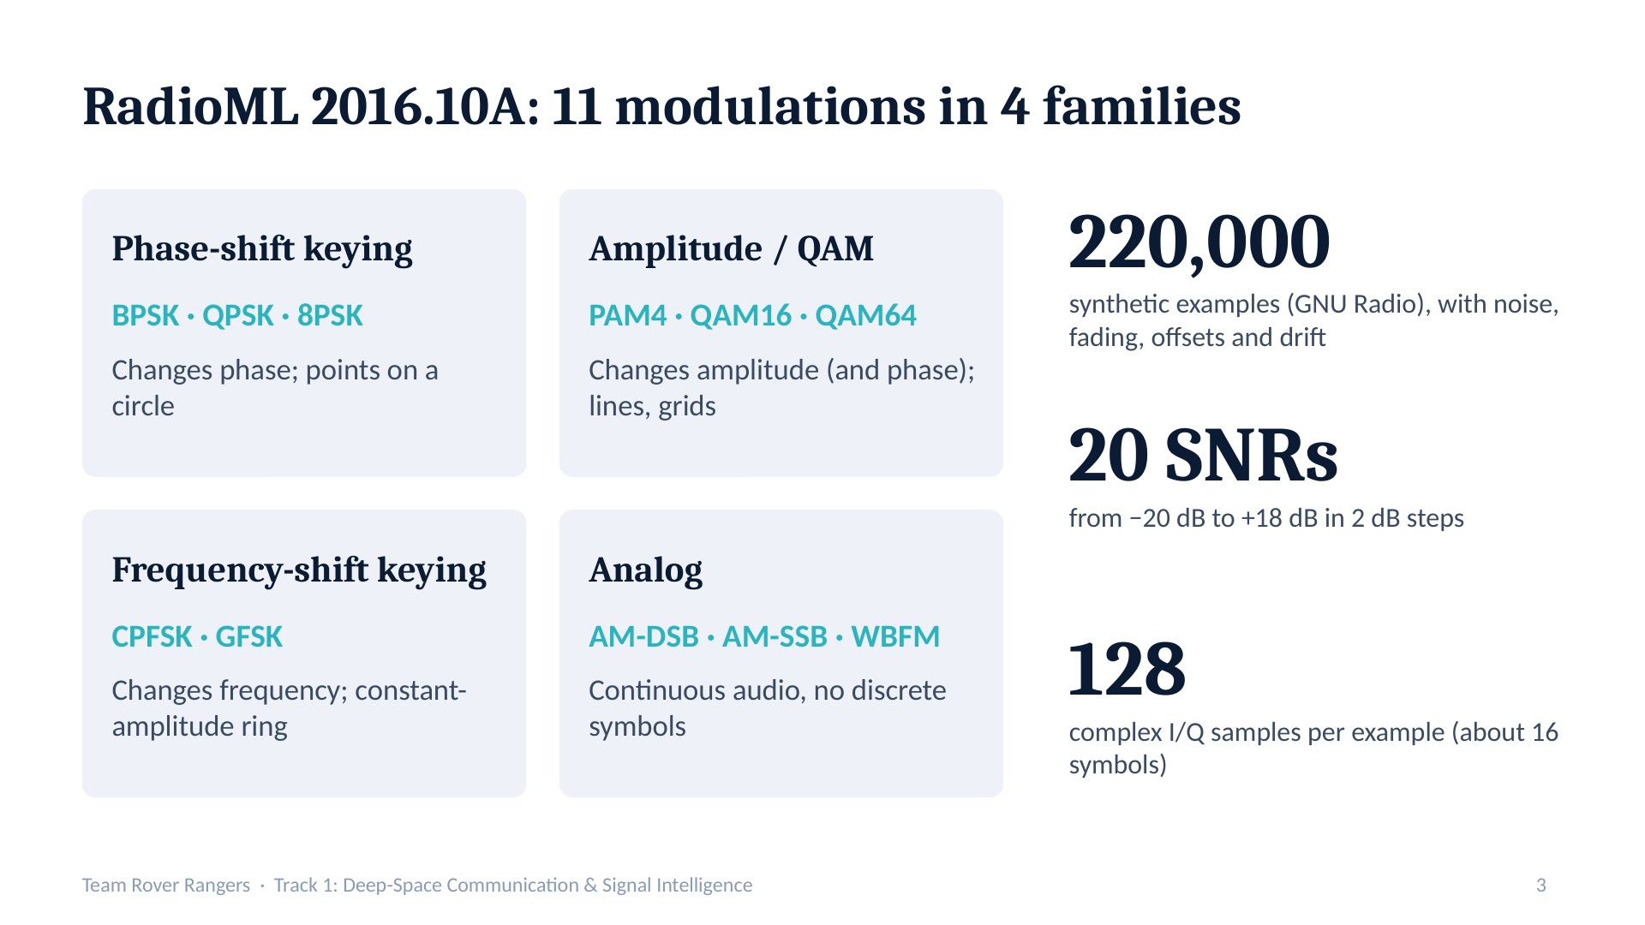
Notes:
RadioML is a benchmark of simulated radio signals with realistic impairments. The 11 modulations fall into four families depending on whether they change phase, amplitude, frequency, or carry analog audio. Each example is only 128 samples, which matters later.

Slide 7
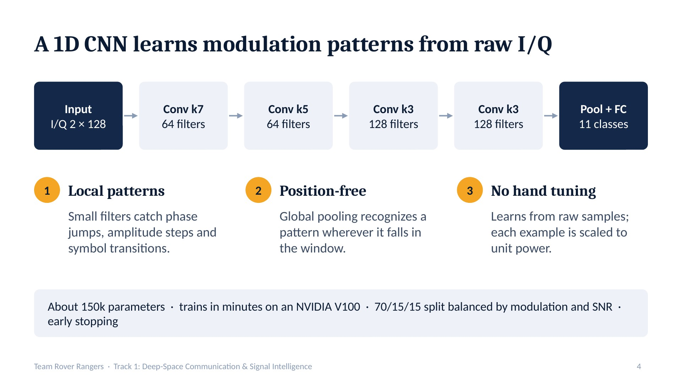
Notes:
We treat I and Q as two channels of a time series. Modulations differ in short waveform patterns, convolution detects them anywhere in the window, and the model learns from raw samples with no hand-crafted features.

Slide 8
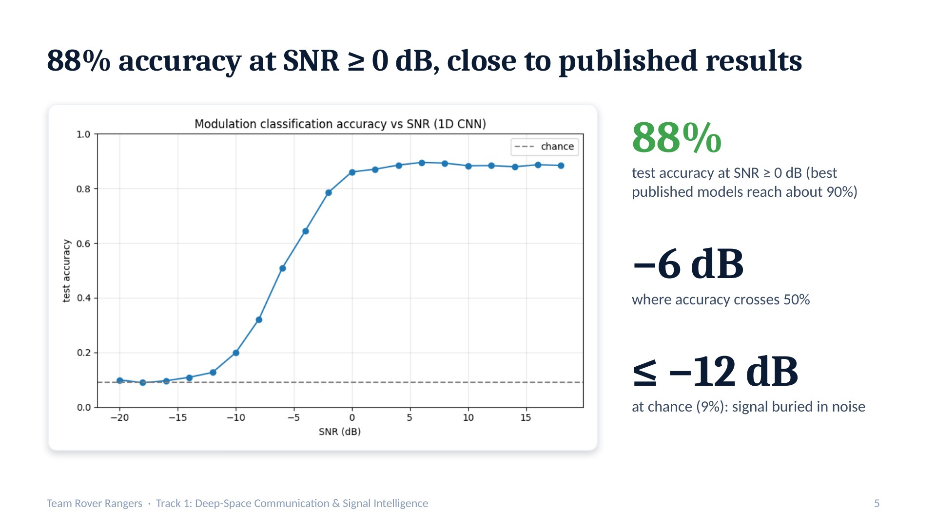
Notes:
Tested on 33,000 held-out examples. Below about −12 dB nothing can be recovered; accuracy climbs between −10 and 0 dB and plateaus at about 88%. Training on the full dataset instead of a 20% smoke test lifted the plateau from 80% to 88%.

Slide 9
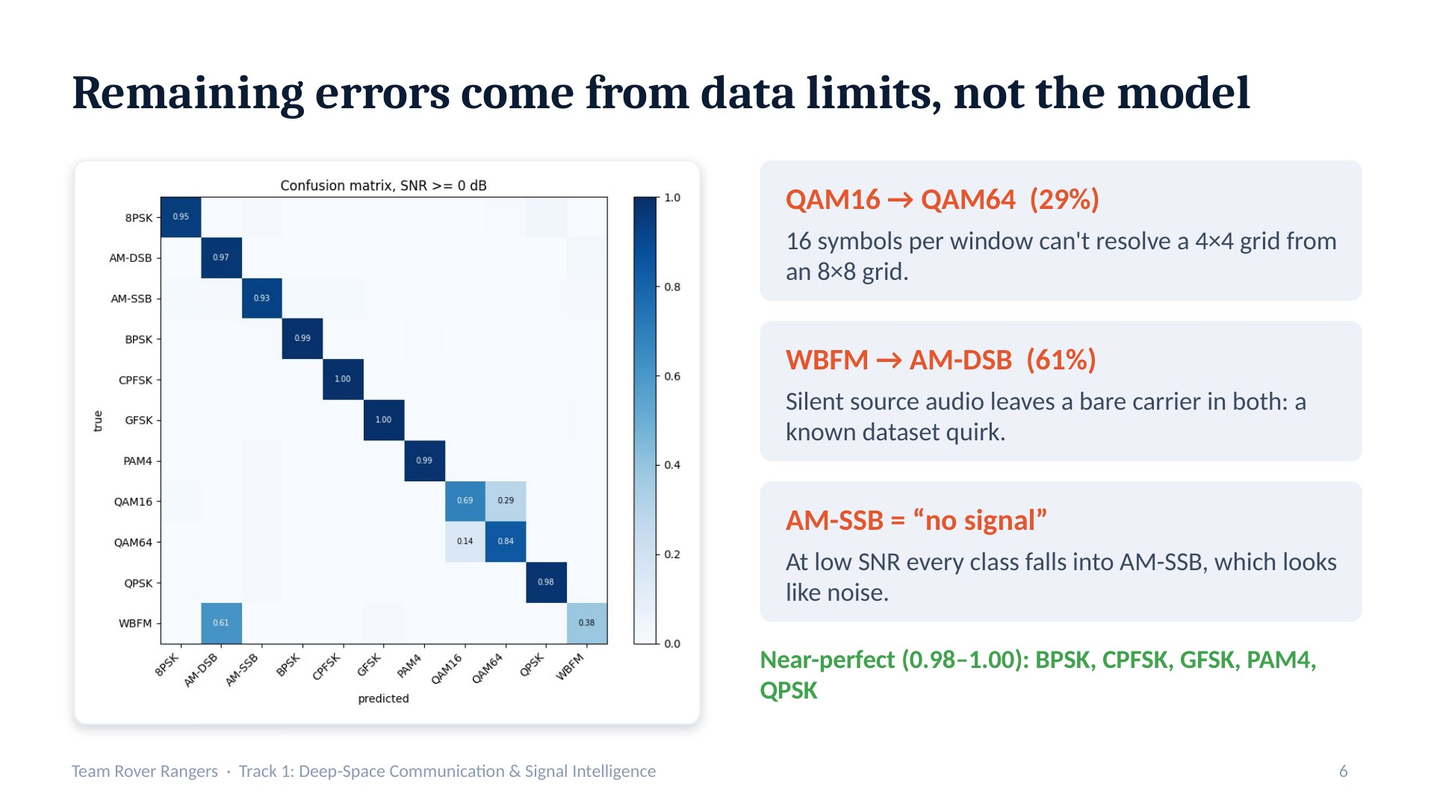
Notes:
The confusion matrix at SNR at or above 0 dB is nearly diagonal. The two remaining confusions are explained by the data: too few symbols to separate QAM16 from QAM64, and silent audio that makes WBFM and AM-DSB identical. At low SNR the model uses AM-SSB as its no-signal answer.

Slide 10
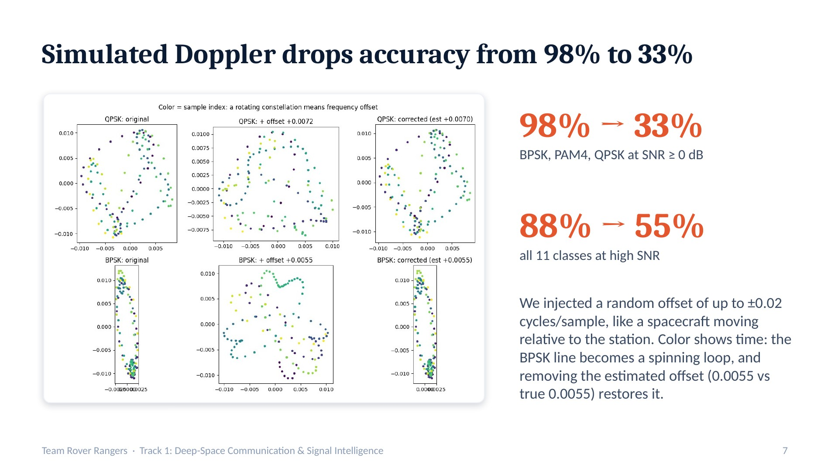
Notes:
A classifier trained without Doppler fails on a moving transmitter. The offset rotates the constellation over time. Because we injected the offset ourselves, we know the true value and can measure exactly how well we remove it.

Slide 11
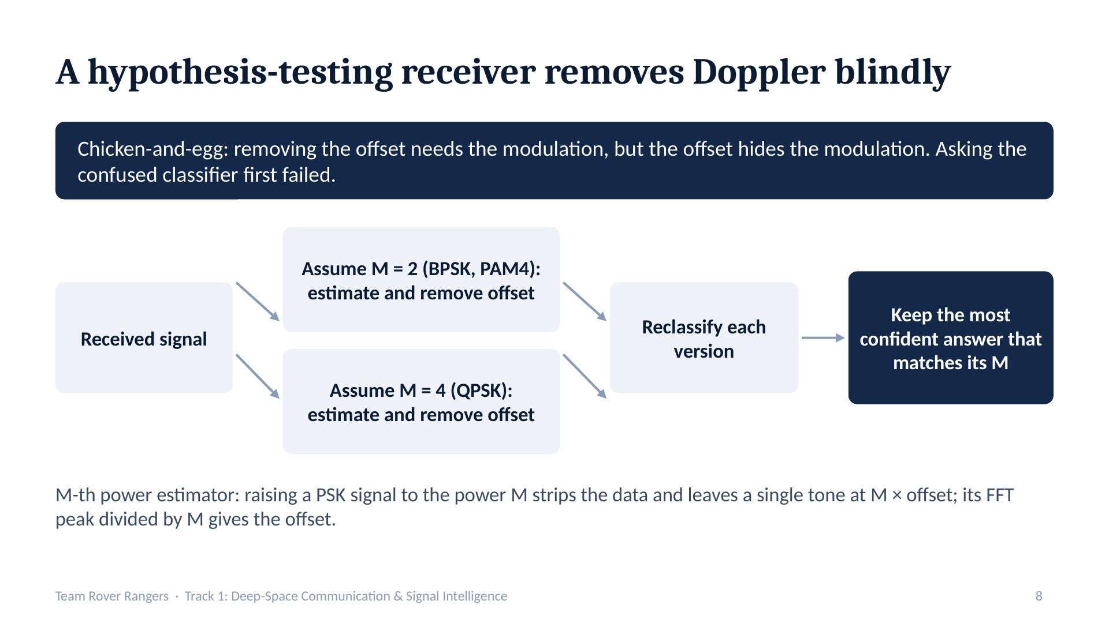
Notes:
Instead of trusting the first, confused prediction, the receiver tries both corrections, reclassifies each, and accepts a correction only if the new prediction agrees with the hypothesis, for example M equals 4 and the model now says QPSK. This uses no true labels.

Slide 12
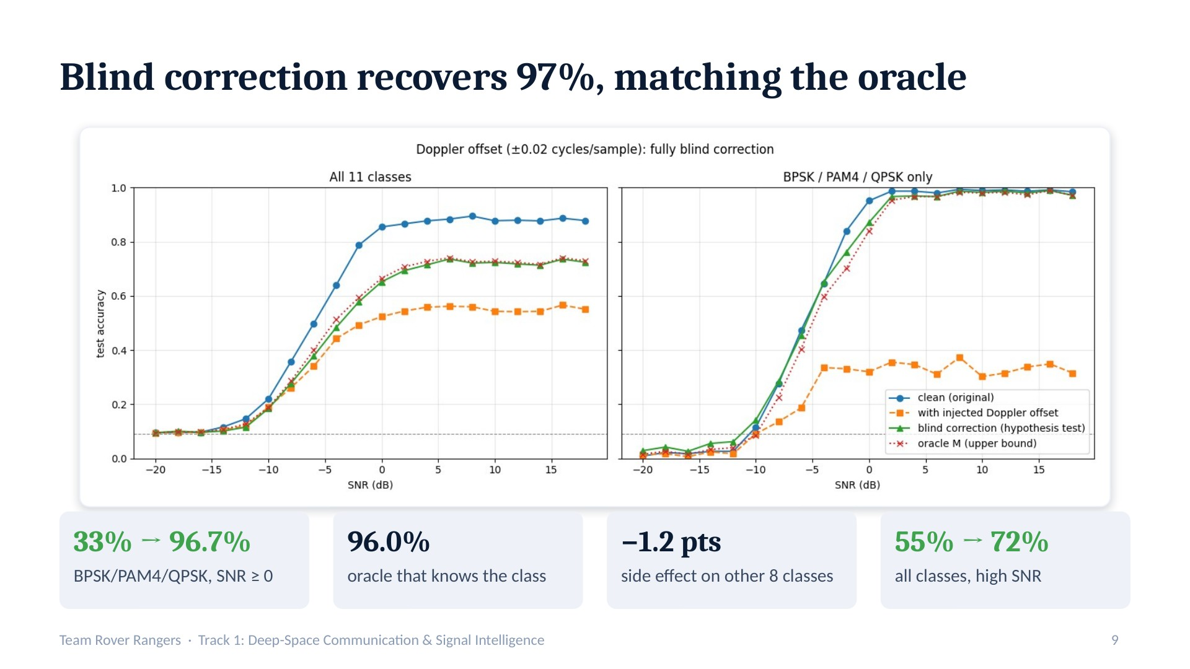
Notes:
Green is our fully blind receiver, red dotted is the oracle that cheats by using the true class. They overlap: the blind version reaches 96.7% for BPSK, PAM4 and QPSK, slightly above the oracle, at a cost of only 1.2 points on other classes. The gap that remains on the left is classes we don't correct yet.

Slide 13
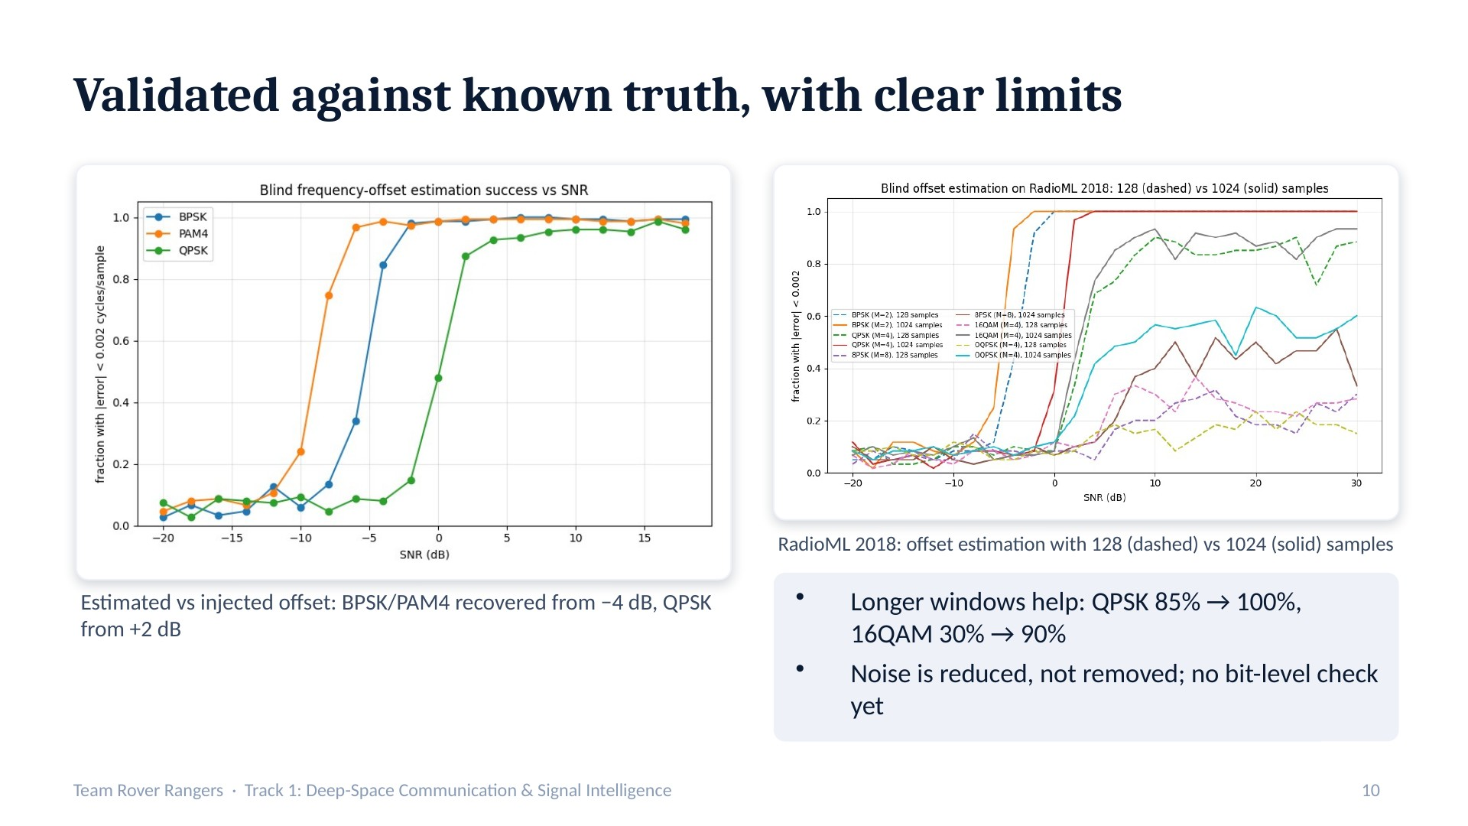
Notes:
Because we injected the Doppler ourselves, every estimate is checked against the true value. On RadioML 2018 we confirmed that longer windows make blind estimation reliable for QPSK and 16QAM; 8PSK still needs symbol timing recovery. Noise can only be reduced, and we have not measured bit error rate.

Slide 14
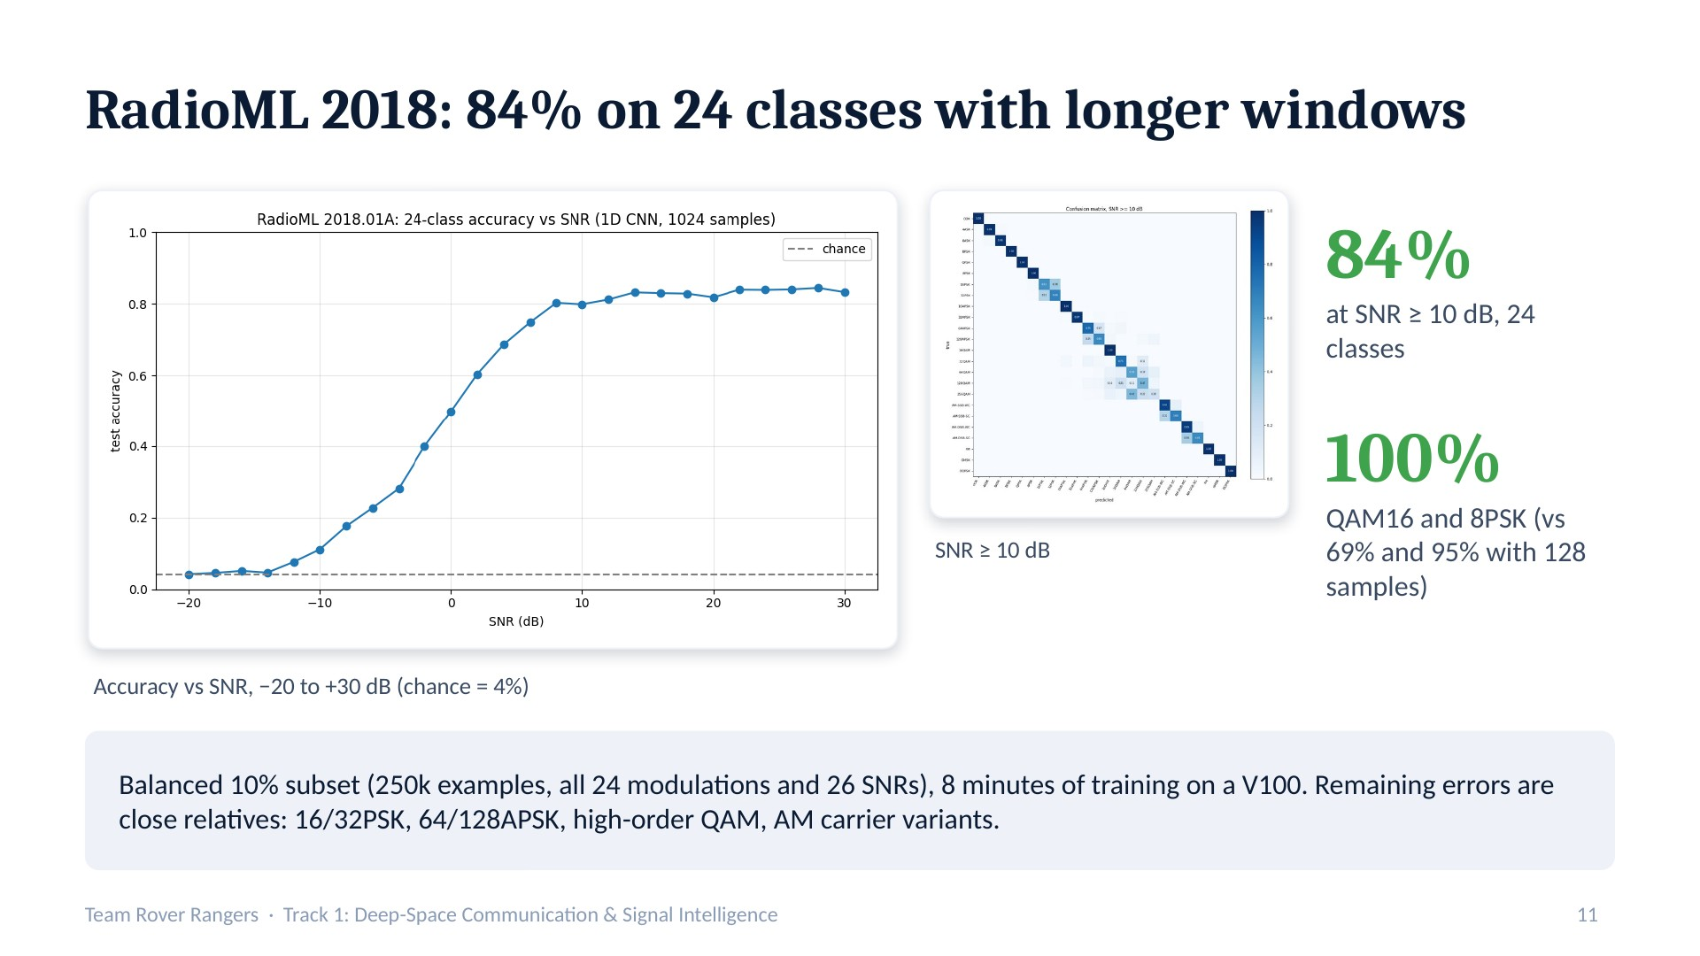
Notes:
On the harder 24-class benchmark with 1024-sample windows, the same kind of CNN reaches 84% at high SNR using only 10% of the data and 8 minutes of training. Longer windows fix the confusions we saw before: QAM16 and 8PSK are now classified perfectly. Published models on the full data reach about 95%, so there is room to grow.

Slide 15
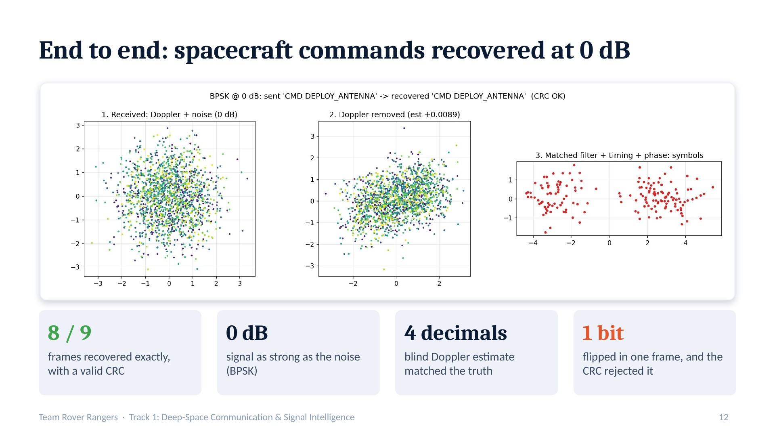
Notes:
We built a simplified CCSDS-style frame: the standard sync word 1ACFFC1D, a length byte, the message and a CRC-16 checksum. We sent commands and telemetry through a link with an unknown Doppler shift. The receiver estimated the Doppler blindly, used a matched filter, recovered timing and phase, found the sync word and decoded the text. At 0 dB, where the signal looks like pure noise, 8 of 9 frames came through exactly; in the ninth, noise flipped one bit and the CRC rejected the frame, exactly as a spacecraft would.

Slide 16
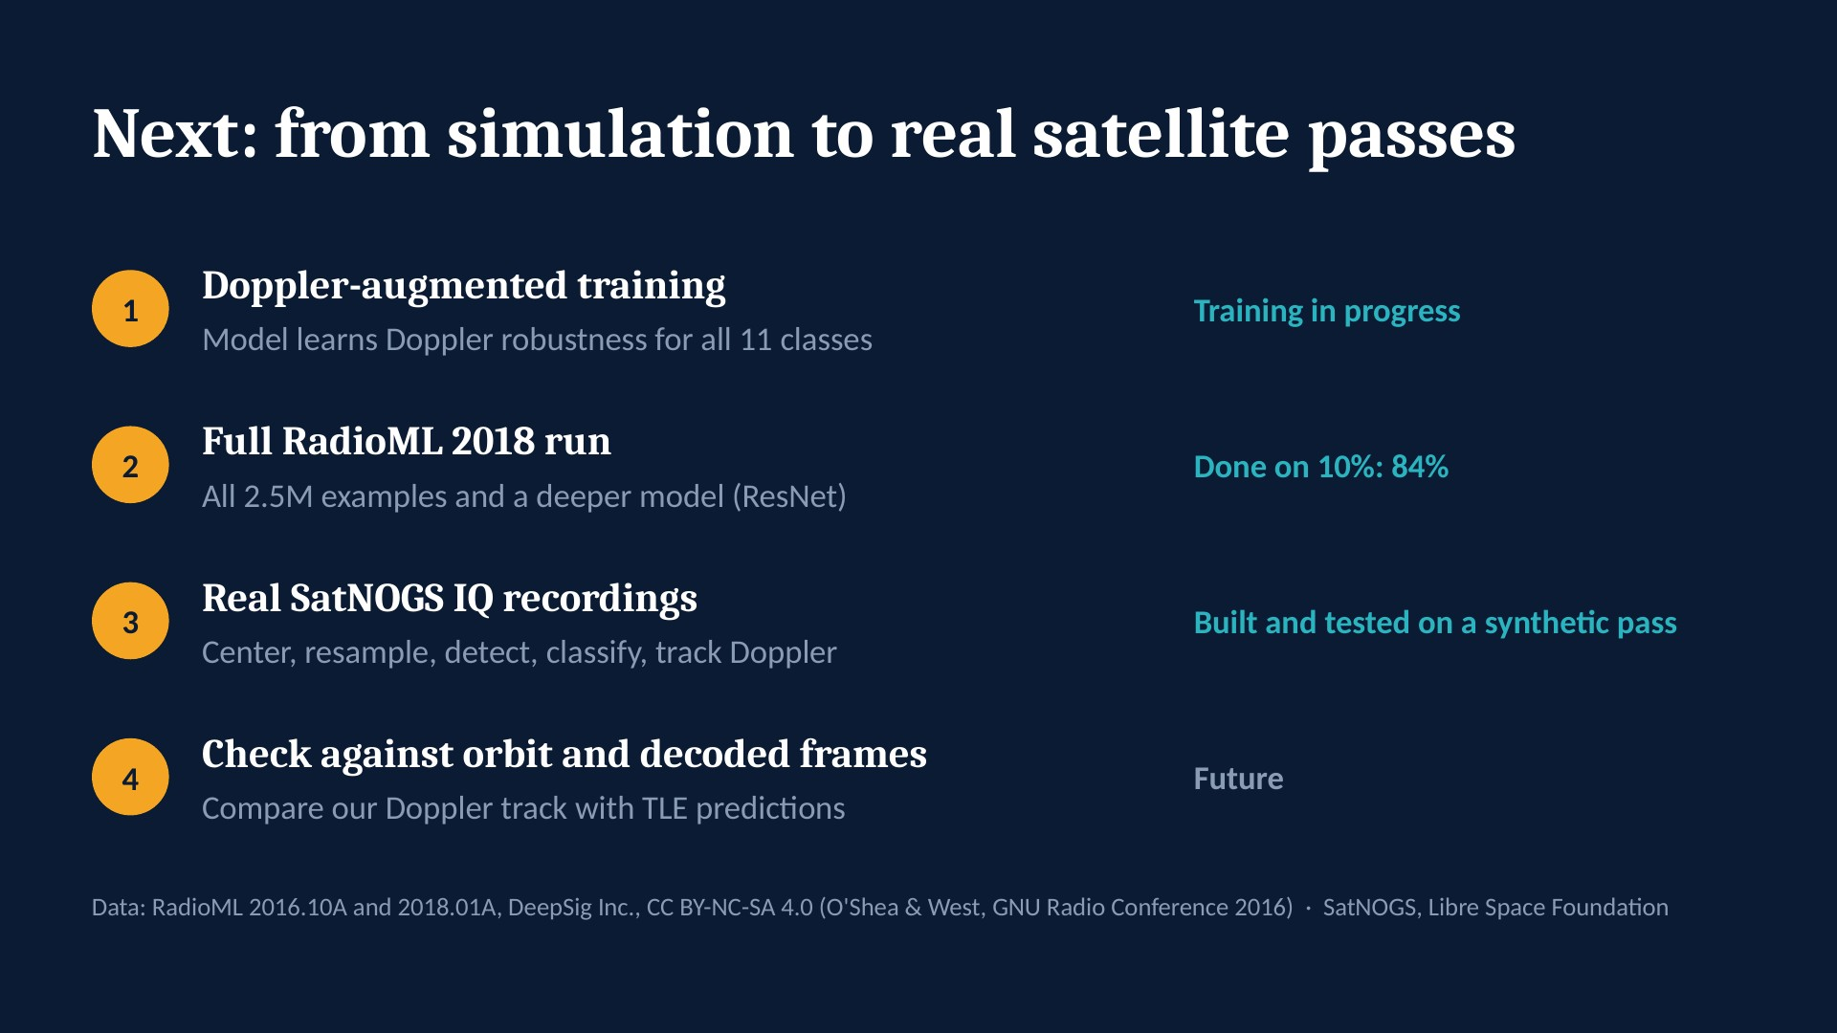
Notes:
Our pipeline is ready for real data. Next steps are running Doppler-robust training, scaling RadioML 2018 to the full dataset, real SatNOGS recordings, and validating our blind Doppler track against orbit predictions and decoded telemetry frames.

Slide 17
Blind deep-space receiver
Part 2
Find, identify, clean and decode on simulated links, with the Voyager convolutional code
Presented by Alay
Notes:
Section divider for Part 2. The following slides are this part's original deck, unchanged.

Slide 18
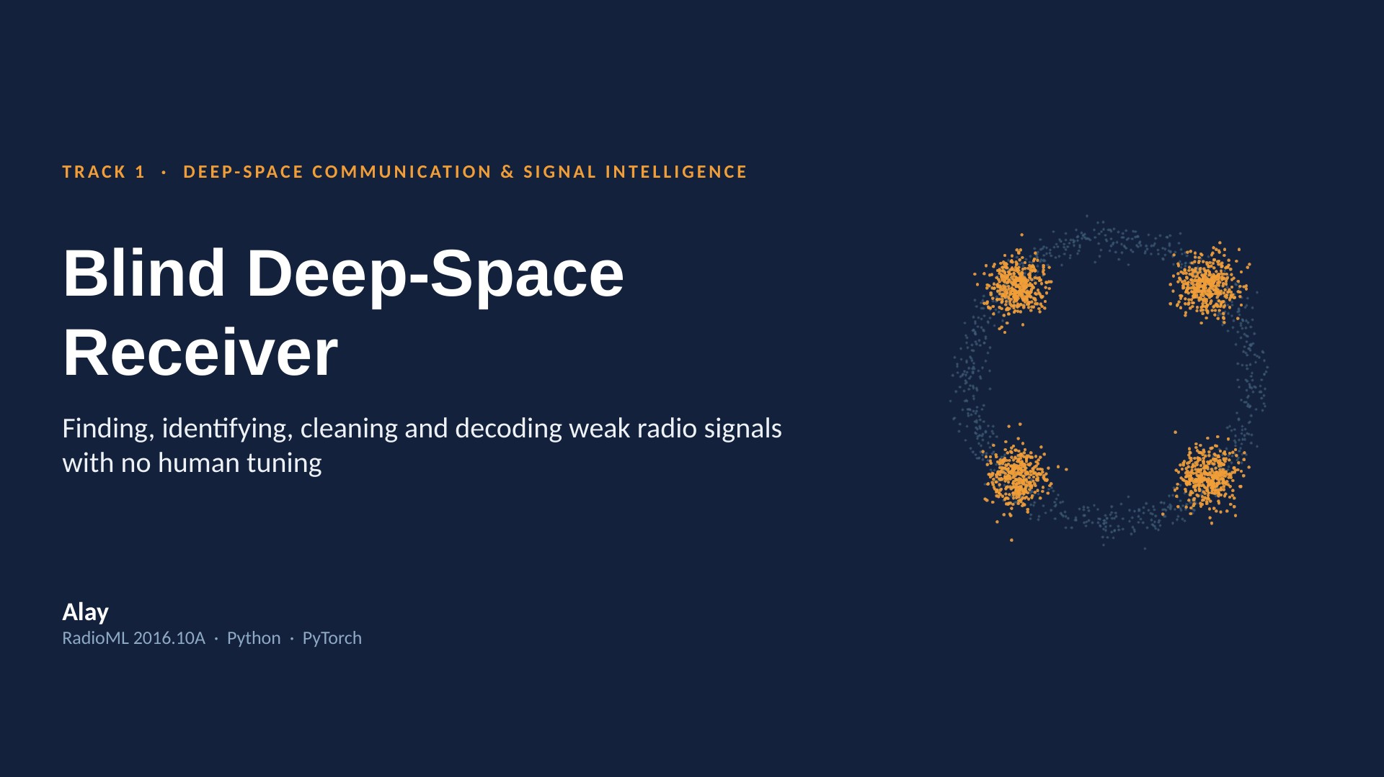
Notes:
A deep-space receiver gets a weak, distorted signal and must recover the data on its own. We built one that finds the signal, identifies its modulation with a neural network, removes timing, Doppler and phase errors, and decodes it with the Voyager error-correcting code, with no hand-tuned parameters.

Slide 19
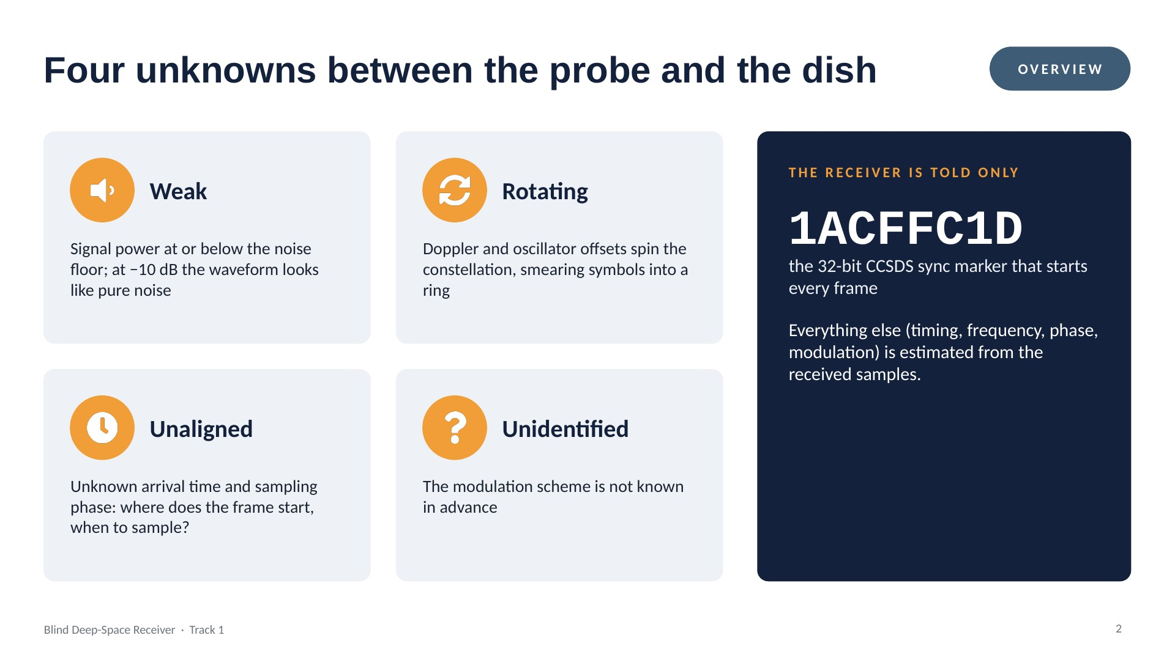
Notes:
The receiver knows nothing about the signal except the standard sync marker real spacecraft frames start with. Weak, rotating, unaligned and unidentified: each of the next sections removes one of these unknowns.

Slide 20
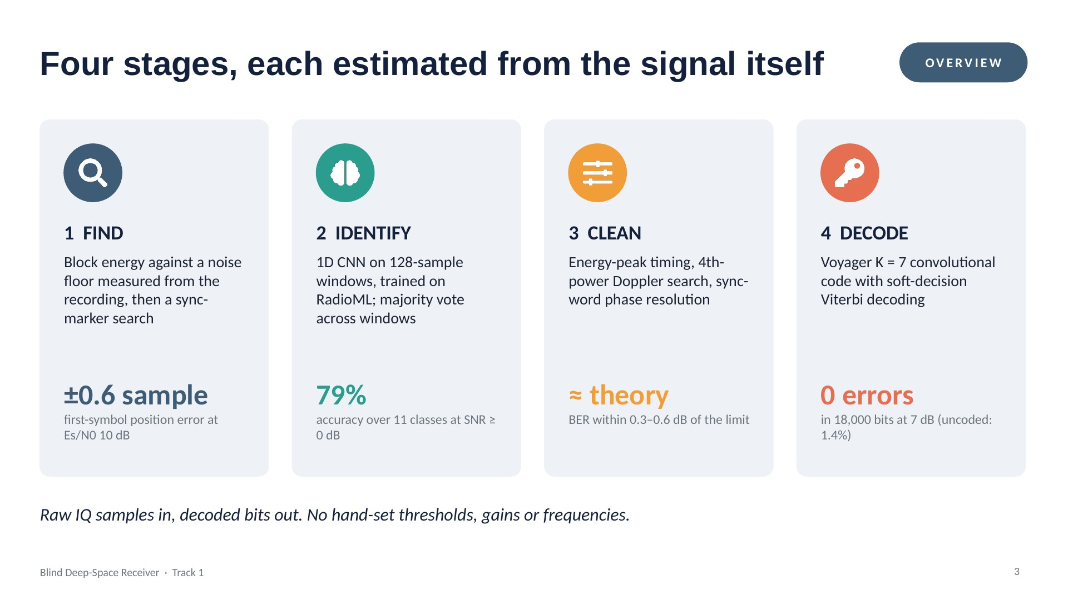
Notes:
This is the whole pipeline. Each stage measures what it needs from the data: the noise floor, the sampling phase, the frequency offset, the rotation. The headline numbers here are each backed by a slide later.

Slide 21
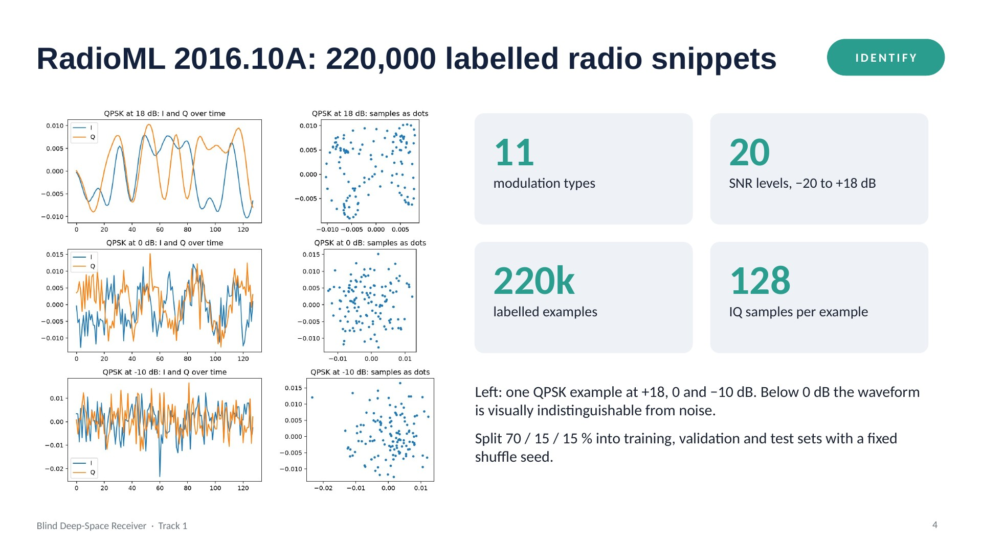
Notes:
RadioML 2016.10A by DeepSig: synthetic signals from GNU Radio with realistic impairments. Each example is 128 complex samples. The I/Q traces on the left show the same modulation getting buried as SNR drops.

Slide 22
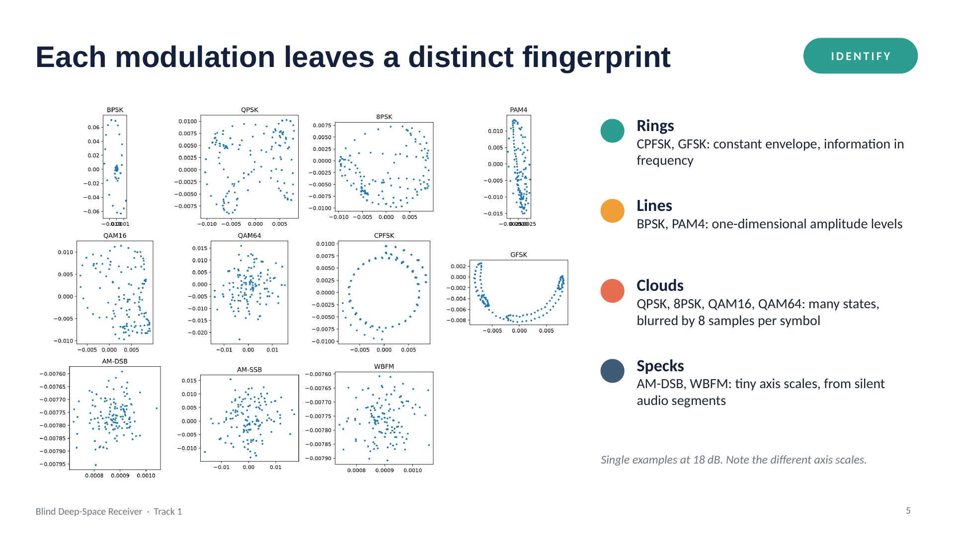
Notes:
Plotting one clean example per class: the shapes differ, which is why a classifier can work. Two pairs already look alike here, QAM16/QAM64 and AM-DSB/WBFM; they come back in the confusion matrix.

Slide 23
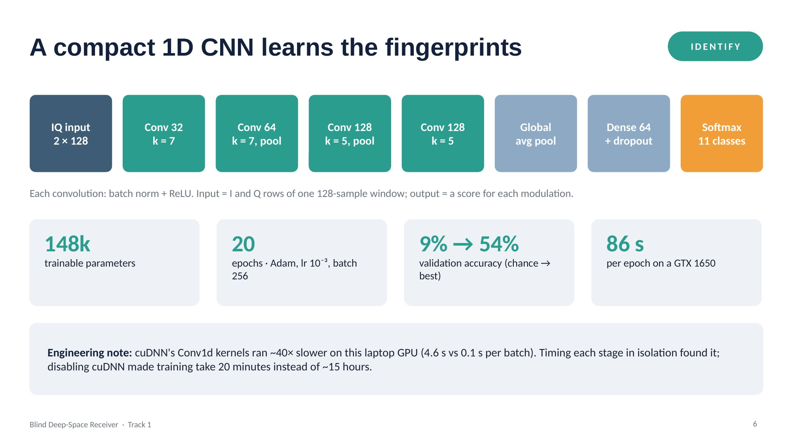
Notes:
A small 1D convolutional network over the raw I/Q samples. We trained it on 154,000 examples. The best validation accuracy across all SNRs was 54.4%. One practical hurdle: cuDNN was pathologically slow on this GPU for 1D convolutions, which we diagnosed with a step-by-step timing script.

Slide 24
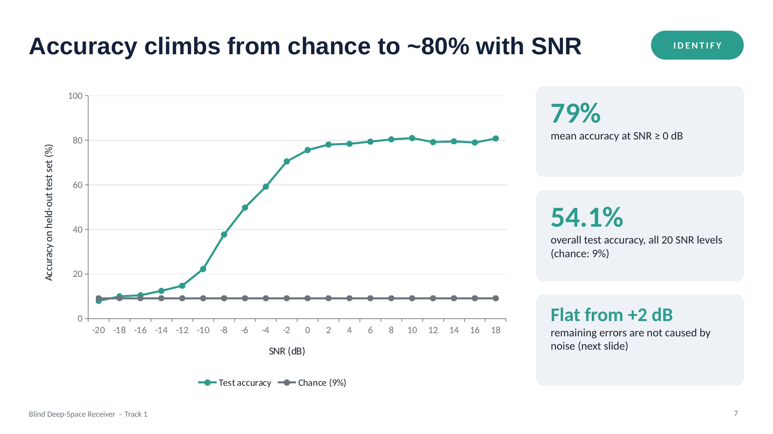
Notes:
Below −12 dB nothing can be identified, as expected. Between −10 and −2 dB accuracy climbs steeply. Above +2 dB it plateaus around 80%: more signal does not help, so the remaining errors are structural.

Slide 25
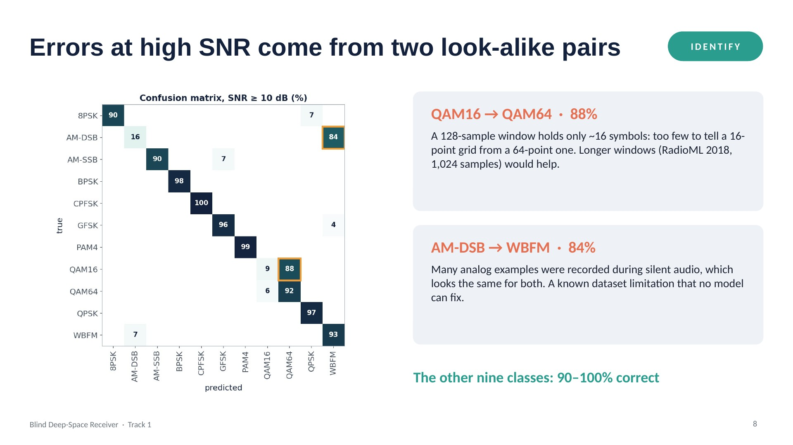
Notes:
At SNR of 10 dB and above, nine classes are 90 to 100% correct. The two highlighted cells account for almost all remaining errors, and both have physical explanations rather than being model failures.

Slide 26
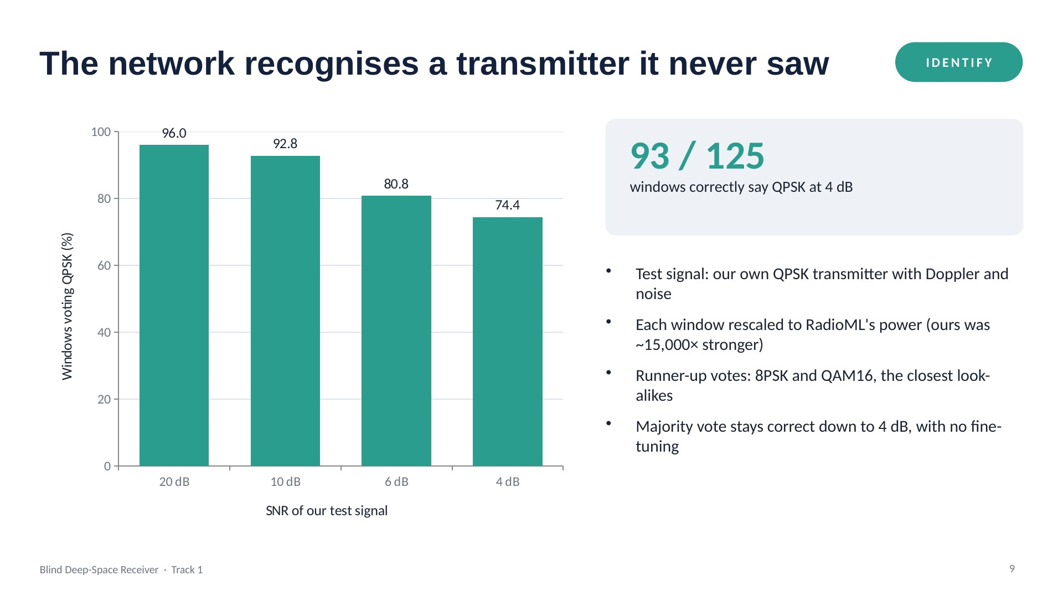
Notes:
Domain shift check: the model only ever saw RadioML, yet it recognises our own transmitter. The one fix needed was matching the signal power to the training data.

Slide 27
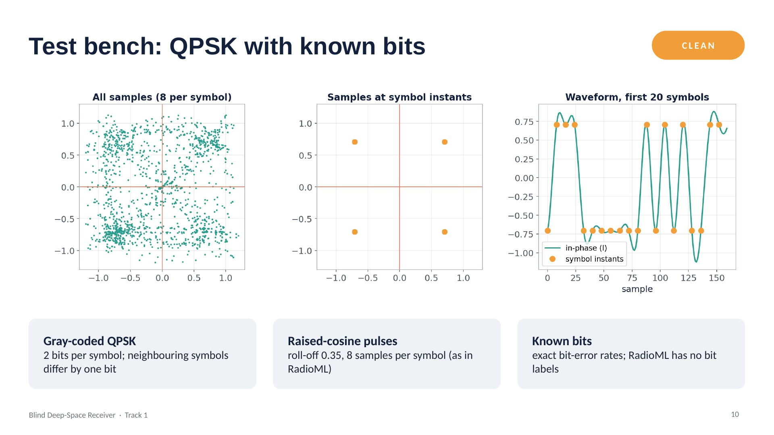
Notes:
To score decoding we need ground-truth bits, so we built our own transmitter. Left: all samples look messy because most are taken between symbols. Middle: sampled at the right instants, the four QPSK points are exact. That's why timing recovery matters.

Slide 28
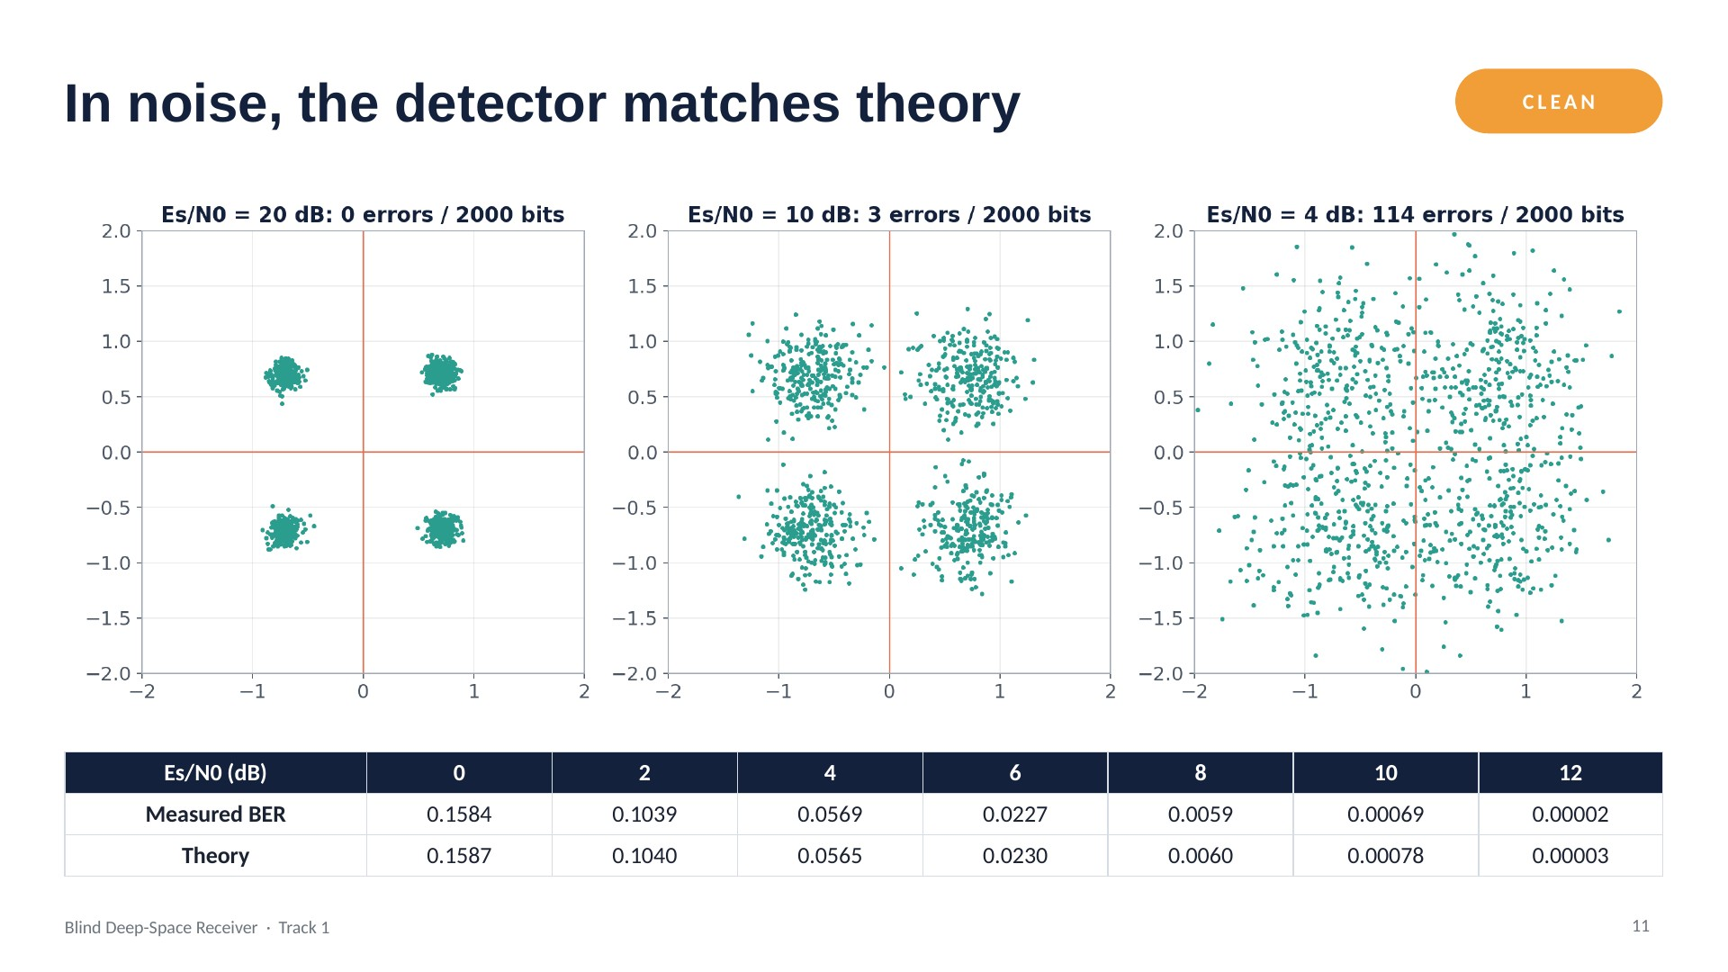
Notes:
With perfect synchronisation, our measured bit error rate matches the textbook QPSK formula at every SNR. This is the target the blind receiver has to reach.

Slide 29
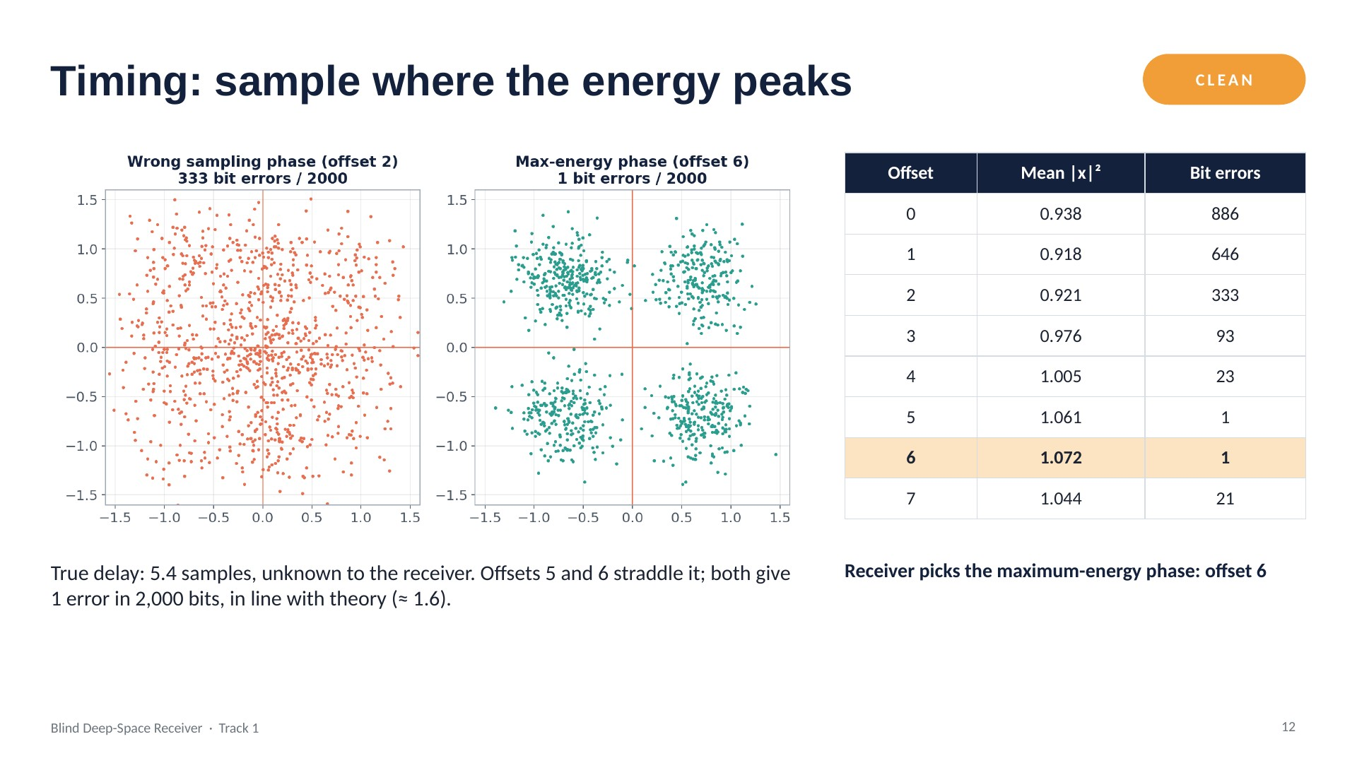
Notes:
At the correct sampling instant the pulse is at its peak, so average energy is highest. The energy curve is shallow but the error curve is steep, so averaging over many symbols matters.

Slide 30
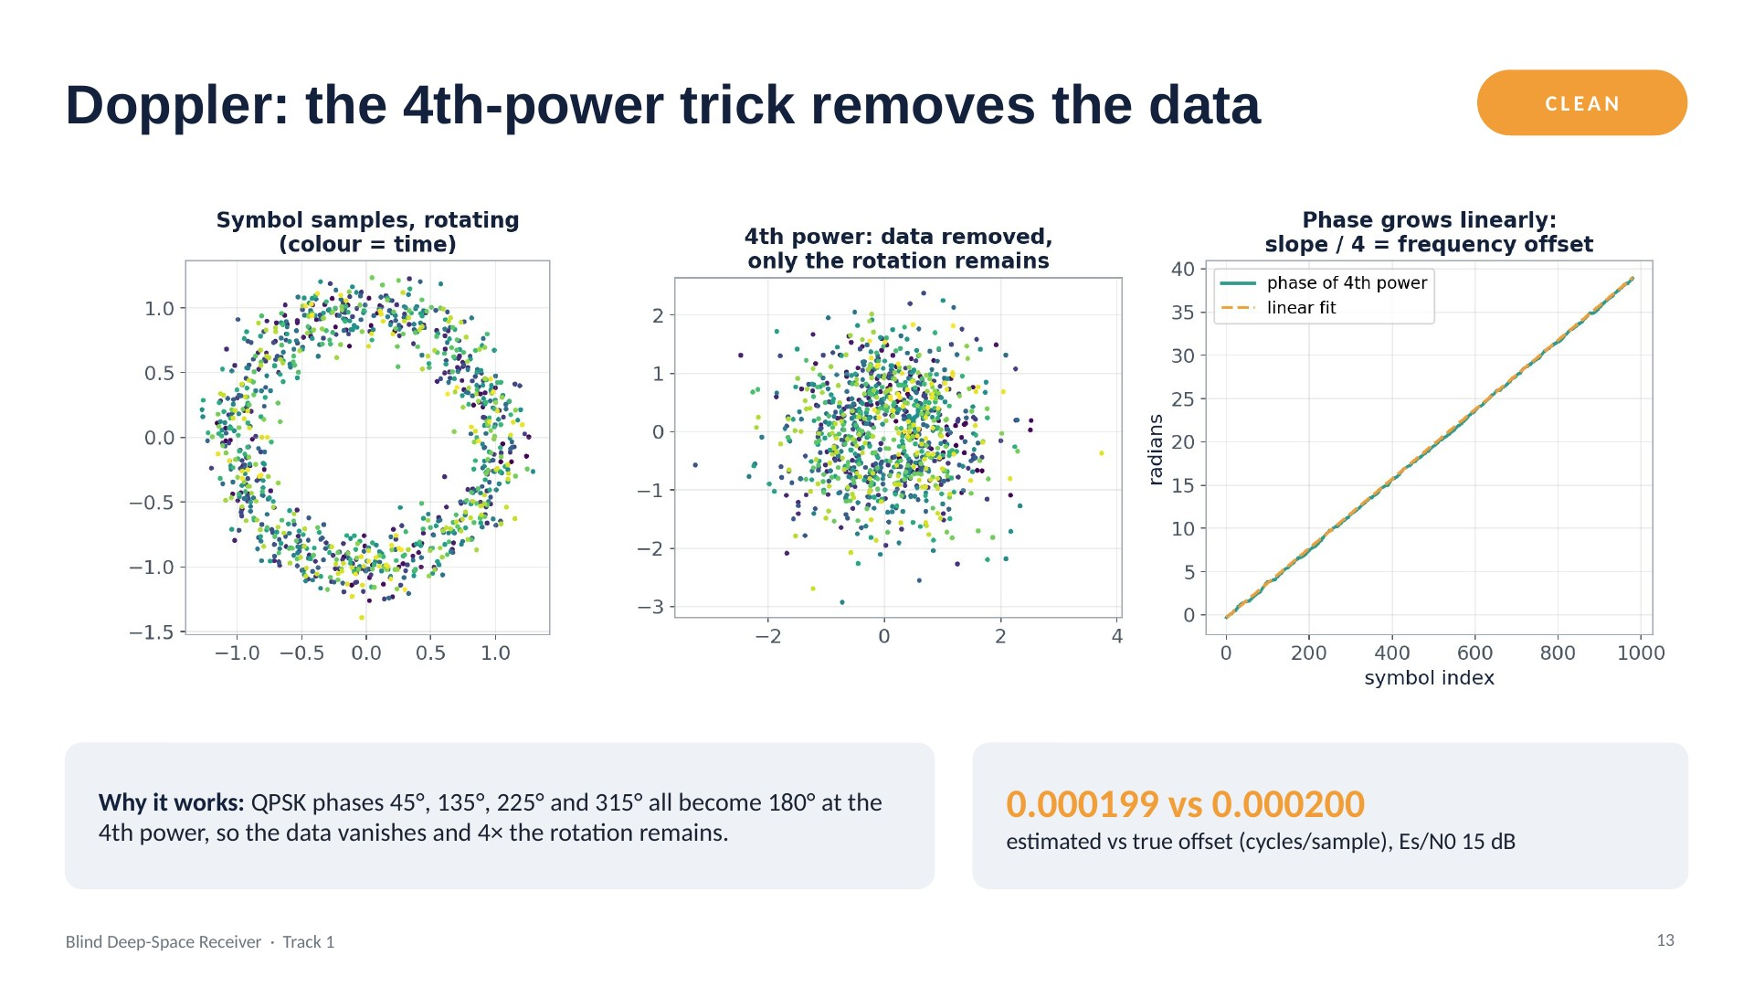
Notes:
Raising each sample to the 4th power maps all four QPSK points to the same angle, removing the data. What remains rotates at four times the offset frequency. Here the phase was fitted with a line; the final receiver uses a grid search over candidate offsets instead, which can't slip at low SNR.

Slide 31
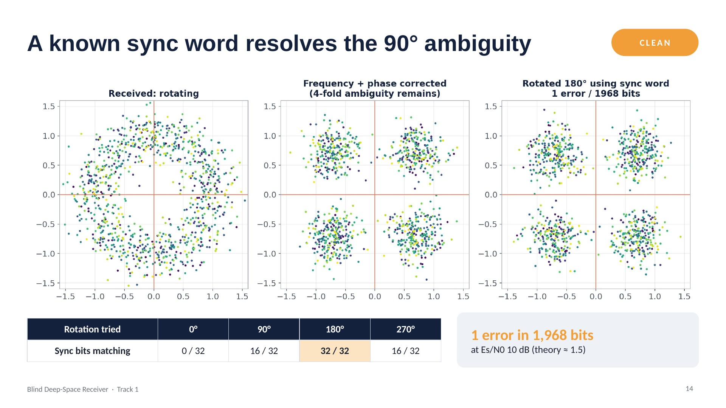
Notes:
After removing the rotation, QPSK still looks identical when turned by 90 degrees, so we can't know which corner is which. The sync word at the start of the frame tells us: only one rotation matches all 32 bits.

Slide 32
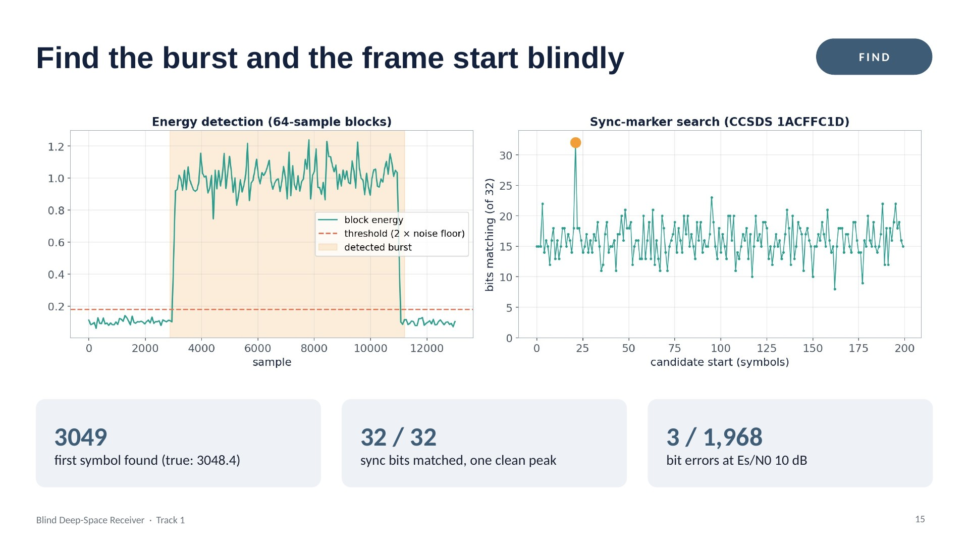
Notes:
The noise floor is measured from the quietest 10% of blocks, and a burst is anything clearly above it, with a safety margin. Then we slide the CCSDS sync marker along the symbols. An earlier periodic sync word gave false peaks when combined with rotation; the CCSDS marker was designed to avoid that.

Slide 33
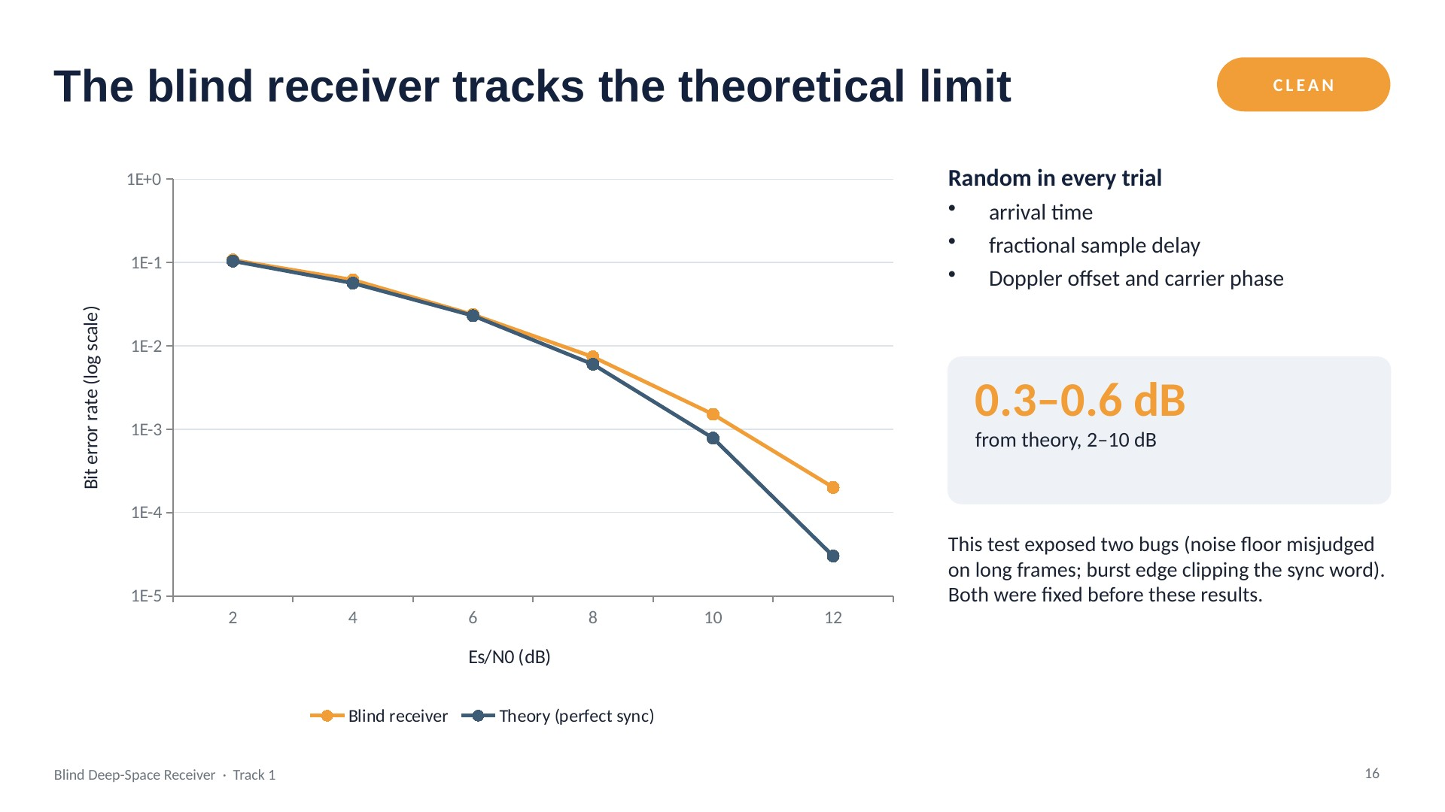
Notes:
Five random trials per point; the receiver knows nothing but the sync marker. It stays within a fraction of a dB of the textbook curve. The remaining gap at high SNR is because we sample at whole-sample instants.

Slide 34
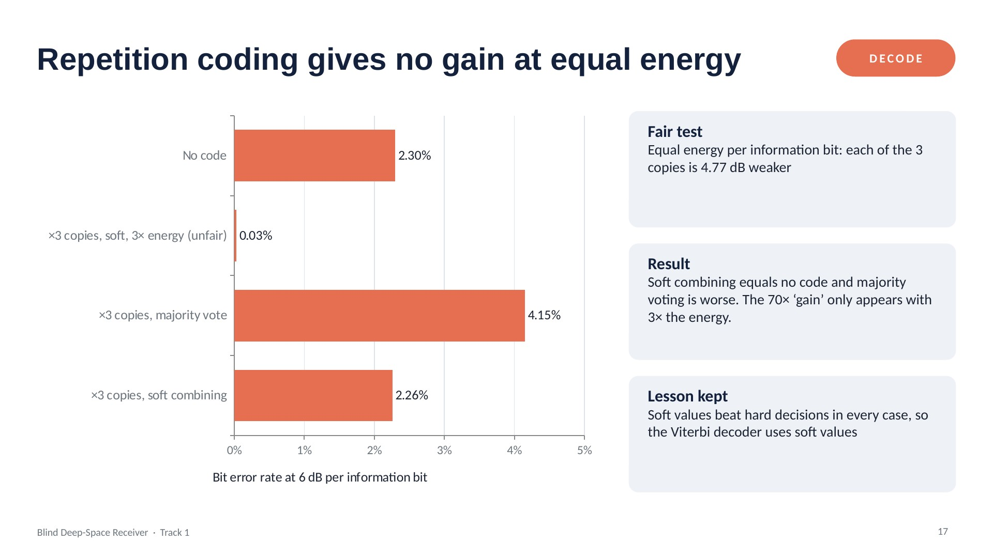
Notes:
Sending every bit three times only looks good if you secretly spend three times the energy. With a fair energy budget it gives nothing. That motivated a real code.

Slide 35
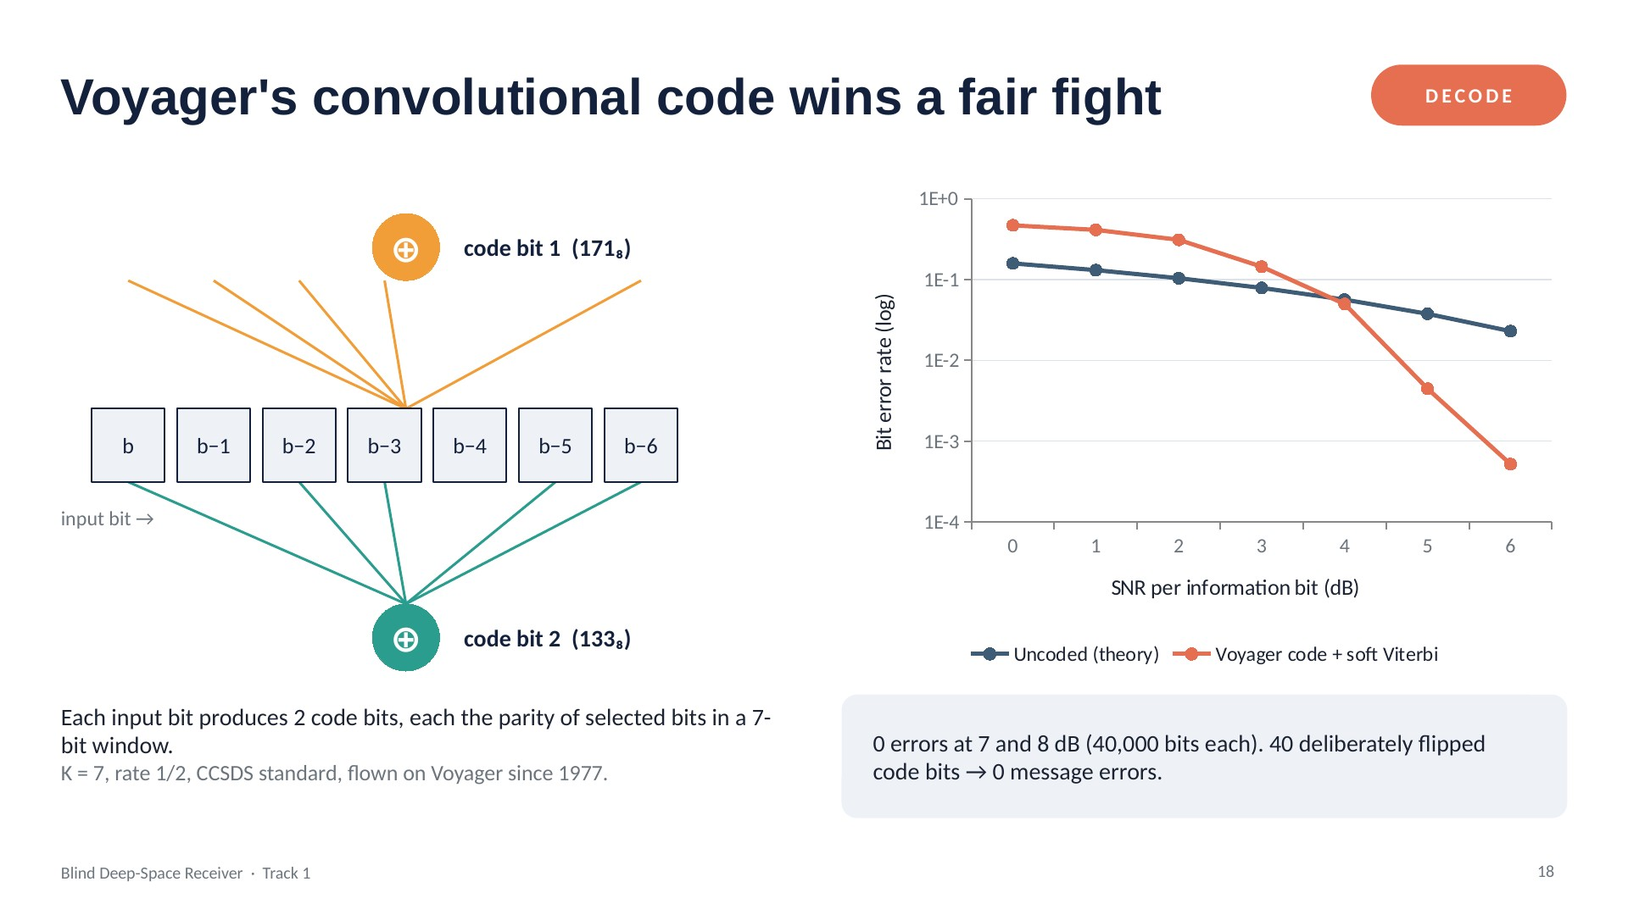
Notes:
Each output bit mixes seven input bits, so every message bit is protected by up to 14 code bits. The Viterbi decoder keeps the best path for each of the 64 encoder states, summing soft confidences. Above about 5 dB it beats uncoded transmission by orders of magnitude, at equal energy.

Slide 36
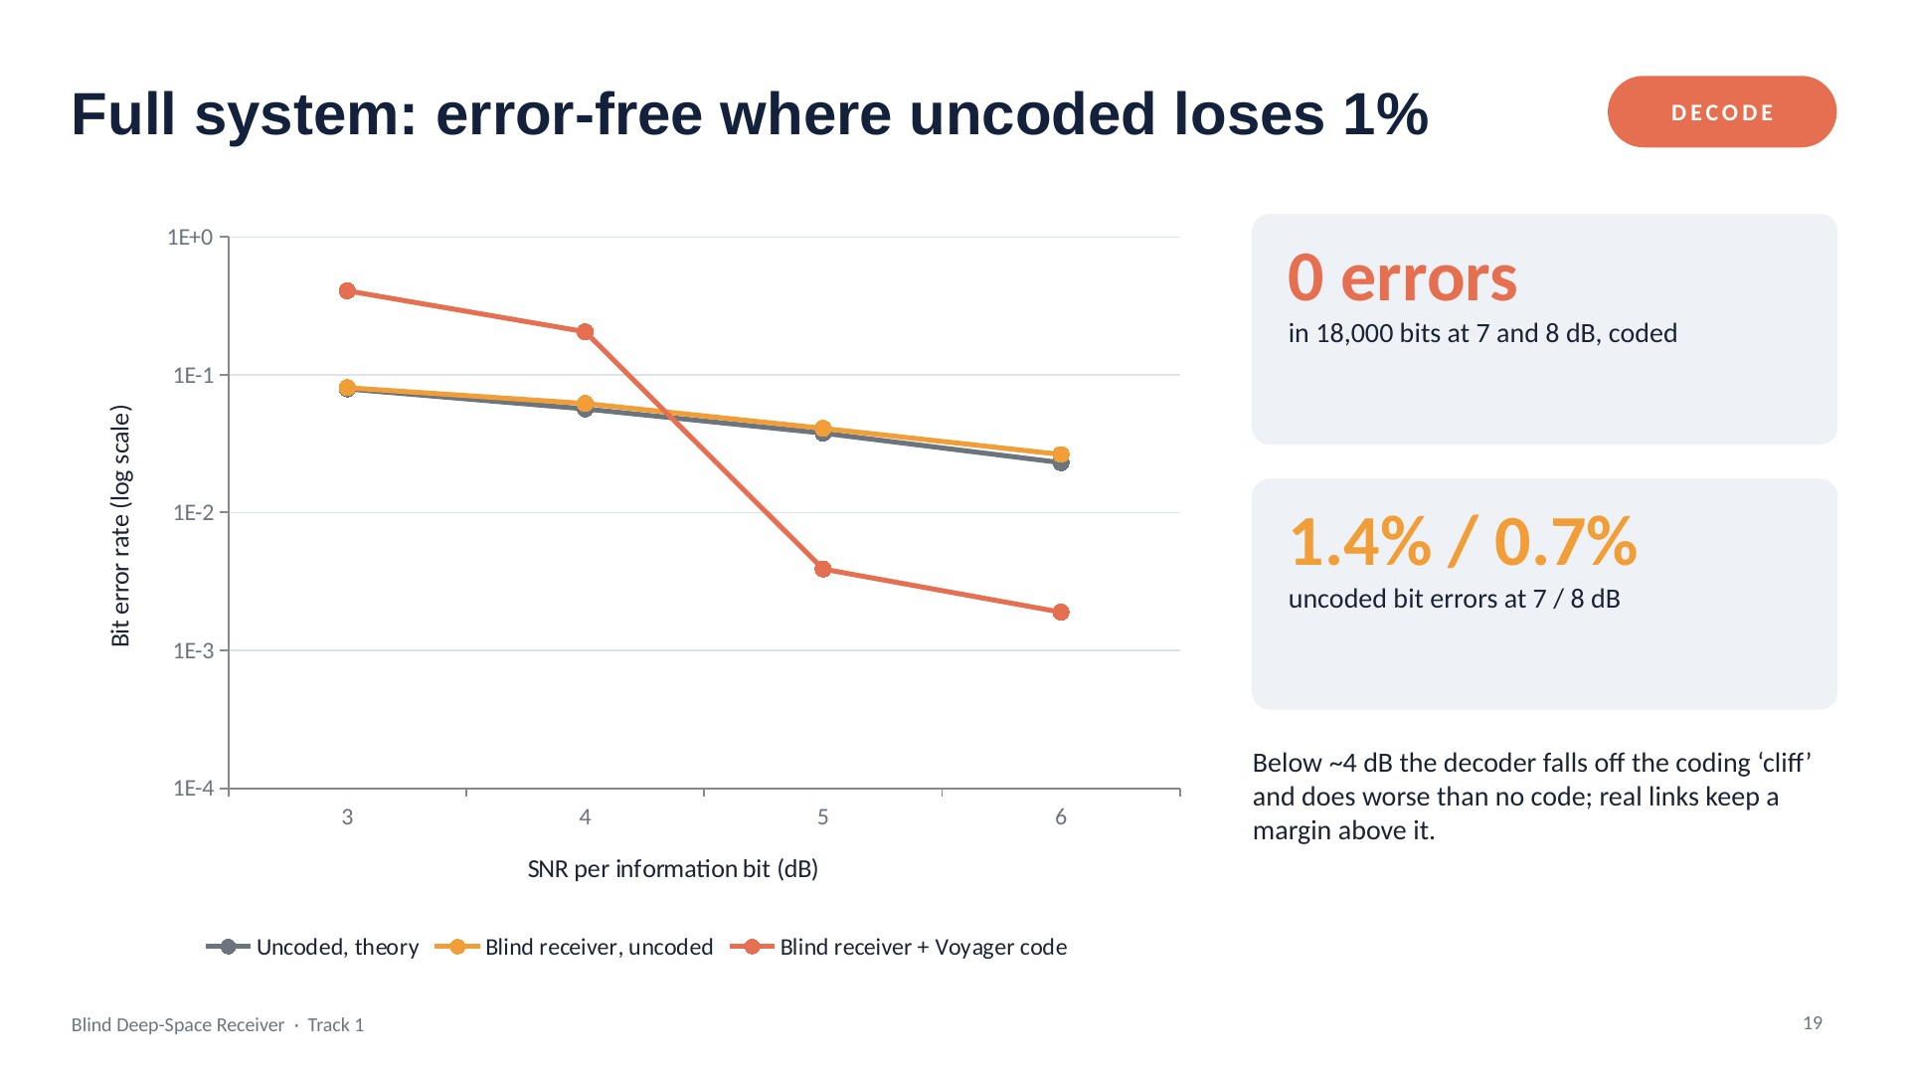
Notes:
Everything together: unknown arrival, delay, Doppler and phase, plus the code. At 7 and 8 dB the coded link had zero errors in 18,000 bits; points with zero errors can't be drawn on a log axis, so they're stated on the right.

Slide 37
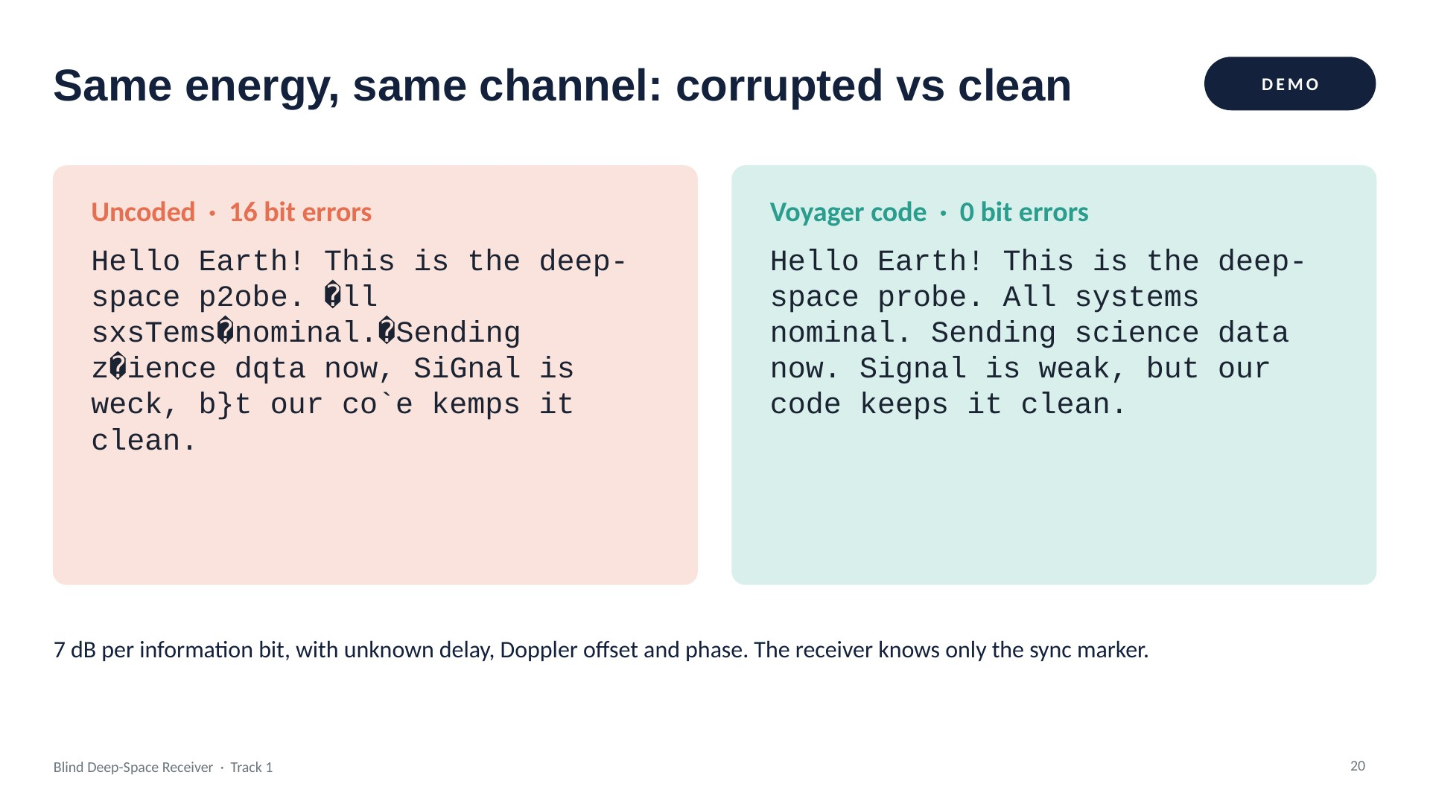
Notes:
A 134-character message sent twice with the same energy budget. Without coding, 16 bit errors corrupt letters. With the Voyager code it arrives perfectly.

Slide 38
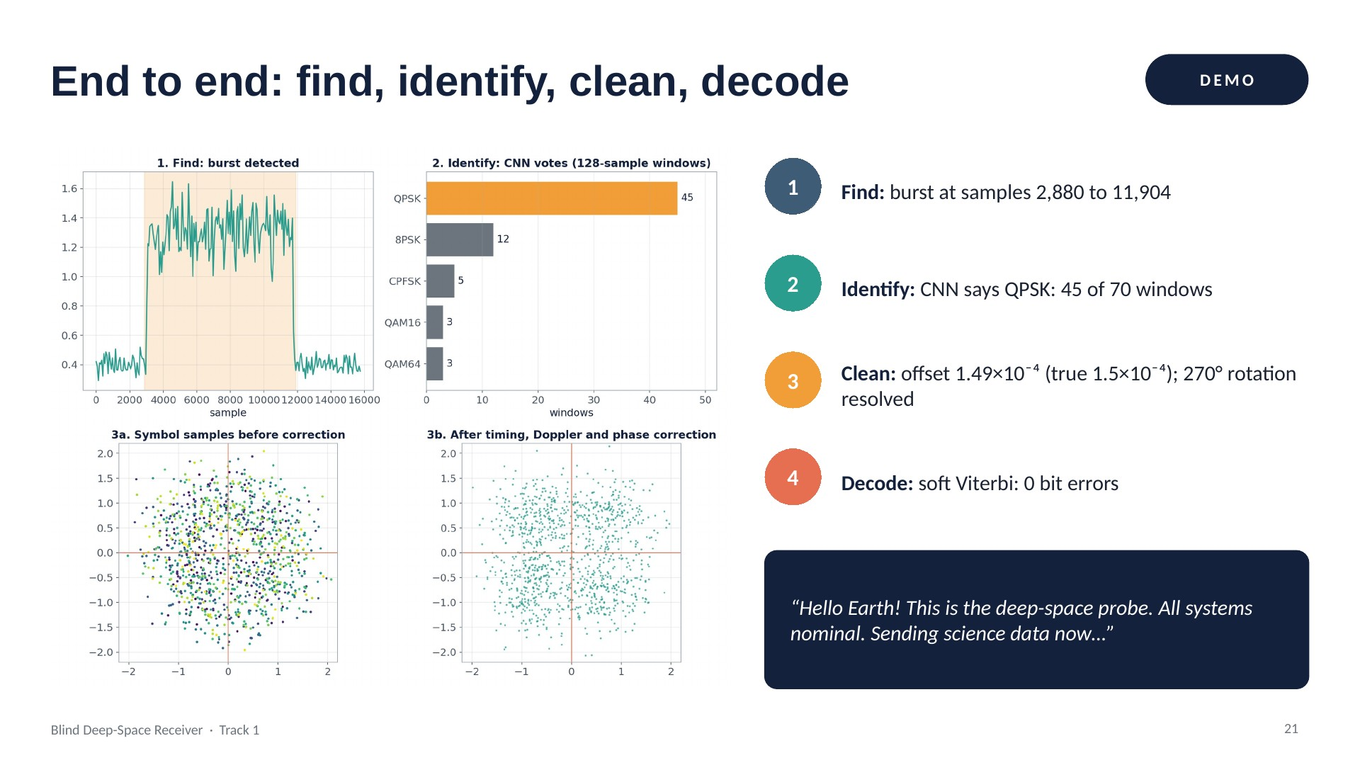
Notes:
The live demo, demo_full.py: one recording in, the decoded message out, with every intermediate step shown. The cleaned constellation still looks foggy, yet the message is decoded with zero errors because the code adds up evidence across many bits.

Slide 39
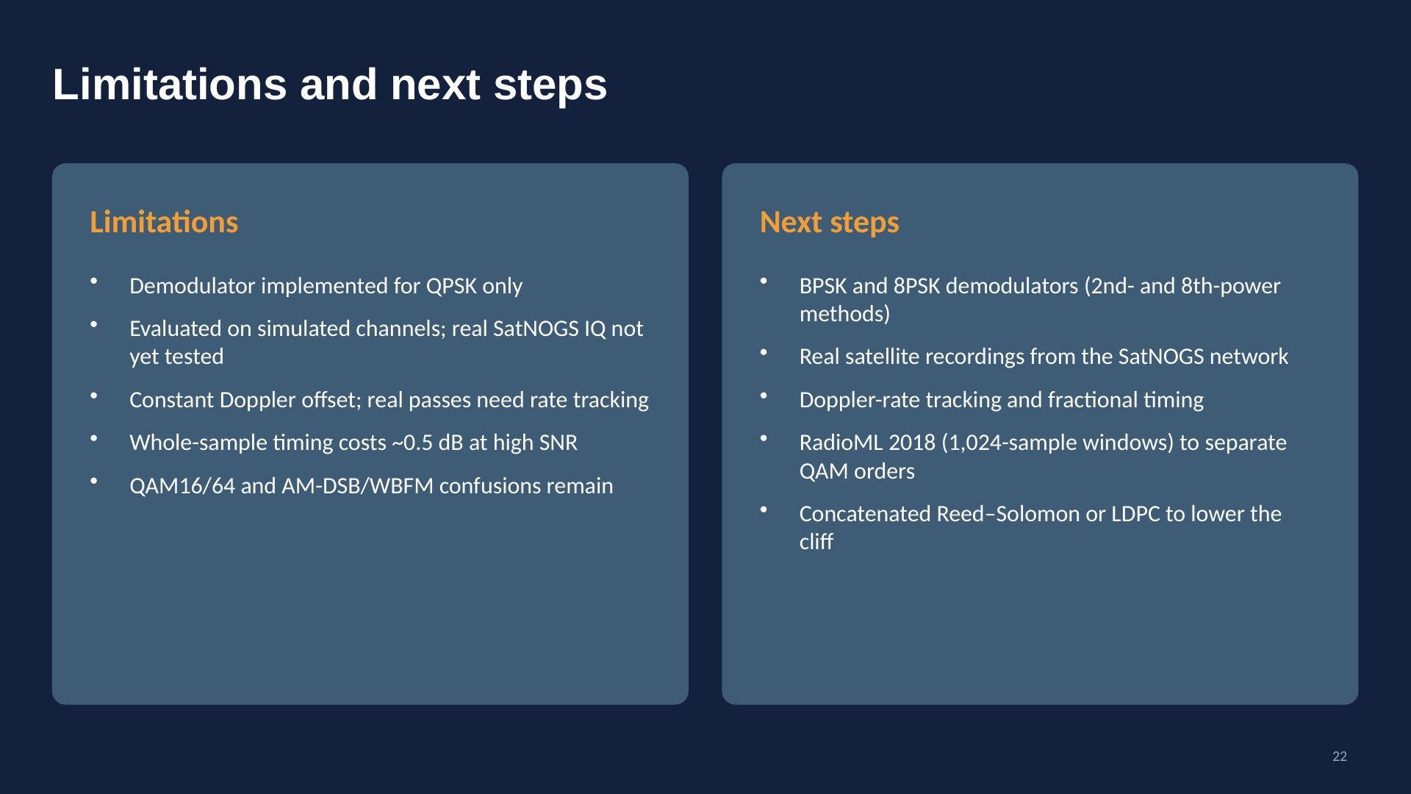
Notes:
Honest limits: one demodulator, simulated channels, a simple Doppler model. Each has a clear next step.

Slide 40
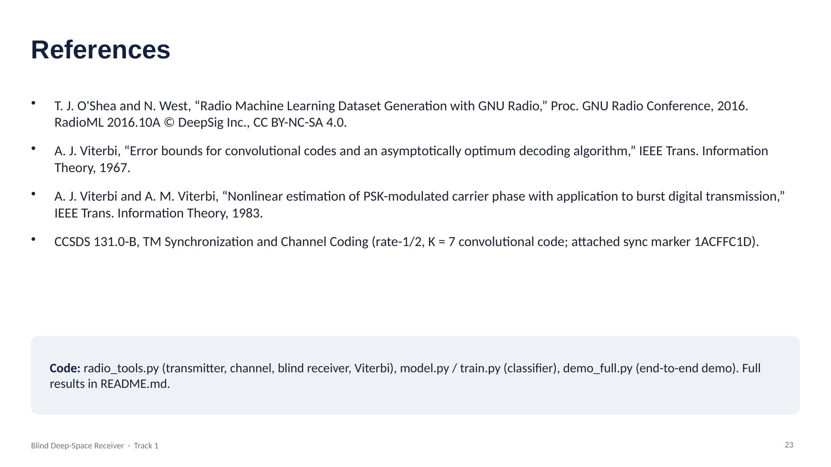
Notes:
Dataset and method references, and where to find the code.

Slide 41
Real telemetry frames through a hostile channel
Part 3
861 real SatNOGS frames sent through Doppler drift, dropouts and hops, recovered autonomously
Notes:
Section divider for Part 3. The following slides are this part's original deck, unchanged.

Slide 42
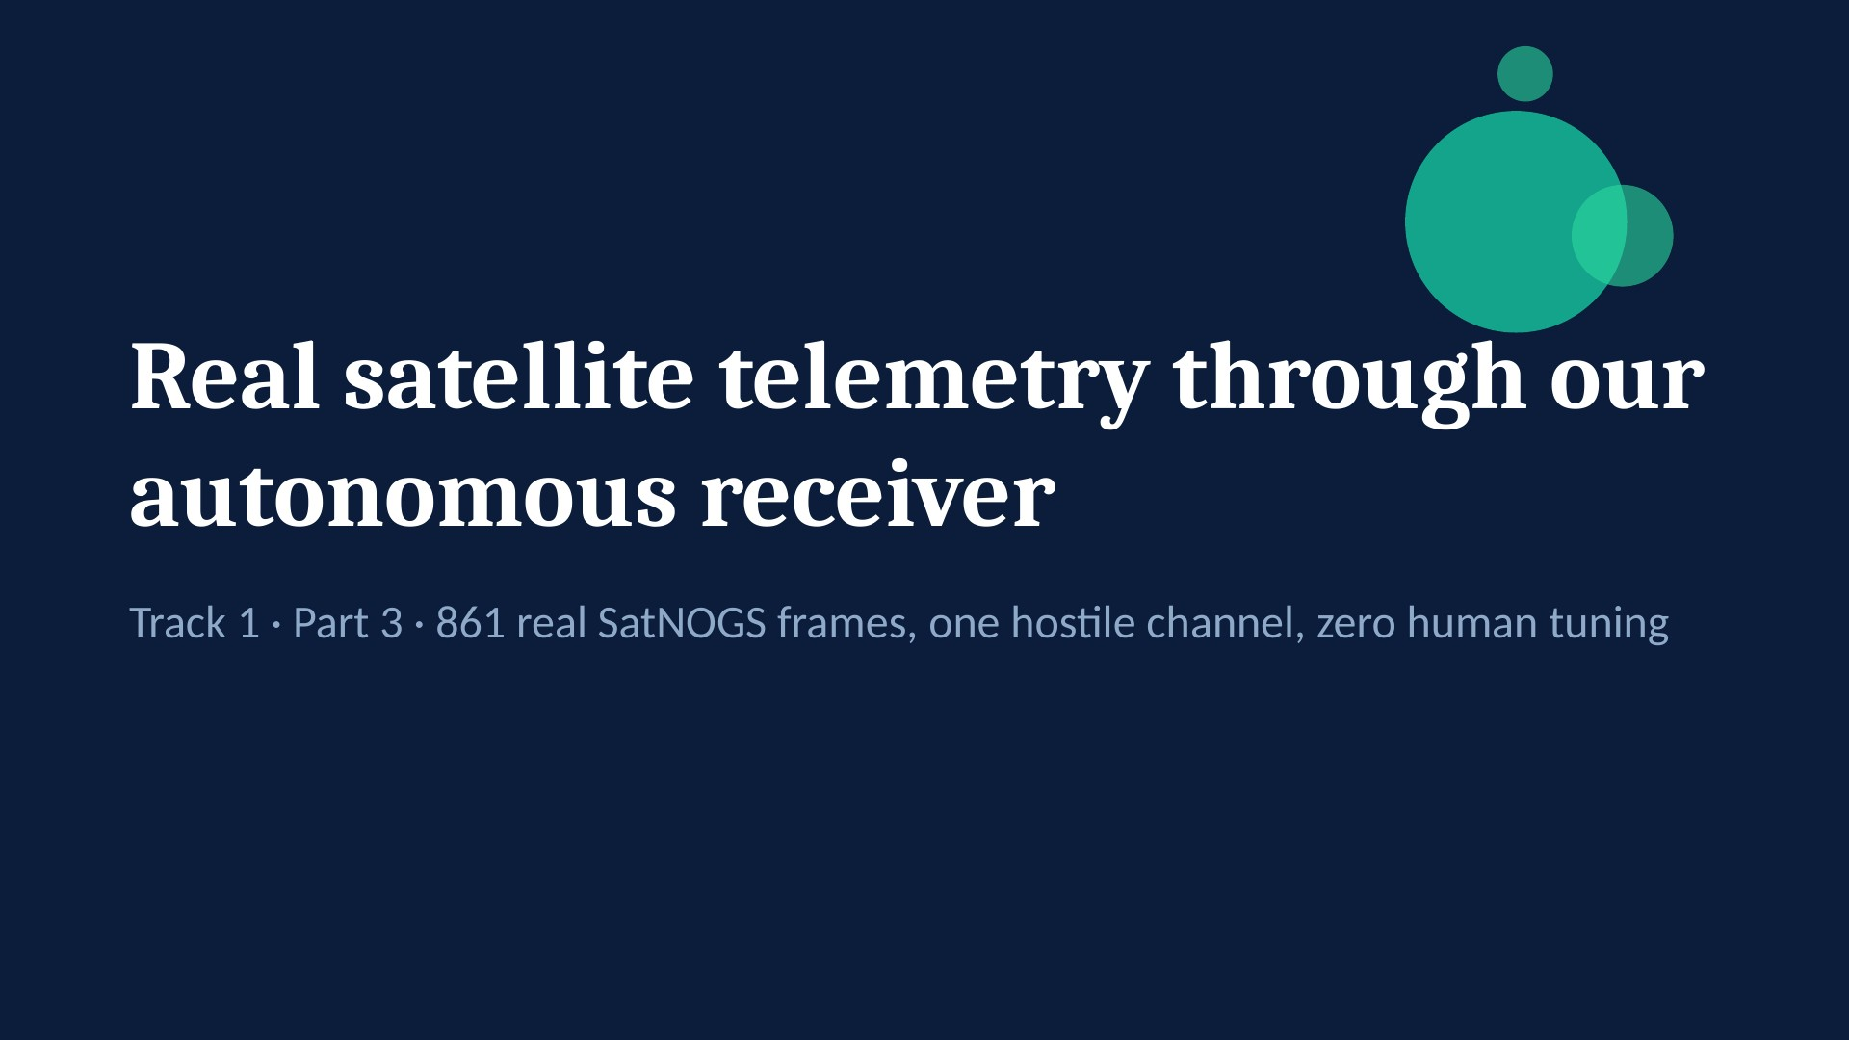
Notes:
This section tests whether REAL satellite telemetry survives our simulated deep-space link. Every byte is checked against the original.

Slide 43
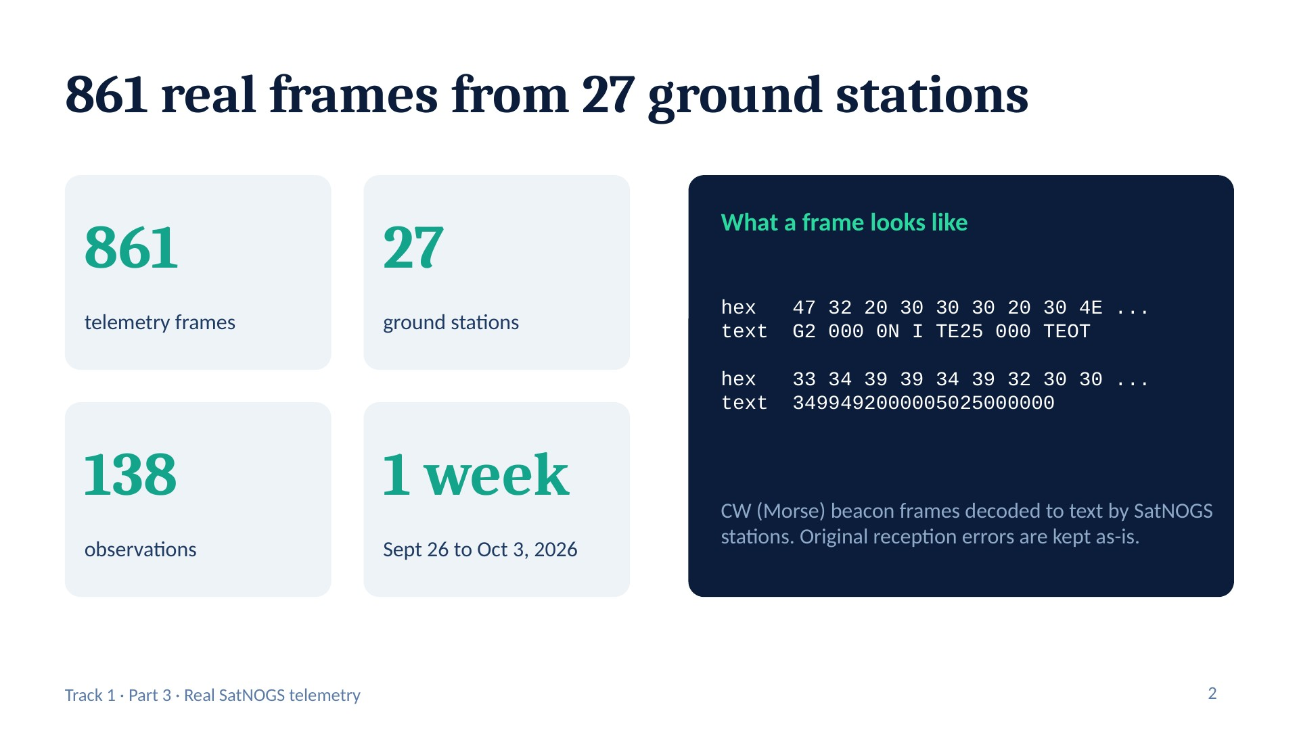
Notes:
Source: SatNOGS DB, one week of frames for one satellite (add its name). The cleanest beacon string, 3499492000005025000000, appears 21 times; the garbled ones are noisy copies from the stations' Morse decoders.

Slide 44
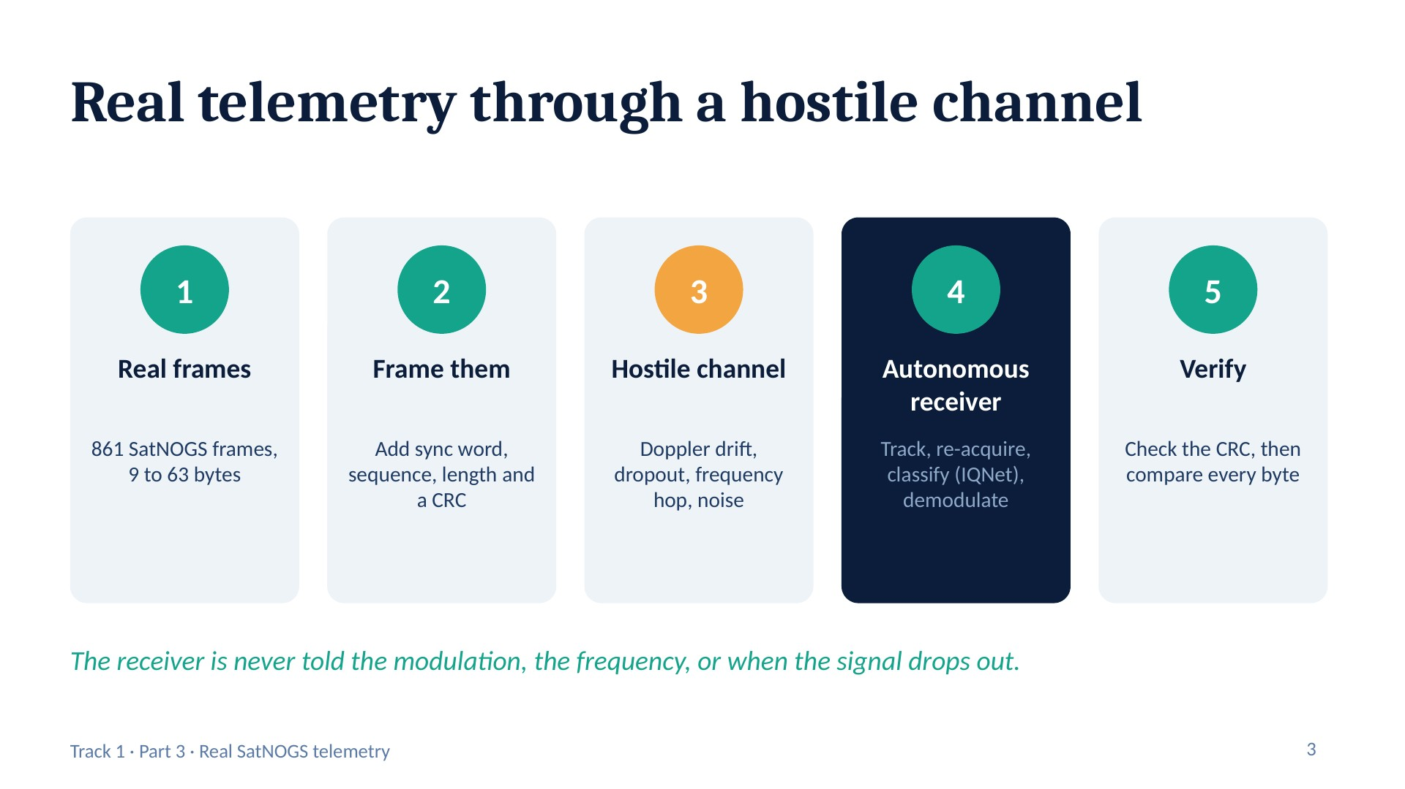
Notes:
Script: satnogs_frames.py. Step 2 mimics a spacecraft radio (CCSDS sync word 0x1ACFFC1D). Step 4 reuses pipeline.py: squaring/4th-power carrier tracking, re-acquisition with hysteresis, IQNet classification, differential demodulation.

Slide 45
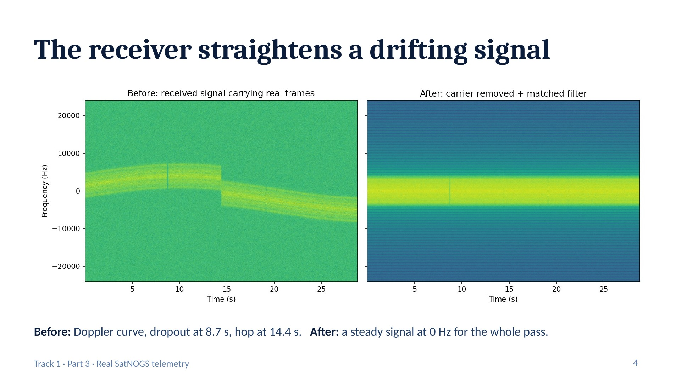
Notes:
Required Track 1 output: before/after spectral plot. Left = raw received signal carrying the real frames. Right = after autonomous carrier tracking, mixdown and matched filtering.

Slide 46
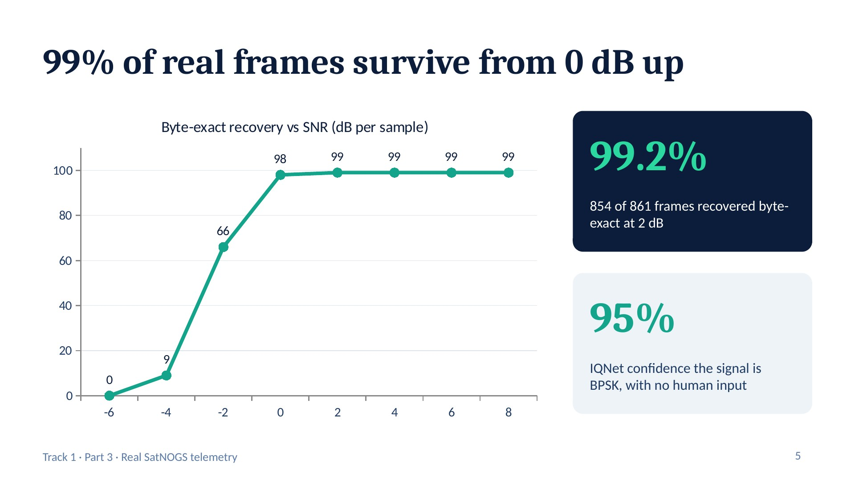
Notes:
Classic digital-link cliff: almost nothing below -4 dB, steep climb, flat near 99% from 0 dB. It tops out just under 100% because frames sent during the dropout cannot be recovered by any receiver.

Slide 47
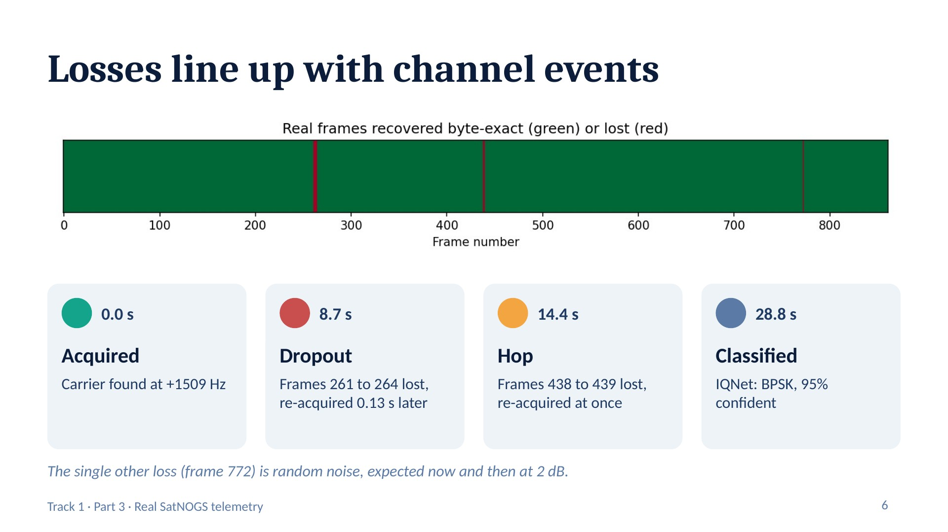
Notes:
Green = recovered byte-exact, red = lost. Times come from events.log. This shows the autonomy: the receiver notices each problem and recovers on its own.

Slide 48
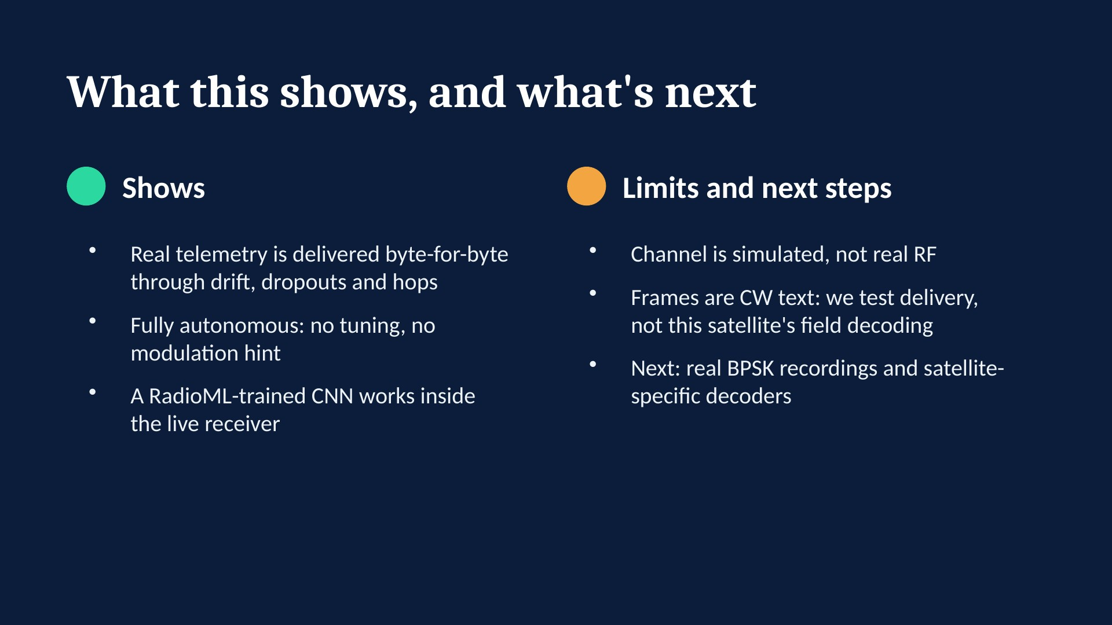
Notes:
Close by linking back to the full pipeline: this part proves the decoded output is trustworthy; the observation part (friend) shows the front end on real radio signals.

Slide 49
Decoding a real satellite pass
Part 4
OrigamiSat-2 pass recorded by a SatNOGS ground station, decoded end to end
Notes:
Section divider for Part 4. The following slides are this part's original deck, unchanged.

Slide 50
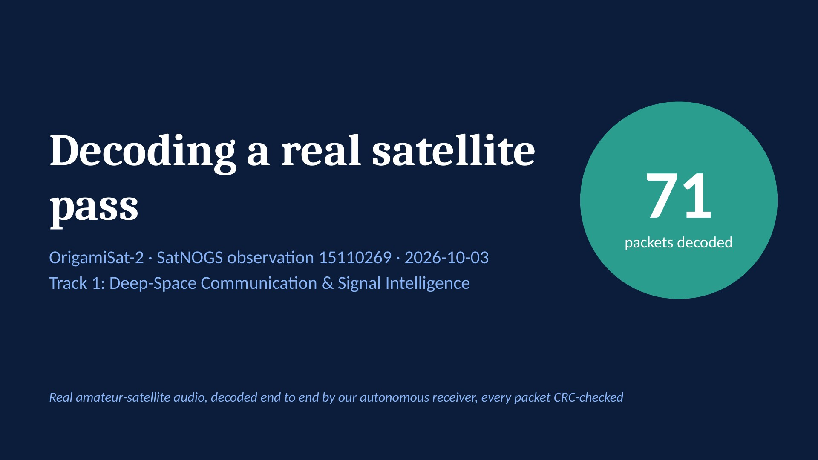
Notes:
Main message: our receiver decoded 71 real telemetry packets from a real satellite pass recorded by a SatNOGS ground station, with no manual tuning.

Slide 51
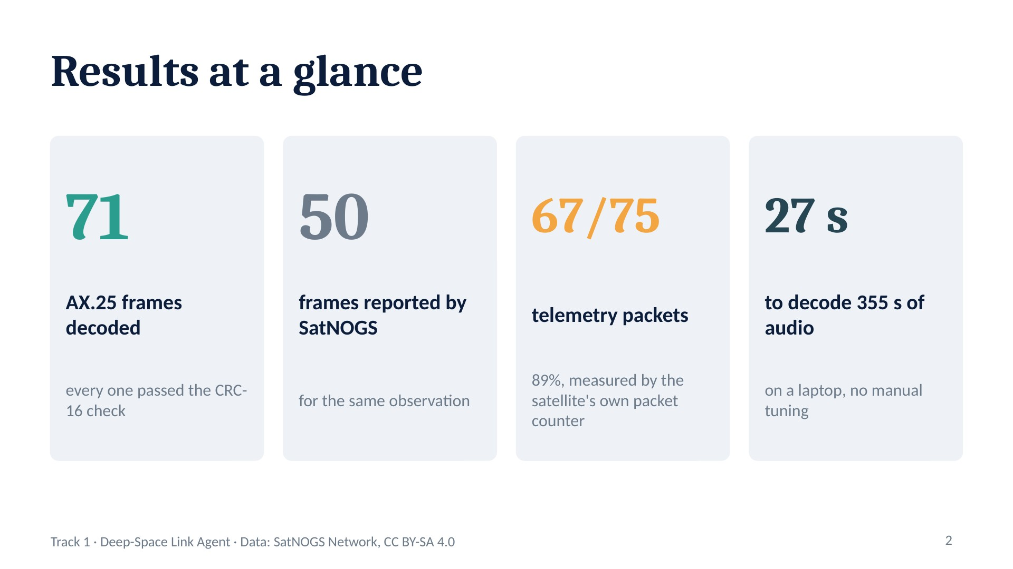
Notes:
71 vs 50 is a count comparison only; a frame-by-frame comparison needs the SatNOGS DB export. The 67 of 75 figure uses byte 4 of the main packet type, which increments by one per packet, so gaps show exactly which packets were missed.

Slide 52
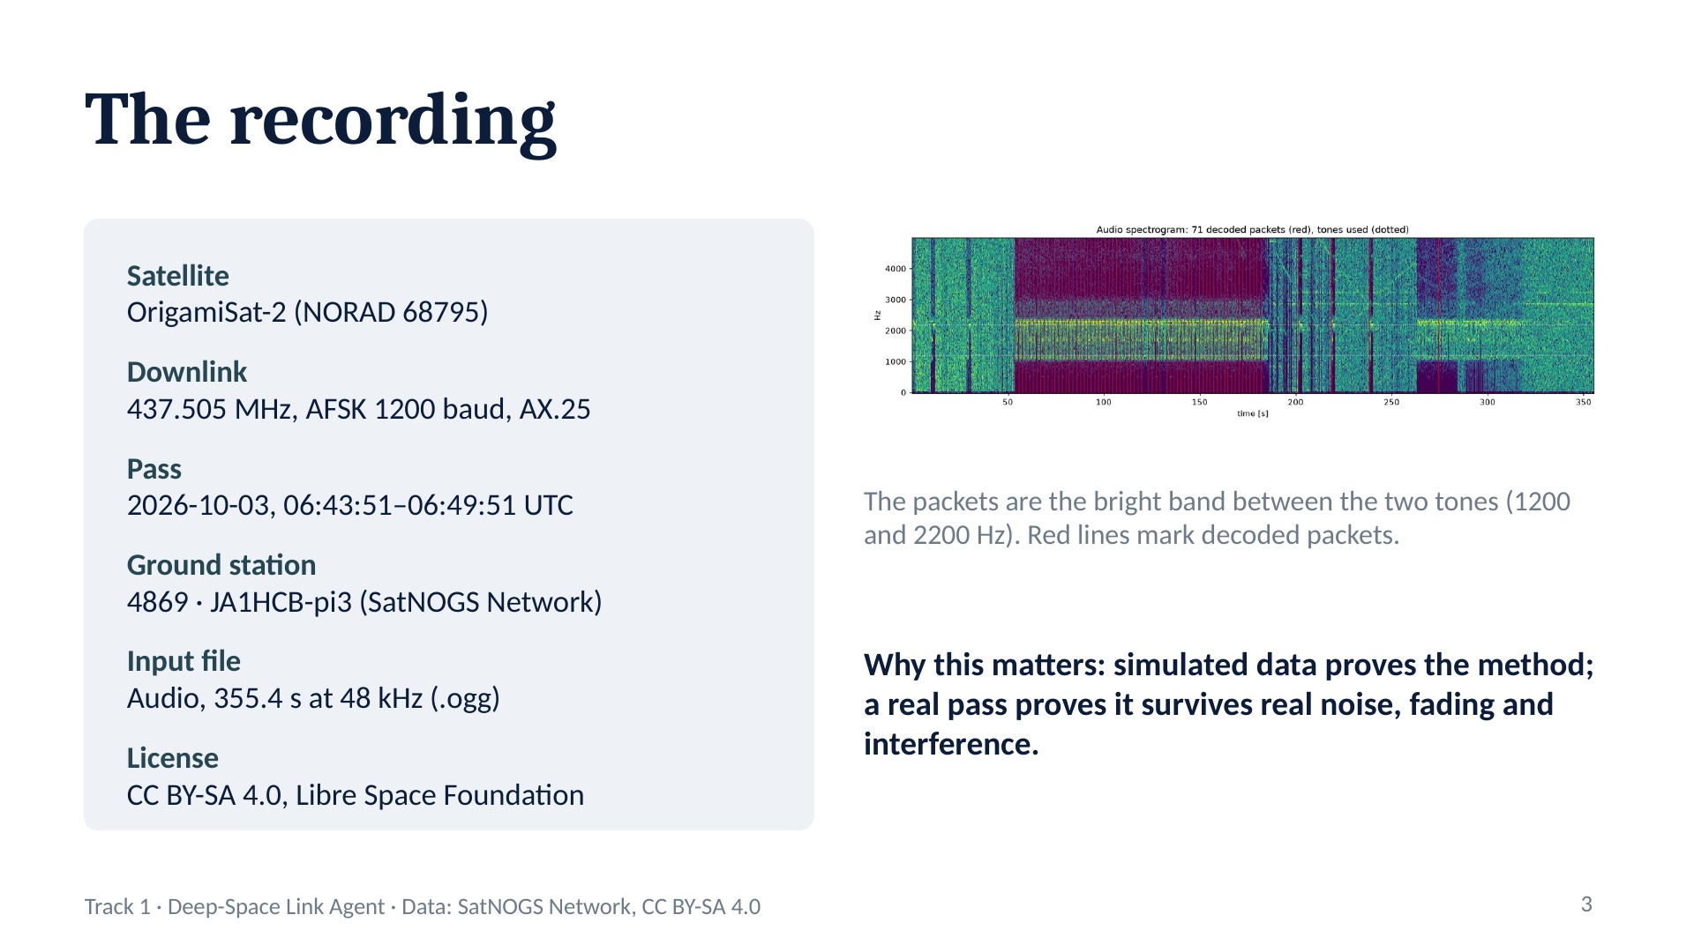
Notes:
Source: SatNOGS observation 15110269. Only the audio was used; IQ was not offered for this observation.

Slide 53
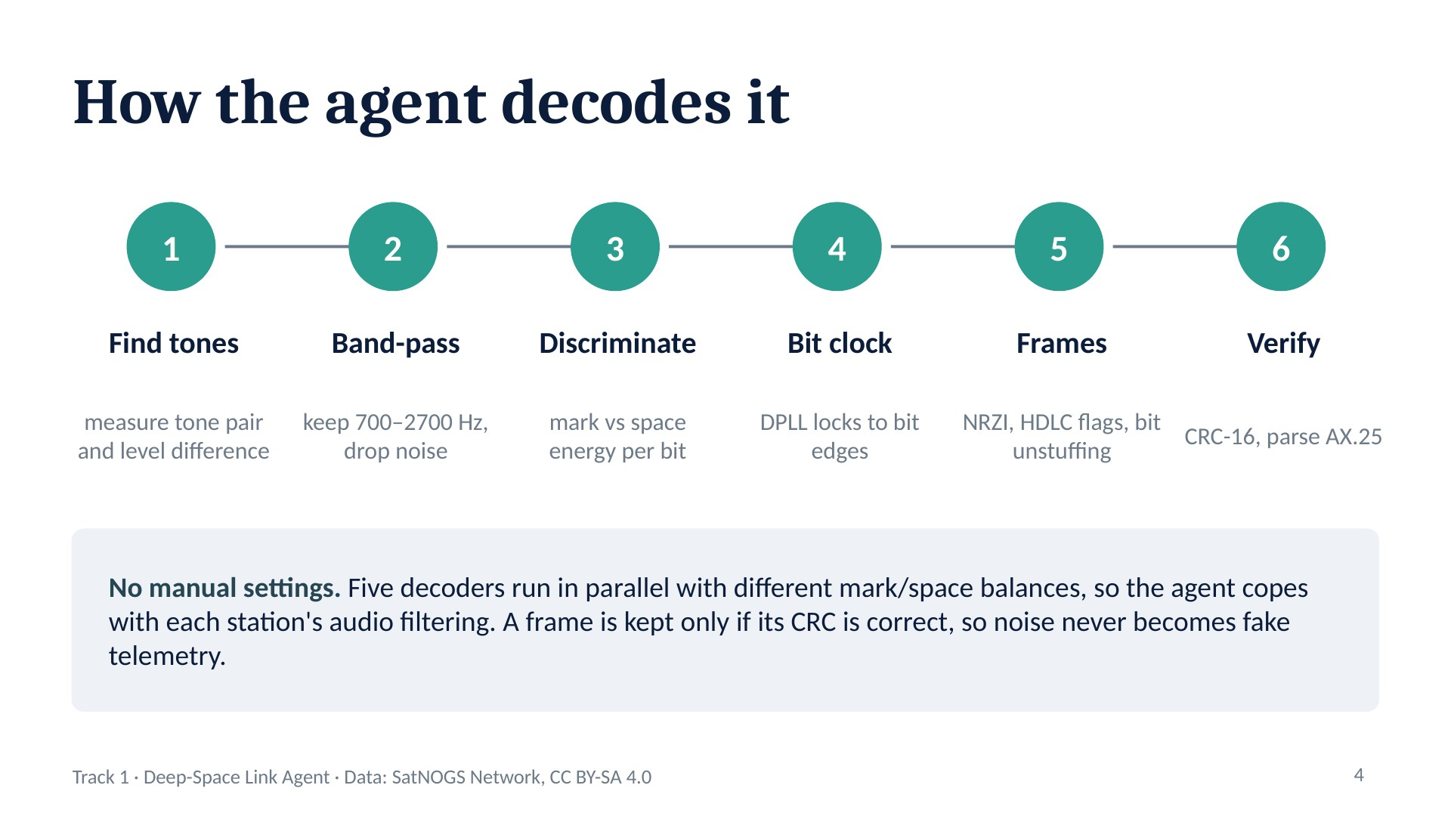
Notes:
Same receiver design as our simulated pipeline: acquire, synchronize, frame, verify.

Slide 54
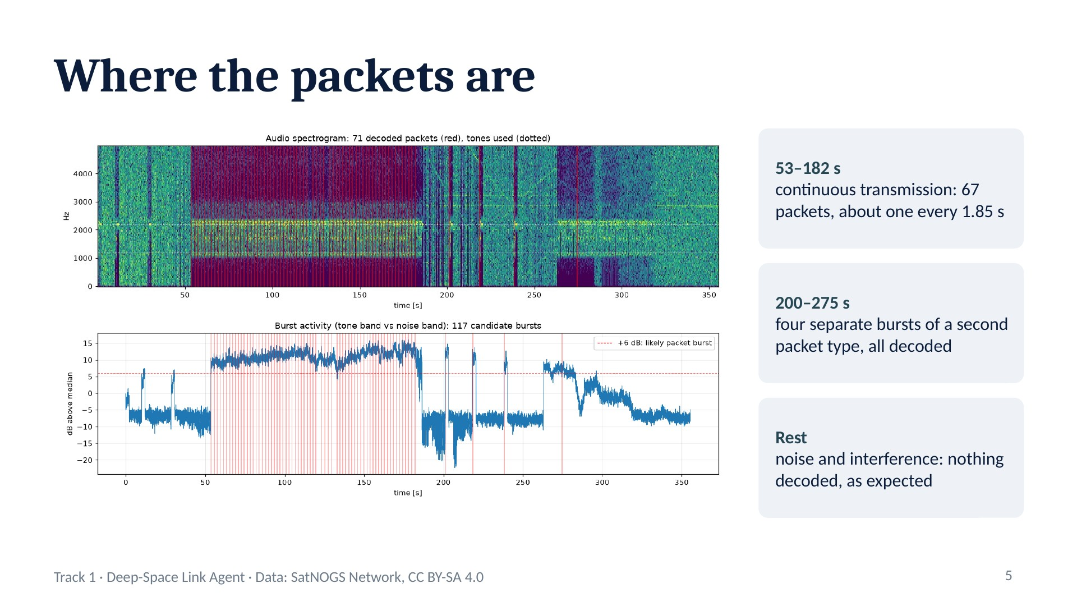
Notes:
Top: spectrogram with decoded packets in red. Bottom: tone-band energy relative to noise. The burst counter shows 117 because the continuous section crosses the threshold many times; the decoded frame count (71) is the real metric.

Slide 55
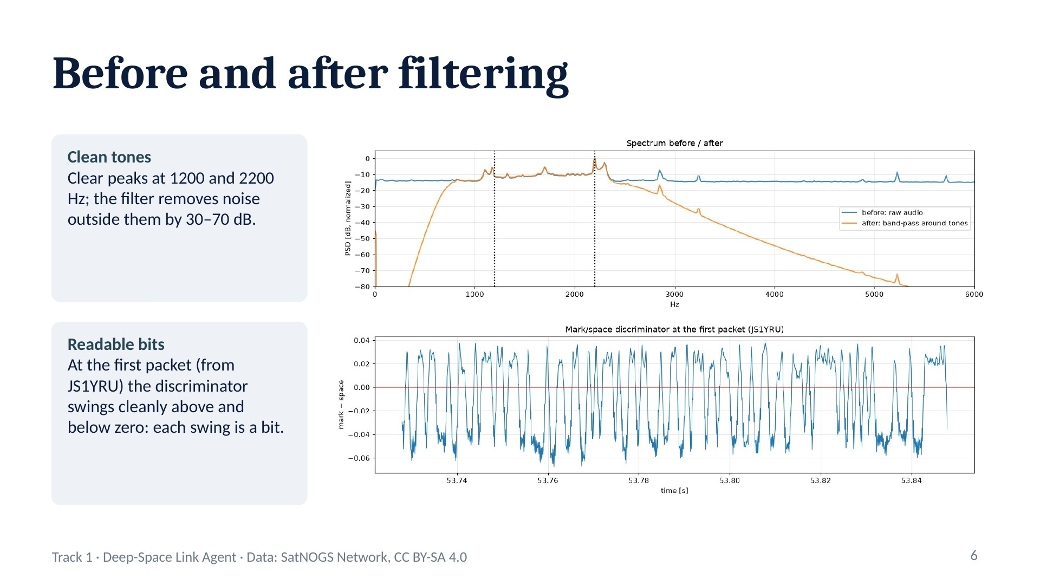
Notes:
Required Track 1 output: before/after spectral plot. Before: flat noise floor everywhere. After: only the 700–2700 Hz band survives.

Slide 56
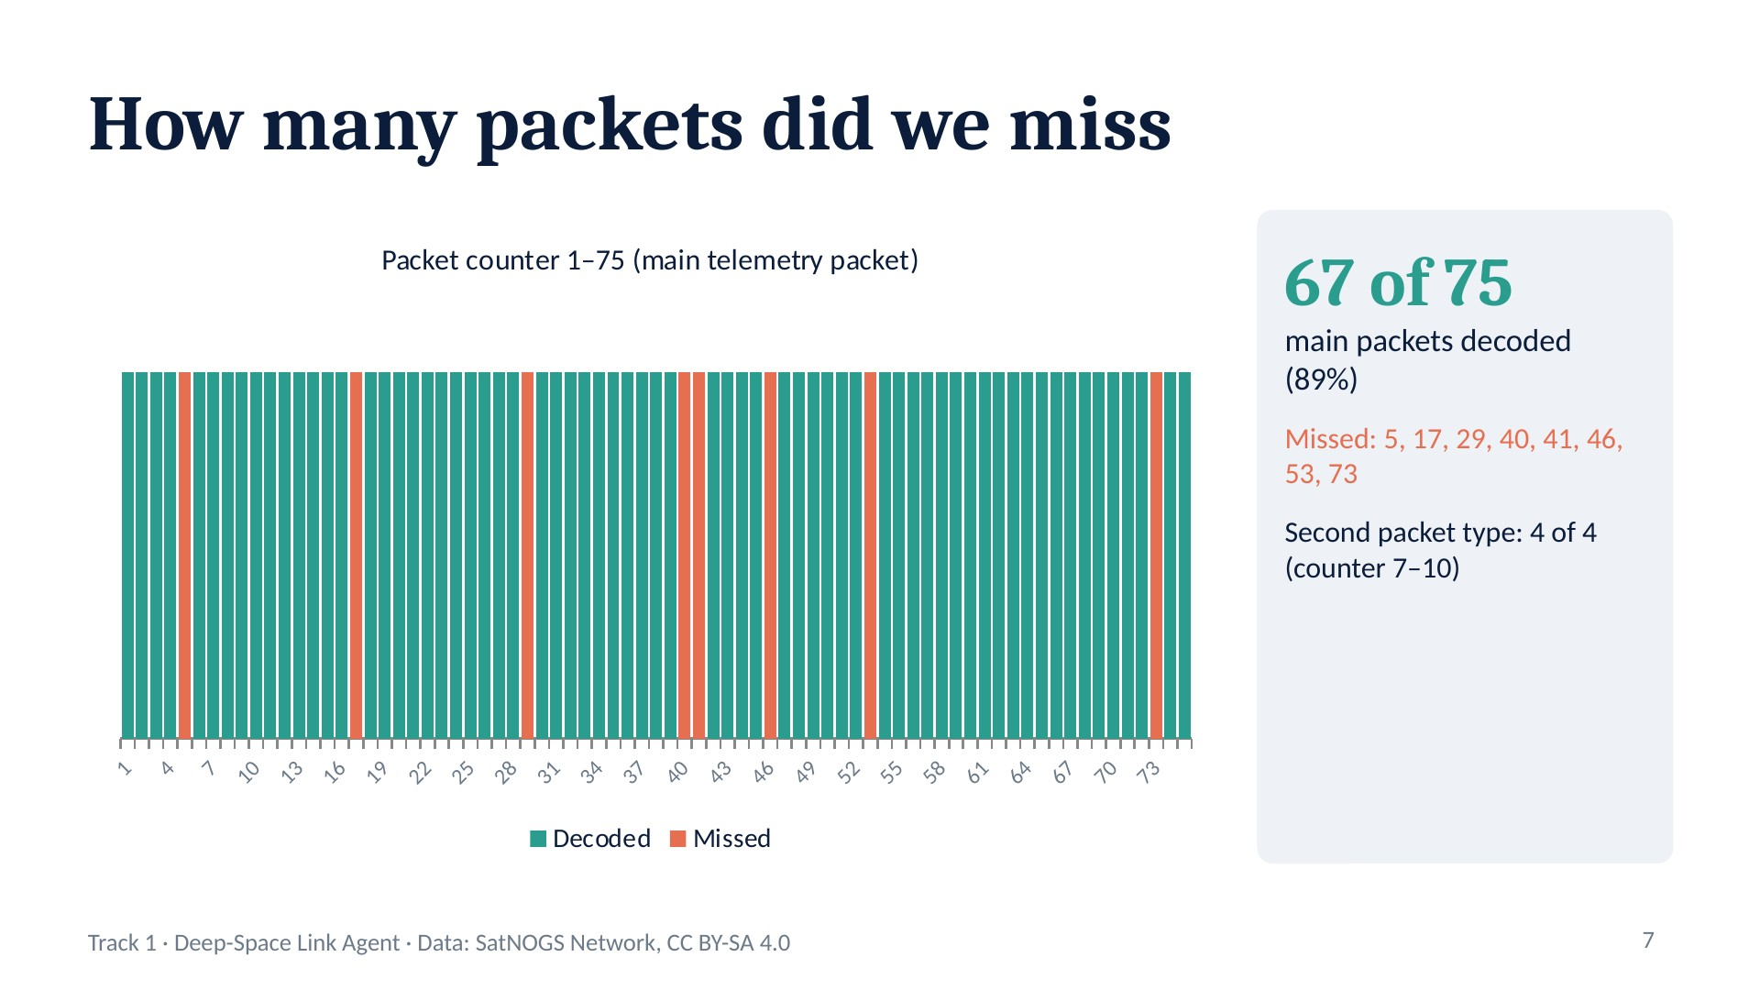
Notes:
Byte 4 of every main packet increases by exactly one, so it works as a sequence counter. This gives a completeness check without needing SatNOGS' frame list. Note: the counter interpretation is inferred from the data, not from satellite documentation.

Slide 57

Notes:
This is the autonomy argument: parameters that suit one station fail on another, so the agent tries several and lets the CRC decide.

Slide 58

Notes:
Required Track 1 output: telemetry log. The sender callsign JS1YRU is consistent across all 71 frames.

Slide 59

Notes:
Be upfront about these: judges value honest limitations.

Slide 60
Conclusion: what we achieved
Part 1
Part 2
Part 3
Part 4
Classification + blind Doppler
Blind deep-space receiver
Real frames, hostile channel
Real satellite pass
88% accuracy at SNR ≥ 0 dB (11 classes)
Doppler: 33% → 96.7%, fully blind
RadioML 2018: 84% on 24 classes
Commands decoded at 0 dB, CRC-checked
79% accuracy at SNR ≥ 0 dB (11 classes)
Blind sync within 0.3–0.6 dB of theory
Voyager code: 0 errors in 18,000 bits at 7 dB
Message decoded end to end
861 real SatNOGS frames
99.2% byte-exact at 2 dB
Survives drift, dropout and hop
IQNet: BPSK, 95% confident
OrigamiSat-2, real SatNOGS audio
71 AX.25 frames, all CRC-valid
67 of 75 main packets (89%)
355 s decoded in 27 s, no tuning
Together: find, identify, clean and decode, from simulated benchmarks to a real satellite pass, with no human tuning.
Notes:
Each part is summarized with its own results; numbers are not combined across parts because each used its own models and test conditions. Part 1 built the classifier and blind Doppler correction on RadioML, including the 24-class RadioML 2018 benchmark and a command-decoding demo. Part 2 built a complete blind receiver that tracks the theoretical error limit and decodes with the Voyager code. Part 3 delivered 861 real SatNOGS frames byte-for-byte through a hostile simulated channel. Part 4 decoded a real OrigamiSat-2 pass, with every packet CRC-checked. Together they cover the whole Track 1 problem: find, identify, clean and decode weak signals with no human tuning.

