Slide 1
Real satellite telemetry through our autonomous receiver
Track 1 · Part 3 · 861 real SatNOGS frames, one hostile channel, zero human tuning
Notes:
This section tests whether REAL satellite telemetry survives our simulated deep-space link. Every byte is checked against the original.

Slide 2
861 real frames from 27 ground stations
861
27
What a frame looks like
hex 47 32 20 30 30 30 20 30 4E ...
text G2 000 0N I TE25 000 TEOT
hex 33 34 39 39 34 39 32 30 30 ...
text 3499492000005025000000
telemetry frames
ground stations
138
1 week
CW (Morse) beacon frames decoded to text by SatNOGS stations. Original reception errors are kept as-is.
observations
Sept 26 to Oct 3, 2026
Notes:
Source: SatNOGS DB, one week of frames for one satellite (add its name). The cleanest beacon string, 3499492000005025000000, appears 21 times; the garbled ones are noisy copies from the stations' Morse decoders.

Slide 3
Real telemetry through a hostile channel
1
2
3
4
5
Real frames
Frame them
Hostile channel
Autonomous receiver
Verify
861 SatNOGS frames, 9 to 63 bytes
Add sync word, sequence, length and a CRC
Doppler drift, dropout, frequency hop, noise
Track, re-acquire, classify (IQNet), demodulate
Check the CRC, then compare every byte
The receiver is never told the modulation, the frequency, or when the signal drops out.
Notes:
Script: satnogs_frames.py. Step 2 mimics a spacecraft radio (CCSDS sync word 0x1ACFFC1D). Step 4 reuses pipeline.py: squaring/4th-power carrier tracking, re-acquisition with hysteresis, IQNet classification, differential demodulation.

Slide 4
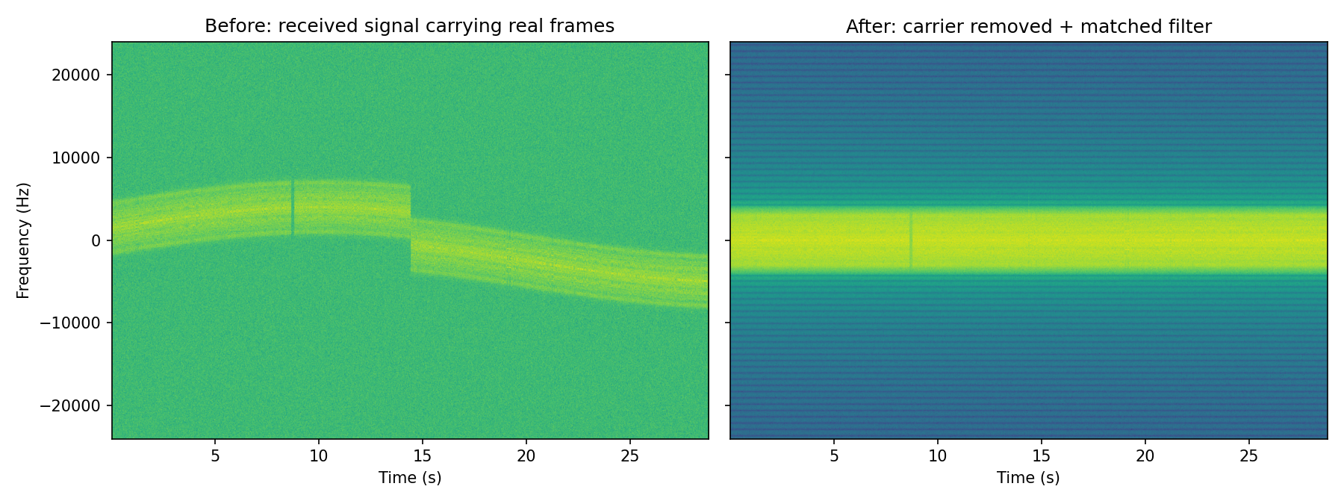
The receiver straightens a drifting signal
Before: Doppler curve, dropout at 8.7 s, hop at 14.4 s. After: a steady signal at 0 Hz for the whole pass.
Notes:
Required Track 1 output: before/after spectral plot. Left = raw received signal carrying the real frames. Right = after autonomous carrier tracking, mixdown and matched filtering.

Slide 5
99% of real frames survive from 0 dB up
99.2%
854 of 861 frames recovered byte-exact at 2 dB
95%
IQNet confidence the signal is BPSK, with no human input
Notes:
Classic digital-link cliff: almost nothing below -4 dB, steep climb, flat near 99% from 0 dB. It tops out just under 100% because frames sent during the dropout cannot be recovered by any receiver.

Slide 6
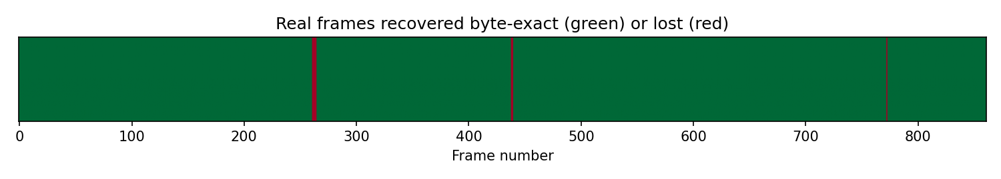
Losses line up with channel events
0.0 s
8.7 s
14.4 s
28.8 s
Acquired
Dropout
Hop
Classified
Carrier found at +1509 Hz
Frames 261 to 264 lost, re-acquired 0.13 s later
Frames 438 to 439 lost, re-acquired at once
IQNet: BPSK, 95% confident
The single other loss (frame 772) is random noise, expected now and then at 2 dB.
Notes:
Green = recovered byte-exact, red = lost. Times come from events.log. This shows the autonomy: the receiver notices each problem and recovers on its own.

Slide 7
What this shows, and what's next
Shows
Limits and next steps
Real telemetry is delivered byte-for-byte through drift, dropouts and hops
Fully autonomous: no tuning, no modulation hint
A RadioML-trained CNN works inside the live receiver
Channel is simulated, not real RF
Frames are CW text: we test delivery, not this satellite's field decoding
Next: real BPSK recordings and satellite-specific decoders
Notes:
Close by linking back to the full pipeline: this part proves the decoded output is trustworthy; the observation part (friend) shows the front end on real radio signals.

