Slide 1
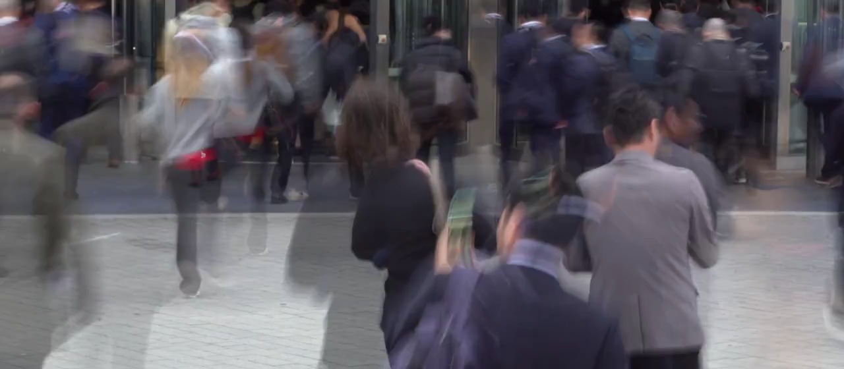
Your next teammate could be right here.
Notes:
TIME 0:00–0:04 | 4 seconds.
SAY: “Your next teammate could be in this room.”
ACTION: Crowd footage starts automatically; the slide advances after four seconds. If autoplay is disabled, click the video. This is illustrative city stock, not footage of our hackathon.
AUDIO: Muted for reliable presentation-room playback; deliver the line yourself.
SOURCE: La Doncella Audiovisual, Pexels — https://www.pexels.com/video/crowded-urban-scene-with-blurred-motion-31741796/
EDIT: First four seconds, resized and cropped to the widescreen media frame.

Slide 2
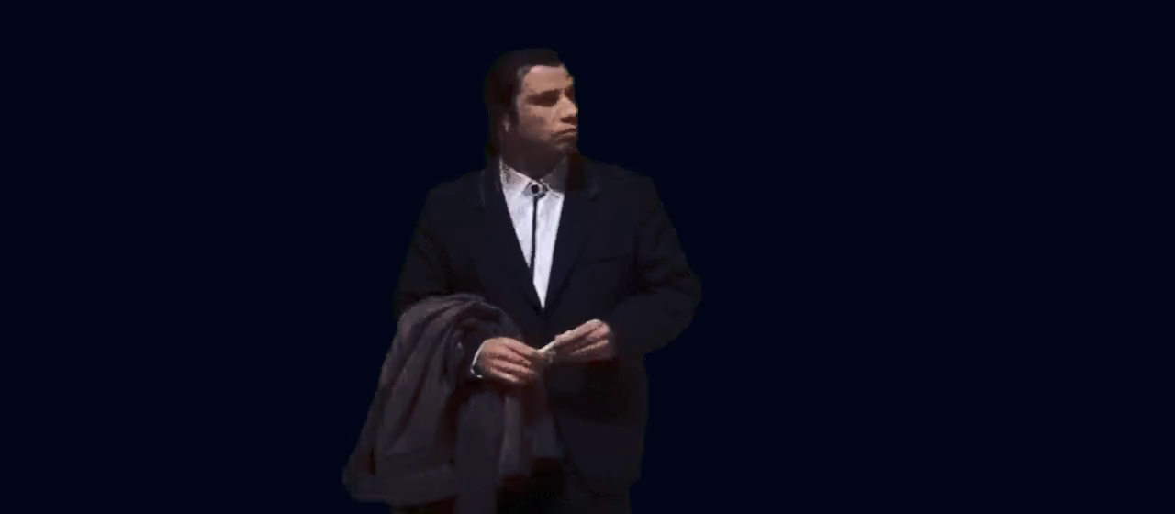
Me trying to find the AI agent builders.
Notes:
TIME 0:04–0:07 | 3 seconds.
SAY: Nothing. Let the visual joke land.
ACTION: Confused Travolta plays automatically, keyed over the deck's dark background. Slide advances after three seconds.
AUDIO: Silence.
SOURCE: Confused Travolta, from Pulp Fiction, via Tenor — https://tenor.com/view/confused-travolta-green-gif-7954354
CAPTION: “Me trying to find the AI agent builders.”
EDIT: A three-second silent loop; green background removed.

Slide 3
BumpIn
Your people are already here.
Make the introduction.
Notes:
TIME 0:07–0:18 | 11 seconds.
SAY: “But you don't know their name, what they're building, or whether they're looking for you. That's the problem BumpIn solves.”
ACTION: Pause on the BumpIn name, then advance manually.
BRIDGE: The opening problem is a missed introduction in a shared room; now reveal the product.
PROJECT SOURCE: README.md and docs/PRD.md in this repository. This is an opt-in event networking proof of concept.

Slide 4
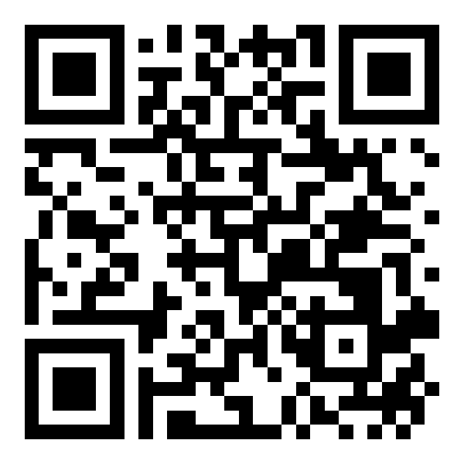
BumpIn
Scan once.
Make the
introduction.
bumpin-silk.vercel.app
Join this event
Notes:
TIME 0:18–0:55 | 37 seconds.
SAY: “Scan one QR code. Join the event. Tell people what you're building and who you'd like to meet.”
ACTION 0:18–0:30: Point to the QR. The QR opens https://bumpin-silk.vercel.app/e/grok-bot-london
ACTION 0:30–0:55: Switch to the live app or mirror Phone A. Join as yourself with prepared, accurate demo details and explicitly enable event visibility.
SAY WHILE JOINING: “I'll join as myself and choose to appear on the attendee map. No GPS is required.”
IMPORTANT REHEARSAL: Do not assume the documented production URL is healthy. Check it before presenting. The local fallback syncs tabs on one browser; cross-phone realtime requires a working configured backend. No live run was verified while creating this deck.
FORM ROUTE: Any automated form entry must follow the repository/user react-form-fill instructions.
SOURCE: docs/DEMO-MEDIA-SCRIPT.md; components/join/join-card.tsx; README.md.

Slide 5
BumpIn
Someone to meet.
A reason to say hello.
See a profile. Make an introduction.
Open the event
Notes:
TIME 0:55–1:40 | 45 seconds.
ACTION: Switch to the app / Phone A projection. Teammate joins on Phone B; wait for the second avatar to appear.
SAY: “Now my teammate joins on another phone.” Pause for the update. “There they are. We're both in the same event, and now we can actually find each other's profiles.”
ACTION: Tap the teammate's avatar, then show the profile and a user-entered LinkedIn link if present.
SAY: “Tap an avatar to see their profile and the LinkedIn link they've chosen to share. Now I have a person to introduce myself to.”
DO NOT NARRATE AN UPDATE BEFORE IT HAPPENS. Demo participants must be clearly introduced; don't present seeded data as live users.
FALLBACK: If cross-phone realtime is unavailable, use a previously verified run labelled “Recorded demo”. Otherwise demonstrate the same-browser mode and state that limit. Do not imply this slide is a live attendee map.
SOURCE: docs/REHEARSAL-CHECKLIST.md; docs/DEMO-MEDIA-SCRIPT.md.

Slide 6
BumpIn
Who is building
AI agents?
Ask a question. See the reason.
Notes:
TIME 1:40–2:08 | 28 seconds.
ACTION: In the app, open “Find people to meet” and choose “Who is building AI agents?” Wait for a matching result and show its reason and source label.
SAY: “And if I know what I'm looking for, I can ask: ‘Who is building AI agents?’ Here's a match, with the reason it was suggested.”
IF SOURCE IS RULES-BASED: “This demo is using the labelled rules-based matcher, based on what attendees have shared.”
IF SOURCE IS GROK BOT, ONLY AFTER VERIFYING THE INTEGRATION WORKS: “This result comes from Grok Bot, using the attendee information shared for this event.”
IF NO RESULT: “Matches depend on what attendees have shared; this event doesn't have a matching profile yet.” Then skip the Interstellar slide and go directly to slide 8.
SETUP: A teammate's accurate demo profile can include “AI agents for event networking” so the query has relevant text to match.
SOURCE: components/grok/ask-grok-panel.tsx; lib/matching/grok-adapter.ts; lib/matching/rules.ts.
This slide is the question, not a fabricated screenshot or a claimed result.

Slide 7
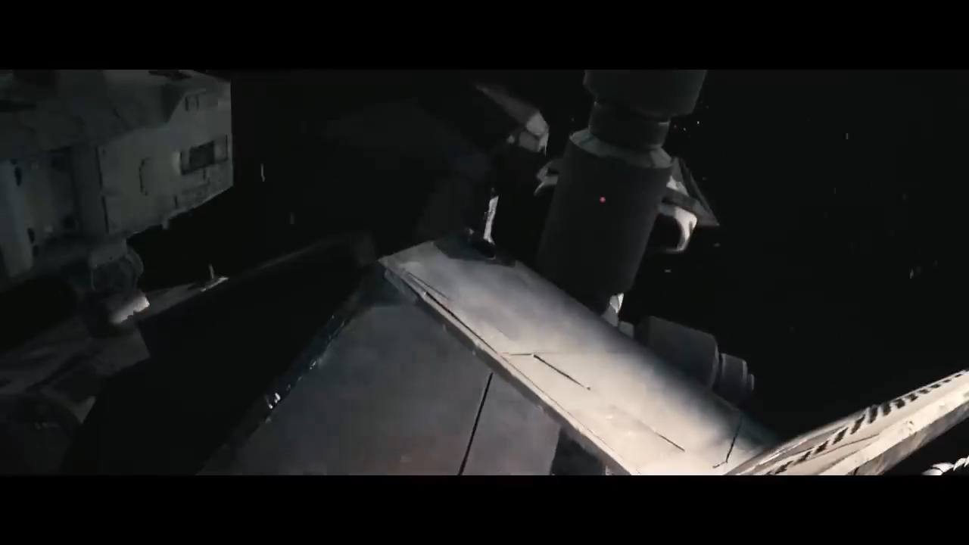
When you find someone building the same thing.
Notes:
TIME 2:08–2:11 | 3 seconds.
SAY: Nothing; let the dramatic reaction play.
ACTION: Return from the app to this slide only after a real matching result is visible. Video starts automatically and the deck advances after three seconds.
IF NO MATCH: Skip this slide (go to slide 8).
AUDIO: Silent cut for consistent playback.
SOURCE: Interstellar | Docking Scene | Paramount Movies — https://www.youtube.com/watch?v=v2H1s9gj5DA
EXACT EXCERPT: 4:30–4:33 of the linked upload. The film footage is a humorous reaction, not a product capability.
Movie/meme sources are credited here; inclusion does not establish a reuse licence.

Slide 8
BumpIn
Visible when
you choose.
Hide your profile. Stay in control.
Notes:
TIME 2:11–2:47 | 36 seconds.
ACTION 2:11–2:34: Return to the app. Toggle visibility off and confirm the change on the other device.
SAY: “And being visible is my choice. I can hide myself again.” Pause for the update. “I control whether I appear on the map.”
ACTION 2:34–2:47: Tap the venue pin and show the event's Luma link.
SAY: “The venue pin also links back to the event, keeping the people and the event together.”
Keep the privacy demonstration concrete. Don't claim exact distance, GPS tracking or automatic introductions.
SOURCE: docs/PRD.md; docs/DEMO-MEDIA-SCRIPT.md.
TRANSITION: Return to the final QR slide and leave it visible.

Slide 9
BumpIn
Find your
people.
bumpin-silk.vercel.app
Make the introduction.
Notes:
TIME 2:47–3:00 | 13 seconds.
SAY: “Your next teammate might be three metres away. BumpIn helps you make the introduction. Scan the code. Find your people.”
ACTION: Keep this QR on screen through the end and during questions.
QR DESTINATION: https://bumpin-silk.vercel.app/e/grok-bot-london
The “three metres” line is an illustrative possibility, not a measured proximity claim.
END OF MAIN DECK. The two following slides are hidden alternatives; do not run them as part of the three-minute presentation.
REHEARSAL: Main times sum to 180 seconds, including app interactions and pauses. Videos are embedded silent H.264 MP4 clips, so no streaming sites are needed for clip playback. The app itself needs its normal connectivity.
MEDIA SOURCES: Crowd: Pexels / La Doncella Audiovisual. Travolta and Mr Bean: Tenor. Interstellar: Paramount Movies. Mission: Impossible: Binge Society. Original source URLs are in each media slide's notes.

Slide 10
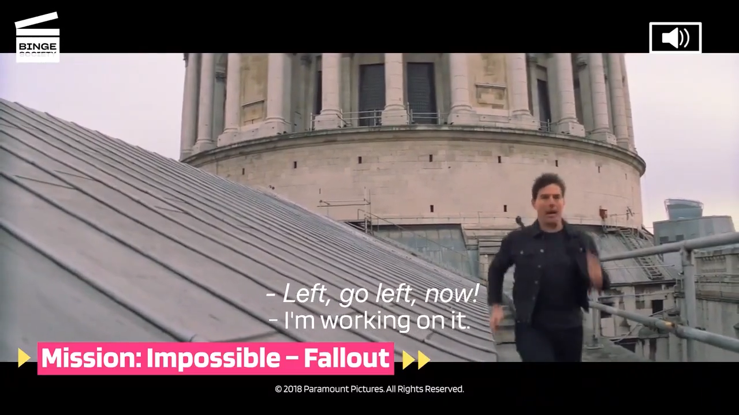
Me finding a teammate before the deadline.
Notes:
HIDDEN ALTERNATIVE | 3 seconds. Replace slide 1 if a more chaotic opener suits the room; do not add it to the main sequence.
SAY BEFORE PLAYING: “Finding the right teammate shouldn't feel like this.”
ACTION: Silent three-second London chase shot; then continue with Travolta or go straight to the BumpIn reveal. Rehearse the revised opening.
SOURCE: Mission: Impossible – Fallout: Manhunt through London's rooftops, Binge Society — https://www.youtube.com/watch?v=M9XZ07XlsEw
EXACT EXCERPT: 0:05–0:08 of the linked upload.
Movie/meme sources are credited here; inclusion does not establish a reuse licence.

Slide 11

Waiting for a reply to “anyone need a teammate?”
Notes:
HIDDEN ALTERNATIVE | 3 seconds. Replace slide 2 (Confused Travolta), not an extra joke.
SAY: Nothing; pause for the caption.
ACTION: Silent Mr Bean waiting clip. Use before the app reveal, never over our loading state.
SOURCE: Mr Bean waiting — https://tenor.com/view/mr-bean-waiting-still-waiting-gif-13052487
EDIT: First three seconds, silent.
Movie/meme sources are credited here; inclusion does not establish a reuse licence.

