Slide 1
Monad Blitz London
Open live demo
Clutch turns virality into a live market
A room scans, gets funded in seconds, trades YES/NO on creator momentum, and watches the odds move live on Monad.
1
Notes:
[Sources]
- Product framing and audience script: /Users/efi/Hackathons/Monad/docs/pitch.md
- Live deployment URL and demo status: /Users/efi/Hackathons/Monad/docs/tasks.md
- Public deployment summary: /Users/efi/Hackathons/Monad/README.md

Slide 2
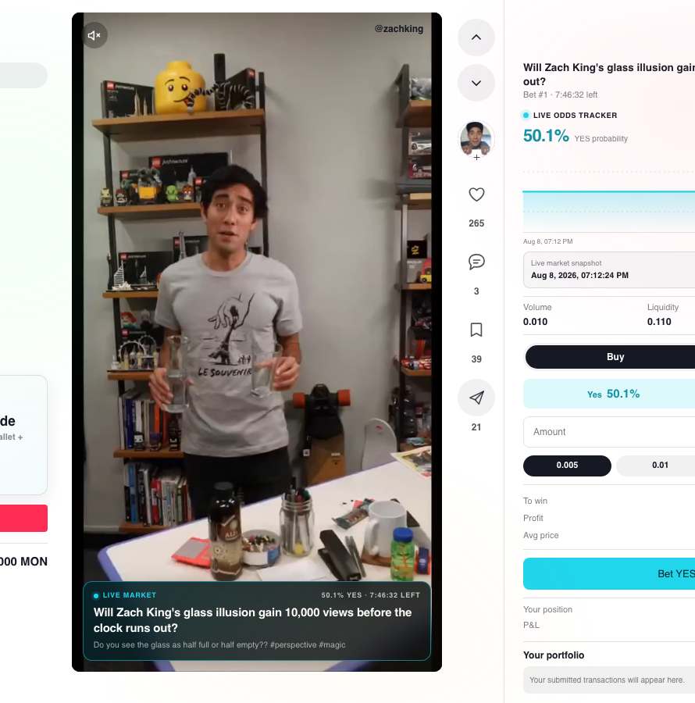
The room joins and trades in seconds
Clutch removes the normal crypto friction. The audience scans one QR, gets a funded burner wallet, and votes YES or NO while the same creator clip is still playing on the projector.
No MetaMask. No faucet. No setup. Just scan and trade.
2
Notes:
[Sources]
- Live screenshot captured 2026-08-08 from https://clutch-597773359205.europe-west2.run.app/screen
- Screenshot asset: /Users/efi/Hackathons/Monad/.tmp/presentation-build/clutch-screen.png
- QR join flow and projector behavior: /Users/efi/Hackathons/Monad/docs/architecture.md
- Audience flow and setup checklist: /Users/efi/Hackathons/Monad/docs/pitch.md

Slide 3
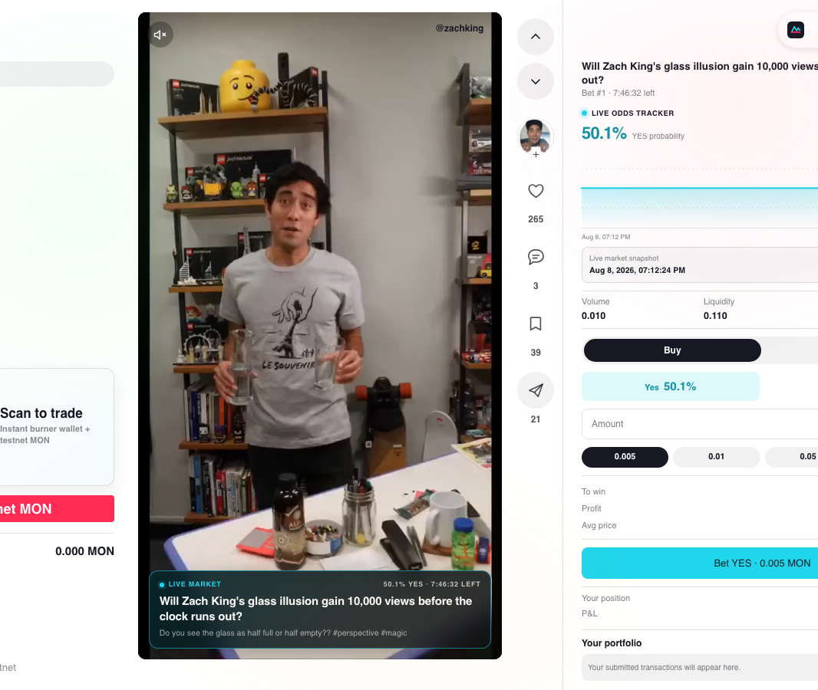
The market already reprices on Monad testnet
Sponsor funding landed
0.200 MON to a fresh burner wallet
Real NO trade moved the odds
YES 50.0% -> 47.6%
Real YES trade moved it back
YES 47.6% -> 50.1%
The audience is not watching a simulated chart. The same live market already has funded wallets, confirmed trades, and MonadScan proof.
3
Notes:
[Sources]
- Live screenshot captured 2026-08-08 from https://clutch-597773359205.europe-west2.run.app/frontend
- Screenshot asset: /Users/efi/Hackathons/Monad/.tmp/presentation-build/clutch-frontend.png
- Funding amount, live market #1, and real trade repricing proofs: /Users/efi/Hackathons/Monad/docs/tasks.md
- Contract page: https://testnet.monadscan.com/address/0x194bd79723fC1C6BC6Cf635349f0190EbCFf59AD

Slide 4

Vote with your phone
Scan, trade, and vote for Clutch
Open the live demo, get testnet MON instantly, and push the market while the reel is still on screen.
clutch-597773359205.europe-west2.run.app/frontend
QR points directly to the live join route
4
Notes:
[Sources]
- QR generated 2026-08-08 from https://clutch-597773359205.europe-west2.run.app/join
- QR asset: /Users/efi/Hackathons/Monad/.tmp/presentation-build/clutch-join-qr.png
- Public app URL and join flow: /Users/efi/Hackathons/Monad/docs/tasks.md
- Public deployment summary: /Users/efi/Hackathons/Monad/README.md

