Slide 1


Slide 2
Introduction
What is NodeJS
Node.js is a framework to develop highly-scalable applications which can handle tens of thousands of simultaneous client connections efficiently
Node.js is based on V8 JavaScript Engine.

Slide 3
Is Real world use Node.js?
Though pretty young, Node.js is already being used by a lot of Organizations, Projects, and Applications. The following list is an indication of, for what kind of applications Node is being used :
HTTP Proxy
IRC Bot / Chat / Messaging
Web service (data)
real time analysis (data, email)
Client of another web service (Like Twitter client)
real time collaboration
Log and log monitoring
Web-based software to serve a specific client requirement (like reservations book for restaurateurs, Grade book)
Application server

Slide 4
What is the advantages of using Node.JS
Event driven and Non-Blocking, so handles concurrent connections efficiently than it's counterparts.
It's great to have common language on both client and server.
Event better, if used with Databases like MongoDb, then it's 100% JavaScript, From DataBase to Server to Client.
Clean, Functional API.

Slide 5
Why people like nodeJS
NPM package
Great libraries
Java script is everywhere
Open source
Great for APIS
Great community
Real time apps
High performance

Slide 6
What is the disadvantages of using Node.js
Since Node is very young, lots of database drivers (required to connect to databases) and modules (for adding some specific functionality), are unstable. It is still unstable on Windows platform. But Node has a very active and responsive community and hope that these problems will be marginalized in near future.

Slide 7
Who uses nodeJS?
Following is the link on github wiki containing an exhaustive list of projects, applications and companies which are using nodeJS.
This is include eBay, general Electric, GoDaddy, PayPAl, yahoo, Uber, Yamer and wikipins.

Slide 8
Sample script in nodejs
/* Hello World! program in Node.js */
console.log("Hello World!");
/*Example : Synchronously reads the file*/
Here we have used fs.readFileSync() which is the synchronous version of fs.readFile(). It also returns the contents of the filename.
var fs = require('fs');
var content = fs.readFileSync("readme.txt", "utf8");
console.log(content);
console.log('Reading file...');
Output :
nodejs synchronously reading a file

Slide 9
Where to use NodeJS
IO bound applications
Data streaming applications
Data intensive real time applications
JSON api based applications
SPA

Slide 10
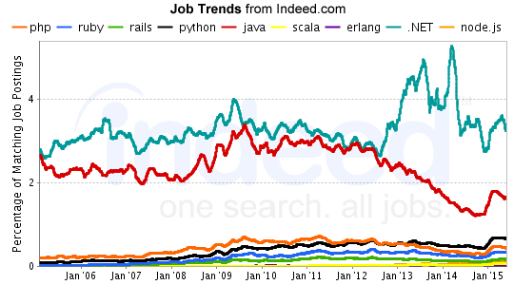

Slide 11
THANKS YOU

