Slide 1

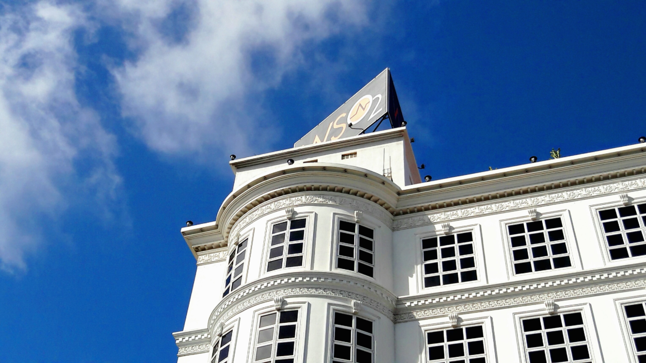
Analyst about WSO₂

Slide 2
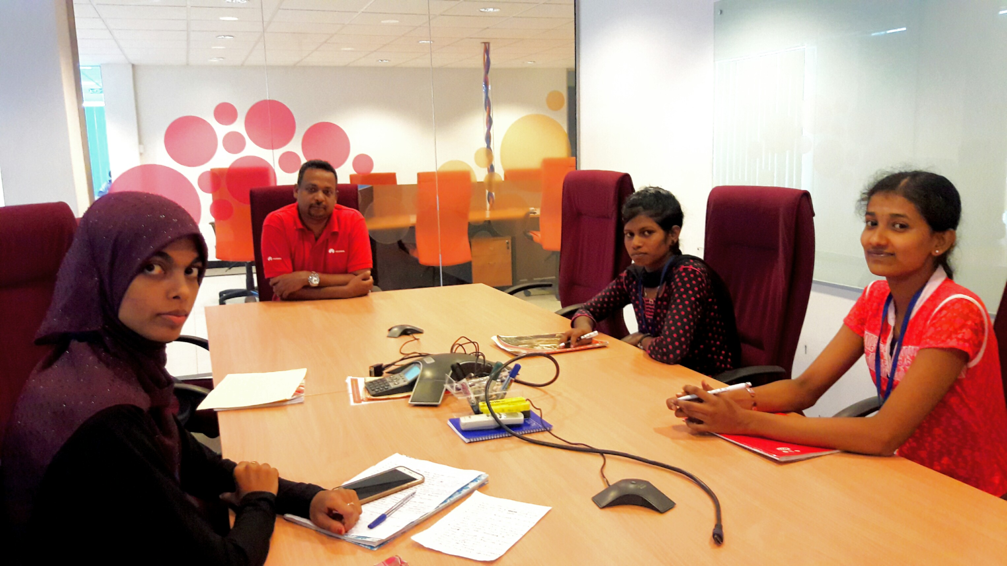
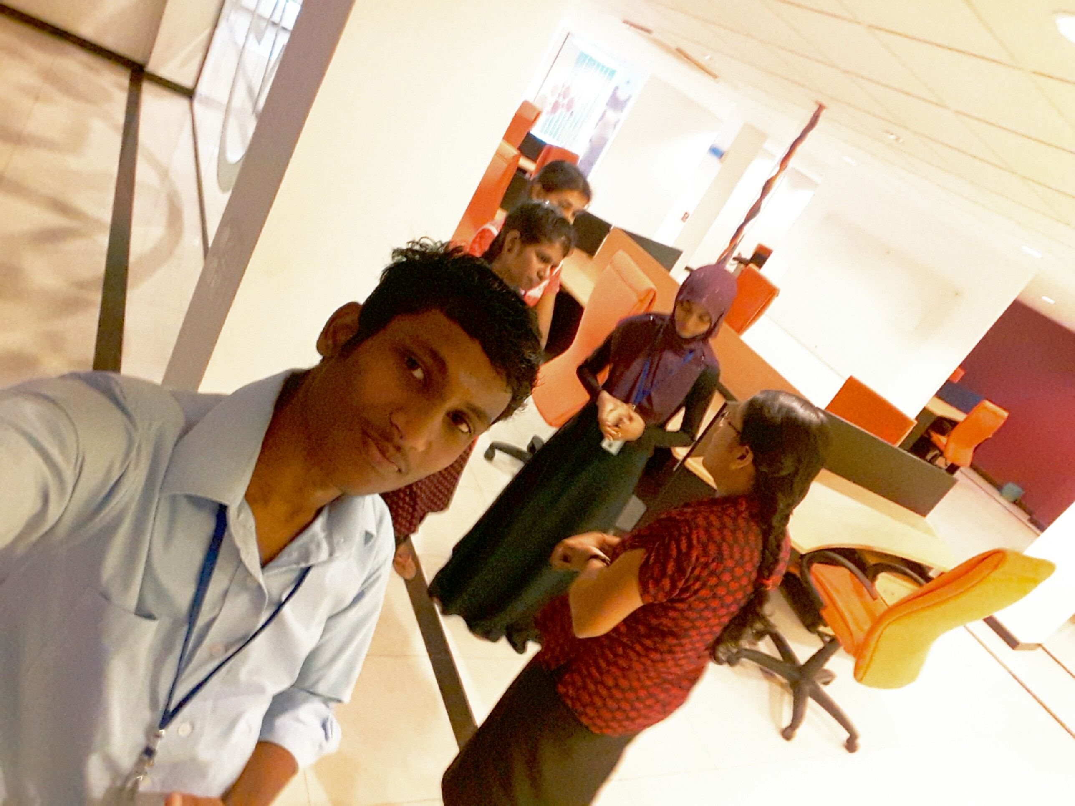
Team members:
R.Jana
R.Mayoori
S.Janusha
S.Shahama

Slide 3
What’s WSO₂?

Slide 4
Who is the founder of WSO₂?

Slide 5
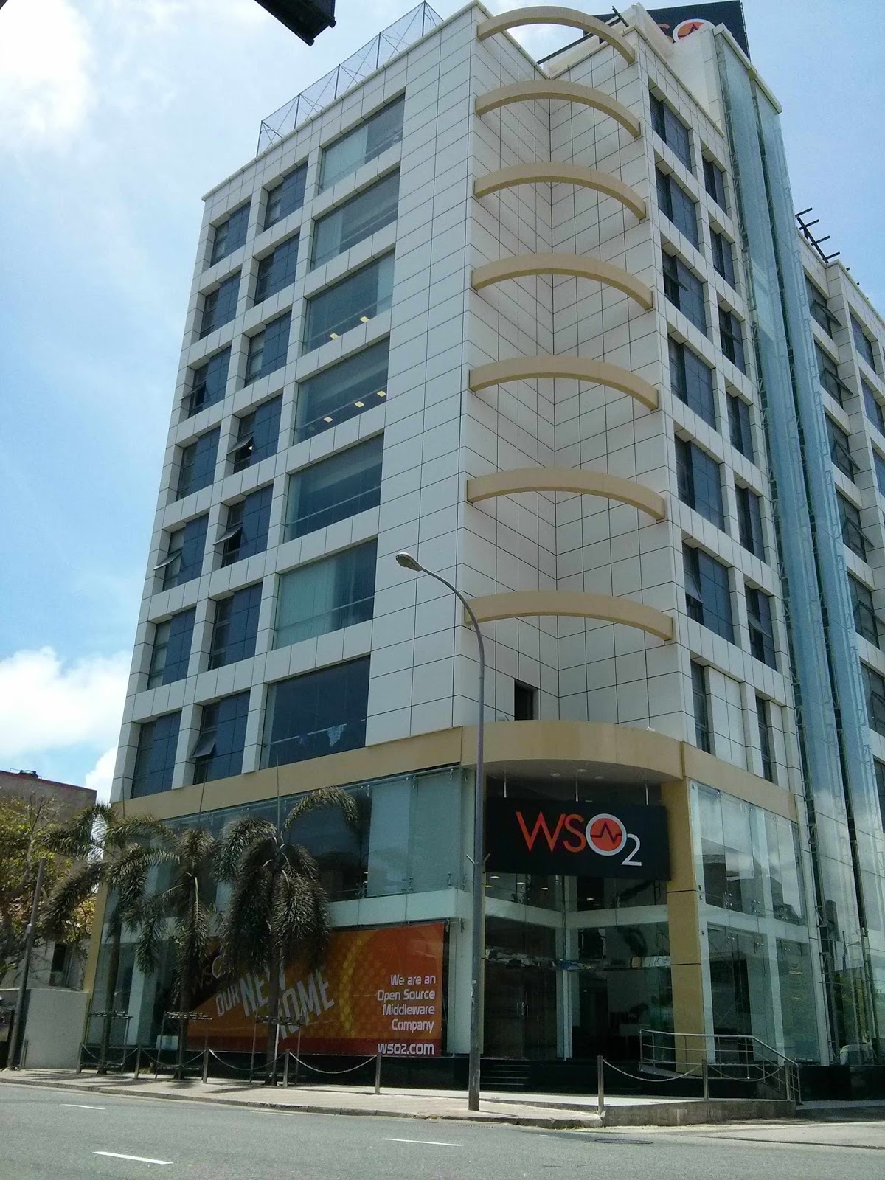
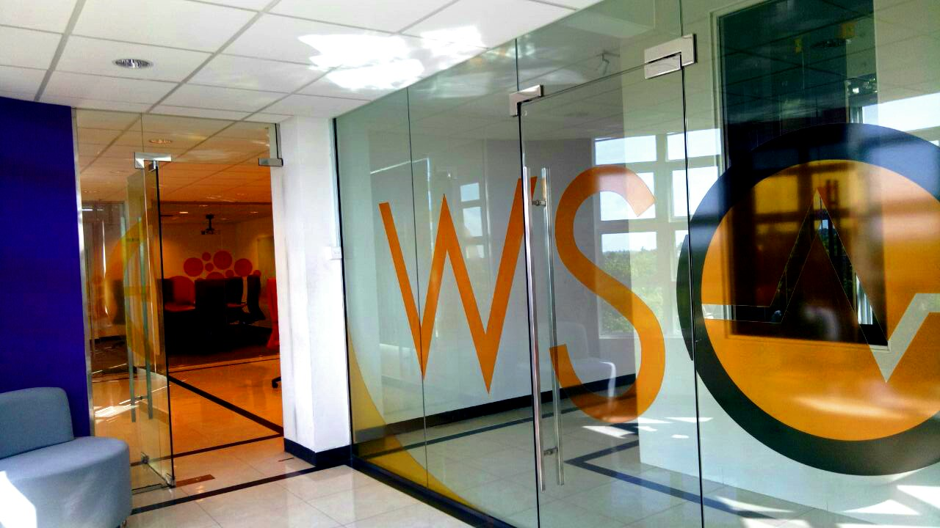
Where is the office of WSO₂?
Colombo office
Jaffna office

Slide 6
Partners of WSO₂?

Slide 7








Premier
Preferred
Community

Slide 8
Salary in WSO₂?

Slide 9
How do they manage WSO₂’s expenses?

Slide 10
What are the qualifications they expect from WSO₂’s employee?

Slide 11
What are the services
WSO₂ gives to customers?

Slide 12
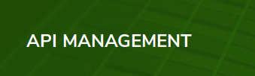





Slide 13
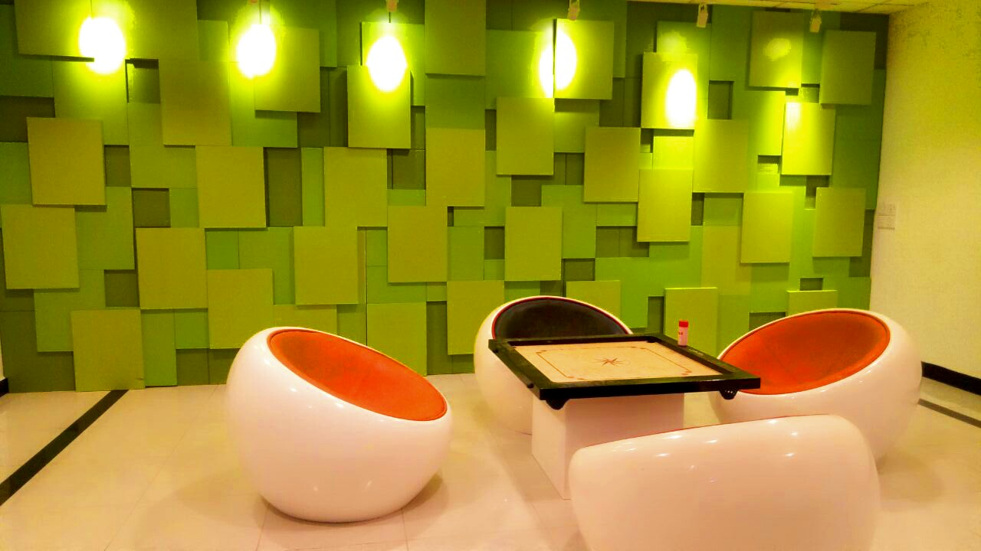
More clicks...
Environment

Slide 14
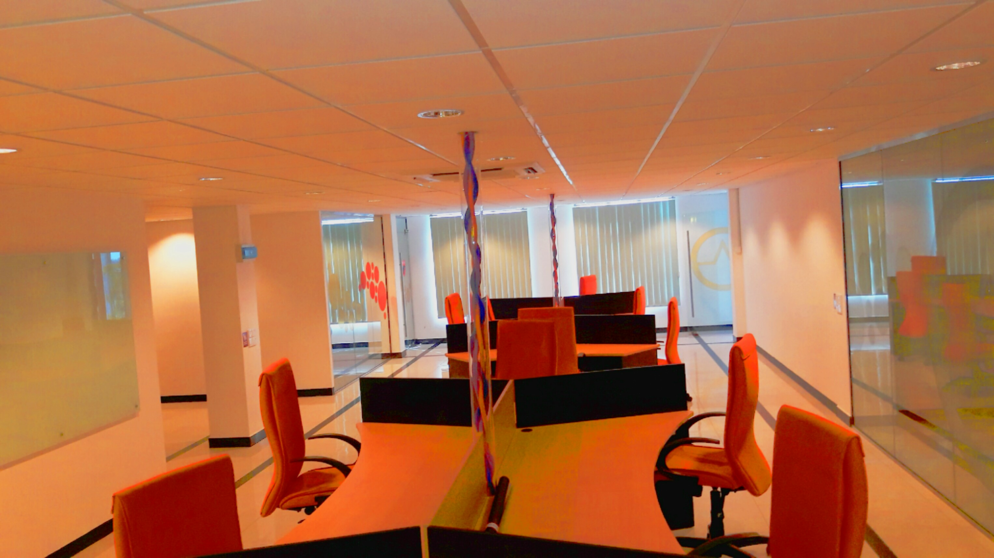
More clicks...
Environment

Slide 15
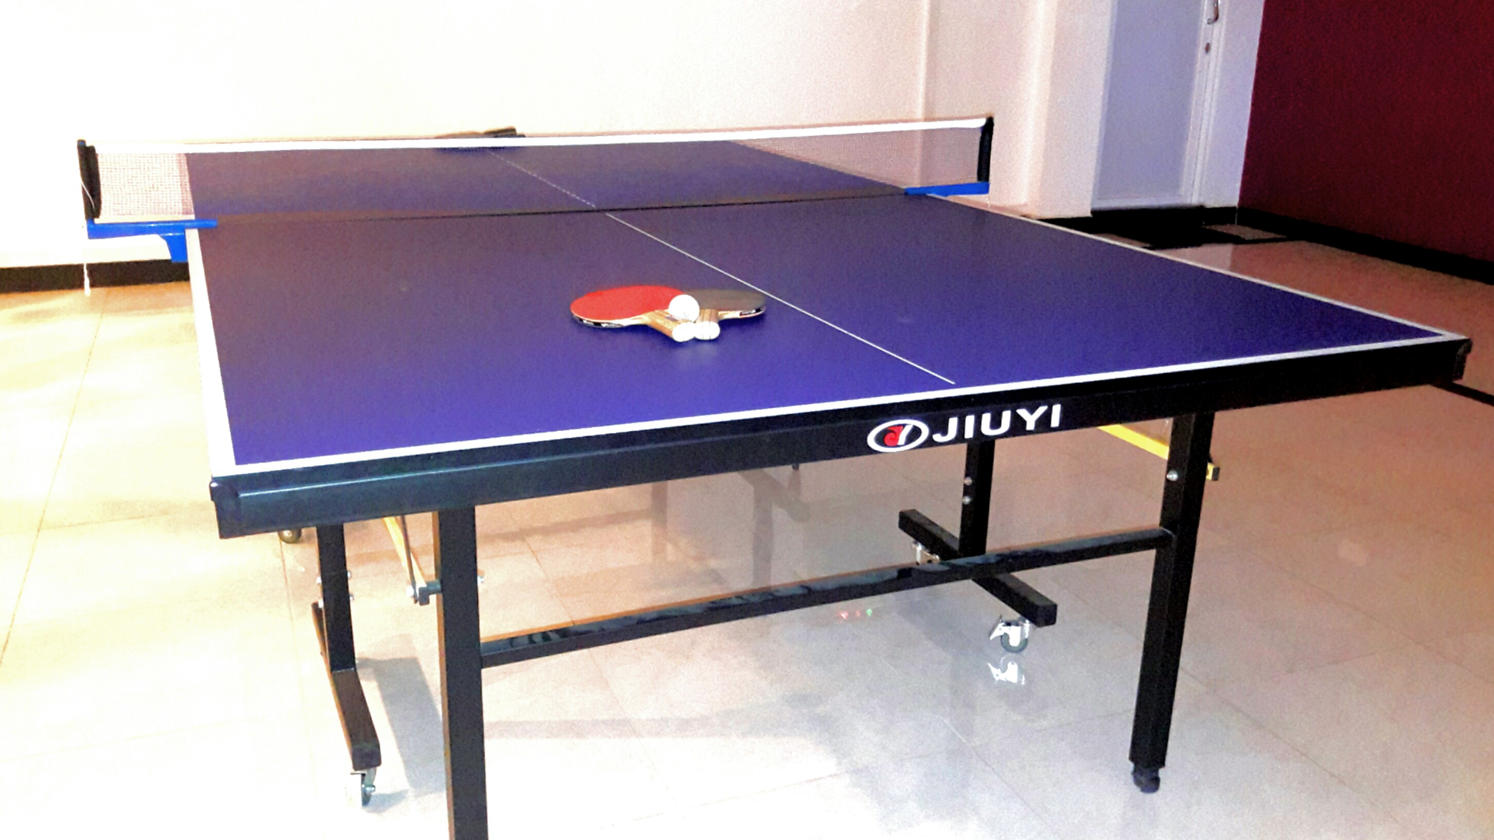
More clicks...
Environment

Slide 16
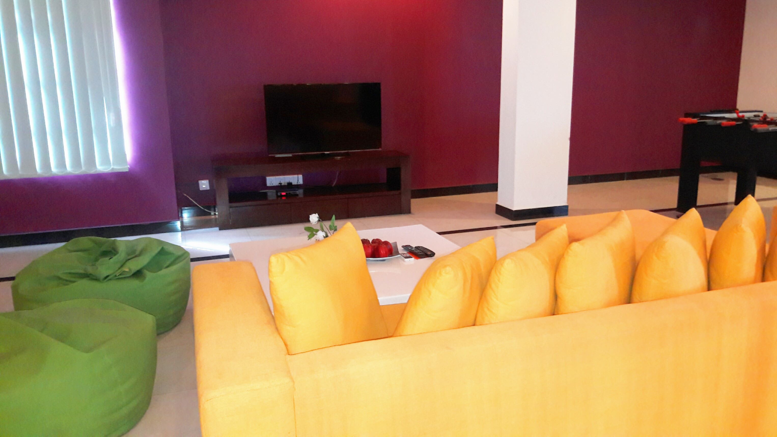
More clicks...
Environment

Slide 17
More clicks...
Environment

Slide 18
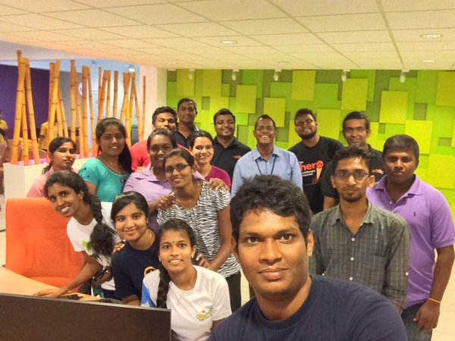
More clicks...
Employees

Slide 19
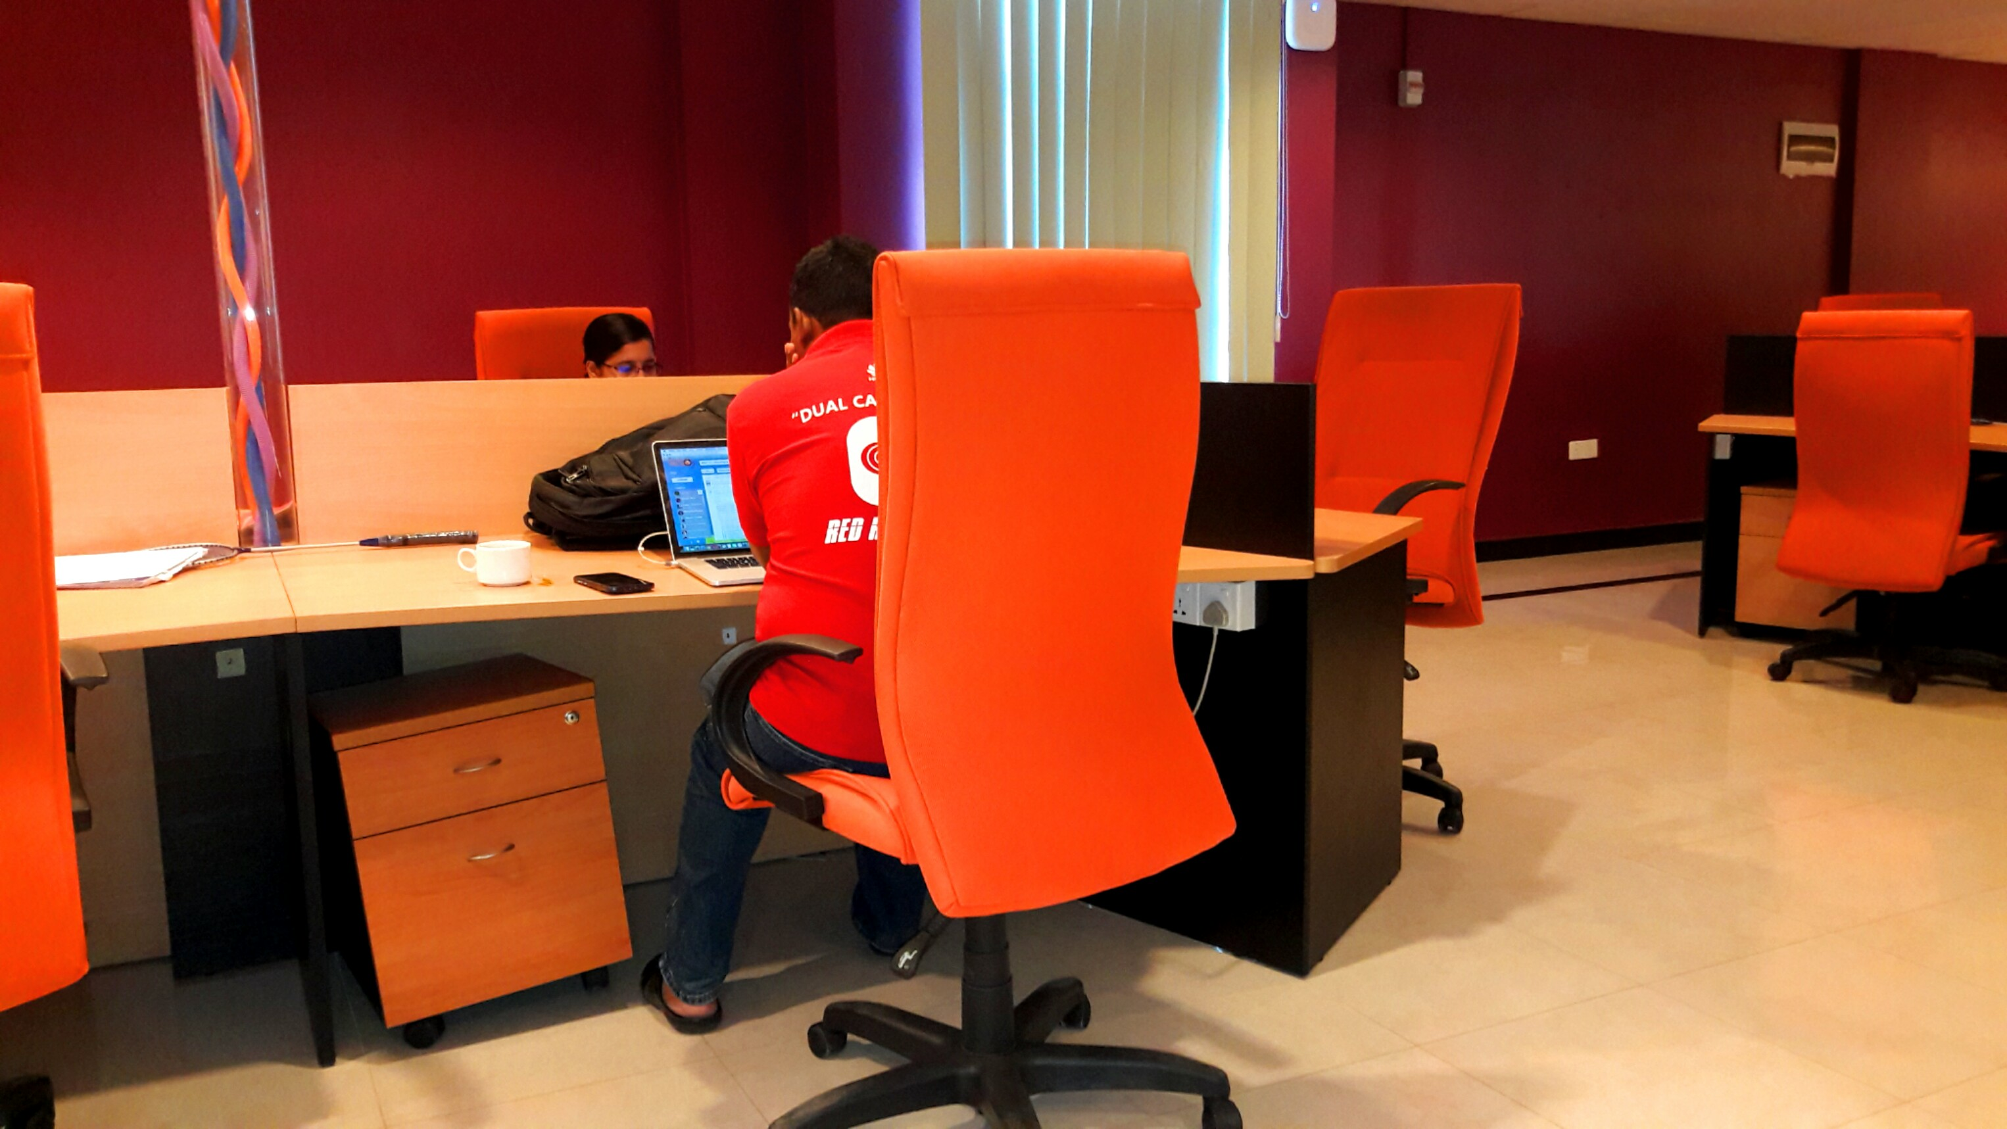
More clicks...
Employees

Slide 20
More clicks...
Data collections

Slide 21
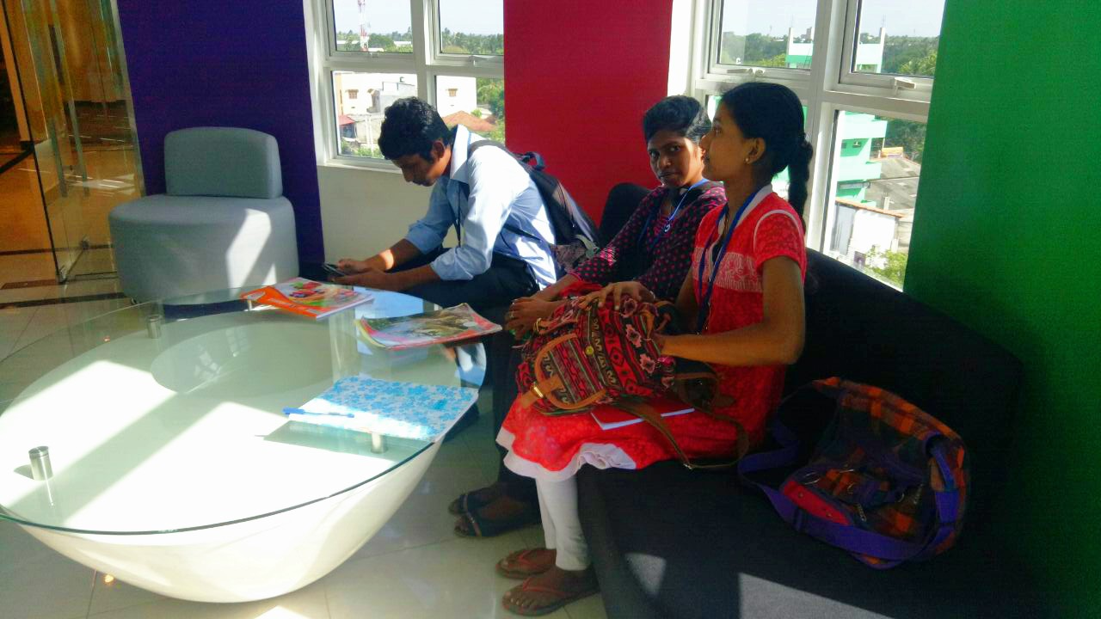
More clicks...
Data collections

Slide 22
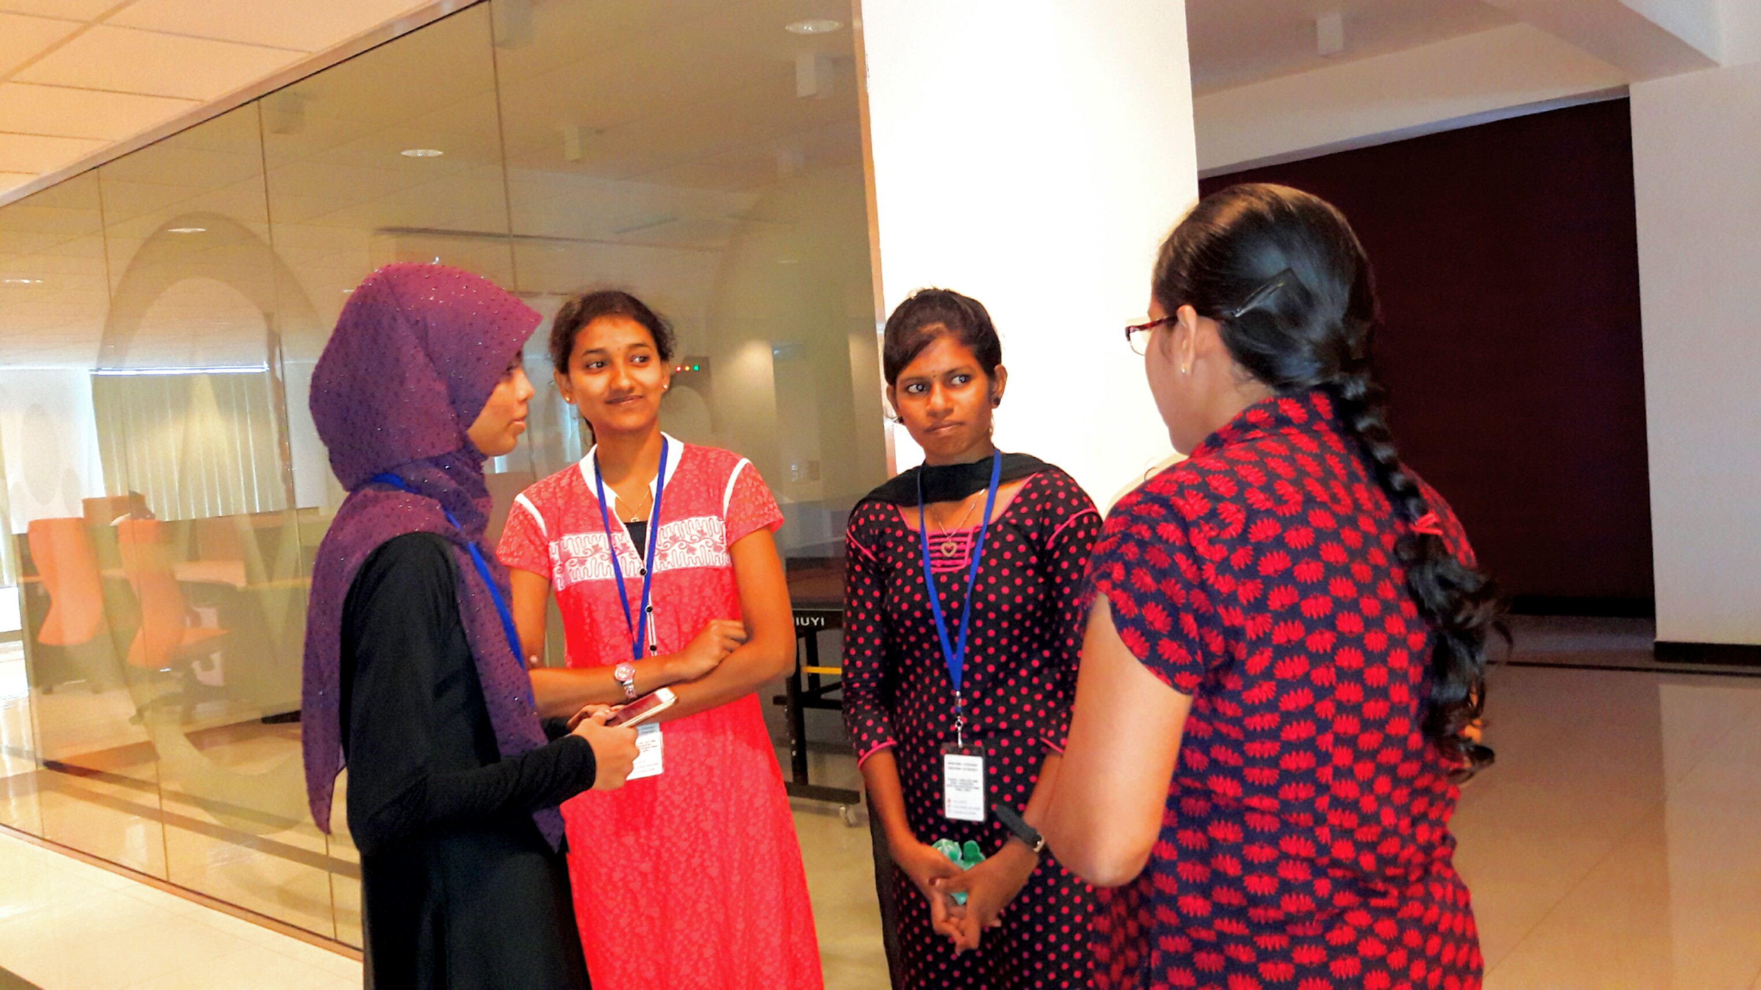
More clicks...
Data collections

Slide 23
Your comments…?

