Slide 1


Energy Forecasting – BigDEAL Challenge 2022
Francisco Flores
Shashank Bhushan
Anubhav Dixit

Slide 2
Presentation Outline
Introduction
Problem Statement
Data Sources
Proposed Methods
Results
Conclusion

Slide 3
Introduction

Slide 4
Energy Forecasting
Load Forecasting
- Predicting future demand of electrical power consumption
- Helps in maintaining normal functioning of grid
Peak Load Forecasting
- Predicting quick surge in electrical power demand
- Helps in avoiding unpredicted grid failures by identifying patterns from grid data

Slide 5
Problem Statement

Slide 6
Challenge
Predicting ex post one-year ahead forecasting
- Predicting future demand of electrical power consumption
- Helps in maintaining normal functioning of grid
Predicting ex ante day ahead peak load forecasting
- Predicting quick surge in electrical power demand
- Helps in avoiding unpredicted grid failures by identifying patterns from grid data

Slide 7
Data Sources

Slide 8
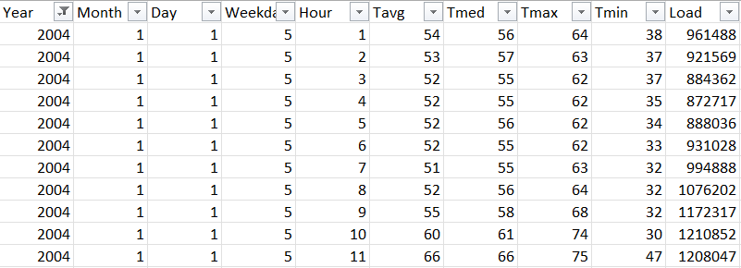
Data Sources
Qualifying Match Data
- Single excel file containing load data for past years
- 5 Columns containing data for time, ex. Year, Month
- 4 Columns containing data for temperature
- 1 Column containing load data from past years

Slide 9
Proposed Methods

Slide 10
Proposed Methods
Random Forest
- XXXXX
- XXXXX
Time Series Analysis
- XXXXXXX
- XXXXXXX

Slide 11
Results

Slide 12
Results
XXXXX
- XXXXXX
- XXXXX
XXXXXX
- XXXXXXXXX
- XXXXXXXXX

Slide 13
Conclusion

Slide 14
Conclusion
XXXXXX
- XXXXXX
- XXXXXXXX
XXXXXX
- XXXXXX
- XXXXXX

