Slide 1

Notes:
Introduction slide – have this open as they come in

Slide 2
Agenda
Intro to the AutoDrive Challenge
Overall competition objectives
Year 1 technical objectives
Year 1 deadlines
Our resources
Our platforms
Team structure
Choose your team
Conclusions

Slide 3
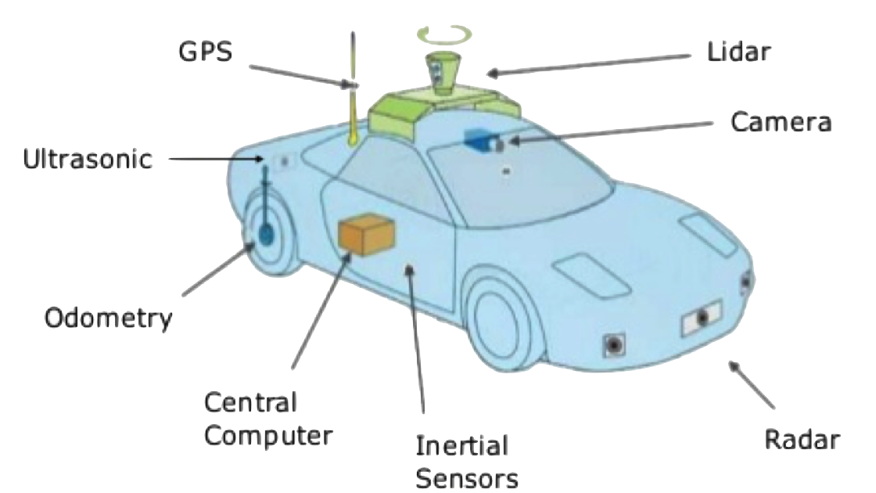
Autonomous Vehicle Technology
Notes:
Intro to autonomous vehicle technology

Slide 4
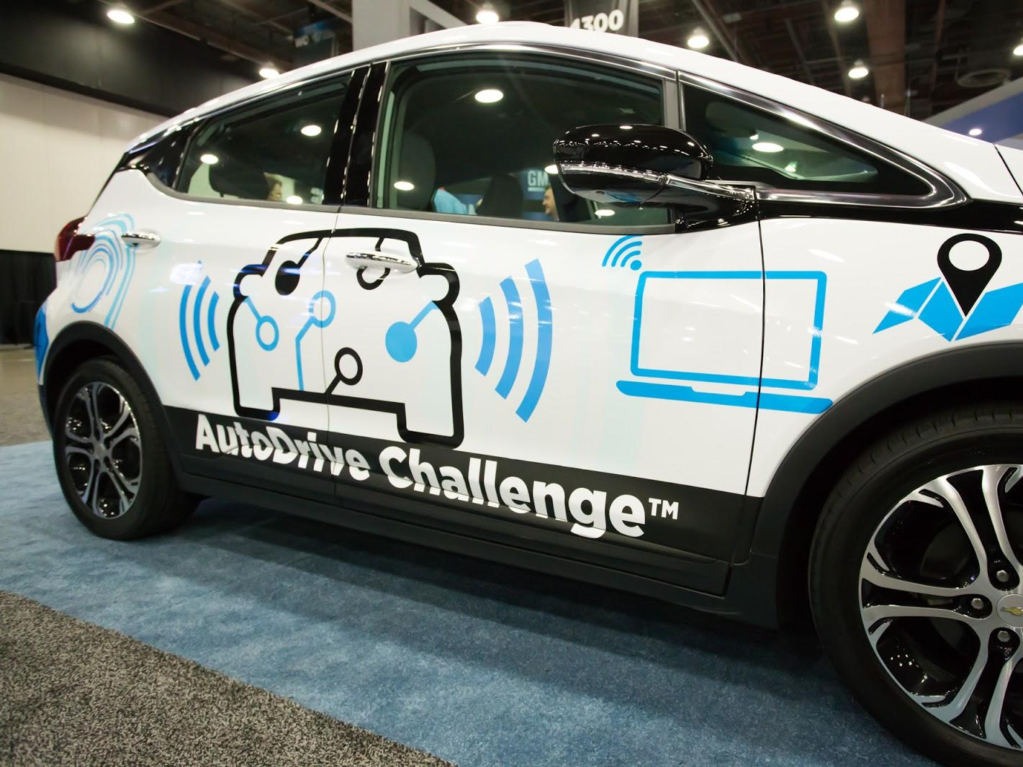



Notes:
Describe the autodrive challenge: -3 year competition
-create an autonomous car using sensing technologies, computing platforms, computer vision, pattern recognition, machine learning, AI, sensor fusion and autonomous vehicle controls
-work hands-on with industry standard technologies
… etc.

Slide 5
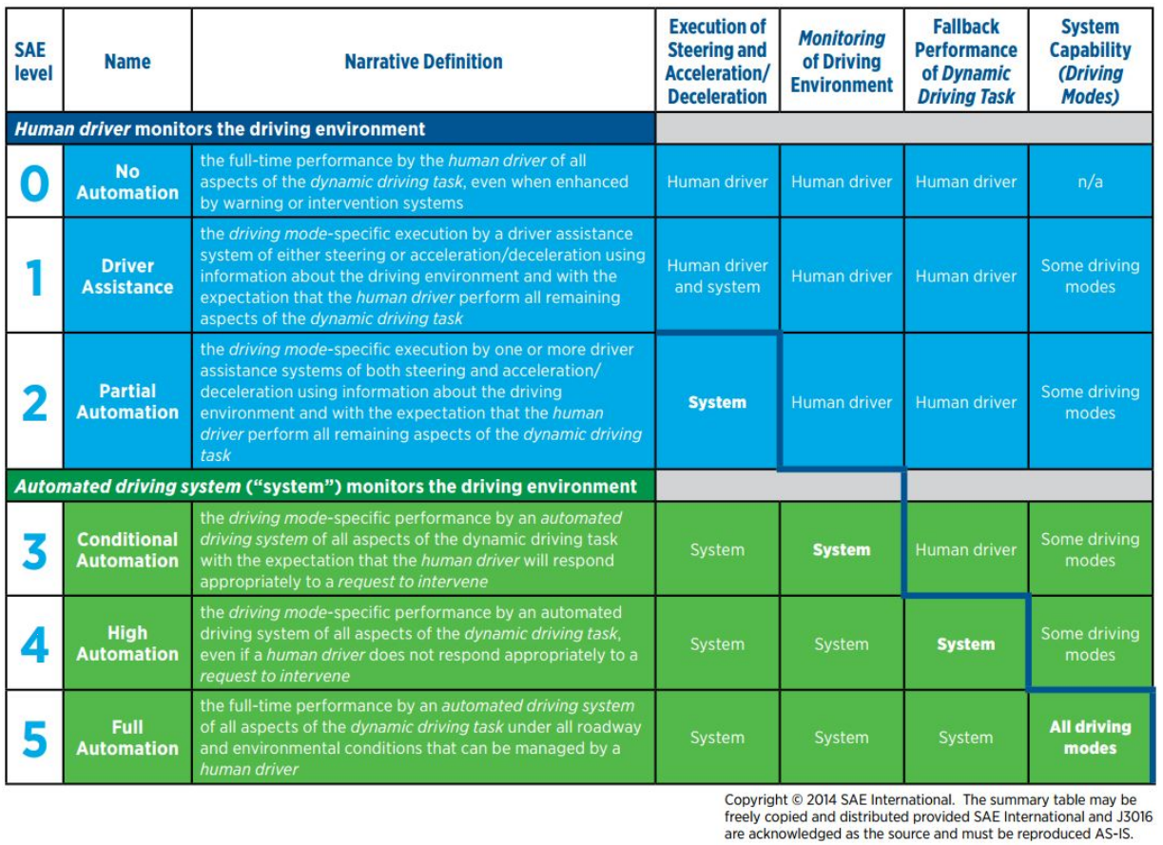
Overall Competition Objective
Notes:
Objective: level 4 autonomous by fourth year. Describe what that means.

Slide 6
Year 1 Technical Objectives
Mapping Challenge
Straight Line Challenge
Lateral Challenge
Object Detection and Avoidance Challenge
Notes:
Describe each of these in more detail

Slide 7
Year 1 Deadlines
August 1: Preliminary Concept Review
August 1: Safety Concept Report
March 1: Concept Design Report
March 15: Interface Analysis
April 1: Social Responsibility Report
April 30: Safety Records
End of April: Competition

Slide 8
Our Resources
A stock Chevrolet Bolt EV
$30,000 of startup funding
$36,000 per year to fund two Graduate Assistants (GRAs)
Computational equipment for the vehicle (provided by Intel)
Sensors (provided by various competition sponsors)
Autonomous vehicle simulation software (such as PreScan)
Access to a 2 km test track in Waterloo

Slide 9
Our Platforms
Version Control: GitLab (UW Server)
Task Management: Pivotal Tracker
Documentation: Nuclino
Team Communication: Discord

Slide 10
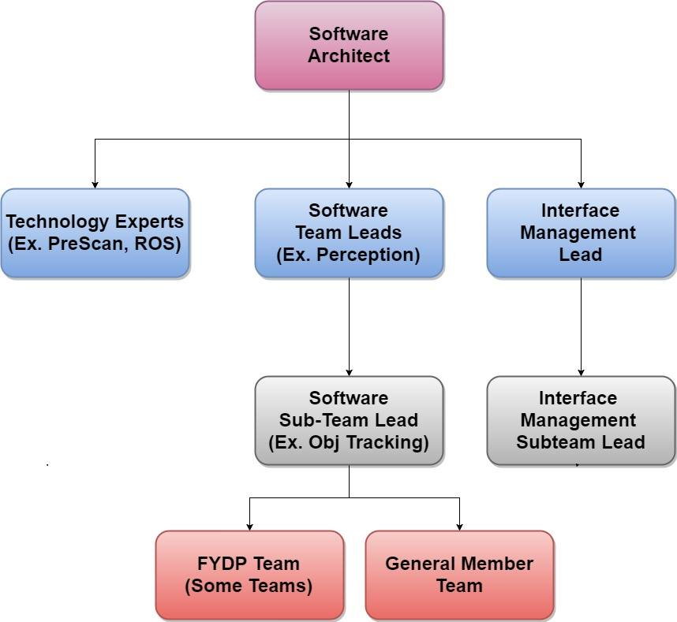
Software Team Structure
Notes:
Describe each of these in more detail. Discuss the fact that there are also electrical, mechanical, and business teams. Make sure to have a list of electrical and mechanical sub-teams with you (the one Melek wrote up) so that if someone asks who is interested in doing an electrical or mechanical FYDP you have options to talk about.

Slide 11
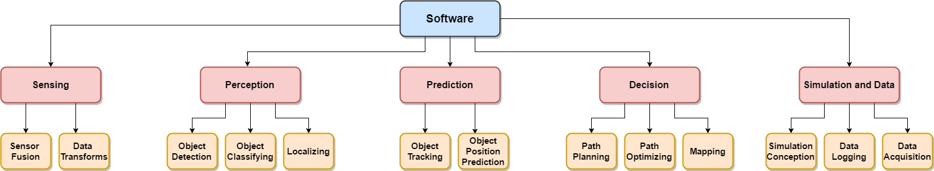
Software Sub Teams
Notes:
Describe each of these in more detail. Note that there will likely be more FYDP team projects than listed.

Slide 12
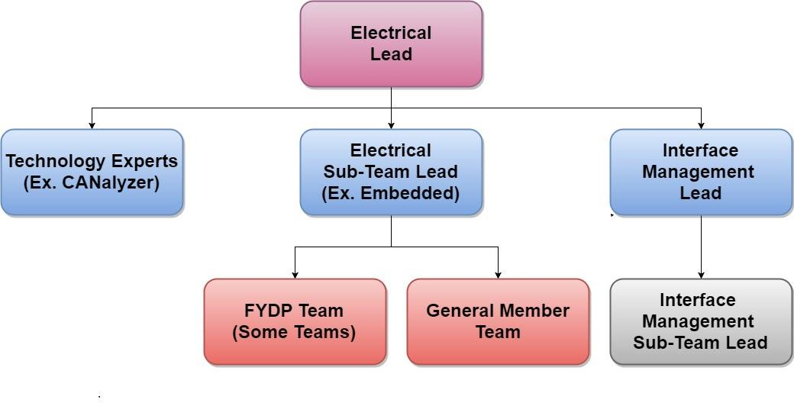
Electrical Team Structure
Notes:
Describe each of these in more detail. Discuss the fact that there are also electrical, mechanical, and business teams. Make sure to have a list of electrical and mechanical sub-teams with you (the one Melek wrote up) so that if someone asks who is interested in doing an electrical or mechanical FYDP you have options to talk about.

Slide 13
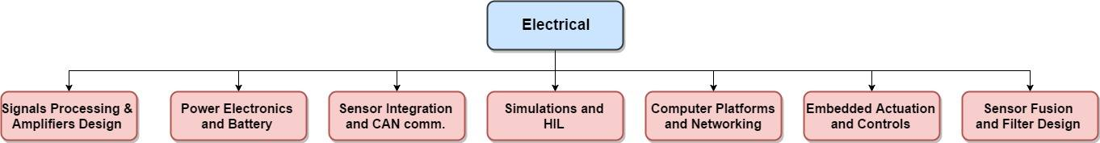
Electrical Sub Teams
Notes:
Describe each of these in more detail. Note that there will likely be more FYDP team projects than listed.

Slide 14
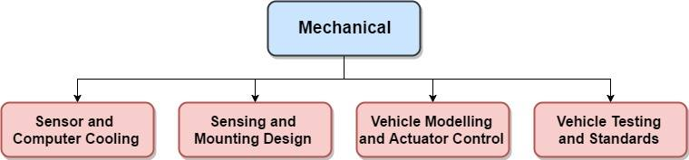
Mechanical Sub Teams
Notes:
Describe each of these in more detail. Note that there will likely be more FYDP team projects than listed.

Slide 15
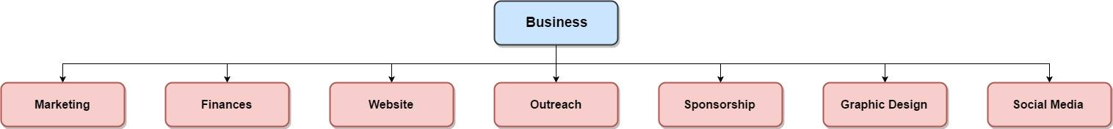
Business Sub Teams
Notes:
Describe each of these in more detail. Note that there will likely be more FYDP team projects than listed.

Slide 16
Select your team preferences!
https://goo.gl/forms/MPFkjIrDt4dOZrd62
or
https://tinyurl.com/kxh4yto
Notes:
Give the floor to derek

Slide 17
Thank you!
We will be sending out links to discord, official rules, etc. to those who completed the survey.
Our website: watonomous.ca
Notes:
Conclusions ☺

