Slide 1


Slide 2
Project Title
MENDELEEV’S MARVEL
Name | Roll Number | Branch
Shahan Ali | R2142211305 | CSE GG
Mridul Pratap Singh | R2142211483 | CSE GG
Priyanshu Raj | R2142211450 | CSE GG
Ahzam Khan | R2141211273 | CSE GG
Project Guide
Alind Sir

Slide 3
INTRODUCTION
The purpose of this project is to create "Mendeleev's Marvel," an educational game designed to help users learn and remember the periodic table's order.
The project aims to address the challenge of making periodic table education engaging and interactive, motivating learners to understand and retain the order of elements.
It uses gamified learning for making the platform much more interactive and helpful in learning.

Slide 4
Literature Review
No. | Source | Connection with Project | Learnings
1 | Mendeleev’s periodic table | It is a learning tool for understanding chemistry better. | Got the fundamentals of the projects for the same.
2 | Crossword Puzzle | Base model for the game experience | Viable source for memorization of table
3 | The C++ Programming Language By: Bjarne Stroustrup | Algorithm and backend | Structuring the backend
4 | 3D Graphics rendering cookbook by:Sergey Kosarevsky, Viktor Latypov | User Interface and Frontend | Visualization of the game

Slide 5
Motivation
Memorizing the order of elements on the periodic table is a common challenge for students of chemistry.
Traditional methods are often inconvenient and less effective.
This project aims to address this challenge for making education interactive and engaging.

Slide 6
Problem Statement
There are no viable sources for Memorizing the order of elements on the periodic table and no fun and interactive way for learning the basics of chemistry. These cause inconvenience and often times problems for students in early grades. Often times the amalgamation of the problems above cause degradation for chemistry basis and structural knowledge. Gamified learning are often frowned upon and not looked up as a futuristic learning platform.

Slide 7
Objectives
Develop an Interactive Learning Tool:
Create an interactive and engaging educational game that assists users in learning the order of elements on the periodic table.
Promote Gamified Learning:
Leverage gamification techniques to make the process of learning element ordering enjoyable, motivating users to actively participate in the learning process.
Enhance Retention and Comprehension:
Improve users' retention and comprehension of the periodic table by providing a visual and interactive learning experience that goes beyond traditional rote memorization.
Utilize OpenGL for Graphics:
Implement graphics and visuals using OpenGL to create an immersive and visually appealing environment that captures the attention of users.
Efficient Data Structure Usage:
Employ efficient data structures to manage and organize the elements of the periodic table, ensuring smooth and optimized gameplay.

Slide 8
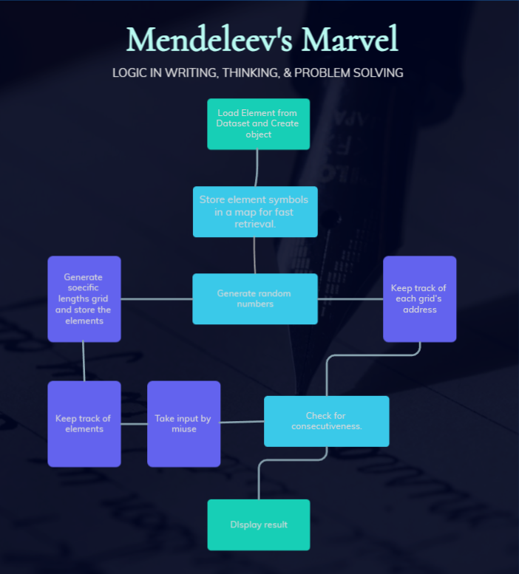
Methodology

Slide 9
Experimental Setup
No. | Specification
1 | Hardware | 64 bits processor architecture supported by windows. Minimum RAM requirement for proper functioning is 4 GB. Required input as well as output devices. Required sufficient Graphic card for image processing.
2 | Software | This system is developed in OpenGL. C++ compiler.

Slide 10
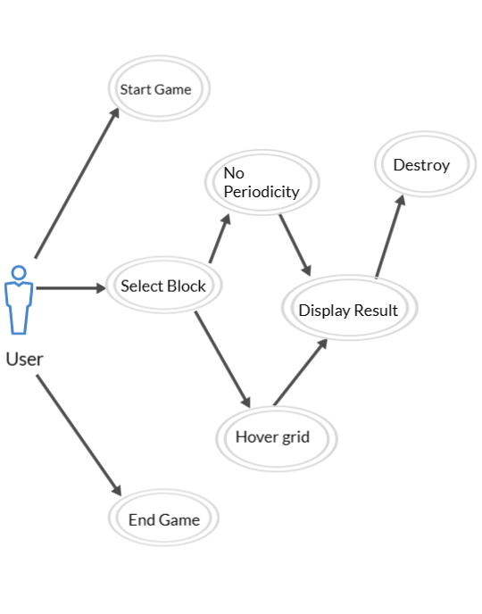
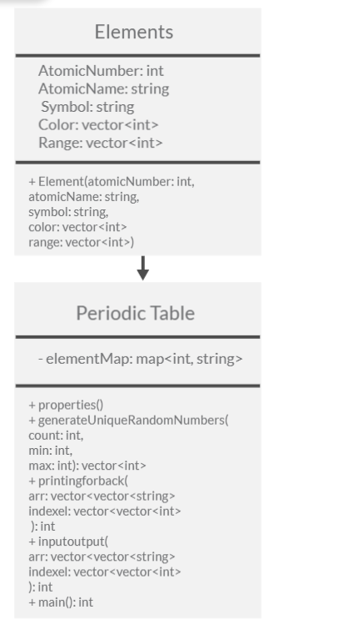
Use case
Class Diagram

Slide 11
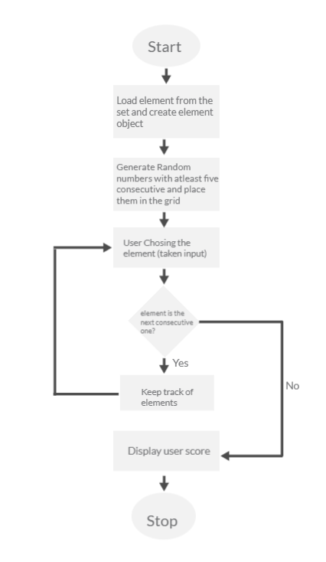
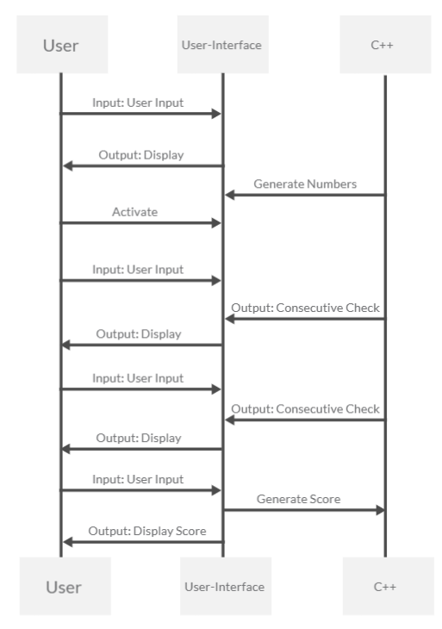
Activity Diagram
Sequence Diagram

Slide 12
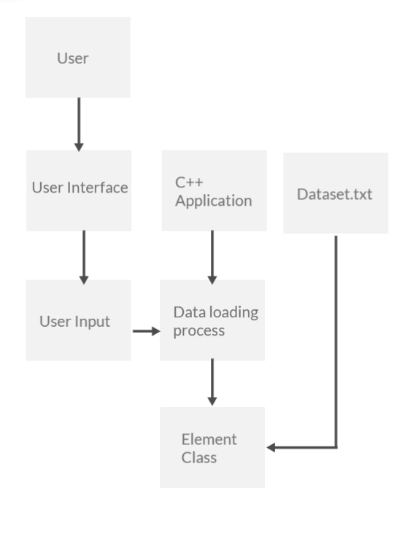
Data Flow diagram

Slide 13
Algorithmic approach / Learnings
Data Loading and Element Initialization:
Read element data from the "datasets.txt" file.
Create instances of the Element class for each element, storing properties such as atomic number, name, symbol, color, and range.
Build a map (elementMap) for quick retrieval of element symbols by their atomic numbers.
Random Number Generation:
Generate a set of unique random numbers for positioning grids and selecting elements.
Ensure that the generated numbers include at least 5 consecutive numbers for initial display.
Game Interface Rendering (drawGrid):
Use OpenGL to draw the game grid and cells.
Display elements in a shuffled order within the grid.
Highlight the selected cell with a different color for user interaction.
Mouse Input Handling (onMouseClick):
Capture mouse clicks to determine selected rows and columns within the grid.
Store selected cells in the selectedCells vector for further processing.
Scoring and Consecutiveness Check:
Track selected elements and their corresponding indexes.
Evaluate consecutiveness based on the indexes and update the counting variable accordingly.
Display the final score and a black screen at the end of the game using drawBlackScreen.

Slide 14
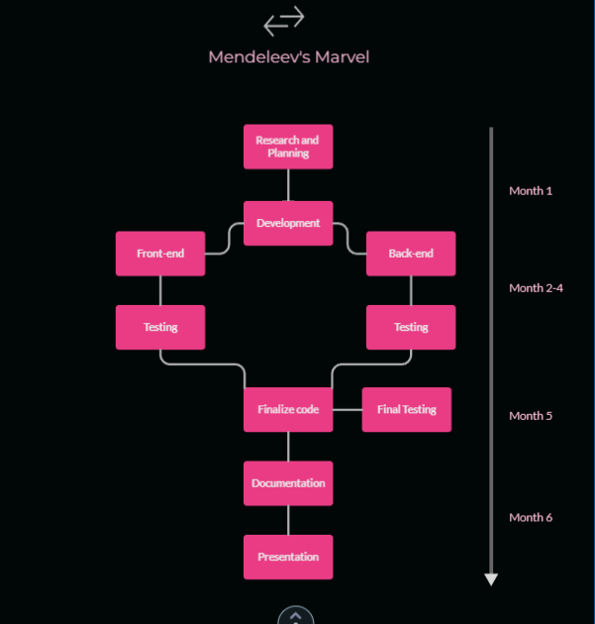
PERT Chart

Slide 15
References & GIT link https://www.geeksforgeeks.org/tag/opengl/ https://pubchem.ncbi.nlm.nih.gov/periodic-table/ https://stackoverflow.com/questions/595131/robust-and-flexible-3d-data-structure https://github.com/topics/opengl-project https://learnopengl.com/Getting-started/OpenGL

