Slide 1
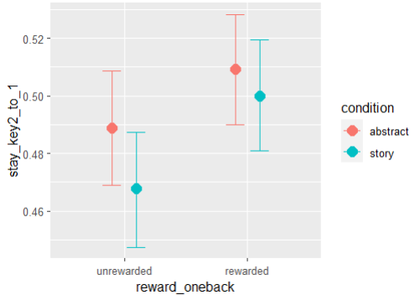
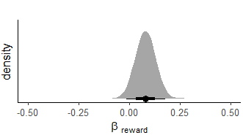
Effect 1: Tendency to repeat the key selected at the second-stage of trial t, at the first-stage of trial t+1
stay_key2_to_1 ~ reward_oneback*condition + (reward_oneback|participant)

Slide 2
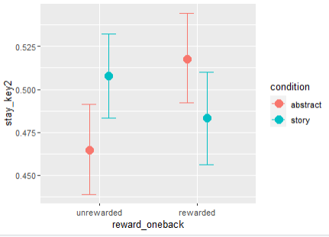
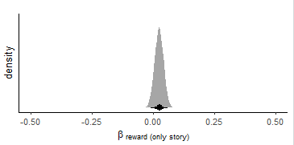
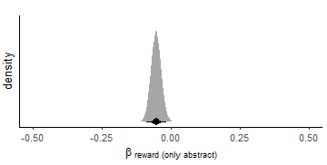
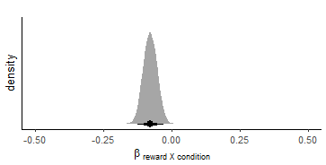
Effect 2: Tendency to repeat the key selected at the second-stage of trial t, at a different second-stage state of trial t+1

Slide 3
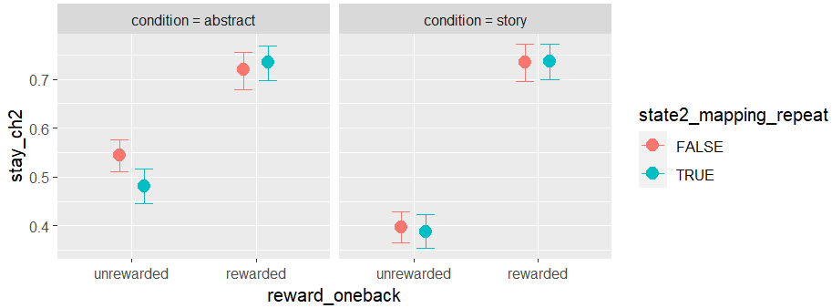
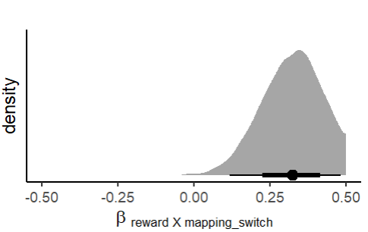
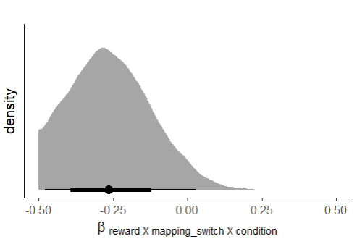
Effect 2: Tendency to repeat the key selected at the second-stage of trial t, at the same second-stage state of trial t+1

