Slide 1
ADIPOSE TRANSCRIPTOMICS
Meta-analysis results
5
studies
29,193
meta-analyzed genes
Exercise and lifestyle intervention signals across GEO cohorts
12
strict genes
105
relaxed genes
A small conservative gene set emerges from broad adipose intervention data, while sensitivity analyses show where the signal is fragile.
Generated from current pipeline outputs

Slide 2
FRAMING
What this analysis is asking
A meta-analysis of adipose tissue expression changes across public intervention datasets.
Unit of analysis
Each GEO study is analyzed separately with limma, then combined gene by gene.
Effect exported
Study-level limma logFC; variance estimated from logFC / t.
Model
Random-effects meta-analysis, REML estimator, DL fallback only if needed.
Best wording: exercise/lifestyle-associated adipose transcriptional response, not a pure endurance-training signature.

Slide 3
MODEL LOGIC
How REMA combines studies
For every gene, each study contributes an effect estimate and its uncertainty.
Study effect
yi = study-level limma logFC
Study variance
vi = estimated variance from limma logFC and t
Random-effects weight
wi* = 1 / (vi + tau2)
Pooled effect
mu-hat = weighted mean of yi using wi*
tau2 is between-study heterogeneity. We estimate tau2 with REML, then report the pooled logFC, confidence interval, heterogeneity, and prediction interval.

Slide 4
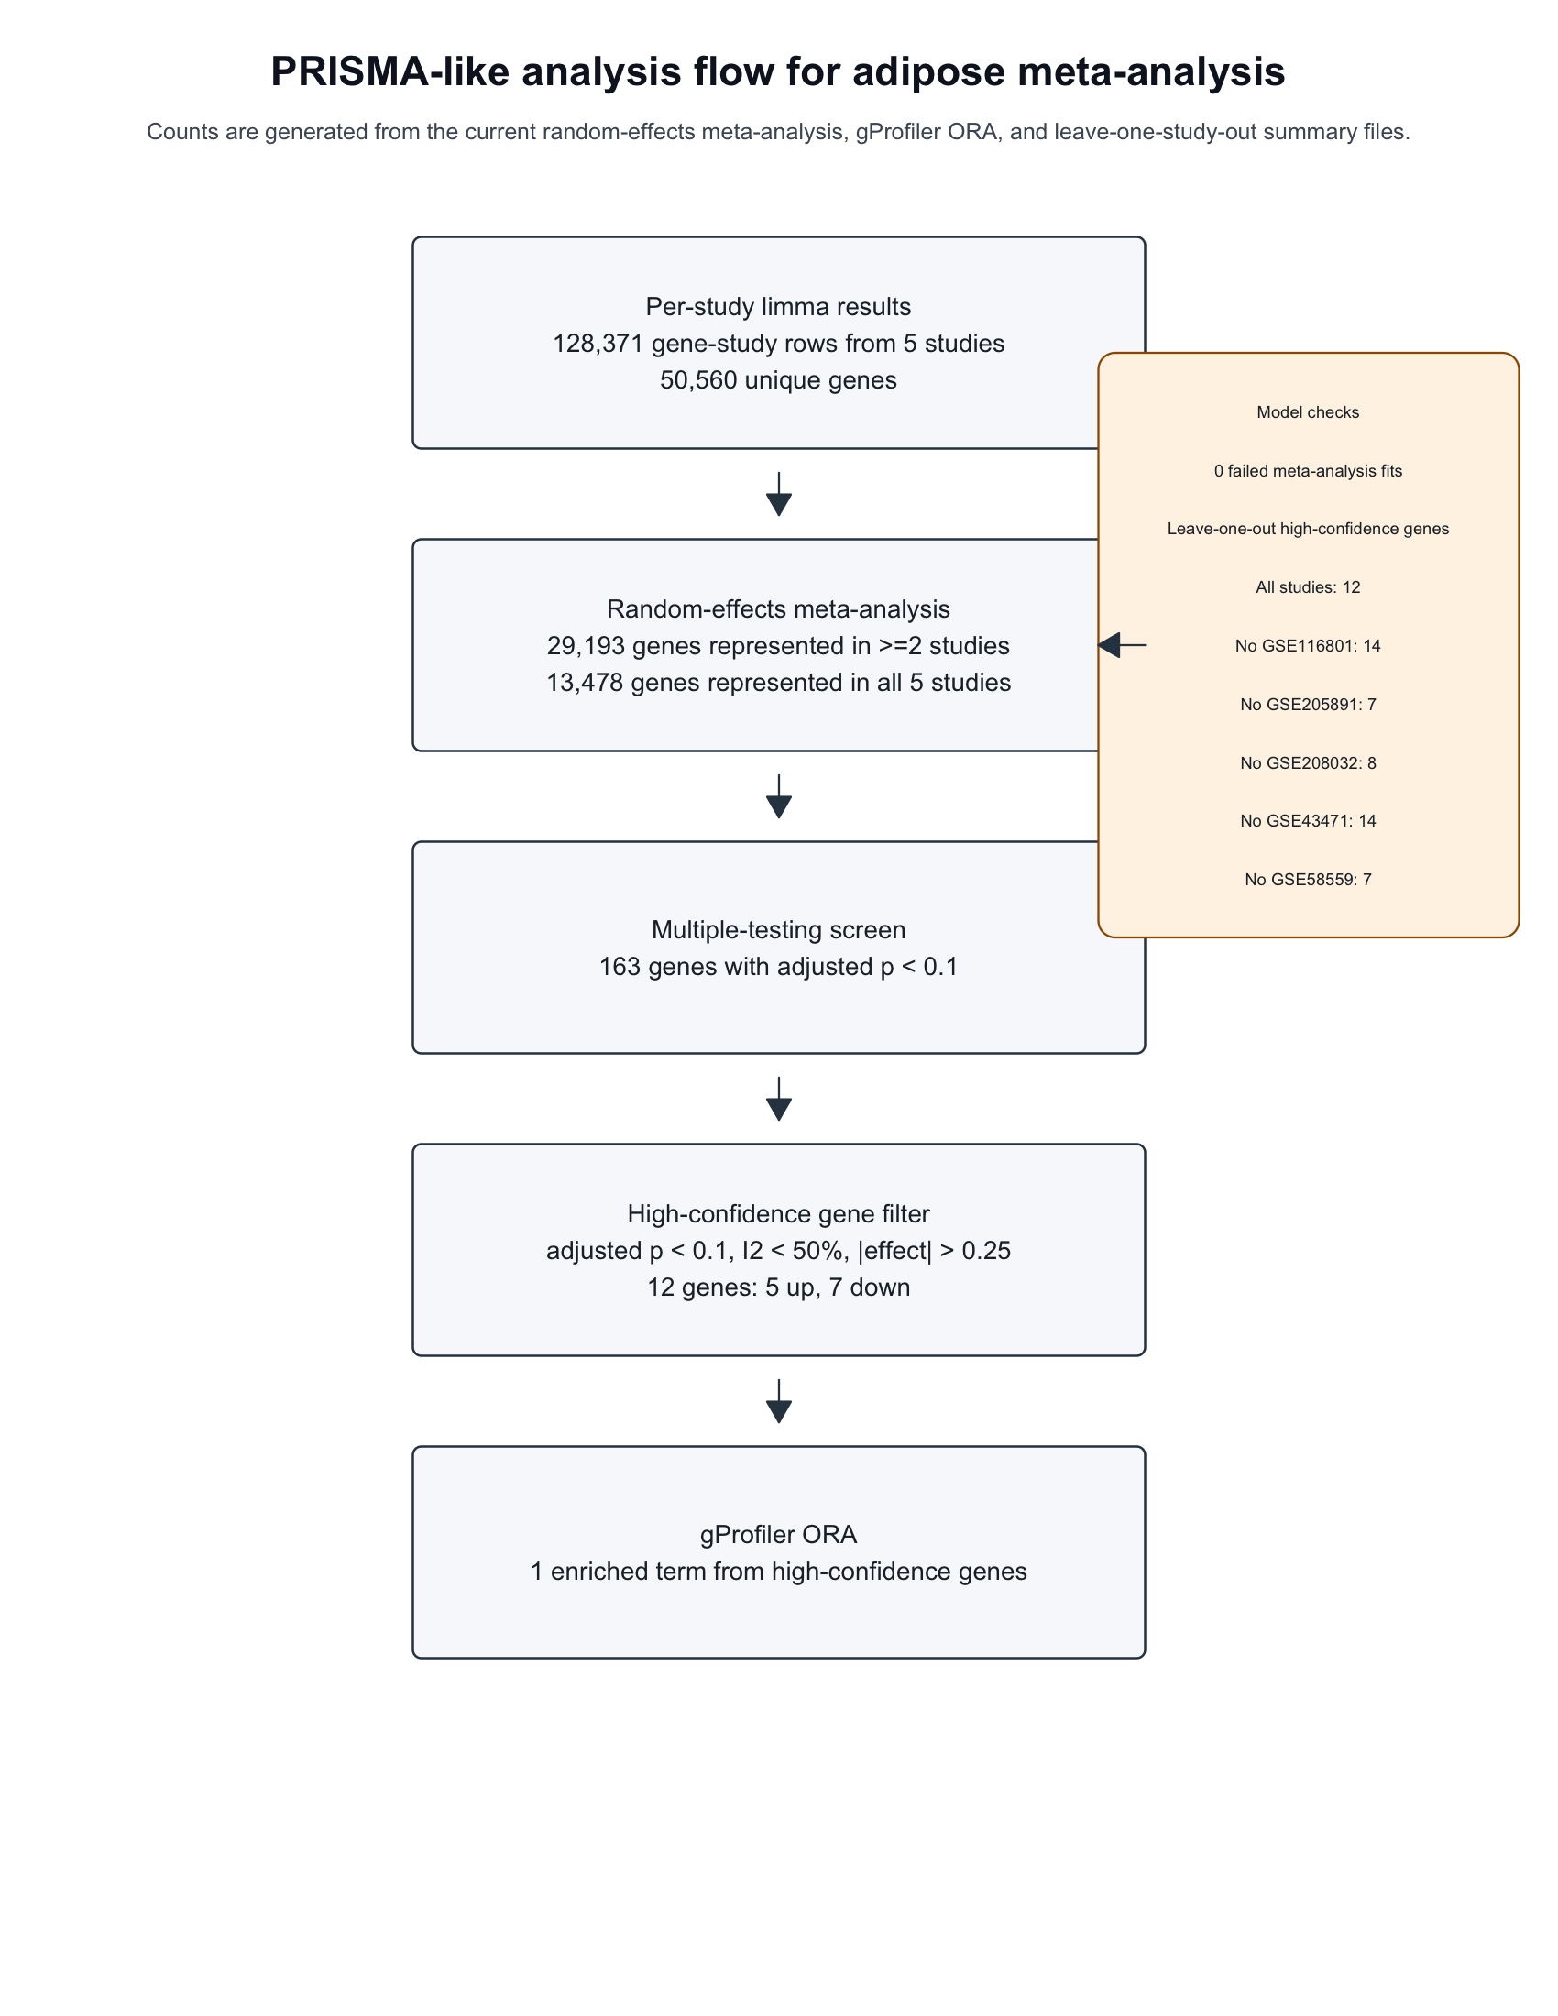
WORKFLOW
From GEO data to meta-analysis
The same pipeline turns study-level limma outputs into pooled gene-level evidence.

Slide 5
RESULTS
Filter sensitivity: what changes?
The strict 12 genes mainly come from the effect-size threshold, not the I2 filter.
29193
All meta-analyzed
163
FDR < 0.1
163
FDR + I2 < 50
105
FDR + |beta| > 0.1
12
Strict: FDR + I2 + |beta| > 0.25
Relaxed no-I2 sensitivity gives 105 genes. The strict set is intentionally conservative: 5 upregulated, 7 downregulated.

Slide 6
CORE RESULT
The strict high-confidence 12
Genes passing FDR < 0.1, I2 < 50%, and absolute pooled beta > 0.25.
Gene
Direction
beta
FDR
I2
Studies
BCYRN1
down
-0.32
2.02e-05
7.02e-04
GSE205891;GSE43471;GSE58559
TMEM170B
down
-0.27
6.70e-05
0.00e+00
GSE116801;GSE205891;GSE208032;GSE58559
LINC00968
down
-1.4
0.0016
0.00e+00
GSE116801;GSE205891
TNMD
down
-0.51
0.0058
39
GSE116801;GSE205891;GSE208032;GSE43471;GSE58559
HCAR2
down
-0.42
0.018
0.00e+00
GSE205891;GSE208032
APOE
up
0.49
0.023
47
GSE116801;GSE205891;GSE208032;GSE43471;GSE58559
CYB561A3
down
-0.27
0.029
0.00e+00
GSE116801;GSE205891;GSE208032
SLF2
up
0.29
0.032
0.00e+00
GSE205891;GSE208032
UCHL1
down
-0.35
0.033
46
GSE116801;GSE205891;GSE208032;GSE43471;GSE58559
MGME1
up
0.26
0.059
0.02
GSE116801;GSE205891;GSE208032
TMEM252
up
0.29
0.08
0.00e+00
GSE116801;GSE205891;GSE208032
FNDC1
up
0.28
0.085
2.1
GSE116801;GSE205891;GSE208032;GSE43471;GSE58559

Slide 7
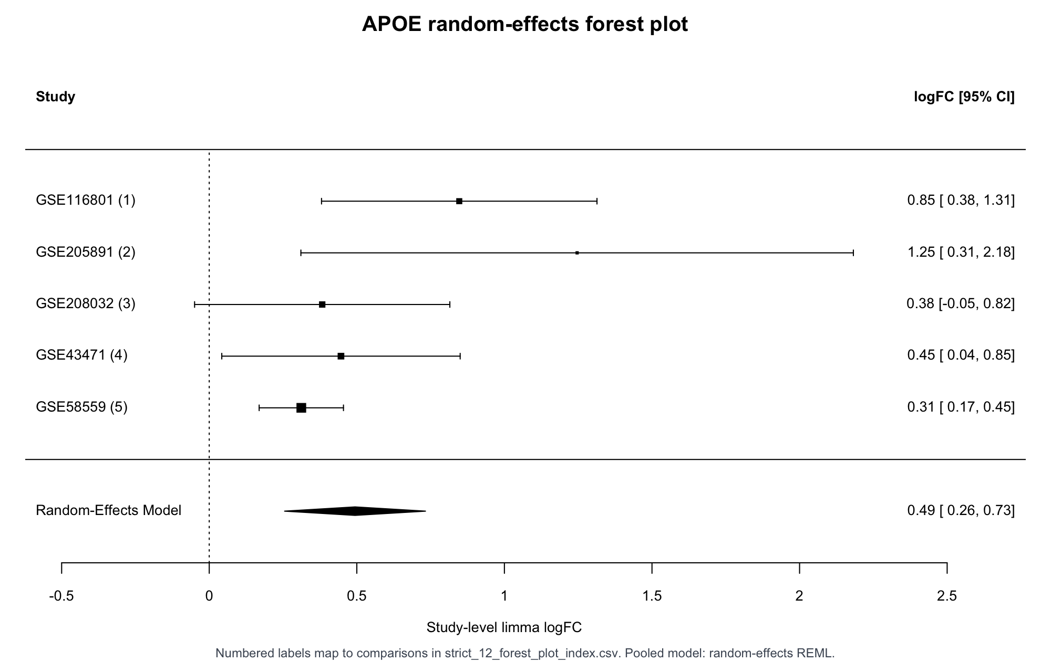
EVIDENCE
Forest plot example: APOE
Study-level logFC estimates point in the same positive direction across all five study contexts.
What to read
Each point is a study-level limma effect.
The pooled diamond is the random-effects estimate.
Prediction intervals are now exported in the meta-analysis CSV.
APOE links this signal to lipid handling in adipose tissue.

Slide 8
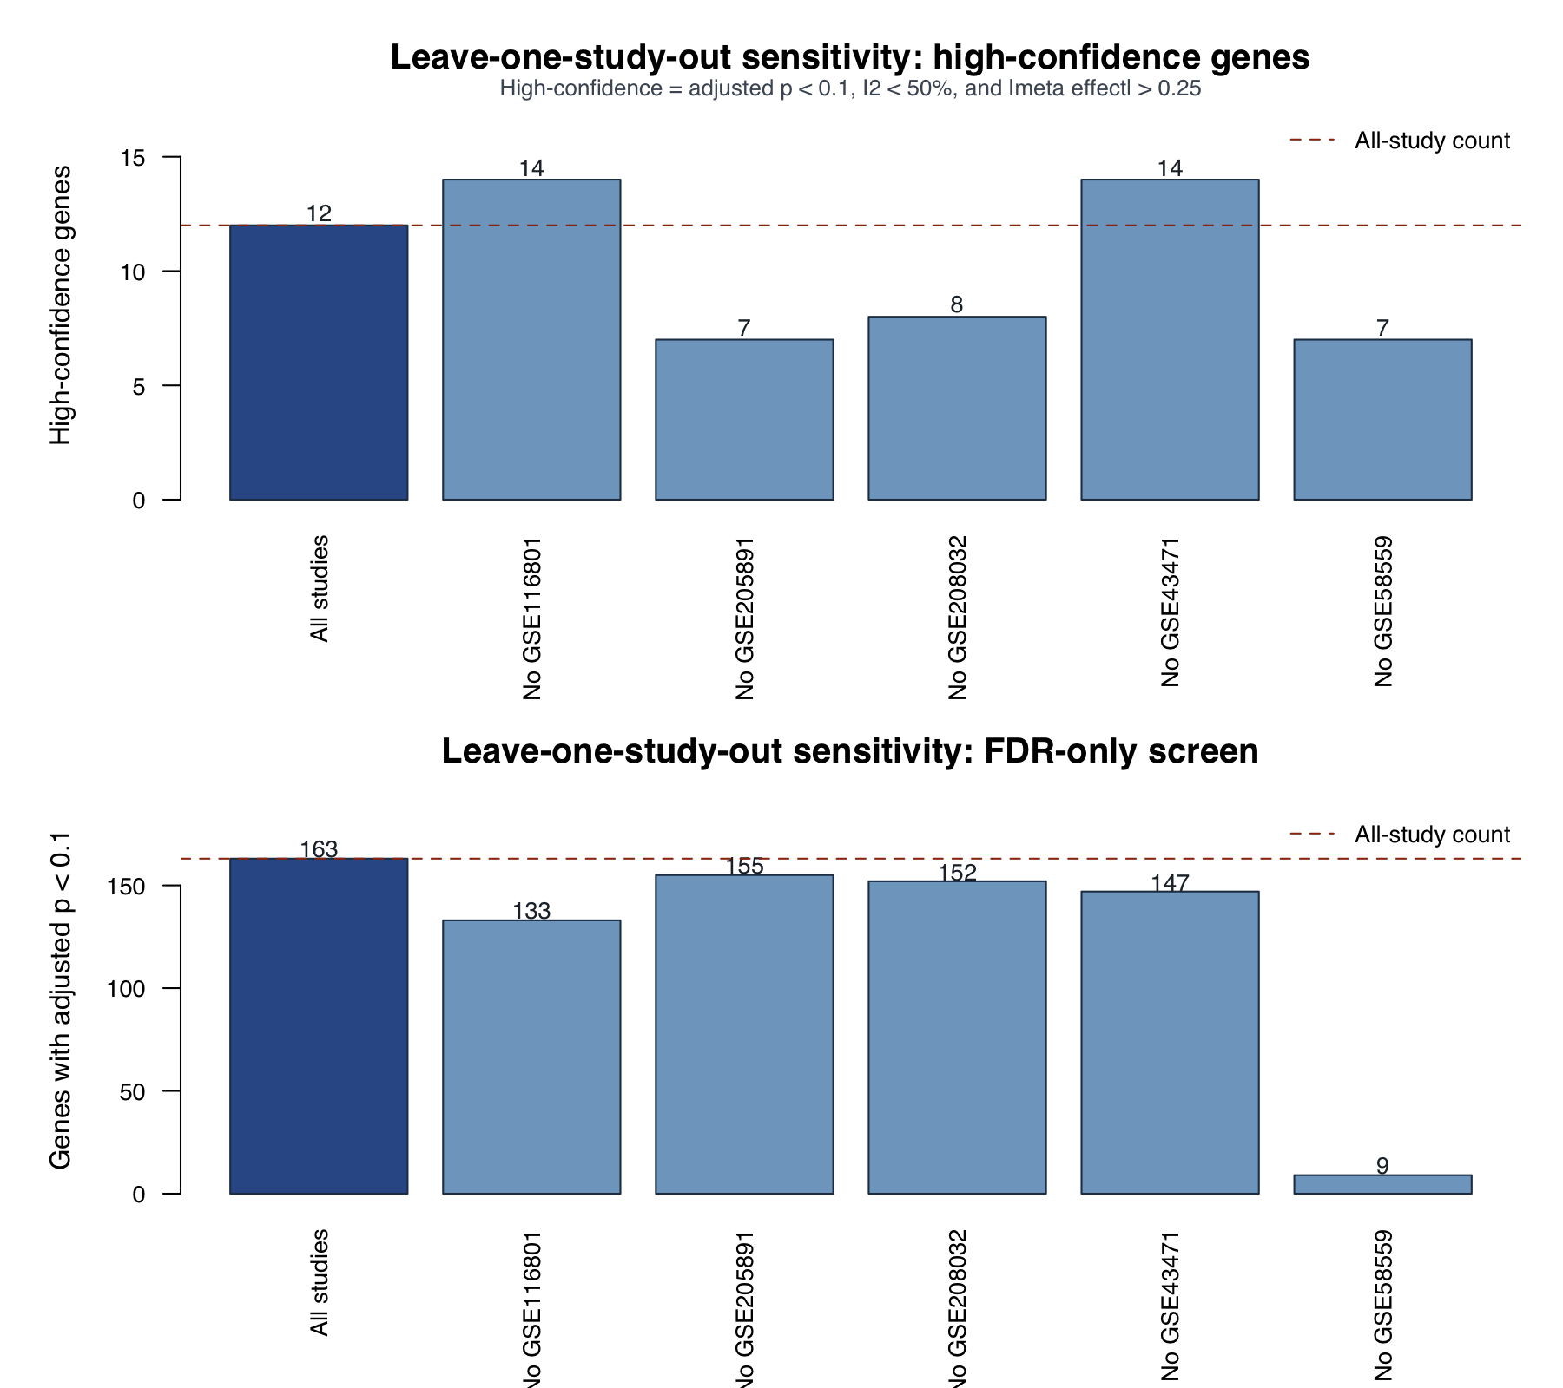
ROBUSTNESS
Sensitivity: leave one study out
A robustness check repeats the meta-analysis after dropping each GEO dataset.
Key read
No gene survived all six runs.
TMEM170B was strongest by survival count.
GSE58559 strongly influences the broader FDR-only signal.

Slide 9
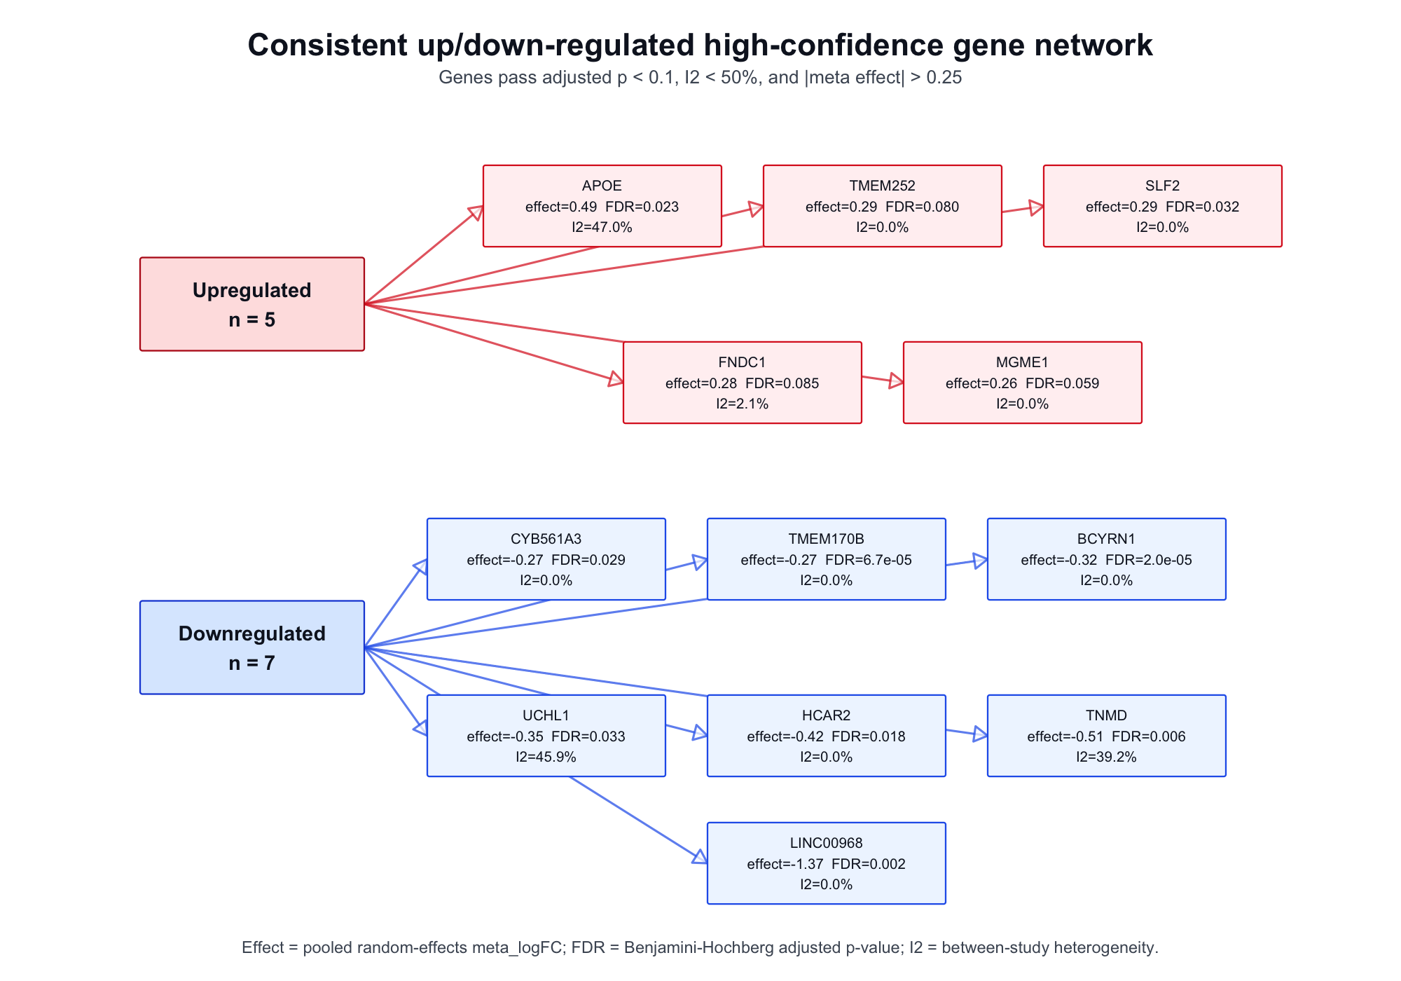
BIOLOGY
Biological interpretation is suggestive, not definitive
The strict gene list is small, so pathway enrichment has limited power.
gProfiler ORA
metal chelating activity (GO:MF); p=0.05; genes=APOE
Current enrichment is APOE-driven, so it is better treated as a clue than a pathway conclusion.

Slide 10
RELAXED ENRICHMENT
Relaxed ORA reveals broader pathway signal
Using FDR < 0.1, no I2 filter, and absolute effect > 0.1 gives a 105-gene list for pathway exploration.
105
genes
45
upregulated
60
downregulated
66
ORA terms
Top relaxed all-gene terms
Where the 66 ORA terms came from
All relaxed genes: 48 terms
Upregulated genes: 8 terms
Downregulated genes: 10 terms
protein binding (GO:MF), p=1.28e-04
regulation of signaling (GO:BP), p=1.44e-04
regulation of cell communication (GO:BP), p=1.51e-04
extracellular exosome (GO:CC), p=2.45e-04
regulation of response to stimulus (GO:BP), p=3.13e-04
extracellular vesicle (GO:CC), p=3.14e-04
Interpretation: the relaxed set gives better pathway discovery power, but it is exploratory because the I2 filter is removed and the effect-size threshold is lower.

Slide 11
TAKEAWAY
What this supports now
A strong exploratory result, with clear manual-review steps before publication.
Defensible claim
A small core set of adipose genes is meta-analytically associated with exercise/lifestyle intervention contexts.
Main caveat
The studies are related but not identical; this is not yet a pure endurance-training signature.
Next step
Use the audit tables, forest plots, and diet-arm sensitivity to decide what belongs in a manuscript.
Companion files: summary PDF, strict/relaxed CSVs, forest plots, leave-one-out figures, manuscript tables.

