Slide 1



Students:
Supervisor:

Slide 2

Project Goals
Chemotaxic behavior of E-coli bacteria
  The results so far
Simulation features
Examples of live simulation
Simulation implementation
Future objectives

Slide 3

Create a platform for simulation and visualization of learning and interacting agent in dynamic environment
Enable “reverse-engineering” of the evolved agent’s “brain” and it’s implication on real-world cases
Enable analysis of the learning process

Slide 4

The E-Coli bacteria
  Moving up the food gradient
  Too small to sense the gradient over it’s own body
  Simple two state propulsion system: run and tumble
  Works in wide range of concentrations

Slide 5
Our model of the problem
  Non-interacting bacteria
  Food – a spatial distribution function
  Single sensor: concentration of food at agent’s spatial position
  Agent has 2 possible behaviors
    Tumble – random direction change
    Run – moving forward
  The agent control the probability to change state
  The agent’s control consists of One Layer Recurrent Neural Network
  Sensor noise - uniformly distributed, zero mean

Slide 6
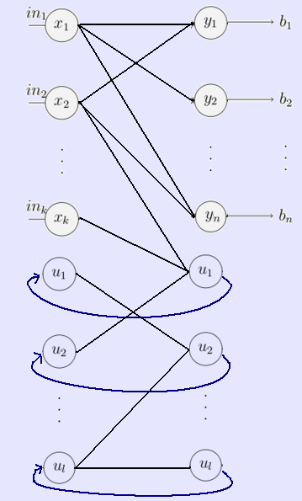
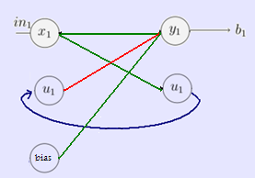
Neural networks structure:
The Agents NN topology:
  in1 – consternation of food
  b1 – probability for a tumble.

Slide 7
The learning process
  Achieved by evolution
    Each phase consist of pre-defined time period in which 200 agents are simulated
    At the end of the time period each agent graded
      The grade is defined to be the sum of food’s concentration at each location the agent was present at
    The top 20 agents are selected to be the “fathers” of the next generation
    Next generation consists of the 20 “parents” and a mutated version of them.

Slide 8
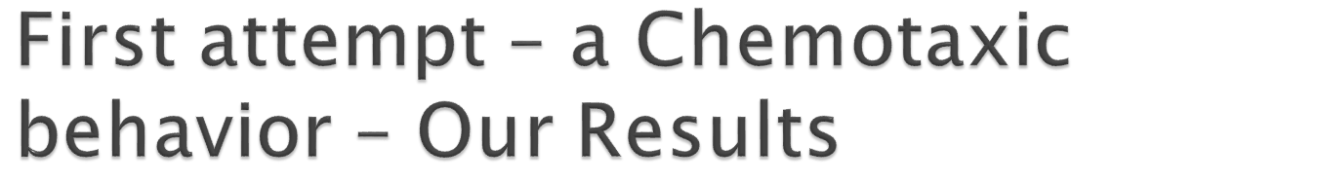
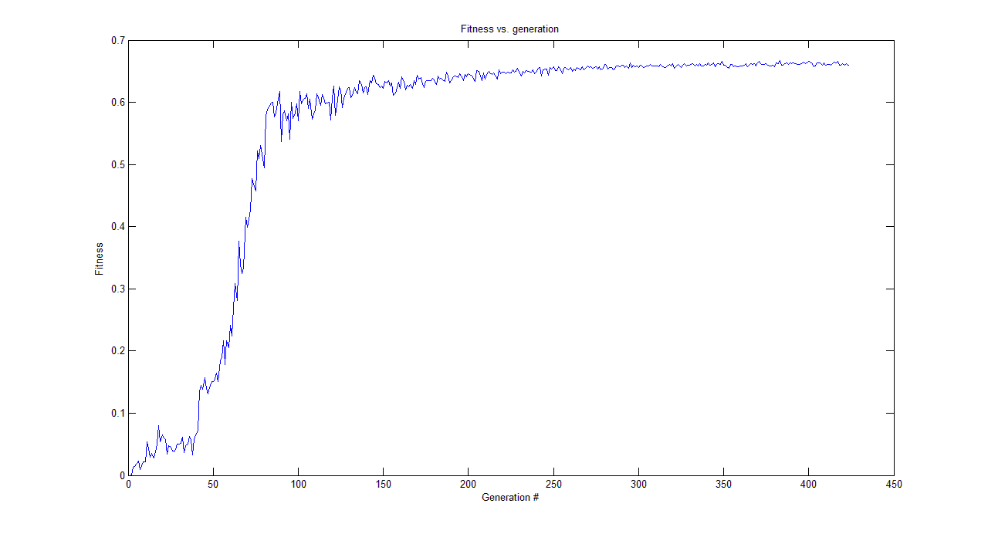
  The grade for each generation is the average grade of 20 best agents

Slide 9
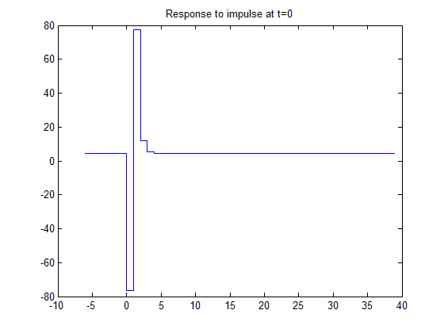
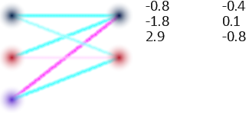
The evolved neural network
Possible explanation:
  The agent attempts to calculate the gradient over his trajectory and modifies it’s course accordingly (positive gradient – lower the probability to tumble, negative gradient – increase the probability to tumble)
  the calculation of the gradient frees the agent for dependence on absolute value of concentration

Slide 10
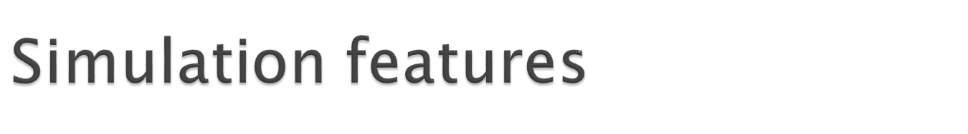
Generic and flexible implementation of agents, environment and the interaction among and between
Modular building of the agents:
  Ability to switch “brains” – e.g. NN, State Machine
  Different sensors
  Different body systems – e.g. energy, propulsion, particle emission system
MATLAB interface – both for simulation design and result anlysis
Graphical results and processes visualization

Slide 11

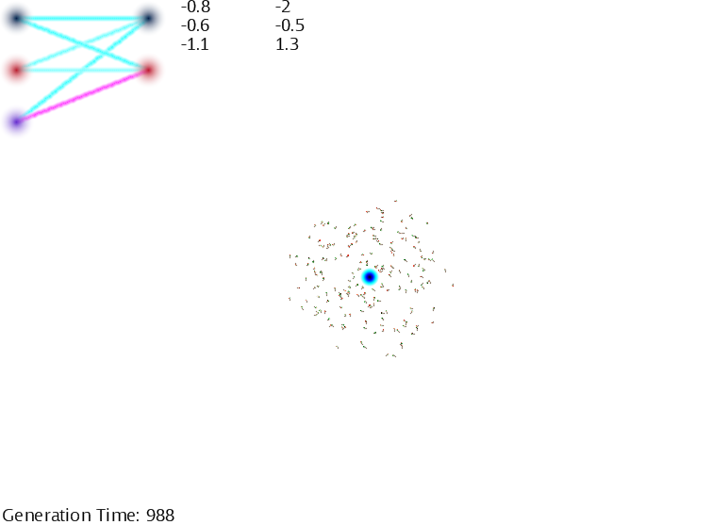
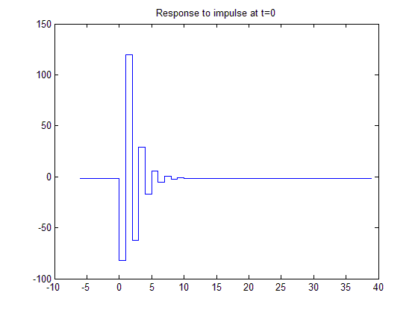

Slide 12
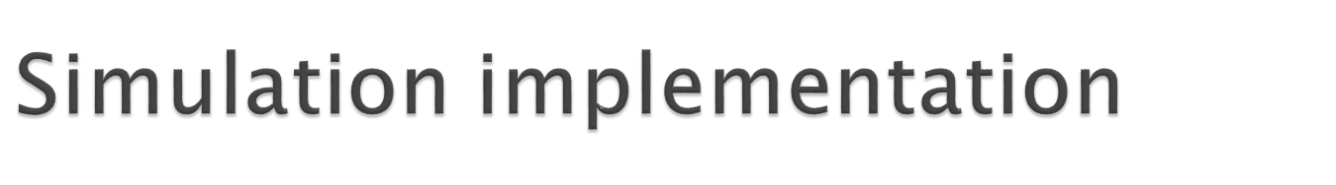
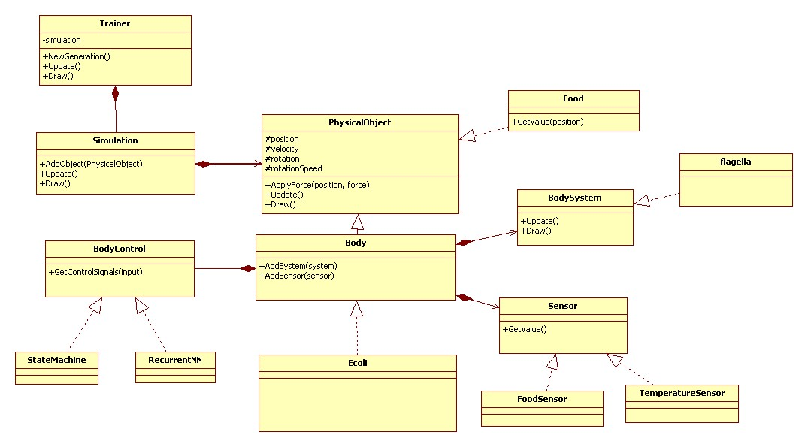
Implemented in C#
  Graphical visualization implemented using Microsoft’s XNA technology
Class Diagram:

Slide 13

Simulation of more complex problems including interacting and cooperating agents
Solving problems requiring types of different agents cooperating
Improvement of evolutionary process?
Improving the Matlab interface

Slide 14

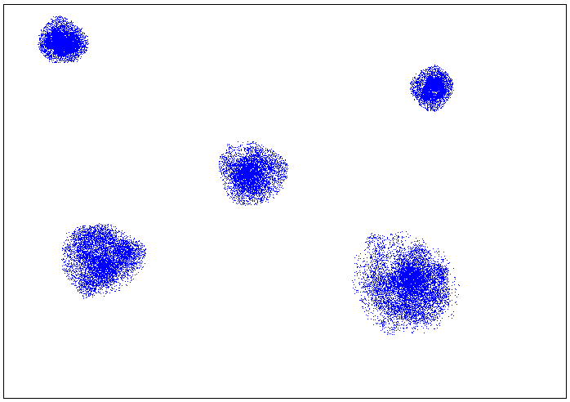
Possible problem example:

