Slide 2
Motivation
Can learning happen in single cells?
Importance of learning (fitness but cost)

Slide 3
Model
Sorek et. al. 2013
A word about population

Slide 4

Problems
Latent inhibition (Yalla Yalla): if we see CS על פארש before, it’ll be harder to pair it with US.
Extinction (wolf wolf): seeing CS without US will extinct the learning.

Slide 5
Proposal
Add repressor

Slide 6
Results
Extinction & Latent inhibition
Capacity when s = 0
Interesting: capacity with s > 0

Slide 7
Conclusion
Mind-blowing speech of Prof. Segel
(biological plausibility)

Slide 8
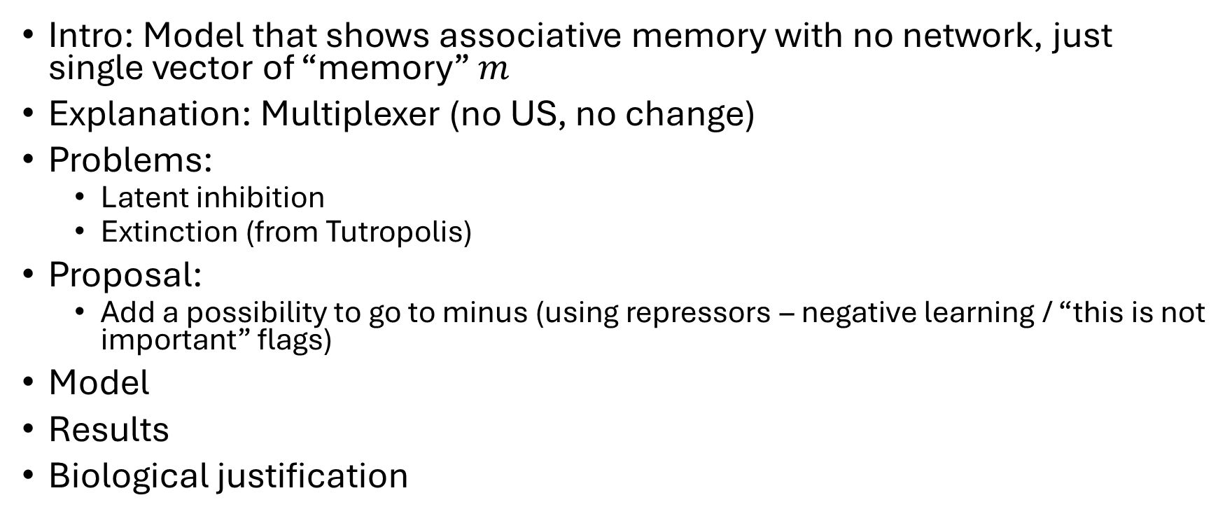
Intro: Model that shows associative memory with no network, just single vector of “memory” $m$
Explanation: Multiplexer (no US, no change)
Problems:
Latent inhibition
Extinction (from Tutropolis)
Proposal:
Add a possibility to go to minus (using repressors – negative learning / “this is not important” flags)
Model
Results
Biological justification

