Slide 2

Latent inhibition (Yalla Yalla): if we see CS על פארש before, it’ll be harder to pair it with US.
Extinction (wolf wolf): seeing CS without US will extinct the learning.

Slide 3
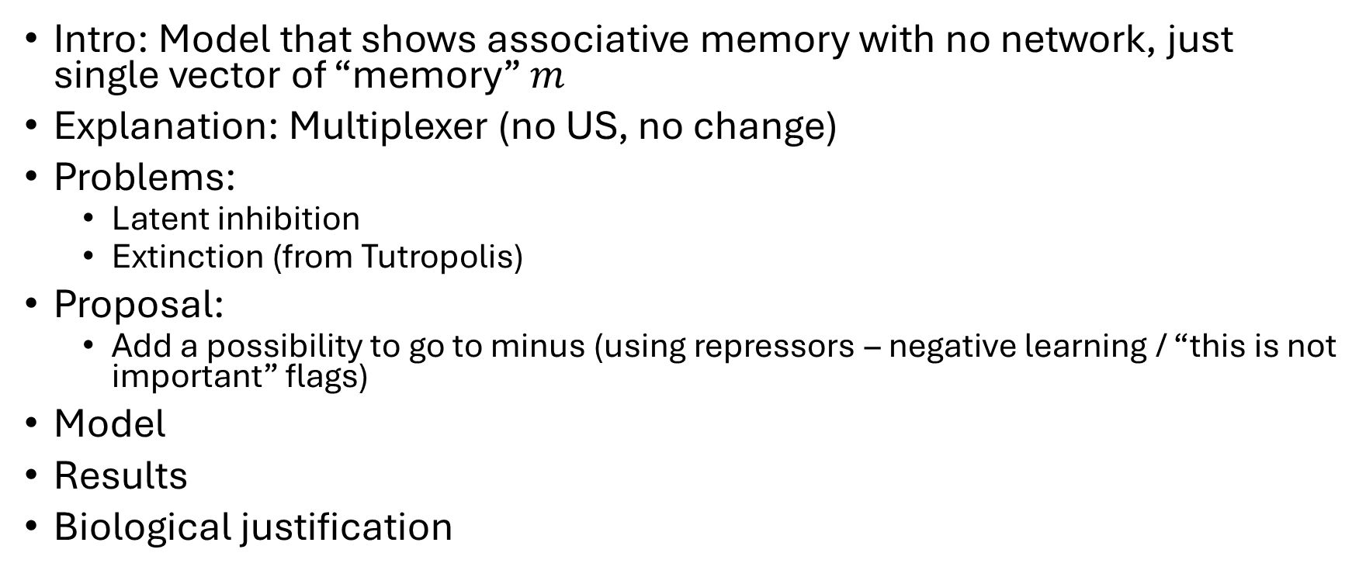
Intro: Model that shows associative memory with no network, just single vector of “memory” $m$
Explanation: Multiplexer (no US, no change)
Problems:
Latent inhibition
Extinction (from Tutropolis)
Proposal:
Add a possibility to go to minus (using repressors – negative learning / “this is not important” flags)
Model
Results
Biological justification

