Slide 1
Classifying Global Catastrophic Risks
Centre for the Study of Existential Risk

Slide 2

Pale Blue Dot
https://commons.wikimedia.org/wiki/File:Pale_Blue_Dot.png

Slide 3
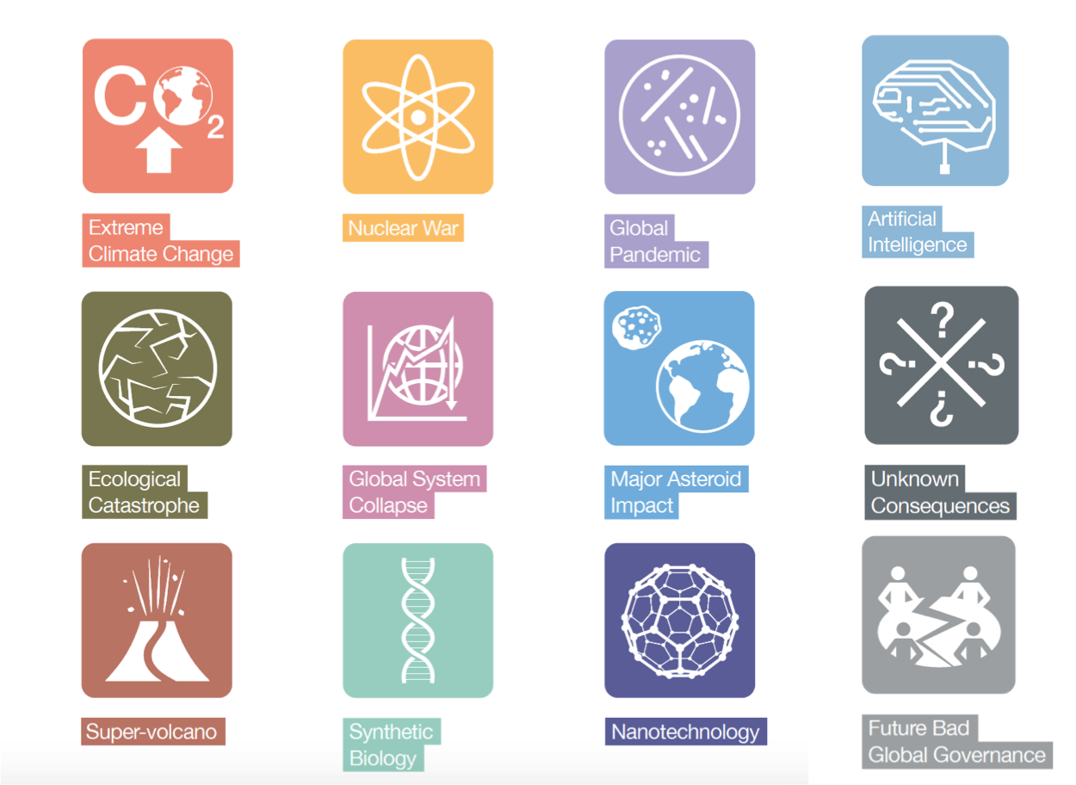
Threats to human survival on the pale blue dot
Global Challenges Foundation (2015) Global Challenges: 12 Risks that threaten human civilization.

Slide 4
Which is great, but has limitations
No tool for systemic exploration of threats.
Worry about “unknown unknowns”.
Not clear to most academic/scientific disciplines outside those directly identified how they relate to this endeavour.
Try a different approach.

Slide 5
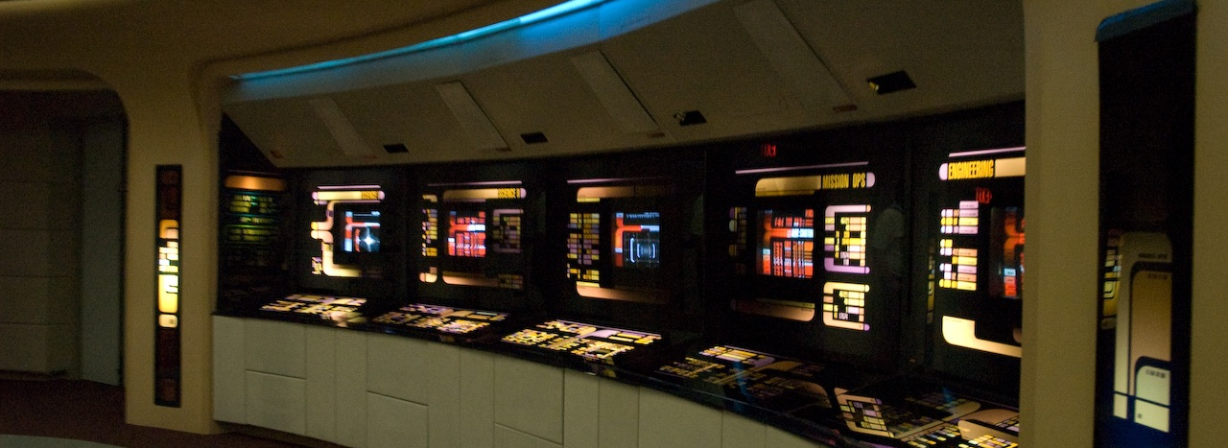
Monitoring Spaceship Earth
Kreg Steppe / CC-BY-SA-2.0 https://commons.wikimedia.org/wiki/File:Enterprise-D_bridge_stations.jpg

Slide 6
Global Catastrophic Risk
Critical System Breach
Global Spread Mechanism
Prevention/Mitigation Failure

Slide 7
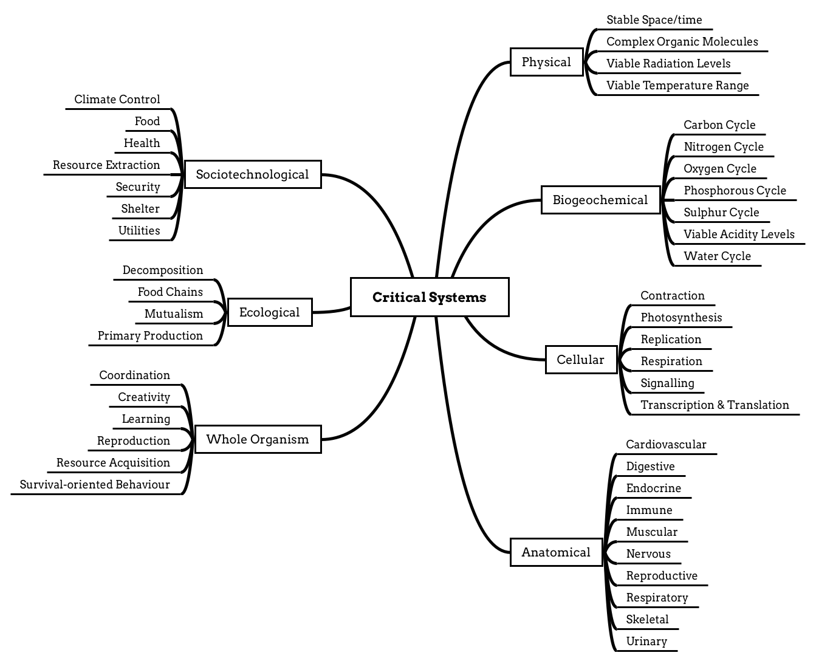

Slide 8
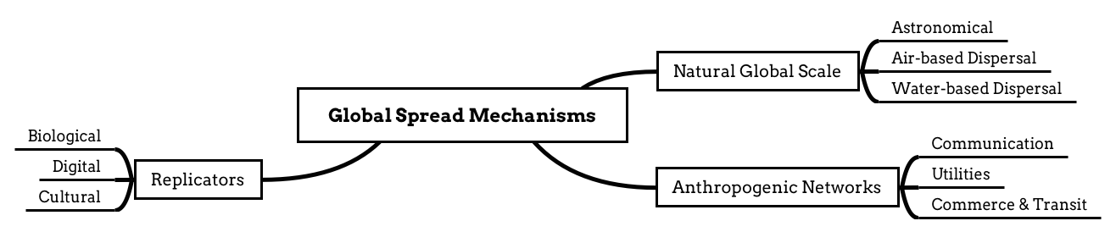

Slide 9
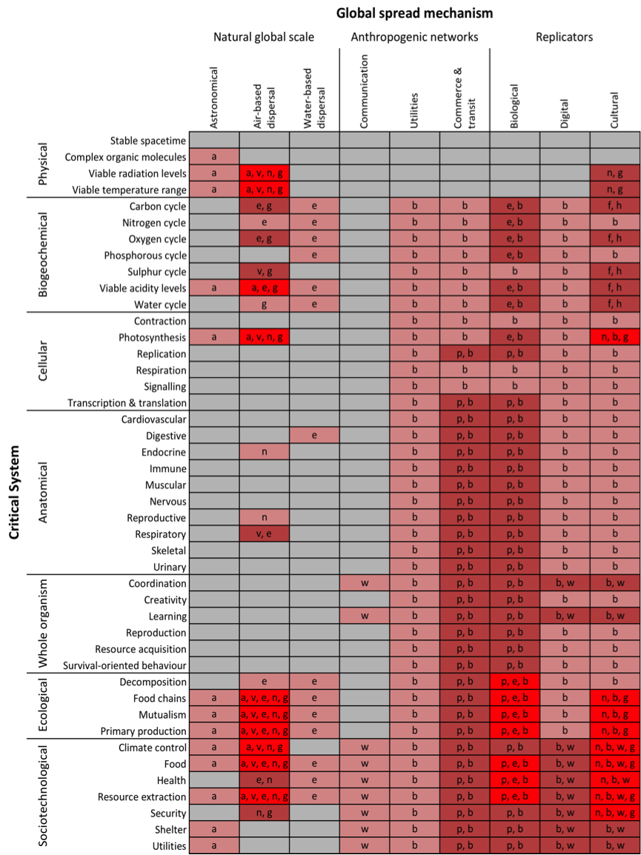

Slide 10
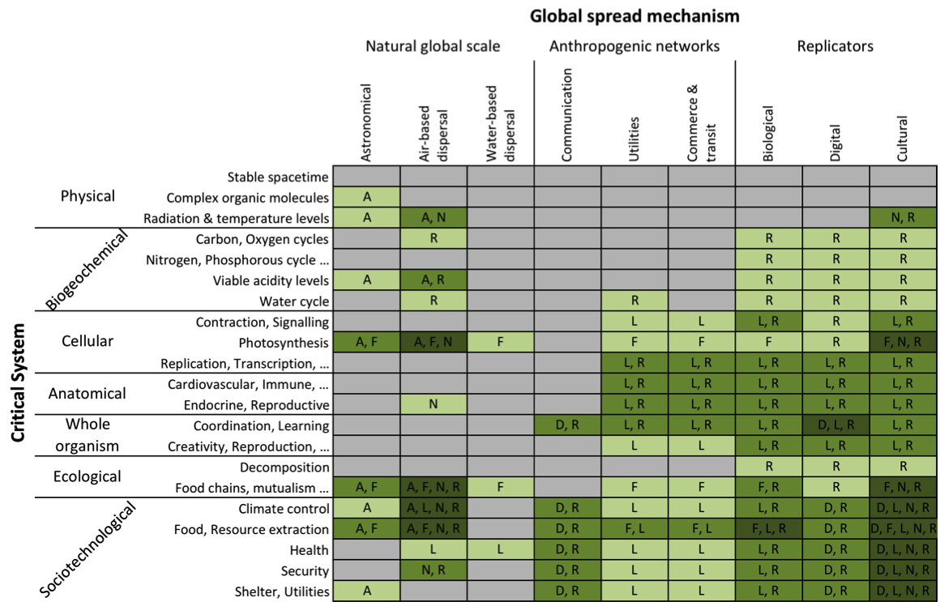

Slide 11
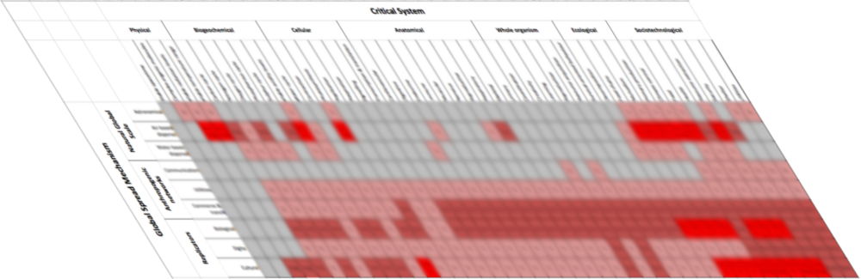
The 3rd Dimension: Prevention/Mitigation

Slide 12
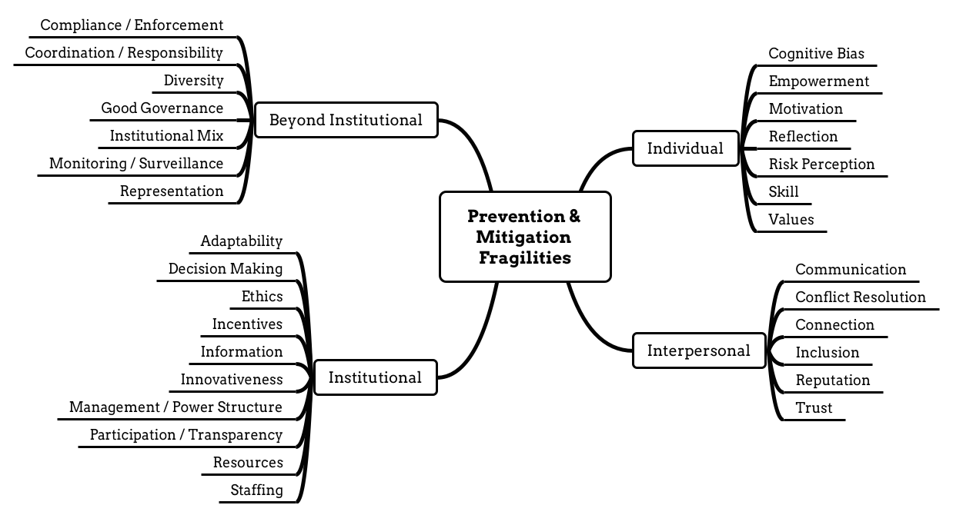

Slide 13
Next Steps
Horizon Scanning
Scenario Planning
Aggregation of Expertise
Interdisciplinary Workshops
Knowledge Sharing
Academic Engineering

