Slide 1
The Malicious Use of Artificial Intelligence
Shahar Avin
Centre for the Study of Existential Risk
sa478@cam.ac.uk

Slide 2
Risk Quadrants
 | Accident Risk (AI Safety) | Malicious Use Risk (AI Security)
Near Term | Amodei, Olah et al (2016) Concrete Problems in AI Safety Leike et al (2017) AI Safety Gridwolds | Brundage, Avin et al (2018) The Malicious Use of Artificial Intelligence: Forecasting, Prevention and Mitigation
Long Term | Bostrom (2014) Superintelligence | :(

Slide 3
Background

Slide 4
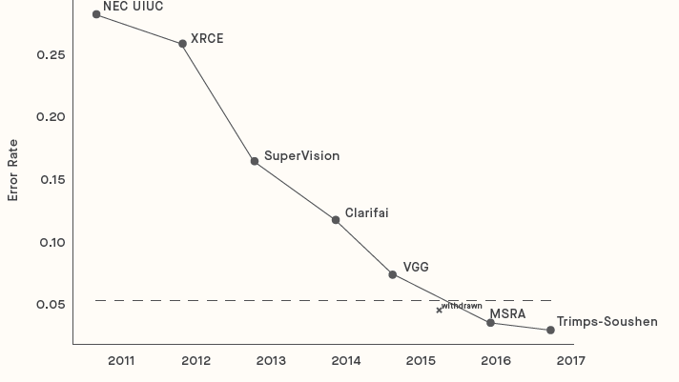
Background: capabilities

Slide 5
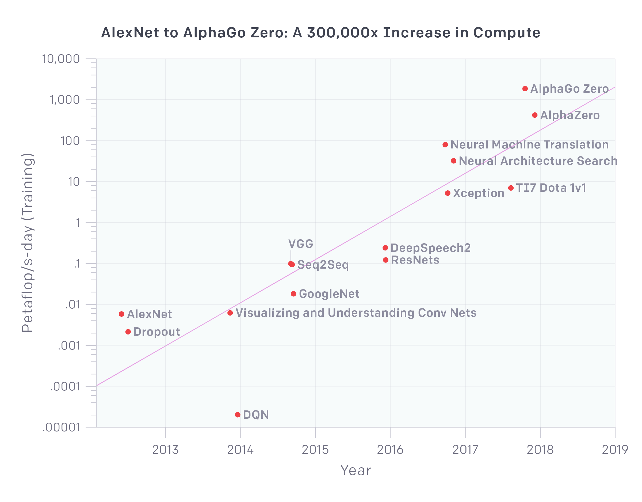
Background: capabilities
https://blog.openai.com/ai-and-compute/

Slide 6
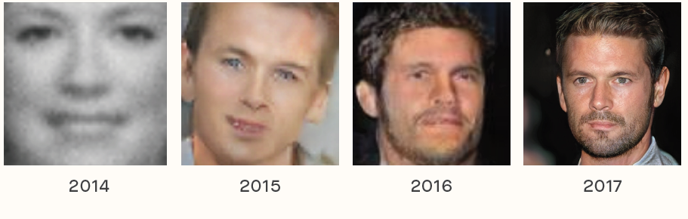
Background: capabilities

Slide 7
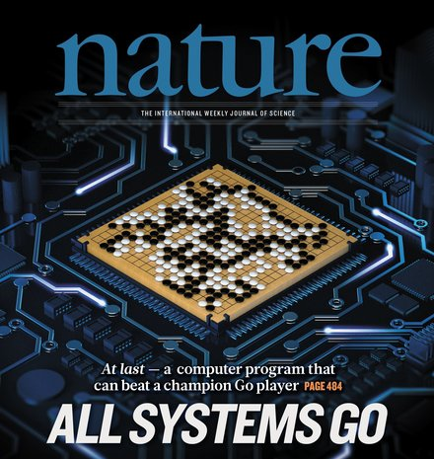

Background: capabilities

Slide 8
Background: access
arXiv
GitHub
TensorFlow
Coursera / YouTube
Cloud GPUs / Cloud TPUs

Slide 9
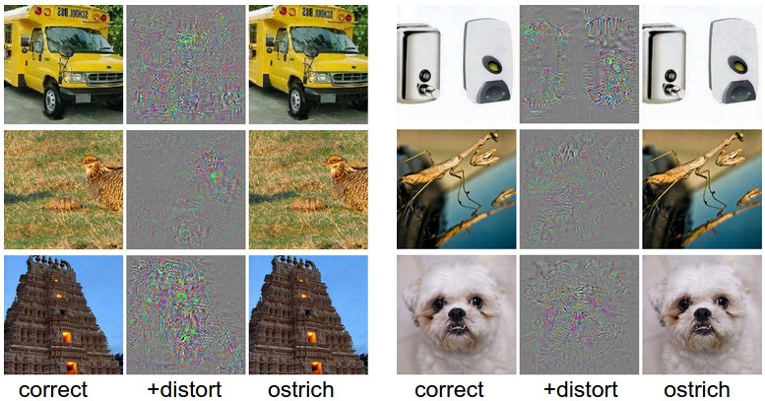
Background: vulnerabilities
http://karpathy.github.io/2015/03/30/breaking-convnets/

Slide 10
Common Threat Factors

Slide 11
Common threat factors
Expand existing threats
Scale
Skill transfer
Diffusion

Slide 12
Common threat factors
Introduce novel threats
Super-human performance
Speed
Attacks on AI systems

Slide 13
Common threat factors
Alter character of threats
Distance and difficulty of attribution
Customization

Slide 14
Security Domains

Slide 15
Security Domains
Digital Security
Against humans: automated spear phishing
Against systems: automated vulnerability discovery
Against AI systems: adversarial examples, data poisoning

Slide 16
Security Domains
Physical Security
Using AI: repurposed drones, robots
Against AI: adversarial examples

Slide 17
Security Domains
Political Security
By governments: profiling, surveillance
Against polities: manipulation, fake content

Slide 18
Recommendations

Slide 19
Recommendations
Policymakers should collaborate closely with technical researchers to investigate, prevent, and mitigate potential malicious uses of AI.

Slide 20
Recommendations
Researchers and engineers in artificial intelligence should take the dual-use nature of their work seriously, allowing misuse-related considerations to influence research priorities and norms, and proactively reaching out to relevant actors when harmful applications are foreseeable.

Slide 21
Recommendations
Best practices should be identified in research areas with more mature methods for addressing dual-use concerns, such as computer security, and imported where applicable to the case of AI.

Slide 22
Recommendations
Actively seek to expand the range of stakeholders and domain experts involved in discussions of these challenges.

Slide 23
Priority Research Areas

Slide 24
Priority research areas
Learning from and with the Cybersecurity Community
Red teaming
Formal verification
Responsible disclosure of AI vulnerabilities
Forecasting security relevant capabilities
Security tools
Secure hardware

Slide 25
Priority research areas
Exploring Different Openness Models
Pre-publication risk assessment in areas of special concern
Central access licensing model
Sharing regimes that favor safety
Dual-use norms

Slide 26
Priority research areas
Promoting a Culture of Responsibility
Education
Ethical statements and standards
Whistleblowing measures
Nuanced narratives

Slide 27
Priority research areas
Developing Technological and Policy Solutions Education
Privacy protection
Coordinated use of AI for public-good security
Monitoring of AI-relevant resources
Explore legislative and regulatory responses

Slide 28
Since the report…

Slide 29
Since the report (random roundup)
Global media coverage
Featured in House of Lords report
Cambridge Analytica story, Facebook congress testimony
ACM call for impact assessment in peer review process
DARPA project on deep fakes
Project MAVEN discontinuation and Google’s AI principles
DeepPhish

Slide 30
Questions?
Shahar Avin
sa478@cam.ac.uk

