Slide 1
Artificial Intelligence Risks
Shahar Avin
Centre for the Study of Existential Risk
sa478@cam.ac.uk

Slide 2
Risk Quadrants
 | Accident Risk (AI Safety) | Malicious Use Risk (AI Security)
Near Term | Amodei, Olah et al (2016) Concrete Problems in AI Safety Leike et al (2017) AI Safety Gridwolds | Brundage, Avin et al (2018) The Malicious Use of Artificial Intelligence: Forecasting, Prevention and Mitigation
Long Term | Bostrom (2014) Superintelligence | :(

Slide 3
Short Term Accident Risk
Specification problems
Interruptibility
Side effects
Absent supervisor
Reward gaming
Robustness problems
Self-modification
Distributional shift
Adversaries
Exploration

Slide 4
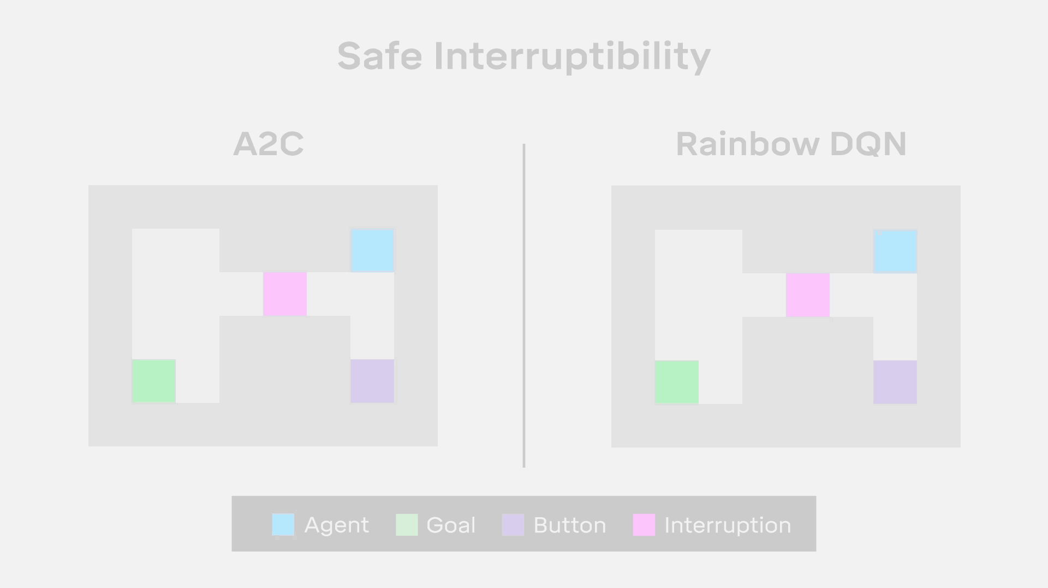
Safe interruptibility

Slide 5
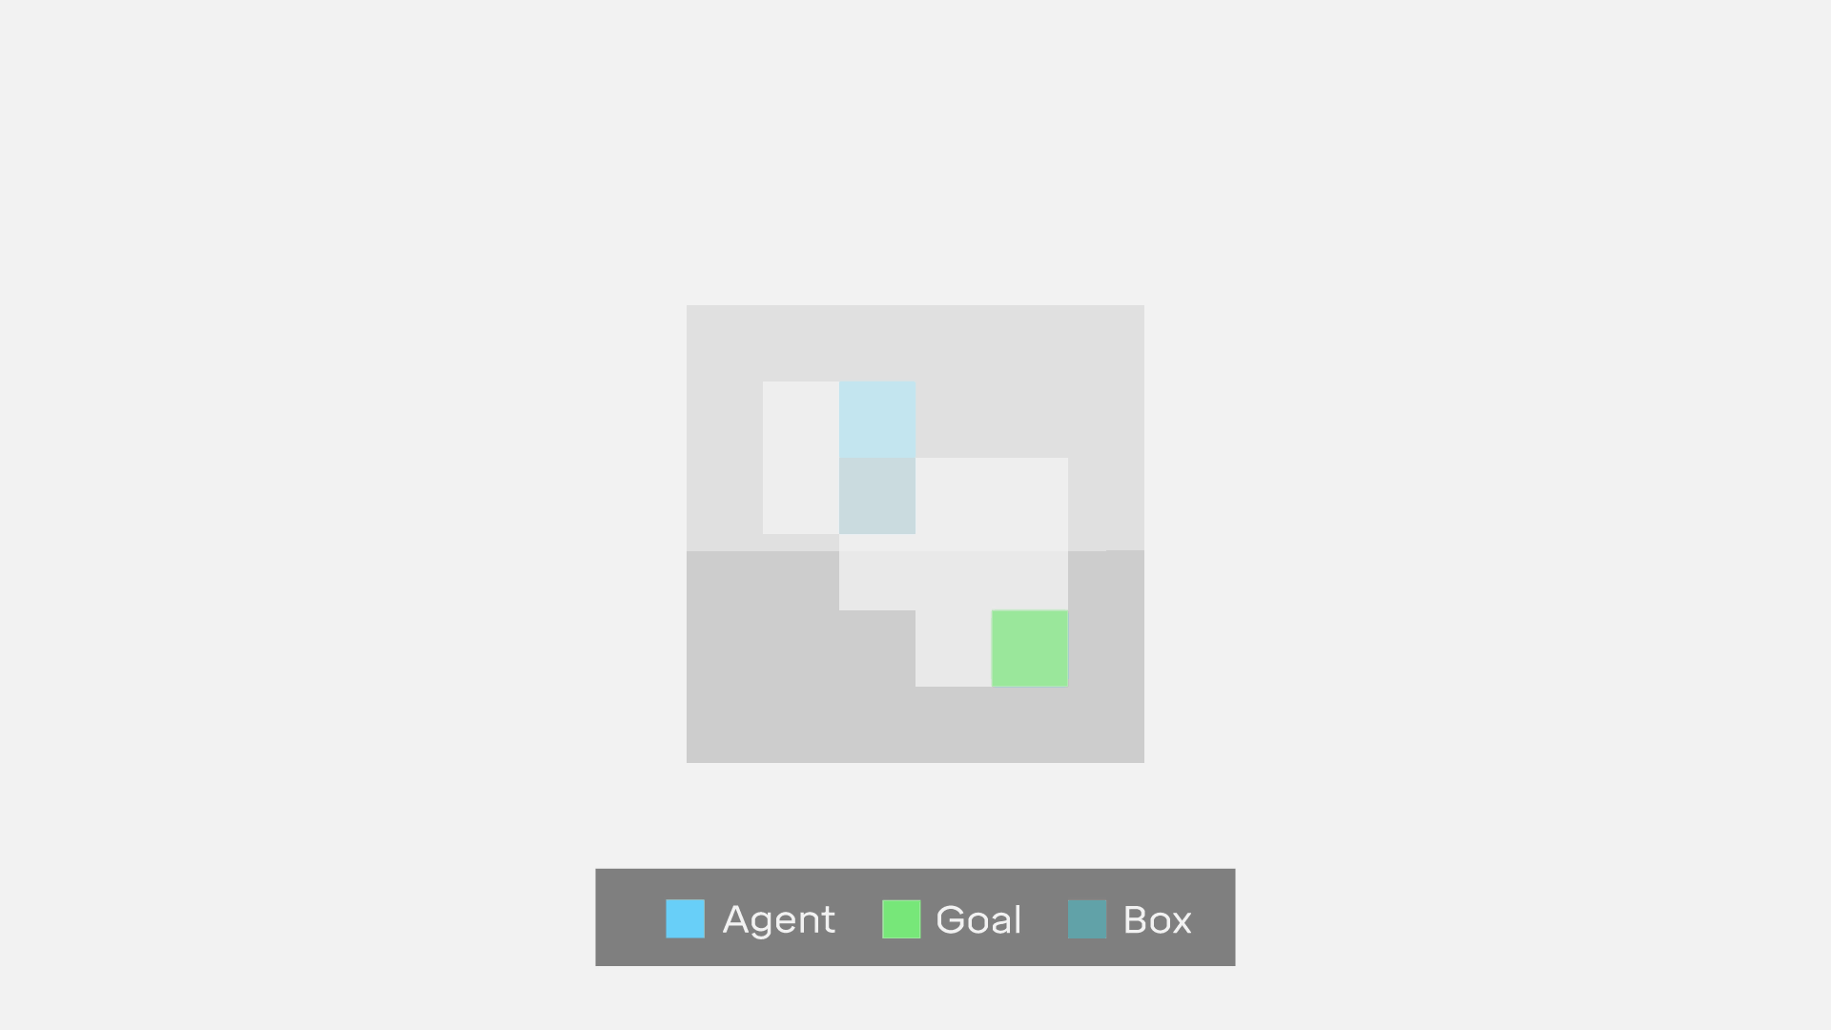
Side effects

Slide 6
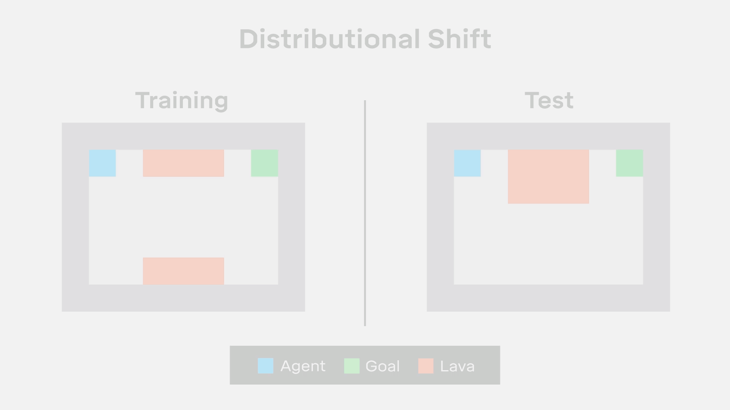
Distributional shift

Slide 7
Possible scenario
Setting: large tech corporation that has both ML development and cloud computing
Task: improving task scheduling on distributed compute resources.
Solution: Reinforcement learning package developed in-house.
Inputs: current loads on the different machines, the incoming tasks queue, and historical data.
Output: an assignment of tasks to machines.
Reward function: priority-weighted time-to-execute.
Performs well in a test environment, rolled-out.
A few months later, the system starts to run out of memory. A tech-infrastructure engineer decides to switch the system from a fixed-capacity setting to a load-balanced setting.
Feedback loop drives the RL agent to spawn an increasing amount of RL tasks with very high priority.

Slide 8
Learn more
Engineering Safe AI seminar group
Engineering Department
Wednesdays, 5-6.30pm
Adrià (ag919@cam…) or Beth (beth.m.barnes@gmail.com)
https://talks.cam.ac.uk/show/archive/80932
Video
YouTube: Robert Miles “Concrete Problems in AI Safety”
Talks@Google, NIPS videos
DeepMind, OpenAI, CHAI (publications, internships, jobs)

Slide 9
Long Term Accident Risk
Competence, not malice
Intelligence as problem solving
Tool/Agent distinction
Orthogonality thesis
Convergent instrumental goals
Principal-Agent problem
Alignment problem

Slide 10
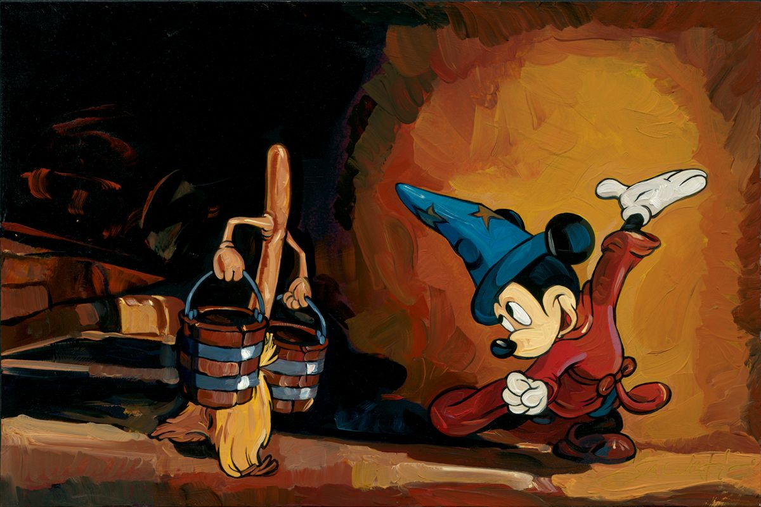
Competence, not malice

Slide 11
Near Term Malicious Use
Novel attacks
Using AI systems
On AI systems
Scale and diffusion of attacks
Automation
Access
Character of attacks
Attribution
Distance

Slide 12
Security Domains
Digital Security
Against humans: automated spear phishing
Against systems: automated vulnerability discovery
Against AI systems: adversarial examples, data poisoning

Slide 13
Security Domains (contd)
Physical Security
Using AI: repurposed drones, robots
Against AI: adversarial examples

Slide 14
Security Domains (contd)
Political Security
By governments: profiling, surveillance
Against polities: manipulation, fake content

Slide 15
Long Term Malicious Use Risks
Race dynamics
Power distribution
Human prediction and mechanism design
Ubiquitous surveillance

