Slide 1
Superstore Data Warehouse with an ETL pipeline on GCP
Automated ETL, BigQuery Fact & Dimension Tables, Visual Analytics
Name: Shaharban V
Date: 08/11/2025

Slide 2
Project Overview
Objective:
Build an automated ETL pipeline for Superstore dataset
Clean and transform data
Store in a data warehouse (BigQuery)
Generate business insights using dashboards
Tools Used: GCS, BigQuery, Airflow, Power BI

Slide 3
Dataset Overview
Dataset Source
Key Columns
Data Volume
Superstore Sales Dataset (Kaggle)
Order ID, Customer, Product, Sales, Profit, Region, Date, etc.
5009 rows

Slide 4
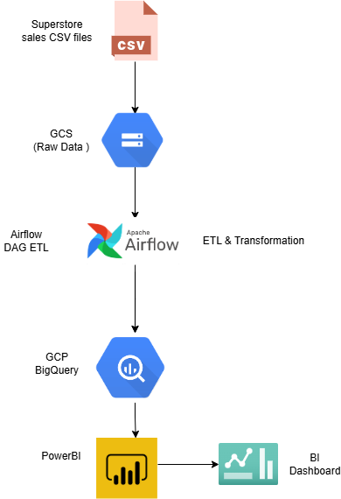
Project Architecture

Slide 5
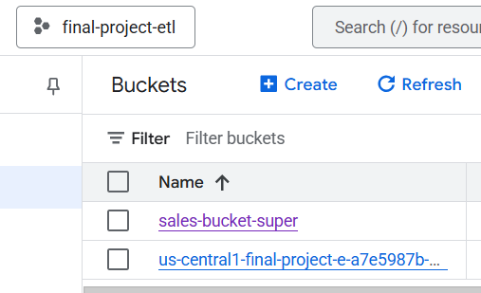
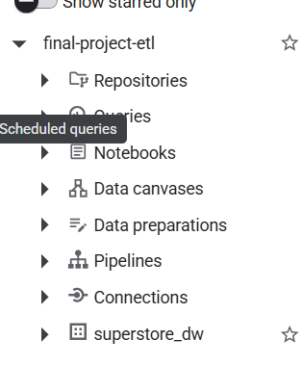
Environment Setup
1
Created a project in GCP
2
Enabled APIs: Storage, BigQuery, Composer (Airflow)
3
Created bucket: sales-bucket-super
4
Created dataset: superstore_dw

Slide 6

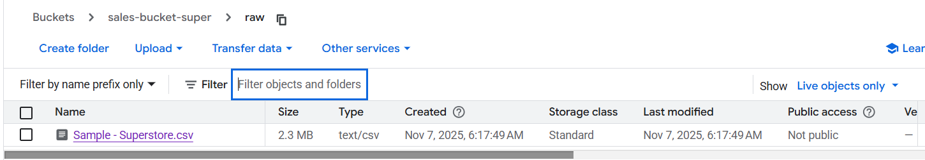
Raw Data in GCS
Description: Original Superstore CSV before cleaning
The raw data is stored in Google Cloud Storage (GCS) bucket gcs-superstore-data as the initial data source for the ETL pipeline. This unprocessed data contains all the original records from the Superstore Sales Dataset before any transformation or cleaning operations are applied.

Slide 7
Airflow ETL DAG
Tasks:
1
Check for new file
GCSObjectExistenceSensor
2
Clean file
PythonOperator
3
Load to BigQuery
GCSToBigQueryOperator
4
Validate data
BigQueryCheckOperator
5
Split into fact and dimension tables
Data warehouse normalisation

Slide 8
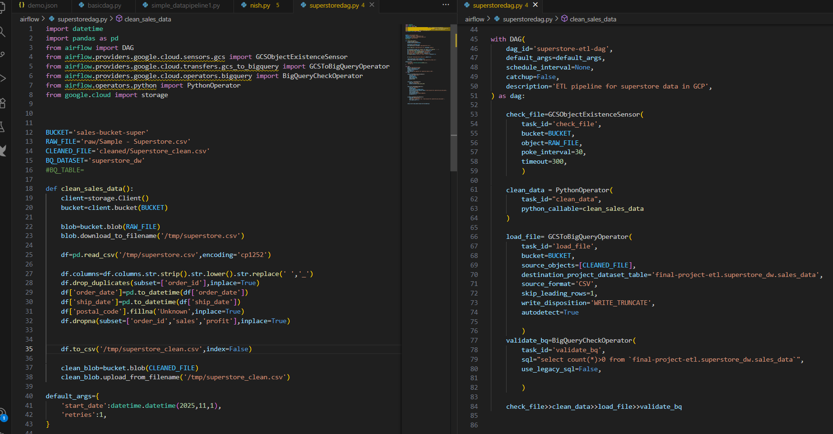
DAG

Slide 9
Data Cleaning using PythonOperator
Cleaning steps:
Remove duplicates
Fix date formats
Fill missing postal codes
Eliminate duplicate records from the dataset
Standardise all date fields to consistent format
Handle missing location data appropriately
Drop nulls in key columns
Standardise column names
Remove records with missing critical values
Ensure consistent naming conventions across all fields

Slide 10
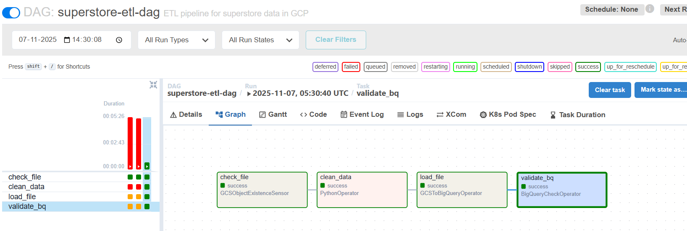
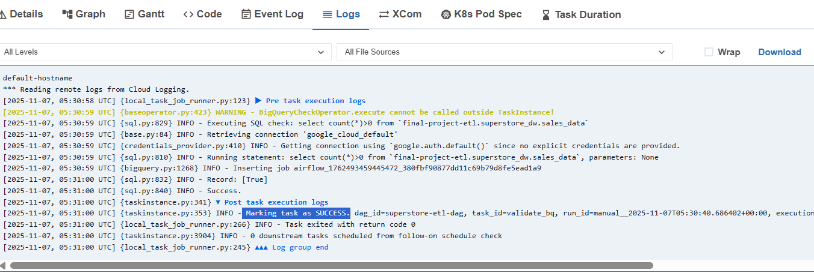
AIRFLOW DAG OUTPUT

Slide 11





Data Warehouse Design
Created dimensional model with the following tables:
dim_product
dim_customer
2
Product dimension table with product information and categories
Customer dimension table containing customer attributes and details
1
dim_region
3
Region dimension table for geographical analysis
fact_sales
5
Central fact table containing sales transactions and metrics
dim_date
4
Date dimension table for temporal analysis

Slide 12
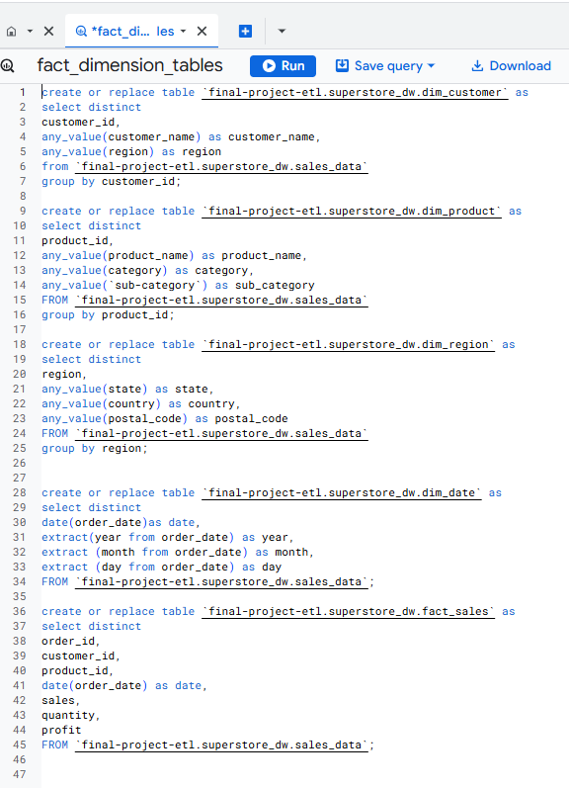
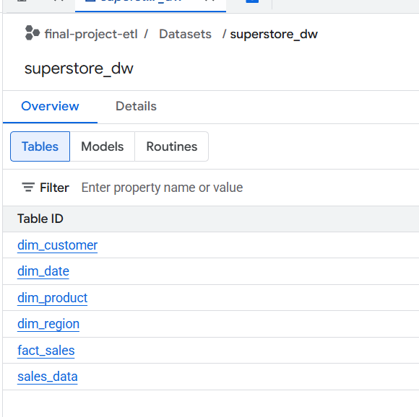
Data Warehouse details

Slide 13
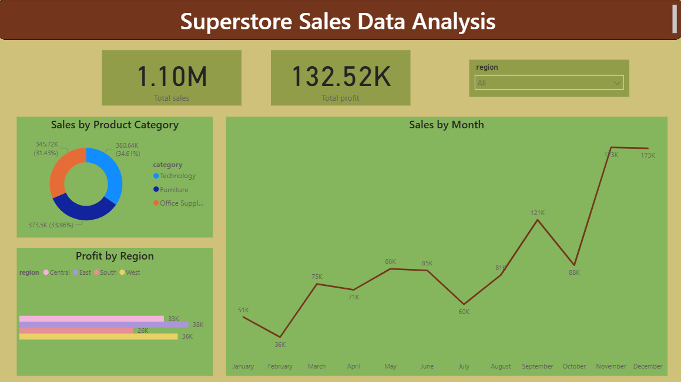
Visualization
-Connected BigQuery dataset to Power BI
Verified relationships between tables
Created visuals

Slide 14
Insights
East region generates highest sales
Technology Supplies have the highest quantity sold
Sales trend peaks in November and December

Slide 15
Conclusion:
ETL pipeline automated (Airflow DAG runs automatically when new data arrives)
Data warehouse created in BigQuery
Dashboards provide actionable insights

Slide 16
THANK YOU

