Slide 1
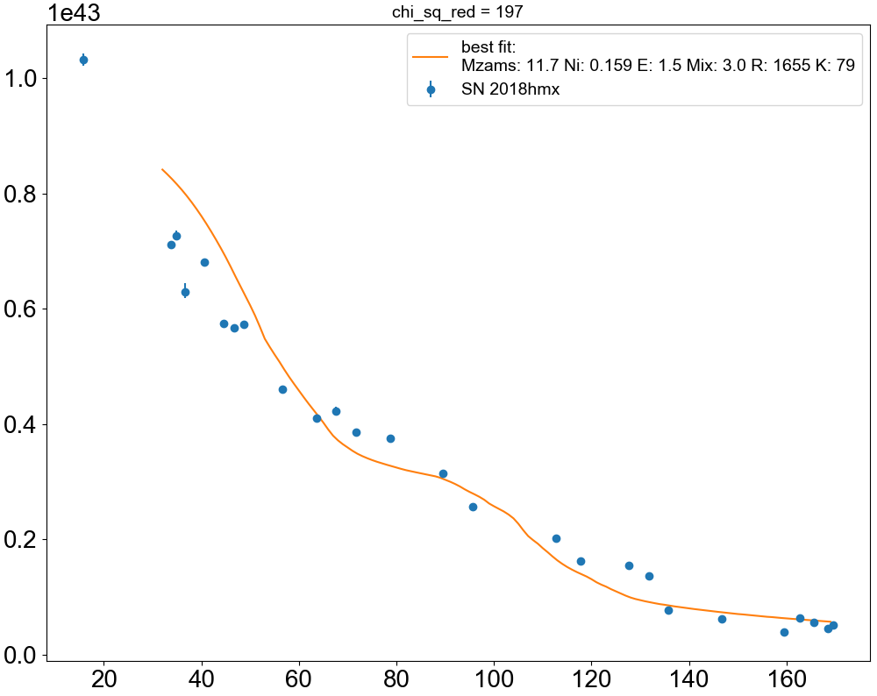
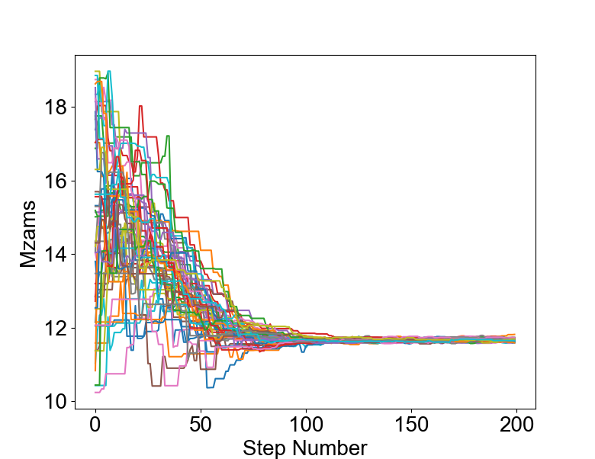
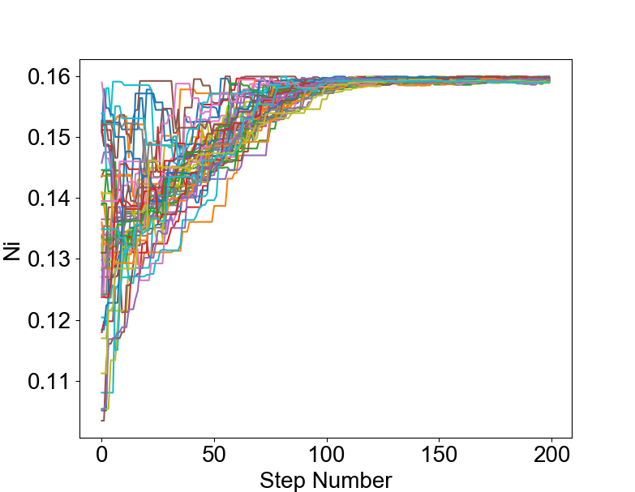
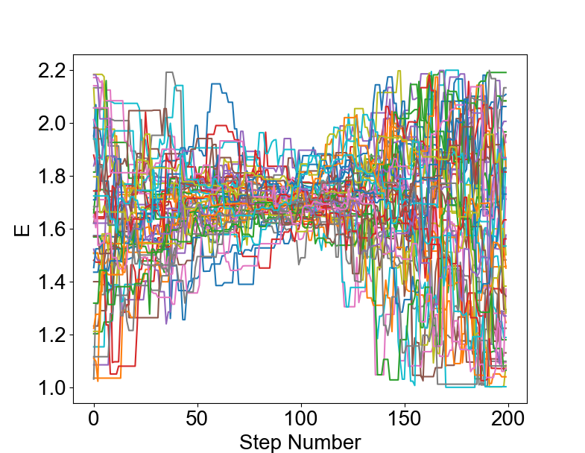
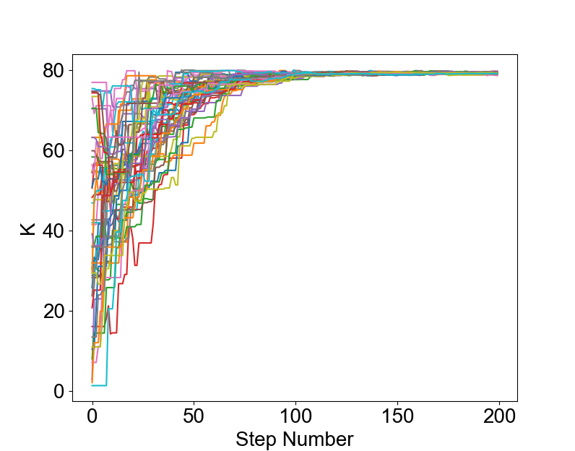
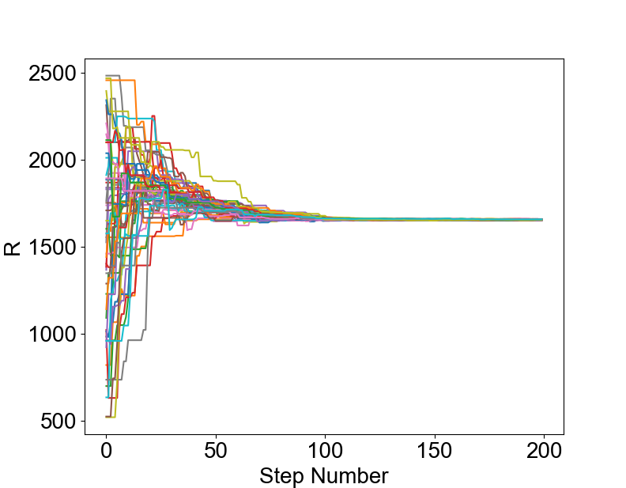
Ranges explored:
Mzams=10 - 19
Ni_mass=0.10 - 0.16
Energy=1.0 - 2.2
R_CSM= 500 - 2500
K_CSM= 0 – 80
Results:
Mzams=11.67 ± 0.04
Ni_mass=0.159 ± 0.0003
Energy= 1.55 ± 0.45
R_CSM= 1655 ± 2.3
K_CSM= 79.2 ± 0.2

