Slide 1
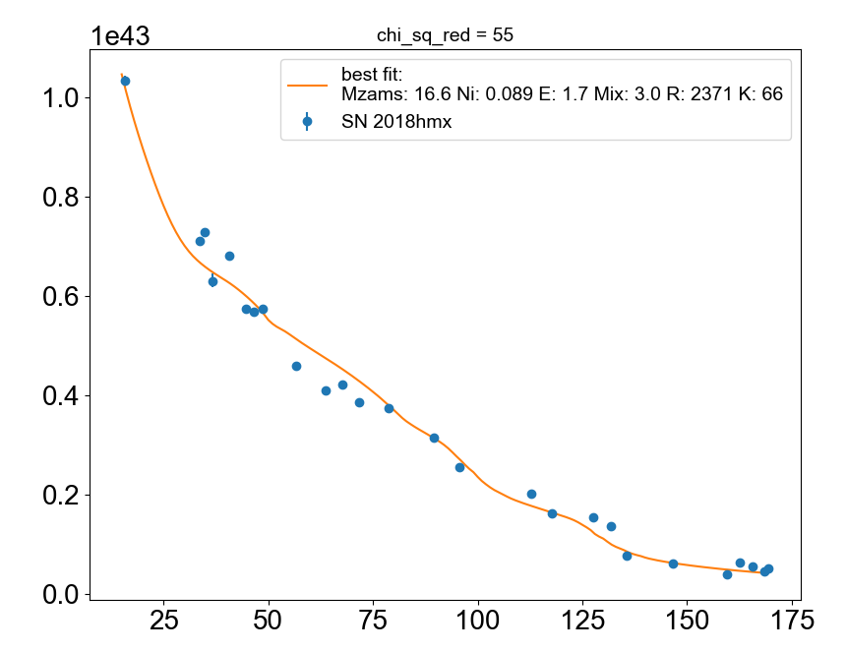
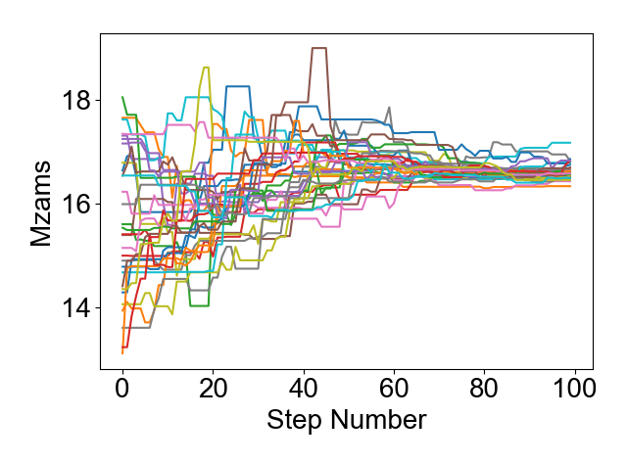
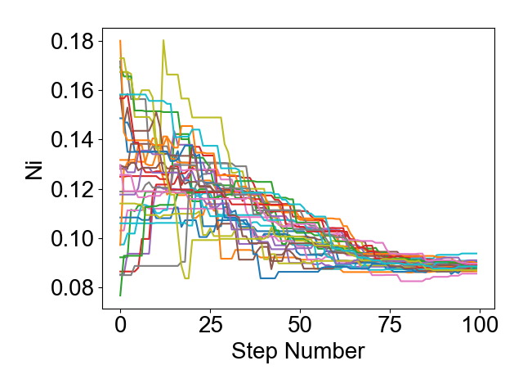
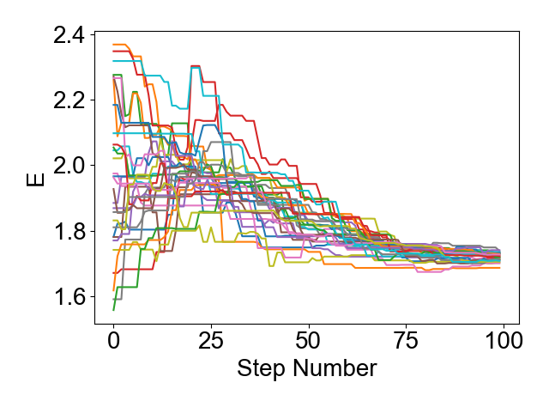
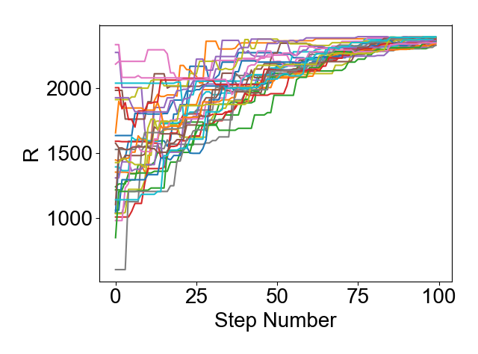
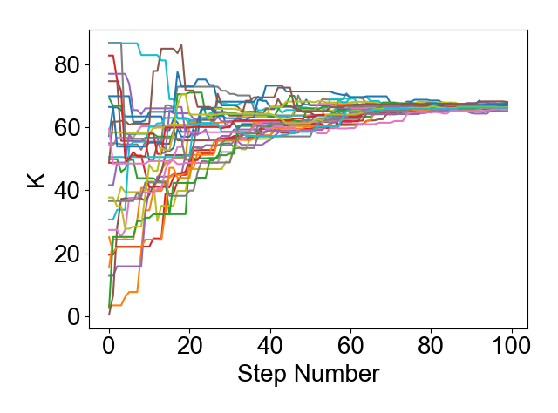
Ranges explored:
Mzams= 13 - 19
Ni_mass= 0.07 - 0.19
Energy= 1.5 - 2.4
R_CSM= 600 - 2400
K_CSM= 0 – 90
Results:
Mzams= 16.6 ± 0.13
Ni_mass= 0.089 ± 0.0014
Energy= 1.7 ± 0.013
R_CSM= 2371 ± 22
K_CSM= 66 ± 0.59

Slide 2
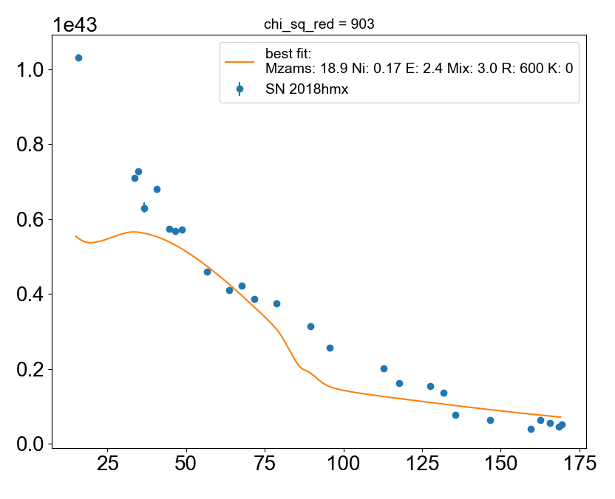
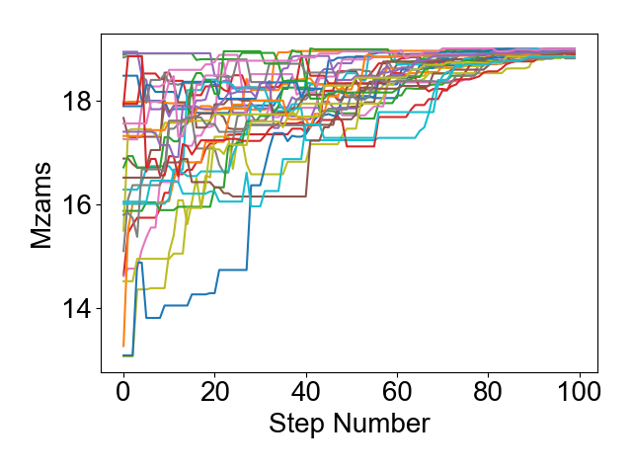
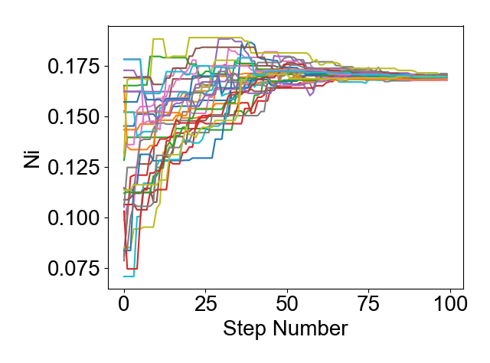
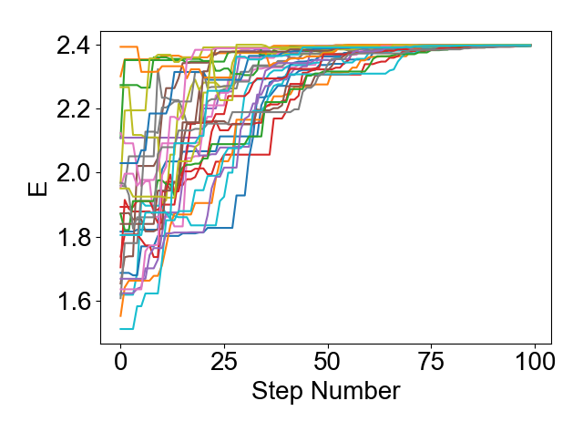
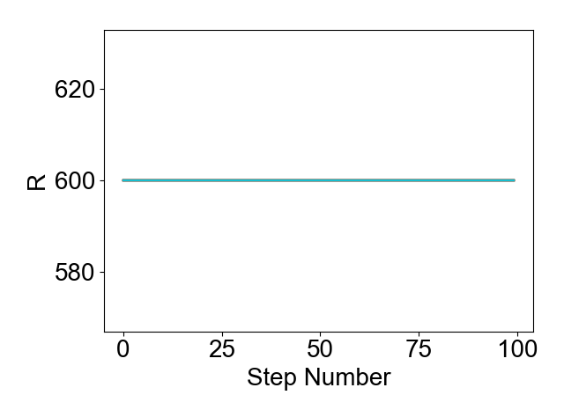
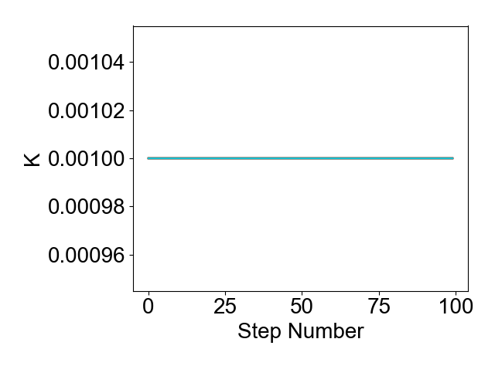
Ranges explored:
Mzams= 13 - 19
Ni_mass= 0.07 - 0.19
Energy= 1.5 - 2.4
R_CSM= 600 (kept constant)
K_CSM= 0 (kept constant)
Results:
Mzams= 18.9 ± 0.06 (max)
Ni_mass= 0.17 ± 0.0006
Energy= 2.5 ± 0.0014 (max)
R_CSM= 600 (kept constant)
K_CSM= 0 (kept constant)

