Slide 1
Interpretable Multi Labeled Bengali Toxic Comments Classification using Deep Learning
Paper ID: 062
Authors:
Tanveer Ahmed Belal
G. M. Shahariar
Dr. Md. Hasanul Kabir
Presented by -
Tanveer Ahmed Belal
Islamic University of Technology

Slide 2
Introduction
Problem Statement
Related Work
Objectives
Dataset Preparation
Methodology
Results and Discussions
Prediction Interpretation
Conclusion and Future Work
Reference
Contents
of
Presentation

Slide 3
Introduction

Slide 4

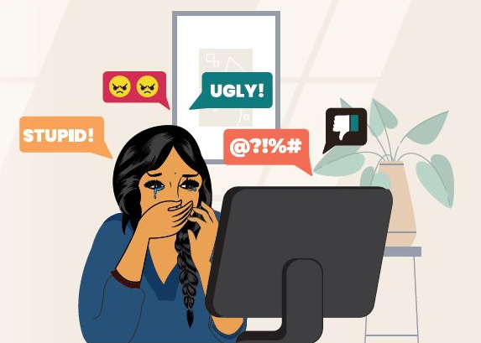
Toxic Text
Text containing offensive or obscene words that makes a person feel uncomfortable or hurt. Toxic content is more audible on digital platforms since it catches the attention of the public.

Slide 5
Problem Statement
Prepare a dataset that contains six types of toxic text and develop a deep learning based detection system that can identify toxic sentences and classify them in multi-label and further interpret the prediction of the classifier models with the help of Explainable Artificial Intelligence.

Slide 6
Related Work

Slide 7
Binary Classification
Banik et al. [1] used both supervised machine learning and deep learning to classify Bengali comments as toxic and non-toxic. For word embedding word2vec was used.
Similar approach but different word embedding techniques (BERT and fastText) was applied by Malik et al. [2] for binary classification. CNN performed better with 82% accuracy.

Slide 8
Binary Classification
Chakraborty et al. [3] classified threat and abusive Bengali texts using Naive Bayes, SVM and CNN with LSTM and got maximum accuracy using SVM with linear kernel.

Slide 9
Multi-Class Classification
Recent studies applied ensemble techniques to classify cyberbullying [4] in multi class and achieved 87.91% accuracy with the of binary classifier.
Pre-training language architectures, BERT and ELECTRA were also used for identifying abusive Bengali comments in multi-class [5]. BERT model performed notably better than ELECTRA.

Slide 10
Multi-Class Classification
Karim et al. [6] detected Bengali hate speech using Multichannel Convolutional-Long Short Term Memory (MConv-LSTM) and for embedding they used BangFastText, Word2Vec, GloVe.

Slide 11
Objectives
Create a Bengali toxic comment detection dataset to detect six types of toxic comments (vulgar, hate, religious, threat, troll, insult)
Employ a pipeline to automatically detect whether a comment is toxic or non-toxic by a binary classifier, and if identified as toxic - a multi-label classifier is employed to classify the toxicity type.
Demonstrate the performance of different deep learning models used.
Interpret the model predictions by a text explainer framework LIME (Local Interpretable Model-agnostic Explanations).

Slide 12
Dataset Preparation

Slide 13
Data Accumulation
The text samples were gathered from three sources:
(a) multi-labeled Bangla-Abusive-Comment-Dataset [7]
(b) Bangla Online Comments Dataset [4]
(c) multi-class Bengali Hate Speech Dataset [6]
Original labeling of the texts in these datasets was not consistent, in some cases, the texts were deemed to belong in multiple categories at once.
Reclassifying the texts from multiple datasets into a new set of categories for ensuring consistency, enhancing data quality, providing more insightful information.

Slide 14
Data Annotation
Each instance was labeled by two annotators.
A third expert was consulted to resolve disagreement through discussion and debate.
The inter-annotator agreement was evaluated by using the Cohen’s Kappa coefficient.
By selecting 100 random samples and creating 30 control samples, the annotators’ trustworthiness was evaluated which was above 80% for all annotators.

Slide 15
Data Statistics
Dataset consists of a total of 16073 instances (7585 data for non-toxic and 8488 data for Toxic class).
Per class toxic instances distribution -
Table 01: Dataset Statistics
Class | No. of Instances | Kappa Score
Vulgar | 2505 | 0.88
Hate | 1898 | 0.79
Religious | 1418 | 0.84
Threat | 1419 | 0.71
Troll | 1643 | 0.66
Insult | 2719 | 0.74

Slide 16
Methodology

Slide 17
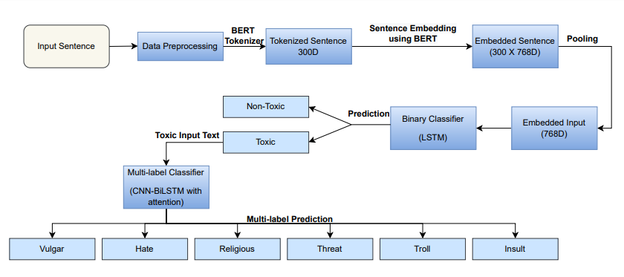
Proposed Approach
Figure 01: Proposed Methodology for toxic comment classification.

Slide 18
Results and Discussions

Slide 19
Experiments
Binary Classification
i. LSTM with BERT embedding
ii. MConv-LSTM with BERT embedding
iii. Bangla BERT fine-tune
Multi-label Classification
i. LSTM with BERT embedding
ii. MConv-LSTM with BERT embedding
iii. Bangla BERT fine-tune
iv. CNN-BiLSTM with Attention

Slide 20
Hyper Parameter Settings
Train/Test Split | Used 60% of total data as training set and rest was used for validation and testing task.
Max sequence length | 300
Batch size | 16
Loss Function | Binary Cross Entropy Categorical Cross Entropy
Learning rate | 1e-5
Optimizer | AdamW

Slide 21
Evaluation Metrics
Precision
Recall
F1-Score
ROC Curve
Confusion Matrix

Slide 22
Experimental Results
Table 02: Performance comparison of different Binary Classifiers
Model | Accuracy | Weighted Precision | Weighted Recall | Weighted F1 score
LSTM + BERT embedding | 89.42% | 0.89 | 0.89 | 0.89
MConv-LSTM + BERT embedding | 87.87% | 0.88 | 0.88 | 0.88
Bangla BERT fine-tune | 88.57% | 0.89 | 0.88 | 0.89

Slide 23
Experimental Results
Table 03: Performance comparison of different Multi-label Classifiers
Model | Accuracy | Weighted Precision | Weighted Recall | Weighted F1 score
LSTM + BERT embedding | 76.52% | 0.83 | 0.82 | 0.82
MConv-LSTM + BERT embedding | 74.72% | 0.83 | 0.78 | 0.80
Bangla BERT fine-tune | 77.66% | 0.86 | 0.85 | 0.85
CNN-BiLSTM with Attention + BERT embedding | 78.92% | 0.87 | 0.85 | 0.86

Slide 24
Experimental Results
Table 04:
Per class performance metrics for CNN-BiLSTM with Attention model
Class | Accuracy | Precision | Recall | F1-score
Vulgar | 94.23% | 0.87 | 0.94 | 0.91
Hate | 91.87 | 0.81 | 0.82 | 0.82
Religious | 97.48% | 0.92 | 0.93 | 0.93
Threat | 92.90% | 0.78 | 0.79 | 0.79
Troll | 94.23% | 0.92 | 0.75 | 0.83
Insult | 92.61% | 0.87 | 0.89 | 0.88

Slide 25
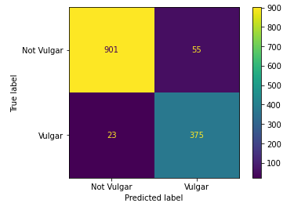
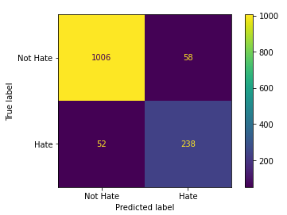
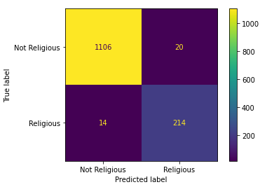
Per class confusion matrix for CNN-BiLSTM with Attention model
Figure 02: Confusion Matrix per class

Slide 26
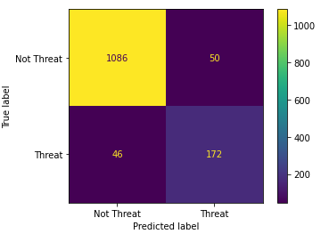
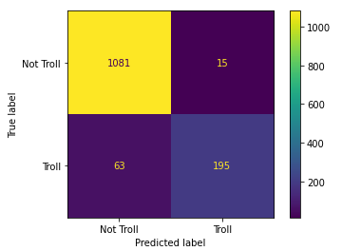
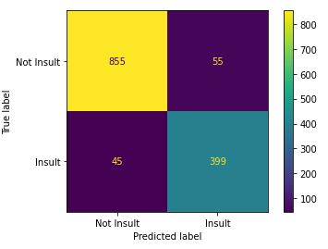
Per class confusion matrix for CNN-BiLSTM with Attention model
Figure 02: Confusion Matrix per class

Slide 27
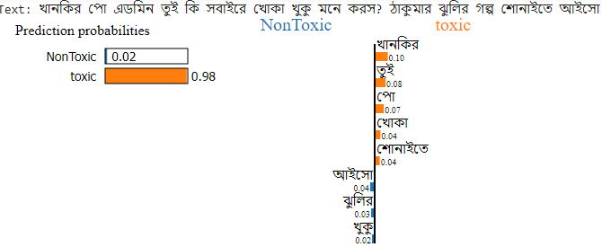
The explanation of the predictions made by the binary classifier (using LSTM with Attention) with class wise interpretation of word feature importance using LIME (Local Interpretable Model-agnostic Explanations)
Prediction Interpretation
Using
LIME
Figure 03: Interpretation of correct prediction for a test text instance (binary classification)

Slide 28
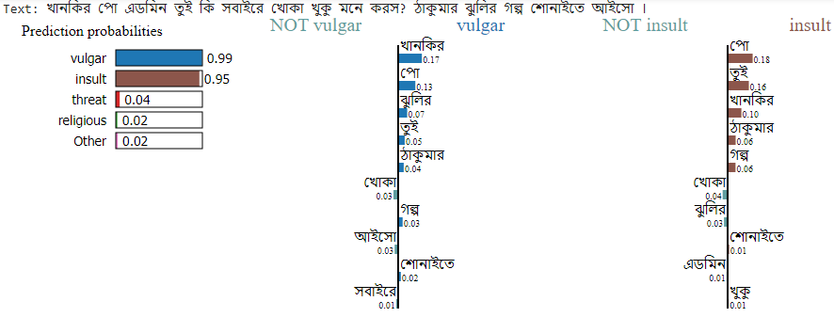
The explanation of the predictions made by the multi-label classifier (using CNN-BiLSTM with Attention) along with top-2 class wise interpretation of word feature importance
Prediction Interpretation
Using
LIME
Figure 04: Interpretation of correct prediction for a test text instance (multi-label classification)

Slide 29
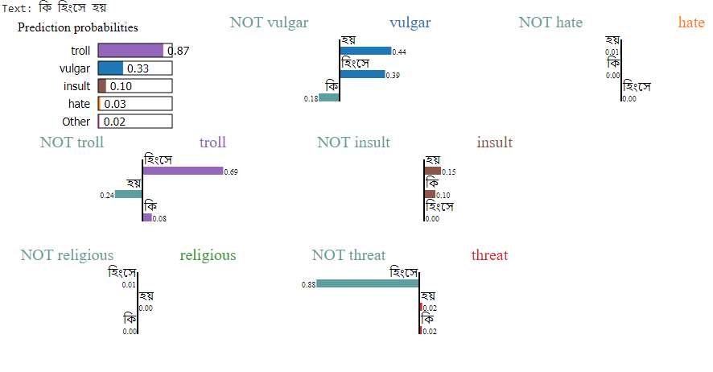
The explanation of the predictions made by the multi-label classifier (using CNN-BiLSTM with Attention) along with top-2 class wise interpretation of word feature importance
Prediction Interpretation
Using
LIME
Figure 05: Interpretation of correct prediction for a test text instance (multi-label classification)

Slide 30
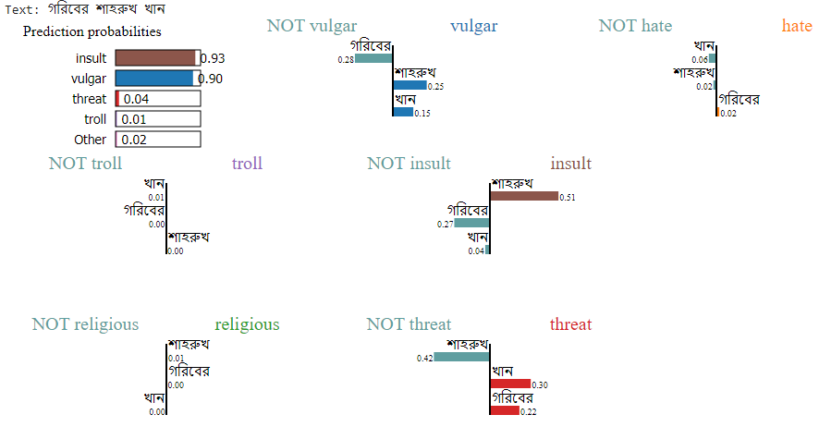
Prediction Interpretation
Using
LIME
Figure 06: Interpretation of incorrect prediction for a test text instance (multi-label classification)

Slide 31
Created a multi labeled dataset for Bengali language
Conclusion
and
Future Works
Proposed a deep learning model based pipeline to effectively capture the dependencies among different labels
Visualized the prediction using text explainer framework
Incorporated extensive experimentation by fine tuning pre-trained Bengali transformer model.
Increasing the data instances per class in the dataset is another effort we may undertake in the future to enhance the outcome.

Slide 32
References
[1] N. Banik and M. H. H. Rahman, ”Toxicity Detection on Bengali Social Media Comments using Supervised Models,” 2019 2nd International Conference on Innovation in Engineering and Technology (ICIET), 2019, pp. 1-5, doi:10.1109/ICIET48527.2019.9290710.
[2] P. Malik, A. Aggrawal and D. K. Vishwakarma, ”Toxic Speech Detection using Traditional Machine Learning Models and BERT and fastText Embedding with Deep Neural Networks,” 2021 5th International Conference on Computing Methodologies and Communication (ICCMC), 2021, pp. 1254-1259, doi: 10.1109/ICCMC51019.2021.9418395.
[3] P. Chakraborty and M. H. Seddiqui, ”Threat and Abusive Language Detection on Social Media in Bengali Language,” 2019 1st International Conference on Advances in Science, Engineering and Robotics Technology (ICASERT), 2019, pp. 1-6, doi: 10.1109/ICASERT.2019.8934609.
[4] M. F. Ahmed, Z. Mahmud, Z. T. Biash, A. A. N. Ryen, A. Hossain, F. B. Ashraf, ”Cyberbullying detection using deep neural network from social media comments in bangla language.”, 2021, arXiv preprint, arXiv:2106.04506.

Slide 33
References
[5] T.T. Aurpa, R. Sadik and M.S. Ahmed, ”Abusive Bangla comments detection on Facebook using transformer-based deep learning models,” Social Network Analysis and Mining, 12.1, 2022,pp. 1-14, doi:10.1007/s13278-021-00852-x.
[6] M. R. Karim, B. Raja Chakravarthi, J. P. McCrae and M. Cochez, ”Classification Benchmarks for Under-resourced Bengali Language based on Multichannel Convolutional-LSTM Network,” 2020 IEEE 7th International Conference on Data Science and Advanced Analytics (DSAA), 2020, pp. 390-399, doi: 10.1109/DSAA49011.2020.00053.
[7] A. Rahman, ”Bangla-Abusive-Comment-Dataset”. GitHub. https://github.com/aimansnigdha/Bangla-Abusive-Comment-Dataset (accessed Feb. 03, 2023).

Slide 34
THANKS!
Any questions?

