Slide 1
Spam Review Detection using Deep Learning
G. M. Shahariar
Swapnil Biswas
Faiza Omar
Mr. Faisal Muhammad Shah
Samiha Binte Hassan

Slide 2

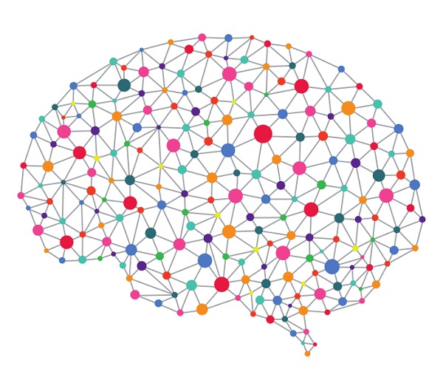
Content
Review Spamming
Spam Detection Methods
Deep Learning
Why to use Deep Learning in text?
Proposed Model
Process of CNN for text
Process of LSTM for text
Experimental Results and Evaluation
Limitations
Future Works

Slide 3
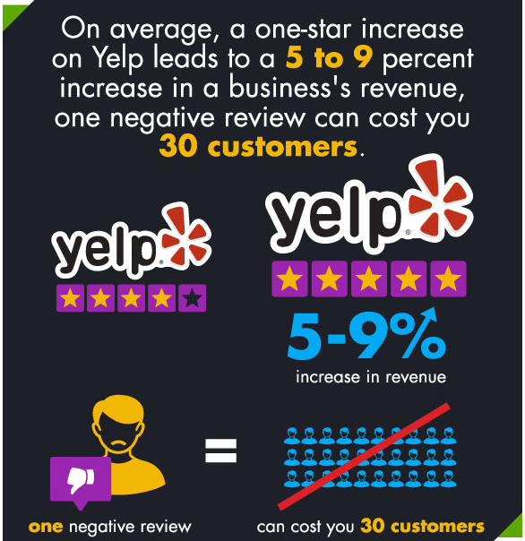
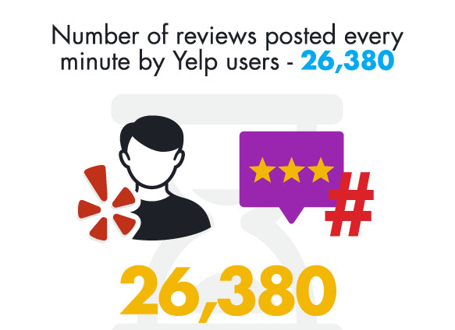
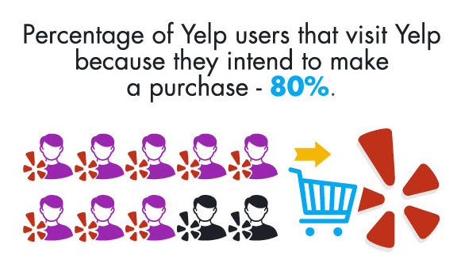
Online purchase and Reviews…
Notes:
Opinions, originating from users’ experiences regarding specific products or topics, straightforwardly influence future customer purchase decisions (Samha, Li & Zhang, 2014; Xu, Xia, Wong & Li, 2008)
Similarly, negative reviews often cause Sales loss (Ho-Dac, Carson & Moore, 2013; Zhu & Zhang, 2010).

Slide 4

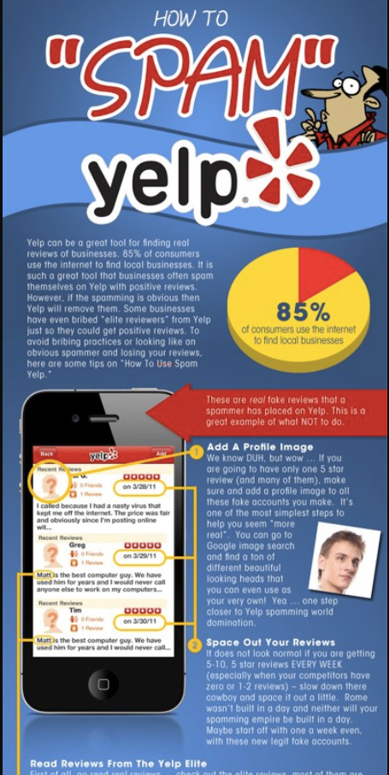
What is Review Spamming?
Two types of Review Spamming :
Boosting up business by providing overrated positive reviews
Providing competitors with unfair negative reviews to defame
Disguised as real reviews
How to spam yelp
Notes:
Review spamming is considered as a business recently.
Providing fake and misleading opinions/reviews.
Writing undeserving positive opinions to promote.
Writing unfair negative opinions to defame.
Disguised as real reviews.
Used as a part of unethical marketing policy.
Our focus is to identify whether a review is spam or ham.
https://avalaunchmedia.com/how-to-spam-yelp/

Slide 5
Our Goal?
To identify whether a review is SPAM or HAM
(using Deep Learning)

Slide 6

Spam Detection Methods
Text Classification steps
Natural Language Processing (NPI)
Machine Learning
Supervised Leaning
Unsupervised Learning
Semi-Supervised Learning
Read documents
Preprocessing
Feature selection
Learning algorithm
Vector representation
Notes:
Reviews are in the form of text/sentences.
We can generalize Review Spam Detection as a Binary Text Classification problem.
We can classify a text review in two classes: Spam and Ham.
We have used both traditional machine learning techniques and deep learning to classify text reviews.
Deep learning performs better than traditional classifiers.

Slide 7
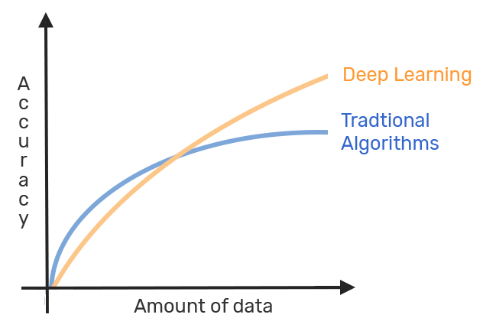
Why use Deep Learning in text?
Solve the problem end to end
Takes a long time to train due to large number of parameters
Popular ResNet algorithm takes about two weeks to train completely from scratch.
At test time, deep learning algorithm takes much less time to run.
Notes:
Requires much more training data.
Traditional machine learning algorithms such as SVM and NB reach a certain threshold where adding more training data doesn’t improve their accuracy.
In contrast, deep learning classifiers continue to get better the more data that we feed them with.
Replace domain specific feature engineering knowledge with broader knowledge of network design and parameter tuning.
Enables more sharing of knowledge
Enables sharing of pre-trained models
Most deep learning networks are open source

Slide 8
Proposed Model
Dataset Acquisition
Phase I
Stop Word Removal
Punctuation Removal
Stemming
Convert to lowercase
Preprocessing
Unlabeled Dataset
Labeled Dataset
Active Learning
Phase II
TF-IDF
Feature Selection
Phase III
N-grams
Word Embeddings (Word2Vec)
CNN
Deep Learning
Machine Learning
SVC
Phase IV
LSTM
KNN
MLP
NB
SPAM or HAM
Majority Voting
Notes:
Algorithm in page 52 of thesis book

Slide 9
Proposed Model : Phase I
Dataset Acquisition
Labeled Dataset 1600 reviews
Unlabeled Dataset from Yelp Dataset Challenge
Data Preprocessing
Tokenization & lowercasing letters
Removing punctuation
Removing stop words
Stemming
Dataset Acquisition
Stop Word Removal
Punctuation Removal
Stemming
Convert to lowercase
Unlabeled Dataset
Preprocessing
Phase I

Slide 10
Phase I – Data Acquisition
Labeled Dataset
Known as “Ott Dataset”
Consists of truthful and deceptive hotel reviews of 20 Chicago hotels
Contains 1600 reviews
800 reviews are truthful
800 reviews ate deceptive
Unlabeled Dataset
Collected from the yelp.com provided by the Yelp Dataset Challenge
More than 2.2 million reviews
We collected the first 2000 review instances from the dataset
Notes:
1) Labeled Dataset:
The labeled dataset we used is known as “Ott Dataset” which can be found at [2].
The dataset consists of truthful and deceptive hotel reviews of 20 Chicago hotels.
This dataset contains 1600 reviews, among them 800 reviews are truthful and 800 reviews are deceptive.
2) Unlabeled Dataset:
More than 2.2 million of reviews.
591K tips by 552K users for 77K businesses.
Social network of 552K users for a total of 3.5M social edges.
Aggregated check-ins over time for each of the 77K businesses.
200,000 pictures from the included businesses.
We needed to extract only the review contents of the dataset as other attributes were of no use in our approach. We collected the first 2000 review instances from the dataset.

Slide 11
Phase I - Data Preprocessing
Action | Result
Input Data | You can not miss If you try the roasted chicken and rib combo. Also gotta get an artichoke....its fire roasted!!
Punctuation Removed | You can not miss If you try the roasted chicken and rib combo Also gotta get an artichoke its fire roasted
Lowercasing letters | you can not miss if you try the roasted chicken and rib combo also gotta get an artichoke its fire roasted
Tokenization | [ ‘you’ ‘can’ ‘not’ ‘miss’ ‘if’ ‘you’ ‘try’ ‘the’ ‘roasted’ ‘chicken’ ‘and’ ‘rib’ ‘combo’ ‘also’ ‘gotta’ ‘get’ ‘an’ ‘artichoke’ ‘its’ ‘fire’ ‘roasted’ ]
Stop Words Removed | [ 'miss' 'try' 'roasted’ 'chicken' 'rib' 'combo' 'also' 'gotta' 'get' 'artichoke’ 'fire' 'roasted' ]
Stemmed words | [ ‘miss’ ‘try ‘roast’ ‘chicken’ ‘rib’ ‘combo’ ‘also’ ‘gotta’ ‘get’ ‘artichoke’ ‘fire’ ‘roast’ ]

Slide 12
Proposed Model : Phase II
Input pre-processed data
For unlabeled dataset, perform data labeling
Data labeling is performed through Active Learning
Otherwise proceed to next phase
Phase II
Labeled Dataset
Active Learning

Slide 13
Phase II – Modified Active Learning
Classifier is trained by 1600 labeled reviews from Ott dataset.
In each iteration, 20 unlabeled reviews were added
The TF-IDF sparse vectors are fed to the classifier.
Classifier performs prediction for each review instance.
Calculated score difference for each instance with predict_proba () function.
A review is considered labeled if score difference between two classes > 0.20
Notes:
Process to label the unlabeled data.
This algorithm is able to interactively query the user.
The algorithm trains the model based on a training dataset and evaluates using a test dataset.
2000 review instances labeled manually.
350 instances were labeled as ’Spam’
1650 instances were labeled as ’Ham’

Slide 14
Proposed Model : Phase III
Labeled Dataset
Input labeled data
Perform feature selection
Texts get numerical values in this phase
Phase II
TF-IDF
Feature Selection
N-grams
Word Embeddings (Word2Vec)
Phase III
Notes:
Input labeled data
Perform feature selection
Texts get numerical values in this phase

Slide 15
Phase III – Feature Selection
TF – IDF + n-grams Traditional Classifiers (SVM, NB, KNN)
N-grams Unigram, bigrams, trigrams
TF-IDF / Word Embedding Deep Learning
TF-IDF + n-grams Multi-Layer Perceptron (MLP)
Word Embedding (Word2Vec) Convolutional Neural Network (CNN)
Word Embedding (Word2Vec) Long Short-Term Memory (LSTM)

Slide 16
Phase III – TF - IDF
Term Frequency, which measures how frequently a term occurs in a document
TF(w) = (Number of times term w appears in a document) / (Total number of terms in the document)
Inverse Document Frequency, which measures how important a term is.
IDF(w) = log_e(Total number of documents / Number of documents with term w in it)
Converts texts into representation of real values.
Creates sparse vectors that produces high dimensions.

Slide 17
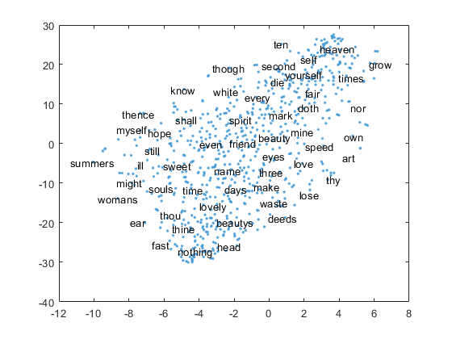
Phase III - Word2Vec Word Embedding
Used to map words or phrases to a corresponding vector of real numbers
Reduces the problem of sparse vectors by producing dense vectors
This vector representation has two important and advantageous properties:
Dimensionality Reduction
Contextual Similarity
Notes:
Word Embedding means building a low-dimensional vector representation from corpus of text, which preserves the numerical representations of contextual similarity of words.
For this low dimensional vector representation this is widely used in case of deep learning.
Dimensionality Reduction
it is a more efficient representation
Contextual Similarity - it is a more expressive representation

Slide 18
Proposed Model : Phase IV
Input labeled data with significant features
Train supervised classifiers
Test the performance of the classifiers
Select the best accuracy given by the classifier and provide result
Feature Selection
Phase III
CNN
SVC
Deep Learning
Machine Learning
LSTM
KNN
LSTM
MLP
NB
SPAM or HAM
Majority Voting
Phase IV

Slide 19
Phase IV - Review Spam Detection
Two approaches:
Traditional machine learning classifiers
Naïve Bayes (NB)
K Nearest Neighbor (KNN)
Support Vector Machine (SVM)
Deep learning classifiers
Multi-Layer Perceptron (MLP)
Convolutional Neural Network (CNN)
Long Short-Term Memory (LSTM)

Slide 20
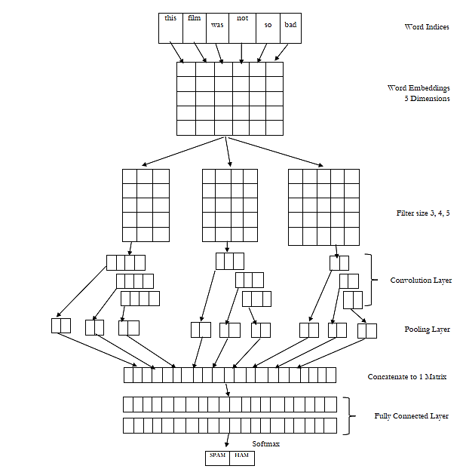
Phase IV – Process of CNN for text classification

Slide 21
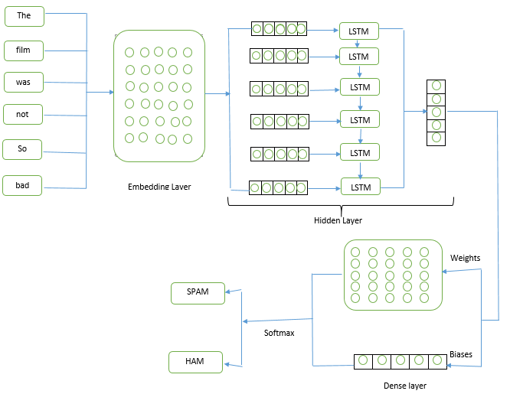
Phase IV – Process of LSTM for text classification

Slide 22
Experiment Results and Evaluation

Slide 23
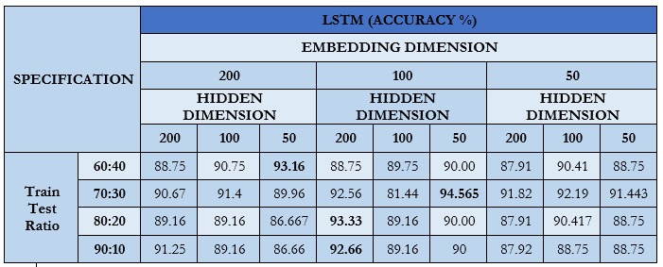
Result of LSTM (Ott Dataset)

Slide 24
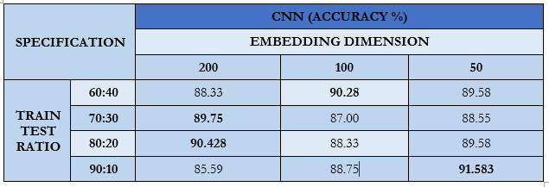
Result of CNN (Ott Dataset)

Slide 25
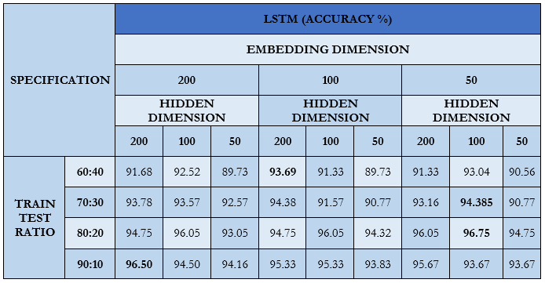
Result of LSTM (Yelp Dataset)

Slide 26
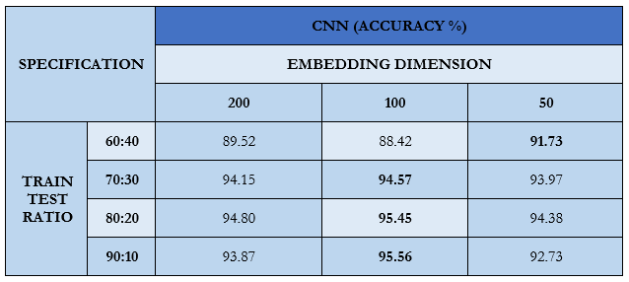
Result of CNN (Yelp Dataset)

Slide 27
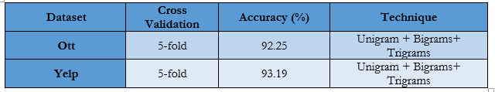
Result of MLP (Ott and Yelp Dataset)

Slide 28
Graphical representation of result comparison

Slide 29
Graphical representation of result comparison

Slide 30

Limitations
Only 1600 review instances of “Ott Dataset” and first 2000 reviews from “Yelp Dataset” were used
Due to hardware limitation we have to use limited dimensions for word embedding
We have used only Word2Vec word embedding, there are other word embedding like GloVe that we did not look into

Slide 31

Future Work
The number of reviews from “Yelp Dataset” can be increased , this will lead to a better trained model
The data labeling process can be improved by introducing Deep Learning methods
It would be useful to look into GloVe and other pre-trained word representation vectors to evaluate the performance of the model instead of word2vec
In future, review spammer detection along with review spam detection can be introduced.
Other variations of CNN & RNN along with hybrid CNN-RNN model can be introduced

Slide 32
[EXTRA] How Review Spam is harmful?
Cost of Spam 2009:
$130 billion worldwide
$42 billion in US alone
30% increase from 2007 estimates
100% increase in 2007 from 2005
Main components of cost:
Productivity loss from inspecting and deleting spam missed by spam control products (False Negatives)
Productivity loss from searching for legitimate mails deleted in error by spam control products (False Positives)
Operations and helpdesk costs (Filters and Firewalls – installment and maintenance)

Slide 33
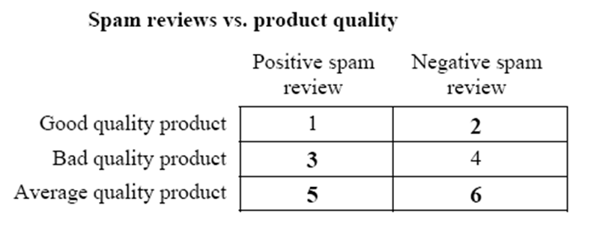
[EXTRA] How Review Spam is harmful?
Harmful Regions
SOURCE: OPINION SPAM & ANALYSIS, JINDAL & LIU (WSDM, 2008)

Slide 34
[EXTRA ]Hyper-parameters set up for deep learning
Word embeddings were trained using word2vec that has vocabulary size 30,000.
We used 90:10, 80:20, 70:30 & 60:40 ratio for train test splitting of our dataset.
The learning rate used is .001.
We tuned the embedding size and hidden layer sizes to 50, 100 & 200.
Three filter regions of sizes: 3, 4 and 5 were used, each of them had 100 filters.
Batch size, number of epochs & drop out values were also tuned as well.
For MLP, 3 layers consisting of 170 neurons each and 5-fold cross validations along with unigram, bigrams & trigrams were used.

Slide 35
[EXTRA] Experimental Setup:
Spyder IDE and various python packages such as Numpy, Scipy, and NLTK etc. for the traditional classifiers
for handling the NLP part, we used the NLTK library version 3.
We used python version 3.5.
For training and testing our model through CNN & LSTM, we used PyTorch framework.
To run our model, a hardware with specification - Intel Core i5 6th Gen, NVIDIA GeForce GTX 1050 Ti, 8 GB RAM was used.

Slide 36
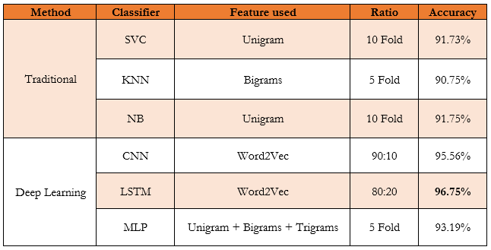
[EXTRA] Comparison of results by traditional and deep learning classifiers (Yelp Dataset)

